Slide 1
Supporting E-science: Progress at Research Institutions and Their Libraries
Presenter: Karla Strieb
Assistant Executive Director
Transforming Research Libraries
June 3, 2010

Slide 2
About ARL
Membership:
  125 Research Libraries
  United States and Canada
Affiliate organizations:
  Coalition for Networked Information (CNI)
  Scholarly Publishing and Academic Resources Coalition (SPARC)

Slide 3
ARL E-Science Activities
2006 Task Force created
  NSF Workshop: To Stand the Test of Time: Long-term Stewardship of Digital Data Sets in Science and Engineering (2006) http://www.arl.org/bm~doc/digdatarpt.pdf
2007 Task Force Report recommendations
  http://www.arl.org/bm~doc/ARL_EScience_final.pdf
2008 ARL/CNI Forum, Reinventing Science Librarianship
  http://www.arl.org/resources/pubs/fallforumproceedings/forum08proceedings.shtml
Resources
  Talking Points http://www.arl.org/bm~doc/e-science-talking-points.pdf
  http://www.arl.org/rtl/eresearch/escience/

Slide 4
E-research engagement:
The new paradigm
Multi-institutional, international, collaborative context
Data roles: planning, management, preservation, curation
Well-integrated, sustainable models of support for research process

Slide 5
The ARL E-Science Survey
Q: What is the status of institutional planning?
  Campus structures
  Infrastructure development
Q: What is the status of library planning & engagement?
  Library role in campus planning
  Library services, infrastructure, capacity (staff)
  Pressure points, areas of interest

Slide 6
Institutional organizing behavior
A: Widespread engagement (61 respondents)
  Institutional infrastructure in place or planned at 77%
  Most institutions have hybrid of institution-wide and unit planning & infrastructure (60%)
  Institution-wide approaches engage: IT, Library, faculty/researchers, Office of Research

Slide 7
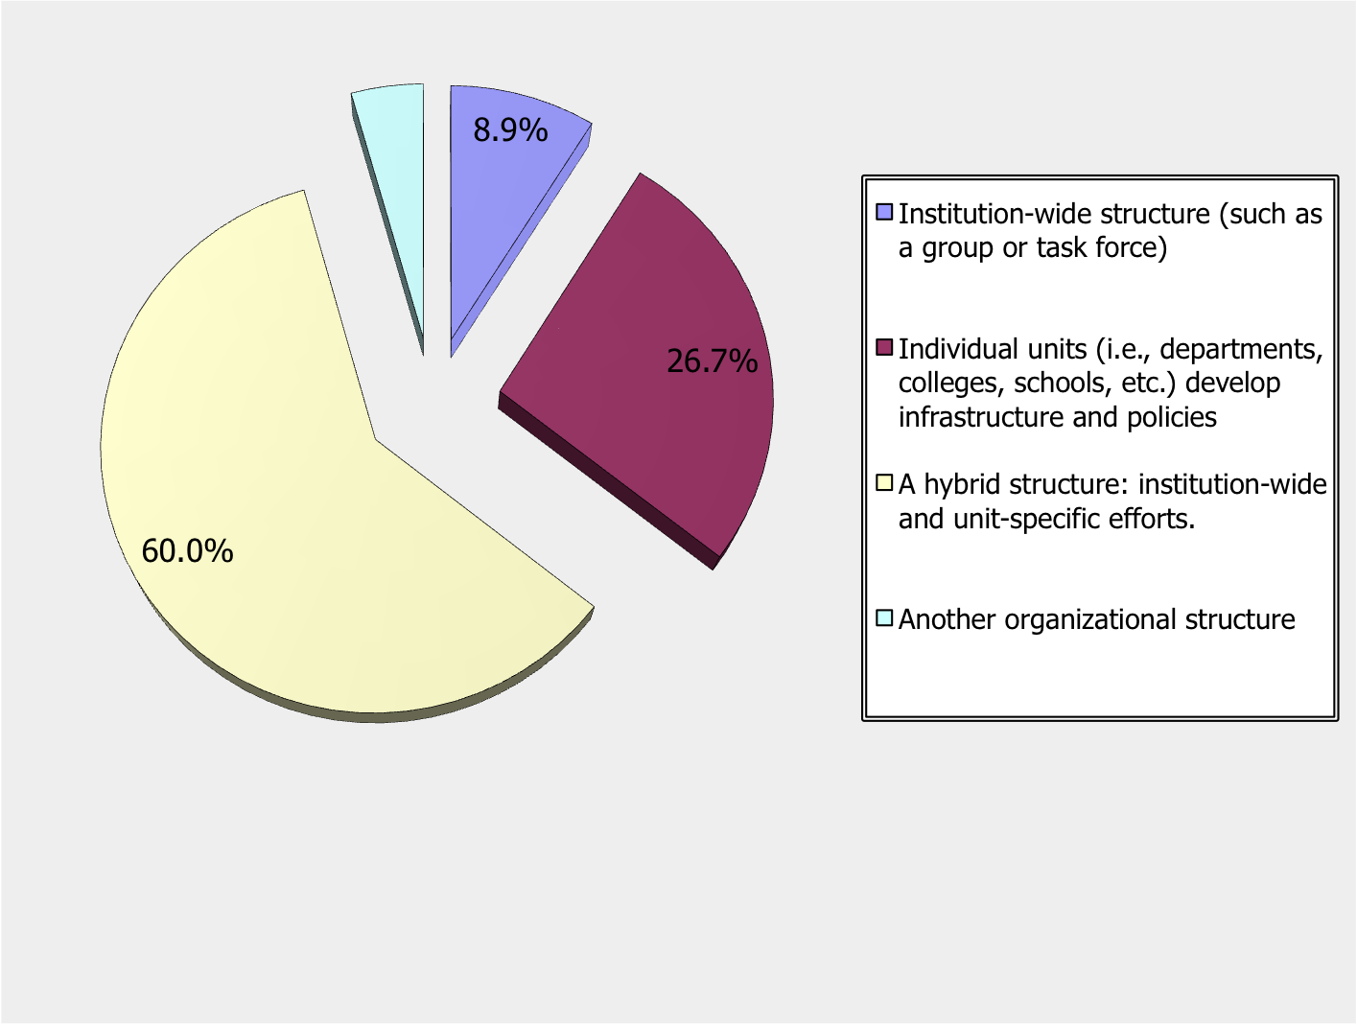
To centralize or decentralize?
The answer is, Yes!

Slide 8
Strategies for supporting e-science
Centralized capacities
Localized capacities
Multi-institutional capacities

Slide 9
Centralizing strategies
“The locus for planning and services around e-science issues at the U. of Washington is the UW eScience Institute, an interdisciplinary and institution-wide coordinating body”
“Two groups exist: Cyberinfrastructure Council and Knowledge
Management Committee. The Council is most involved in the
high performance computing, data centers, other computing and
network issues. The Knowledge Management Committee is
more oriented to the content of escience and data curation…” – U Utah
“A cyberinfrastructure task force is in the planning stages, and it will report to the President of the University.” – U Oregon

Slide 10
Put someone in charge?
Of those institutions with focused infrastructure
45% report designated unit to provide data curation support

Slide 11
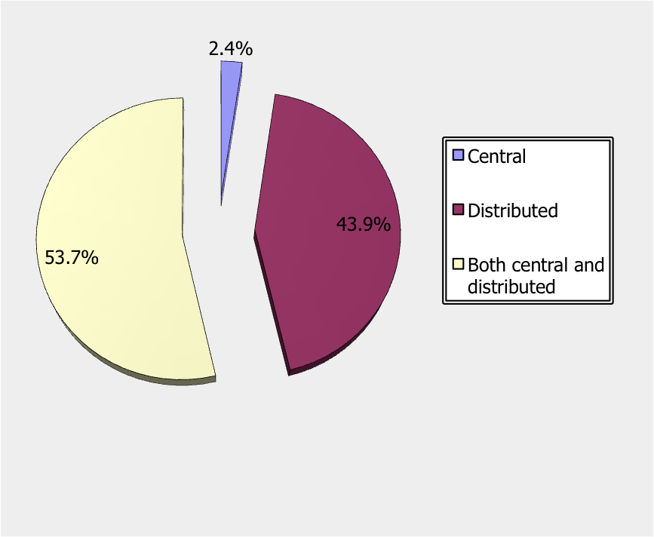
Create a “Data Center”?

Slide 12
Decentralized themes
“Most science and engineering departments, labs and centers…have some infrastructure to support high performance computing, or provide software tools to process/visualize research data. But none…are clearly documented on a single webpage or other place where researchers can easily locate.” - MIT
“Currently there is no one central group or effort that focuses on overall
planning, but a collection of overlapping initiatives and activities –
This is largely because the university is highly decentralized and others in
the institution do not think in terms of e-science but in terms of
research supported by cyberinfrastructure.” - Purdue

Slide 13
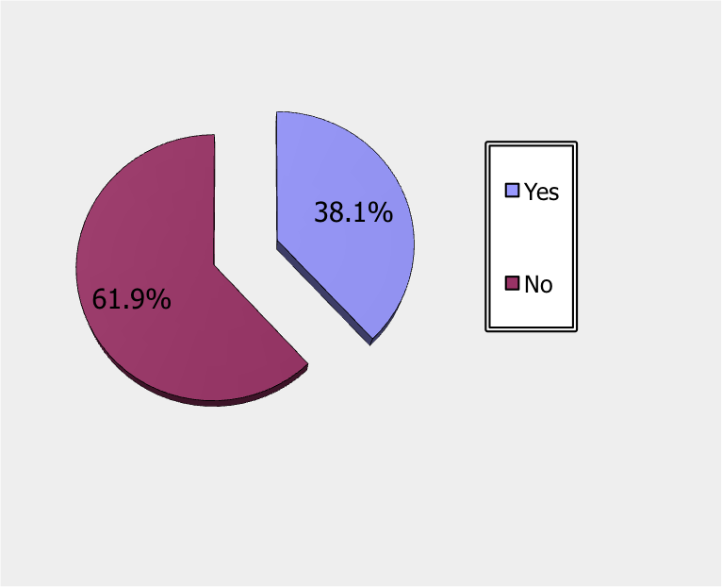
What’s happening with needs assessment?
Examples gathered at: http://www.arl.org/rtl/eresearch/escien/esciensurvey/surveyresearch.shtml#instdatres

Slide 14
Are institutions getting grant funding?
19 institutions engaged in DataNet proposal development, most involved the library
14 libraries involved in other e-science grants (NIH, NSF, Mellon and Gates Foundations)

Slide 15
Libraries are supporting e-Science
Of libraries with institutional activity, 73% reported library involvement.
87% libraries offering service collaborate with other units (e.g., IT, colleges/departments, centers, Ofc. Research)

Slide 16
The emerging library service portfolio
Finding, using available infrastructure
  8 libraries maintain web site on services
Finding relevant data, developing data management plans, rights management
  8 libraries offer training in data management
Metadata and archiving consultation/support

Slide 17
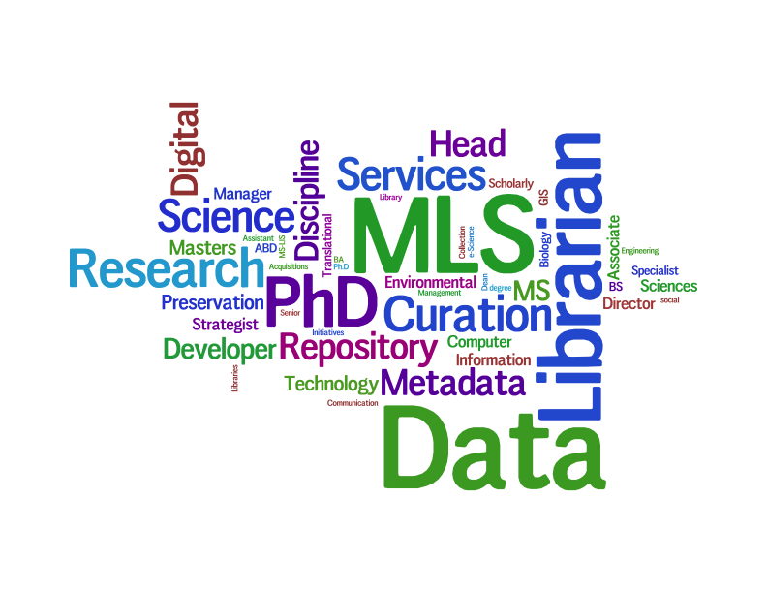
Building teams on the service side to work with teams of researchers

Slide 18
How is the staff issue being addressed?
Most (90%) rely on discipline librarians, many (66%) also have data librarians
64% reassigning existing staff
39% have hired e-science expertise
39% are planning to hire e-science expertise

Slide 19
Who are these people?
65 positions detailed:
  Two named chairs
  71% had library/info science degree
  34% had disciplinary degree
  17% had both library and other disciplinary degree

Slide 20
Pressure Points for ARL Libraries
Organizational:
  Low recognition of importance of e-science support
  Coordination issues within and across institutions

Slide 21
Pressure Points for ARL Libraries
Resources:
  Staff with relevant expertise
  Technology infrastructure
  Budget constraints: Few business models for aligning demand for library services with research funding

Slide 22
Learn more
ARL page for the survey:
http://www.arl.org/rtl/eresearch/escien/esciensurvey/
Forthcoming report: July 2010

