Slide 1



DTIC Overview
Mr. Al Astley
Defense Technical Information Center
Director, Information Science & Technology
June 3, 2010
Approved for Public Release
U.S. Government Work (17 USC § 105)
Not copyrighted in the U.S.

Slide 2
DTIC Successes
DTIC Online
Aristotle
DoDTechipedia
DefenseSolutions
Open Archives Initiative
DoD Datasets

Slide 3
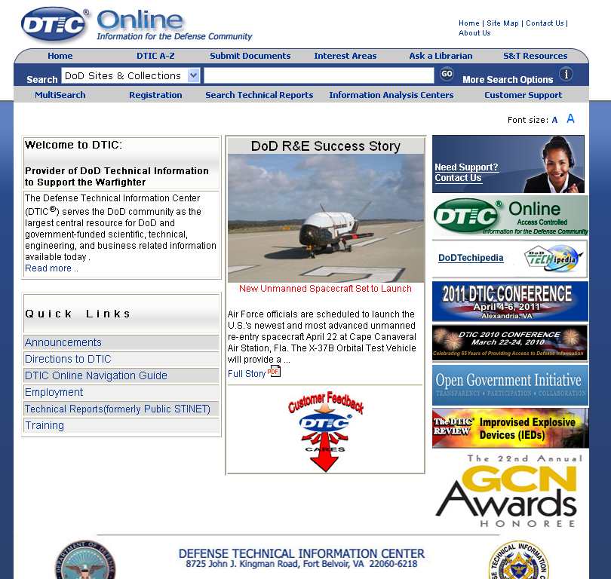
DTIC Online - Public
Launched July 2008
Searchable metadata for 5.8M documents
Unclassified, Unlimited (Public) content only
Provides registration information for additional services
http://www.dtic.mil

Slide 4
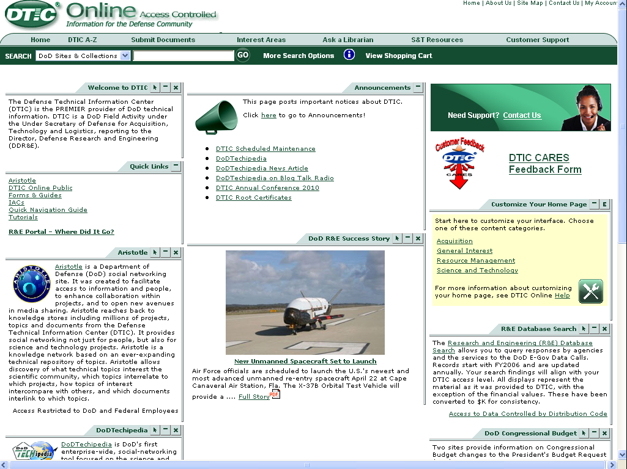
DTIC Online - Access Controlled
Launched September 2009
Streamlines access to DTIC products and services
Searchable metadata for 8.9M documents
Includes controlled unclassified information
https://www.dtic.mil

Slide 5
DTIC Online Enhancements
Improved Search Infrastructure
Fail-over redundancy established for production environment
Future access to full feature set will require use of Microsoft-based servers
New hardware architecture (x86)
Usability Study for Access Controlled
Additional Features

Slide 6
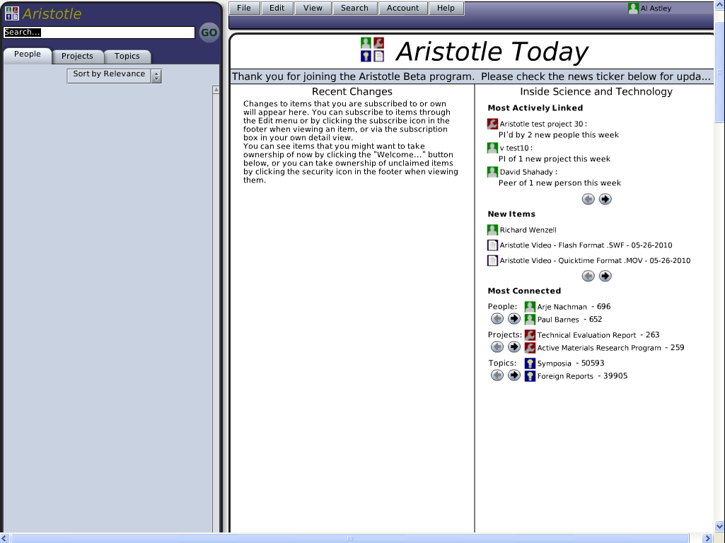
Aristotle
Beta launched March 2010
Accessible from DTIC Online - Access Controlled
Professional social networking tool for DoD S&T workers.
Similar to Facebook, MySpace, and LinkedIn
In addition to People, also links to Projects and Topics

Slide 7
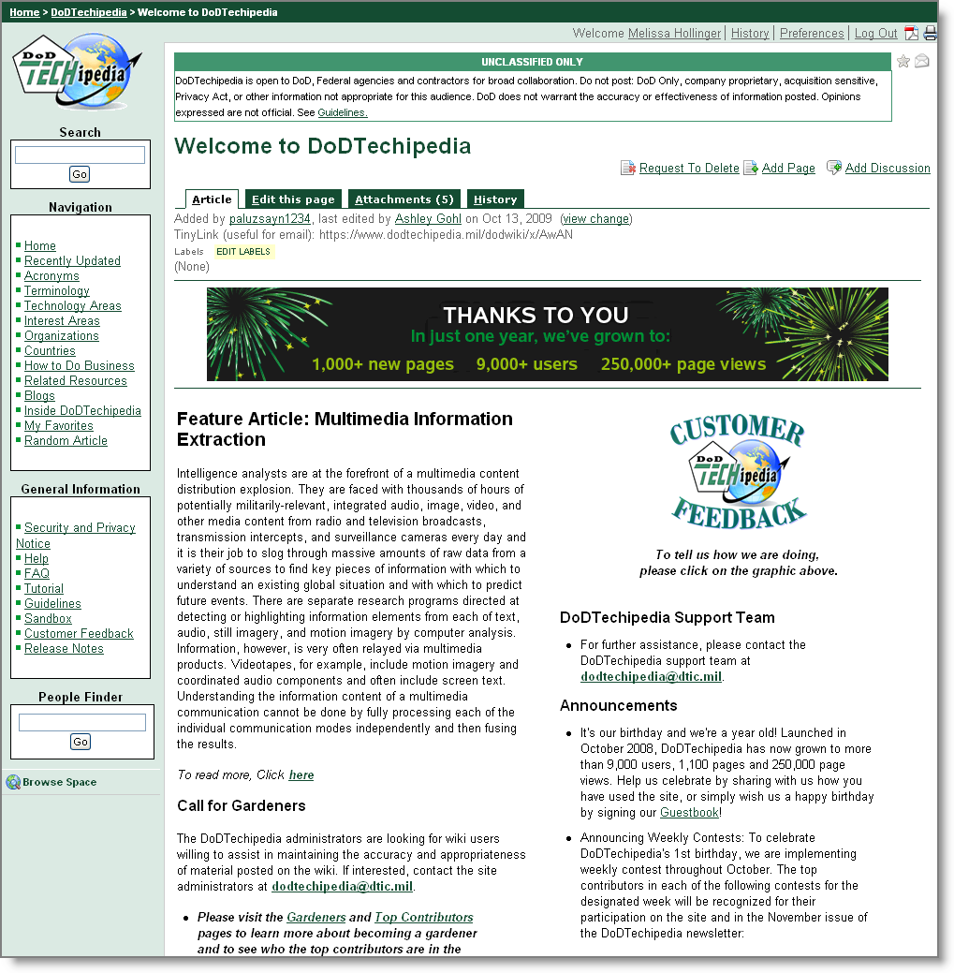
DoDTechipedia
Launched October 2008
Wiki for US Government S&T community
Based on Confluence v3.1.1
Fosters collaboration on science and technology within the Department of Defense
Provides Web 2.0 capabilities such as Community Spaces and Blogs
Recent enhancements include: improved performance, improved editing capabilities, additional browser support, improved access controls
https://www.dodtechipedia.mil

Slide 8
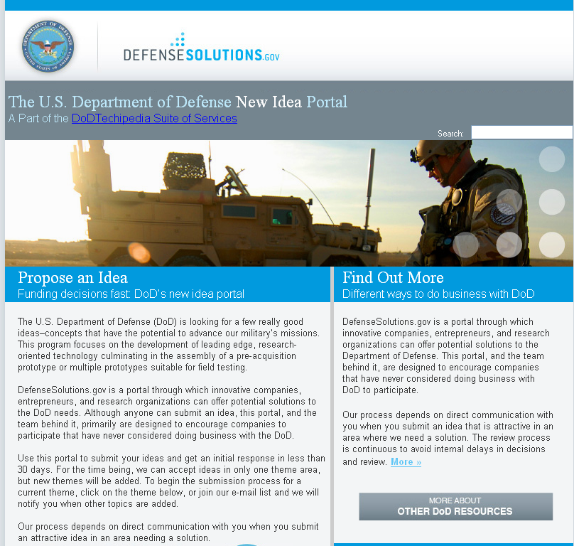
DefenseSolutions
Launched February 2009
Portal for submitting ideas to DoD.
Targets non-traditional technology providers who have not done business previously with DoD
Provides “theme” for which DoD is soliciting ideas.
Battlefield Forensics -- 105 total ideas received, 42% from non-traditional sources.
Current theme: Non-lethal weapons.
http://defensesolutions.gov

Slide 9
Open Archives Initiative (OAI)
Exposes metadata for Unclassified, Unlimited content to Internet search engines (e.g., Google, Yahoo!, MSN, etc.)
Search engines refer users to DTIC to view or download full-text document
Broadens exposure of DTIC content while reducing computer workload
So far this year:
112M citations retrieved (>760K/day)
53M downloads to .mil
Primarily via Google

Slide 10
DoD Datasets
Study completed May 2010
Many communities of various, disparate datasets
Collections online, offline, and/or “orphaned”
No systematic approach to allow discovery or reuse
DTIC could help
Next step – design and develop prototype for online collections
Expose metadata via DTIC Online - Access Controlled
DTIC validates user’s eligibility, and notifies data owner
Data owner delivers
Status – awaiting funding
10
Notes:
10

Slide 11
Disclaimer of Endorsement
Reference herein to any specific commercial products, process, or service by trade name, trademark, manufacturer, or otherwise, does not necessarily constitute or imply its endorsement, recommendation, or favoring by the United States Government. The views and opinions of authors expressed herein do not necessarily state or reflect those of the United States Government, and shall not be used for advertising or product endorsement purposes.
11
Notes:
11

Slide 12
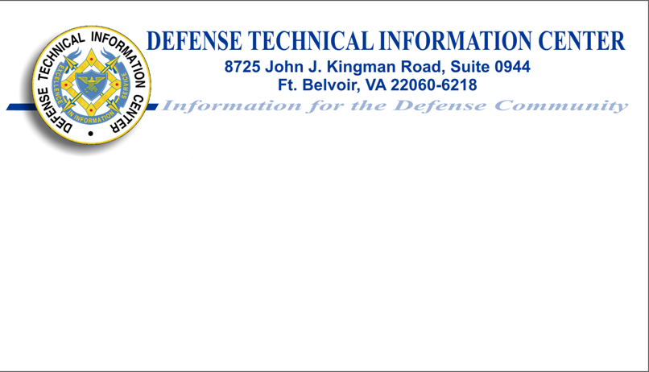
Allan A. Astley
Director, Information Science & Technology
Phone: (703) 767-9180
DSN 427-9180
Fax: (703) 767-9119
Email: aastley@dtic.mil
www.dtic.mil

