Slide 1

Alzheimer’s Disease Neuroimaging Initiative
December, 2010

Slide 2
NEED FOR VALIDATED BIOMARKERS FOR AD TRIALS
Biomarkers useful in Phase 2 to make decisions about Phase 3 (e.g. doses)
Biomarkers useful in Phase 3
  Provide additional evidence to support primary outcome findings
  Provide evidence for “disease modification” and not simply symptomatic improvement

Slide 3


GOALS OF THE ADNI:
LONGITUDINAL MULTI-SITE OBSERVATIONAL STUDY
Major goal is collection of data and samples to establish a brain imaging, biomarker, and clinical database in order to identify the best markers for following disease progression and monitoring treatment response
Determine the optimum methods for acquiring, processing, and distributing images and biomarkers in conjunction with clinical and neuropsychological data in a multi-site context
“Validate” imaging and biomarker data by correlating with neuropsychological and clinical data.
Rapid public access of all data and access to samples

Slide 4
Mild Cognitive Impairment
Normal
MCI
AD
ADNI 2
(EMCI)
ADNI 1
(LMCI)
0
0.5
1
CDR
3004153-1

Slide 5
STUDY DESIGN-ADNI1
MCI (n= 400): 0, 6, 12, 18, 24, 36 months
AD (n= 200): 0, 6, 12, 24 months
Controls (n= 200): 0, 6, 12, 24, 36 months
Clinical/neuropsychological evaluations, MRI (1.5 T) at all time points
FDG PET at all time points in 50%
3 T MRI at all time points in 25%
PIB sub-study on 120 subjects
Blood and urine at all time points from all subjects; CSF from 50% of subjects 0, 1 yr, 2 yr (subset); DNA and immortalized cell lines from all subjects
GWAS study

Slide 6
Subject Evaluation
Baseline/screening eval and q 6 mo.
  Labs, Apo E
  Hamilton(S)
  Beck
  MMSE
  ANART
  ADAS-cog
  NPI
  CDR
  ADL
Neuropsyc(B and q 6 mo)
  Logical Memory(S)
  AVLT
  BNT
  Trails A &B
  Symbol digit
  Clock drawing
  Category fluency

Slide 7
















ADNI Public-Private Partnership Structure
Private/Philanthropic
+
Public
David Lee
Alison Drone
FDA
Neil Buckholtz
NIBIB, NINDS, NIMH, NIDA, NCRR, NINR
ADNI Executive Steering Committee
PI: Mike Weiner
Administrative Core: UCSF
Publications Core:
BostonU: Green
Biostatistics Core:
UCD: Beckett
PET Core:
Berkeley:
Jagust
MRI Core:
Mayo: Jack
Clinical Core:
UCSD: Aisen
Mayo: Peterson
Biomarkers Core:
UPenn: Trojanowski/Shaw
Informatics Core:
UCLA: Toga
Neuropathology Core:
WashU: Morris
57 Clinical Sites: ADNI PIs and Cores

Slide 8
Data and Sample Sharing
Goal is rapid public access of all raw and processed data
Central repository for all QA’d MRI and PET [Laboratory of Neuroimaging, UCLA (LONI)]
Clinical data base at UCSD is linked to LONI
Databases- in the public domain, available to all qualified investigators
Sample sharing-Resource Allocation Review Committee
No special access
Data Sharing & Publication Committee (DPC)
  -ADNI Data Use Agreement

Slide 9
ADNI Demographics
Normal controls MCI AD
(n=229) (n=398) (n=192) P
Age, mean (SD) 76.4 (5.0) 75.3 (7.5) 75.8 (7.4) 0.15
Female (%) 48.0 35.4 47.4 0.002
Years of education, 15.6 (3.1) 16.0 (2.9) 14.7 (3.1) <0.001
mean (SD)
Apolipoprotein E e4: 26.6 53.5 65.6 <0.001
Positive (%)
CP1307278-1

Slide 10
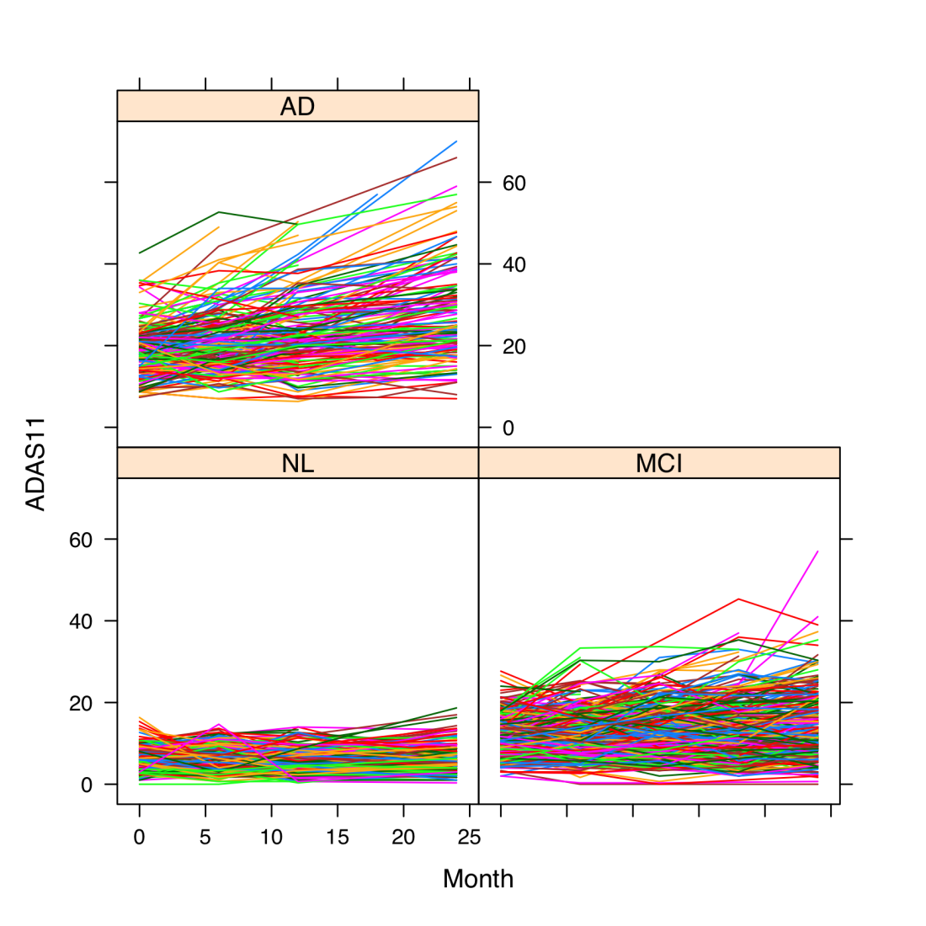
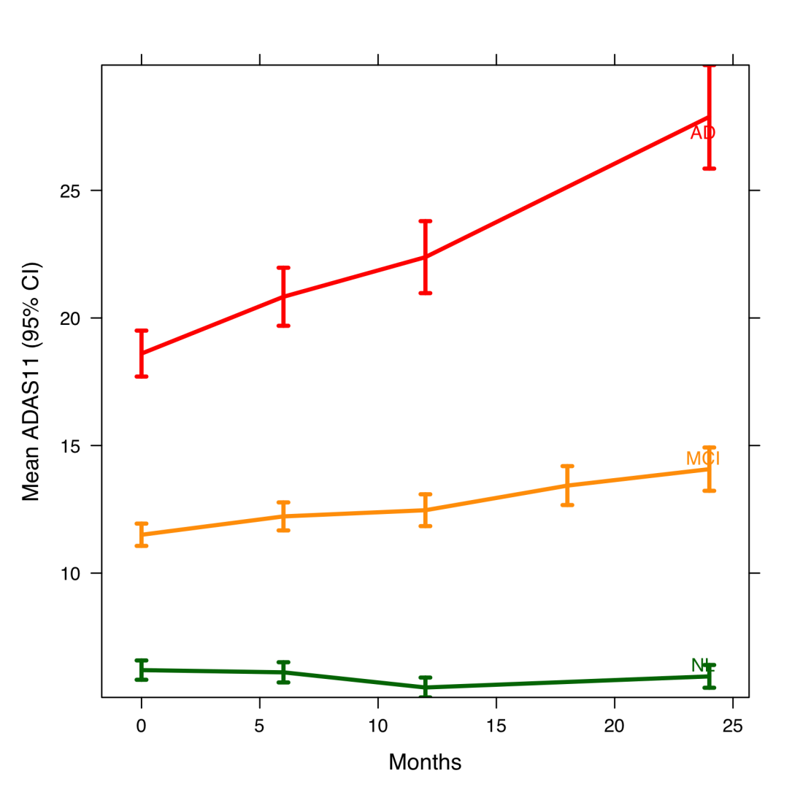
ADAS Cog 11

Slide 11
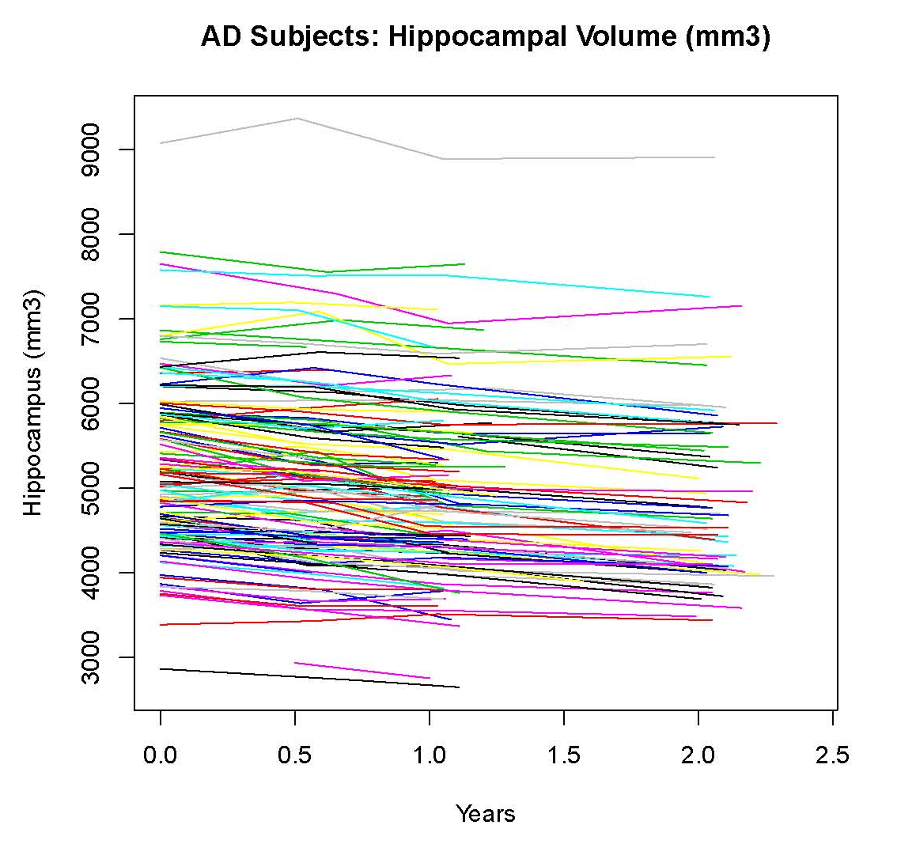

Slide 12
ADNI Conversion Rates
Year | Normal ➔ MCI | MCI ➔ AD
0-1 | 1.4% (0.0-3.2) | 16.0% (11.3-20.4)
1-2 | 2.4% (0.0-4.7) | 23.9% (19.0-29.5)
2-3 | 0.0% (0.0-3.4) | 9.1% (5.8-13.5)

Slide 13
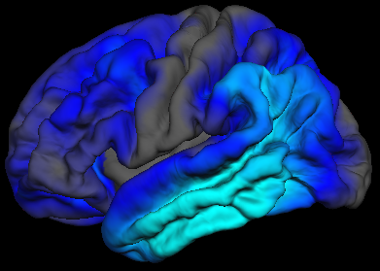
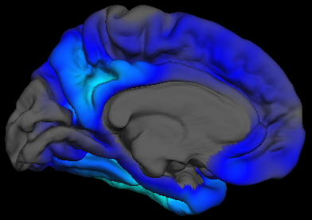
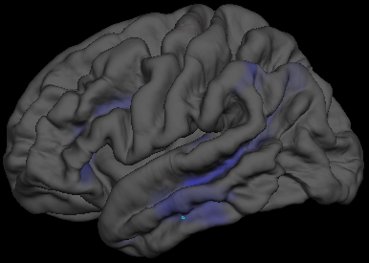
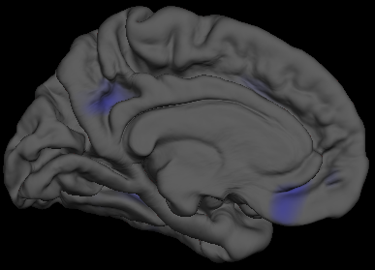
Mean Cortical Thickness Change
(over 12 months)
Diagnosed as AD
+2%
Diagnosed as NC
-2%
Lateral View
Medial View
Holland et al.
Notes:
13
Scale ranges from -20% (cyan) to +20% (yellow)

Slide 14
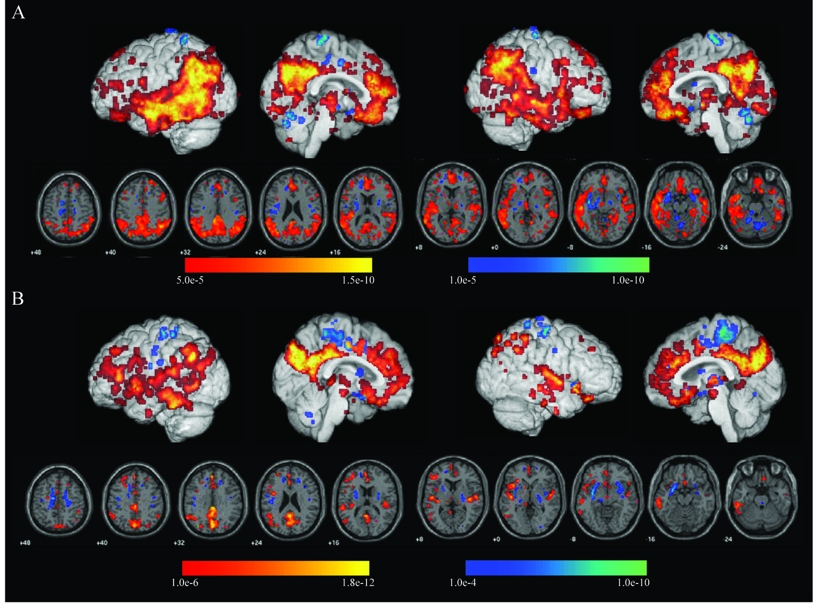
Statistical ROI’s of 12-Month CMRglDecline
AD
MCI

Slide 15
ADNI 1 Baseline PIB data (N=101)
Cutoff > 1.46 PIB+
(Berkeley Data)
Normals
MCI
AD
9/19 (47%)
PIB+
47/63 (68%)
PIB+
17/19 (89%)
PIB+

Slide 16
Follow-Up of PIB-Positive ADNI MCI’s
ADNI PiB MCI’s
N = 65, 12 mo. follow-up
PiB(-) 18
Converters to AD 3
PiB(+) 47
Converters to AD 21

Slide 17
ADNI BASELINE CSF biomarker concentrations show the expected average differences between AD and MCI and NC
p<0.0001, for each of the 5 biomarker tests for AD vs NC and for MCI vs NC.
For AD vs MCI:p<0.005, Tau; p<0.01, Aβ₁₋₄₂; p<0.01, P-Tau _{181P}; p<0.0005, Tau/Aβ₁₋₄₂; p<0.005, P-Tau _{181P}/Aβ₁₋₄₂.
Mann-Whitney test for statistical differences used for these non-normally distributed data sets.
Notes:
Tau and pTau181p concentrations are highest in AD compared to NC and next highest in MCI vs NC.
Ab1-42 is lowest in AD, highest in NC and intermedicate in MCI. Tau/Ab1-42 and pTau/Ab1-42
Ratio values are highest in AD compared to NC and next highest in MCI vs NC. These differences
Are expected for these ADNI populations and comparable with data from published studies.

Slide 18
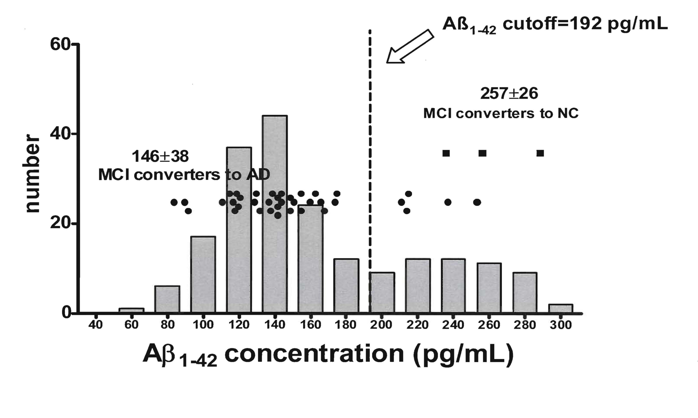
MCI progressors to AD at YEAR 1(n=37)
MCI converters to normal
Ab₁₋₄₂ concentrations in CSF, collected at the baseline visit, of 37 ADNI MCI subjects who at their one year visit converted to a diagnosis of probable AD. The data points for the MCI→AD converters are presented as a horizontal dot plot with the x axis scale identical to that of the Ab₁₋₄₂ frequency plot for the entire ADNI MCI group. The vertical line indicates the Ab₁₋₄₂ cutoff concentration obtained from ROC analysis of an ADNI-independent cohort of autopsy-based AD subjects’ CSF.

Slide 19
Recommendation for revised
Project Plan study design
RBM has agreed to run 1,000 samples using the full panel (500 at baseline, 500 at one year):
    300 MCI samples each
    100 AD samples each
    100 control samples each
Include all subjects with CSF and PIB PET data.
Try to balance non-progressor MCI vs progressing MCI.

Slide 20
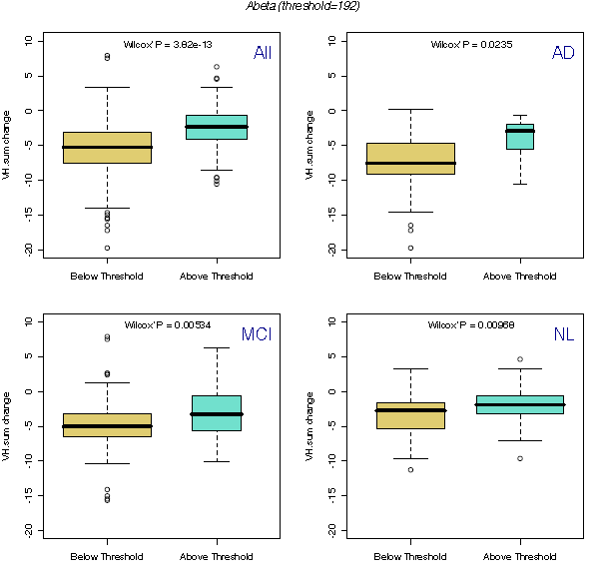
Hippocampal atrophy rates (L+R) – free surfer data – in ADNI subjects with CSF Aβ₁₋₄₂ >192 pg/mL or <192 pg/mL
Hippocampal % atrophy rates
(BL→12 mos), for ADNI subjects
with Aβ₁₋₄₂< 192 or >192 pg/mL
 | Aβ₁₋₄₂ <192pg/mL | Aβ₁₋₄₂ >192pg/mL
ALL | -5.6±4.7 | -2.6±4.1
AD | -8.0±5.9 | -4.2±3.5
MCI | -4.8±3.6 | -2.9±3.7
NC | -3.6±3.2 | -2.2±4.3
These data show that in ADNI AD, MCI and NC
subjects the rate of hippocampal atrophy
increases at a significantly higher rate in
subjects with Ab₁₋₄₂ <192 pg/mL cutoff
concentration compared to those >192 pg/mL

Slide 21
POWER OF CLINICAL/COGNITIVE TESTS
25% CHANGE 1YR STUDY (2 ARM) :
AD
Test | Sample Size
MMSE | 803
RAVLT | 607
ADAS | 592
CDR SOB | 449

Slide 22
1.5T MRI Comparisons - AD (n=69)
Lab | Variable | SS/arm
Alexander | L. Hippo. Formation | 334
Dale | Whole Brain | 207
Schuff - FS | Hippocampus | 201
Dale | Ventricles | 132
Dale | Hippocampus | 126
Studholme | Temporal lobe % change | 123
Schuff - FS | Ventricles | 119
Studhome | CV - % change | 106
Fox | VBSI % change | 105
Fox | BSI % change | 71
Thompson | CV - % change | 54

Slide 23
ADNI Genotyping
Initial goal: high density genome wide scan
  Identified major microarray platforms for GWAS
    Compared marker selection strategies, HapMap coverage of genome, performance & reliability, as well as cost/sample
  Illumina platform was selected by consensus of the Genetics Committee & ISAB for this project
  TGen (Phoenix, AZ) was selected to perform the assays
  Illumina Human 610-Quad

Slide 24


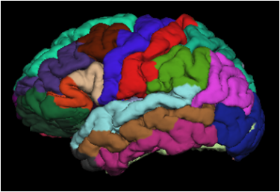

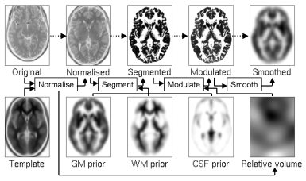
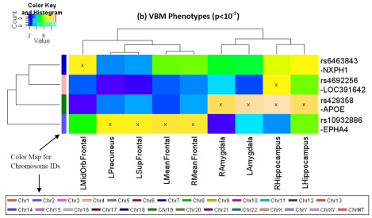
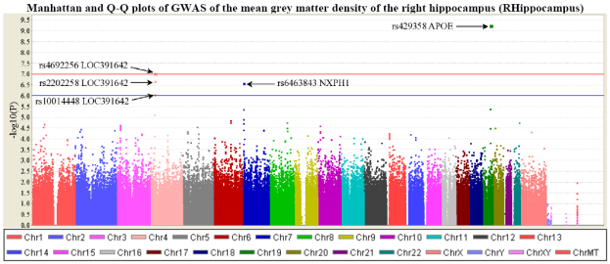
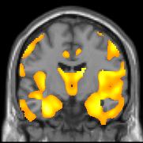
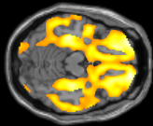
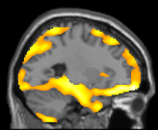
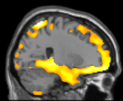
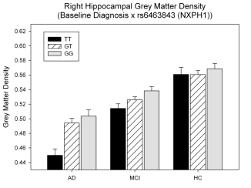
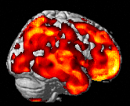
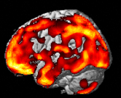
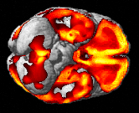

Shen et al 2010: Overview
FreeSurfer: 56 volume or
cortical thickness measures
QC’ed genotyping data
530,992 SNPs
Baseline MRI Scans
142 QTs
GWAS of Imaging Phenotypes
Strong associations represented by heat maps
VBM: 86 GM density measures
R
L
L
R
R
L
R
Refined modeling of
candidate association
GWAS of candidate QT
VBM of candidate SNP
Notes:
142 measures of grey matter (GM) density, volume, and cortical thickness were extracted from baseline scans.
GWAS, using PLINK, were performed on each phenotype using quality controlled genotype and scan data including 530,992 of 620,903 single nucleotide polymorphisms (SNPs) and 733 of 818 participants (175 AD, 354 amnestic mild cognitive impairment, MCI, and 204 healthy controls, HC).
Hierarchical clustering and heat maps were used to analyze the GWAS results and associations are reported at two significance thresholds (p<10⁻⁷ and p<10⁻⁶). As expected, SNPs in the APOE and TOMM40 genes were confirmed as markers strongly associated with multiple brain regions. Other top SNPs were proximal to the EPHA4, TP63 and NXPH1 genes.
Detailed image analyses of rs6463843 (flanking NXPH1) revealed reduced global and regional GM density across diagnostic groups in TT relative to GG homozygotes. Interaction analysis indicated that AD patients homozygous for the T allele showed differential vulnerability to right hippocampal GM density loss. NXPH1 codes for a protein implicated in promotion of adhesion between dendrites and axons, a key factor in synaptic integrity, the loss of which is a hallmark of AD.

Slide 25
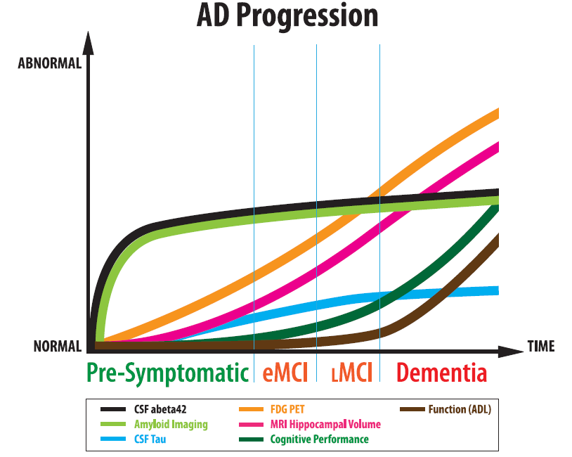
FDG-PET
CSF Aβ42
MRI hipp
Cog
Amyloid imaging
CSF tau
Fxn

Slide 26
ADNI GO
EMCI: 200 new subjects
Continued follow-up of LMCI and controls from ADNI 1
All subjects to have LP, AV-45 amyloid imaging, FDG-PET, vMRI
Some adjustments to cognitive assessment
Additional analysis funds

Slide 27
ADNI 2
Continue to follow all EMCI, LMCI and NC from ADNI 1 and ADNI GO for 5 more years
Enroll:
  100 additional EMCI (supplements 200 from GO)
  150 new controls, LMCI, and AD
MRI at 3, 6, months and annually
F18 amyloid (AV-45)/FDG every other year
LP on 100% of subjects at enrollment
Genetics

Slide 28
Enrollment
ADNI 1 ADNI GO ADNI 2 Cumulative
CN 202 – 150 352
EMCI – 200 100 300
LMCI 274 – 150 424
AD 200 – 150 350

Slide 29
Summary: ADNI
Standardization: imaging, biomarkers
Neuroscience: relationships among biomarker trajectories elucidate neurobiology
Trials: new understanding of biomarkers has facilitated interventional studies in very early AD
Data sharing: ADNI has demonstrated the power of real-time public data sharing
Collaboration: academia, industry, non-profits, regulatory agencies world-wide

Slide 30
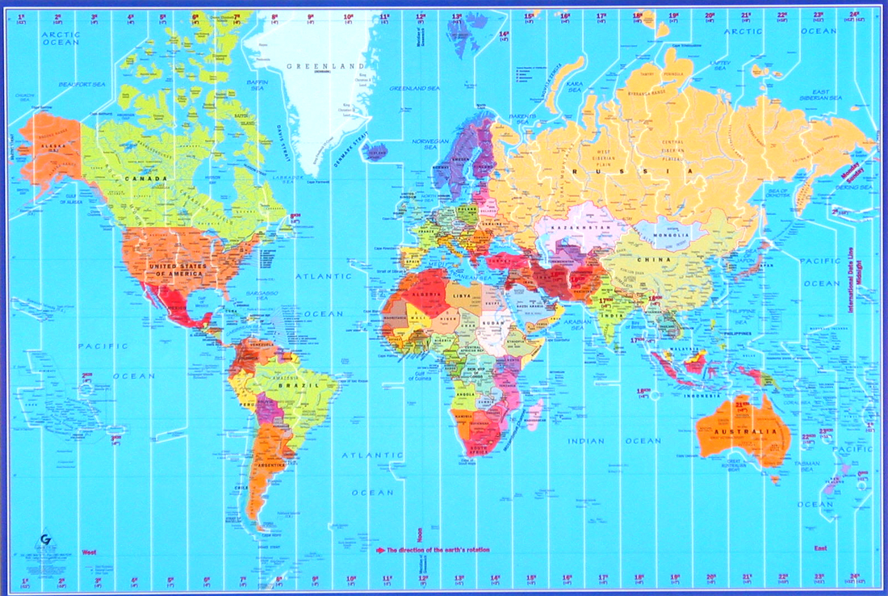
J-ADNI
EU-ADNI
NA-ADNI
A-ADNI
WW-ADNI
Notes:
Engagement of the Global community
ADNI-like studies now underway in Australia, Japan, China and Europe.

Slide 31
ADNI as a model for other diseases
Parkinson’s disease
FTD
Atherosclerosis
Interaction with Wellcome Trust UK Biobank Project through NCI

Slide 32
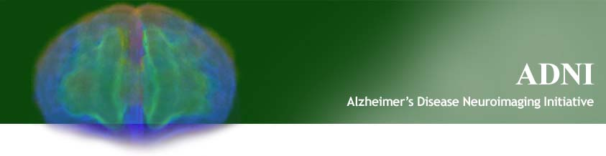
http://www.adni-info.org http://www.loni.ucla.edu/ADNI

