Slide 1
Evaluating the use of publicly funded scientific data for decision making
Richard Bernknopf
Western Geographic Science Center USGS
Economic
Ecologic
Social
Laws &
Regulations
Domestic
Politics
DECISION or
POLICY
Morals
& Ethics
International
Politics
Science &
Technology

Slide 2
Motivation for research and analyses
What is the value of publicly provided scientific information?
How can we integrate natural science information with socioeconomic information?
Can quantitative forecasts about future physical and
ecological outcomes be developed to project outcomes
associated with different scenarios?
How can uncertainty be understood and reduced to inform
decisions with natural science?

Slide 3
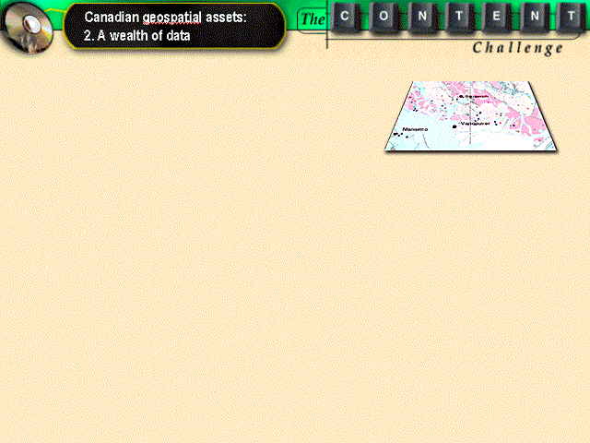
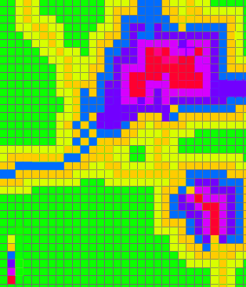
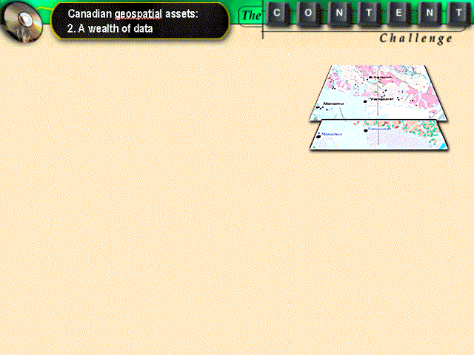
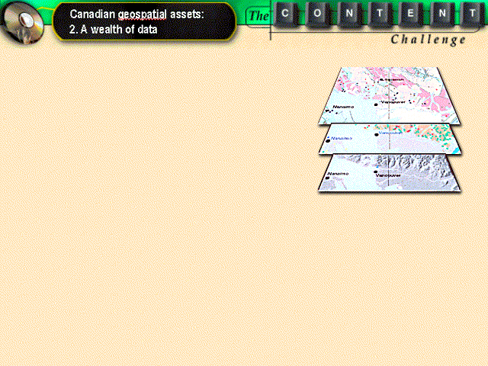
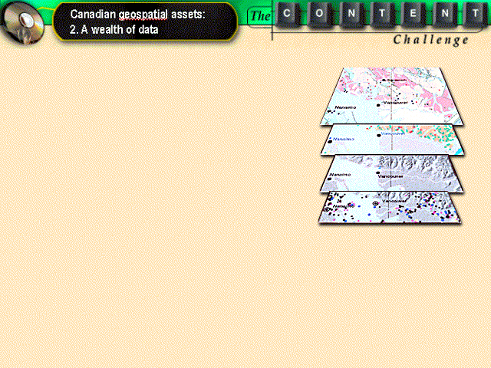
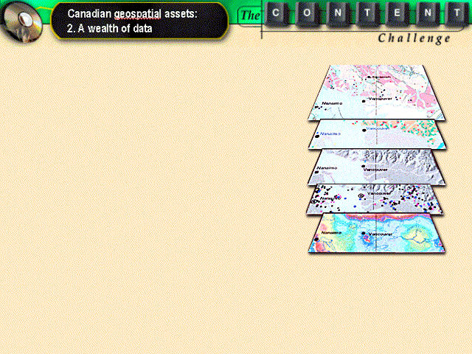
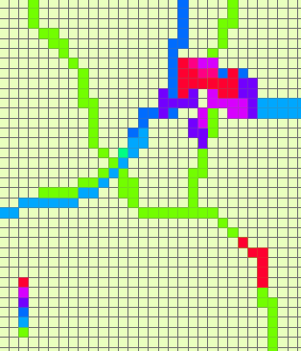
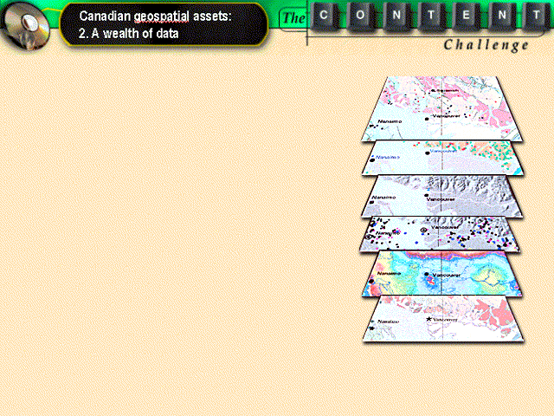
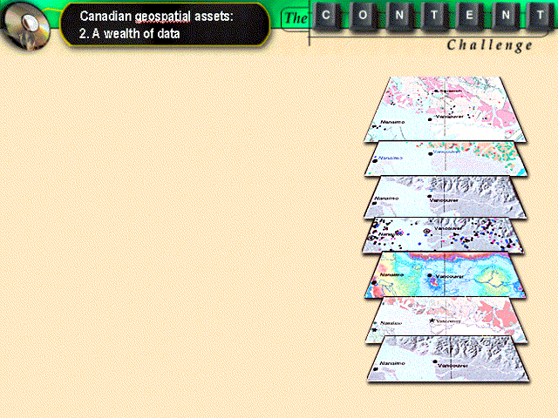
A Geospatial Decision Framework
Process models and data that integrate natural science information with social and economic models and factors to describe the implications of policy and management decisions.
Information
Assessment
Outcome
Socioeconomic
Environment
scientific
social
Risk
Environmental
economic
Valuation
Scientific
Modeling
Integrated
Assessment
Modeling
VOI

Slide 4
Examples of USGS VOI applications
Earth science
What is a geologic map worth?
Infrastructure issues: locating a landfill and a freeway
retaining wall
Remote sensing
Should Landsat be an operational land imaging system?
(‘Operational’ means routine use of imagery for decisions.)
Land use policy: protecting ecosystem services
Valuation of benefits
Private (Financial) is from the point of view of the individual: cash flows as perceived by the operator guides decision making. Externalities are not included.
Societal (Economic) is from the point of view of society: prices may be shadow, i.e., different from real prices, to reflect some social benefit. Externalities are included.

Slide 5
Economic model: the demand for safety
Uncertainty in the context of loss avoidance causes decision makers to take precautions until they have better clarifying information. They will over-regulate or under-regulate.
E.g., under-regulation: occurs if uncertainty in the information produces an underestimation of the safety concern, the demand for safety is perceived to be lower than it should be.
.
E(L_{a}) is the expected loss avoided K* is the optimal level of safety

Slide 6
VOI:
Landfill B=$1.5M
Retaining wall B=$1-3M
Cost=$1.2M
Problem: Where should the county locate the next landfill?
Spatial distribution of cells in eastern Loudon County, VA, restricted from further consideration as a possible landfill site on the basis of existing (1963) and improved (1992) geologic map information

Slide 7
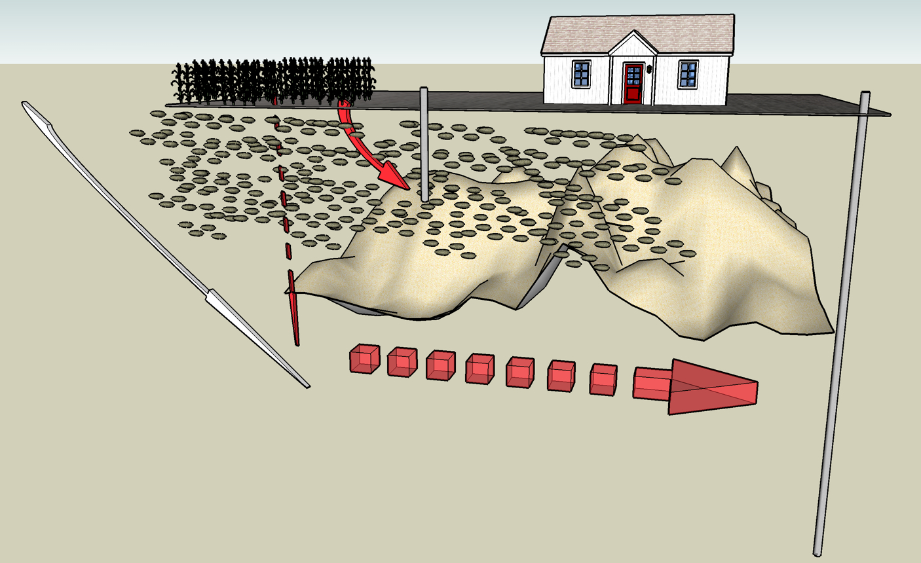
A general framework for estimating the benefits of moderate resolution land imagery (MRLI) in environmental applications: a case study in nonpoint source pollution of groundwater resources

Slide 8
Landsat imagery and ground based sampling
Central Hypothesis: Regional resource policy can be based on coupling the Landsat archive (history of land use) with a time series of groundwater vulnerability sample measurements to probabilistically forecast the timing of exceeding a regulatory health standard that is caused by nonpoint source pollution.
Landsat imagery facilitates spatiotemporal analysis of groundwater pollution at regional scale to estimate chemical concentrations in groundwater.
Landsat imagery and its archive are critical because groundwater pollution is 1) nonpoint source pollution occurring 2) over a period of time.
Landsat imagery provides a population of land uses and their associated pollution dynamics, while ground based sampling techniques focuses on only a sample of land uses.

Slide 9
Economic decisions
Producer behavior is to maximize profit given subsidies, taxes, and regulations
Revealed preference for social risk: policy makers consider social risk in developing policy; preference for social risk is revealed by observed behavior
Societal cost (e.g. groundwater damage)
Income loss (e.g. agricultural production)
Loss
Too little
Too much
Regulation

Slide 10
Sources of nitrogen inputs in Upper Midwest Region (average annual values lb/acre)
Crop | Commercial fertilizer | Manure | Atmospheric Deposition | Bio-fixation | Sum of inputs
Corn | 114.2 | 12.6 | 6.2 | 0 | 133
Grass hay | 64.4 | 4 | 6.1 | 0 | 74.6
Legume hay | 35.9 | 0.8 | 5.8 | 420.8 | 463.4
Oats | 18.9 | 0.3 | 5.6 | 0 | 24.8
Spring wheat | 81.3 | 0.2 | 4.9 | 0 | 86.4
Sorghum | 82.4 | 1.2 | 6 | 0 | 89.6
Soybeans | 3 | 0.8 | 6.2 | 181.6 | 191.7
Winter wheat | 82.5 | 0.2 | 6.3 | 0 | 89.1
Source: Potter et al. 2006

Slide 11
Conceptual framework for using MRLI in an integrated assessment
Prices and market mechanisms
Policies and regulations
Local and regional land attributes
Management decisions: land use, input use
Output: acres/yield
Pollution of common pool resources
Joint output estimates with MRLI in various models
Regional land use portfolio for policy analysis
Benefit estimation of MRLI
Adapted from Antle and Just, 1991

Slide 12
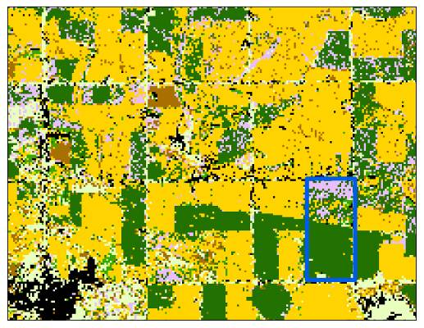
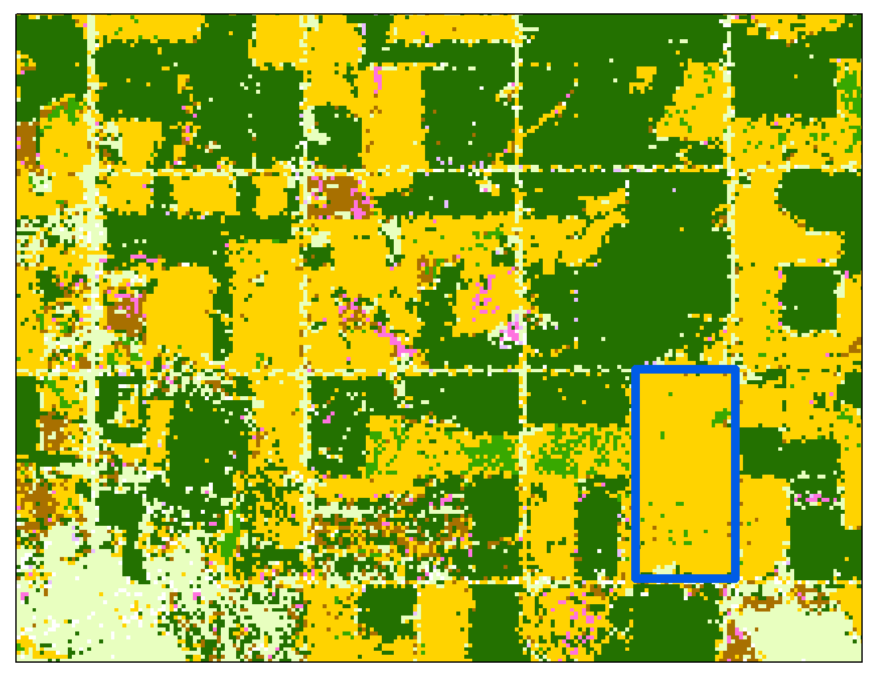
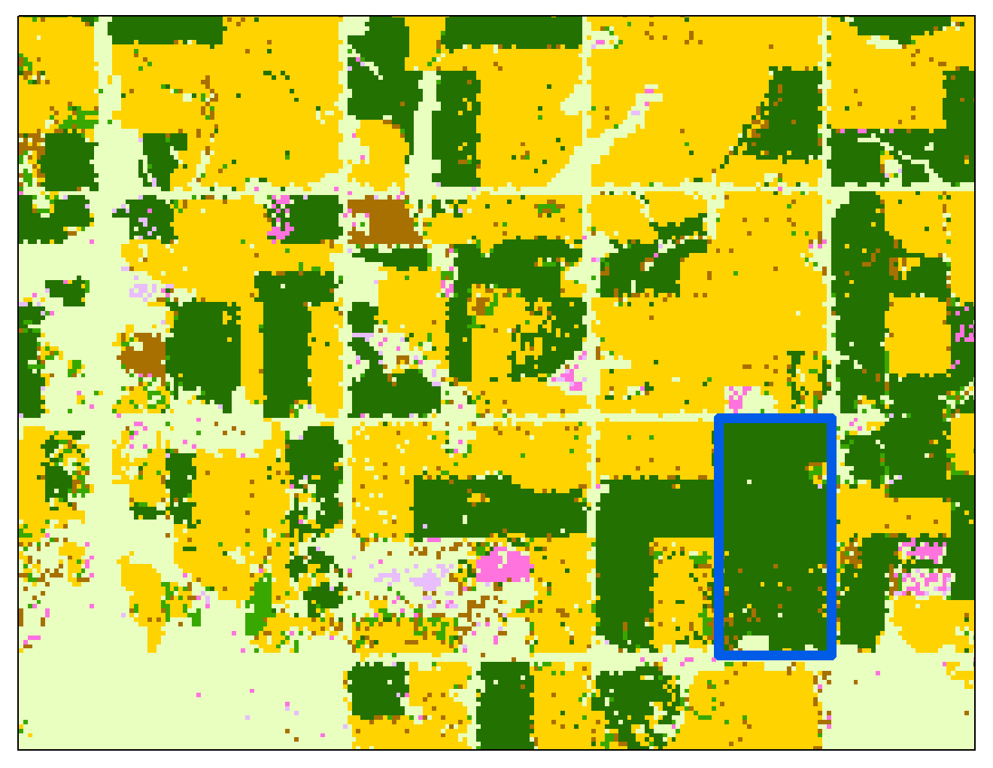
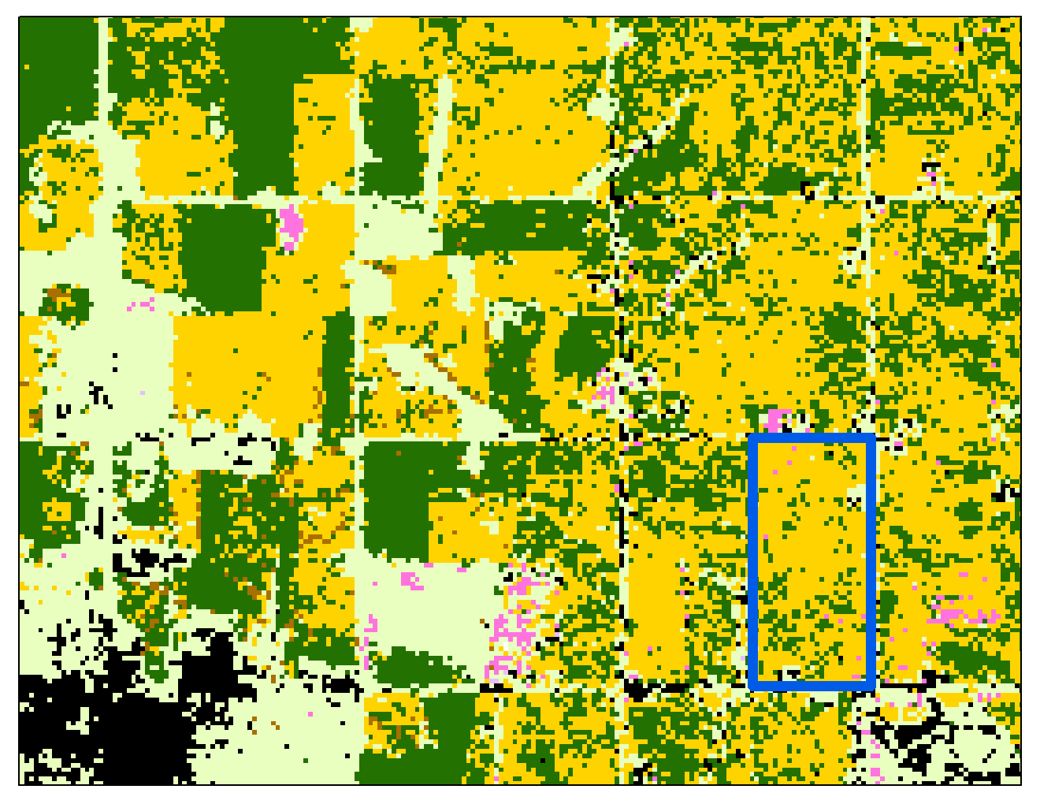
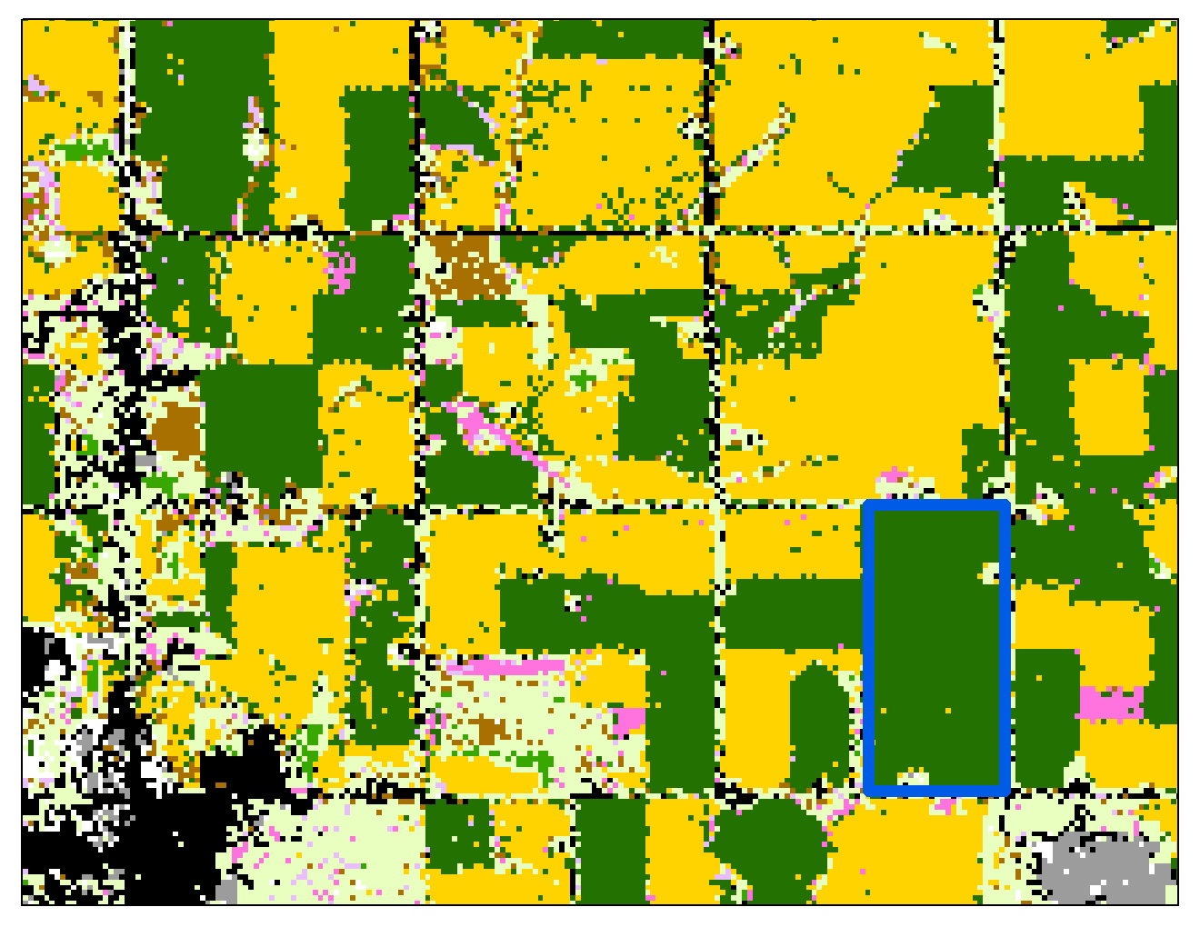
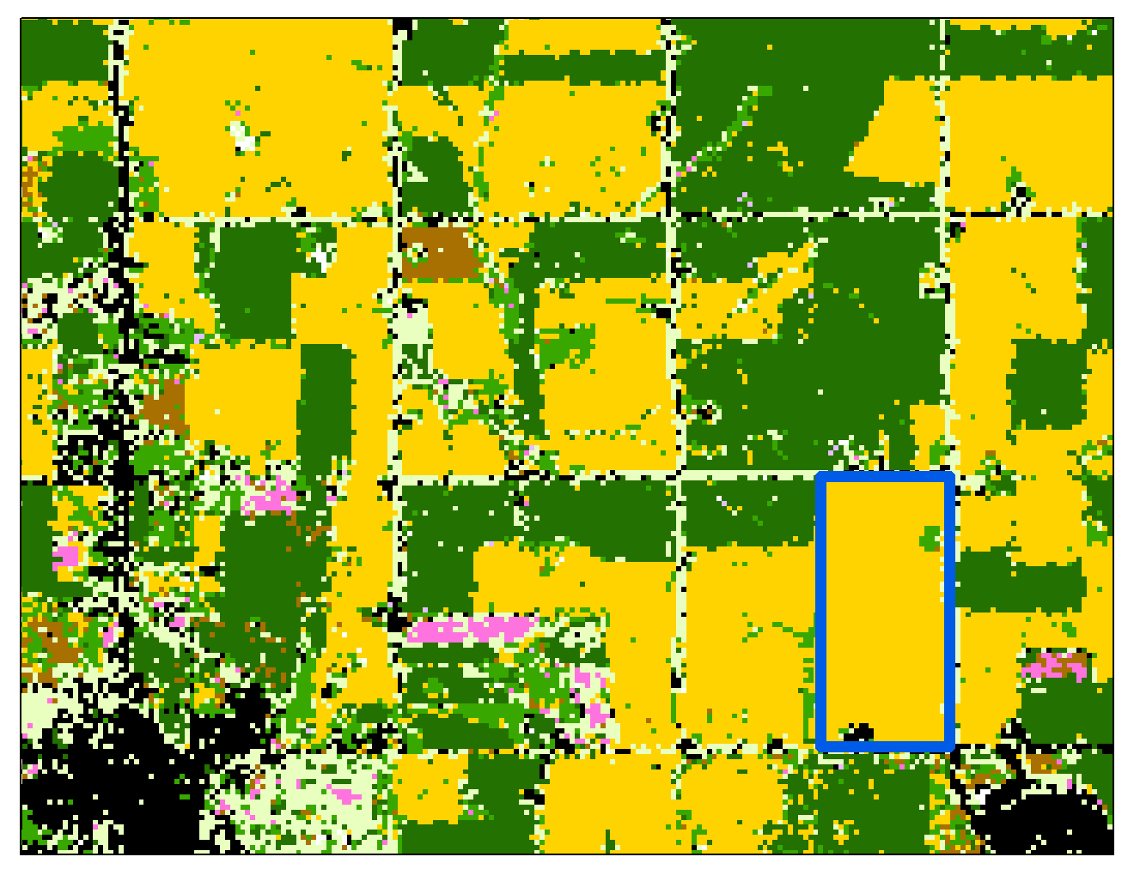
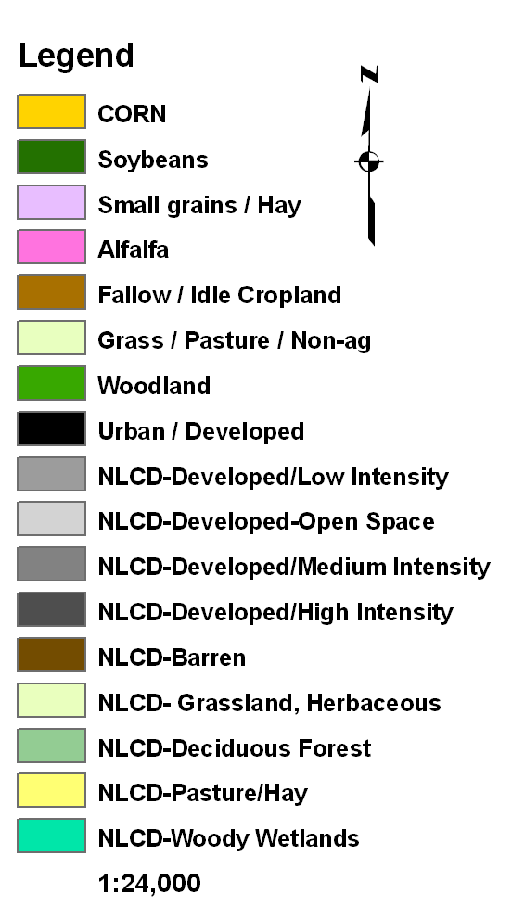
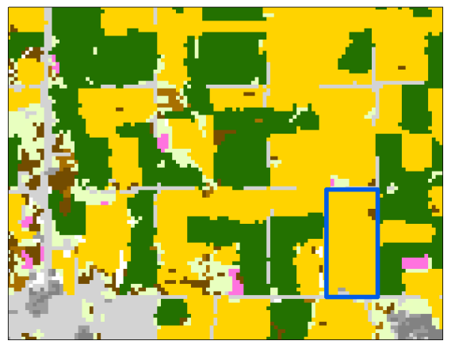
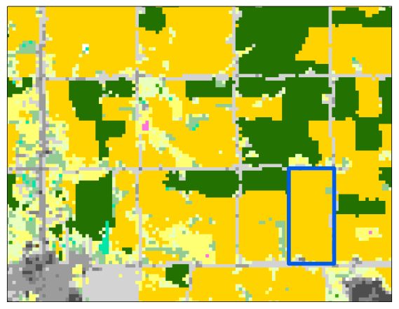
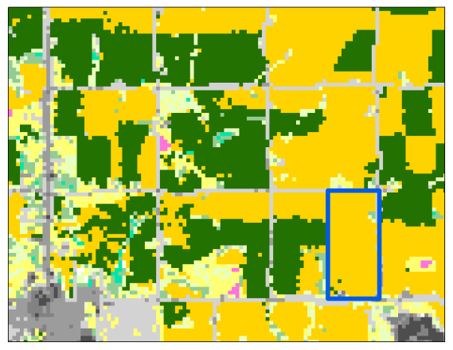
NASS’s Cropland Data Layer: Landsat (2000-2005) and AWiFS (2006-present)
Corn and Soy Classification
2000
2001
2002
Waterloo
2003
2004
2005
2006
2007
2008

Slide 13
The cumulative nitrate indicator (CNI)
CNI_{t}
v=application of variable inputs (fertilizer), z=agricultural methods (no till), e=properties of the site (residual nitrogen, moisture content, slope, soil type, depth to water), g is the zone of the groundwater catchment basin that affects the well bottom, g years after a surface activity by the function. G is the set of zones identified for the catchment basin and some recovery is possible depending on the properties of the well bottom, e⁰_{t}

Slide 14
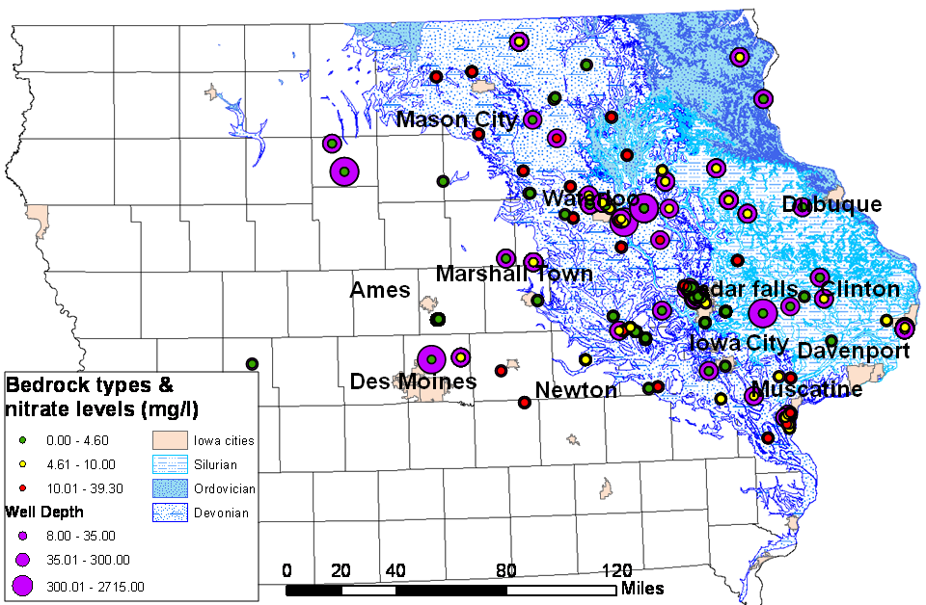
NAWQA Wells. Additional wells from the state of Iowa will be considered for inclusion

Slide 15
2017 ????

Slide 16
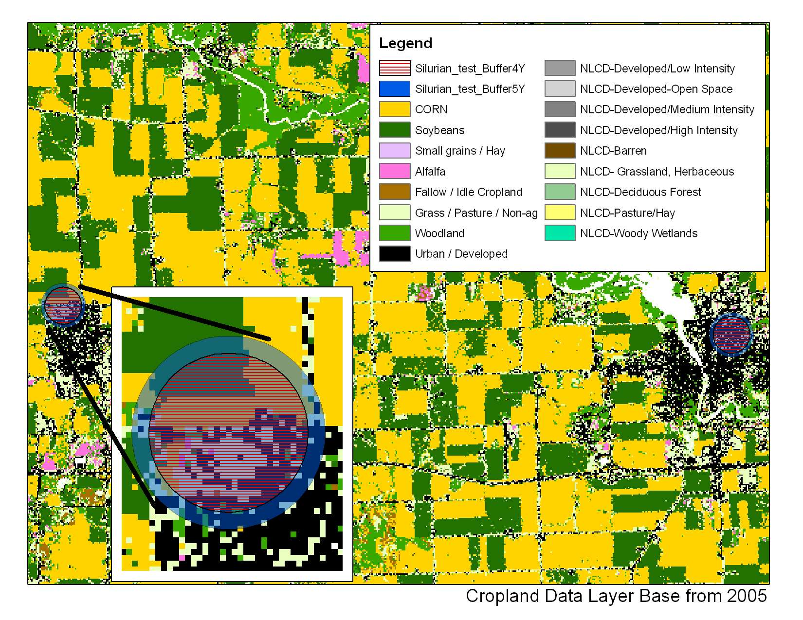
Corn and soybean acres around a public well
Catchment Zone | Corn (ac) | Soybeans (ac)
4 years | 38.03 | 23.8
5 years | 52.26 | 40.25

Slide 17

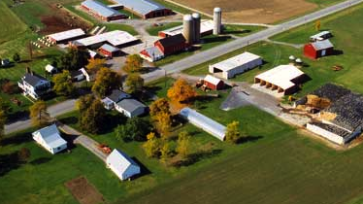
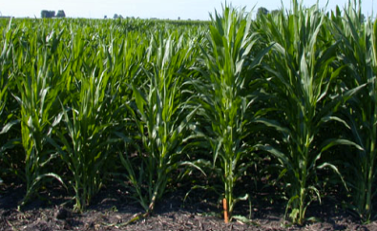

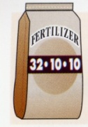




Application
Agricultural production and nutrient loading
Issue: What is the minimum $ value of lost ag. production necessary to maintain groundwater potability with 95%-99% confidence? This is a spatio-temporal portfolio risk problem.
Corn field
Nitrogen
Fertilizer
Nitrates
Nitrates
Nitrates
25 ft
Nitrates
Top Soil
Nitrates
Private Well
Public well
Sub Soil
Strata
Nitrates
Impermeable layer
Nitrates
Aquifer
>100 ft

Slide 18
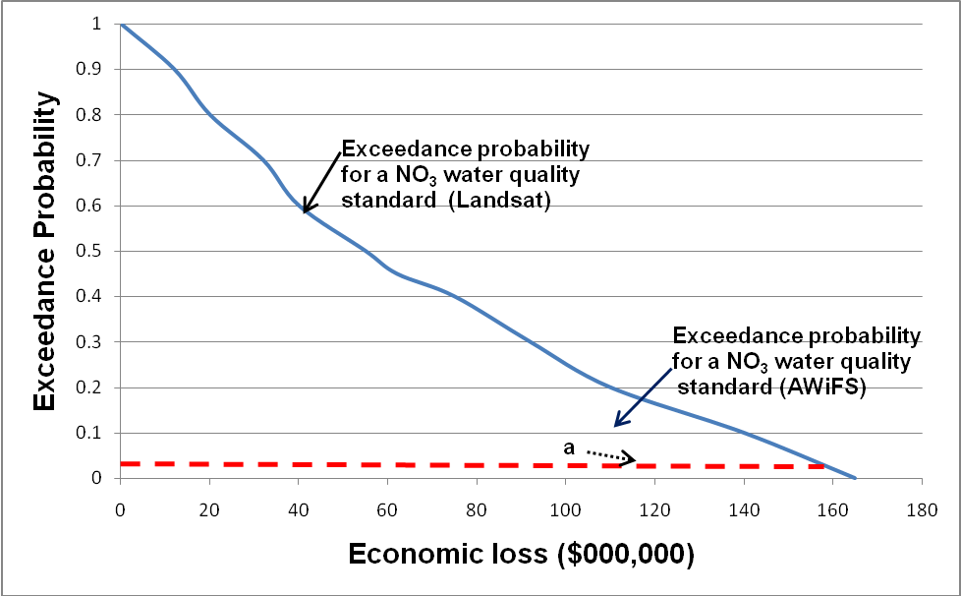
Hypothetical exceedance probability for MRLI
(Landsat) observations & ground based sampling
, α
(ground based)
Exceedance probability for NO₃ water quality standard(Landsat)
α=.01
b
, L_{i}, ($000,000)
given an exceedance probability of .01
b = economic loss with ground based sampling
a = economic loss with MRLI (Landsat)
VOI = b-a

Slide 19
Summary
Derived a flexible method for considering the societal value of information from a public good that depends on the use of the information as determined by critical decision making elements
Demonstrated that updated and / or new information provides economic benefits by reducing decision risk
Justified the cost of producing the information for societal decisions (regional scale geologic maps); investment choice is based on a conservative estimate of benefits to society (Landsat imagery archive)
rbern@usgs.gov

Slide 20
References
Bernknopf, R., W. Forney, R. Raunikar, and S. Mishra, 2010, A general framework for estimating the benefits of Moderate Resolution Land Imagery in environmental applications, in M. Macauley and R. Laxminarayan (eds.), Value of Information: Methodological Frontiers and New Applications, Resources for the Future, Washington, DC, in press.
Smith, T, R. Bernknopf, and A. Wein, A spatial modeling framework for analyzing potential earthquake damage: an application to Memphis, Risk Analysis, in review.
Bernknopf, R., A. Wein, S. Lucas, and M. St-Onge, 2007, Analysis of Improved Government Geological Map Information to Mineral Exploration: Incorporating Efficiency, Effectiveness and Risk Considerations, Joint USGS Professional Paper 1721 - Geological Survey of Canada Bulletin 593, 45p.
Bernknopf, R., P. Hearn, A. Wein, and D. Strong, 2007, The Effect of Scientific and Socioeconomic Uncertainty on a Natural Hazards Policy Choice, Modeling and Simulation 2007, Christ Church, New Zealand, 7p.
Bernknopf, R., S. Rabinovici, L. Dinitz, and N. Wood, 2006, The Influence of Hazard Models on GIS-Based Regional Risk Assessments and Mitigation Policies, International Journal of Risk Assessment and Management, v.6, nos. 4/5/6, p. 369-387.
Ganderton, P., D. Brookshire, and R. Bernknopf, 2005, Improving the Homeland Security Advisory System: an experimental analysis of threat communication for national security, in Richardson, H., P. Gordon, and J. Moore II, ed., The Economic Impacts of Terrorist Attacks, Edward Elger, Cheltenham, p. 133-151.
Bernknopf, R., 2005, Geospatial Decision Support Systems for Societal Decision Making, Boletin Geologico y Minero, v.116, no.4, p. 325-330.
Halsing, D., K. Theissen, and R. Bernknopf, 2004, A Cost-Benefit Analysis of The National Map, USGS Circular 1271, 40p.
Bernknopf, R., D. Brookshire, and P. Ganderton, 2003, The role of geo-science information in reducing catastrophic loss using a web-based economics experiment, USGS Professional Paper 1683, 28p.
Bernknopf, R., L. Dinitz, and K. Loague, 2001, An Interdisciplinary assessment of regional-scale nonpoint source groundwater vulnerability: theory and application, USGS Professional Paper 1645, 21p.
Bernknopf, R., K. Lenkeit, L. Dinitz, and K. Loague, 1999, Estimating a societal value of earth science information in the assessment of nonpoint source pollutants, in Corwin, D., K. Loague, and T. Ellsworth, (eds.), AGU Special Publication: Application of GIS, Remote Sensing, Geostatistics, and Solute Transport Modeling to the Assessment of Nonpoint Source Pollution in the Vadose Zone, p.291-308.
Bernknopf, R., and H. Karl, 1998, Thoughts on the application of science to decision making, Water Resources Update, no. 113, p.14-20.
Bernknopf, R., D. Brookshire, M. McKee, and D. Soller, 1997, Estimating the social value of geologic map information: a regulatory application, Journal of Environmental Economics and Management, p.204-217.
Bernknopf, R., D. Brookshire, D. Soller, M. McKee, J. Sutter, J. Matti, and R. Campbell, 1993, The societal value of geologic maps, USGS Circular 1111, 53p.
Bernknopf, R., D. Brookshire, and R. Campbell, 1989, Evaluation of landslide hazards: an economic synthesis of geologic information, in Landslides in a semi-arid environment: studies from inland valleys of southern California ed., P.M. Sadler and D.M. Morton, Inland Geological Society.
Bernknopf, R. L., and W. Watson, 1988, Regional availability and economics of coal, in National energy issues: geologic perspective and the role of geologic information, ed., T.W. Offield, USGS Bulletin 1850.

