Slide 1
Data-Intensive
Scientific Discovery
Tony Hey
Microsoft Research
Notes:
© 2010 Microsoft Corporation. All rights reserved. Microsoft, Windows, Windows Vista and other product names are or may be registered trademarks and/or trademarks in the U.S. and/or other countries.
The information herein is for informational purposes only and represents the current view of Microsoft Corporation as of the date of this presentation. Because Microsoft must respond to changing market conditions, it should not be interpreted to be a commitment on the part of Microsoft, and Microsoft cannot guarantee the accuracy of any information provided after the date of this presentation.
MICROSOFT MAKES NO WARRANTIES, EXPRESS, IMPLIED OR STATUTORY, AS TO THE INFORMATION IN THIS PRESENTATION.

Slide 2
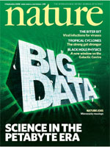
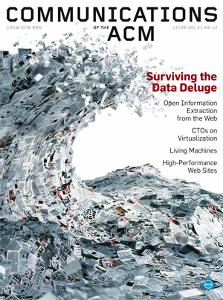
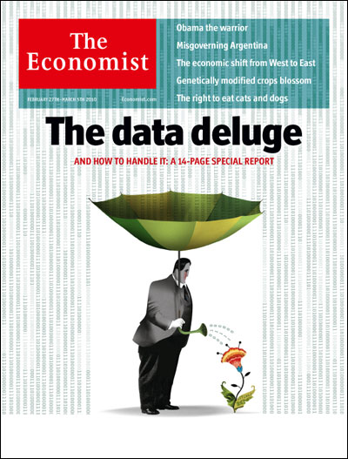
A Tidal Wave of Scientific Data

Slide 3
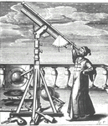
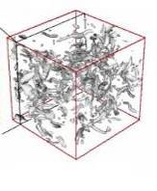


Emergence of a Fourth Research Paradigm
Thousand years ago – Experimental Science
  Description of natural phenomena
Last few hundred years – Theoretical Science
  Newton’s Laws, Maxwell’s Equations…
Last few decades – Computational Science
  Simulation of complex phenomena
Today – Data-Intensive Science
  Scientists overwhelmed with data sets
  from many different sources
    Data captured by instruments
    Data generated by simulations
    Data generated by sensor networks
  eScience is the set of tools and technologies
  to support data federation and collaboration
    For analysis and data mining
    For data visualization and exploration
    For scholarly communication and dissemination
(With thanks to Jim Gray)

Slide 4
X-Info
The evolution of X-Info and Comp-X for each discipline X
How to codify and represent our knowledge
Experiments &
Instruments
facts
Other Archives
facts
?
questions
Literature
facts
answers
facts
Simulations
The Generic Problems
Data ingest
Managing a petabyte
Common schema
How to organize it
How to reorganize it
How to share with others
Query and Vis tools
Building and executing models
Integrating data and Literature
Documenting experiments
Curation and long-term preservation
(With thanks to Jim Gray)

Slide 5
All Scientific Data Online
Many disciplines overlap and use data from other sciences.
Internet can unify all literature and data
Go from literature to computation to data back to literature.
Information at your fingertips –
For everyone, everywhere
Increase Scientific Information
Velocity
Huge increase in Science Productivity
Literature
Derived and recombined data
Raw Data
(From Jim Gray’s last talk)

Slide 6
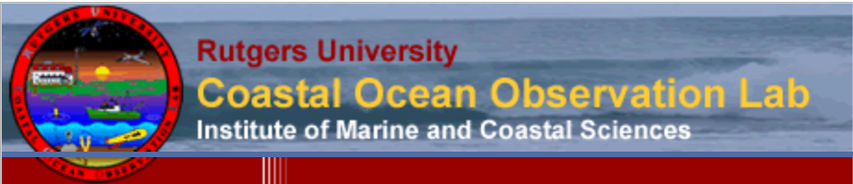
Coastal Ocean Observation Lab
Oceans of data
After a boating or aircraft accident at sea, the U.S. Coast Guard historically has relied on current charts and wind gauges to figure out where to hunt for survivors. But thanks to data originally collected by Rutgers University oceanographers to answer scientific questions about earth-ocean-atmosphere interactions, the USCG has a new resource that promises to literally save lives. It’s a powerful example that large data sets can drive myriad new and unexpected opportunities and it’s an argument for funding and building robust systems to manage and store the data.
At Rutgers University’s Coastal Ocean Observation Lab, scientists have been collecting high frequency radar data that can remotely measure ocean surface waves and currents. The data are generated from antennae located along the eastern seaboard from Massachusetts to Chesapeake Bay.
One of the group’s frustrations today, unfortunately, is the lack of funding to design and support long-term preservation of data. A large fraction of the data the Rutgers team collects has to be thrown out because there is no room to store it and no support within existing research projects to better curate and manage the data. “I can get funding to put equipment into the ocean, but not to analyze that data on the back end,” says Schofield.

Slide 7

Galaxy Zoo
Citizen Science
If people do not understand what a cell is how can they understand the ethics and implications of stem-cell research? If the general public does not understand molecules and DNA how can they understand the principals of heredity and risks in healthcare and disease management? Or, put another way, scientific illiteracy undermines citizens' ability to take part in the democratic process ⁽³⁰⁾ . Although the NSF is not focused on broad-scale education it can catalyze community engagement in exciting scientific discovery and, through this, both advance scientific discovery and help educate US citizens in key scientific principles.
There are now many examples of meaningful citizen science engagement however Galaxy Zoo ⁽¹⁵⁾ activities give a useful indication of the latent appetite for scientific engagement in society. This is a collection of online astronomy projects which invite members of the public to assist in classifying galaxies. In the first year, the initial project boasted over 50 million classifications made by 150,000 individuals in the general public – it quickly became the world's largest database of galaxy shapes. So successful was the original project that it spawned Galaxy Zoo 2 in February 2009 to classify another 250,000 SDSS galaxies. The project included unique scientific discoveries such as Hanny’s Voorwerp ⁽³¹⁾ and ‘Green Pea’ galaxies.

Slide 8

The Nearby Supernova Factory
RoI of scientific data services
One of astrophysics’ great quests is to comprehend the mysterious “dark energy” which acts to accelerate the expansion of the universe primarily based on the study of supernovae. The Nearby Supernova Factory (SNfactory) is an international astrophysics experiment designed to discover and measure Type Ia supernovae in greater number and detail than has ever been done before. It has about 30 members; about half in the U.S. and the other half in France. On any given night, the project’s primary telescope which is in Hawaii, is used to collect up to 80 GB of data and is typically operated by a geographically separated group of two to six people. Because data curation and management were considered a priority in this project, today SNfactory is a shining example of the significant return on investment – both in terms of financial resources and in terms of scientific productivity that cyberinfrastructure can provide.
The project brought together an interdisciplinary team including physicists, computer scientists, and software engineers. They put their shoulders to the challenge of creating what came to be known as Sunfall (SuperNova Factory AssembLy Line). The solution reduced false supernovae identification by 40%; it improved scanning and vetting times by 70%; and it reduced labor for search and scanning from 6-8 people working four hours per day to one person working one hour per day. Not only did the system pay for itself operationally within 1.5 years, but it enabled new science discovery. It led to ten publications in 2009 in both computer science and physics journals, and three best paper awards in computer science.

Slide 9
Jim Gray’s Call to Action (Part 1)
Listed 7 key areas for action by Funding Agencies:
Fund both development and support of software tools
Invest at all levels of the finding ‘pyramid’
Fund development of ‘generic’ Laboratory Information Management Systems
Fund research into scientific data management, data analysis, data visualization, new algorithms and tools

Slide 10
Supporting the Data Life Cycle
Data Acquisition and Modeling
Collaboration and Visualization
Analysis and Data Mining
Disseminate and Share
Archiving and Preservation
Data Acquisition and Modeling
  Data capture from source, cleaning, storage, Clouds, etc.
  Relational and non-relational Databases, workflows, provenance …
Support Collaboration
  Allow researchers to work together, share context, facilitate interactions
  Collaboratories/Virtual Organizations
Data Analysis, Data Mining and Visualization
  Data Mining techniques (Machine Learning, OLAP)
  Visualization and visual analytics
Disseminate and Share Research Outputs
  Publish, Present, Blogs, Wikis …
  Review and Rate, social networks, tagging …
Archiving and Preservation
  Published literature, reference data, curated data, etc.
  Digital repositories, semantic computing

Slide 11
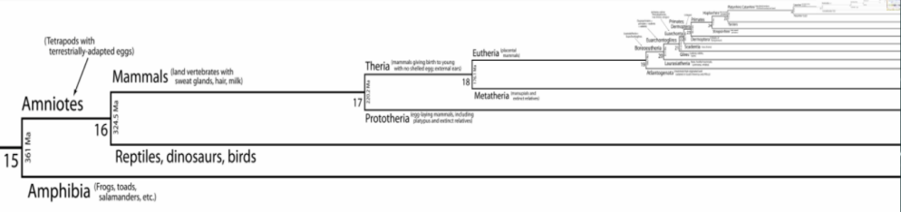
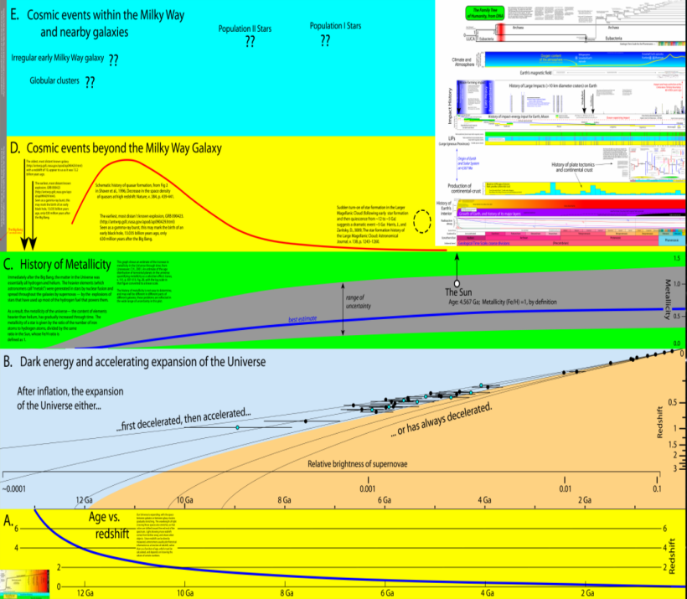
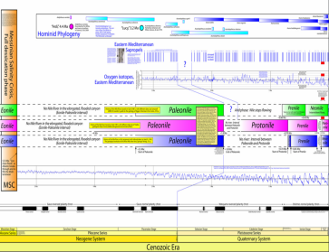
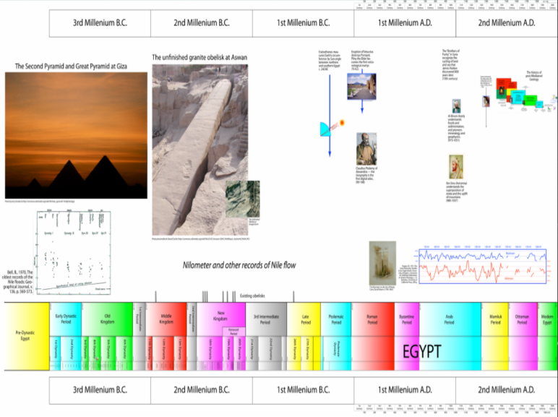
New explorations of the history of the universe
ChronoZoom
www.chronozoomtimescale.org
Walter Alvarez with Roland Saekow

Slide 12


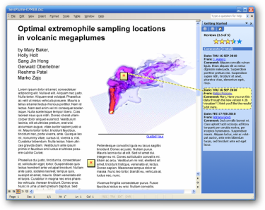



Envisioning a New Era of Research Reporting
Reproducible
Research
Collaboration
Reputation
& Influence
Dynamic
Documents
Interactive
Data
Notes:
c.f. Wilbanks, John “It’s not the Container” presentation

Slide 13


Datacite and ORCID
DataCite is an international consortium to establish easier access to scientific research data on the Internet increase acceptance of research data as legitimate, citable contributions to the scientific record, and to support data archiving that will permit results to be verified and re-purposed for future study.
ORCID (Open Research & Contributor ID) aims to solve the author/contributor name ambiguity problem in scholarly communications by creating a central registry of unique identifiers for individual researchers and an open and transparent linking mechanism between ORCID and other current author ID schemes. These identifiers, and the relationships among them, can be linked to the researcher’s output to enhance the scientific discovery process and to improve the efficiency of research funding and collaboration within the research community.

Slide 14
Jim Gray’s Call to Action (Part 2)
Remaining three key areas for action relate to the future of Scholarly Communication and Libraries:
5. Establish Digital Libraries that support the other sciences like the NLM does for Medicine
6. Fund development of new authoring tools and publication models
7. Explore development of digital data libraries that contain scientific data (not just the metadata) and support integration with published literature

Slide 15
The Michigan Daily, September 24, 2007
University of Michigan’s libraries are canceling some journal subscriptions because of budget cuts and the increasing costs of the subscriptions
University Librarian Paul Courant said that about 2,500 were canceled in the 2007 fiscal year
The University Library budget has gone up by an average of 3.1 percent per year since 2004
According to Library Journal magazine, the average subscription price of national arts and humanities journals has increased 6.8 percent per year since 2003. National social science journals increased 9.2 percent and national science journals increased by 8.3 percent

Slide 16
Open Access and Repositories
As Dean of Engineering at Southampton I was ‘responsible’ for monitoring the research output of over 200 Faculty and 500 Post Docs and Grad Students
  The University library could not afford to subscribe to all the journals that my staff published in, not to mention conference proceedings and workshop contributions, so we insisted on keeping a digital copy of all output in a University Repository …
‘Green Open Access’ or ‘Self-Archiving’ has authors making peer-reviewed final drafts of their articles accessible by depositing them in their Institution's OA Repository upon acceptance for publication
  Note that individual papers can be set to be immediately visible outside the institution or set to ‘delayed open access’ as in PubMedCentral. Web copies of non-journal versions are allowed by most publishers …

Slide 17
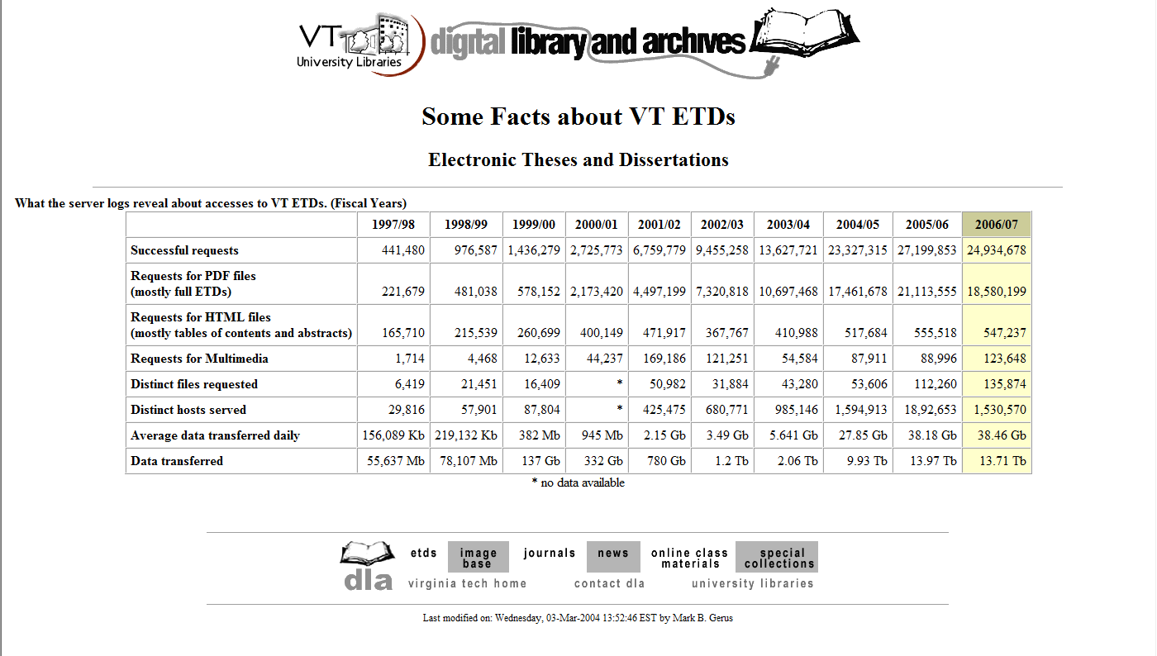
200,000 requests to 20M requests from 1997 to 2007
Graphic demonstration of the power of Open Access

Slide 18
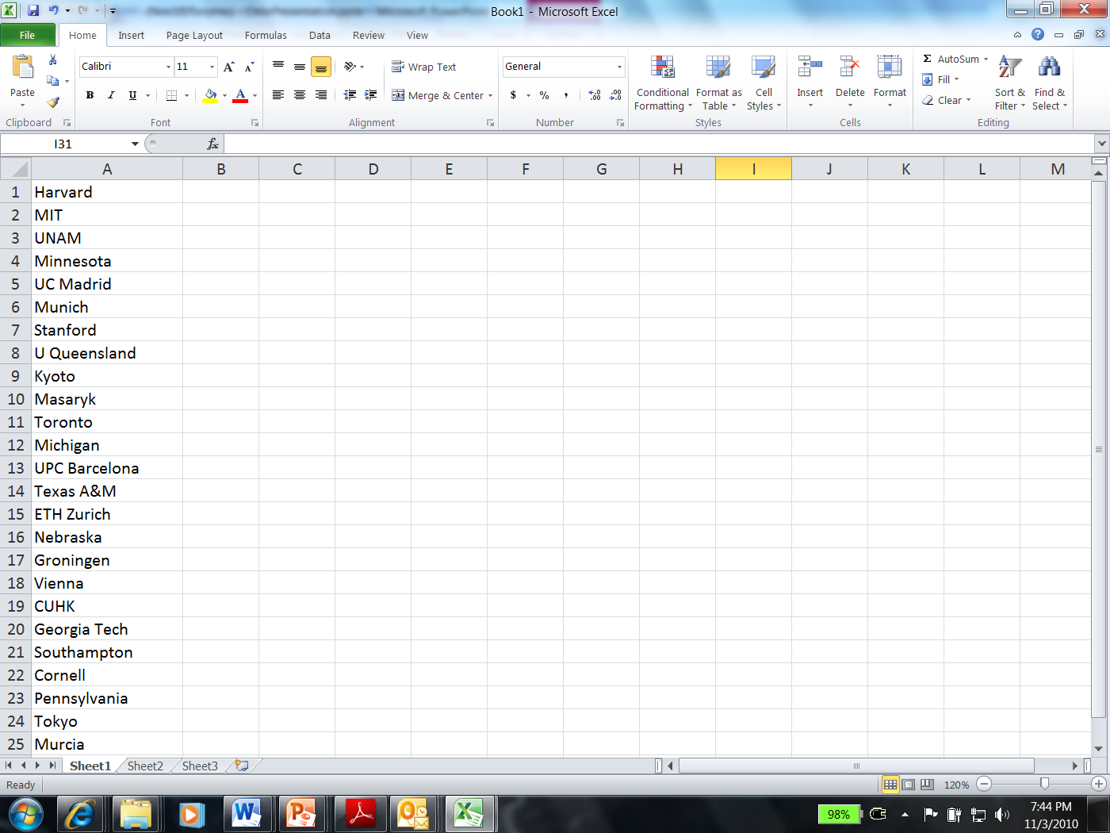
Webometrics Google Scholar Ranking
July 2010
Southampton # 21
VirginiaTech # 37
Cambridge # 97
Oxford # 115
Clearly not a ‘perfect’ metric -
but equally clearly, this must measure something of relevance for the research reputation of a university …
Institutional Research Repository must be part of the university’s ‘Reputation Management’ strategy

Slide 19
Future of Research Repositories?
Repositories will contain not only full text versions of research papers but also ‘grey’ literature such as workshop papers, presentations, technical reports and theses
  In the future repositories will also contain data, images and software
Need for federated databases of scientific information and cross database search tools
  NIH National Library of Medicine
  WorldWideScience.org

Slide 20

The US NLM and PubMed Central
The NIH Public Access Policy ensures that the public has access to the published results of NIH funded research.
It requires scientists to submit final peer-reviewed journal manuscripts that arise from NIH funds to the digital archive PubMed Central upon acceptance for publication.
To help advance science and improve human health, the Policy requires that these papers are accessible to the public on PubMed Central no later than 12 months after publication.
PubMed
PubMed abstracts
Complete Genomes
Entrez Genomes
Publishers
Genome Centers
Taxon
Phylogeny
3 -D Structure
MMDB
Nucleotide sequences
Protein sequences
Entrez cross-database search

Slide 21
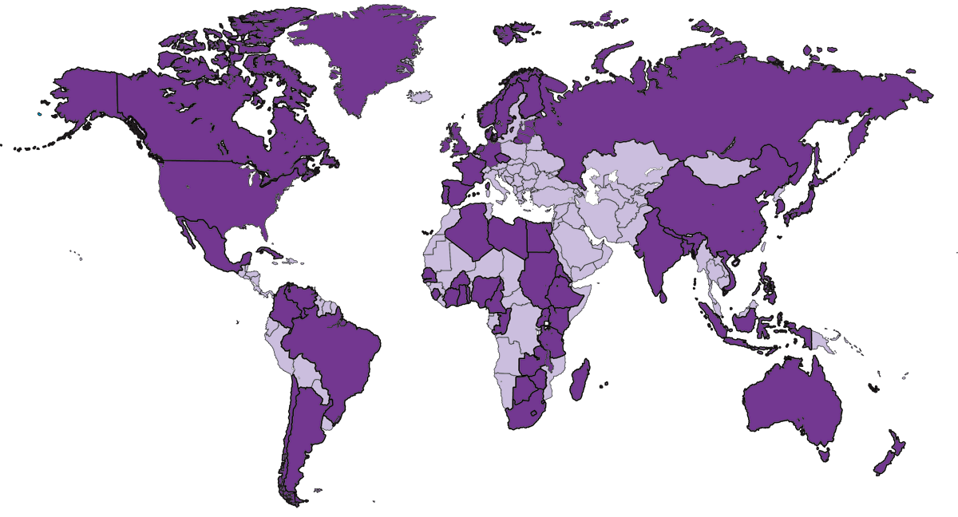
WorldWideScience – Facts and Figures
Tremendous growth in search content: from 10 nations to 65 nations in 3 years
> 400 million pages
  From well-known sources: e.g., PubMed, CERN, KoreaScience
  To more obscure sources: e.g., Bangladesh Journals Online

Slide 22
Paul Ginsparg: “As We May Read”
“On the one-decade time scale, it is likely that more research communities will join some form of global unified archive system without the current partitioning and access restrictions familiar from the paper medium, for the simple reason that it is the best way to communicate knowledge and hence to create new knowledge.”
“Ironically, it is also possible that the technology of the 21st century will allow the traditional players from a century ago, namely the professional societies and institutional libraries, to return to their dominant role in support of the research Enterprise.”

Slide 23


NSF-OCI Task Force on Data and Visualization
Advisory Committee on Cyberinfrastructure
December 8, 2010
Tony Hey, Co-Chair
  Microsoft Corporation
  Dan Atkins, Co-Chair
  University of Michigan
Margaret Hedstrom
  University of Michigan

Slide 24
Principal Recommendations
The Task Force strongly encourages the NSF to create a sustainable data infrastructure fit to support world-class research and innovation. It believes that such infrastructure is essential to sustain the USA’s long-term leadership in scientific research and a legacy which can drive future discoveries, innovation and national prosperity.
To help realize this potential the Task Force identified challenges and opportunities which will require focused and sustained investment with clear intent and purpose; these are clustered into six main areas:
Infrastructure Delivery
Culture and Sociological Change
Roles and Responsibilities
Economic Value and Sustainability
Data Management Guidelines
Ethics, Privacy and Intellectual Property
http://bit.ly/DTFDraft

Slide 25
Infrastructure Delivery
Issue: The requirements for the sustainable development, delivery and maintenance of long-term data infrastructure have been confused/conflated with those of technical experimentation.
Key Recommendation: Recognize data infrastructure and services as essential research assets fundamental to today’s science and long-term investments in national prosperity. Make specific budget provisions for the establishment and maintenance of data sets/services and the associated software and visualization tools infrastructure.
Supporting Recommendation: Serve scientific communities’ data service requirements through:
Having key research domains identify and triage their essential data (including meta data) needing to be retained and archived
Issuing an open call for large-scale data services across these science disciplines and across a range of data types.
  Working with research community to actively promote open access to new data services.
Leading Practices:
Incorporated Research Institutions for Seismology; The National Institutes of Health: the GenBank and Protein Data Bank databases

Slide 26
Culture and Sociological Change
Issue: Entrenched culture is a roadblock to change in the practice of scientific research. Few researchers place importance on or value the people involved in data management and/or data curation. This leads to there being inadequate career opportunities for those essential to the future of scientific research and no clear pipeline of expertise to support the required skills and resources.
Key Recommendation: Introduce new funding models which have specific data-sharing expectations.
Key Recommendation: Create new citation models and tracking in which data and software tool providers are credited with their data contributions.
Supporting Recommendation: Encourage ‘freedom of research information’ principle where possible to ensure the accessibility of key scientific data by researchers, society and industry.
Leading Practices :
The open data sharing through Galaxy Zoo , Microsoft Research’s World-Wide Telescope , Google’s Flu Trends, and IBM’s Many Eyes provide excellent examples of how open access to scientific data delivers multiple potential benefits.

Slide 27
Roles and Responsibilities
Issue: Confusion and ambiguity over who owns and is responsible for research data. For example, it is unclear who is accountable for important issues such as the reproducibility of science, data retention, and data accessibility. Current guidelines appear weak and suffer from little or no policing or enforcement; and as a result there is little or no effective accountability.
Key Recommendation: Orchestrate discussions to determine a model for data stewardship clarifying data and software services and, most importantly, roles/responsibilities and interdependencies on each other’s services.
Supporting Recommendation: The NSF should actively review project Data Management Plans and more directly and intentionally monitor the actual level of data openness, accessibility and level of effective sharing across the projects it sponsors.
Leading Practices : The global data infrastructure associated with the Large Hadron Collider: DataGrid distributes PetaBytes of data from the Tier 0 site at CERN to a network of Tier 1 processing and archival sites throughout the world. This federated design is an essential component of the cyberinfrastructure and key to the international collaboration, indeed, it is a critical feature of the new way in which High-Energy Physics (HEP) research is conducted

Slide 28
Economic Value and Sustainability
Issue: Unclear what the actual costs/value should be associated with long-term data management/preservation and there is no easy or agree method with which to determine the opportunity costs from its losing/deleting/neglecting data and software assets. Additionally there is a lack of sustainable service or RoI models.
Key Recommendation: Develop and publish realistic cost models to underpin institutional/national business plans for research repositories/data services
Supporting Recommendation: The NSF should investigate data and software licensing options with a view to helping supplement research budgets.
Supporting Recommendation: Investigate the potential business value derived from both data and from the software developed as part of the NSF’s research investments.
Leading Practices: Longitudinal studies have huge and measurable value and clearly represent critical resources for future research:
Climate change data
National census data

Slide 29
Data Management Guidelines
Issue: Data management best practices are not well understood across most of the scientific researchers. This is in part because leading practices have not been sufficiently well identified but also because existing effective approaches and successful solutions are not well promulgated through the scientific community.
Key Recommendation: Identify and share best-practices for the critical areas of data management.
Supporting Recommendation: Consider an initial focus on mid-scale science as there is a large volume of science data which is currently being lost through inadequate focus on data management.
Supporting Recommendation: Broker PI-data center relationships/recommendations
Leading Practices: UK’s Digital Curation Centre (DCC) was a key recommendation in the Joint Information Systems Committee (JISC) program. DCC has produced a set of guidelines for UK researchers needing to create management data plans. It has issued templates and guidance on how to think about data curation and how to go about considering the policy decisions and any associated legal issues. These guidelines are heavily exploited by researchers and institutes throughout the world.

Slide 30
Ethics, Privacy and Intellectual Property
Issue: The growth in cyberinfrastructure raises new and far more challenging questions about the ethics and protection of privacy associated with electronic databases involving individuals as well as of organizations. There are equally challenging legal and business issues regarding ownership of data.
Key Recommendation: Increase investment on research and training of the research community in privacy-preserving data-access so that PIs can embrace privacy by design with clear guidelines on producing a privacy data plan.
Supporting Recommendation: Explore and establish new data licensing mechanisms.
Leading Practices : It is easier to find examples of risk associated with failures of privacy, ethics and IP protections than exemplars implementing robust technical and societal solutions allowing to successfully share data for research (be it raw data or access done via privacy-preserving mechanisms). A few examples of these risks include the following:
  AOL’s release of ‘anonymized’ user search data leads to PII exposure
  Anonymized patient record information plus anonymized voting data allows 1997 governor of Massachusetts of the time to be re-identified using only his date of birth, gender and ZIP code

Slide 31
Future Research Cyberinfrastructure

Slide 32
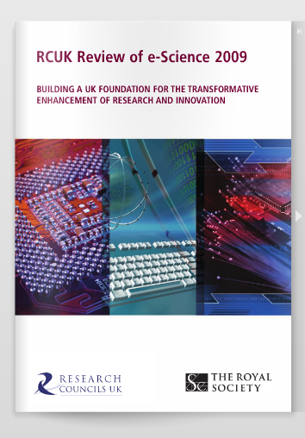

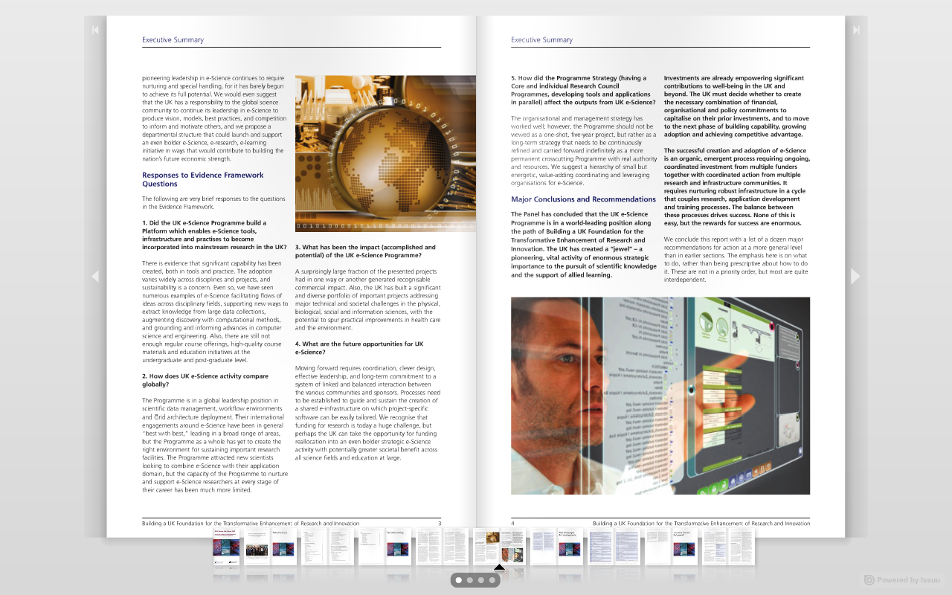
Chair: Dan Atkins
http://www.epsrc.ac.uk/research/intrevs/escience/Pages/default.aspx

Slide 33
Six Key Elements for a Global e-Infrastructure for e-Science (2004)
High bandwidth Research Networks
Internationally agreed AAA Infrastructure
Development Centers for Open Software
Technologies and standards for Data Provenance, Curation and Preservation
Open access to Data and Publications via Interoperable Repositories
Discovery Services and Collaborative Tools

Slide 34
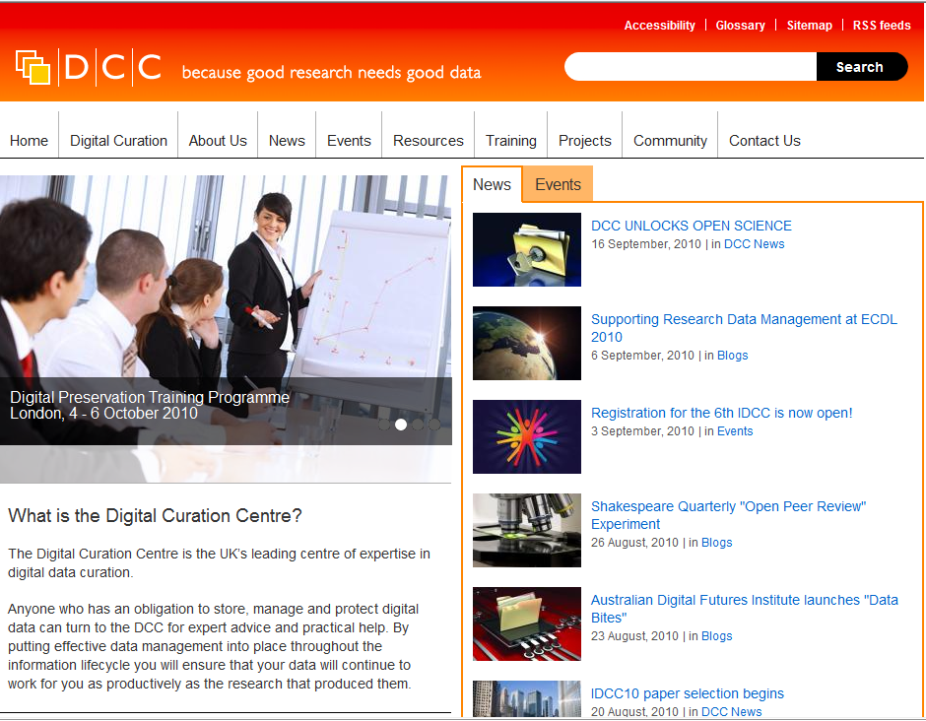
UK Digital Curation Centre (JISC funded 2004)
http://www.dcc.ac.uk

Slide 35
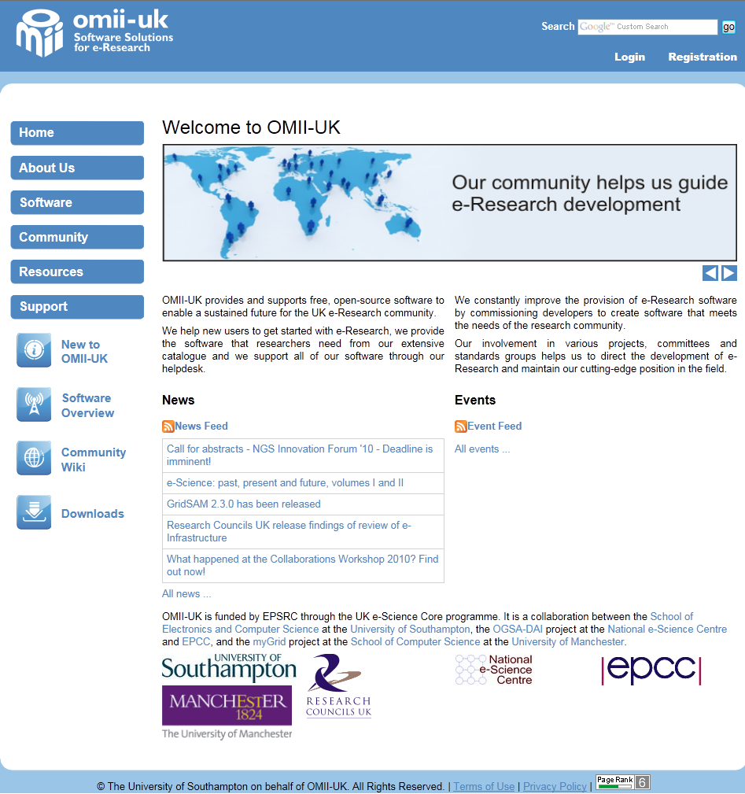

Slide 36


Slide 37

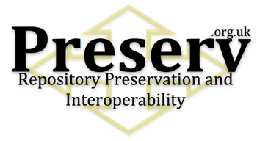



Slide 38
Towards a Semantic Future

Slide 39
Semantic Computing
storing
computing
managing
indexing
Computers are
great tools for
huge amounts
of data
In the future
we will need
computers to
help with the
automatic
acquisition
aggregation
organization
correlation
interpretation
inference
discovery
analysis
of the world’s
information

Slide 40
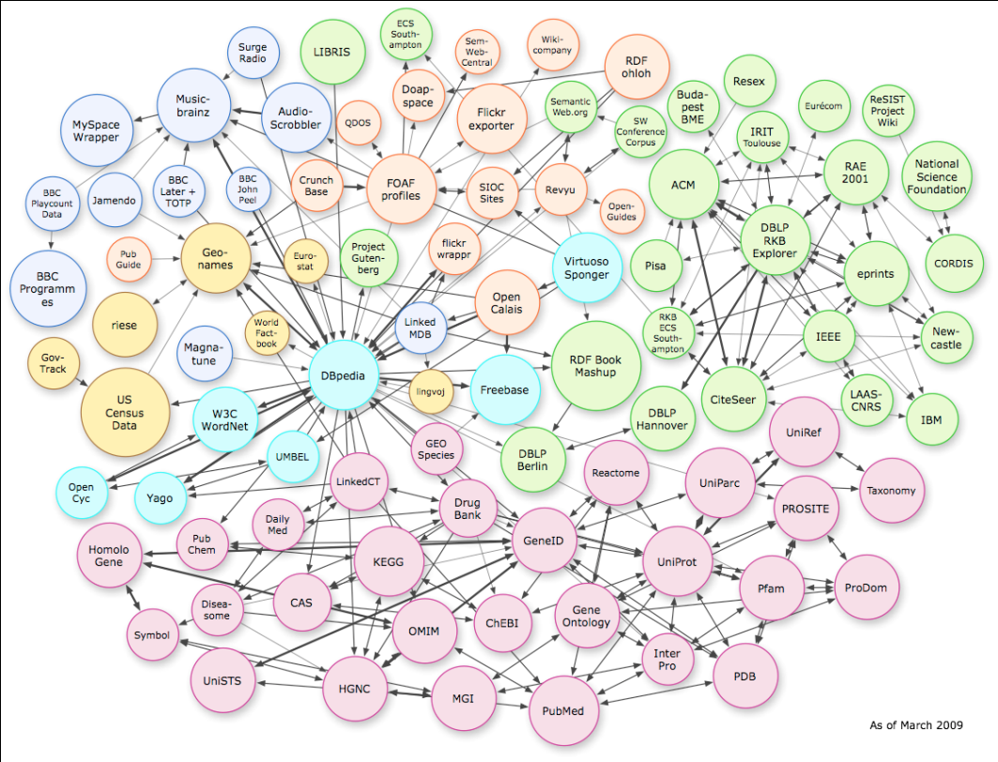
Moving to a world where all data is linked …
Data/information is inter-connected through machine-interpretable information (e.g. paper X is about star Y)
Social networks are a special case of ‘data meshes’
A knowledge ecosystem:
  A richer authoring experience
  An ecosystem of services
  Semantic storage
  Open, Collaborative,
  Interoperable, and Automatic
Attribution: Chris Bizer

Slide 41






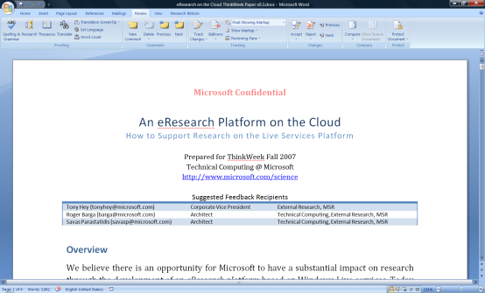

… and can be stored/analyzed in the Cloud
Future Research
Infrastructure will use
Client + Cloud resources
visualization and analysis services
scholarly communications
domain-specific services
search
books
citations
blogs &
social networking
Reference management
instant messaging
Project management
identity
mail
notification
document store
storage/data services
The Microsoft Technical Computing mission to reduce time to scientific insights is exemplified by the June 13, 2007 release of a set of four free software tools designed to advance AIDS vaccine research. The code for the tools is available now via CodePlex, an online portal created by Microsoft in 2006 to foster collaborative software development projects and host shared source code. Microsoft researchers hope that the tools will help the worldwide scientific community take new strides toward an AIDS vaccine. See more.
knowledge management
compute
services
virtualization
knowledge discovery

