Slide 1

Changing Practices…
Changing Values
Computer Mediated Scientific Knowledge Discovery Symposium
March 10-11, 2011
Deborah L. Crawford, Ph.D.
Vice Provost for Research, Drexel University

Slide 2
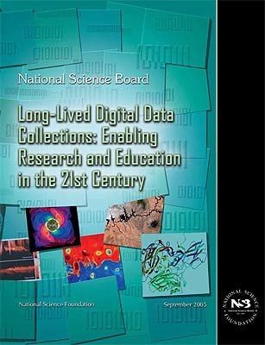
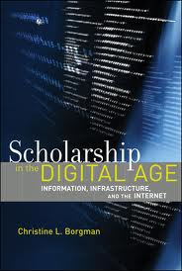
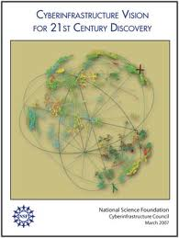
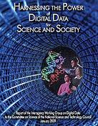
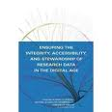
Opportunities Heralded…
http://www.nsf.gov/pubs/2005/nsb0540/
http://mitpress.mit.edu/catalog/item/default.asp?ttype=2&tid=11333
http://www.nsf.gov/pubs/2007/nsf0728/index.jsp
http://www.nitrd.gov/About/Harnessing_Power_Web.pdf
http://www.nap.edu/openbook.php?record_id=12615&page=133

Slide 3

The widespread availability of digital content creates opportunities for new kinds of research and scholarship that are qualitatively different from traditional ways of using academic publications and research data.
The Future of Scholarly Publication, NSF-JISC Workshop, 2007

Slide 4

2010-2011 Snapshot
Computer-mediated knowledge discovery practices vary widely among scientific communities…….. and among colleges and universities
Three fundamental issues
What kinds of data and information are made open, at what stage in the research process, and how?
To which groups of people are the data and information made available and on what terms or conditions?
Who develops and who has access to the tools and training to fully leverage the power of this discovery modality

Slide 5

Open to All: Case Studies of Openness in Research, Digital Curation Center, UK, 2010, http://www.rin.ac.uk/our-work/data-management-and-curation/open-science-case-studies, a sponsor/community perspective
Research Data Task Force Report, Office of Digital Assets and Infrastructure, Yale University, 2010, http://odai.research.yale.edu/sites/default/files/file/research%20data%20report%20final%20v2.pdf, an institutional perspective

Slide 6

“Open to All”
Purpose: Understand how principles of digitally-enabled openness are translated into practice in a range of disciplines
Open to All: Case Studies of Openness in Research
http://www.rin.ac.uk/our-work/data-management-and-curation/open-science-case-studies

Slide 7
Research Lifecycle Model
Conceptualizing and Networking
Translating and Engaging
Proposal Writing and Design
Publishing, Reporting and Peer Review
Collecting and Analyzing
Documenting and Describing
Infrastructuring: tools, services and standards
Open to All: Case Studies of Openness in Research
http://www.rin.ac.uk/our-work/data-management-and-curation/open-science-case-studies

Slide 8
Research Groups Surveyed
Chemistry
Astronomy
Image bioinformatics
Clinical neuroimaging
Language technology
Epidemiology

Slide 9
Perceived Benefits
Improve efficiency of research
Increase quality of research and scholarly rigor
Enhance visibility of and access to science
Enable researchers to ask new questions
Enhance collaboration and community building
Increase the economic and social impact of research
Open to All: Case Studies of Openness in Research
http://www.rin.ac.uk/our-work/data-management-and-curation/open-science-case-studies

Slide 10
Perceived Impediments
Lack of evidence of benefits
No clear incentives to change
Conflict with culture of independence and competition
Inadequate skills, time and insufficient access to resources
Concern about quality
Ethical, legal and other restrictions to access
Open to All: Case Studies of Openness in Research
http://www.rin.ac.uk/our-work/data-management-and-curation/open-science-case-studies

Slide 11
Recommendations
Need policies and practices for data management and sharing
Value contributions to research infrastructure
Provide training and professional development
Increase awareness of open business models
Develop assessment and quality assurance mechanisms
Identify promising practices
Open to All: Case Studies of Openness in Research
http://www.rin.ac.uk/our-work/data-management-and-curation/open-science-case-studies

Slide 12

Yale University Research Data Task Force
Purpose: Define faculty requirements and components of a coherent technical infrastructure, service definitions, and comprehensive policies to support the lifecycle management of research data
Method: Faculty survey
Sciences
Social sciences
Humanities
Research Data Task Force Report http://odai.research.yale.edu/sites/default/files/file/research%20data%20report%20final%20v2.pdf

Slide 13
Findings (1)
Data sharing practices vary widely among disciplines
Willingness and ability to share data
Data provided for scholarly publications
Data submission to external repositories
Researcher has most significant stake
Create institutional repository and services to secure and store and share, as appropriate, large volumes of data. Some institutional pioneers.
Research Data Task Force Report http://odai.research.yale.edu/sites/default/files/file/research%20data%20report%20final%20v2.pdf

Slide 14
Findings (2)
Data management key component in digital curation spanning the lifecycle of a digital asset yet seen as a nuisance or a chore by researchers – institution or sponsor has most significant stake.
Develop and deliver research data curation services and tools. Some institutional pioneers.
Research Data Task Force Report http://odai.research.yale.edu/sites/default/files/file/research%20data%20report%20final%20v2.pdf

Slide 15
Findings (3)
Long term persistent access and preservation not assured in faculty research practices. No curation and preservation services available (in most institutions?)
Establish a digital preservation program to reduce the risk that valuable digital assets will be lost and to establish program for persistent access to digital resources.
Research Data Task Force Report http://odai.research.yale.edu/sites/default/files/file/research%20data%20report%20final%20v2.pdf

Slide 16
Findings (4)
Data ownership is unclear to most faculty, especially when research data are merged or blended with data from other sources. Most faculty believed they owned the data.
Clear policies regarding data ownership must be developed. Services, policies, and best practices that assist researcher awareness about data ownership, IP and copyright must be developed and must take into account all aspects of the research data lifecycle.
Research Data Task Force Report http://odai.research.yale.edu/sites/default/files/file/research%20data%20report%20final%20v2.pdf

Slide 17
Changes In Play at Multiple Scales
International
National
Institution
Indiv
idual
Community

Slide 18
Culture does not change because we desire it to change. It changes when the organization is transformed; the culture reflects the realities of people working together every day.
Frances Hesselbein, The Key to Cultural Transformation

Slide 19

In working towards the comprehensive adoption of computer-mediated scientific knowledge discovery, stakeholders will need to determine the appropriate balance between the costs of improved access to scientific opportunity and the benefits that result. The efforts to improve …… need to be carried out within existing financial limitations.

Slide 20
Digital Data in Research Lifecycle
Conceptualizing and networking: messages, posts, user profiles, bibliographies, resumes
Proposal writing and design: proposal drafts, data management plans, compliance documents, study protocols
Conducting and presenting: raw and derived data, metadata, presentations, podcasts, workshop papers
Documenting and sharing: lab notes, research memos, study-level metadata, supplementary info
Publishing and reporting: conference papers, journal articles, technical reports
Engaging and translating: general articles, web pages, briefings, public exhibits, presentations
Infrastructuring: software tools, databases, repositories, web services, schemas and standards
Open to All: Case Studies of Openness in Research
http://www.rin.ac.uk/our-work/data-management-and-curation/open-science-case-studies

Slide 21
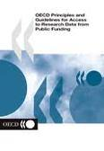
2007 OECD Report
Publicly funded research data are a public good, produced in the public interest, and should be available to the maximum extent possible
conforming with the principles of Openness, Flexibility, Transparency, Legal Conformity, Protection of Intellectual Property, Formal Responsibility, Professionalism, Interoperability, Quality, Security, Efficiency, Accountability, Sustainability
Principles and Guidelines for Access to Research Data from Public Funding,
http://ec.europa.eu/research/era/docs/en/others-9.pdf

