Slide 1
PRODUCTION AND ACCESS TO SCIENTIFIC DATA IN AFRICA
A Framework for Improving the Contribution of Research Institutions
An invited presentation
by
Prof. Hilary I. Inyang
Duke Energy Distinguished Professor of Environmental Engineering and Science,
University of North Caroline-Charlotte, NC, USA;
Email: h.inyang26@gmail.com
at the
International Symposium on the Case for International Sharing of Scientific Data
organized
by
U S. National Academy of Science (NAS) Board on International Scientific Organization
U S. Committee on Data for Science and Technology (US CODATA)
held at the
NAS Keck Center, 500 Fifth Street, NW
Washington DC, USA
April 18 – 19, 2011

Slide 2
ROLES OF RESEARCH ORGANIZATIONS THAT CAN BE ENHANCED BY COST-EFFECTIVE AND EFFICIENT DATA GENERATION, STORAGE, DISTRIBUTION AND ACCESS SYSTEMS
Supply of options for sustainable development
Production of data for decision support systems
Development of human resources and capacity
Creation of innovative ideas and products
Guardians of rationality and human rights

Slide 3
CONFIGURATION OF INFORMATION GENERATION, STORAGE AND ACCESS SYSTEMS
ACADEMIC INSTITUTIONS
GOVERNMENT AGENCIES
CORPORATIONS
Banks
Industry
Analysts
CIVIL SOCIETY GROUPS
SCREENING PROCESSES
DATABANKS
SCREENING PROCESSES
NON-SENSITIVE INFORMATION
SENSITIVE INFORMATION
DISSEMINATION TO PUBLIC
INACCESSIBLE INFORMATION DOMAIN
ACADEMIC INSTITUTIONS
PUBLIC AGENCIES
THE PRESS AND PUBLISHERS
CIVIL/CORPORATE GROUPS
LIBRARIES
INTERNET & BROADCASTERS

Slide 4
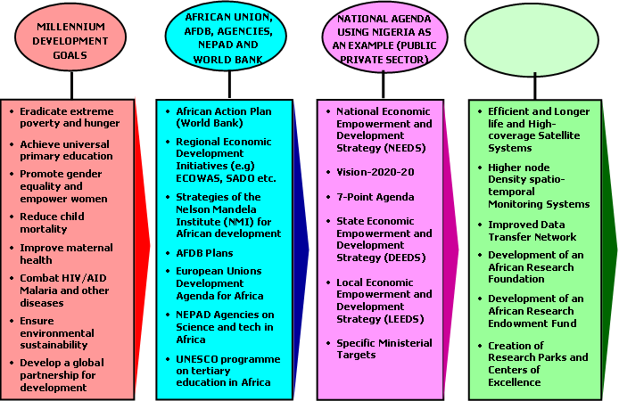
DATA PRODUCTION, STORAGE, TRANSFER AND ACCESS NEEDS FOR ATTAINMENT OF SUSTAINABLE DEVELOPMENT TARGETS
NEEDED DATA INFRASTRUCTURE & MANAGEMENT / UTILIZATION SYSTEMS

Slide 5
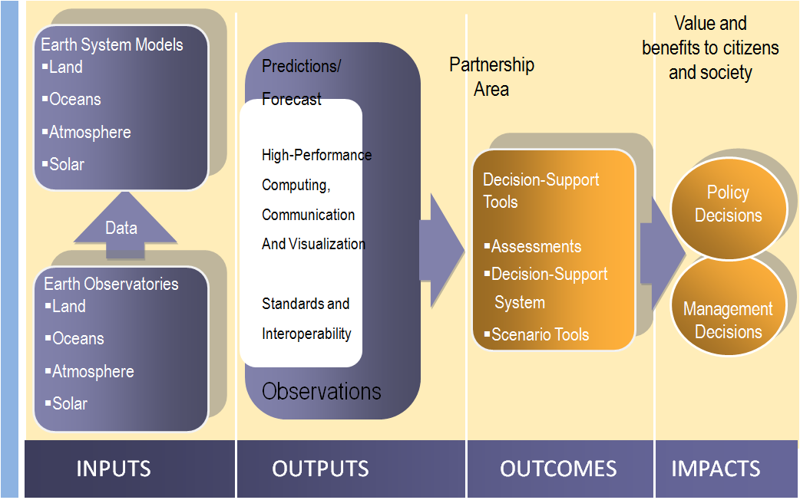
RESEARCH DATA ARE NEEDED IN GOVERNANCE /POLICY MAKING, ECONOMIC DEVELOPMENT, ENVIRONMENTAL STEWARDSHIP AND POPULATION MANAGEMENT

Slide 6
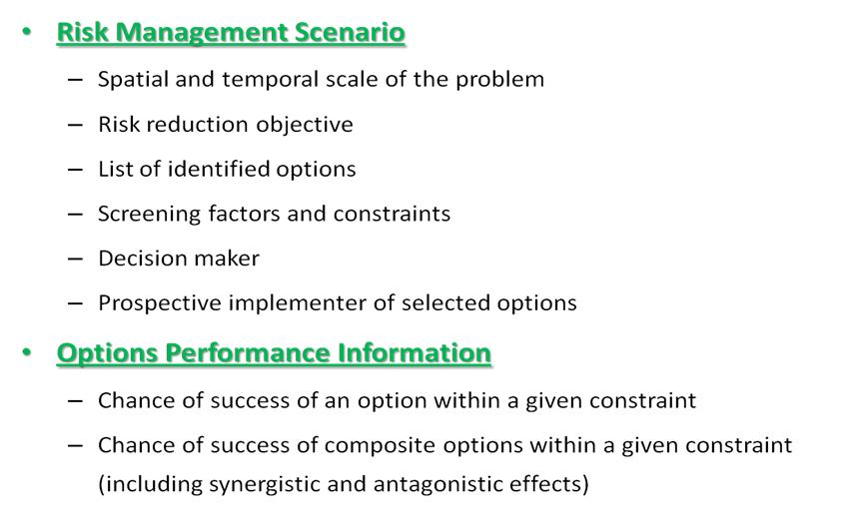
RISK MANAGEMENT AND ECONOMIC DEVELOPMENT
FACTORS THAT NEED DATA

Slide 7
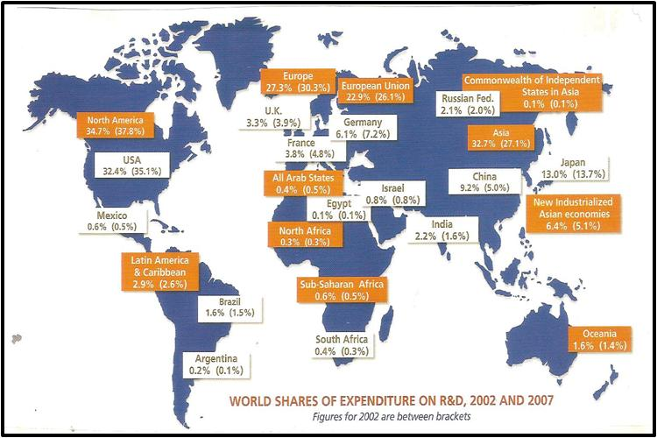
GLOBAL DISTRIBUTION OF INVESTMENTS IN RESEARCH AND DEVELOPMENT SHOWING DEFICIENCES IN AFRICA (UNESCO)

Slide 8
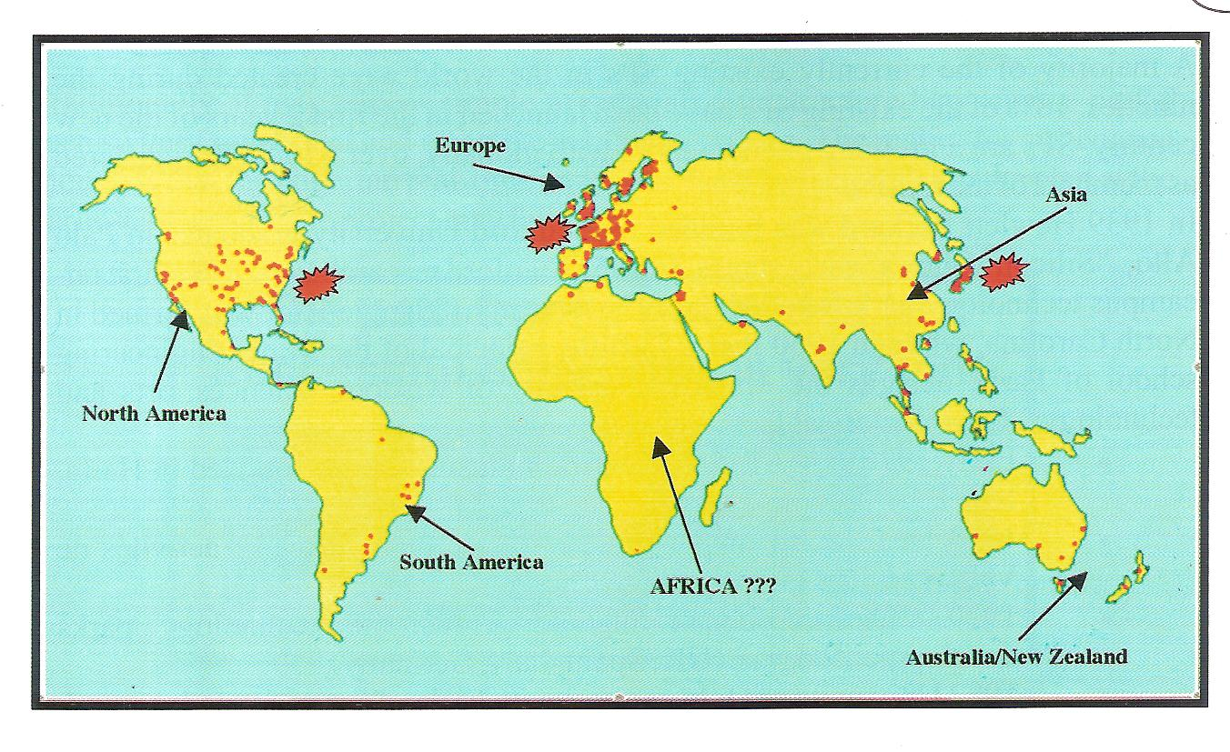
THE PAUCITY OF SCIENCE AND TECH/RESEARCH PARKS IN AFRICA IMPERILS ENTREPREURSHIP AND INNOVATION

Slide 9
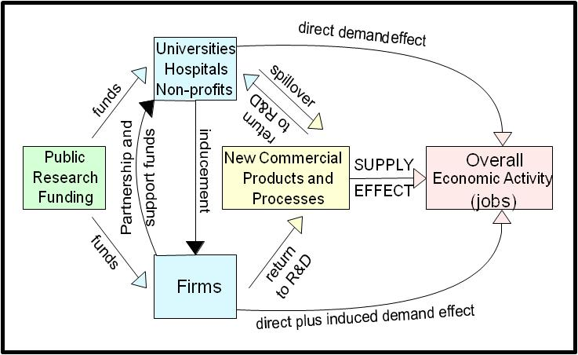
INTERLINKAGES OF RESEARCH ENTITIES AND THEIR UTILITIES : THE APPROXIMATE US MODEL

Slide 10
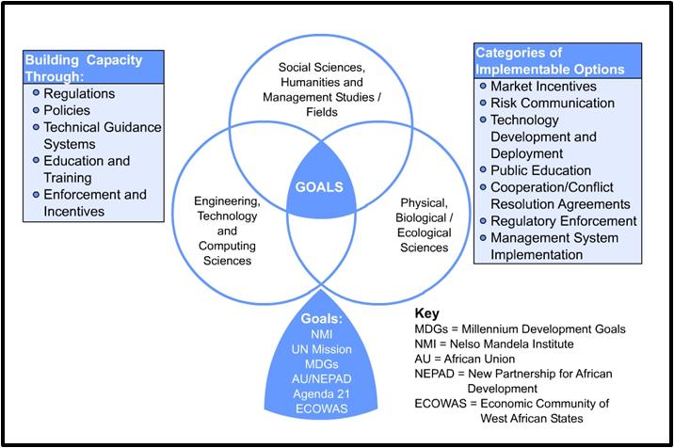
SOURCE DISCIPLINES FOR DATA AND TECHNIQUES THAT ARE NEEDED FOR SUSTAINABLE DEVELOPMENT

Slide 11
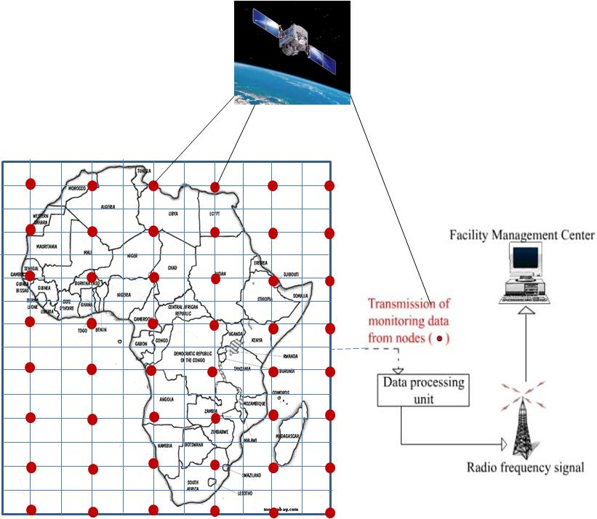
EXISTING DATA THAT ARE GIVEN VARIOUS SPATIO-TEMPORAL COORDINATES NEED TO BE INTERLINKED WITH MORE RECENT DATA THAT CAN BE GENERATED BY SATELLITES AND TRANSFERRED BY BOTH SATELLITE AND CABLE COMMUNICATION SYSTEMS

Slide 12
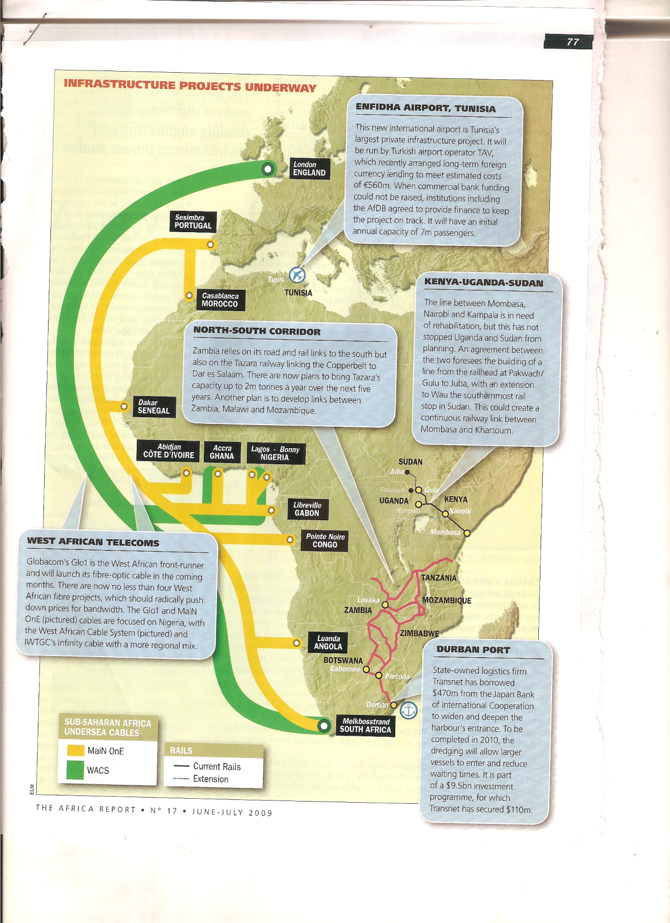
SOME MAJOR TELECOM PROJECTS THAT WILL ENHANCE DATA DISSEMINATION IN AFRICA
( The Africa Report, No. 17, June-July, 2009, pp. 77)

Slide 13
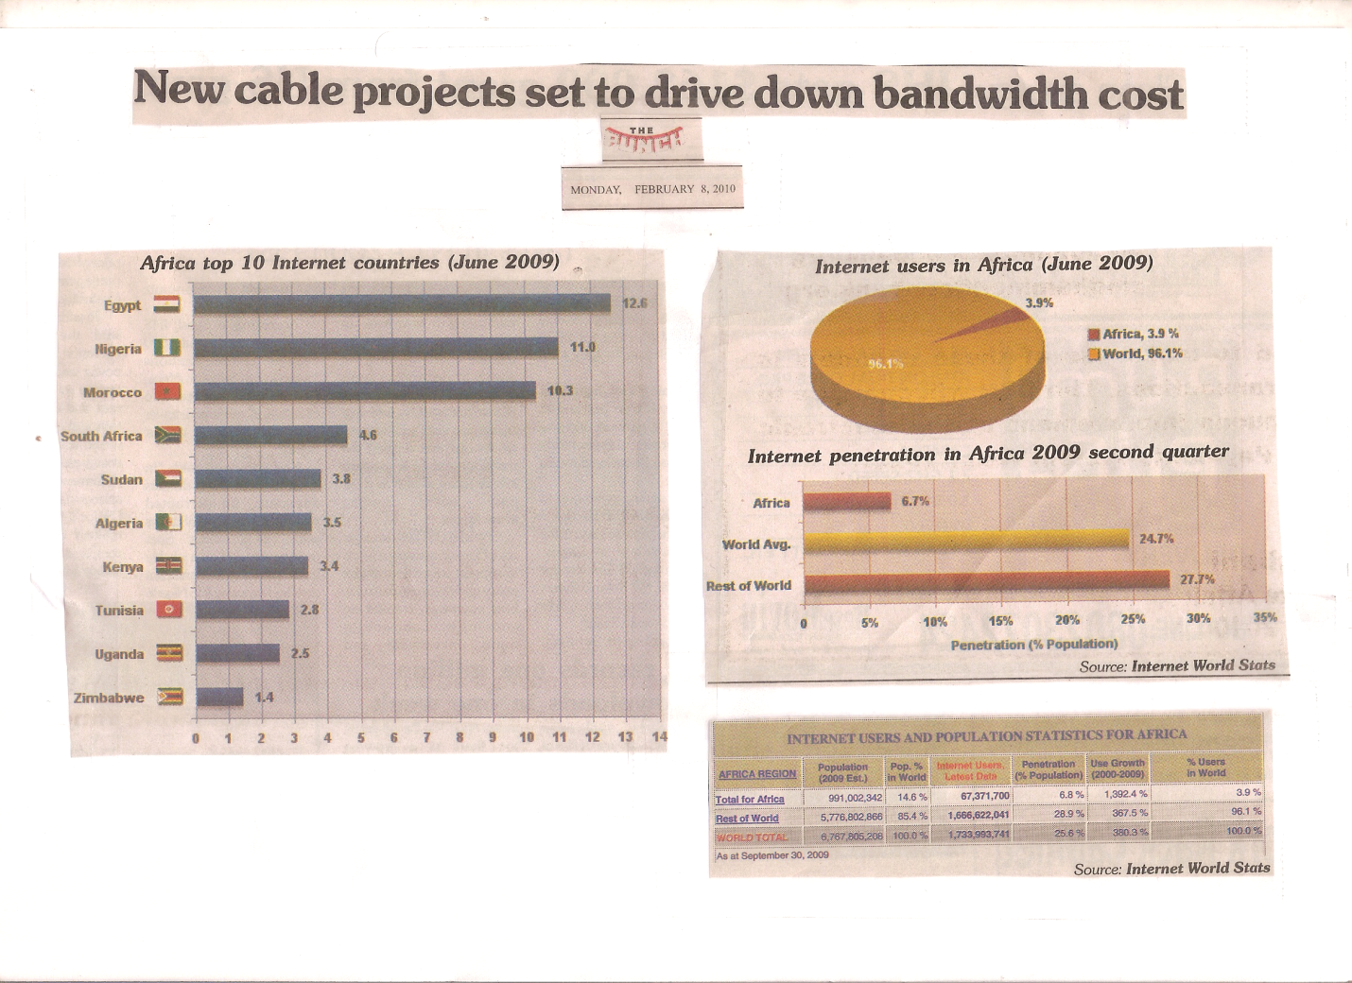
INCREASING INTERNET USE IN AFRICA IS USEFUL FOR INFORMATION ACCESS AND DISSEMINATON

Slide 14
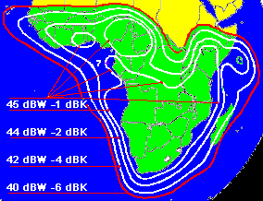
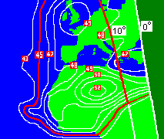
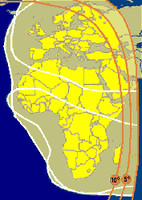
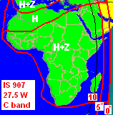
EXAMPLES OF DATA/INFORMATION COMMUNICATION SATELLITES WITH SIGNIFICANT FOCUS ON AFRICA (1)
BENTLEY TELECOM EUTELSAT W3A
Bentley Telecom Eutelsat W3A
Eutelsat W3A ( 7 deg east) broadband internet via satellite coverage using the new Hughes HX and LinkStar DVB-S2 and iDirect technologies. The Hughes HX, introduced in March 2008, represents a significant step forwards. Various grades of service plus special quality of service controls and advanced proprietary TCP/IP compression to give faster downloads compared with unprocessed feeds, plus customer access to traffic monitoring system.
Click here to email: sales@bentleywalker.com or phone now 00 44 239 246 3943 (ref:satsig)
Also iDirect STAR COM service in North East Africa
Mid Africa and
South
Africa coverage Direct connection
provider.
Customer VSAT dishes are typically 1.2m diameter with up to 61 PCs connected
All Africa, Middle East
and Europe. C band on 1.8m dish
PanAmSat 1R at 45 west is also available and provides good coverage of North West Africa.

Slide 15
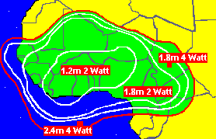
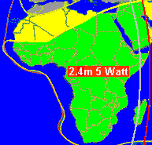
LINK-SAT BROADBAND SATELLITE INTERNET WEST AFRICA
West Africa Ku band coverage include: (some partially): Senegal, The Gambia, Gambie, Guinea, Mali, Sierra Leone, Liberia, Ivory Coast, Ghana, Burkina -Faso, (Upper Volta), Togo, Benin, Niger, Nigerian, Chad, Tchad, Cameroon, Equatorial Guinea, Central African Republic (CAR), Occidentale Quest Afrique. The broader C band beam covers all Africa except the north west as shown: This comprises of a high-powered West Africa Ku band beam from Newskies satellite NSS-7 at orbit 21.5W and Africa C-band beam from Intelsat 905 at 24-5W. A 2-way business satellite internet with direct access correction to the US
Inclusion : VOIP telephone service
Downlink : up to 60 mbit/s download speed
Uplink : up to 4 mbit/s upload speed
Entry Level : 96 kbit/s download and 32kbit/s uplink
Ku band coverage
C band coverage

Slide 16
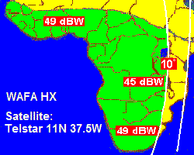
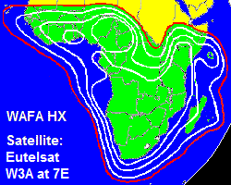
WAFA SATELLITE SYSTEMS
This organization offers high-speed VSAT satellite internet access services on both Telstar 11N (at 37.5 west) and provides coverage from Senegal through Nigeria to Southern Africa
Telstar 11N beam.
Eutelsat W3A beam

Slide 17
FORMATION AND OPERATION OF AN AFRICAN CONTINENTAL RESEARCH FOUNDATION (ACRF) WITH THE FOLLOWING MANDATES WOULD GREATLY ENHANCE THE GENERATION OF DATA AND OTHER TYPES OF INFORMANTION FOR REGIONAL DEVELOPMENT
To support research for production of information, including data, for use in African sustainable development programmes
To provide opportunity for engagement of African and other experts and development of African talent (in Africa and the Diaspora) on S & T research on critical issues that affect Africa.
To catalyze science & technology-based African entrepreneurship and improve infrastructure for access to data in locations within and outside Africa.

