Slide 1
Social Statistics as One of the Instruments of Strategic Management of Sustainable Development Processes: Compelling Examples
1
Victoria A. Bakhtina
International Finance Corporation (IFC, World Bank Group)
1 The views expressed herein are those of the individual contributor
and do not necessarily reflect the views of IFC or its management

Slide 2
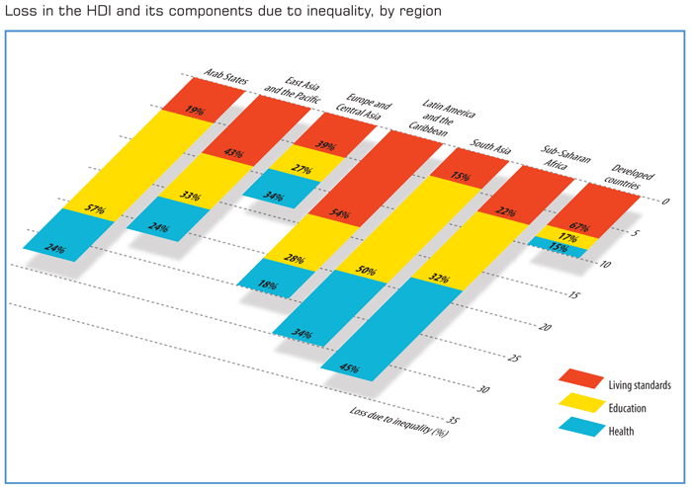
HDI index adjustments due to inequality
HDI index adjustments due to inequality. (Source: HDR 2010)

Slide 3
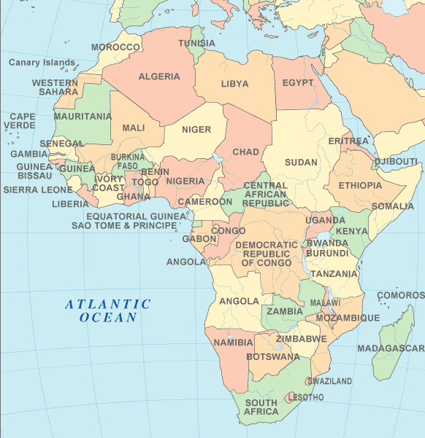
Example of Six African Countries

Slide 4
Selected Indices, 2010
Data Source: HDR 2010

Slide 5
Overall Satisfaction with Life, 2010
1
NA?
Do people in Gabon feel happier than in Malawi or Botswana?
What is the picture in relation to Norway? Costa Rica?
1
Source: HDR 2010. Overall Satisfaction with Life is based on responses to a question about satisfaction with life in a Gallup World Poll

Slide 6
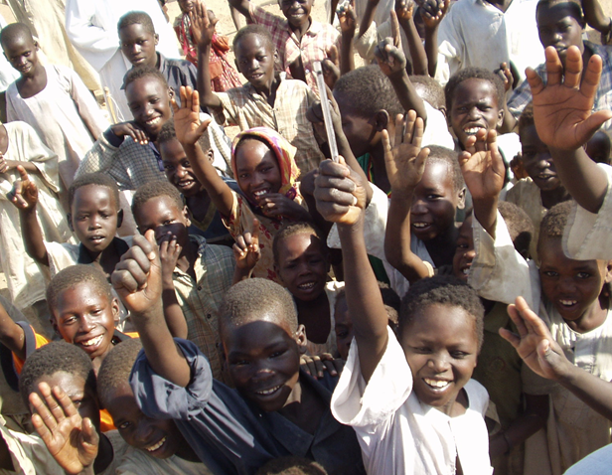


Questions Comments Ideas

