Slide 1
Understanding Biodiversity: examples where more data sharing could make a big difference
Vanderlei Perez Canhos
Centro de Referência em Informação Ambiental (CRIA)
vcanhos@cria.org.br
International Symposium The Case for International Sharing of Scientific Data:
A Focus on Developing Countries
National Academy of Sciences, 18-19 April 2011

Slide 2
Complexity of biodiversity data
Biosphere – The world we live in
Ecosystem – The set of communities of all domains of life that interact with one another and the
abiotic environment to form a unit
Community – Interacting populations of organisms
Population – All individuals of a species or phylotype within a community
Organism – A single individual
Organ system– a specialized functional system of an organism
Organ – a set of tissues that function as a unit
Tissue A set of interacting cells
Cell – the functional unit of all living organisms
Organelle a specialized subunit within a cell
Source: Committee on A New Biology for the 21st Century
Molecule – biochemical constituents of cells

Slide 3
Conservation planning in Brazil
Brazilian Ministry of Environment effort to set-up priorities for biodiversity conservation (1990´s)
Static system of protected areas
Environmental degradation and climate changes not taken into consideration
Global changes are are making conservation very difficult!
Priorities and strategies need to be continuosly revised

Slide 4
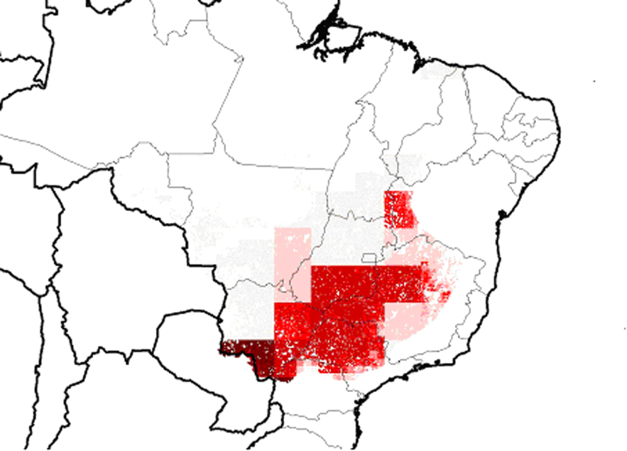
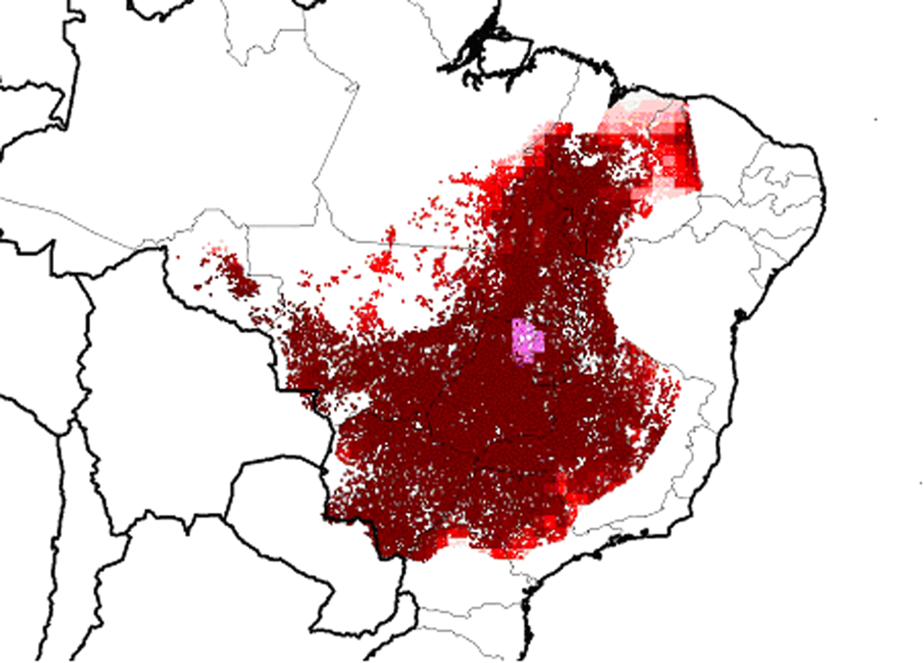
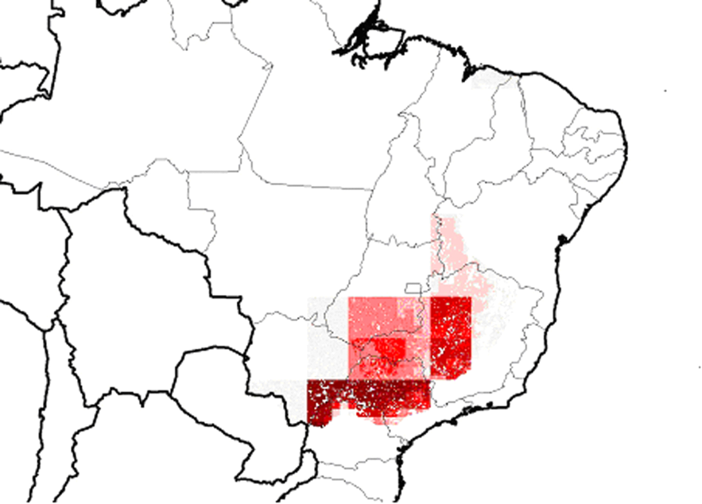
Impact of climate change on Brazilian plant species
(Siqueira & Peterson, 2003)
hotspot
Potential distribution in 2053 with 0.5% annual increase of CO₂
Potential distribution of 162 vascular plant species for the Brazilian Cerrado
Potential distribution in 2053 with 0.5% annual increase of CO₂
no

Slide 5
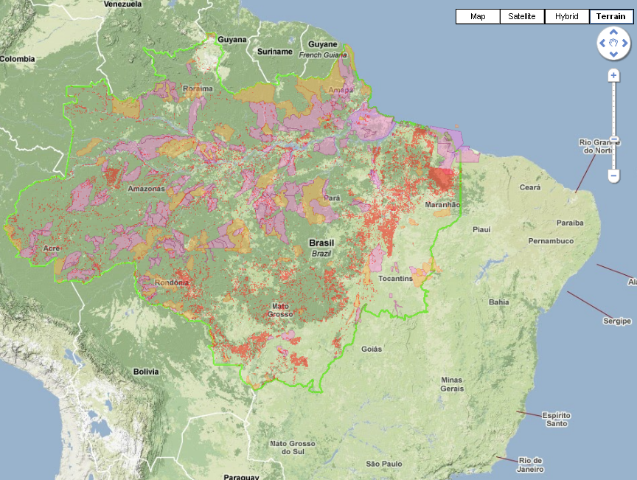
Accumulated deforestation up to year 2000

Slide 6
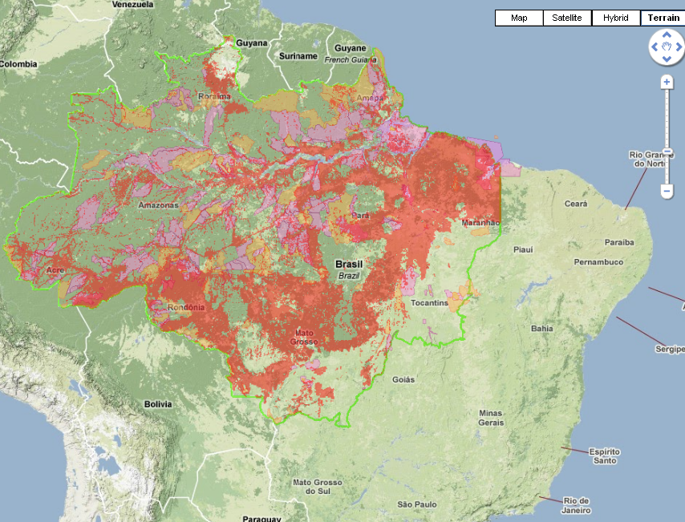
Accumulated deforestation up to year 2009

Slide 7
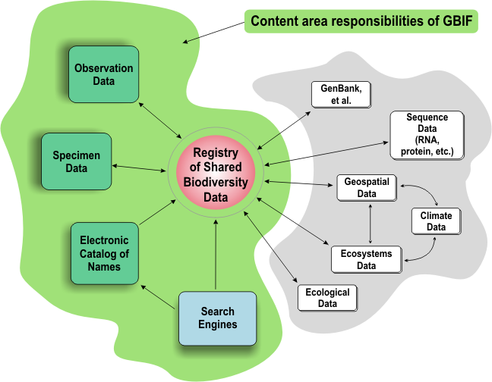
Global Biodiversity Information Facility - GBIF
Building the biodiversity knowledge base
  Collective, multi and interdisciplinar effort
  Requires a global cooperation environment
  Integration of local and global efforts
Compiled data and information on species, specimens and ecosystems
Notes:
Interoperability is often defined as “databases talking to each other” but that isn’t quite right. In an interoperable system, the same query can be made against databases that differ from one another in structure and content and the answer to the query retrieved in a single session.
In this example slide, the blue arrows disappear because this kind of work by a person is not often done (also to get them out of the way for the next animation).
In the GBIF query portion of the example, the first arrow and the last arrow remain in place because all that the user would experience is the interaction with the search engine. Everything else would be transparent, even though vast distances and many databases might be involved.
The GBIF query first taps ECAT to find any synonyms of the name of species X, and these are included in the query to the registry. The query then goes to the databases that have the requested kinds of data (GenBank and ecological). The retrieved data are then relayed to the search engine and the user.

Slide 8

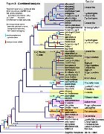
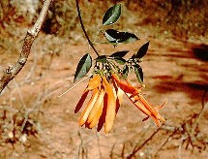

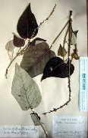

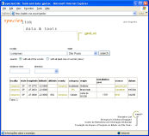
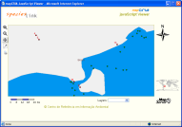

Biological Collections are Data Centers
Research
Taxonomy and nomenclature
Education
Descriptive data
Decision making
Primay data
Modeling
Data quality
Maps
Biological collection

Slide 9
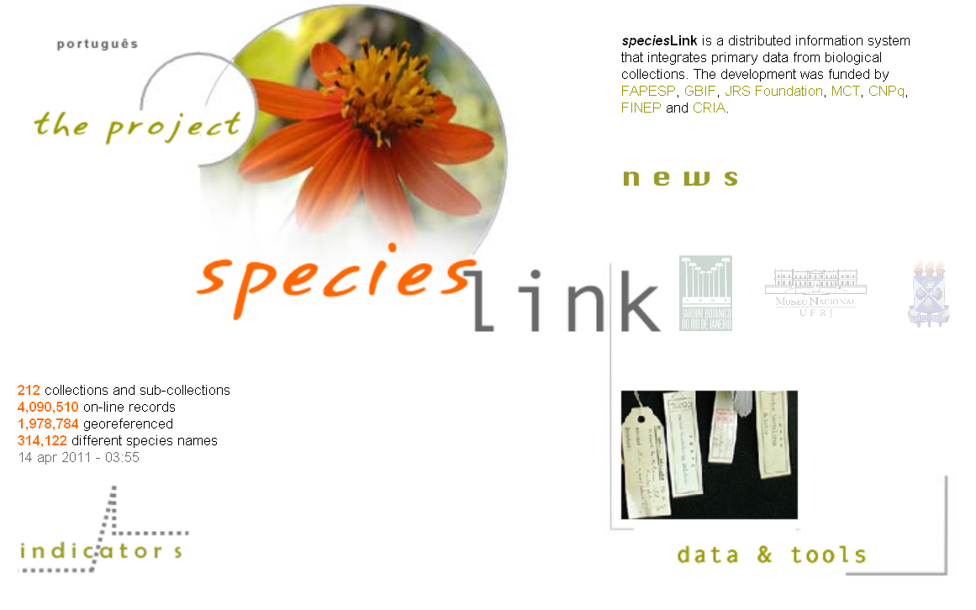
http://splink.cria.org.br

Slide 10
speciesLink network architecture

Slide 11

speciesLink architecture
Reports
Web Site
mapcria
webservice
WMS
Network Manager
Query interface
Geographic data
Maps
PostGIS
Indicators
Data cleaning
Central Repository
TAPIR Provider
webservice
Data analysis
Data Harvester
TAPIR Portal
DiGIR
TAPIR
Collections with
a DiGIR provider
Cache node
Cache node
SOAP
Collections with
spLinker

Slide 12
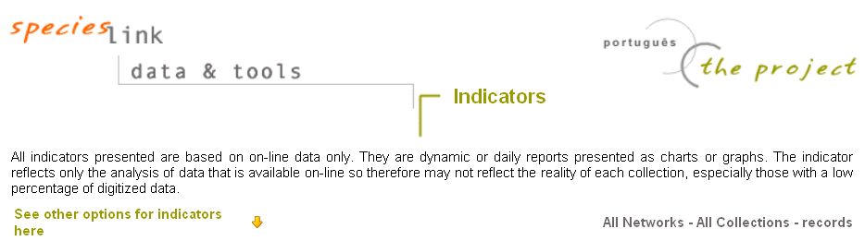
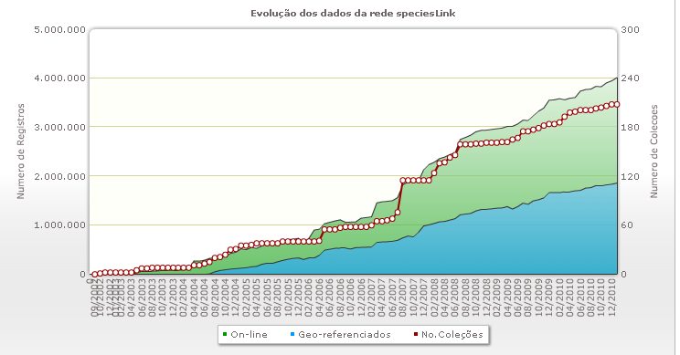
The development of the speciesLink network
Dec. 2010
4 million records
Oct. 2005
709,306 records
Launched
Oct. 2002
5,280 records

Slide 13






2010 List of Brazilian Plants
2002 GSPC Target 1 in 2010
Working List of Plants
2008 meetings to define the strategy
2009 expert network effort to revise the working list
May 2010 List was published
Sept 2010 Nagoya CBD COP
Definition of the method and content

Slide 14
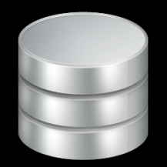
Hepaticas
Briófitas da Mata Atlântica
Pteridófitas
Annonaceae
Burmanniaceae
Cannaceae
Costaceae
Haemodoraceae
Thismiaceae
Triuridaceae
Zingiberaceae
Fungos (12)
More than 40 lists integrated
Angiospermas da Mata Atlântica
Fabaceae da Mata Atlântica
Flora do Nordeste
Flora do Acre
Flora do Semi-Árido
Flora do Cerrado
Kew Gardens
Typus RB
Mike Hopkins
Algas (Várias)
Musgos
Antoceros
Lista de Angiospermas da Mata Atlântica (MS-Excel)
Lista de Fabaceae da Mata Atlântica (MS-Excel)
Flora do Nordeste (MS-Word)
Flora do Acre (MS-Word)
Flora do Semi-Árido (MS-Excel)
Flora do Cerrado (MS-Word);
Lista de Kew Gardens (Texto tab-delimited)
Lista de Typus do RB (MS-Excel)
Lista do Mike Hopkins (MS-Excel)
Várias listas de Algas (MS-Word)
Lista de Musgos (MS-Excel, MS-Word)
Lista de Antoceros (MS-Excel)
Lista de Hepaticas (MS-Excel)
Lista de Briófitas da Mata Atlântica (MS-Excel)
Lista de Pteridófitas (MS-Excel)
Lista de Annonaceae (MS-Excel)
Lista de Burmanniaceae (MS-Excel)
Lista de Cannaceae (MS-Excel)
Lista de Costaceae (MS-Excel)
Lista de Haemodoraceae (MS-Excel)
Lista de Thismiaceae (MS-Excel)
Lista de Triuridaceae (MS-Excel)
Lista de Zingiberaceae (MS-Excel)
Doze Listas de Fungos (MS-Excel)
Famílias do sistema Flora brasiliensis revisitada:
Cactaceae (Daniela Zappi)
Rutaceae (José Rubens Pirani);
Simaroubaceae (José Rubens Pirani)
Bignoniaceae (Lucia G Lohman)
Onagraceae (Ana Odete Santos Vieira)
Clusiaceae (Volker Bittrich)
Hypericaceae Volker Bittrich)
Fbr - Cactaceae
Fbr - Rutaceae
Fbr - Simaroubaceae
Fbr - Bignoniaceae
Fbr - Onagraceae
Fbr - Clusiaceae
Fbr - Hypericacea

Slide 15













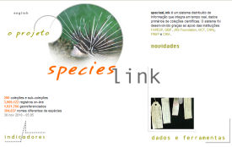
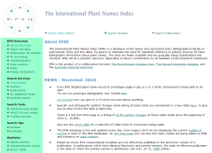
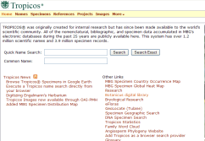




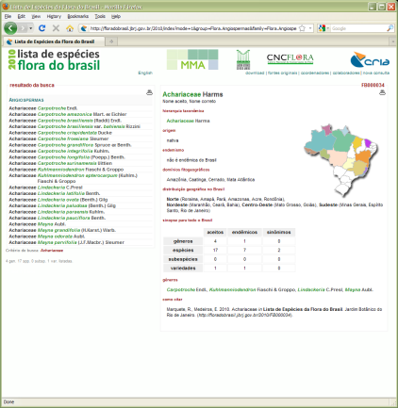
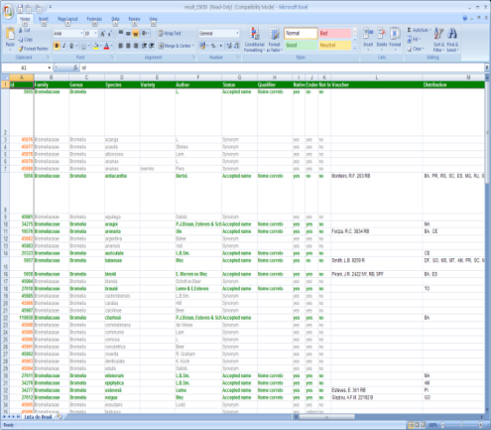
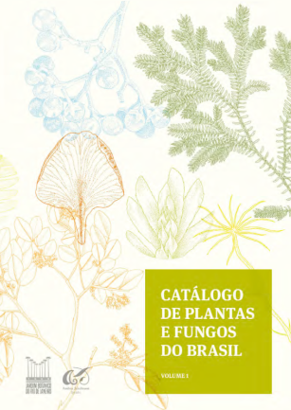
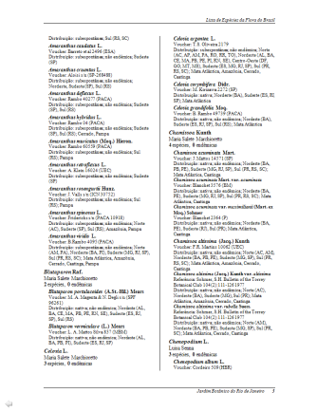
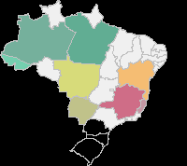
Developments at CRIA
Coordination: BGRJ
Expert Network
Checklists integration
Users control
Data cleaning interface
Maintenance and de-bugging
Global corrections
Statistics interface
New developments
Control & logs
Editing interface
Support to the coordination team
Help desk to the experts
Access to external resources
backups, backups, backups, backups …
Web interface
Xls spreadsheet output
Rtf output for printing
Distribution maps

Slide 16

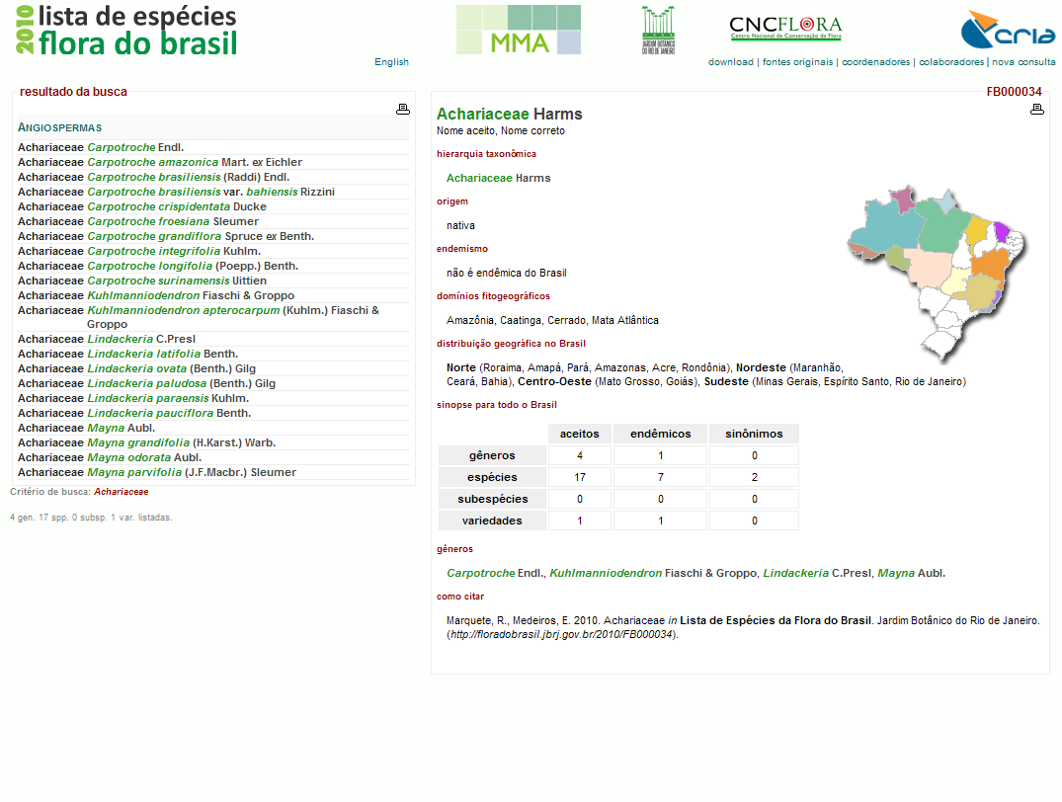
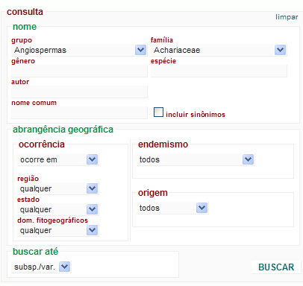
All Achariaceae
species

Slide 17
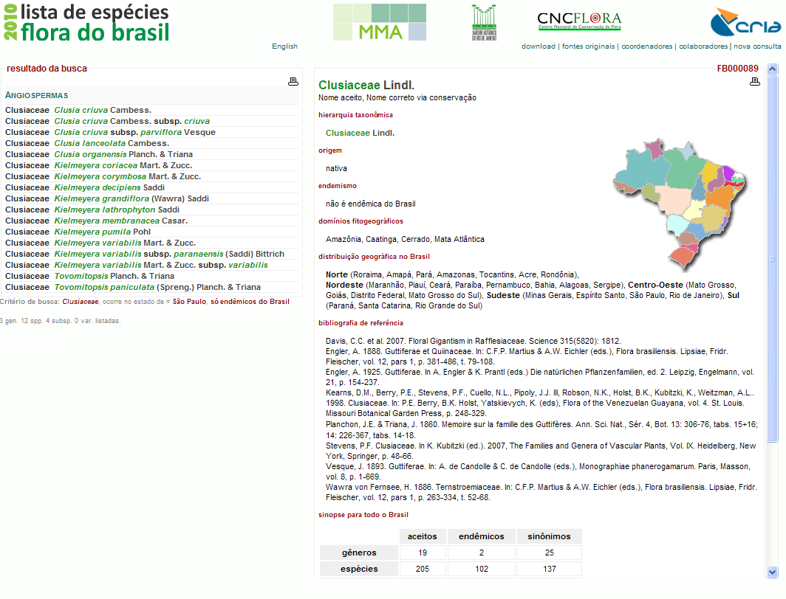
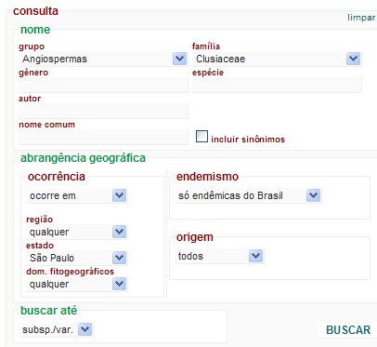
All Clusiaceae endemic to São Paulo state

Slide 18
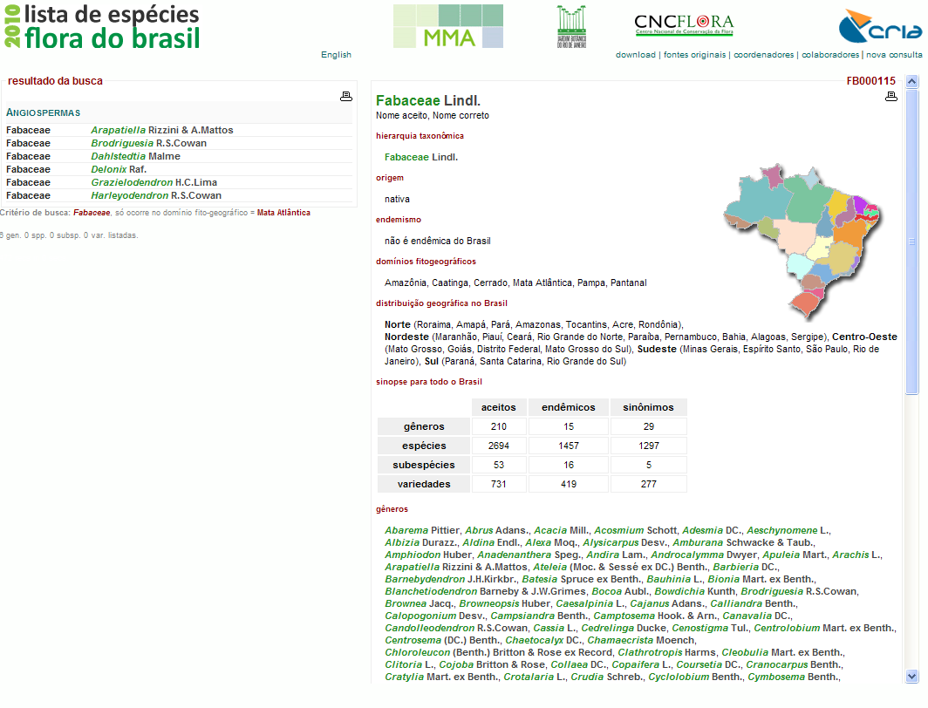
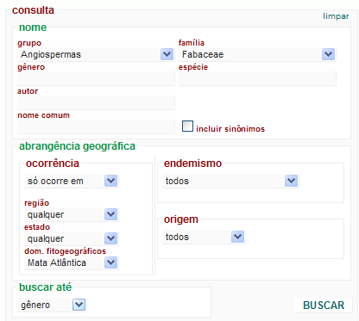
All Fabaceae genera from the Atlantic Forest

Slide 19
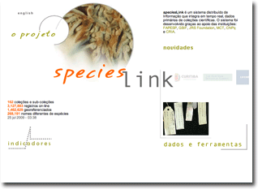
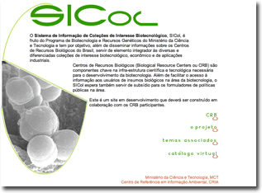
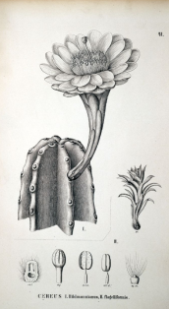
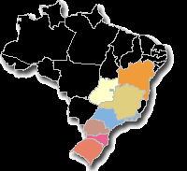
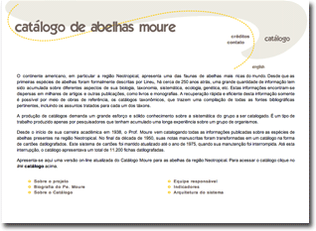
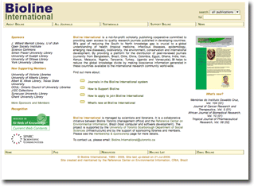
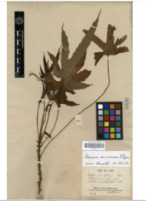
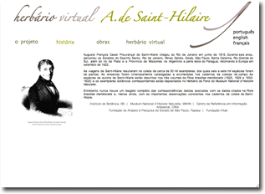
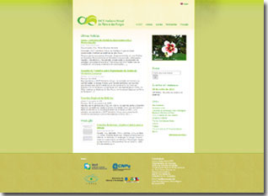
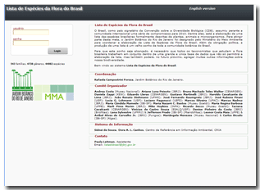
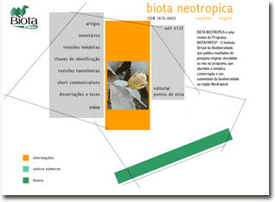
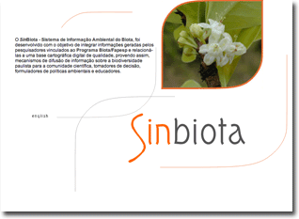
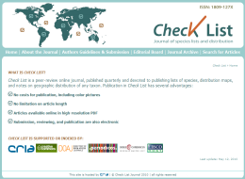
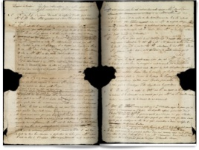
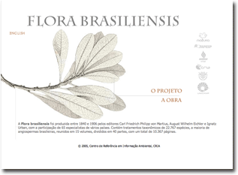

Specimen
species
publications
Moure Catalogue
Flora of Brazil List
Fauna of Brazil List
Bioline International
Biota Neotropica
Check List
Flora brasiliensis
images
drawings
exsicates
illustrations
SIColNet
speciesLink
photos
maps
HV Saint-Hilaire
HV INCT
SinBiota
Rare works

Slide 20
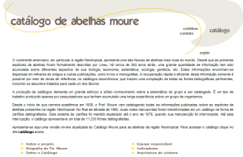
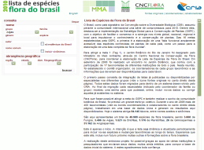
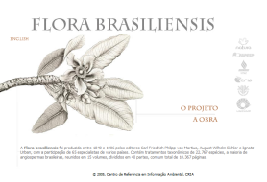
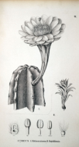
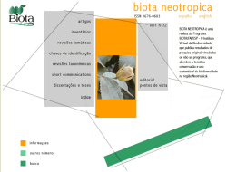
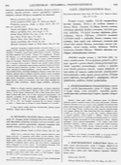















Slide 21

Usage is increasing !
Notes:
Access number to CRIA´s systems in 2010 are 4.2 million visits, 24 million webpages and a traffic of 1.6 Terabites and 65 million hits.
For the speciesLink network we had 60 thousand unique visitors in 2010, and 130 thousand visits. For the occurrence data (lat/long) the trafic was 100 GB in 2010.

Slide 22
Usage: mainly Brazil

Slide 23
CRIA´s systems architecture
user
indicators
images
Collections data
Data cleaning reports
maps
data
tools
Web Services
Data analysis
External
requisitions
mapCRIA
indicators
collection profile
TAPIR Provider
data cleaning
manager
Images
Central Repository
Indexing
Collections with providers
Collections without providers
TAPIR
TAPIR/DiGIR
Cache nodes
spLinker
NYBG
MNHN
Smithsonian
Mobot
….
JBRJ

Slide 24





Sonnerat DB
France
XML
eRez image server
SH@CRIA DB
Brasil
Transcriptions

Slide 25


Slide 26


Slide 27


Slide 28


Slide 29








SP
R
P
RB
UFG
CCFF
INCQS
CFP
speciesLink
data bank
Image server
web services
Images metadata

Slide 30

Centro de Referência em Informação Ambiental
http://www.cria.org.br
Vanderlei Canhos
vcanhos@cria.org.br

Slide 31











































































Sponsors and funding agencies
International partners
Brazilian partners

