Slide 1



Integrated Disaster Research: Issues Around Data
Dr. Jane Rovins, CEM
Executive Director

Slide 2
Issues
Globalization
Population growth
Widespread poverty
Changing climate
Urban areas
  Complex infrastructure
  Concentration and centralization of economic and political functions
  Social segregation and
  Complex spatial and functional inter-relationships
Key question:
Why, despite advances in the natural and social science of hazards and disasters, do losses continue to increase?

Slide 3
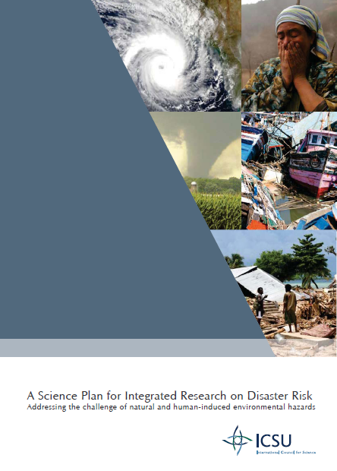
The Science Plan
Addressing the challenge of natural and human-induced environmental hazards
An integrated approach to research on disaster risk through: an international, multidisciplinary (natural, health, engineering and social sciences, including socio-economic analysis) collaborative research programme.
IRDR Science Plan at: http://www.irdrinternational.org/

Slide 4
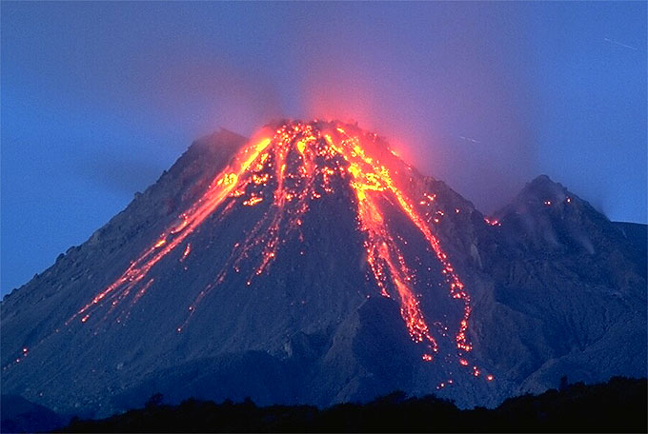
Scope of IRDR
Geophysical and hydro-meteorological trigger events
Earthquakes – tsunamis – volcanoes – floods – storms (hurricanes, cyclones, typhoons) – heat waves – droughts – wildfires – landslides – coastal erosion – climate change
Space weather and impact by near-Earth objects
Effects of human activities on creating or enhancing disasters, including land-use practices
NOT technological disasters, warfare

Slide 5
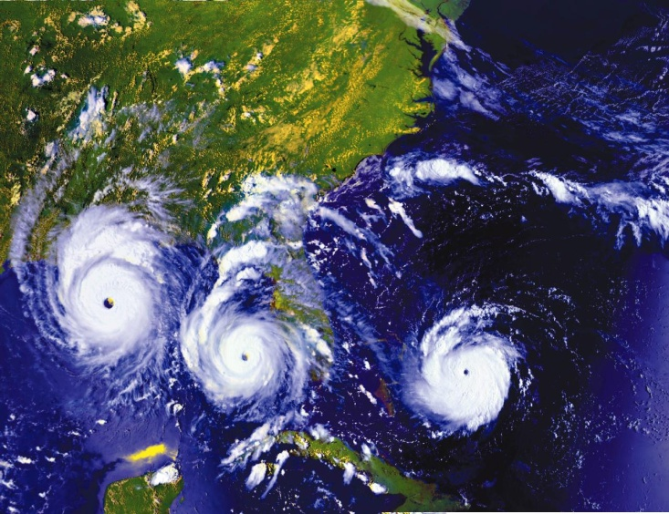
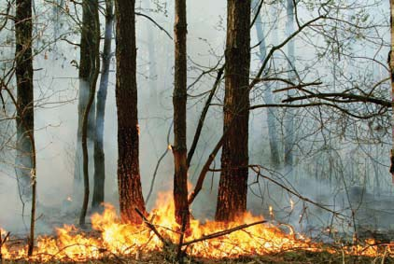
Objective 1: Characterization of hazard, vulnerability and risk
  1.1: Identifying hazards and vulnerabilities leading to risks
  1.2: Forecasting hazards and assessing risks
  1.3: Dynamic modelling of risk

Slide 6
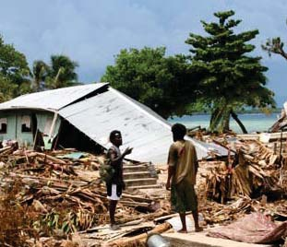
Objective 2: Effective Decision-Making in Complex and Changing Risk Contexts
2.1: Identifying relevant decision-making systems and their interactions
  2.2: Understanding decision-making in the context of environmental hazards
  2.3: Improving the quality of decision-making practice

Slide 7
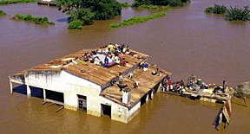
Objective 3: Reducing Risk and Curbing Losses Through Knowledge-Based Actions
  3.1: Vulnerability assessments
  3.2: Effective approaches to risk reduction
  Long-term database, monitoring systems and tools

Slide 8
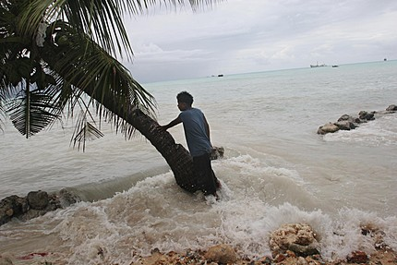
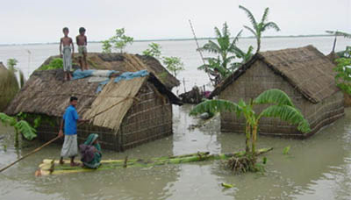
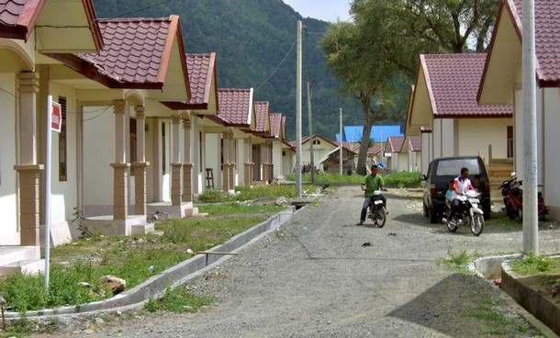
Cross Cutting Themes
Capacity building
Case studies and demonstration projects
Assessment, data management and monitoring

Slide 9

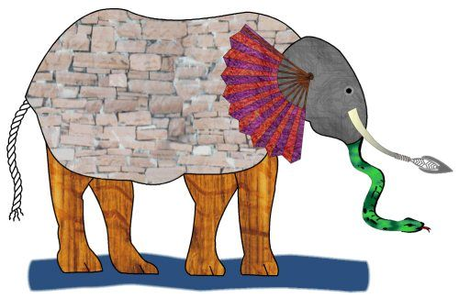
Wind speed
Religion
Wave action
Ethnicity
Risk Reduction
rainfall
Age
Ground motion
gender

Slide 10
Where we are
Meetings between UNDP Desenventar, MunichRe, SwissRe, CRED, Asian Disaster Reduction Center (Glide) on regional and global databases
Geocoding, technical standards, terminology, and hierarchy established
Limited downscaling to sub-national level
Quality and quantity of data on impacts of disasters

Slide 11
Biases in Loss Databases Remain
Hazard bias—every hazard type is represented
Temporal bias—losses are comparable over time
Threshold bias—all losses regardless of size are counted
Accounting bias— all types of losses included (monetary, human, direct, insured, uninsured)
Geographic bias—hazard losses are comparable across geographic units, boundaries not change
Systemic bias—losses recorded are the same regardless of source
M. Gall, K.A. Borden, S. L. Cutter, 2009. When do losses count? Six fallacies of natural hazard loss data. BAMS 90 (6): 799-809.

Slide 12
What is needed
Education of users regarding data biases and issues of social loss data
Comparable, and accessible human disaster loss data to support research and policy
Identify existing databases (from national to regional to global) existing project
Increased downscaling of loss data to sub-national geographies for policy makers
What is a loss and how to assess it--methodology

Slide 13
How do we get there??
Establish an overall framework for disaster loss data for all providers
Establish nodes and networks for data bases
Sensitivity testing among existing databases
Mechanisms for archiving loss data, perhaps a central data repository

Slide 14
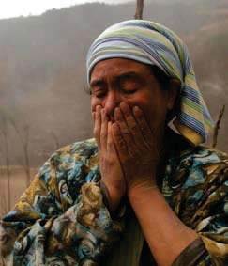
Risk Interpretation and Action
What do people (especially those at risk) think is likely to happen? & What will they do about it?
Estimation of the likelihood and magnitude
Evaluation of the vulnerability/resilience of the physical infrastructure
Consideration of social and behavioral factors that place the local population at greater or lesser risk

Slide 15
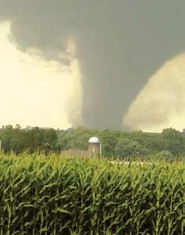
Forensic Disaster Investigations (FORIN)
Probe further into complex and underlying causes of growing disaster loss
Fundamental cause of disasters
Trace out and assign causal explanation of losses
Intervening conditions that increased or reduce losses
Series of case studies
Common template and methodology

Slide 16
Partners
Co-Sponsors
National and international science institutions
National and international development assistance agencies and funding bodies
National Committees

Slide 17

Sponsors: ICSU, ISSC,
UN-ISDR
Consultative
Forum
Scientific Committee
IPO
Working Group-Task Teams:
FORIN
RIA
Long-term database and
Monitoring systems and tools
Socio-economic research activity
Partners in research:
Unions and National
Members of ICSU & ISSC
IUGG – ENHANS
WMO
UNESCO
CoDATA
JRC
WCRP- Extremes
WWRP
IHDP-IGBP-LOICZ-IRG
ICL
Int. Floods Initiative
IOC tsunami prog.
…
National Committees
Capacity building
Regional Programmes
Canada
China
France
Germany
Japan
New Zealand
International Centres of Excellence
ICSU- ROAP
ICSU - ROA

Slide 18
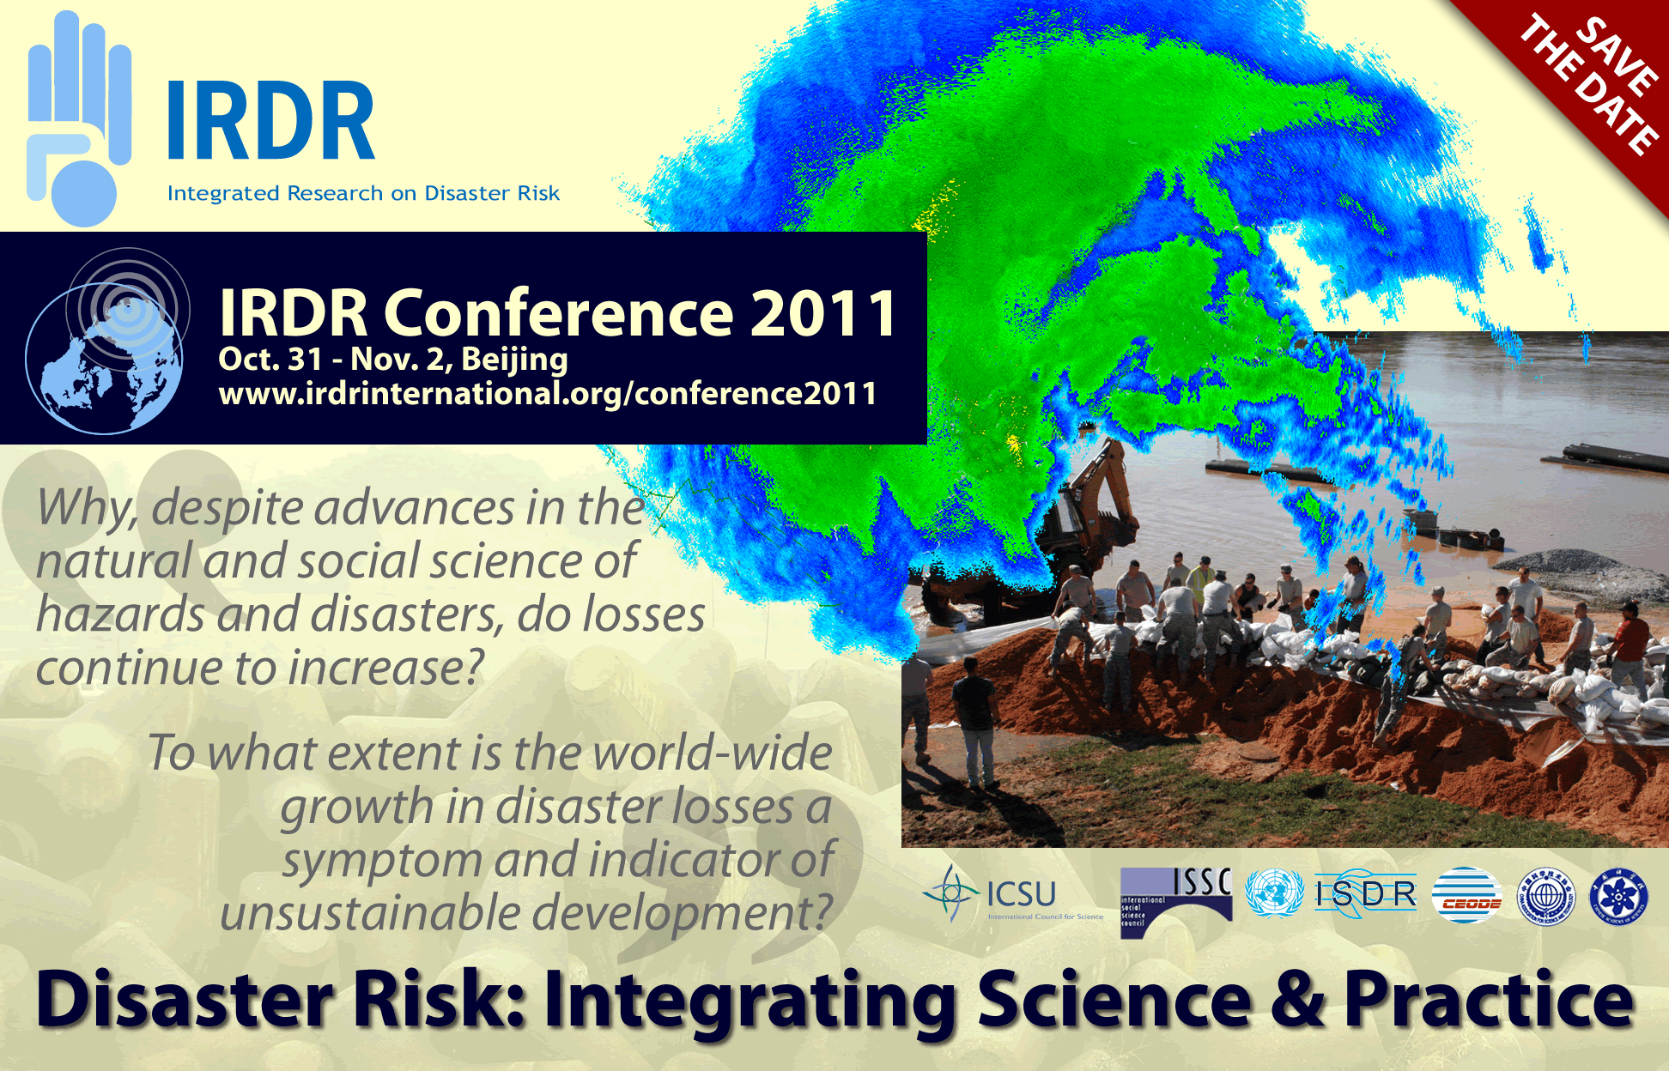

Slide 19
IRDR Legacy
An enhanced capacity around the world to address hazards and make informed decisions on actions to reduce their impacts.
Societies to shift focus from response-recovery towards prevention-mitigation, building resilience and reducing risks, learning from experience and avoiding past mistakes.

Slide 20
Thank you
www.irdrinternational.org
jane.rovins@irdrinternational.org

