Slide 1
Laboratory Capacity , biosafety, and biosecurity in Africa: Gaps, goals, needs and Progress
Willy Tonui, PhD
Founder Member and President, African Biological Safety Association (AfBSA)

Slide 2
Discussion Format
Status of Biosafety and Biosecurity in Africa
Laboratory Capacity in Africa
Common Challenges among laboratories
Needs and recommendations
Role of AfBSA in implementation of Biosafety and Biosecurity in Africa
Brief about IFBA

Slide 3
Status of Biosafety & Biosecurity in Africa

Slide 4
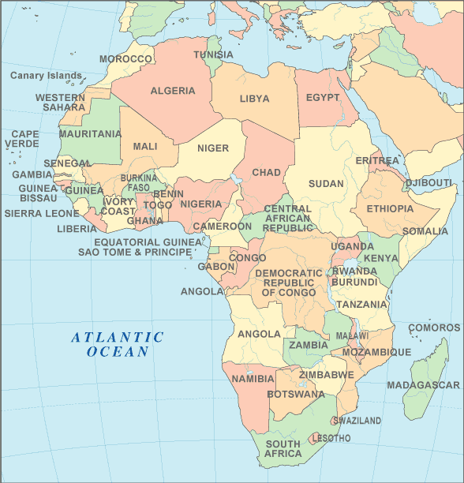
Biosafety and Biosecurity in Africa
Biosafety and biosecurity as scientific disciplines are still at their formative stages in most Institutions in Africa.
Biosafety awareness has been promoted through Biotechnology innovations (Mainly GMOs) within the framework of the “Cartegena Protocol”
Cartegna Protocol promoting Biosafety Regulations and Laws in Africa
The capacity of countries to carry out risk assessments is shaping up in Africa .
Countries are now building capacities in Biosecurity through BTWC and UN 1540 requirements

Slide 5
Laboratory Facilities in Africa
Majority are the typical university research laboratory i.e. a BSL-1 facility.
Most Research Institutions have BSL-2 and mushrooming BSL-3 facilities (KEMRI 5 BSL-3)
Enhanced BSL-3 facilities exists
Naval Medical Research Unit No. 3 Cairo, Egypt (NAMRU-3 (Cairo, Egypt)
UON/Manitoba in Nairobi
Only 2 BSL-4 facilities in Africa
Centre International de Recherches Médicales de Franceville, Franceville, Gabon);
National Institute for Communicable Diseases (NICD), Grahamstown, South Africa;

Slide 6
Common Challenges on Laboratory Biosafety and Biosecurity in Laboratories

Slide 7
What are laboratories in Africa look like?
Occupational health and Emergency response plans
– Poorly defined spill-management
– Post-exposure management (HBV/HIV)
Recording mechanism for laboratory acquired infections and other safety errors
– Minimal
Inadequate availability or use of personal protective equipment (PPE)
Poor use, operation and maintenance of biosafety equipment
Inappropriate waste disposal

Slide 8
Cont…..
Minimal biosafety training programmes
– Occasionally with training on techniques
– Very small part of quality system
Biosafety/Safety Officers not designated
Safety Guidelines not available
Policies and SOPs not available or not followed
No mandatory immunization of lab personnel (TB, HBV, Typhoid fever)

Slide 9
Common Challenges
Regulations, Legislation
National policy at the laboratory level
Laboratory Biosecurity
Laboratory Management
Physical environment in containment laboratories
Dual Use Research

Slide 10
Constraints for improvement
Lack of awareness at highest level
– Policy / standards / regulations
Inadequate resources and infrastructure
Lack of sufficient technical expertise
– Practices
– Construction
– Validation
– Documentation
Inadequate emphasis on training courses or exclusive training courses
Lack of budgetary resources to run and maintain containment laboratories

Slide 11
Needs and Recommendations

Slide 12
At National levels
Awareness raising on Biosafety and Biosecurity including Dual Use Research should be done in countries and Institutions
Implementation of Biological and Toxins Weapons Convention & UN 1540 Regulations in Countries
Sensitization of policy makers and Institutional Management (to support lab needs)

Slide 13
At Laboratory level
There is need for guidelines and clear regulations on Biorisk management including hazardous Waste management in most countries
Need for expertise and waste management facilities in Africa
Need for Training and Capacity building in Biosafety & Biosecurity including on Hazardous waste management in Africa

Slide 14
Progress Made

Slide 15
Positive outcomes and opportunities for progress
International Partnerships is encouraging Laboratory programmes to establishing and maintaining Laboratory quality systems.
WHO accreditation and surveillance systems
CLIA’88 and CAP Certification by American Partners (CDC etc)
ISO Systems (ISO 9001; 17027; 15189; 14001 and 18001

Slide 16
AfBSA: Bridging Gaps
Among the opportunities that AfBSA has to address the gaps include:
Promote International partnerships towards reducing the risk of biological threats by collaborating with governments to develop biosafety and biosecurity standards that are consistent with national and international guidelines, norms and requirements.
Enhance collaboration and networking between laboratories in areas of biosafety and biosecurity, including risk assessment on implementation of these principles among African laboratories.
Design and implement training programmes that increase knowledge and skills towards biosafety and biosecurity in Africa.

Slide 17
Brief about AfBSA

Slide 18
About AfBSA
The African Biological Safety Association (AfBSA) is a professional association formed to congregate practitioners of biological safety for the promotion of Biosafety and Biosecurity and to facilitate the sharing of Biosafety and Biosecurity information in the African region.
Established May 31, 2007
Website: www.afbsa.org
E-mail: afbsa@afbsa.org

Slide 19
The AfBSA Council

Slide 20
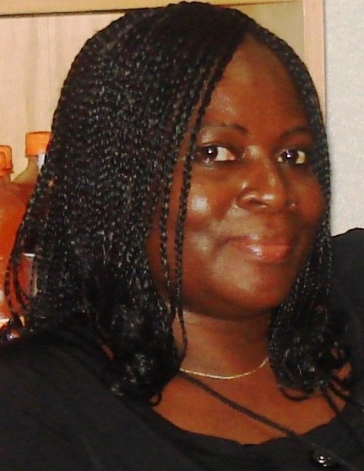
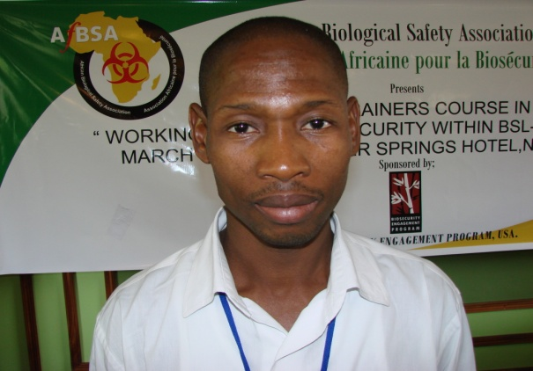
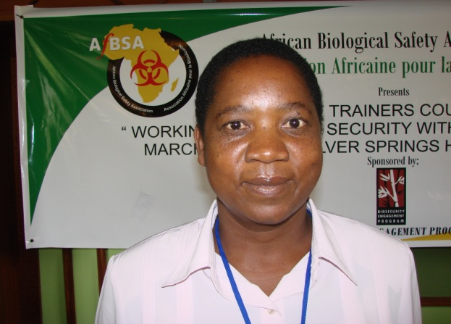
Council members.. Cont’
Mahama Toure, Cotre D’ Voire: Hon Treasurer
Abiola Tubi, Vice President
Juliana Kinkese, , Zambia: Hon Secretary

Slide 21
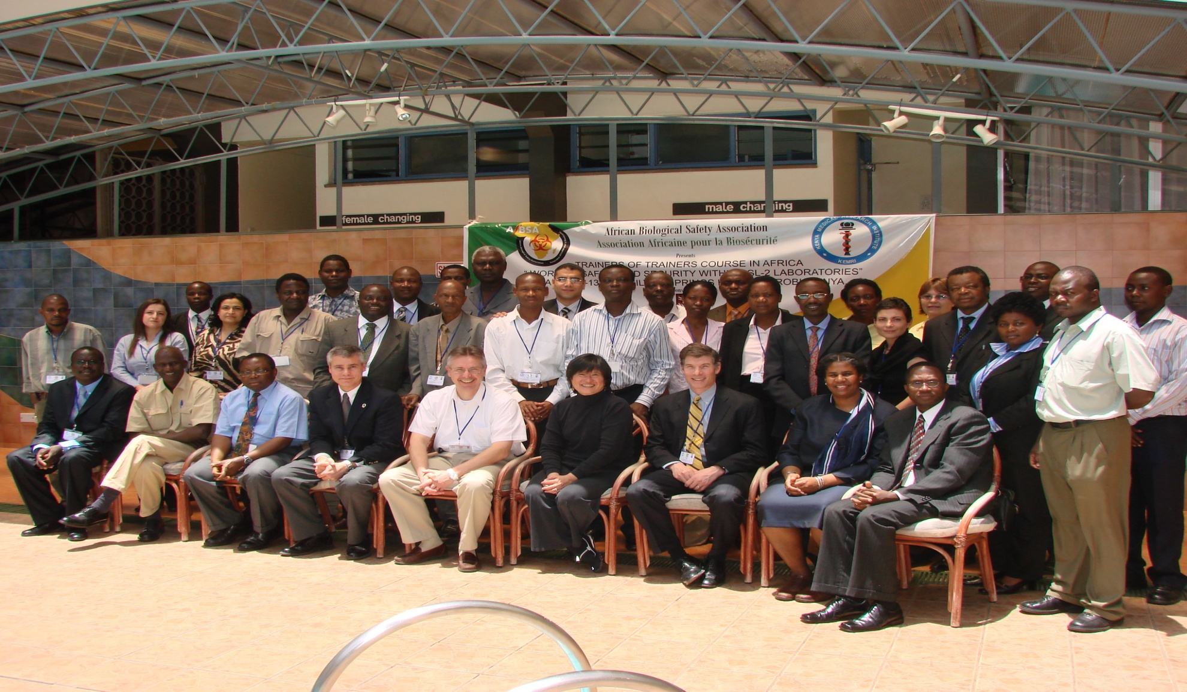
TRAINER OF TRAINERS COURSE IN AFRICA “WORKING SAFELY AND SECURITY WITHIN BSL-2 LABORATORIES” MARCH 9-13, 2009 SILVERSPRINGS HOTEL, NAIROBI, KENYA

Slide 22
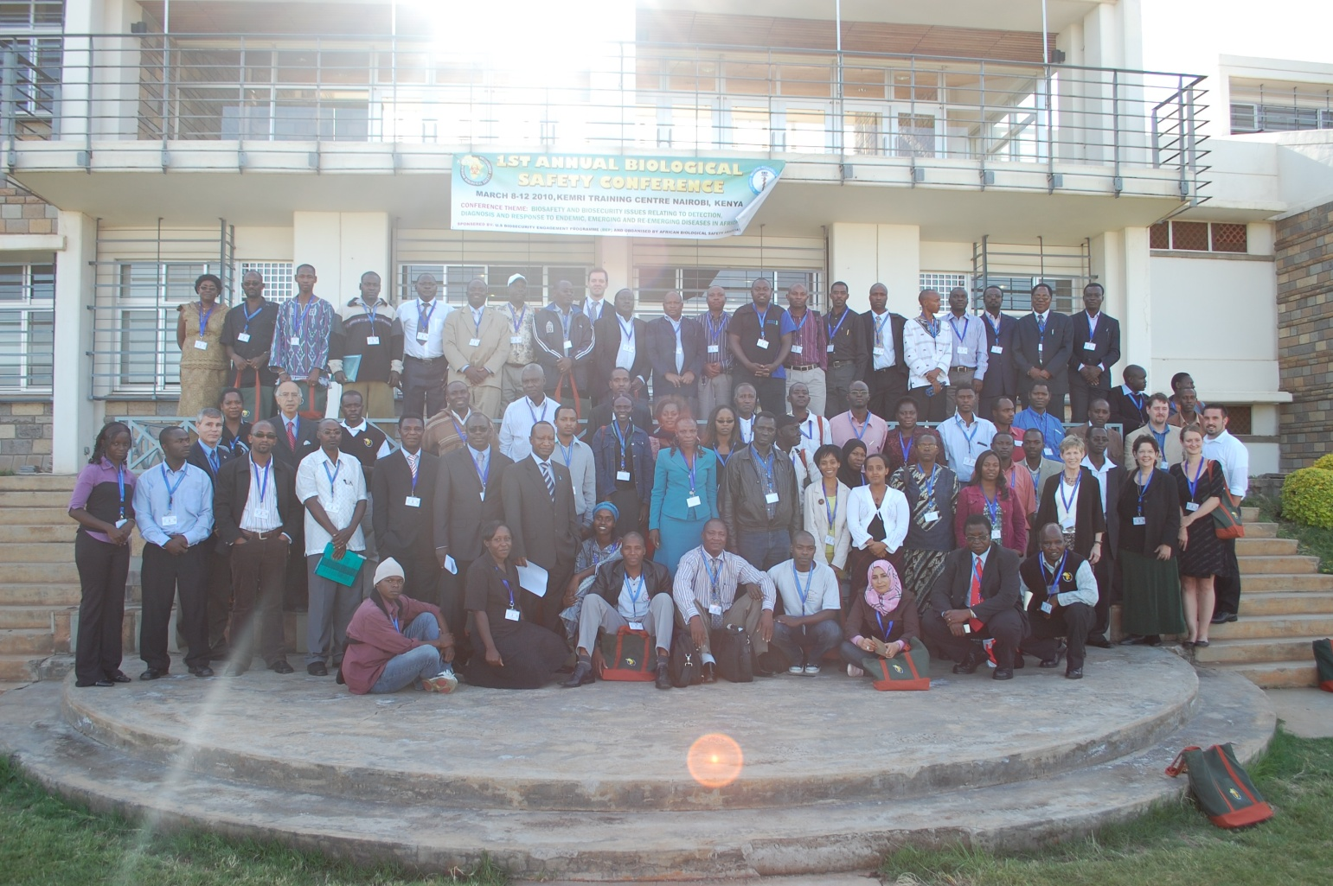
1st AfBSA Annual Conference, March 8-12, 2010, Nairobi, Kenya

Slide 23
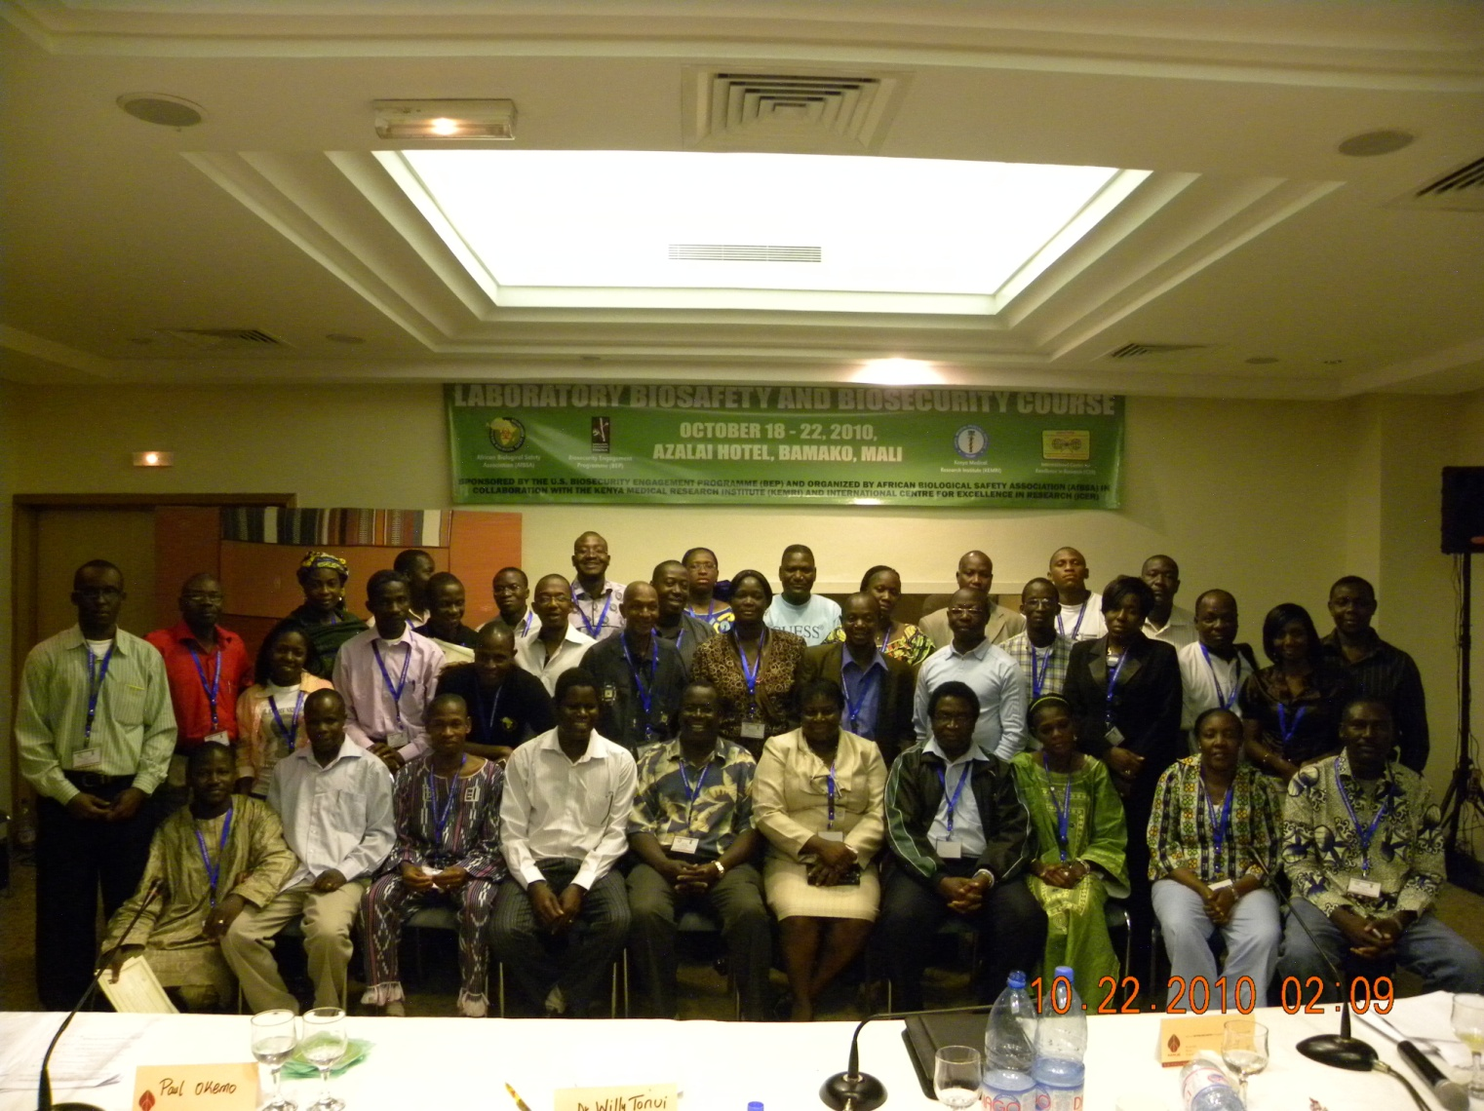
LABORATORY BIOSAFETY AND BIOSECURITY WORKSHOP AT AZALAI HOTEL, BAMAKO, MALI FROM OCTOBER 18 - 22, 2010

Slide 24
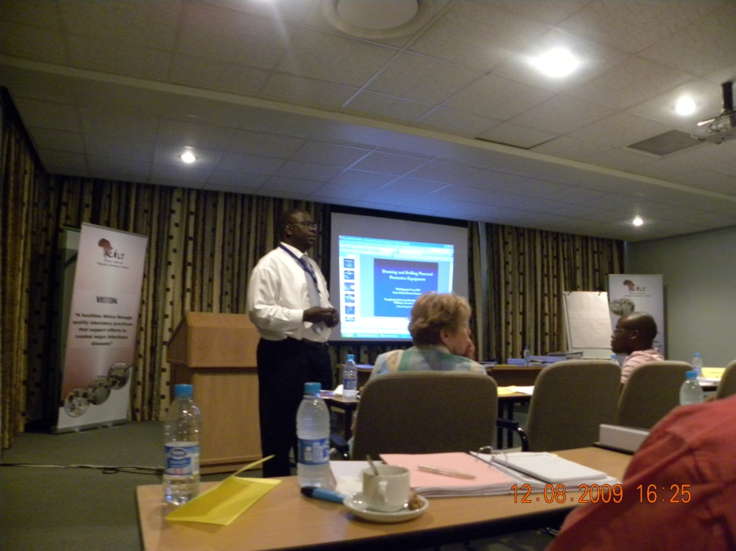
AfBSA Supports the Africa Centre for Integrated Laboratory Training Course (ACILT) held twice a year in Johannesburg, South Africa
Course held twice a year in July and December

Slide 25
Associations Already formed in Africa
Egyptian Biosafety Association
Assocaition Moroccaine Biosecurite (AMBS)
Moroccan Biosafety Association (MOBSA)
Nigerian Biosafety Association
Many others are in process (Mali, Cameroon, Ghana, Ethiopia)

Slide 26
Brief about IFBA

Slide 27
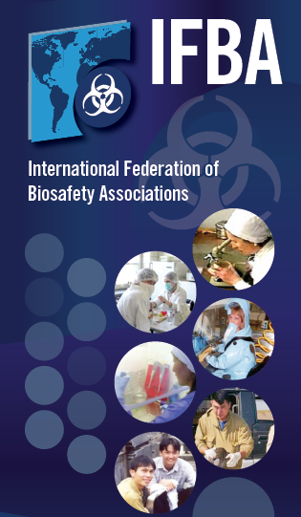
About IFBA
Not-for-profit, NGO that works with national and international public and animal health authorities and international agencies (e.g. WHO, OIE, FAO) to enhance biosafety, biosecurity and Biocontainment laboratory capacity within the greater framework of strengthening health systems.

Slide 28
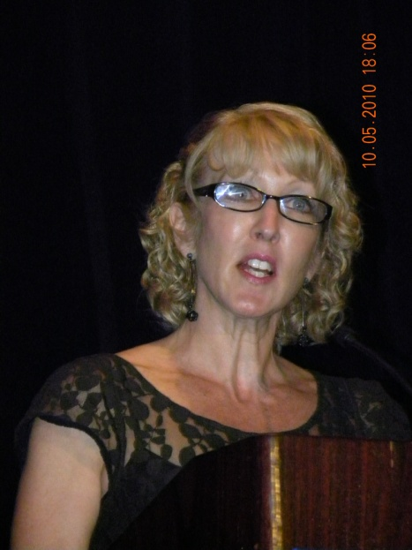
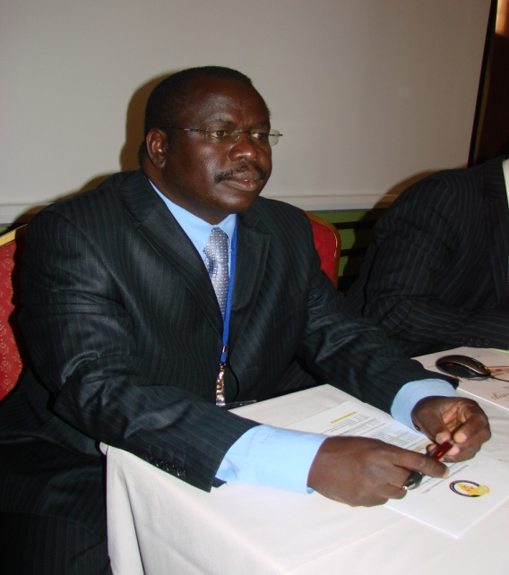
IFBA Co- Chairs
Maureen Ellis, Canada-APBA
Willy Tonui, Kenya-AfBSA

Slide 29
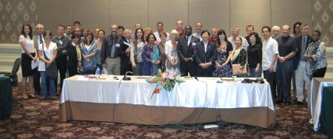
International Federation of Biosafety Associations
Member associations
AfBSA, Morocco, Egypt, A-PBA, BACAC, AnBio, AmexBio, ABSA, ABSA-Canada, EBSA, Australia/New Zealand, Japan, Thailand, Pakistan, Afghanistan, Philippines, Caribbean, Korea, Georgia, Azerbaijan.....
Observer organizations
Griffin Foundation, US BEP, ICLS, GPP, CDC, Redi Centre, Sandia...
Co-chairs
W. Tonui, M. Ellis
www.internationalbiosafety.org

Slide 30
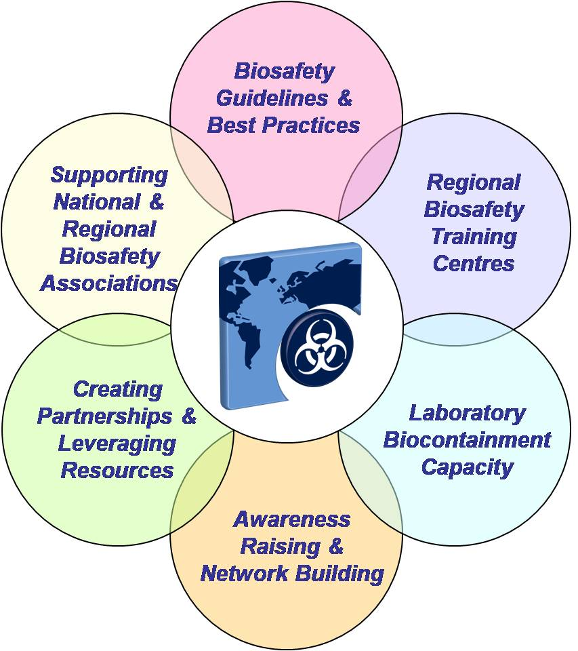
Role of IFBA
Promoting Biosafety through World-wide Collaboration

Slide 31
IFBA Programmes
The IFBA has developed comprehensive biosafety programs across the full spectrum of biological threats including:
Biosafety guidelines & policies - Developing national biosafety guidelines and policies and adapting international best practices (e.g WHO Laboratory Biosafety Manual) to local needs and conditions.
Diagnostic laboratories infrastructure - Designing, equipping and operating diagnostic laboratories to safely handle and contain infectious diseases.
Training & awareness raising - Establishing and supporting regional biosafety training Centre's, train-the-trainer programs, and twinning and mentoring programs.
Associations & network building – Supporting nascent biosafety associations, facilitating the twinning of associations and integration of national associations into the international biosafety community.

Slide 32



2011 – The Year of Building International Biosafety Communities
Developed in collaboration with Elizabeth R. Griffin Foundation as a result of discussions held during biosafety associations workshop at 2010 APBA conference in Korea
Provoke dialogue and action among governments, international organizations, private industry and other stakeholders
Empower biosafety associations to grow in a meaningful and sustainable manner

Slide 33
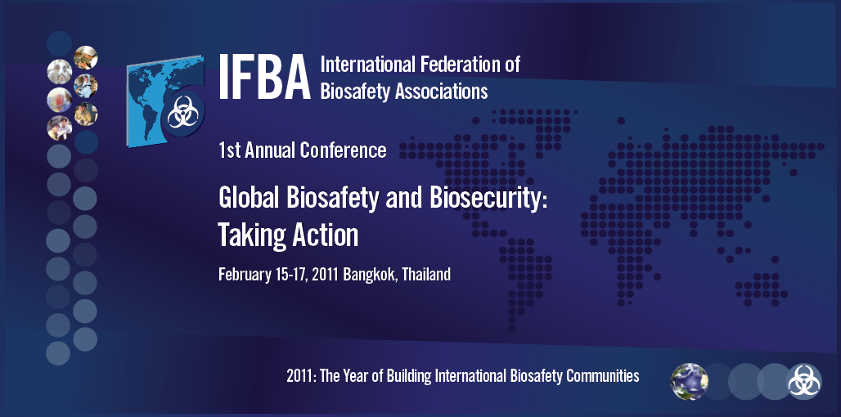
2011 – The Year of Building International Biosafety Communities
Launched February 15, 2011 in Bangkok, Thailand
Series of specific projects and events to build our international community through the year and beyond

Slide 34
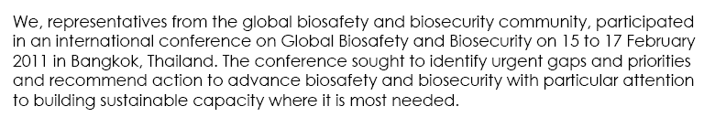
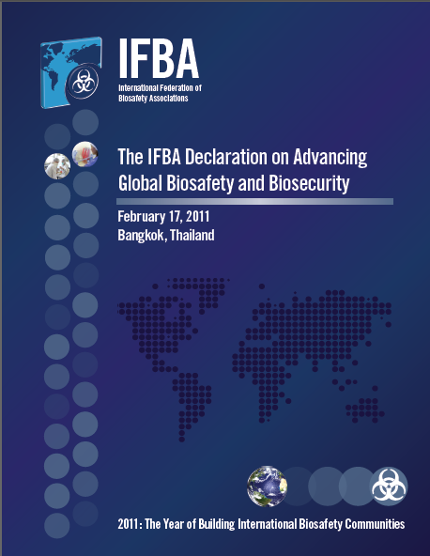
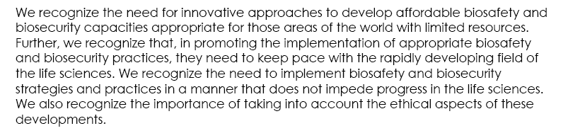
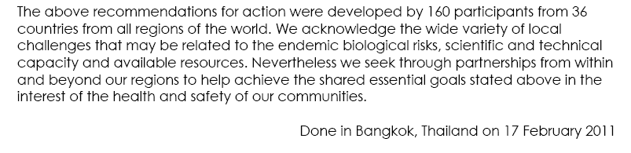
IFBA Declaration on Building Global Biosafety and Biosecurity

Slide 35
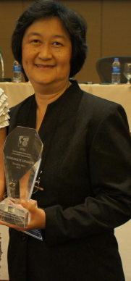
Biosafety Heroes Program
IFBA Heroes Working Group
Celebrate extraordinary individuals who are making significant contributions to advance biosafety in their region of the world
Operating under challenging circumstances with limited resources
Developing unique solutions to addressing these challenges
Nurture them to be future biosafety leaders
Role models on the ground around the world...

Slide 36

Welcome to our 3rd AfBSA Conference Sandton Convention Centre, Johannesburg, South Africa, June 24-27, 2012
Registration at
www.conference. afbsa.org
E-mail: afbsa@afbsa.org
Admin@afbsa.org

Slide 37

Welcome to 2nd IFBA Conference, Sandton Convention Centre, Johannesburg South Africa June 28 & 29, 2012

Slide 38
Thank You

