Slide 1
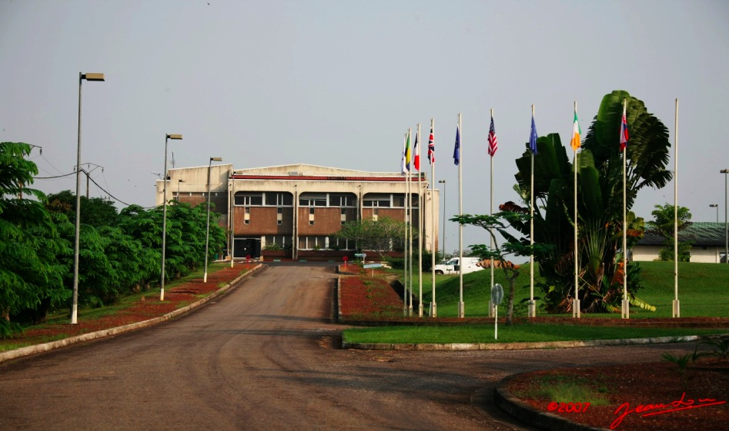
The International Centre of Medical Research of Franceville: A Medical Research Center in the heart of tropical rainforest. Jean-Paul Gonzalez, Director

Slide 2
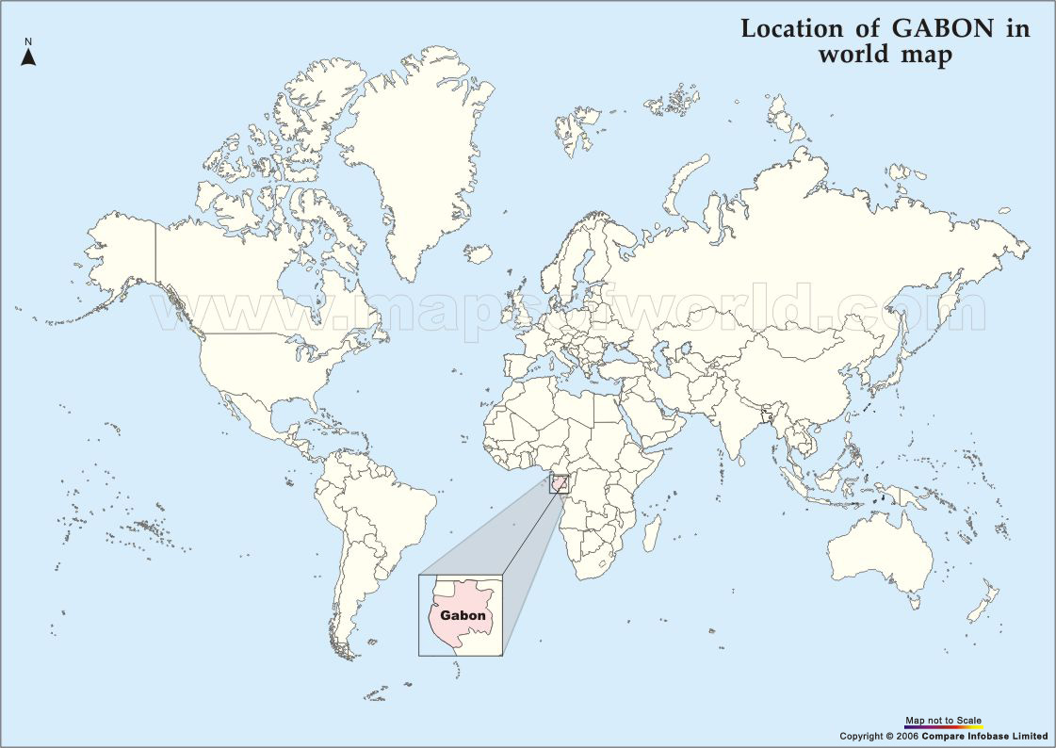
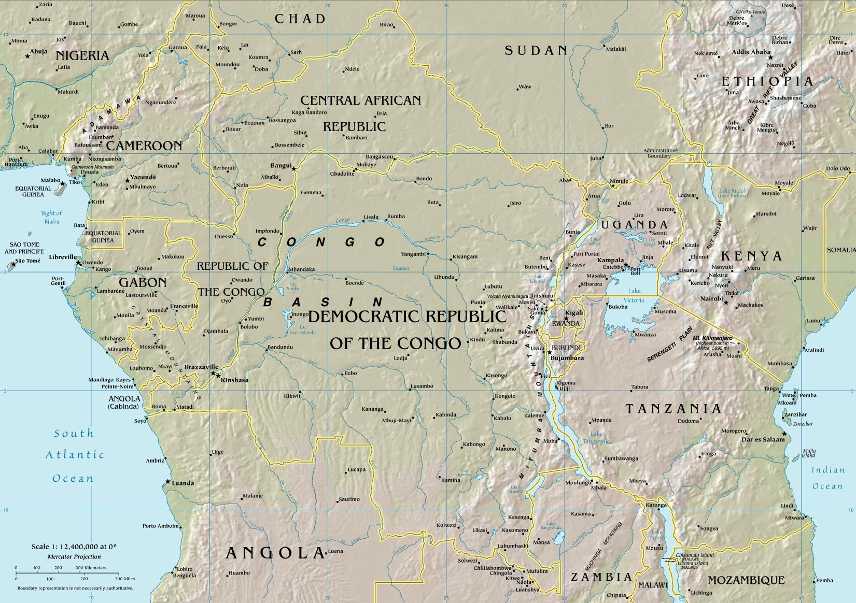
Where
REPUBLIC OF GABON

Slide 3
CAMEROUN
EQUATORIAL GUINEA
REPUBLIC
OF
CONGO
Franceville

Slide 4
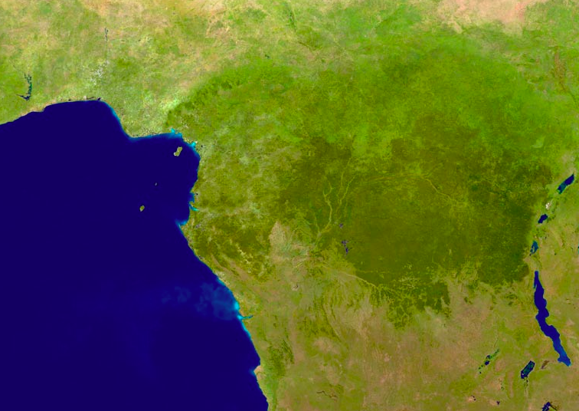
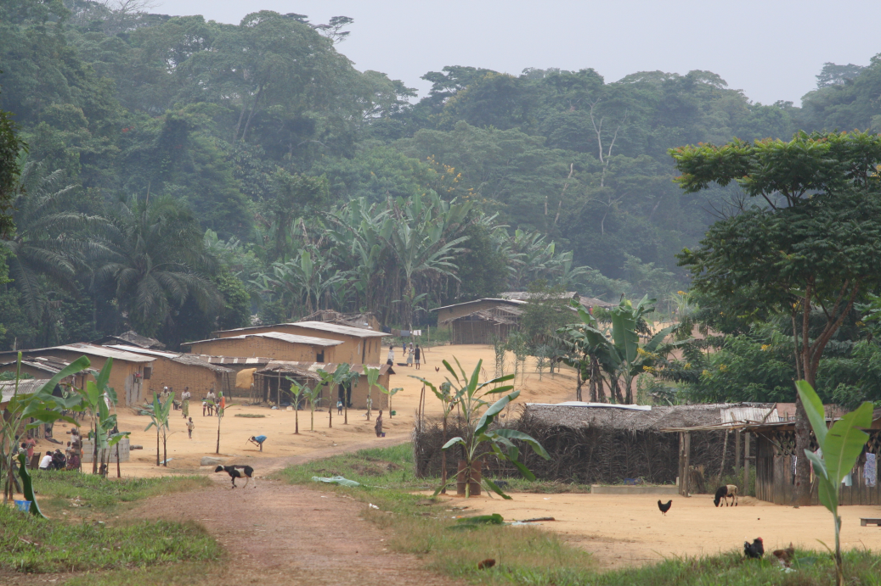
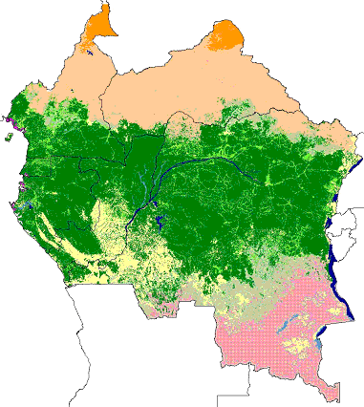
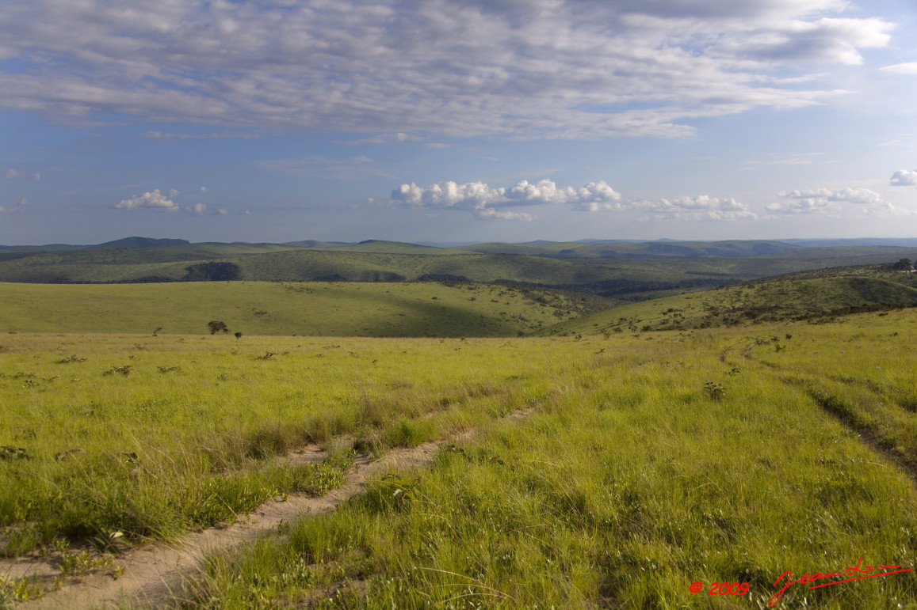
The Congolese Tropical Rainforest Basin

Slide 5
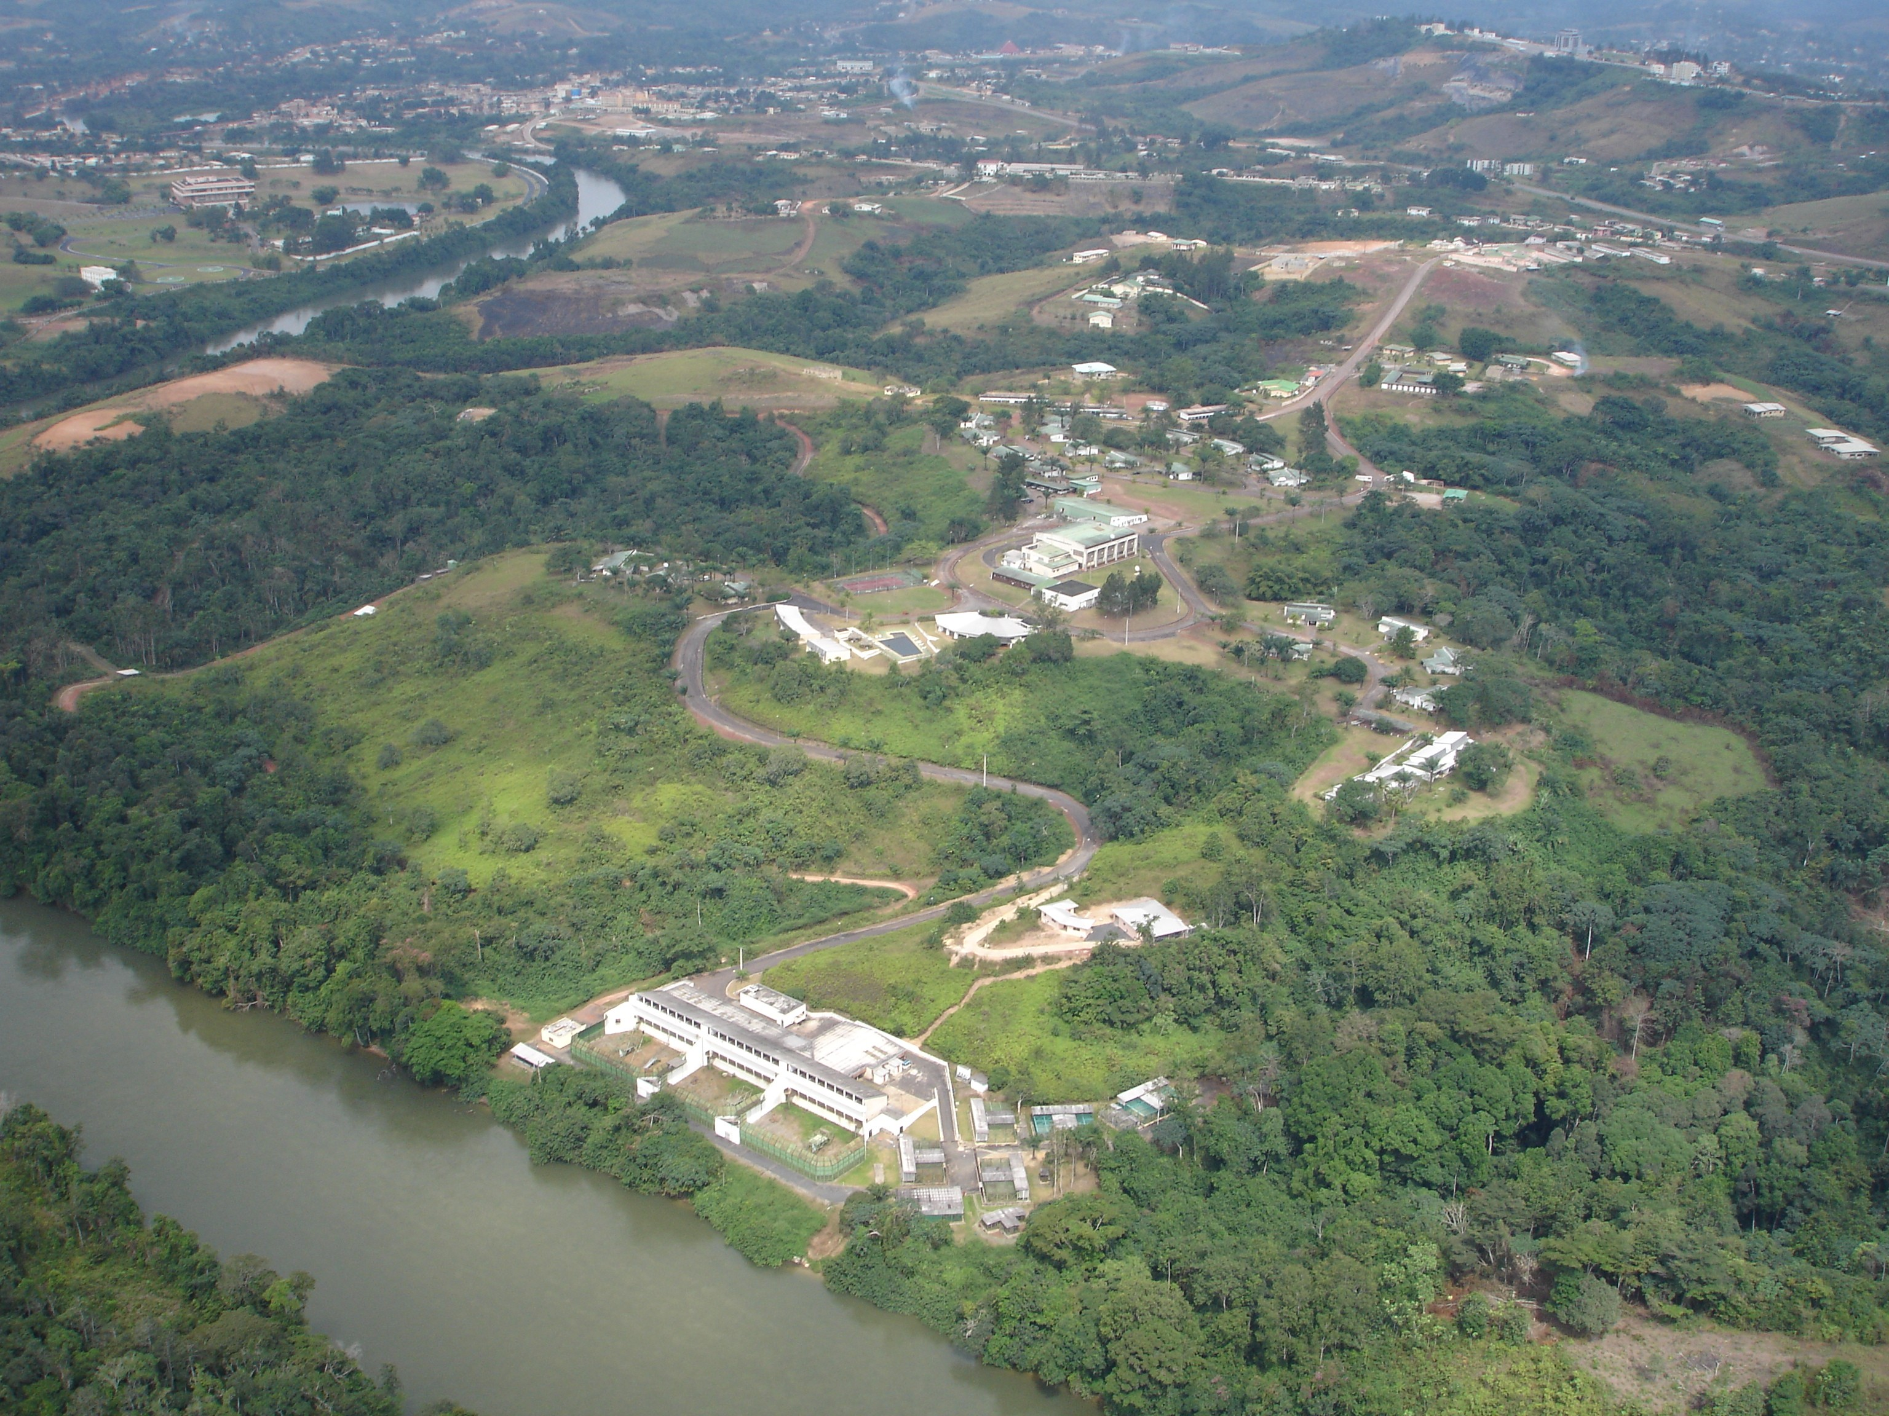
Structure
CIRMF: A campus of 98 acres (400 000 sq meter)
BSL3
BSL4
ABSL3

Slide 6
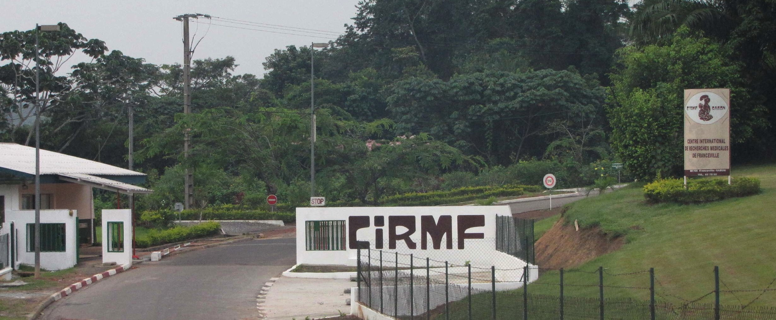
Accounts from the past
1974 : The President of Gabon, Omar BONGO, decide to create the CIRMF
1979: The CIRMF is operational with a main goal to study hypofecondity in Central Africa
1982 : BSL3 Laboratory developed for the study of HIV
1985 : Primate containment structure (ABSL3)
1996 : BSL3+/4 developed for Ebola research
2011 : BSL4 with “glove box” operational

Slide 7
Few numbers
160 + Agents (60 scientists / 2 expatriates)
1,500sqm Of laboratories
2 Field stations
1 Laboratory of genetics in Libreville
1 Centre of Primatology (450 apes)
46 Living accommodations

Slide 8
Seven Research Units
EMERGING VIRAL DISEASES
RETROVIROLOGY
MEDICAL PARASITOLOGY,
HEALTH ECOLOGY
SICKCLE CELL DISEASE
MEDICAL BIOLOGY & PUBLIC HEALTH
PRIMATOLOGY CENTRE

Slide 9









FUNDINGS
20% : Gabonese State
65% : Oil Company TOTAL-Gabon
10% : French Ministry of Foreign and European Affairs
5% : International Insitutions
http://www.cirmf.org/

Slide 10
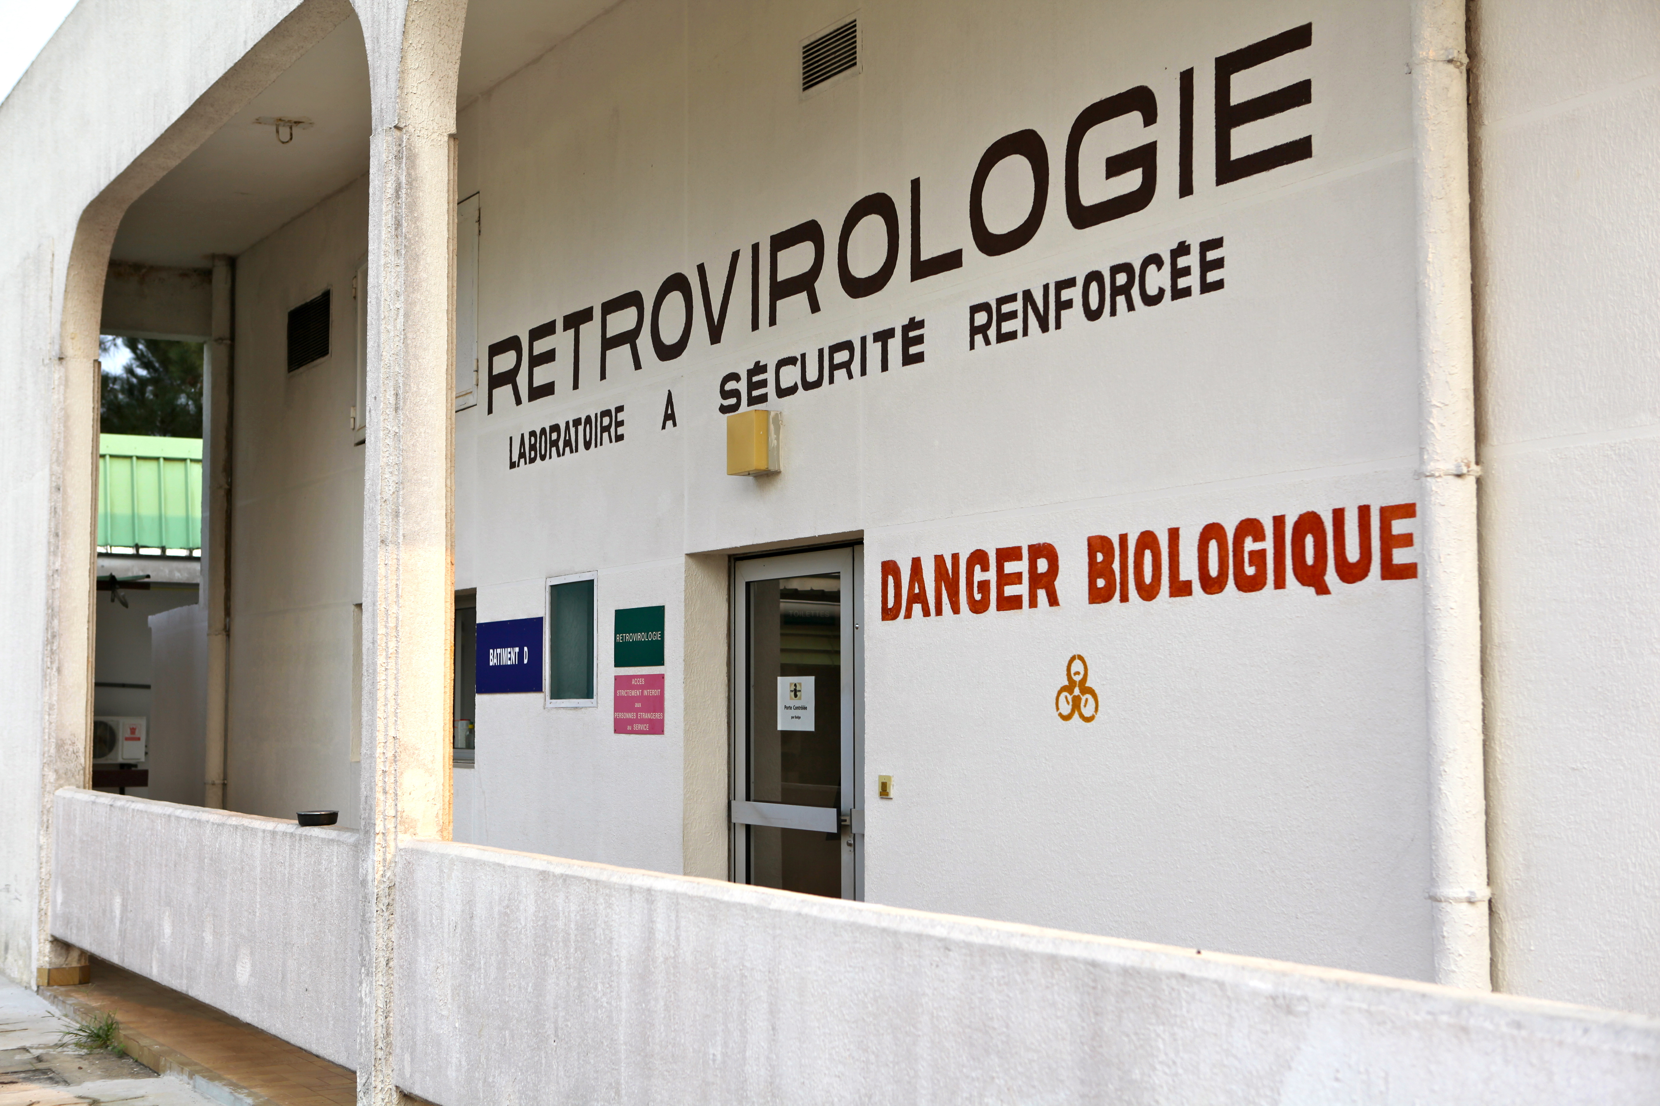
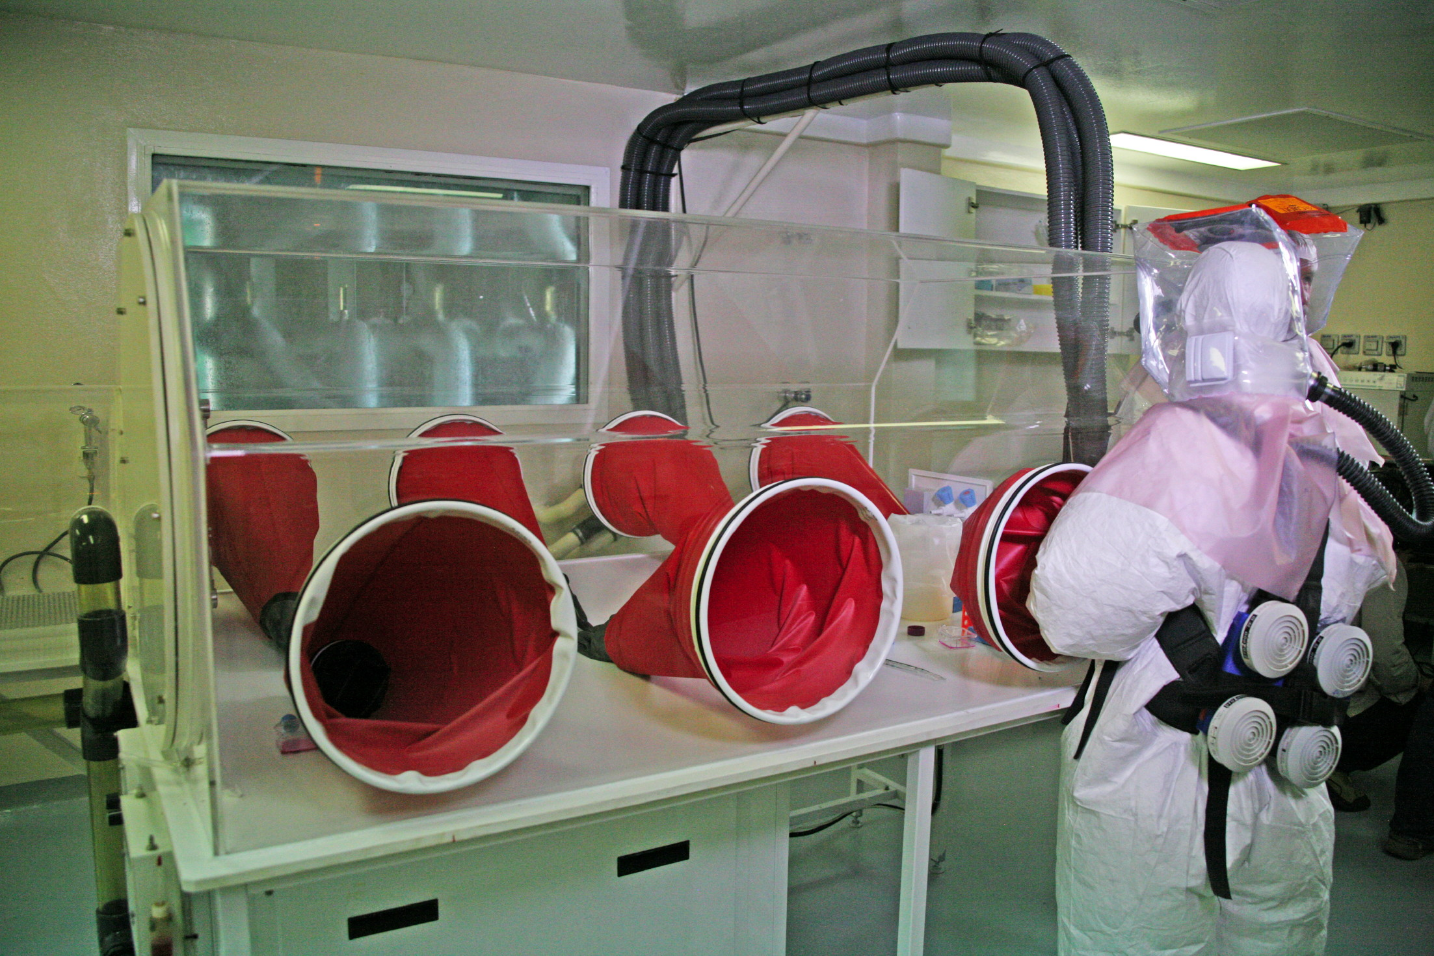
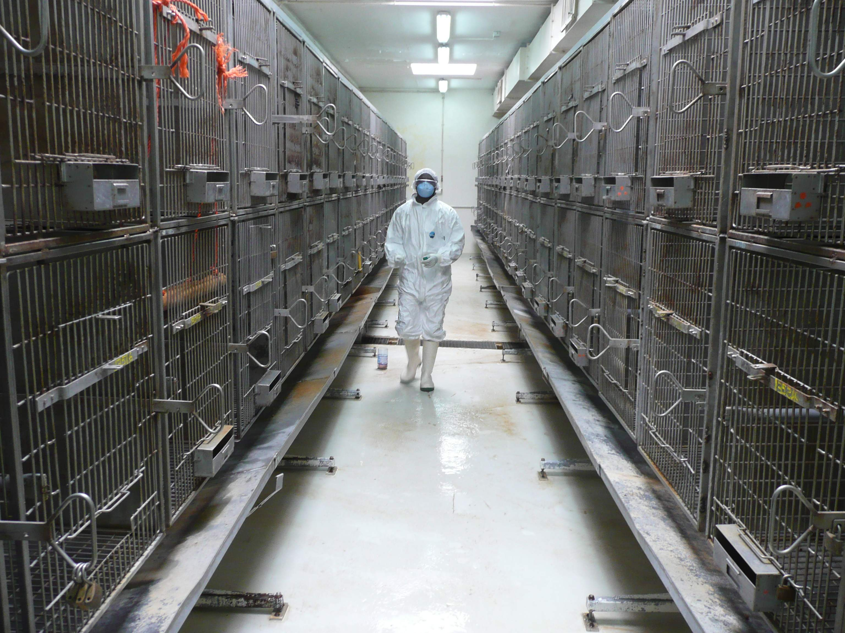
CIRMF high containment laboratories
BSL4
BSL3
ABSL3

Slide 11
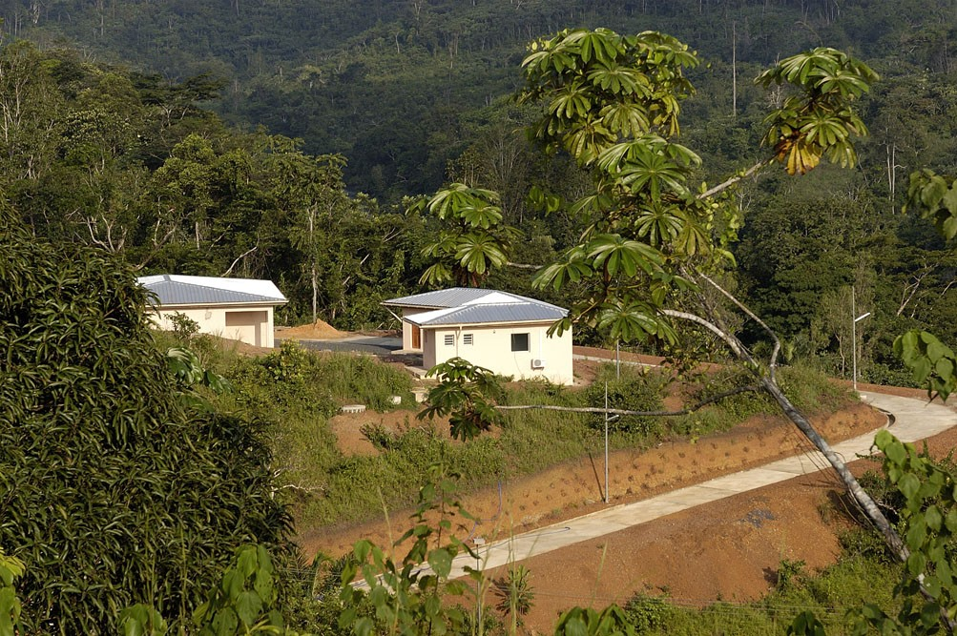
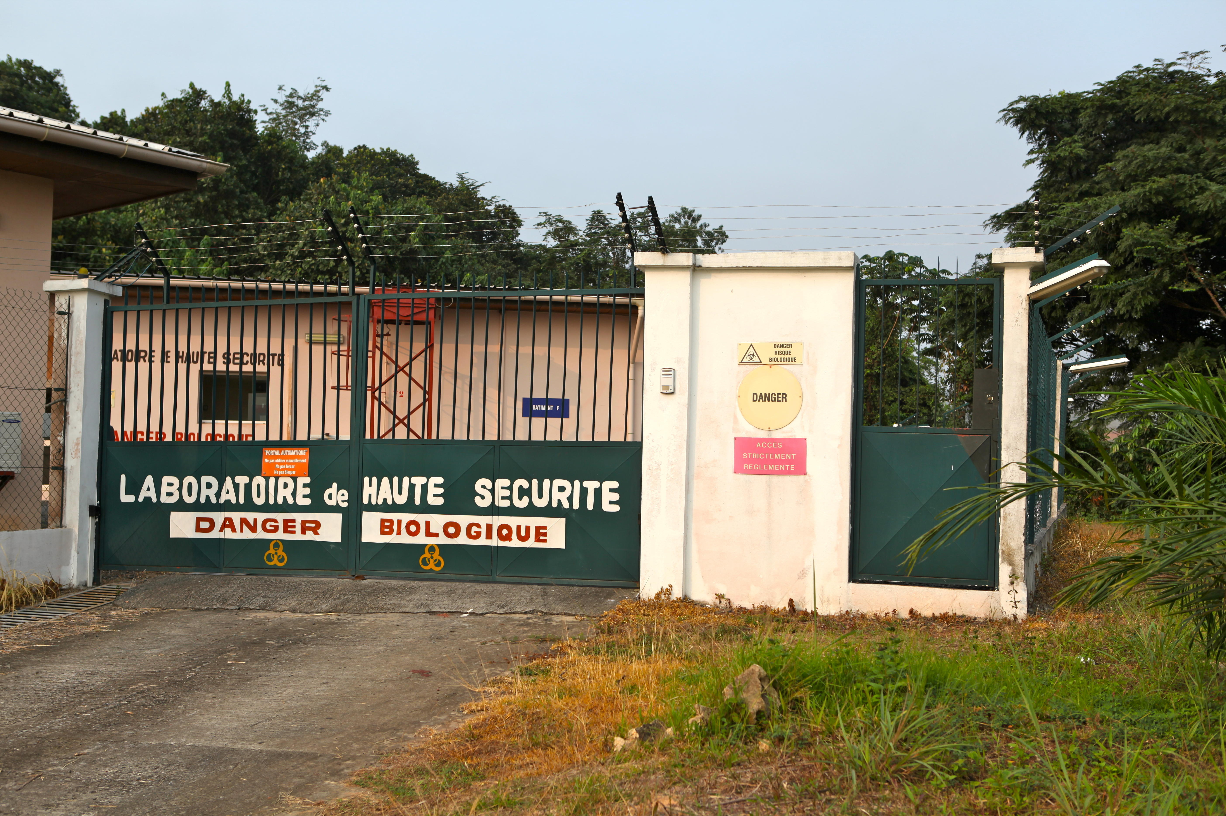
CIRMF P4 Laboratory
A first P3+ laboratory was developed in 1997 after the emergence (1995-1996 epidemics) of Ebola virus in Gabon
The construction of the actual P4 laboratory began in 2001 and the structure appraised and empowered in 2008

Slide 12
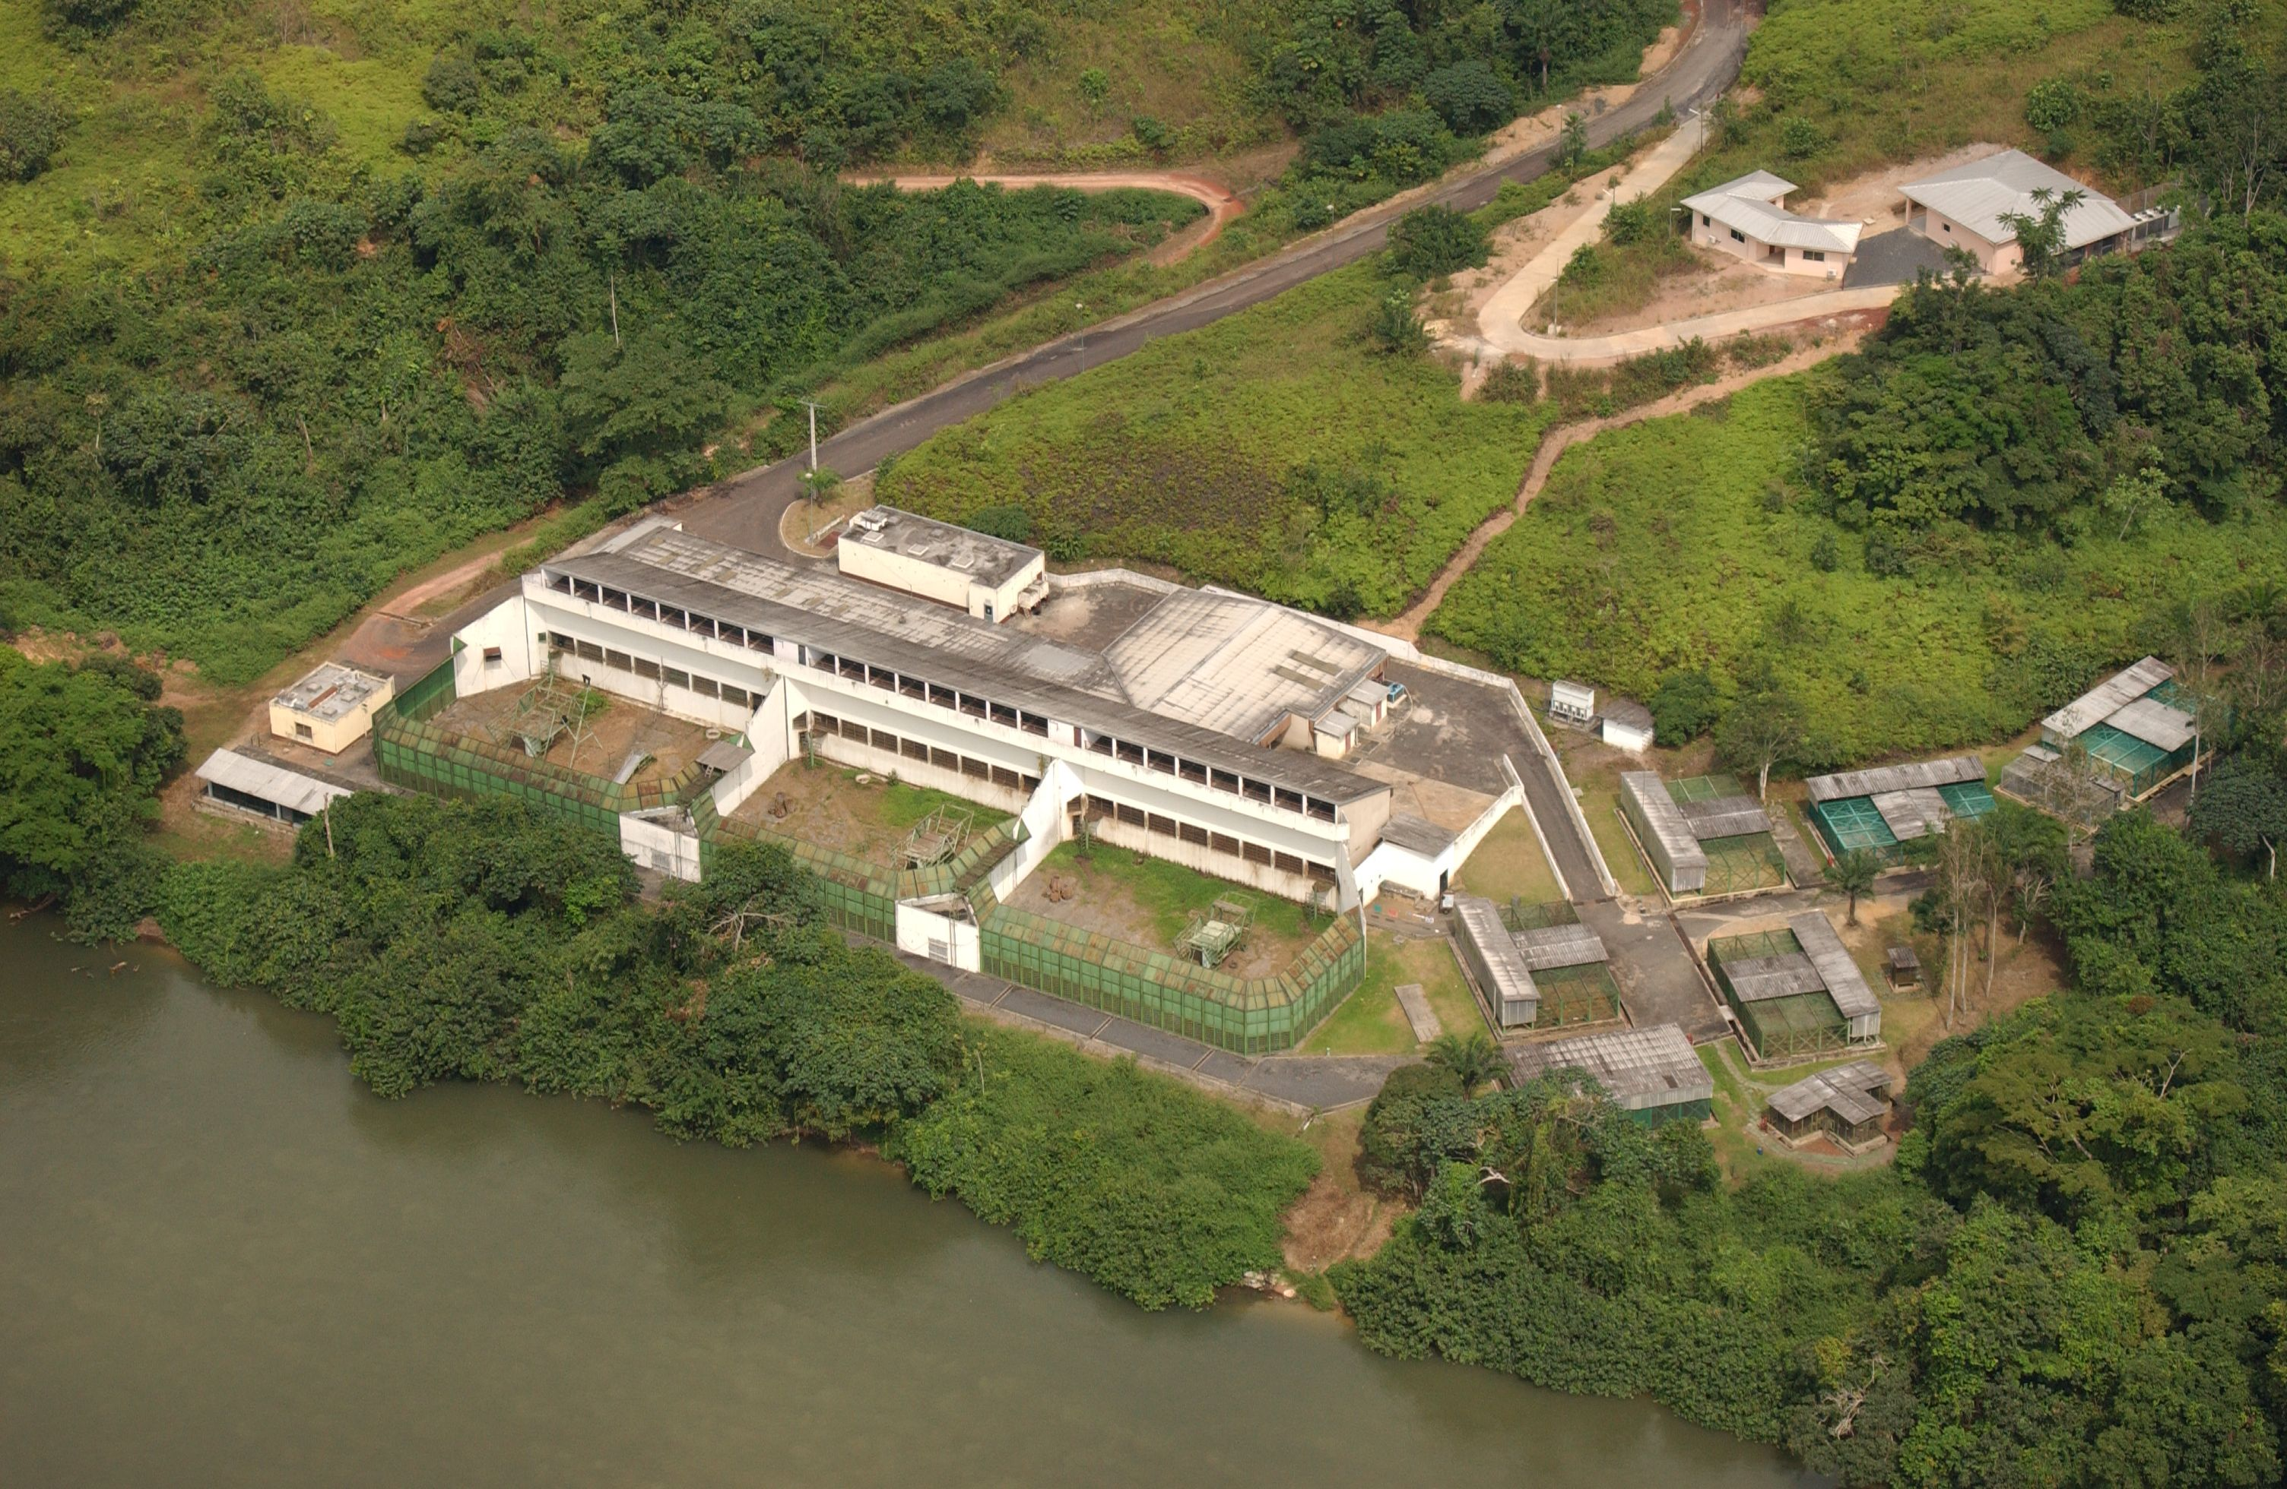
CIRMF P4 Laboratory
Objective: diagnostic and characterization of P4 agents at the regional level
Security : Isolated, electric fences, guard in duty permanently

Slide 13
Emerging Viral Diseases Research Unit (Eric Leroy, Head)
Objectives
Viral biodiversity of the Central African tropical rainforest
Understanding the emergence of human viral diseases
Fundamentals of cross-species transmission
Tools & methods
Molecular virology
In vivo immunology (luminex, flow cytometry, cytotoxicity …)
Human Cohort, Animal trapping & Entomological studies
Outbreak field investigations

Slide 14
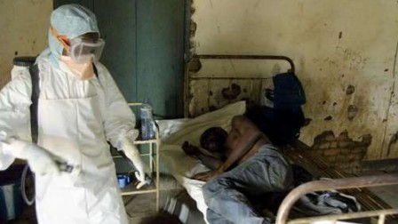
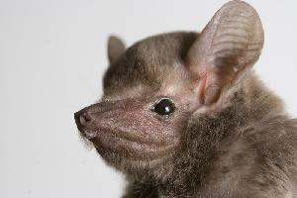
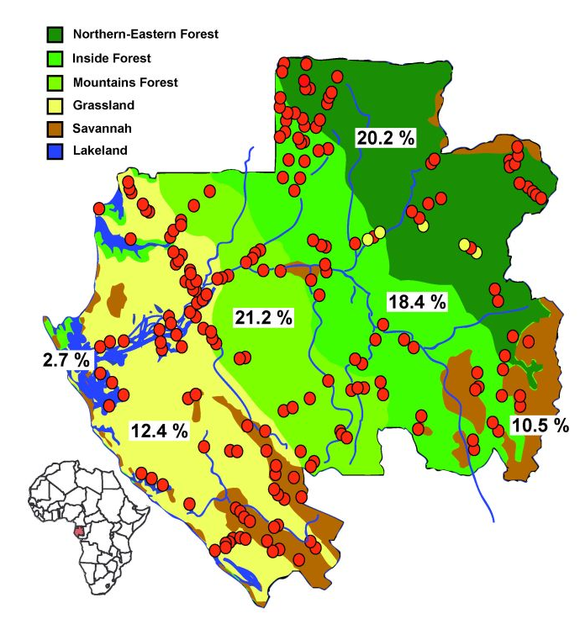
Results
Emerging Viral Diseases Research Unit (Eric Leroy, Head)
Ebola
Ebola Natural history
Ebola Genomic & phylogenetic
Ebola fever Deep immunosuppression
Asymptomatic infection
Other Viruses
Chikungunya & Dengue outbreaks (co-circulation) & follow up
Comprehensive study on arboviruses : RVF, DHF,
Poliovirus epidemic….

Slide 15
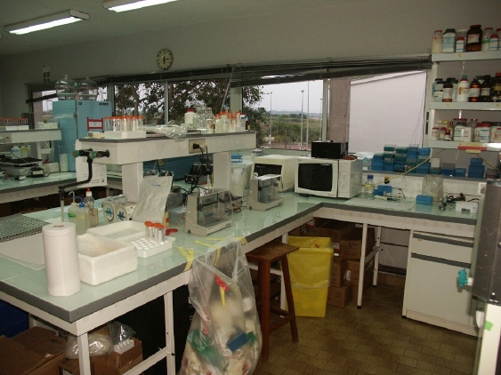
BSL3 for Retrovirology
Objectives
Diagnostic HIV / AIDS
HIV genotyping
HIV load & treatment follow-up
Retrovirus Characterization (SIV, HIV, HTLV, STLV, Foamy virus Virus)
HIV Genotypes & genetic diversity
SIV Phylogeny / risk
Retrovirus discovery (ex.: SIV Gor2, SIV )
Antiviral drugs
Results

Slide 16
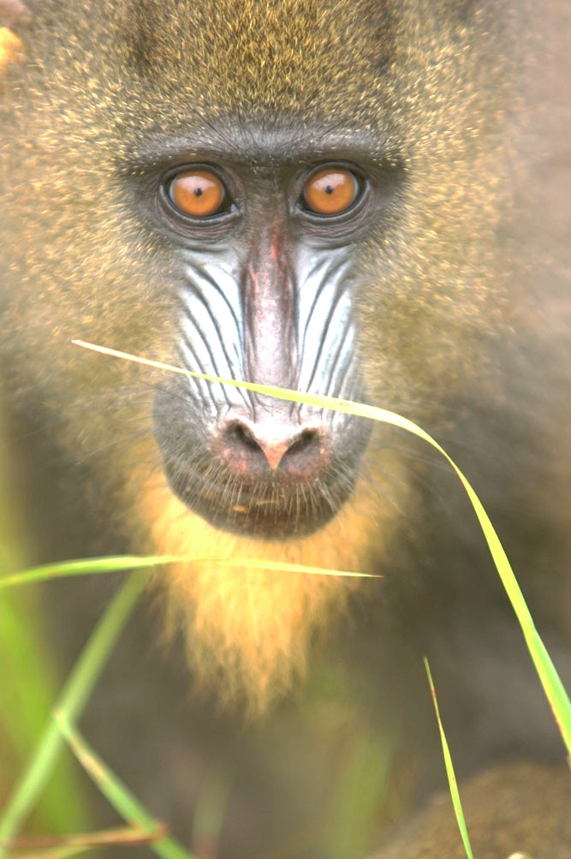
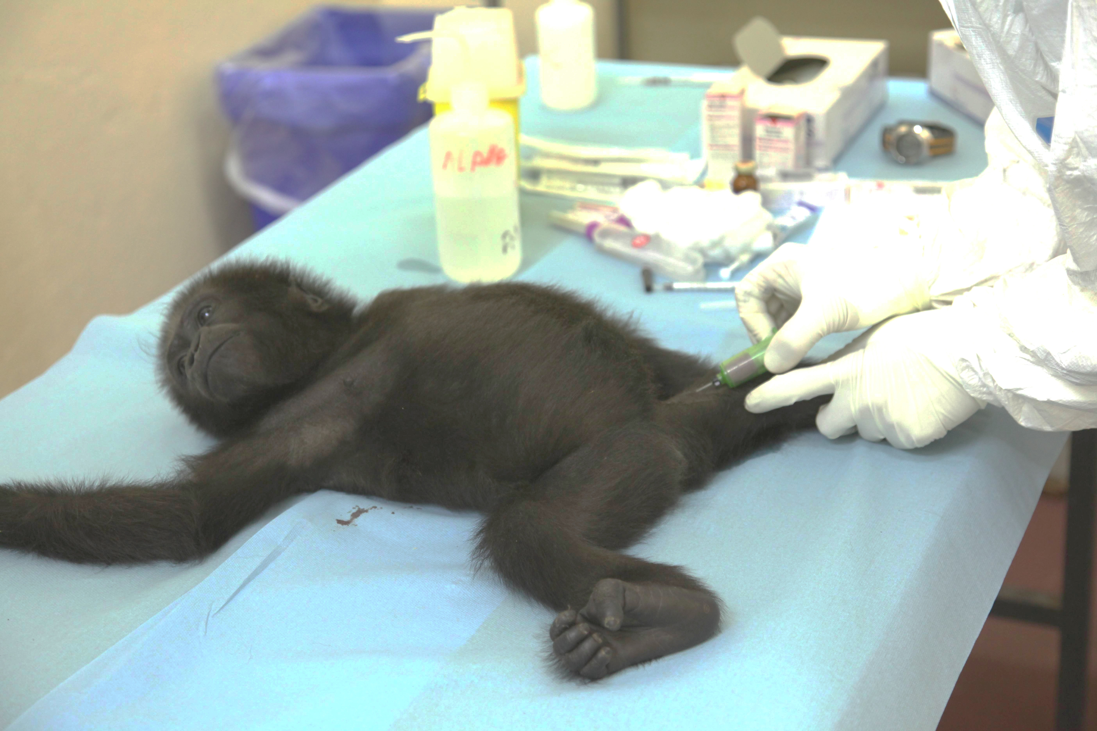
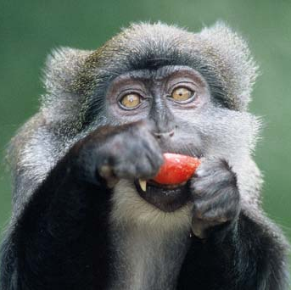
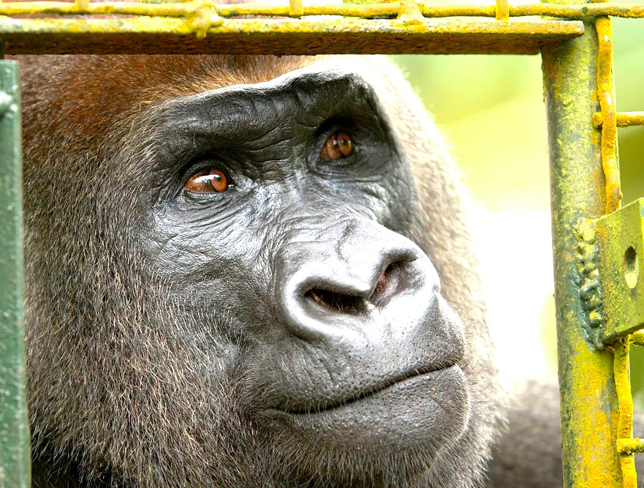
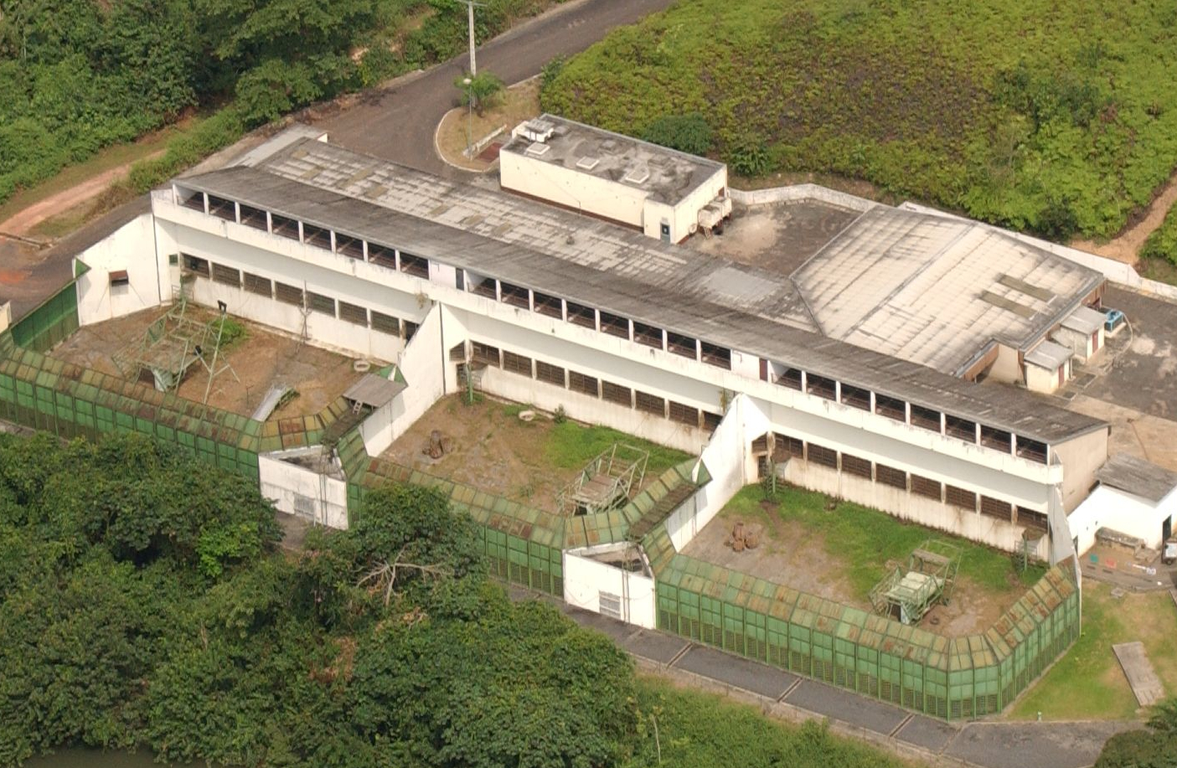
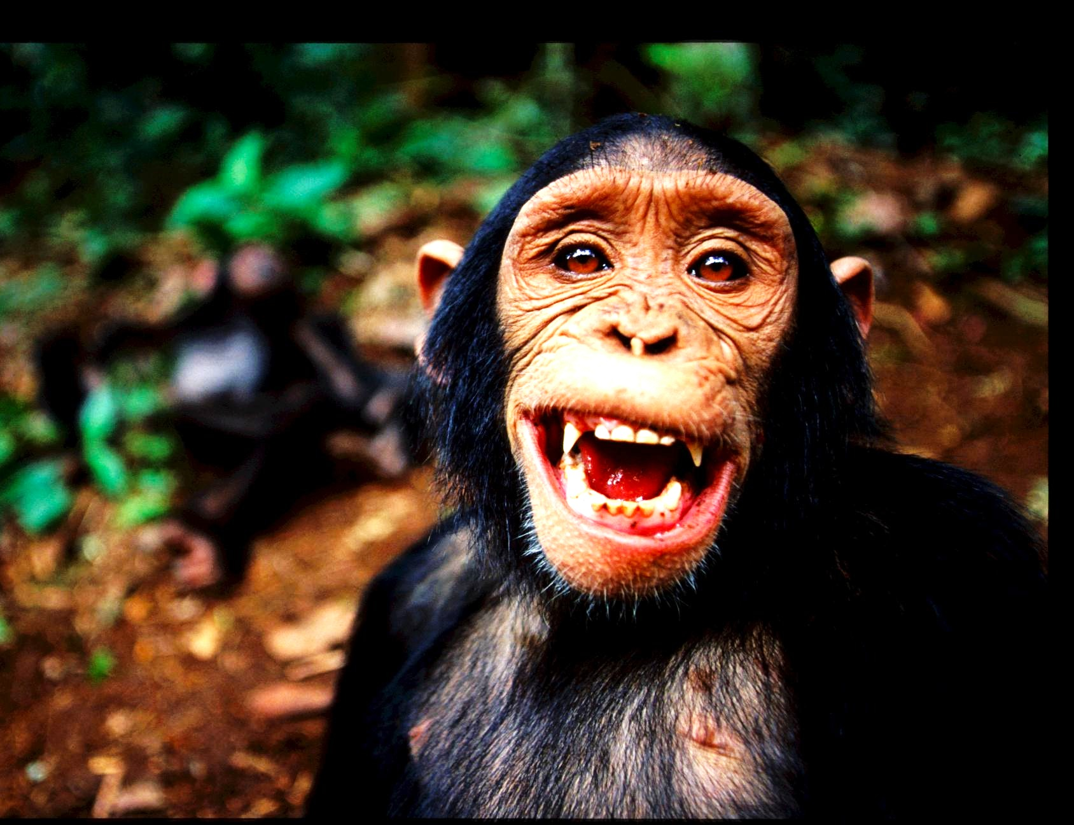
Primate Center

Slide 17
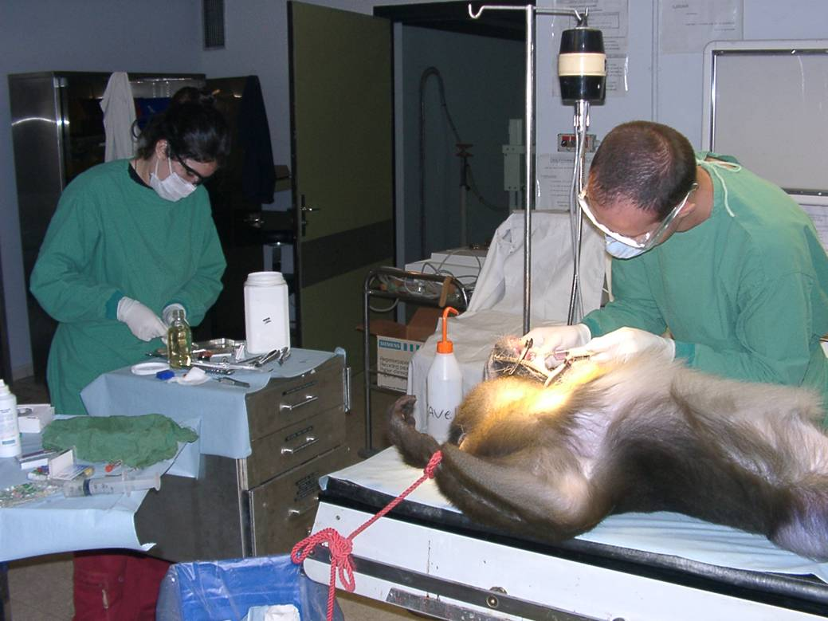
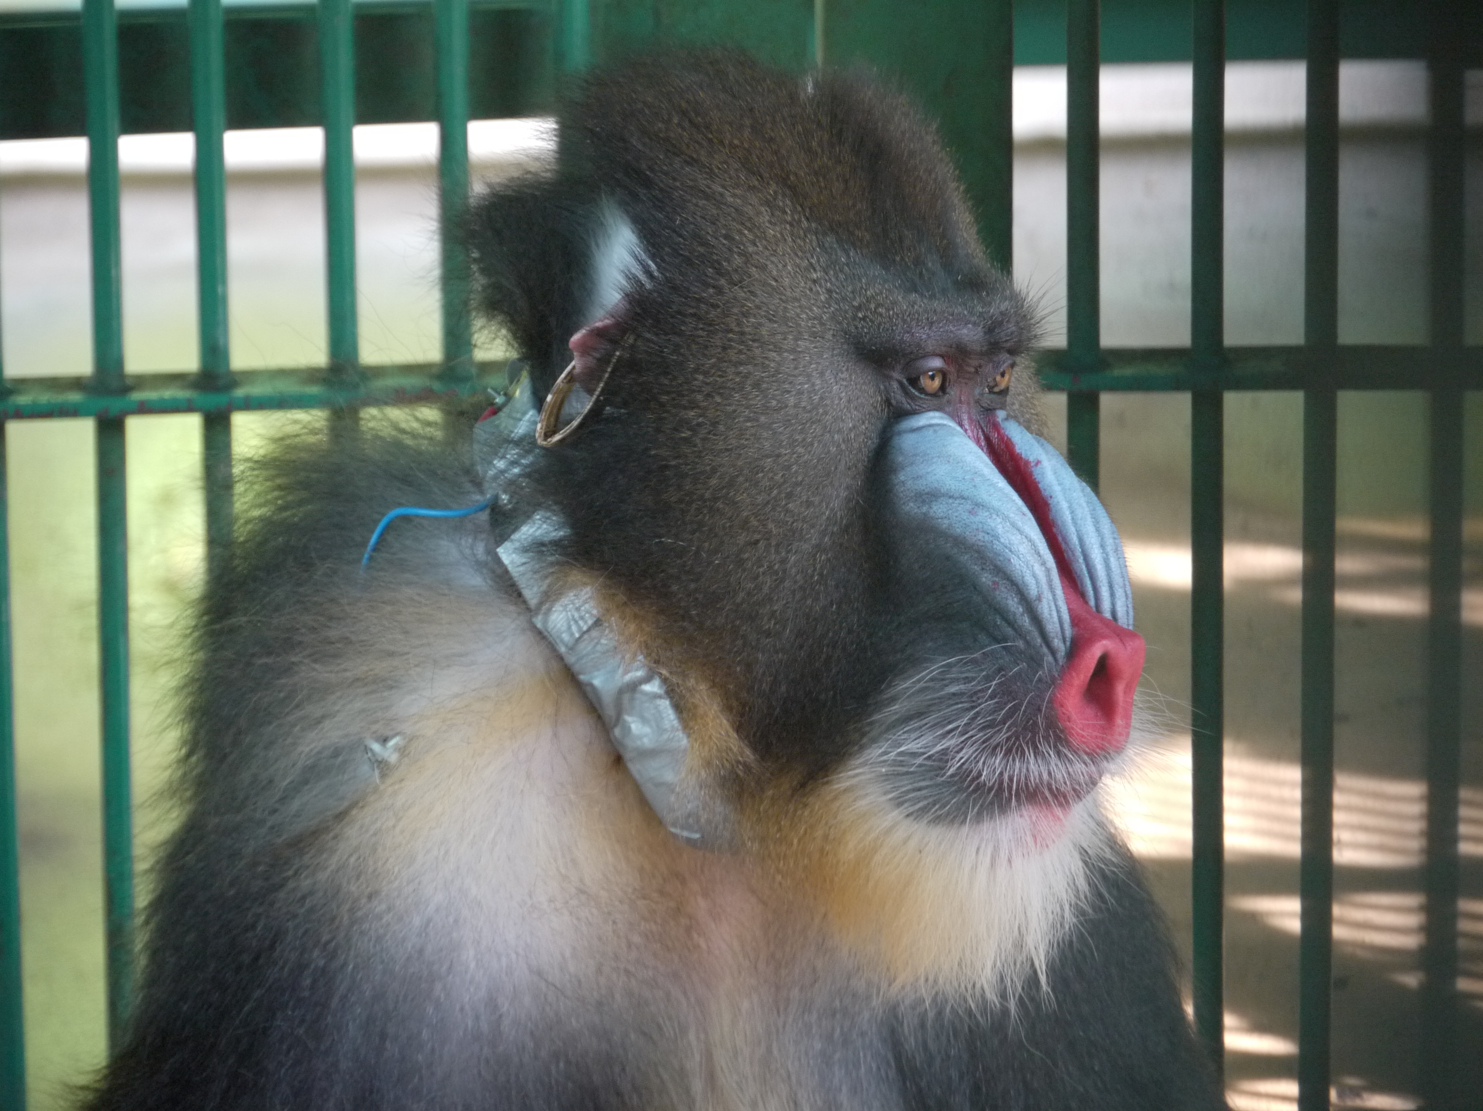
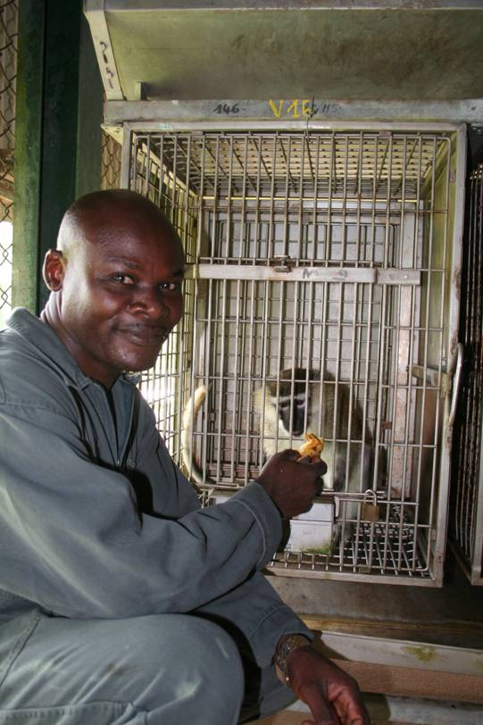
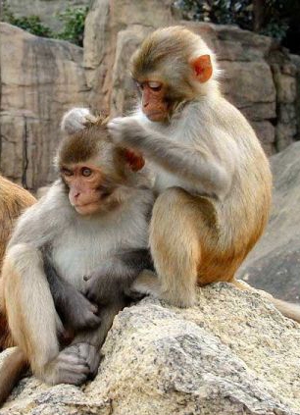
Animal facilities
ABSL 3
Surgery room
Containment
Objectives
Comparative Medicine
Conservation Medicine
Experimental Medicine
Results
Drug therapy tests (Anti HIV)
Viral physiopathology (SIV/Mandrill; Chikungunya/Macacca)
Vaccine (Chikungunya/Macacca)
Ethology & virus transmission

Slide 18
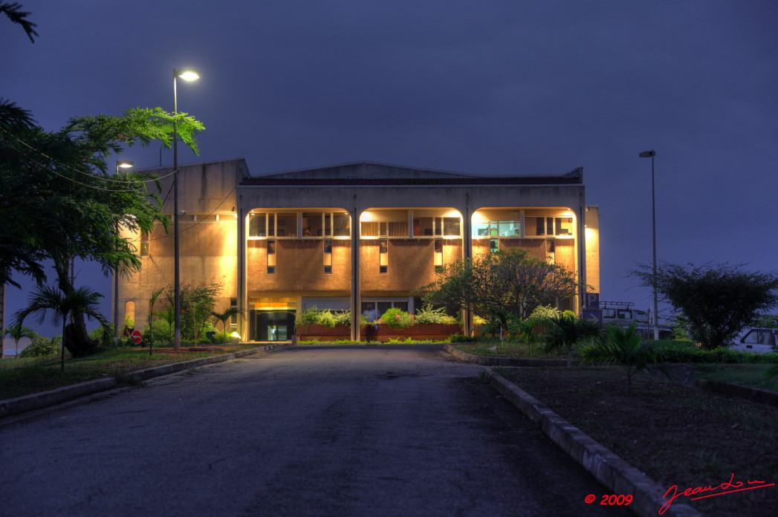

Thank you

