Slide 1
PANDEMIC INFLUENZA VIRUSES: PAST AND FUTURE
PETER PALESE
DEPARTMENT OF MICROBIOLOGY MOUNT SINAI SCHOOL OF MEDICINE, NEW YORK
ISTANBUL, JULY 11, 2011

Slide 2
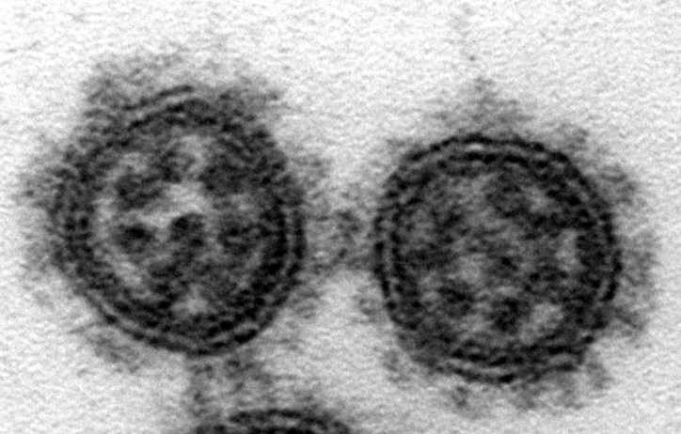
Yi-ying Chou

Slide 3
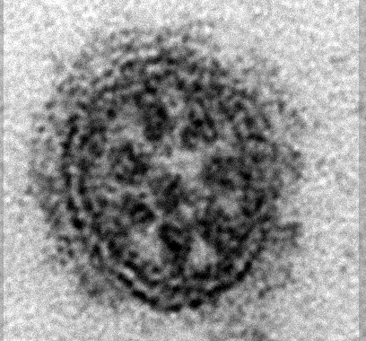
H1
N1
Yi-ying Chou

Slide 4
INFLUENZA VIRUSES CIRCULATING IN THE HUMAN POPULATION
pH1N1
?
A
H3N2 (Group2)
H2N2 (Group1)
H1N1 (Group1) H1N1
1918
1940
1960
1980
2000

Slide 5
INFLUENZA VIRUSES CIRCULATING IN THE HUMAN POPULATION
B
pH1N1
?
A
H3N2 (Group2)
H2N2 (Group1)
H1N1 (Group1) H1N1
1918
1940
1960
1980
2000

Slide 6
THE BURDEN OF SEASONAL INFLUENZA
250,000 to 500,000 deaths globally/year
More than 200,000 hospitalizations/year in US; deaths vary, more than 3,000 in 1986-7 and more than 48,000 in 2003-4
$37.5 billion on economic costs/year in US related to influenza and pneumonia
Ever-present threat of pandemic influenza
Sources: CDC, WHO, Am. Lung Assoc.

Slide 7
LIFE EXPECTANCY IN THE UNITED STATES 1900-2001: BOTH SEXES
AGE
YEAR

Slide 8
1918 influenza lung block from AFIP (Armed Forces Institute of Pathology)

Slide 9
REVERSE GENETICS
Viral RNA expression plasmids
Protein expression plasmids
PB2
PB1
PA
PB2
HA
PB1
NP
PA
NA
NP
M
NS
Transfection
Cells
Recombinant influenza virus

Slide 10
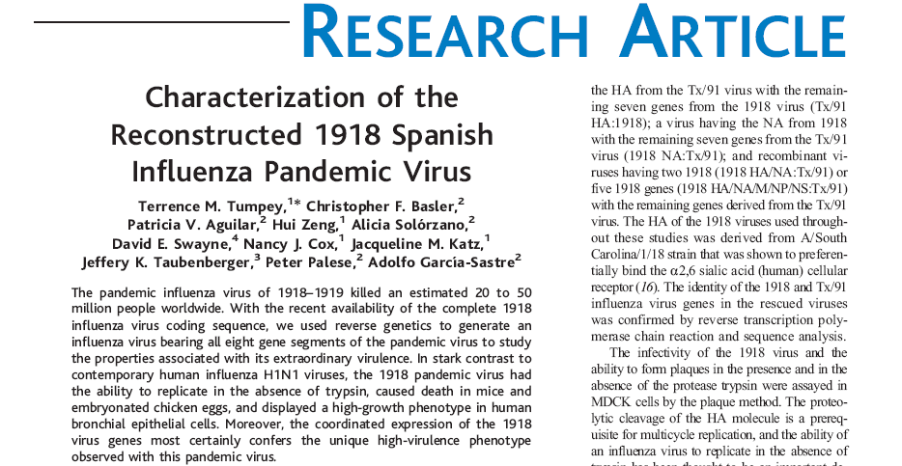
THE LANCET PAPER
OF THE YEAR 2005
Tumpey et al., Science, 310, 77, 2005

Slide 11
Virulence of the 1918 virus in mice: mouse lethal dose 50 (log pfu)
Tx/91: PB2, PB1, PA, NP, M, NS
1918: HA, NA
Texas/36/91
>6
4.75
1918 “Spanish” flu
3.3

Slide 12
Single gene reassortants identify a critical role for PB1, HA and NA in the high virulence of the 1918 pandemic influenza virus
Pappas et al. PNAS 105, 3064, 2008

Slide 13
Properties (LD50) of 1:7 Reassortants (Texas/91:1918)
Virus stock* | Lethal Dose₅₀‡
1918 | 3.25
Tx PA:1918 | 3.5
Tx PB1:1918 | 5.5
Tx PB2:1918 | 3.75
Tx HA:1918 | > 6
Tx NP:1918 | 3.5
Tx NA:1918 | 5.5
Tx M:1918 | 3.5
Tx NS:1918 | 3.25
Tx/91 | > 6

Slide 14
SUMMARY
THE 1918 VIRUS IS THE MOST VIRULENT HUMAN INFLUENZA VIRUS
THE HEMAGGLUTININ, NEURAMINIDASE AND THE PB1 (PB1-F2) GENES ARE IMPORTANT VIRULENCE MARKERS

Slide 15
SEVERITY OF INFLUENZA PANDEMICS (deaths/US numbers)
1918-1919 (H1N1) 675 K
1957-1958 (H2N2) 70 K
1968-1969 (H3N2) 34 K
2009-2010 (pH1N1) 8-18K

Slide 16
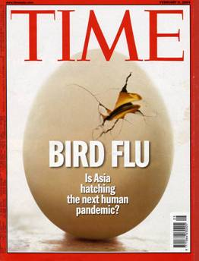

Pandemic Influenza: What’s Next?

Slide 17
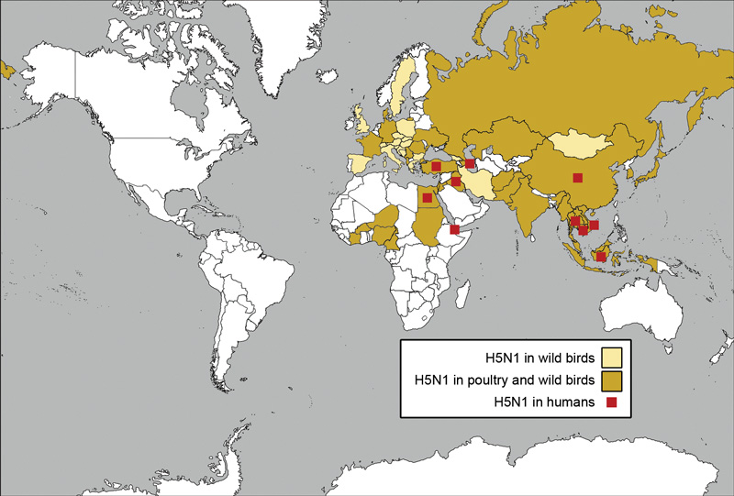
AVIAN INFLUENZA IS A THREAT

Slide 18
Confirmed Human H5N1 Cases Updated June 22, 2011
Cases Deaths
Azerbaijan 8 5
Bangladesh 3 0
Cambodia 16 14
China 40 26
Djibouti 1 0
Egypt 150 52
Indonesia 178 146
Iraq 3 2
Lao 2 2
Myanmar 1 0
Nigeria 1 1
Pakistan 3 1
Thailand 25 17
Turkey 12 4
Viet Nam 119 59
Total 562 329
WHO

Slide 19
THE AVIAN H5N1 INFLUENZA VIRUS DOES NOT EFFICIENTLY TRANSMIT FROM HUMAN TO HUMAN

Slide 20
INFLUENZA VIRUSES CIRCULATING IN THE HUMAN POPULATION
B
pH1N1
?
A
H3N2 (Group2)
H2N2 (Group1)
H1N1 (Group1) H1N1
1918
1940
1960
1980
2000

Slide 21
Swine Origin H1N1 Influenza Virus
First confirmed cases reported to WHO in late April 2009
Global spread prompted WHO to declare pandemic 11 June 2009
As of 23 August 2009, number of confirmed cases was ~209,000, with 2185 deaths
As of March 2010 the CDC estimates up to 80 million cases, as many as 362,000 hospitalizations and 14,460 H1N1-related deaths in the US
90% of hospitalizations and 88% of deaths occurred in individuals younger than 65 years of age

Slide 22
THE 2009 SWINE H1N1 INFLUENZA VIRUS:
TRANSMITS WELL
HAS H1 (HEMAGGLUTININ) AND N1 (NEURAMINIDASE) SURFACE GLYCOPROTEINS SUGGESTING THAT THE HUMAN POPULATION HAS PARTIAL HERD IMMUNITY.
DOES NOT EXPRESS THE VIRULENCE GENE, PB1-F2.
IS SENSITIVE TO NEURAMINIDASE INHIBITORS.

Slide 23
ORIGIN OF GENES OF THE 2009 SWINE
H1N1 INFLUENZA VIRUS

Slide 24
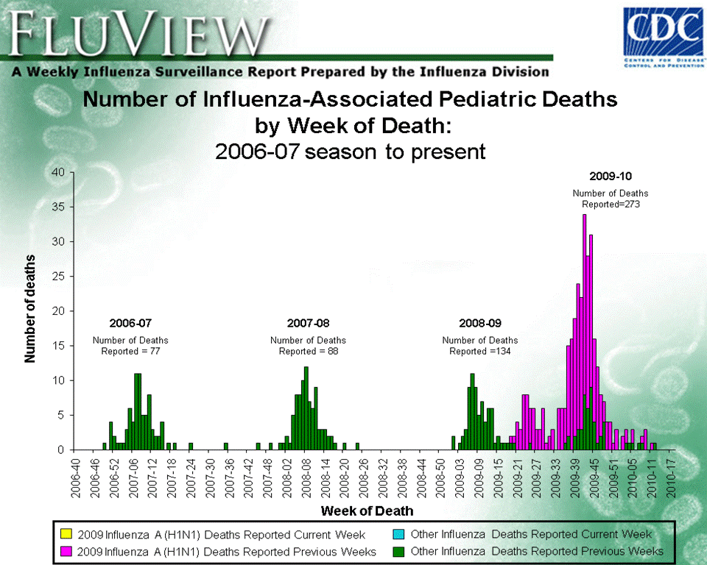

Slide 25
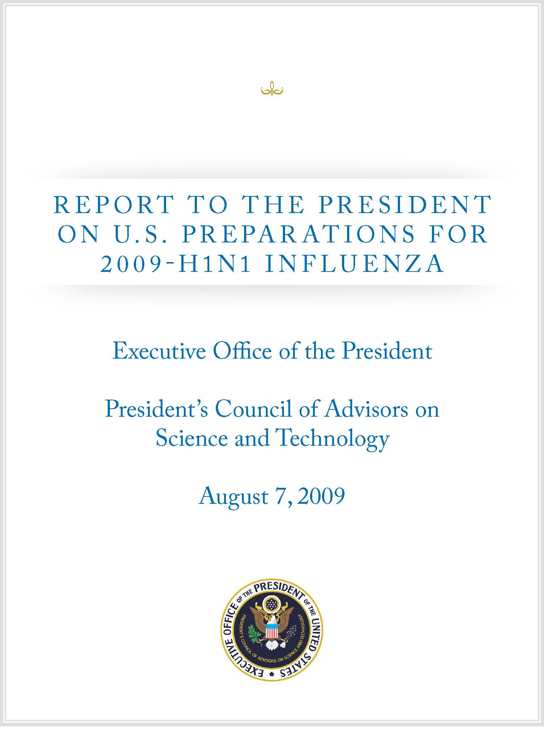

Slide 26
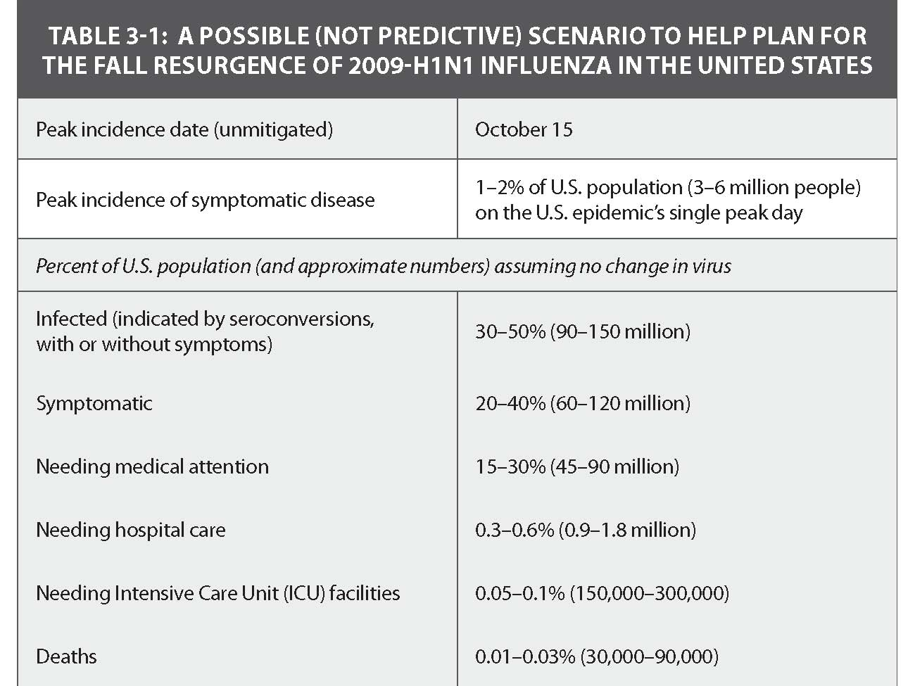

Slide 27
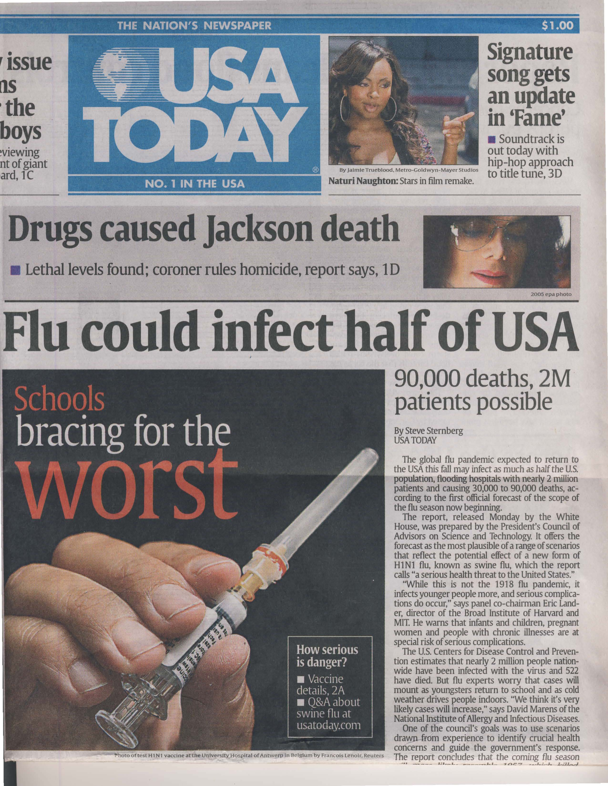

Slide 28
TOWARDS A UNIVERSAL INFLUENZA VIRUS VACCINE

Slide 29
INFLUENZA VIRUSES CIRCULATING IN THE HUMAN POPULATION
B
pH1N1
?
A
H3N2 (Group2)
H2N2 (Group1)
H1N1 (Group1) H1N1
1918
1940
1960
1980
2000

Slide 30
Influenza virus vaccine formulations (2000 – 2010)
Vaccine Recommendations | H1N1 | H3N2 | B
2000 – 2001 | A/NEW CALEDONIA/20/99 | A/MOSCOW/10/99 | B/BEIJING/184/93
2001 – 2002 | A/NEW CALEDONIA/20/99 | A/MOSCOW/10/99 | B/SICHUAN/379/99
2002 – 2003 | A/NEW CALEDONIA/20/99 | A/MOSCOW/10/99 | B/HONG KONG/330/2001
2003 – 2004 | A/NEW CALEDONIA/20/99 | A/MOSCOW/10/99 | B/HONG KONG/330/2001
2004 – 2005 | A/NEW CALEDONIA/20/99 | A/FUJIAN/411/2002 | B/SHANGHAI/361/2002
2005 – 2006 | A/NEW CALEDONIA/20/99 | A/CALIFORNIA/7/2004 | B/SHANGHAI/361/2002
2006 – 2007 | A/NEW CALEDONIA/20/99 | A/WISCONSIN/67/2005 | B/MALAYSIA/2506/2004
2007 – 2008 | A/SOLOMON ISLANDS/3/2006 | A/WISCONSIN/67/2005 | B/MALAYSIA/2506/2004
2008 – 2009 | A/BRISBANE/59/2007 | A/BRISBANE/10/2007 | B/FLORIDA/4/2006
2009 – 2010 | A/BRISBANE/59/2007 | A/BRISBANE/10/2007 | B/BRISBANE/60/2008

Slide 31
MONOVALENT INFLUENZA VIRUS VACCINE (PANDEMIC H1N1, NOVEL H1N1, SWINE-ORIGIN)
2009/2010
A/CALIFORNIA/7/2009 (H1N1)

Slide 32
Visits for Influenza-like-Illness (ILI) and pH1N1 Vaccine Distribution
Sep 2009 – May 2010
Source: CDC ILI and Vaccine Distribution Data
Notes:
32

Slide 33
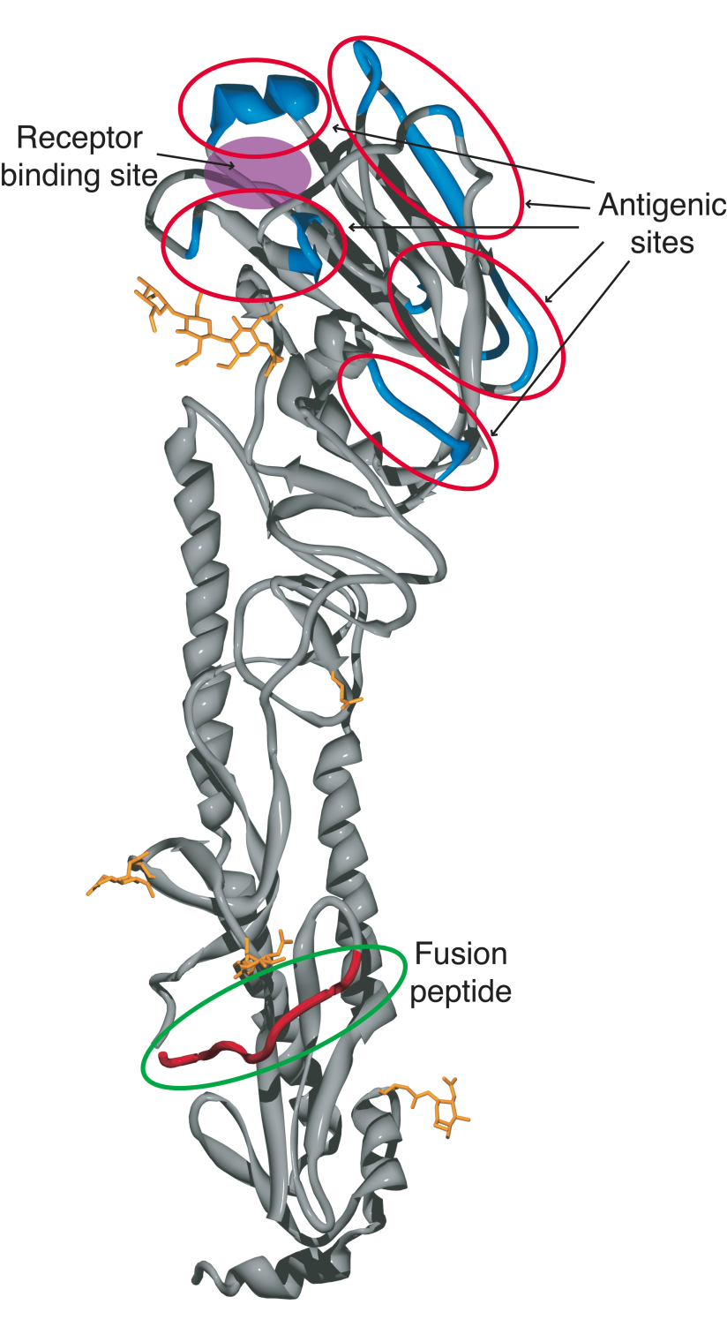
1918 INFLUENZA VIRUS HEMAGGLUTININ
Receptor binding site
Antigenic sites
Fusion peptide
Stevens et al. Science, 303,1866,2004

Slide 34
Sui, J.,Hwang, W. C., Perez, S., Wei, G., Aird, D., Chen, L. M., Santelli, E., Stec, B., Cadwell, G. Ali, M., Wan, H., Murakami, A., Yammanuru, A., Han, T., Cox, N. J., Bankston, L. A., Donis, R. O., Liddington, R. C., Marasco, W. A. (2009) Structural and functional bases for broad-spectrum neutralization of avian and human influenza A viruses. Nat Struct Mol Biol 16: 265-273.
CROSS-REACTIVE ANTIBODY BINDS TO STALK REGION OF HEMAGGLUTININ

Slide 35
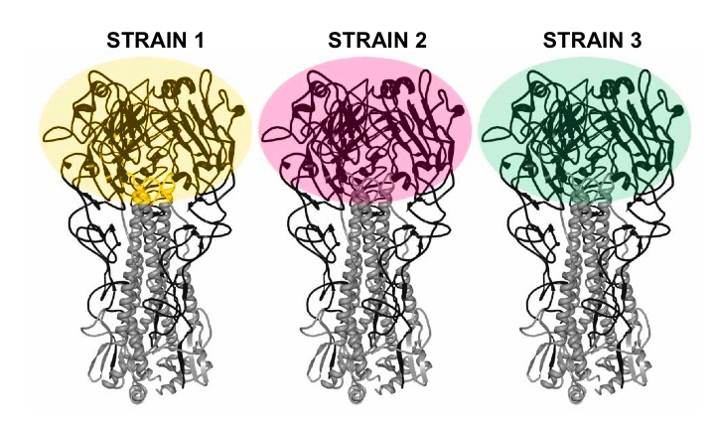
Strategy for boosting the antibody response against the conserved regions (grey) of the influenza virus hemagglutinin
Wang et al., Broadly protective monoclonal antibodies against H3 influenza viruses following sequential immunization with different hemagglutinins. PLoS Pathogen 2010

Slide 36
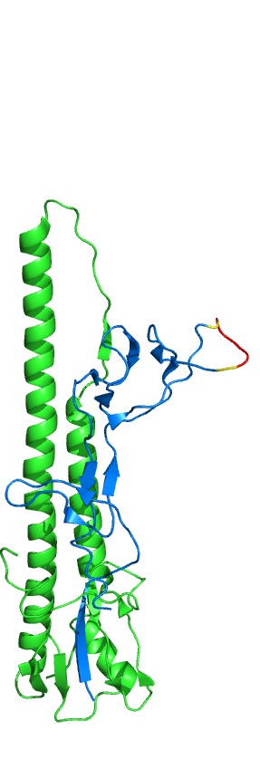
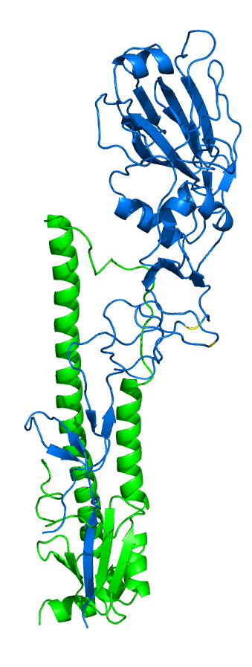
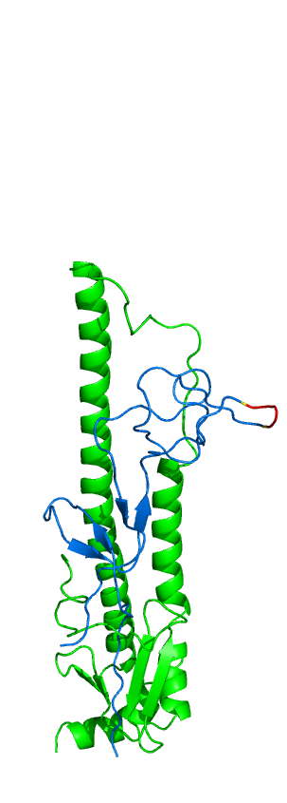
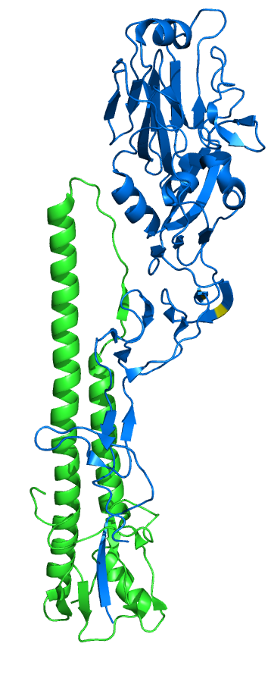
HEADLESS HEMAGGLUTININ
CONSTRUCTS AS VACCINES
PR8 HA
PR8 Headless HA
HK68 HA
HK68 Headless HA

Slide 37
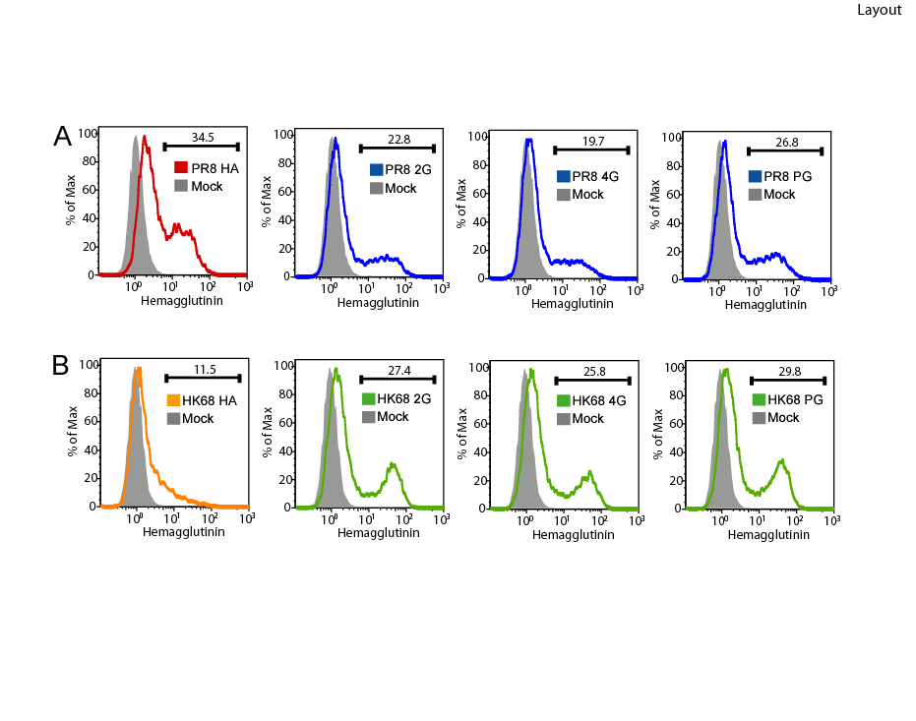
Headless HAs are detected at the cell surface

Slide 38
Headless HA vaccinated mice are protected from PR8 virus challenge
-10
Day post-challenge
-5
0
1
2
3
4
5
6
7
8
9
10
0
5
10
Average % weight loss
15
*
*
20
*
GAG only
*
25
*
GAG HK68 4G
30
GAG PR8 4G
GAG PR8 HA&NA
35

Slide 39
SUMMARY
A panel of antibodies that broadly neutralize influenza A viruses of different subtypes have been identified.
Vaccination of mice with a novel immunogen comprising the conserved HA stalk domain and lacking the globular head induces immune sera with broader reactivity than those obtained from mice immunized with a full length HA.
Furthermore, the headless HA vaccine (DNA and VLP) provides full protection against death and partial protection against disease following lethal viral challenge

