Slide 1
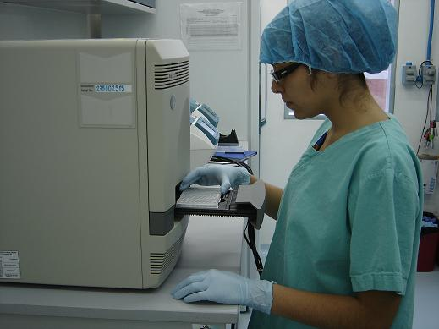
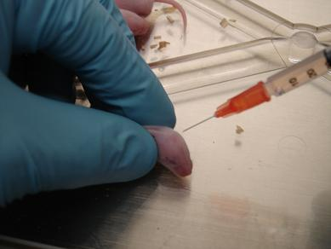
Diagnostic Capability on Exotic and Emerging Animal Diseases of the Mexico’s Official Laboratory Network
Anticipating Biosecurity Challenges of the Global Expansion of High Containment Biological Laboratories
Marco Antonio Rico Gaytán
Biosafety Department
marco.rico@senasica.gob.mx
July 12, 2011

Slide 2
Content
General Organization Chart
CPA Mision
CPA Functions
Laboratory network structure and characteristics
Currently diagnosticated diseases
Laboratory diagnostic techniques
Estimated costs

Slide 3
SENASICA General Chart
Ministry of Agriculture, Livestock, Rural Development, Fishery and Feeding
National Services Of Health, Safety And Agroalimentary Quality
SENASICA’S CHIEF DIRECTOR
SUPPORT STAFF
INTERNAL CONTROL BODY
PLANT HEALTH GENERAL DIRECTION
ANIMAL HEALTH GENERAL DIRECTION
PHYTO ZOOSANITARY INSPECTION GENERAL DIRECTION
AGROALIMENTARY SAFETY GENERAL DIRECTION
LEGAL/JURIDICAL GENERAL DIRECTION
ADMINISTRATION AND INFORMATICS GENERAL DIRECTION
STANDARDIZATION AND VERIFICATION DIRECTION
PROJECTS AND INSTITUTIONAL DEVELOPMENT DIRECTION
PLANNING DIRECTION
PROMOTION AND LIAISON UNIT

Slide 4
Animal Health Direction General Chart
ANIMAL HEALTH GENERAL DIRECTION
EPIDEMIOLOGY AND RISK ASSESSMENT
DIRECTION
(DEAR)
ANIMAL HEALTH CAMPAIGNS DIRECTION
(DCZ)
IMPORT AND EXPORT DIRECTION
(DIE)
CERTIFICATION, REGISTRATION AND SERVICES IN LIVESTOCK PRODUCTION DIRECTION
(DSCP)
AQUACULTURE AND FISHERY HEALTH DIRECTION (DSAP)
NATIONAL ANIMAL HEALTH VERIFICATION SERVICES CENTER
(CENAPA)
NATIONAL ANIMAL HEALTH DIAGNOSTIC SERVICES CENTER (CENASA)
MEXICO-USA COMMISSION FOR THE PREVENTION OF FOOT AND MOUTH DISEASE & OTHER EXOTIC ANIMAL DISEASES
(CPA)

Slide 5
CPA Mission and Functions
Mission
Protect terrestrial and acuatic animal species from exotic and emerging diseases and plagues, wich negatively impact on the livestock, fishery and acuatic patrimony and human health in Mexico.
Functions
Perform surveillance of exotic and emerging diseases .
Establish and coordinate active surveillance programs
(AI, SI, ND, CSF, BSE, Scrapie, CAE-MV, CBPP).
Enforce the diagnostic of fish, molluscs and crustaceans diseases.
Notes:
Esta diapo no me gusta

Slide 6
CPA Mission and Functions
Functions (cont.)
Promotion of disease reporting
Technical training (Laboratory Diagnostic , epidemiology surveillance)
Operate the program for the atention of health emergencies (Outbreaks)
Ensure and enhancement of the quality and efficiency of the laboratory diagnostic (infrastructure and procedures).

Slide 7
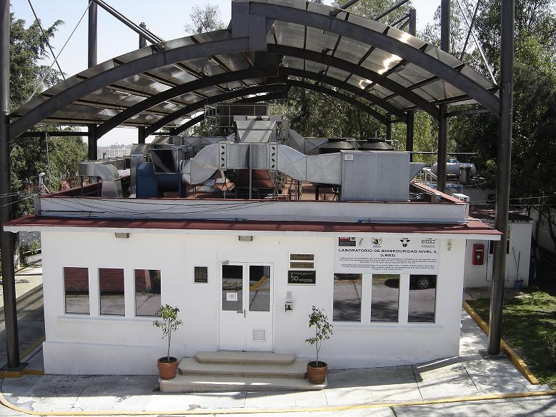
CPA Laboratory Network – BSL3

Slide 8
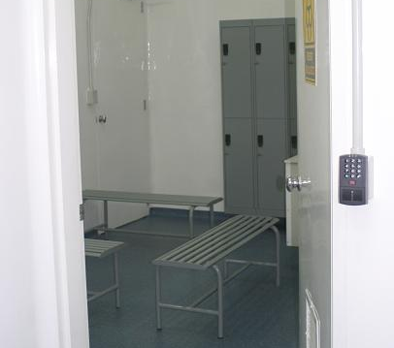
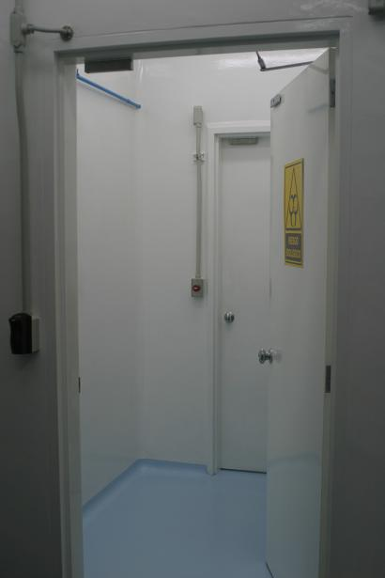
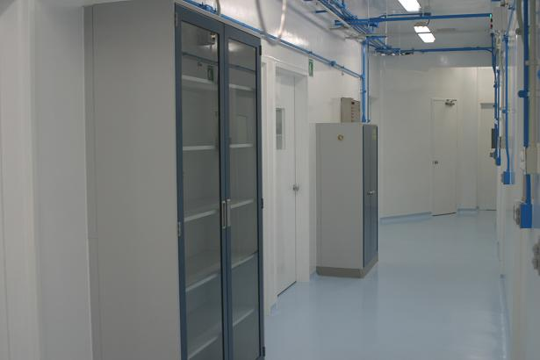
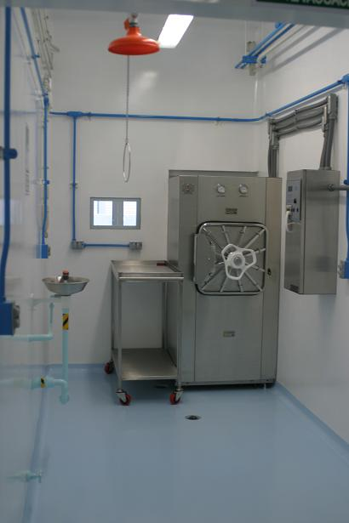
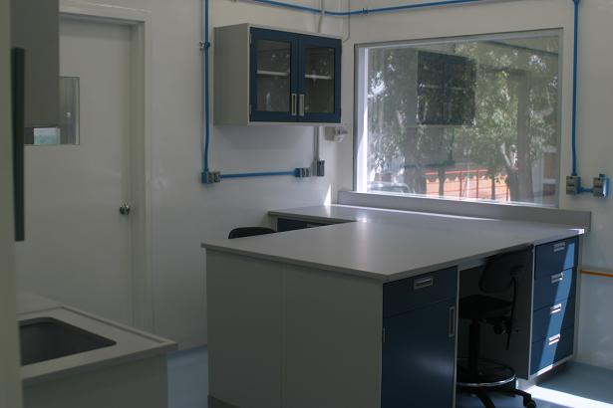
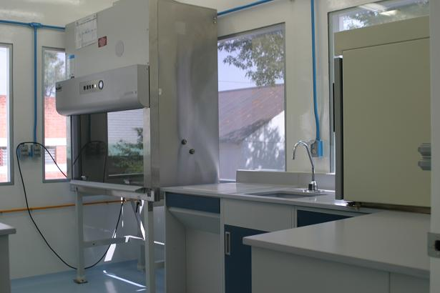
BSL3 – Containment

Slide 9
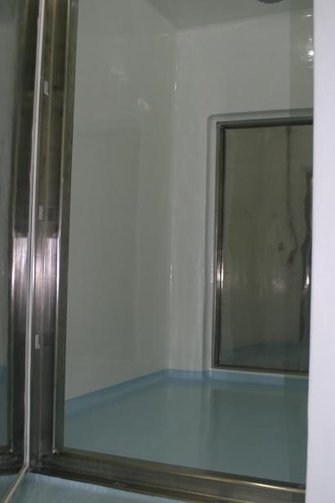
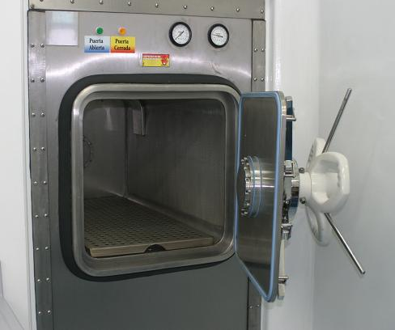
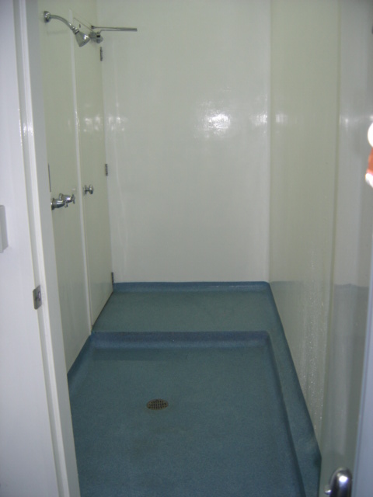
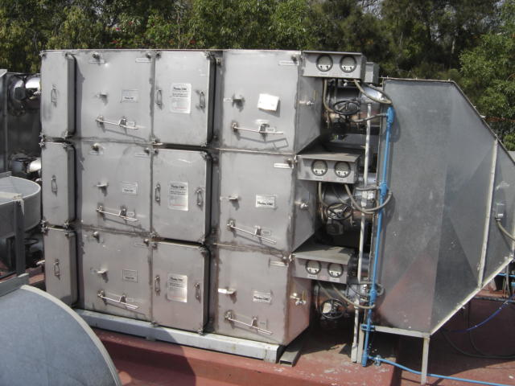
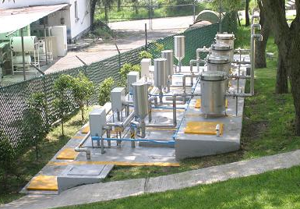
BSL3 – Containment

Slide 10
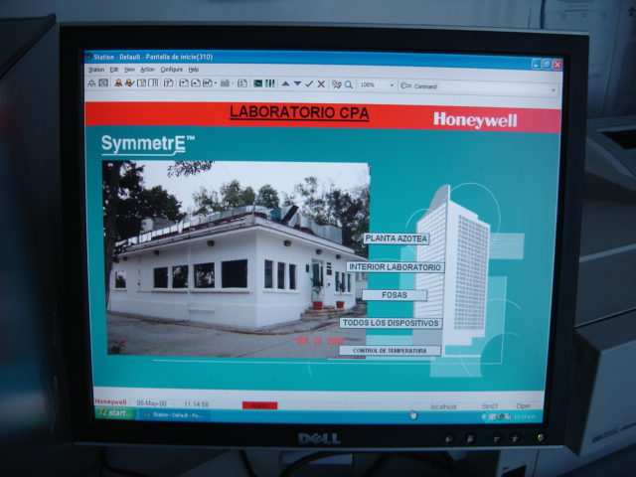
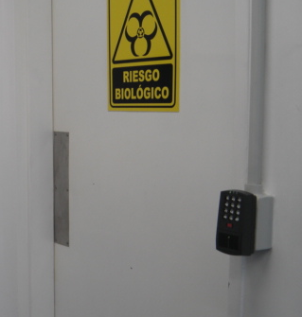
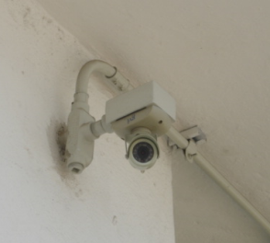
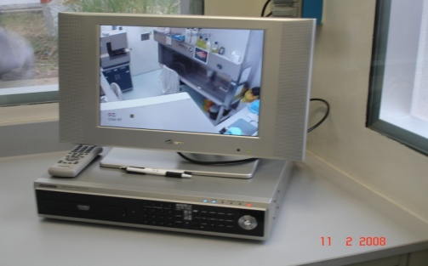
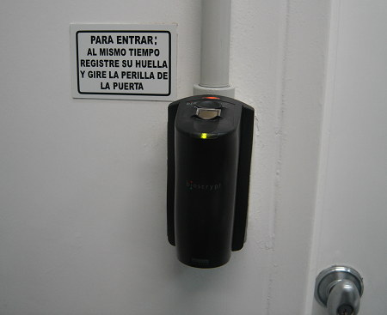
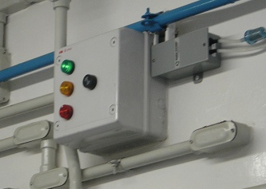
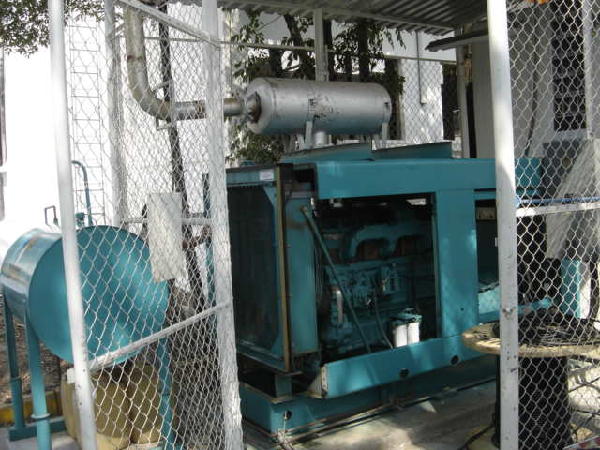
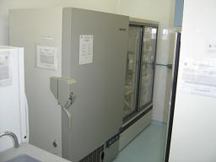
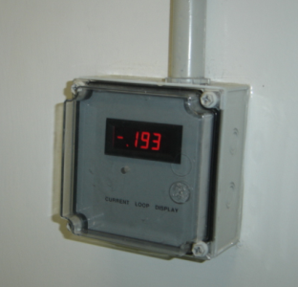
BSL3 – Biosecurity

Slide 11
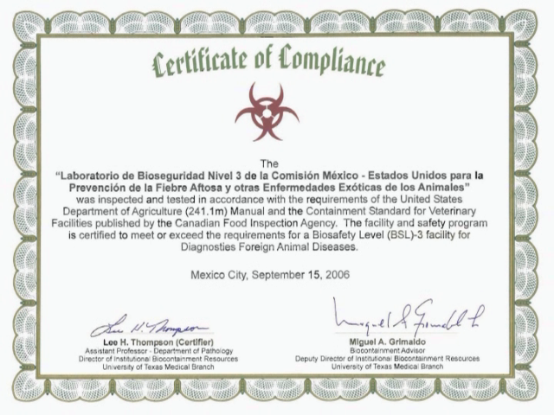

Slide 12
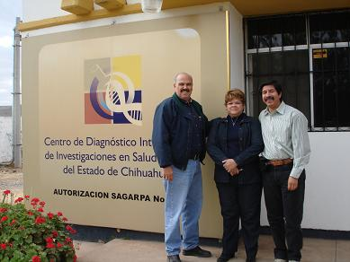
CPA Laboratory Network – Regional Labs
2005 – 2011: Construction - remodeling of 7 facilities
Agreement with local authorities
Biosafety level 2 (with improvements)
Very specific diagnostic tests (Equipment, reagents)
Location | Diagnosed Diseases
Aguascalientes, Ags. | BSE
Chihuahua, Chih. | BSE
Torreón, Coah. | BSE
El Salto, Jal. | AI, ND
Villahermosa, Tab. | AI, ND, BSE
Cholula, Puebla | AI, ND
Celaya, Guanajuato | AI, ND, Scrapie, BSE, CAE-MV

Slide 13
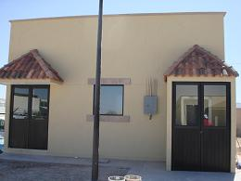
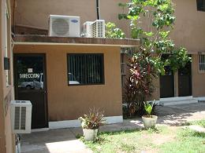
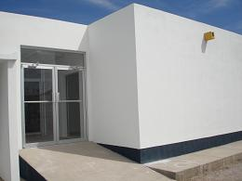
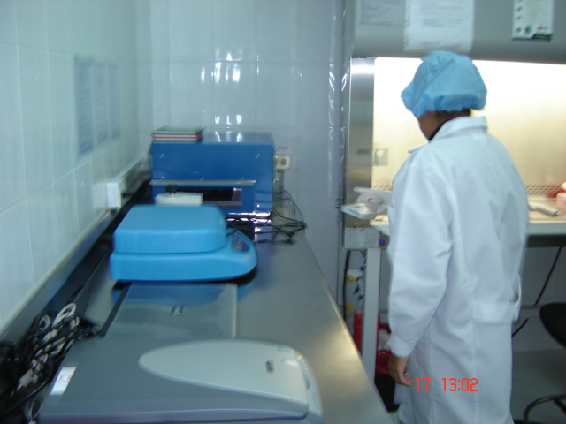
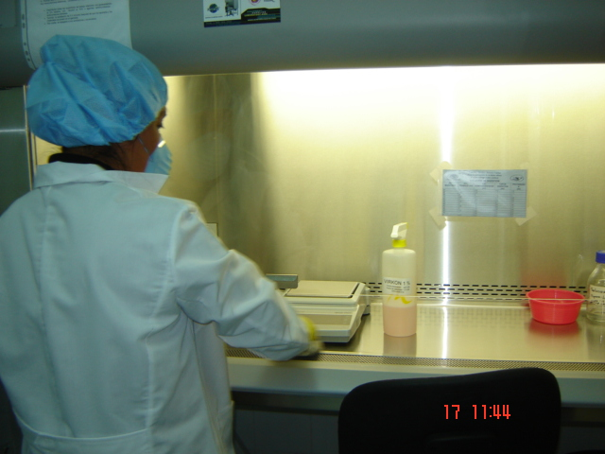
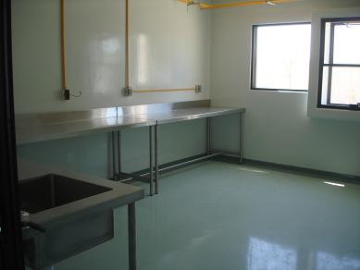
CPA Laboratory Network – Regional Labs

Slide 14
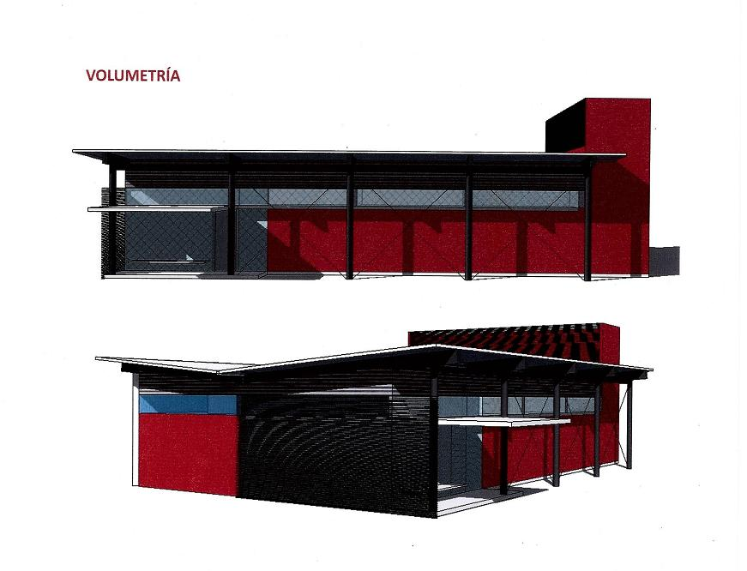
CPA Laboratory Network – Molecular Biology Labs
2009 - 2010: SENASICA’s proyect for construction of 16 facilities
13 laboratories under control of CPA
Biosafety level 2 (with improvements)
Diagnostic test based in molecular biology and serology:
Standard PCR
Real time PCR
Sequencing (only 3 labs)
ELISA test (comercial kits)
Diagnosis of CSF, AI, ND and Crustaceans diseases

Slide 15
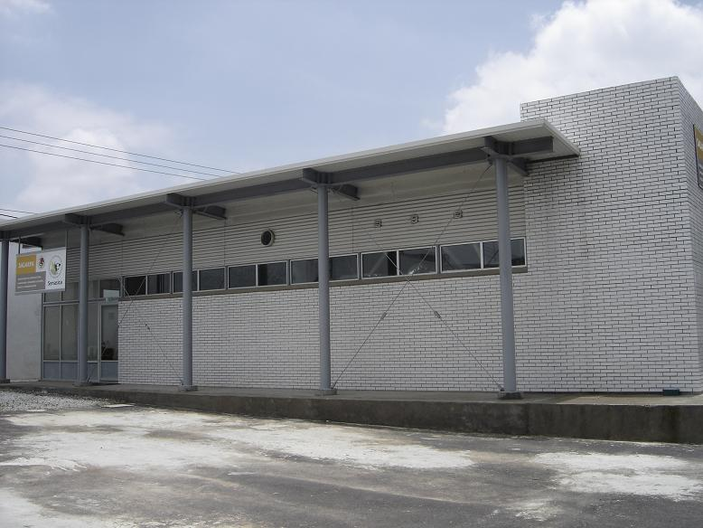
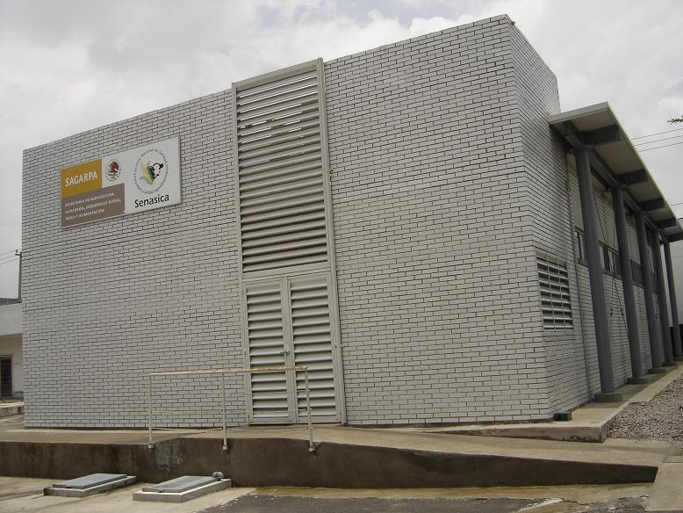
CPA Laboratory Network – Molecular Biology Labs

Slide 16
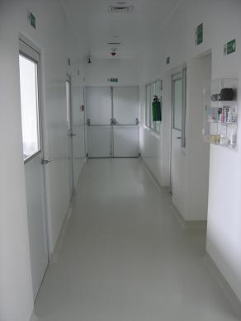
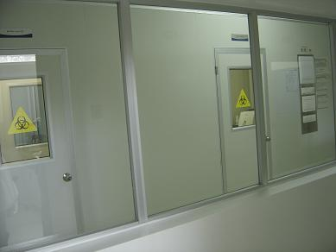
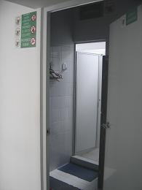
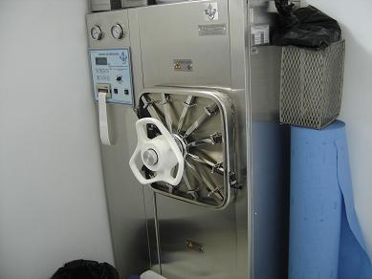
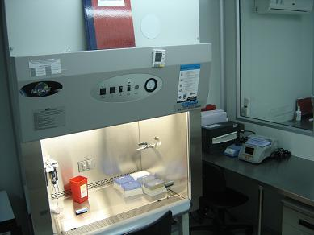
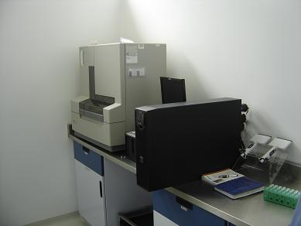
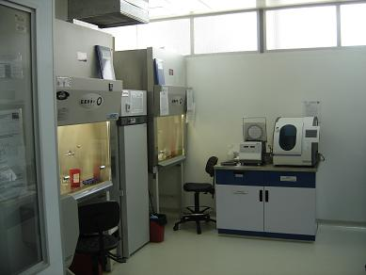
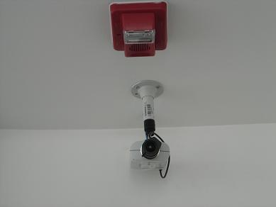
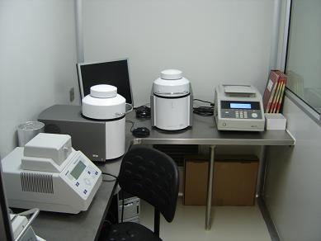
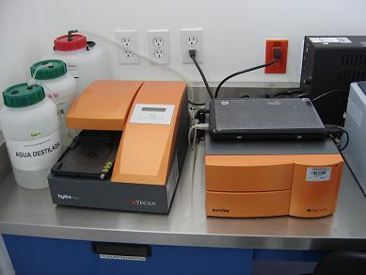
CPA Laboratory Network – Molecular Biology Labs

Slide 17
CPA Laboratory Network - Distribution
BSL3
1. CUAJIMALPA, D.F.
REGIONAL LABS
1. AGUASCALIENTES, AGS.
2. CHIHUAHUA, CHIH.
3. TORREÓN, COAH.
4. CELAYA, GTO.
5. EL SALTO, JAL.
6. CHOLULA, PUE.
7. VILLAHERMOSA, TAB.
MOLECULAR B. LABS
1. MEXICALI, B.C.N.
2. CAMPECHE, CAMP.
3. TUXTLA GUTIÉRREZ, CHIS.
4. CUAJIMALPA, D.F.
5. GÓMEZ PALACIO, DGO.
6. CHILPANCINGO, GRO.
7. ZAPOTLANEJO, JAL.
8. AJUCHITLÁN, QRO.
9. MATEHUALA, S.L.P.
10. HERMOSILLO, SON.
11. MATAMOROS, TAMPS.
12. JALAPA, VER.
13. MÉRIDA, YUC.

Slide 18
Current Diagnosis
No | Specie | Disease
1 | Multiple | Aujeszky’s disease
2 | Multiple | Bluetongue
3 | Multiple | Foot and mouth disease
4 | Multiple | New World screwworm (Cochliomyia hominivorax)
5 | Multiple | Rabies
6 | Multiple | Vesicular stomatitis
7 | Multiple | West Nile fever
8 | Apidae | Small hive beetle infestation (Aethina tumida)
9 | Aves | Avian influenza
10 | Aves | Newcastle disease
11 | Bovidae | Bovine spongiform encephalopathy
12 | Bovidae | Bovine viral diarrhoea
13 | Equidae | Eastern equine encephalomyelitis
14 | Equidae | Equine influenza
15 | Equidae | Equine viral arteritis
16 | Equidae | Venezuelan equine encephalomyelitis
17 | Equidae | Western equine encephalomyelitis

Slide 19
Current diagnosis
No | Specie | Disease
18 | Lagomorpha | Myxomatosis
19 | Lagomorpha | Rabbit haemorrhagic disease
20 | Ovidae and Capridae | Caprine arthritis/encephalitis and Maedi-visna
21 | Ovidae and Capridae | Contagious ectima
22 | Ovidae and Capridae | Scrapie
23 | Suidae | Classical swine fever (hog cholera)
24 | Suidae | Porcine Circovirus
25 | Suidae | Porcine reproductive and respiratory syndrome
26 | Suidae | Swine influenza
27 | Suidae | Swine vesicular disease
28 | Suidae | Vesicular exanthema of swine
29 | Crustaceans | Infectious hypodermal and haematopoietic necrosis
30 | Crustaceans | Taura syndrome
31 | Crustaceans | White spot disease
32 | Crustaceans | White tail disease
33 | Crustaceans | Yellowhead disease

Slide 20
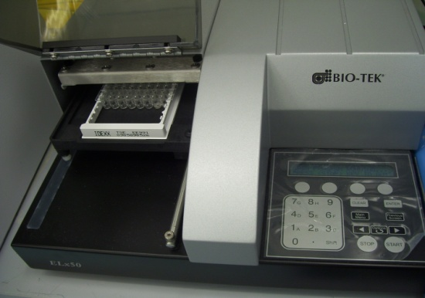
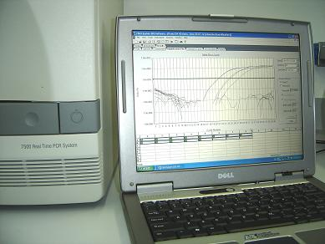
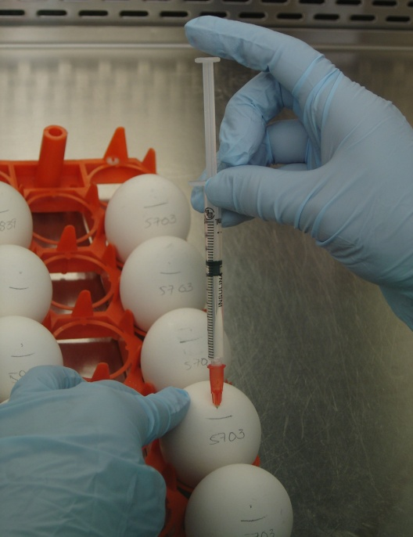
Laboratory Test
No | Abr | Test
1 | AGID | Agar gel immunodiffusion
2 | Agent Id. | Agent identification
3 | CF | Complement fixation
4 | ELISA | Enzyme-linked immunosorbent assay
5 | HI | Haemagglutination inhibition
6 | IHC | Immunohistochemical
7 | IFA | Indirect fluorescent antibody
8 | ICPI | Intracerebral pathogenicity index
9 | IVPI | Intravenous pathogenicity index
10 | MDT | Mean death time
11 | NPLA | Neutralizing peroxidase-linked assay
12 | SEQ | Nucleid Acid Sequencing
13 | PRN | Plaque reduction neutralisation
14 | PCR | Polimerase chain reaction
15 | RT | Rapid test (Priostrip)
16 | VICC | Virus isolation in cell culture
17 | VIEE | Virus isolation in embrionated eggs
18 | VILA | Virus isolation in laboratory animals
19 | VN | Virus neutralisation
20 | WB | Western Blot

Slide 21
Laboratory Test
No. | Disease | Agent Id | AGID | CF | ELISA | HI | IHC | IFA | ICPI | IVPI | MDT | NPLA | SEQ | PRN | PCR | RT | VICC | VIEE | VILA | VN | WB | Total
1 | Aujeszky’s disease |  |  |  | X |  |  |  |  |  |  |  |  |  | X |  | X |  | X |  |  | 4
2 | Bluetongue |  | X |  | X |  |  |  |  |  |  |  |  |  | X |  | X | X |  |  |  | 5
3 | Foot and mouth disease |  |  | X | X |  |  |  |  |  |  |  |  |  | X |  | X |  |  |  |  | 4
4 | New World screwworm (Cochliomyia hominivorax) | X |  |  |  |  |  |  |  |  |  |  |  |  |  |  |  |  |  |  |  | 1
5 | Rabies |  |  |  |  |  |  | X |  |  |  |  |  |  |  |  | X |  | X |  |  | 3
6 | Vesicular stomatitis |  |  | X | X |  |  |  |  |  |  |  |  |  | X |  | X |  | X | X |  | 6
7 | West Nile fever |  |  |  | X |  |  |  |  |  |  |  |  | X | X |  | X |  | X |  |  | 5
8 | Small hive beetle infestation (Aethina tumida) | X |  |  |  |  |  |  |  |  |  |  |  |  |  |  |  |  |  |  |  | 1
9 | Avian influenza |  | X |  | X | X |  |  |  | X |  |  | X |  | X |  |  | X |  |  |  | 7
10 | Newcastle disease |  |  |  |  | X |  |  | X | X | X |  | X |  | X |  |  | X |  |  |  | 7
11 | Bovine spongiform encephalopathy |  |  |  | X |  | X |  |  |  |  |  |  |  |  | X |  |  |  |  |  | 3
12 | Bovine viral diarrhoea |  |  |  |  |  |  |  |  |  |  |  |  |  | X |  | X |  |  | X |  | 3
13 | Eastern equine encephalomyelitis |  |  |  |  | X |  |  |  |  |  |  |  |  | X |  | X |  | X |  |  | 4
14 | Equine influenza |  | X |  |  | X |  |  |  |  |  |  |  |  | X |  | X |  |  |  |  | 4
15 | Equine viral arteritis |  |  |  | X |  |  |  |  |  |  |  |  |  |  |  |  |  |  |  |  | 1
16 | Venezuelan equine encephalomyelitis |  |  |  |  | X |  |  |  |  |  |  |  |  | X |  | X |  | X |  |  | 4
17 | Western equine encephalomyelitis |  |  |  |  | X |  |  |  |  |  |  |  |  | X |  | X |  | X |  |  | 4
18 | Myxomatosis |  | X |  |  |  |  |  |  |  |  |  | X |  | X |  | X | X | X |  |  | 6
19 | Rabbit haemorrhagic disease |  |  |  |  | X |  |  |  |  |  |  |  |  |  |  |  |  | X |  |  | 2
20 | Caprine arthritis/encephalitis and Maedi-visna |  |  |  | X |  |  |  |  |  |  |  |  |  |  |  |  |  |  |  |  | 1
21 | Contagious ectima |  |  |  |  |  |  |  |  |  |  |  |  |  | X |  | X |  | X |  |  | 3
22 | Scrapie |  |  |  | X |  | X |  |  |  |  |  |  |  |  |  |  |  |  |  | X | 3
23 | Classical swine fever (hog cholera) |  |  |  | X |  |  |  |  |  |  | X | X |  | X |  | X |  |  | X |  | 6
24 | Porcine Circovirus |  |  |  |  |  |  |  |  |  |  |  |  |  | X |  | X |  |  |  |  | 2
25 | Porcine reproductive and respiratory syndrome |  |  |  |  |  |  |  |  |  |  |  |  |  | X |  | X |  |  |  |  | 2
26 | Swine influenza |  | X |  |  |  |  |  |  |  |  |  | X |  | X |  | X |  |  |  |  | 4
27 | Swine vesicular disease |  |  | X | X |  |  |  |  |  |  |  | X |  | X |  | X |  | X |  |  | 6
28 | Vesicular exanthema of swine |  |  | X | X |  |  |  |  |  |  |  |  |  |  |  | X |  | X |  |  | 4
29 | Infectious hypodermal and haematopoietic necrosis |  |  |  |  |  |  |  |  |  |  |  |  |  | X |  |  |  |  |  |  | 1
30 | Taura syndrome |  |  |  |  |  |  |  |  |  |  |  |  |  | X |  |  |  |  |  |  | 1
31 | White spot disease |  |  |  |  |  |  |  |  |  |  |  |  |  | X |  |  |  |  |  |  | 1
32 | White tail disease |  |  |  |  |  |  |  |  |  |  |  |  |  | X |  |  |  |  |  |  | 1
33 | Yellowhead disease |  |  |  |  |  |  |  |  |  |  |  |  |  | X |  |  |  |  |  |  | 1
 |  | 2 | 5 | 4 | 13 | 7 | 2 | 1 | 1 | 2 | 1 | 1 | 6 | 1 | 24 | 1 | 19 | 4 | 12 | 3 | 1 | 110

Slide 22
Estimated costs
Very hard to stablish → a lot of variables:
All the CPA services are for free
Different funding sources (federal and comission)
Different buying pathways (public tender, direct acquisition)
Laboratory materials and reagents are imported (>50%)
Imported laboratory equipment (95%)
Dependency of local distribuitors (exclusive or authorized)

Slide 23
Estimated costs
Some gross calculations…
Estimated amount for the Laboratory Network operation in one year (ideal):
USD $27 millions
Test | Cost (US dlls)*
Hemmaglutination inhibition | > $1
CSF ELISA | $5
Virus isolation in embrionated eggs | $10
Real time PCR | $20 - $95
BSE rapid test (Priostrip) | $25
BSE western blot | $100
Sequencing | $120
* Includes only the cost of materials and reagents

Slide 24
