Slide 1


Coping with deadly viruses
WHO Collaborating Centre for Research and Training on Viral Zoonoses
WHO Collaborating Centre for Research and Training on Viral Zoonoses
Faculty of Medicine, Chulalongkorn University
Supaporn Wacharapluesadee
Anticipating Biosecurity Challenges of the Global Expansion
Of High Containment Biological Laboratories
Istanbul, Turkey
11-13 July 2011
Notes:
I would like to introduce our work and briefly summarize what we have been doing at our Chulalongkorn University, WHO cc viral zoonoses

Slide 2










WHO Collaborating Centre for Research and Training on Viral Zoonoses

Slide 3
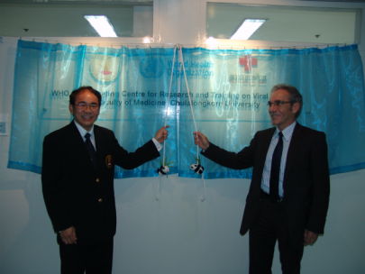
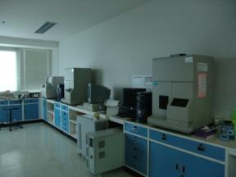
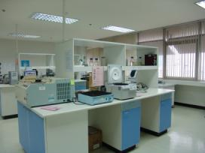
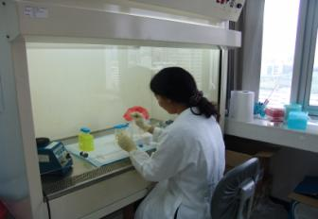
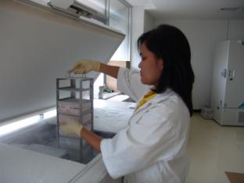
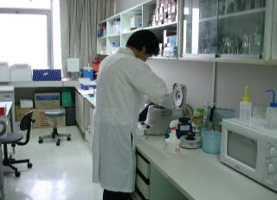
WHO Collaborating Centre for Research and Training on Viral Zoonoses
Faculty of Medicine, Chulalongkorn University
WHO Collaborating Centre for Research and Training on Viral Zoonoses
Notes:
Our center was established as WHO cc. Viral zoonoses in 2009 as a result of our continuing work on rabies, Nipah and other encephalitis viruses since 1989. Our center is also a referral hospital for patients with encephalitis

Slide 4
Active Surveillance in Animals joint MD-DVM-wildlife activities
WHO Collaborating Centre for Research and Training on Viral Zoonoses
During 2002-2010
Bat survey for
Lyssavirus Nipah virus
corona virus
Grants:
Thailand Research fund
Partial funding from EcoHealth Alliance (2010)
From 2011 –
Unified team under One Health program
Animal survey
wildlife: bats/terrestrial
domestic: pigs
Vector borne diseases
Teaching modules
human and animal health
personnel
Grants:
Thailand Research Fund
Notes:
Joint Active Surveillance in Animals has been done since 2002. This year 2011, three components human, domestic and wildlife animals are working together using Nipah virus as a study model.
Today I would like to focus on the topics of rabies diagnosis in patients and bat surveillance

Slide 5
Coping with deadly viruses
WHO Collaborating Centre for Research and Training on Viral Zoonoses
Rabies virus
Nipah virus
Discovery new pathogen
Notes:
I would like to introduce our work and briefly summarize what we have been doing at our Chulalongkorn University, WHO cc viral zoonoses

Slide 6
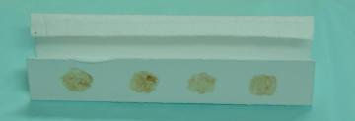
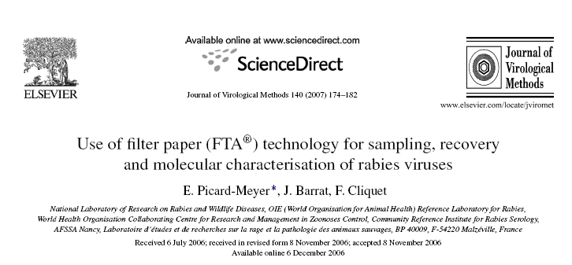
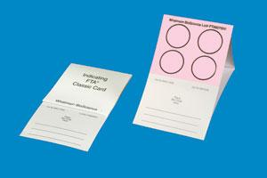
WHO Collaborating Centre for Research and Training on Viral Zoonoses
Case study in safe diagnostics: rabies
222 days storage at room temperature
Wacharapluesadee S, Phumesin P, Hemachudha T.
Dried brain spot in the diagnosis of human and animal rabies. Clin Infect Dis 2003; 36:674-5.
rapidly inactivates rabies virus after a 2 h contact
Notes:
We found that brain tissue can be stored on filter paper for more than 200 days and the results remain reliable.
Other report in 2007, FTA card was evaluated for the shipment, storage and detection of RNA rabies viruses by heminested PCR. It rapidly inactivates rabies virus after a 2 h contact with FTA® paper.

Slide 7
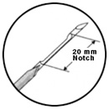
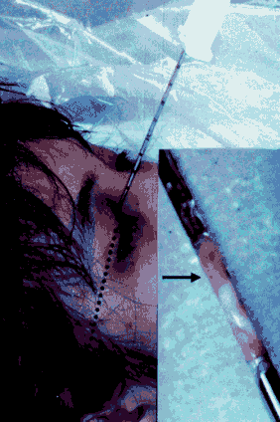
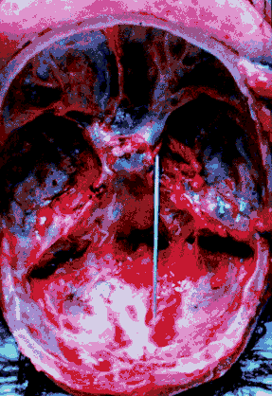

CaseStudy: Safe biopsy of infectious tissue
WHO Collaborating Centre for Research and Training on Viral Zoonoses
Lancet, 1999
Using trucut needle inserted through transorbital fissure into a cranial cavity.
www.cueid.org >>e-learning>>vido-clip
Notes:
In case of post-mortem diagnosis, if the full autopsy can not be performed, brain tissue can be collected by Necropsy method.
It can be done by using a trucut needle inserted through the superior orbital fissure into a cranial cavity.

Slide 8
WHO Collaborating Centre for Research and Training on Viral Zoonoses
Case study: diagnostic imaging for dangerous infections
Day 6 post-Inoculation
with rabies virus
ex vivo image of mice brain in day 6 post inoculation
artificial microRNAs can retard the spread of rabies virus
Excited wavelength : 535 nm
Emitted wavelength : 600 nm
pAAV-RFP + CVS
pAAV-RFP-miR + CVS
Intracerebral inoculation into left frontal lobe
with approximately 1,000 transfected cells / 30 μl
Dr.Nipan Israsena
Dr.Aekkapol Mahavihakanont
Phatthamon Virojanapirom

Slide 9
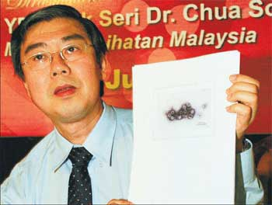
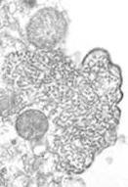
Nipah virus
WHO Collaborating Centre for Research and Training on Viral Zoonoses
Genus Henipavirus
  Newly discovered virus, first found in 1998
  Related to Hendra virus
BSL4 agent
Severe, rapidly progressive
encephalitis in humans
  High mortality rate (40-70%)
Severe, respiratory disease in pigs
1998:Malaysia
BSL4 agent
Notes:
Nipah virus is a zoonotic Biosafety Level 4 (BSL4) agent.
It was first found in 1998 after the first outbreak in Malaysia.
It causes severe, rapidly progressive encephalitis in humans with high mortality rate (40% in Malaysia outbreak and 70% in Bangladesh).
It causes a severe respiratory illness in pigs.

Slide 10
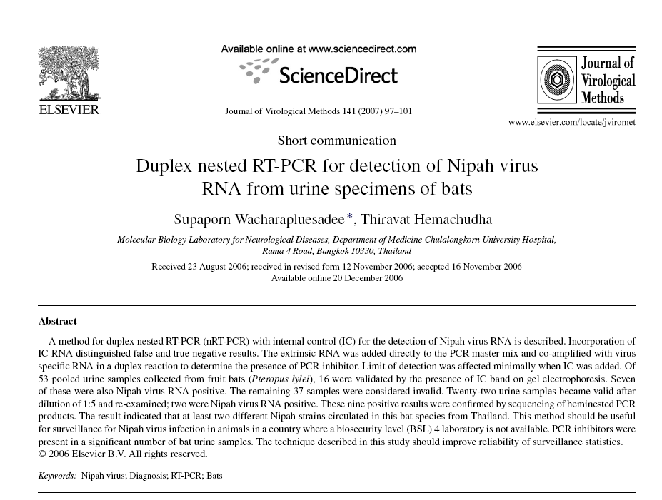
WHO Collaborating Centre for Research and Training on Viral Zoonoses
Notes:
There is no Biosafety level 4 laboratory in Thailand. To study the Nipah virus infection among bats in Thailand, we developed duplex nested RT-PCR method that can detect low amount of viral RNA in urine, saliva, serum and blood from bats.

Slide 11
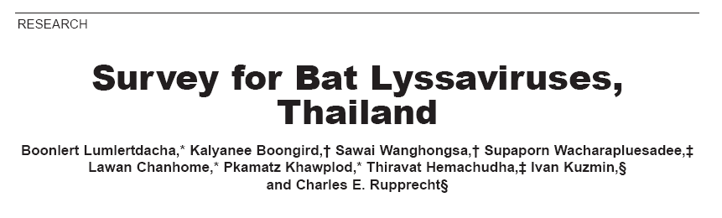
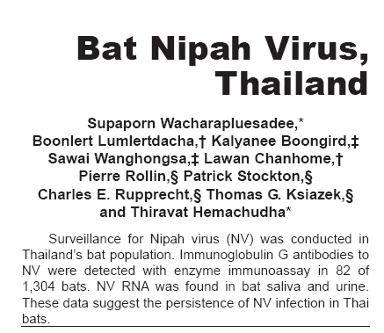
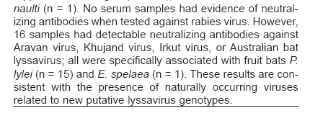
Bat research in Thailand
WHO Collaborating Centre for Research and Training on Viral Zoonoses
Notes:
From our first survey we study both Nipah and Lyssa viruses, antibody against lyssavirus were found which could not match with any known genotypes. Both antibody to Nipah virus and viral RNA were found from bat specimens.

Slide 12
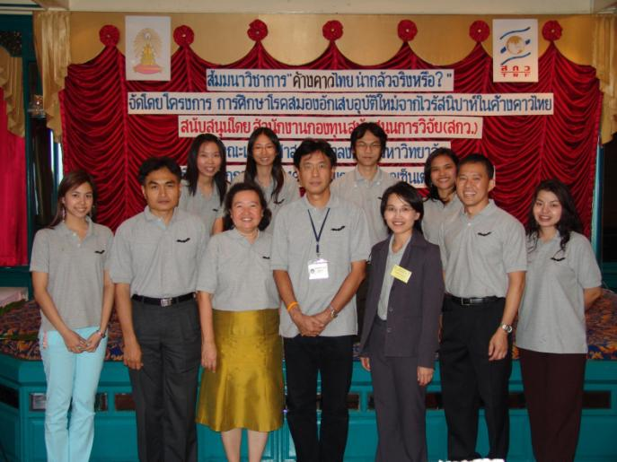
Bat Team: 2002
WHO Collaborating Centre for Research and Training on Viral Zoonoses
Notes:
Our team including Veterinarian doctor, Medical doctor, Scientist and zoologist from wildlife department.

Slide 13

Discovery of viral pathogens by Metagenomics analysis using NGS

