Slide 1
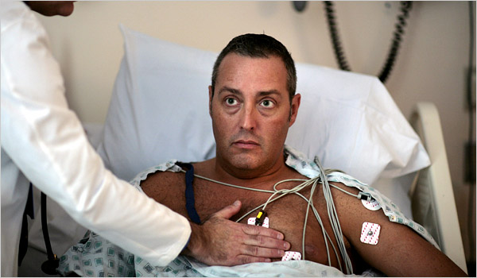
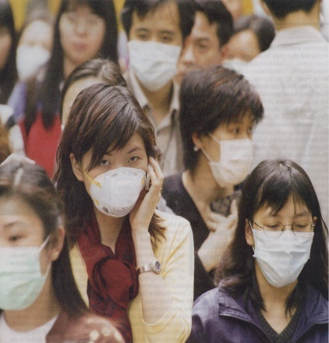
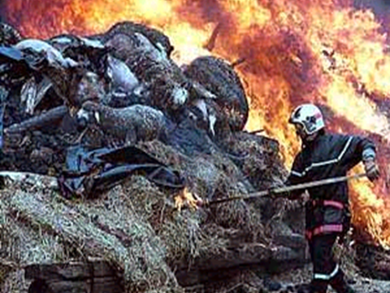
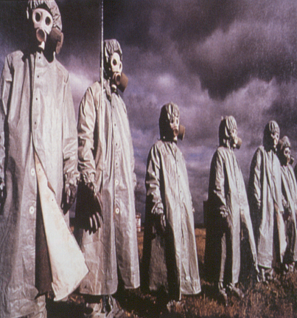

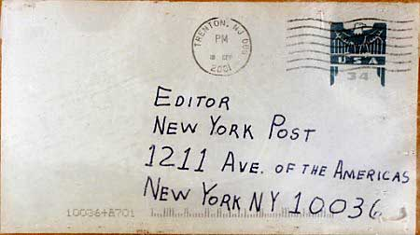
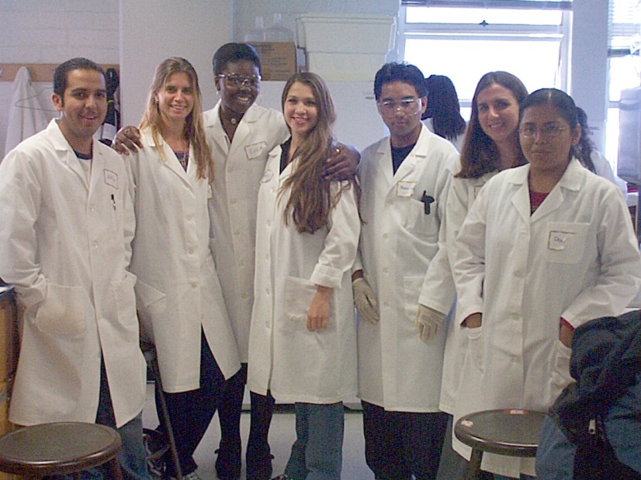
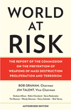

‘Enlightened Leadership’ more powerful than guns, gates and guards
David R. Franz D.V.M., Ph.D.

Slide 2
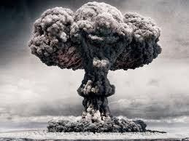
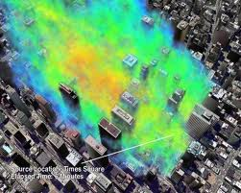
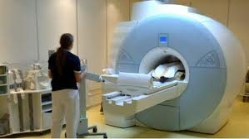
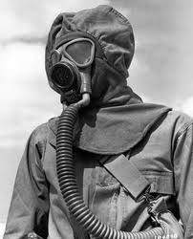
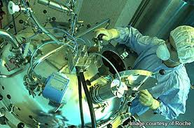

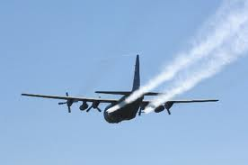
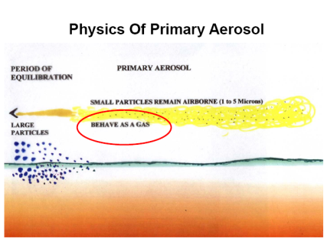
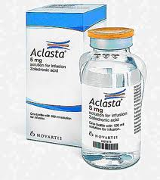
Preserving the ‘good’ of powerful science: …in a dangerous world
Martin Shubik,
Accident
Nature
Intent

Slide 3


Historically….it was Lab Biosafety
1940s - 2001
Lessons learned from USG offensive program
Dr. Arnold G. Wedum (Camp Detrick)
Biosafety in Microbiological and Biomedical Laboratories (BMBL)
Facilities, Equipment & Procedures
“To further reduce the potential for laboratory-
associated infections, the guidelines presented here
should be considered minimal guidance for
containment. They must be customized for each
individual laboratory and can be used in conjunction
with other available scientific information.”
1st Edition
1984

Slide 4
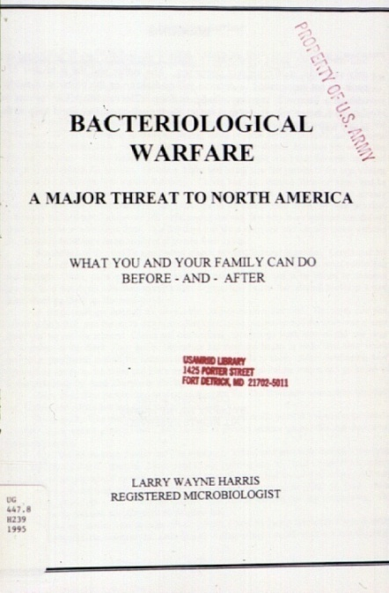
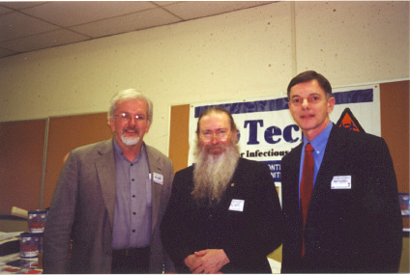
Then in 1996….Biosecurity
“The Select Agent Rule”
Anti-Terrorism and Effective Death Penalty Act of 1996
Larry Wayne Harris
Selected agents to be controlled
Registration of laboratories for agent transfer
A ‘bio-unabomber’ ?

Slide 5
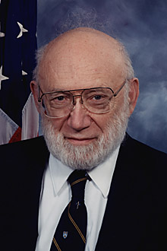
“No technical solution…”
“There is no technical solution to the problem of biological weapons. It needs an ethical, human, and moral solution if it’s going to happen at all. Don’t ask me what the odds are for an ethical solution, but there is no other solution.”
<Then Dr. Lederberg paused and said,>
“But would an ethical solution appeal to a sociopath?”
The New Yorker 1998

Slide 6
The USA Patriot Act: 2001 & The Public Health Security and Bioterrorism Preparedness and Response Act of 2002
Title II: Enhancing controls on dangerous biological agents and Toxins
Regulatory control of certain biological agents and toxins (BSAT)
Regulation of transfers of BSAT
Possession and use of BSAT
Registration (of persons) who work with BSAT
Safeguard and security requirements for registered persons
Inspections
Disclosure of information…re databases
Civil money penalty
Notification in event of release of BSAT
Reporting requirements
Not required in 1996 Act
April 2008---9,918 individuals approved to work with Select Agents
May 2008---324 entities registered with CDC (gov, corp, acad, NGOs)

Slide 7

In the face of an unknown threat, the science community tried to help… …and to protect itself.
The birth of the “dual-use” dilemma
2003

Slide 8
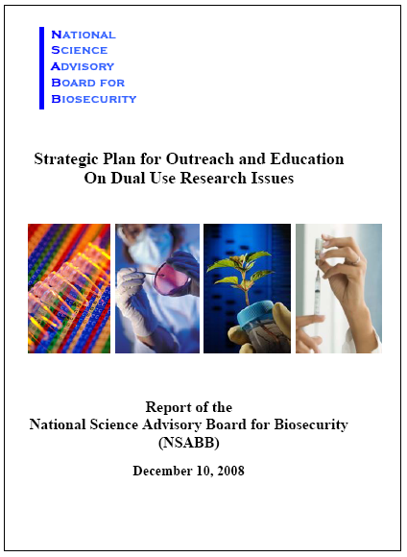
NSABB Reports
Notes:
Levy:
To date, we have submitted 4 reports to the US government.
Our first report involved biosecurity concerns surrounding the synthesis of select agents.
In our second report we proposed an oversight framework for dual use research in the United States.
We have also proposed a strategic plan for outreach and education on dual use research and our most recent report addresses the issue of personnel reliability among select agent researchers.

Slide 9
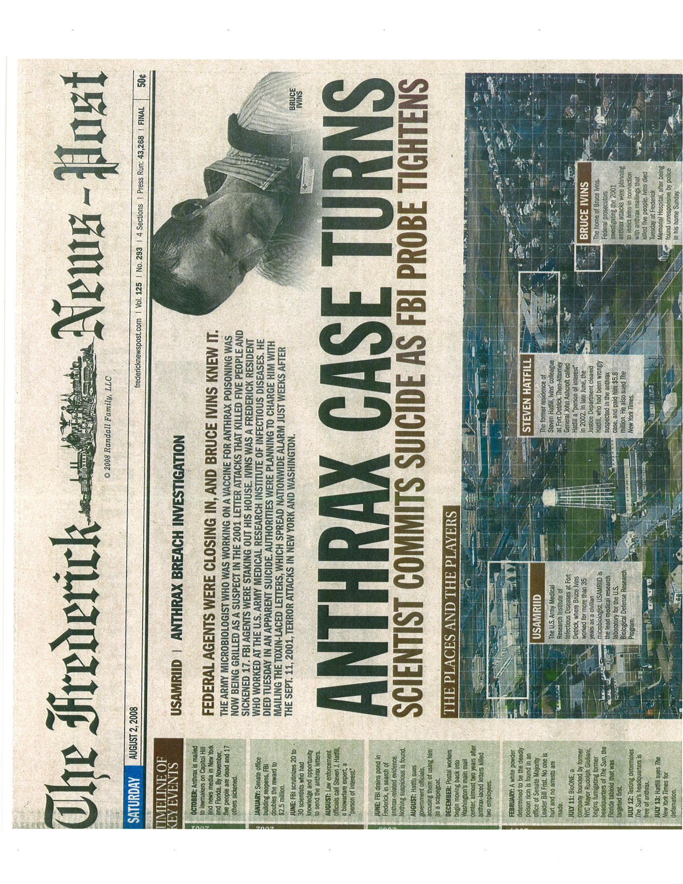

Slide 10
difficult
Assuming the FBI is correct….
The insider threat is more serious than I believed…

Slide 11
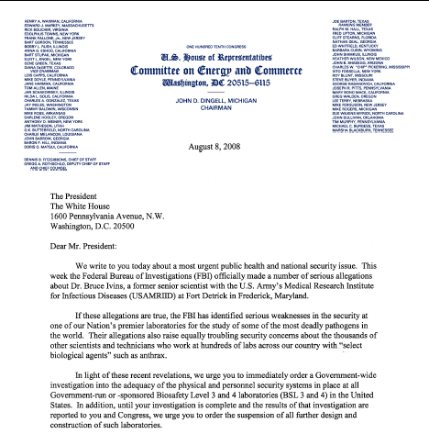
The Dingell – Stupak Letter

Slide 12
The Dingell – Stupak Letter

Slide 13
Biological ‘Surety’ 2008
Biological ‘Surety’
Biological Safety
Physical Security
Agent Accountability
Personnel Reliability*
* Requires that persons with access to select agents are “mentally
alert, mentally and emotionally stable, trustworthy, and physically
competent”. AR 50-1

Slide 14
Personnel Reliability: AR 50-1 28 July 08…..AR 50-X since 2004
2–8. Other disqualifying factors Any of the following traits,, based on the certifying official’s informed judgment.
d. Inappropriate attitude, conduct, or behavior...
(1) Negligence or delinquency in performance of duty. (2) … a contemptuous attitude toward the law, regulations, or other duly constituted authority…. (3) Poor attitude or lack of motivation… arrogance, inflexibility, suspiciousness, hostility, flippancy toward BPRP responsibilities, and extreme moods or mood swings. (4) Aggressive/threatening behavior toward other individuals. (5) Attempting to conceal PDI [potentially disqualifying information] from certifying officials

Slide 15
Personnel Reliability: AR 50-1 28 July 08…..AR 50-X since 2004
2–8. Other disqualifying factors Any of the following traits,, based on the certifying official’s informed judgment.
d. Inappropriate attitude, conduct, or behavior...
(1) Negligence or delinquency in performance of duty. (2) … a contemptuous attitude toward the law, regulations, or other duly constituted authority…. (3) Poor attitude or lack of motivation… arrogance, inflexibility, suspiciousness, hostility, flippancy toward BPRP responsibilities, and extreme moods or mood swings. (4) Aggressive/threatening behavior toward other individuals. (5) Attempting to conceal PDI [potentially disqualifying information] from certifying officials
“This reminds me of many scientists I know. Really smart people are often just a tiny bit weird and quirky, in case you haven’t noticed…and often irritating…” web blog editorial

Slide 16
Fear the Slippery Slope
Biological ‘Select Agent’ Research
Infectious Disease Research
?
Synthetic Biology
?
?
Nanotechnology
?
Understanding of the Human Immune System

Slide 17
Over Regulation could impact…
Our ability to provide
Healthcare
Food and agriculture
Energy
Our nations’ economies
Our ability to complete globally
The security of our nations
It could take 5-10 years to know that we have over-regulated… …and 15-20 years to turn it around

Slide 18
The ‘insider threat’
Enlightened Leadership
Regulatory Oversight
Lead with Science
Quality Research
Emphasis on Safety
Vision
Education
Responsibility
Accountability
Honesty
Transparency
Ethics
A Culture of Trust!!
Lead with Security
Guns, Gates and Guards
Background Checks
Psychological Evaluation
Lists & Pathogen Control
A Culture of Mistrust?
Some labs will need some of
the right column, but every
lab can benefit from the left…

Slide 19

The ‘insider threat’
Enlightened Leadership
Regulatory Oversight
Lead with Science
Quality Research
Emphasis on Safety
Vision
Education
Responsibility
Accountability
Honesty
Transparency
Ethics
A Culture of Trust and Accountability
Lead with Security
Guns, Gates and Guards
Background Checks
Psychological Evaluation
Lists & Pathogen Control
Which will make us more productive, safer…and more secure?

Slide 20
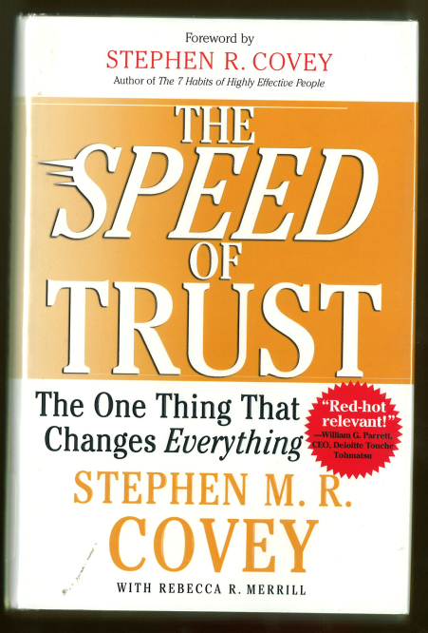
The Value of Trust
High Trust Organization
Increased Value
Accelerated Growth
Enhanced Innovation
Improved collaboration
Stronger Partnering
Better Execution
Heightened Loyalty
Low Trust Organization
Redundancy
Bureaucracy
Politics
Disengagement
Turnover
Churn
Fraud
1-Leadership can make this much difference!
2-Are we doing all we can to encourage this kind of leadership?
3-Are we doing all we can to develop and maintain high-trust organizations?

Slide 21


We can work together globally…
Life sciences community takes back momentum:
Transparency in science
Communicate, Educate, Recruit…Lead!
Demonstrate a Culture of Responsibility
Build Public Trust
Work with “the Regulators” and concerned citizens to:
Carefully consider real risk
Carefully consider real value of all proposed solutions
Consider the entire cost of all solutions
Real costs: Equipment, scientist time, Decreased ‘tooth-to-tail’ ratio
Intangible costs: Scientists move to other fields, Research offshore
Seek solutions that limit frustration to scientists

Slide 22
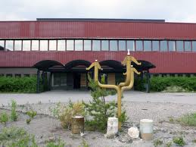
ZERO INSIDER RISK IS POSSIBLE in individual laboratories like this one…

Slide 23
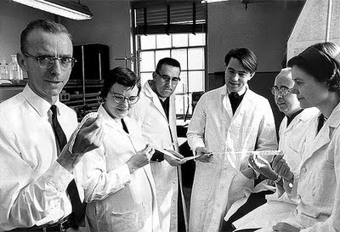

But we can’t afford Zero Risk
dfra
Really good leadership from ALL of us, at all levels
WILL make a difference….
in our labs…in our nations…and globally.

