Slide 1
Requirements for and Challenges associated with BSL4 laboratories
Dr Greg Smith
Microbiological Security Manager
Australian Animal Health Laboratory
Geelong, Victoria

Slide 2
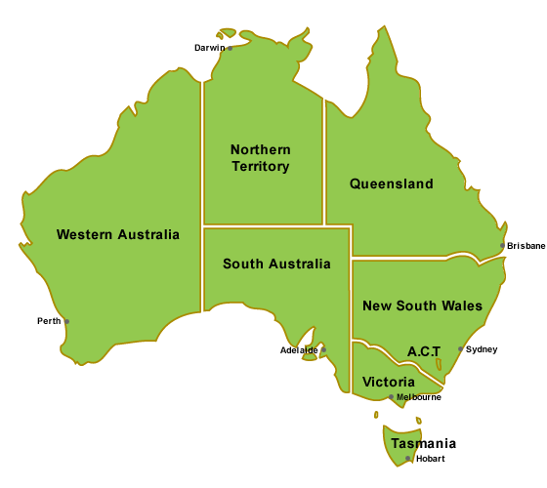
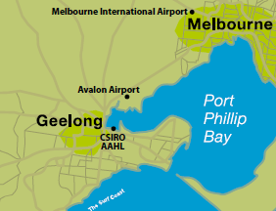
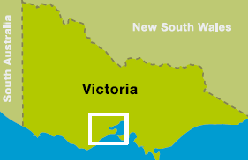
How many are needed?
Australia – population of 22.5 million
4x BSL4 Laboratories
1 x National Animal High Containment Lab (AAHL)
3x State Public Health PC4 labs (Brisbane, Sydney and Melbourne)
Expansion of AAHL new PC4 lab 320 m²

Slide 3
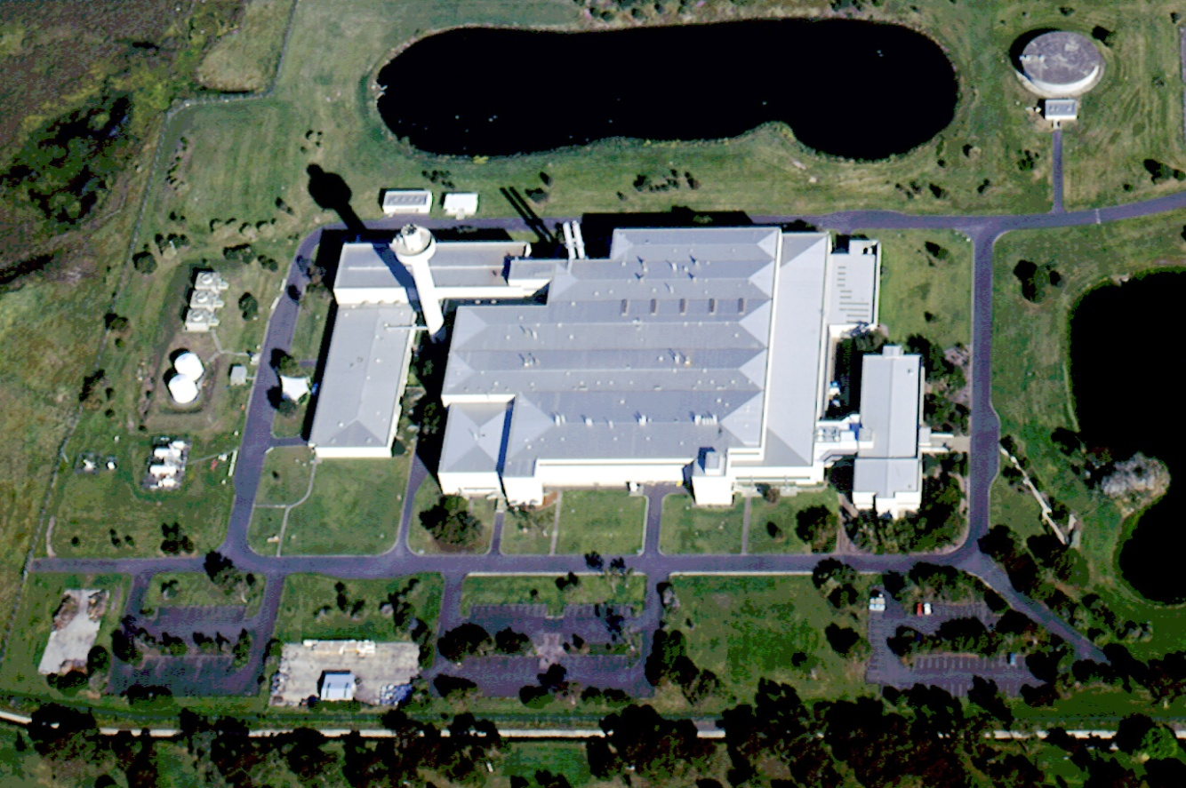
Australian Animal Health Lab
Opened in 1985
26 years old
$200M to build
Replace $650-700
35 hectares
Building 2 Ha
6 Floors
65,000 m²
15,000m^{2 ‘}lab’
Lab
BSL2 = 2600 m2
BSL3 = 2900 m2
BSL4 = 100 m2 (400m²)
Animal Facility
BSL3 = 955 m²
BSL4 = 127m²

Slide 4
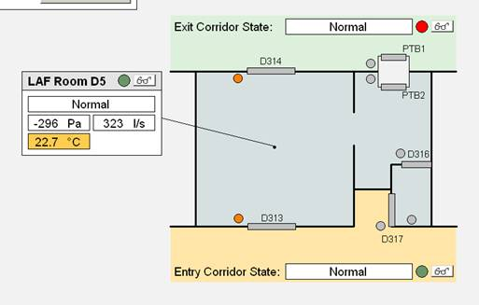
Construction and Maintenance costs
60 F/T Engineering staff
10 Microbiological Security Staff ($1M annually)
$6.8M annual maintenance & running cost
$15M/yr depreciation
$25M engineering upgrade just completed focused on control and monitoring
5
Server Rm North
Server Rm South
Machine Hall
L5 Plant Room
Admin
CMS
ESB CMS
3
5
5
4
3
1
2

Slide 5
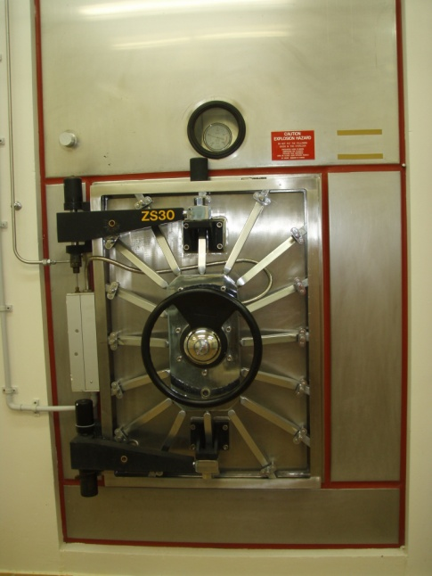
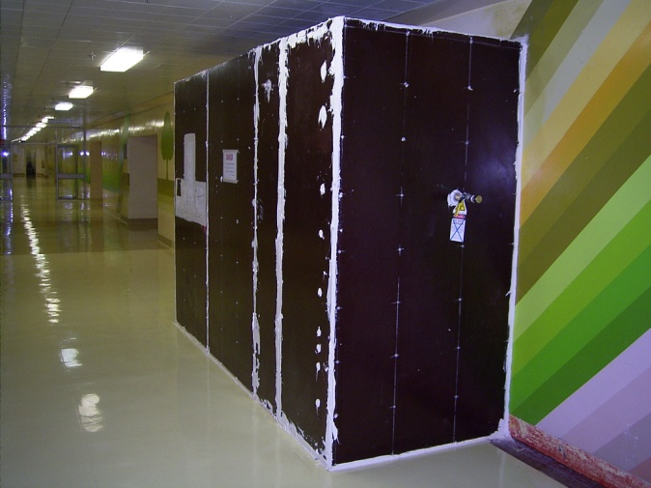
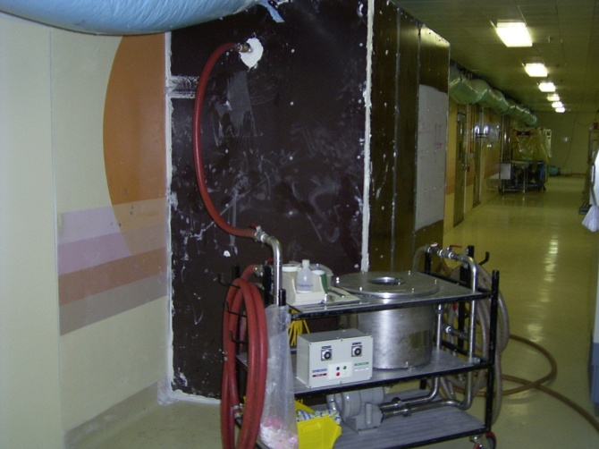
Construction and Maintenance costs
Changing standards will require additional & significant investment
30 autoclaves to be refurbished or replaced ($5M-$15M)
Laboratory has operated continuously since opening
Science mission requires continuous operation during refurbishment
Construction costs while operating $$$$

Slide 6
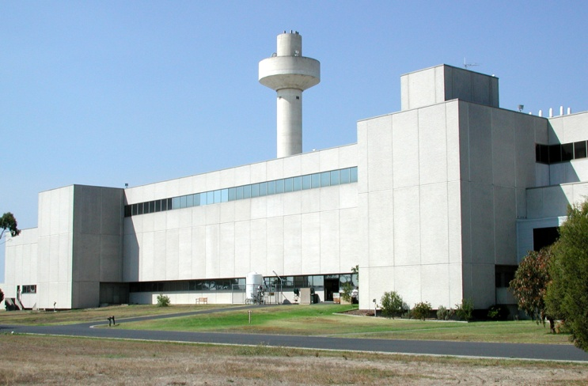


Biosecurity
Perimeter fence, box within box, infrared cameras
Dual access controls & Cyberlocks
Critical Infrastructure protection branch
All AAHL staff with security access are ASIO cleared
CWA 15793

Slide 7
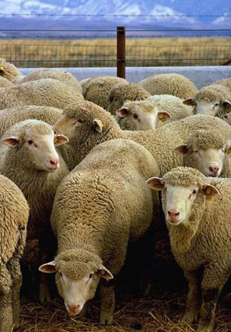
Environmental issues
Originally built to provided diagnostic capacity and vaccine production facilities for FMDV
FMDV has never been introduced to the lab
Local council regulations prevent residents keeping cloven hoofed animals within 5 kilometres.
Staff not permitted to live on farm
7 day exclusion for all staff and visitors

Slide 8
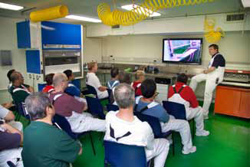
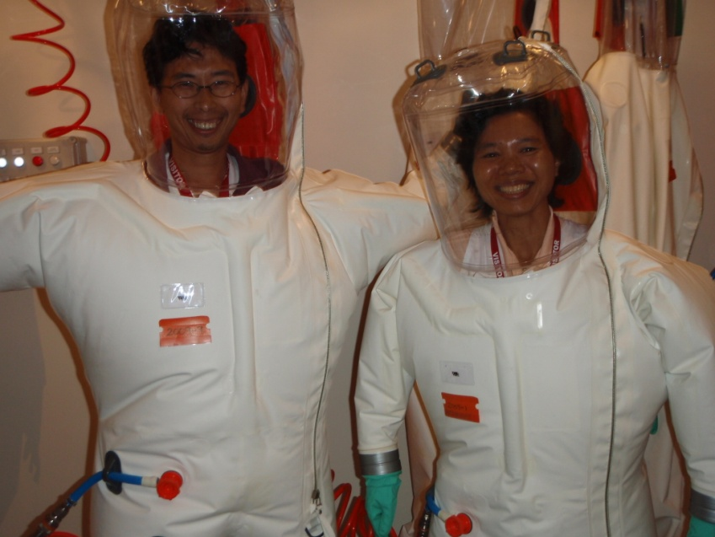
Training
Structured competency based training
Must first complete all BSL3 training and be signed off as competent to work at BSL3/4
Dedicated training lab
All routine and emergency procedures in training lab
Supervisors sign off BSL4 competency

Slide 9
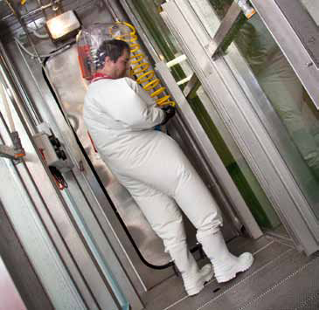
Strategies to manage infected individuals
Medical Advisory Committee
State Chief Health Officer
State Chief Veterinary Officer
Local General Practitioner
Infectious Disease Physician
All incidents referred to MAC
Home quarantine or admission to ID ward

Slide 10
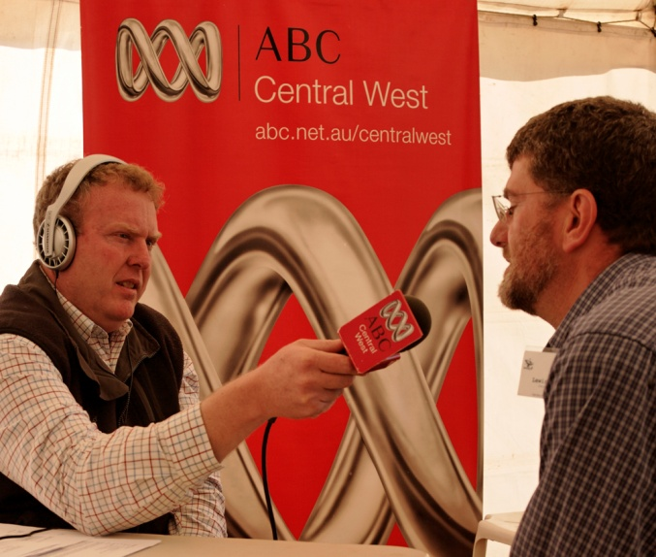
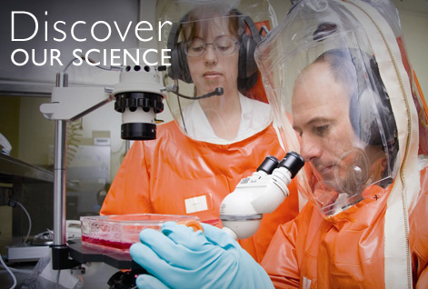
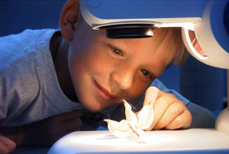
Community Relations
Dedicated Media Officer
Active engagement of public including schools
Tours for key State and Federal politicians
Facilitate media coverage (60 minutes, Catalyst etc.)
Helps to have a long record >25 yrs of safe operation within the community

Slide 11
Maximising the investment; reducing the risk
$10M to convert existing facility to specialised BSL3 and BSL4 lab space
Available to scientists across Australia and globally
Government, academic or commercial clients
Existing & proven systems and experienced staff

Slide 12

Thanks for your attention!

