Slide 1
Data Attribution and Citation Practices and Standards Fifth China - U.S. Roundtable on Scientific Data Cooperation
Christine L. Borgman, PhD, Professor & Presidential Chair in Information Studies, University of California, Los Angeles
Beijing, China, 27- 28 October, 2011
Notes:
Greetings everyone. We’ve assembled an amazing group of speakers and participants for this very focused meeting. We have much to accomplish in two days, so will dig right in.

Slide 2
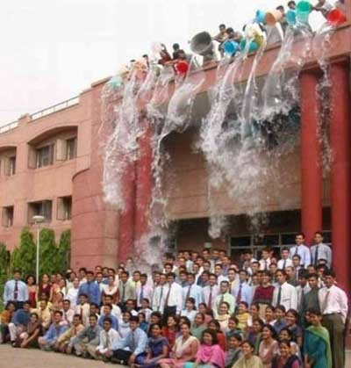

Deluge!!!
Data!
Scientists
Social Scientists
Humanists
Funding agencies
Policy makers
Librarians
Publishers
Internet architects
http://www.guzer.com/pictures/suprise_suprise.jpg
Notes:
We are all familiar with the metaphor of the data deluge … we are all being drowned in data
And we all may be drowning, period….
Concerns with data capture the prior trends in significant ways
And yet, much of that data is runoff – it is not curated, and maybe should not be kept
We need to identify what is the “right stuff” to keep
The right way to keep it
And the right tools and services to make it useful
**
Data have become a critical focus for scholarly communication – but we cannot address ALL, or even very many, of those issues here.

Slide 3
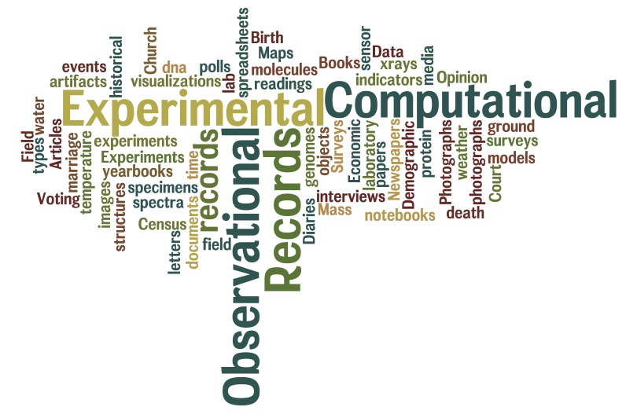
Data
Notes:
First is the question of what ARE data?! We’ll set that messy question aside also – acknowledging that data are many things to many people.
Further, what are data and what data may be shared, reused, or citable, is a separable question.

Slide 4
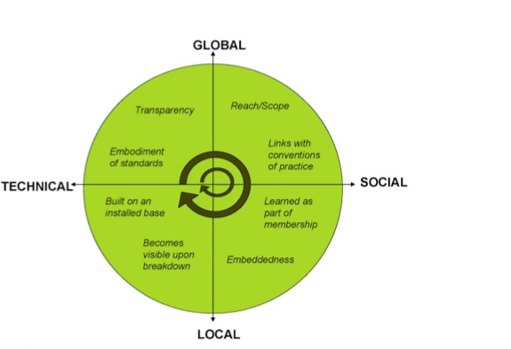
Infrastructure
Star, S. L. & Ruhleder, K. (1996). Steps toward an ecology of infrastructure: Design and access for large information spaces. Information Systems Research, 7(1): 111-134.
Figure: Bowker, G. C., Baker, K., Millerand, F., Ribes, D., Hunsinger, J., Klastrup, L. & Allen, M. (2010). Toward Information Infrastructure Studies: Ways of Knowing in a Networked Environment. In Hunsinger, J., Klastrup, L. & Allen, M. (Eds.). International Handbook of Internet Research. Dordrecht, Springer Netherlands: 97-117.
Notes:
CI is the form of infra that this community knows best…
Let’s look more specifically what is meant by infrastructure
Building infrastructure is an ongoing effort – and my challenges to this community, are how to build what we need going forward.
not a new idea, but one that is invisible by its nature. We’ve had plenty of breakdowns lately,which makes us even more aware of
The 8 dimensions of infra from the seminal paper by Star & Ruhleder are nicely captured along two dimensions by Florence Millerand –
At the technical end of the spectrum, infra is the embodiment of stds, and it builds upon an installed base
At the social end, infra is linked with conventions of practice – whether cataloging or data mgt, and learned as part of membership in a community, whether libns or literary scholars
At the local end, infra is very much embedded in activities and arrangements such as how libs are managed; it may not be visible until it breaks down – online catalog goes offline, the systems that cease to interoperate
At the global end, infra may have very broadr each, and be transparent – the inverse of visibility; (Japanese have learned how deeply interconnected and interdependent their power and transportation networks are, sadly)

Slide 5
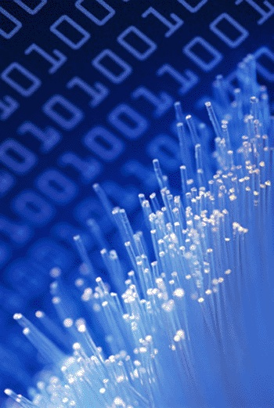
Infrastructure for digital objects
Social practice
Usability
Identity
Persistence
Discoverability
Provenance
Relationships
Intellectual property
Policy
http://datalib.ed.ac.uk/GRAPHICS/blue_data.gif
Notes:
An infrastructure for digital objects has many features – we’re concerned at this meeting with how they apply to data, attribution, and citation – but must remember that they are part of a larger internet architecture of digital objects
I will provide a brief overview of these relationships as background to the issues we will address this week

Slide 6
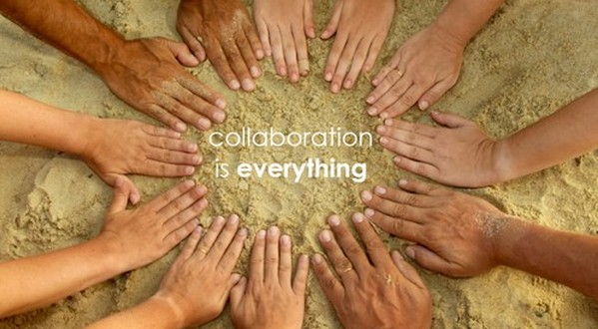
Social practice
Why cite data?
Reproduce research
Replicate findings
Reuse data
Why attribute data?
Social expectation
Legal responsibility
How to cite data?
Bibliographic reference
Identifier
Link
http://farm2.static.flickr.com/1207/707625876_46aa44851f_o.jpg
Notes:
Usability – really reusability – how valuable is an object if you can’t open it? Need software? Locked up in PDF?
Related to discoverabilty
IP
If we could release everything under CC0 licenses, the world would be a simpler place. That won’t happen
Need to know what rights are attached, what you can do with it.
Open data – in sense of no rights attached, in sense of reusable (structured vs pdf)
Open bib – citations per se are facts, and generally not copyrightable.
Movement toward open bib – let the descriptions, the metadta go free, then others can map the world of content and ideas. Separate from the payrwalls.

Slide 7

Usability of cited objects
Identify the form and content
Interpret
Evaluate
Open
Read
Compute upon
Reuse
Combine
Describe
Annotate…
Notes:
The ability to discover the existence of data is a critical requirement for a data-sharing infrastructure. We can define discovery as being the ability to determine the existence of a set of data objects with specified attributes or characteristics. The attributes of interest include aspects such as the producer of the data, the date of production, the method or production, a description of its contents, its representation. Discovery may also include aspects such as levels of quality, certification, or validation by third parties.
Discoverability depends both on the description and representation of data and on tools and services to search for data objects. Data rarely are self-describing . Description and representation usually take the form of metadata, some of which may be automated if data are generated by instruments such as sensor networks or telescopes. Much metadata creation requires human intervention, making it an expensive process that is often avoided by researchers (Edwards, Mayernik, Batcheller, Bowker & Borgman, 2011, forthcoming; Mayernik, 2011; Mayernik, Batcheller & Borgman, 2011). The lack of standards and practices for citing data, akin to citing publications, is a barrier to discoverability [cite BRDI mtg Aug 2011].
A variety of approaches to discovery are possible. Web search engines that walk the visible internet are one possibility assuming that data descriptions are reachable via standard web protocols. With the introduction of semantic web technologies and associated crawlers and search engines, location of data-sets of interest based on semantic content becomes possible. Alternatively, more discipline-specific and structured catalogs can be created.
Arguably quite a bit of data is self describing: e.g., FITS, NetCDF, …
Tho even those are incomplete. The more succinct ex we can include the better.
Seems to me to be a distinct issue, related to naming not discoverability?
A bit of both. Let’s discuss.

Slide 8
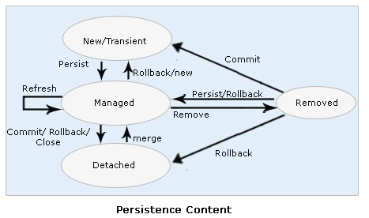
Identity and persistence of digital objects
Identity
Identifiers
DOI, Handles, URI, PURL…
Naming and namespaces
Authors/creators: ORCID, VIAF…
Generic/specific: registry number…
Description
Self-describing
Metadata augmentation
Persistence
Permanent
Long-lived
Scratch spaces
http://web-interview-questions.blogspot.com/2010_06_21_archive.html
Notes:
Let’s look more closely at each of these
Identity – unique, and in what space should it be?
Generic or field specific?
Persistence – not all data should be available forecver – what needs to be identified and why?

Slide 9
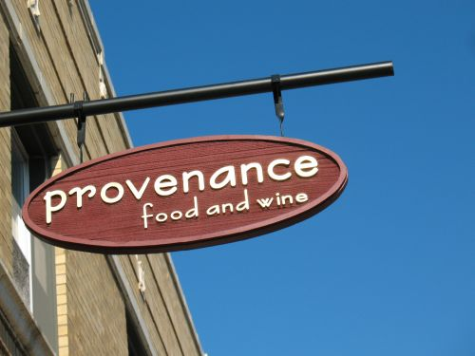
Finding and following digital objects
Discoverability
Identify existence
Locate
Retrieve
Provenance
Chain of custody
Transformations from original state
Relationships
Units identified
Links between units
Actions on relationships
http://chicagoist.com/2008/10/09/a_gourmet_oasis_provenance_food_and.php
Notes:
The ability to discover the existence of data is a critical requirement for a data-sharing infrastructure. We can define discovery as being the ability to determine the existence of a set of data objects with specified attributes or characteristics. The attributes of interest include aspects such as the producer of the data, the date of production, the method or production, a description of its contents, its representation. Discovery may also include aspects such as levels of quality, certification, or validation by third parties.
Discoverability depends both on the description and representation of data and on tools and services to search for data objects. Data rarely are self-describing . Description and representation usually take the form of metadata, some of which may be automated if data are generated by instruments such as sensor networks or telescopes. Much metadata creation requires human intervention, making it an expensive process that is often avoided by researchers (Edwards, Mayernik, Batcheller, Bowker & Borgman, 2011, forthcoming; Mayernik, 2011; Mayernik, Batcheller & Borgman, 2011). The lack of standards and practices for citing data, akin to citing publications, is a barrier to discoverability [cite BRDI mtg Aug 2011].
A variety of approaches to discovery are possible. Web search engines that walk the visible internet are one possibility assuming that data descriptions are reachable via standard web protocols. With the introduction of semantic web technologies and associated crawlers and search engines, location of data-sets of interest based on semantic content becomes possible. Alternatively, more discipline-specific and structured catalogs can be created.
Arguably quite a bit of data is self describing: e.g., FITS, NetCDF, …
Tho even those are incomplete. The more succinct ex we can include the better.
Seems to me to be a distinct issue, related to naming not discoverability?
A bit of both. Let’s discuss.

Slide 10
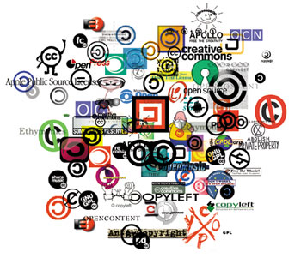
Intellectual property
What can I do with this object?
What rights are associated?
Reuse
Reproduce
Attribute
Who owns the rights?
How open are data?
Open data
Open bibliography
http://pzwart.wdka.hro.nl/mdr/research/lliang/mdr/mdr_images/opencontent.jpg/
Notes:
The ability to discover the existence of data is a critical requirement for a data-sharing infrastructure. We can define discovery as being the ability to determine the existence of a set of data objects with specified attributes or characteristics. The attributes of interest include aspects such as the producer of the data, the date of production, the method or production, a description of its contents, its representation. Discovery may also include aspects such as levels of quality, certification, or validation by third parties.
Discoverability depends both on the description and representation of data and on tools and services to search for data objects. Data rarely are self-describing . Description and representation usually take the form of metadata, some of which may be automated if data are generated by instruments such as sensor networks or telescopes. Much metadata creation requires human intervention, making it an expensive process that is often avoided by researchers (Edwards, Mayernik, Batcheller, Bowker & Borgman, 2011, forthcoming; Mayernik, 2011; Mayernik, Batcheller & Borgman, 2011). The lack of standards and practices for citing data, akin to citing publications, is a barrier to discoverability [cite BRDI mtg Aug 2011].
A variety of approaches to discovery are possible. Web search engines that walk the visible internet are one possibility assuming that data descriptions are reachable via standard web protocols. With the introduction of semantic web technologies and associated crawlers and search engines, location of data-sets of interest based on semantic content becomes possible. Alternatively, more discipline-specific and structured catalogs can be created.
Arguably quite a bit of data is self describing: e.g., FITS, NetCDF, …
Tho even those are incomplete. The more succinct ex we can include the better.
Seems to me to be a distinct issue, related to naming not discoverability?
A bit of both. Let’s discuss.

Slide 11
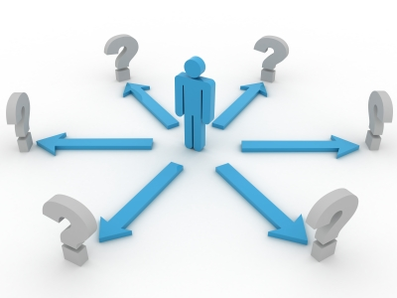
Policy for digital objects
Whose policy?
Funding agencies
Publishers
Data repositories
Universities
Investigators…
Types of policy
What to release
What description
What citation
What attribution
Who can describe, annotate…
http://www.dlorg.eu/index.php/publications/ec-policy/ec-publications-policy
Notes:
Usability – really reusability – how valuable is an object if you can’t open it? Need software? Locked up in PDF?
Related to discoverabilty
IP
If we could release everything under CC0 licenses, the world would be a simpler place. That won’t happen
Need to know what rights are attached, what you can do with it.
Open data – in sense of no rights attached, in sense of reusable (structured vs pdf)
Open bib – citations per se are facts, and generally not copyrightable.
Movement toward open bib – let the descriptions, the metadta go free, then others can map the world of content and ideas. Separate from the payrwalls.

Slide 12
Driving questions for symposium
What are the major technical issues that need to be considered in developing and implementing scientific data citation standards and practices?
What are the major scientific issues that need to be considered in developing and implementing scientific data citation standards and practices? Which ones are universal for all types of research and which ones are field- or context- specific?
What are the major institutional, financial, legal, and socio-cultural issues that need to be considered in developing and implementing scientific data citation standards and practices? Which ones are universal for all types of research and which ones are field- or context-specific?
What is the status of data attribution and citation practices in individual fields in the natural and social (economic and political) sciences in United States and internationally? Case Studies.
Institutional Roles and Perspectives: What are the respective roles and approaches of the main actors in the research enterprise and what are the similarities and differences in disciplines and countries? The roles of research funders, universities, data centers, libraries, scientific societies, and publishers will be explored.
Notes:
These are very wordy – you have them in your agenda; won’t parse them further here! Highlighted key phrases in blue.
Origins: months of discussion within BRDI, CODATA, Task Group, and Steering committee to arrive at these.
The steering cmte, in consultation with the task group, assembled the distinguished group of speakers from around the world
Data management, use, reuse, and incentives to share and reuse are hot topics. We cannot address all of them in two days – we have tried to keep our attention narrowly focused on these questions – we are not ignoring the other ones; just taking this rare opportunity to identify answers to key questions that will help the community move forward on standards, practices, and policy.

Slide 13

Next steps
BRDI-CODATA Symposium and Workshop, August 2011
BRDI-CODATA Report to CODATA Task Group
Kyoto meeting (Paul Uhlir)
Beijing meeting
Taiwan meeting, 2012
Best practices recommendations
Community activities
…
http://cof-interspiritual-mindfulness.blogspot.com/2011/07/from-daily-om-most-fulfilling-road.html
Notes:
Where do we go from here? What do we expect the outcomes of the symposium to be?

