Slide 1
Introduction of International Scientific Data Service Platform
Scientific Data Center
Computer Network Information Center,CAS
Lin Qinghui
2011/10/27
Notes:
Good mornring everyone, My name is Lin Qinghui, a staff of Scientific Data Center,CNIC.Today, I’m glad to have this chance to communicate directly with every experts here.
NEXT, I will introduct our work about data mirror and data sharing in the last few years.
The title of my report is “Introduction of International Scientific Data Service Platform”.

Slide 2
CATALOG
1
Objectives
Objectives
2
Data Resources
3
Multi-services
4
Sharing Archievements
5
Future Prospect
Notes:
There are 5 parts in this report. First is the Summary of International Scientific Data Service Platform, Then I will introduct the Data Resources, Multi-services methods and theSharing Archievements of the Plaform. At last, I will introduct the Future Prospect of the Platform breifly.
Now, let’s begin from the Summary of the Platform. Firstly, we need to understand the basic condition of SDC, that is the Scientific Data Center.

Slide 3
1. Objectives
Aggregating international excelent data resources
  Chinese scientist urgently need a platform which can gather and manage distributed geospatial science data
Developing high quality data products
Integrating data resources, algorithm models and realizing online simulation
Sharing data, products, models, storage and suppling all kinds of support and services to users
Notes:
There are four main objectives of the platform, first is Cooperativing[kəu'ɔpərətiv] with overseas partners and aggregating international excelent data resources.because Chinese scientist['saiəntist] urgently['ə:dʒəntli] need a platform which can gather and manage distributed geospatial science data .Second is Cooperativing with experts of different professional fields and developing high quality data products.third is Integrating data resources, algorithm ['ælɡəriðəm] models and realizing online simulation.at last,on the basis of above objectives, sharing data products, models, storage and suppling all kinds of support and services ['sə:visis] to users is our final objective

Slide 4
CATALOG
1
Summary of the Platform
2
Data Resources
3
Multi-services
4
Sharing Archievements
5
Future Prospect
Notes:
Now, let’s come to the second part: data resources.

Slide 5
2. Data Resources
Mirror Data
  After 4 years of efforts, International Scientific Data Service Platform has accumulated mass data resources . Including LANDSAT, MODIS, EO-1, DEM, NCAR
  Time up to September , 2011, the volume of data reached 160 TB, the number of data entries reached 3,000,000
  Most of the data has provided online service
Data products
  In order to meet the needs of chinese user, besides the Mirrored initial Data, the platform processed a series of data products
Now there are 66 Mirrored initial Datasets and up to 40 Data products in the platform
Notes:
In summary, data resources in the platform can be divided into two kinds,
Mirror Data means the data download from international data resources. After 4 years of efforts, International Scientific Data Service Platform has accumulated[ə'kju:mjuleit] mass data resources . Including LANDSAT, MODIS, EO-1, DEM,NCAR and so on.Time up to this month, the volume of data achieved[ə'tʃi:vd] 160 TB, the number of data entries[e'tri:s] reached three million. and most of the data provide online service.
At the same time, In order to meet the needs of chinese user the platform processed a series of data products.
Now there are 66 Mirror initial Datasets and up to 40 Data products in the platform.
Now I want to especially introduce several datamirror resource.

Slide 6
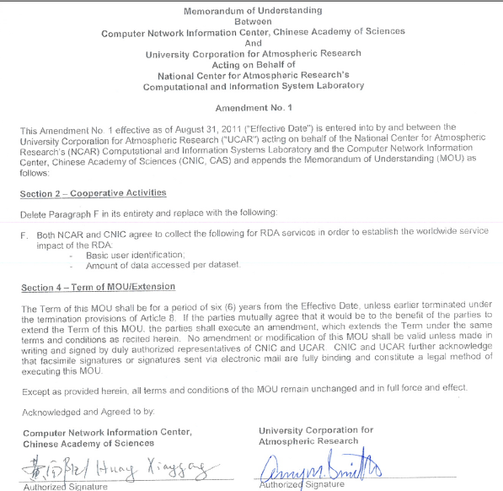
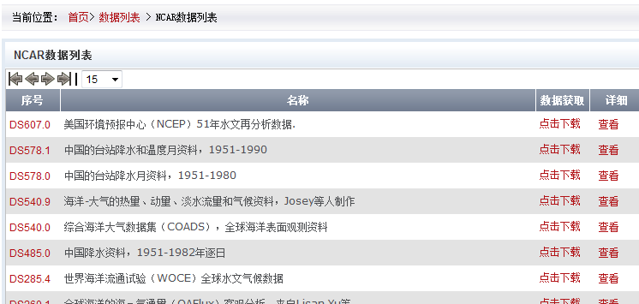
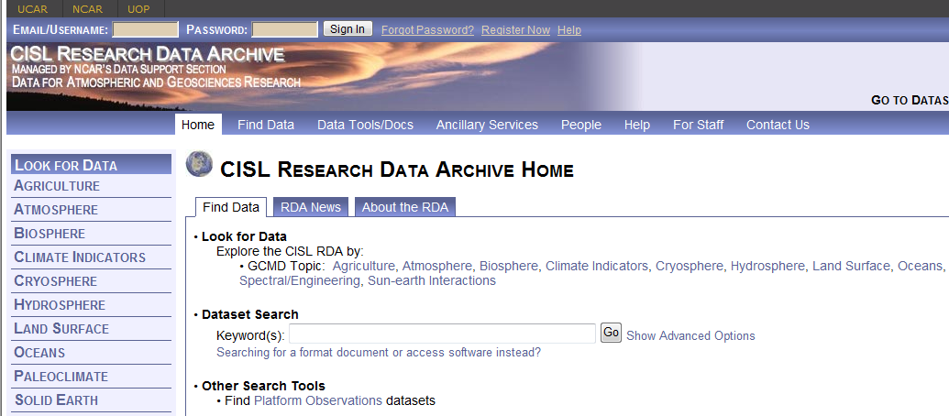
2. Data Resources--NCAR
  NCAR: The National Center for Atmospheric Research (NCAR) is a federally funded research and development center devoted to service, research and education in the atmospheric and related sciences.
  Cooperation between CNIC & NCAR
  Cooperation between CNIC & NCAR started from 2008.
  The term of the renewed MOU is for a period of six years from 2011, up to 2017
  Contents: share data and user usage metrics
  In cooperation period, CNIC have about 14 datasets mirrored from NCAR for serving users in China, data quantity reach about 1TB.
Notes:
The first one I hope to recommend[,rekə'mend] is datasets from NCAR(namely the national center for atmospheric[,ætməs'ferik] ) Research.it must be very familiar to ererybody here.in this August, we renewed the MOU until to 2017.
This cooperation is a data sharing project, both NCAR and CNIC agree to mirror datasets and share user usage metrics['metriks] each other.
In Cooperation [kəu,ɔpə'reiʃən] Period, CNIC have about 14 datasets mirrored from NCAR for serving users in China. Data quantity achieved about 1TB.

Slide 7
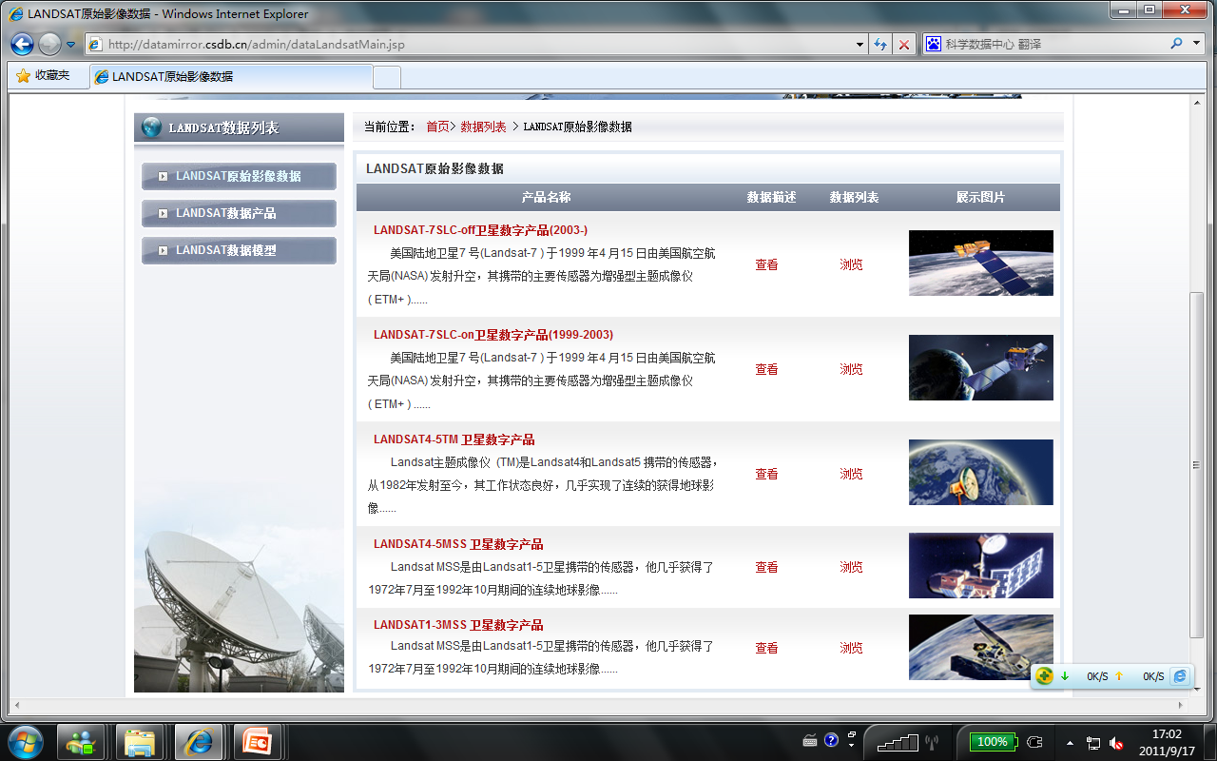
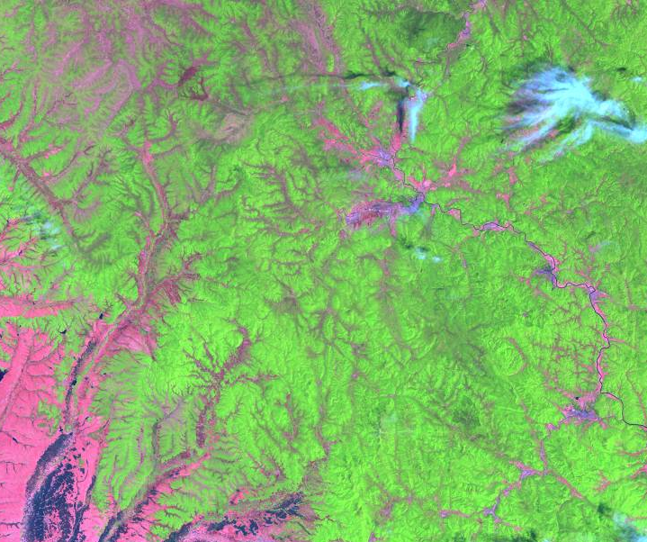
2.Data Resources--LANDSAT
LANDSAT archive data
  On April 21, 2008, the USGS announced plans to provide all archived Landsat scenes at no charge to all users.
  On July, 2008,CNIC came to an agreement with USGS and began to mirror LANDSAT archive data.
  Data volume : 8TB
  Availability: Online download form http://datamirror.csdb.cn/
Notes:
The second datasets I want to talk about is the Landsat image.Ecerybody know that Landsat is a very important Remote sensing data resources.On April,2008, the USGS announced[ə'naunst] plans to provide all archived Landsat images at no charge to all users. On July, 2008,CNIC came to an agreement with USGS and began to mirror LANDSAT Archive data.
Now the Data quantity of landsat archive up to 8TB.

Slide 8
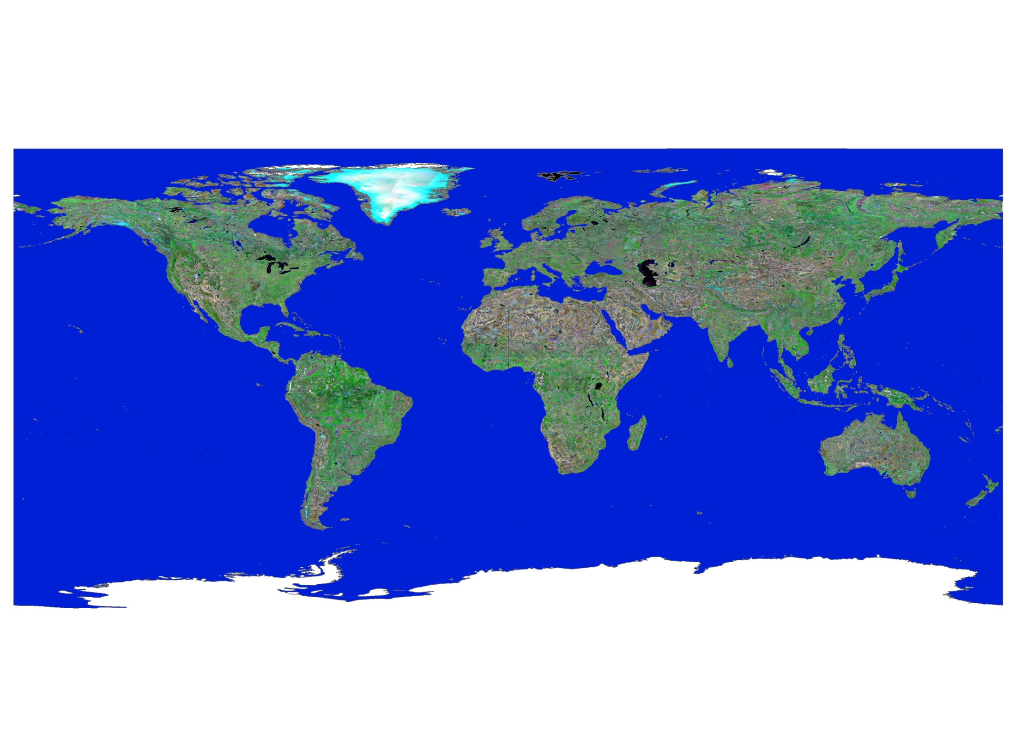
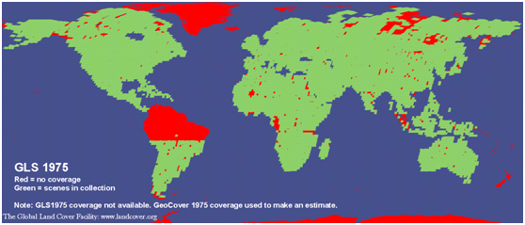
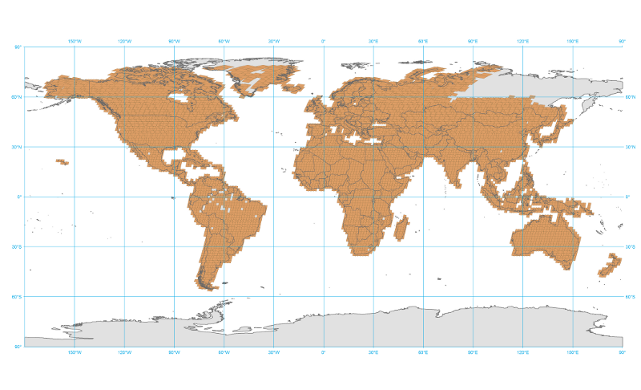
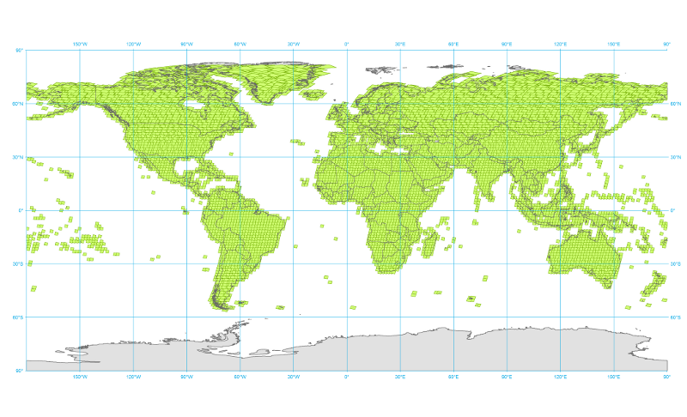
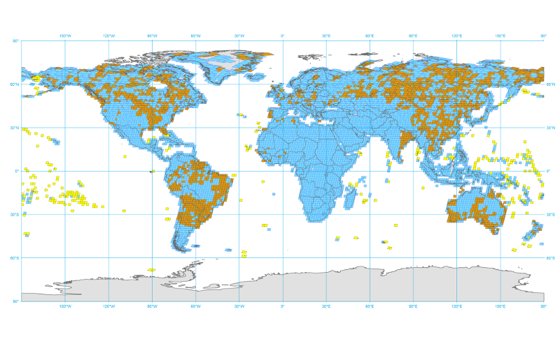
2.Data Resources--LANDSAT
The Global Land Survey (GLS)
  Availability: We archive all the GLS datasets, GLS 1975, 1990, 2000, 2005
  Data source: The University of Maryland
Global Landsat TM and ETM Mosaic Data
  The U.S. Geological Survey (USGS)
GLS1975
GLS1990
GLS2000
GLS2005
Notes:
Besides Landsat archive data, there are other two important Landsat datasets in the platform: one is The Global Land Survey [sə:'vei] which comes from The University of Maryland['mεərilænd] and the other is the Global Landsat TM and ETM Mosaic Data which comes from USGS.

Slide 9
2. Data Resources--MODIS
The Moderate-resolution Imaging Spectroradiometer (MODIS) offers a unique combination of features:
  It detects a wide spectral range: 36 bands‎
  It takes measurements at three spatial resolutions (250m,500m,1KM)
  I takes measurements all day, every day
  It has a wide field of view.
These data will improve our understanding of global dynamics and processes occurring on the land, in the oceans, and in the lower atmosphere. MODIS is playing a vital role in the development of validated, global, interactive Earth system models able to predict global change accurately enough to assist policy makers in making sound decisions concerning the protection of our environment.
Notes:
MODIS is a important mirrored data in international scientific data services platform.MODIS offers a unique combination[,kɔmbi'neiʃən] of features:it detects a wide spectral['spektrəl] range, at the same time it takes measurements at three spatial resolutions, takes measurements all day and every day and it has a wide field of view
So it a very important data resources for scientific research.

Slide 10
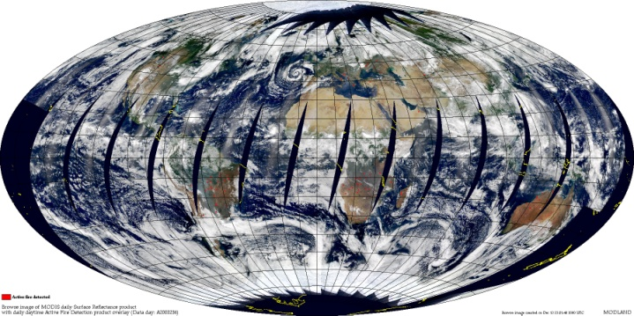
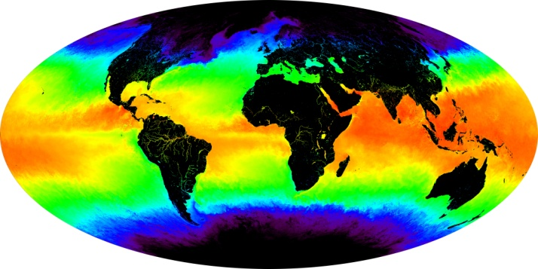
2. Data Resources--MODIS
Data Source: National Aeronautics and Space Administration(NASA)
MODIS products in the Platform
  MODIS Level 1 data
  MODIS land products
  Data volume
  The total modis data volume in our mass data storage is more than 120TB, and the number of metadata reached 10,000,000.
Notes:
MODIS data in our platform download from NASA. MODIS products include MODIS Level 1 data,and MODIS land products. The total modis data volume in our mass data storage is more than 120TB, and the number of metadata reached ten million.

Slide 11
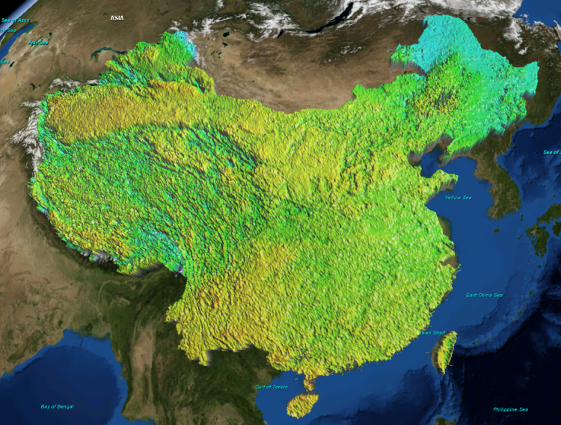
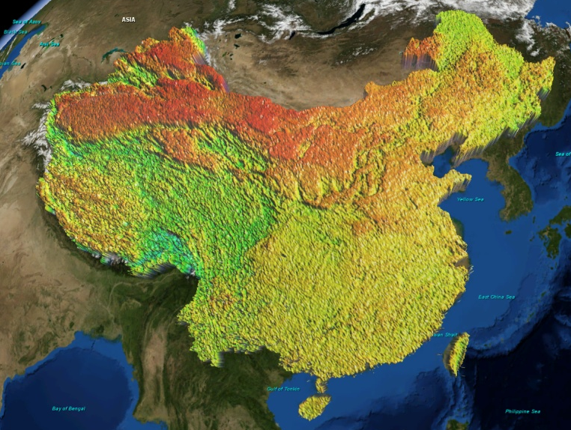
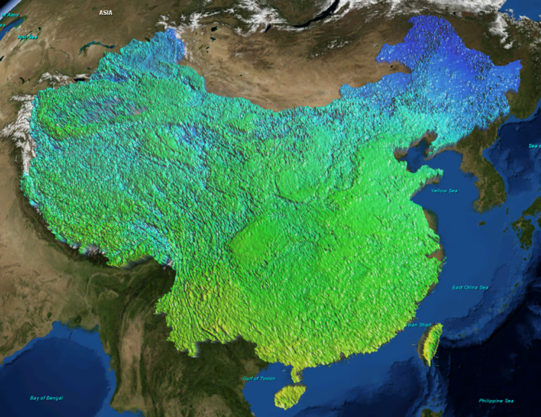
2. Data Resources--Other Data
SRTM ： Shuttle Radar Topography Mission
GDEM： ASTER Global Digital Elevation Map
SIR-C ： Spaceborne Imaging Radar C-band
ALI：Advanced Land Imager
Hyperion：
Mass of data products processed by SDC
2010年3月中旬LST
2010年7月下旬LST
2010年12月中旬LST
Notes:
Besides NCAR，Landsat，MODIS，we also mirrored many other data resources，such as SRTM，GDEM，SIR-C、Hyperion [hai‘piəriən] ，and so on.
Of course, as I said earily, data resources in our platform allso including mass of data products processed by SDC. Time is short,So I have to end here about the introduction of data resources.

Slide 12
CATALOG
1
Objectives
2
Data Resource
3
Multi-services
4
Sharing Archievements
5
Future Prospect
Notes:
In fact, mirrored initial data and processed data products not the end for us, The final purpose of the platform is to supply all kinds of support and services['sə:visis] to our users.so in the next several minituies, I will introduce the Multi-services['sə:visis] system of our platform.

Slide 13



3. Multi-services
Modle Online
Consultant Online
Data Online
Notes:
The platform supplies many kinds of services['sə:visis], on the whole,all the services can fall into three kinds, They are data online, Consultant[kən'sʌltənt] Online and Data Online.

Slide 14
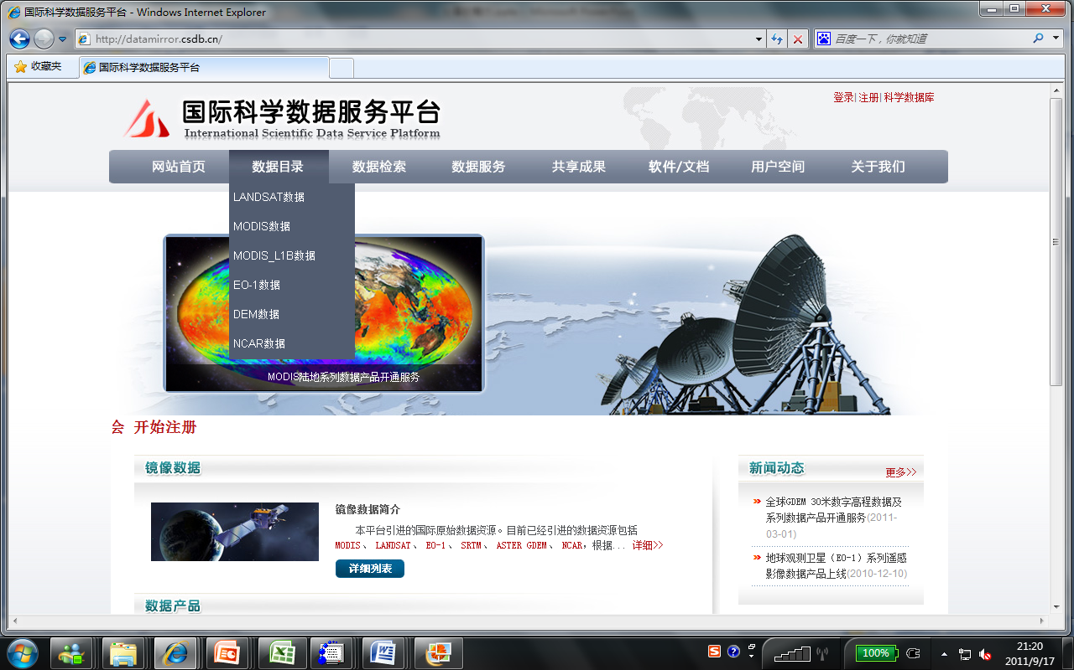
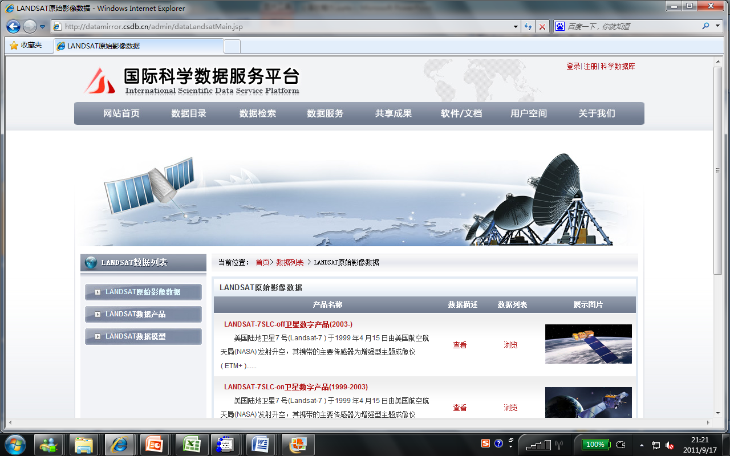
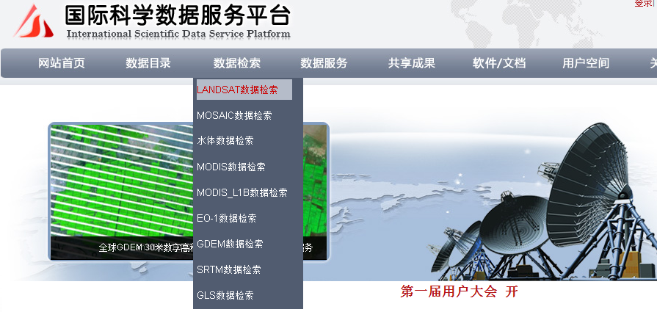
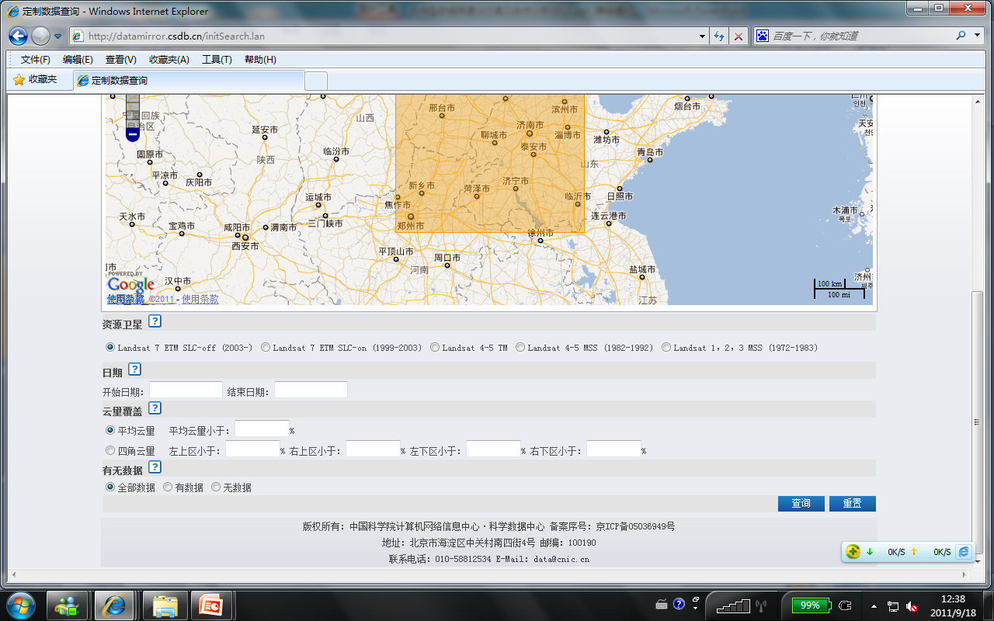
3. Multi-services -- data online
Data Online
  The Platform distributes data resources through online portal system.Any users can search, learn, download data from website by themselves easily.
Data Catalog & Data List
Retrieval System
Notes:
Let’s see data online at first. International Scientific Data Service Platform distributes data resources through online portal system.it mean Users can search and download data from website by themselves.
By Data Catalog & Data List user can learn the data resources general situation which published on the platform and Discovered the resources they interested.
By the retrieval[ri'tri:vəl] system, user can specify a search requirement,including Time Condition，spatial condition，Cloud cover condition，Thereby achieve[ə'tʃi:v] the fast and exact data location.

Slide 15
3. Multi-services -- Consultant Online
Consultant Online
  Specified staffs of platform and experts from different research fields provide consulting service for users.
    Question & Answer : User can raise question by Consulting Service System ,telephone or E-mail, Consultant will give serious reply as soon as possible.
    Data Reservation : From the Platform , user can reserve the data which they need but cannot download from website.
    Data Application & Express : the platform Provide Data application and data Express service. By this service, users can get mass of data by FTP Site. They can require us to post CD-ROM to them o if they need. Of cause they also can come to our laboratory and copy the data they need directly.
Notes:
The second services ['sə:visis] is Consultant[kən'sʌltənt] Online. Specified Consultants and experts provide consulting service for users. Which mainly include three types,one is Question & Answer, User can raise question by consulting Service System ,telephone or E-mail, some consultant will give reply as soon as possible.
the other one is Data Reservation, From the platform, user['ju:zə] can reserve the data which they need but cannot download from website.
the last one is Data Application and Express, By this service, user can get mass of data by FTP Site, They can require us to post CD-ROM to them.Of cause they also can come to our laboratory and copy the data they need directly as soon as they want.

Slide 16
3. Multi-services -- Model Online
Model Online
  Integrating data resources and professional models, and based on which realizing online simulation is an outstanding feature of the platform
  Based on the mass data resoures and the powerful infrastructure of CNIC, the platform realized online calculation of some Remote Sensing models
    Gaps-filled model of SLC-off Landsat ETM+ satellite image
    Abstracting Vegetation Index from Remote Sening Image
    Abstracting of water infromation from Remote Sening Image
    Some inverse models Base on MODIS products.
      Land surface temperature
      Vegetation Indeces
      Surface Reflectance
Notes:
The last type services['sə:visis] is Modle Online.Integrating data resources and professional models, and based on which realizing online simulation is an outstanding feature of the platform. Based on the mass data resoures and the powerful infrastructure of CNIC, the platform realized online calculation of some Remote Sensing models.such as the Gaps-filled model of SLC-off Landsat ETM+ satellite image ,the Vegetation Indeces['indisi:z] model,and some MODIS inverse ['invə:s] models.

Slide 17
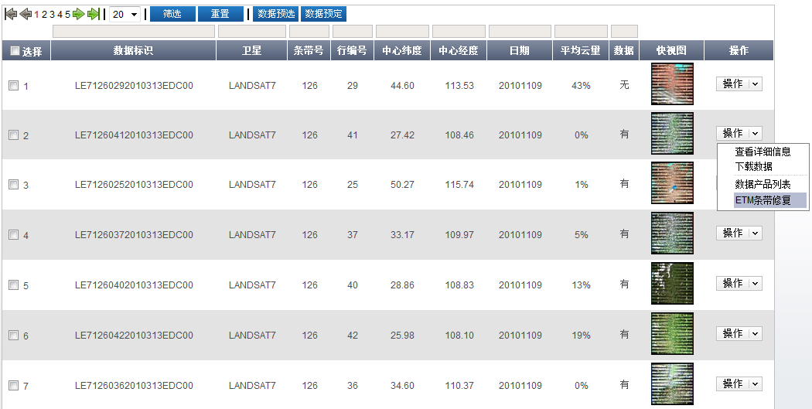
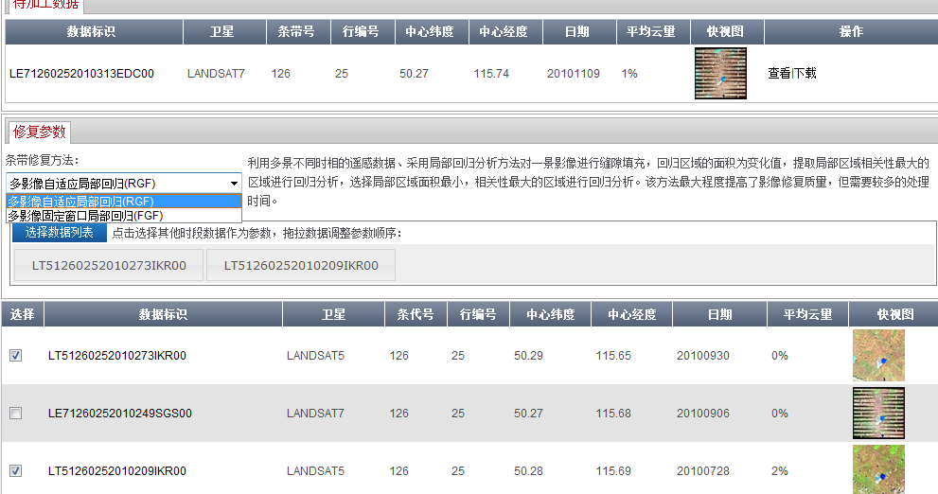
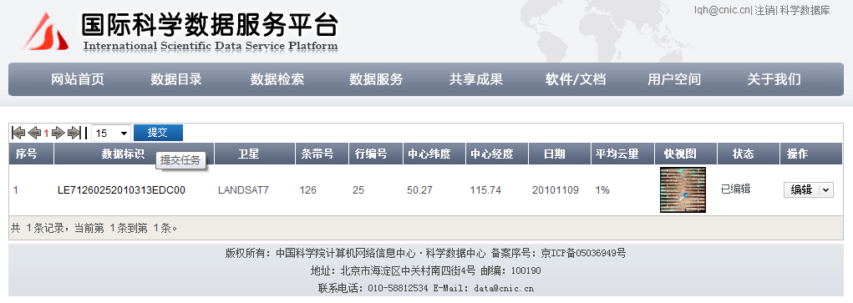
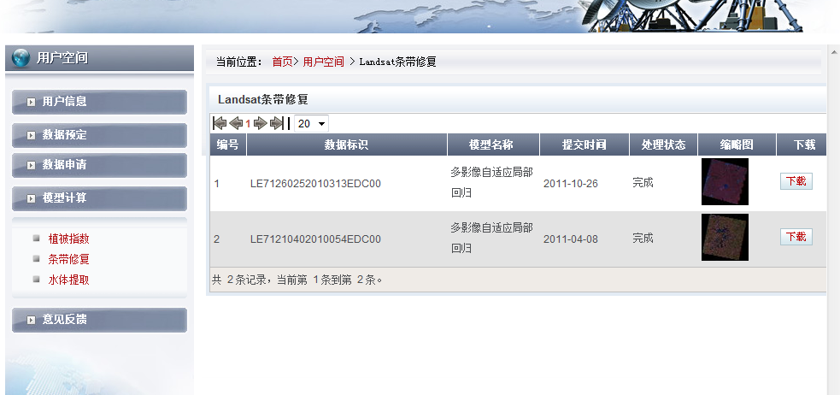
3. Multi-services -- Model Online
User space
Notes:
Next, I will show the main steps of online calculation very quickly.firstly, select the right data and model, then choose the suitable method and parameter ,and sumbit the task at last.it very easy for users. Of cause, from the “user space”, anyone can check the status of eighter task and download the result data.

Slide 18
CATALOG
1
Summary of the platform
2
Data Resource
3
Multi-services
4
Sharing Archievements
5
Future Prospect
Notes:
Now, I will introduce the Sharing Archievements of international scientific data service platform during the last few years.

Slide 19
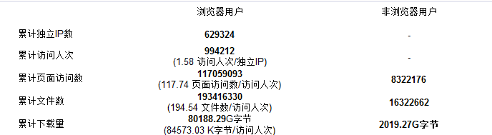
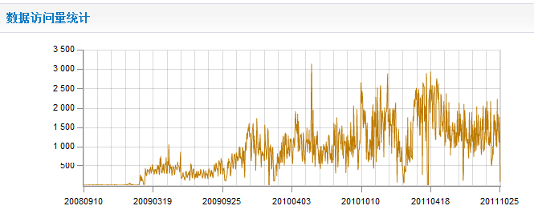
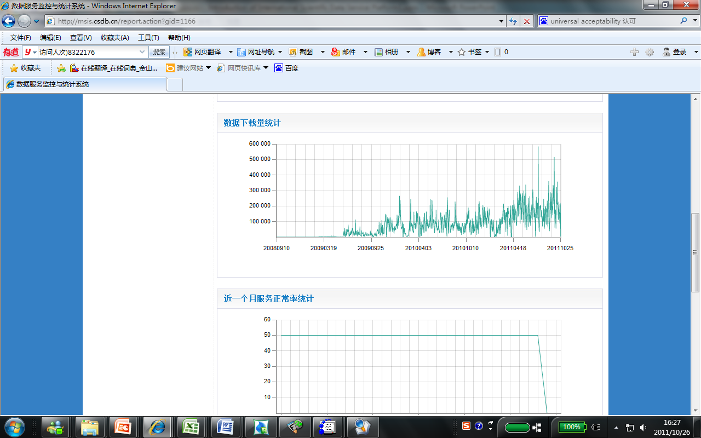
4. Sharing Archievements -- Visit Statistic
  Up to October 26,2011, the visits of Platform achieved ten millions, and the downloaded data reached 112TB
Number of Independent IP | 629,324
User Sessions | 994,212
Pageviews | 117,059,093
Online downloaded | 80.19TB
Offline downloaded | 32.05TB
Notes:
At first I hope to analysis the Visit Statistic of the Platform. Until to yesteday, the visits of the Platform achieved ten millions, the downloaded data reached 112 Terabyte['terəbait].the Total Pageviews has already Over one hundred million.
The middle graph is the statistics of visits volume['vɔlju:m] of our platform.The bottom graph is the statistics of download data of the platform.

Slide 20
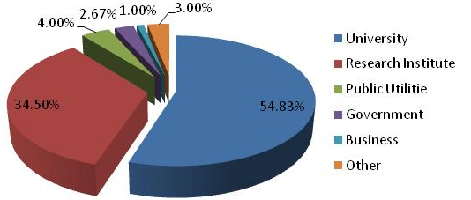
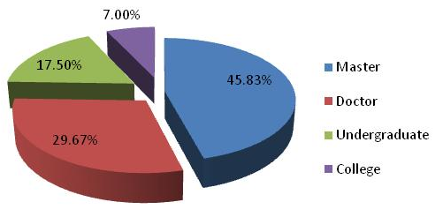
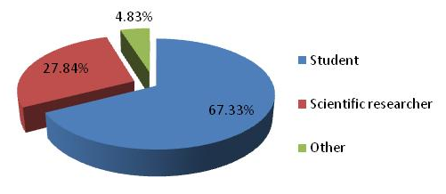
4. Sharing Archievements -- Registered User
  Up to October 26, 2011,the number of registered user achieved 21,043.
organization type
education background
occupation
Notes:
Until to yesteday,the number of registered['redʒistəd] user achieved twenty-one thousand.Most of them come from University and Research institutes, Most of them are master and doctor, about two-thirds of our users are students.
20

Slide 21
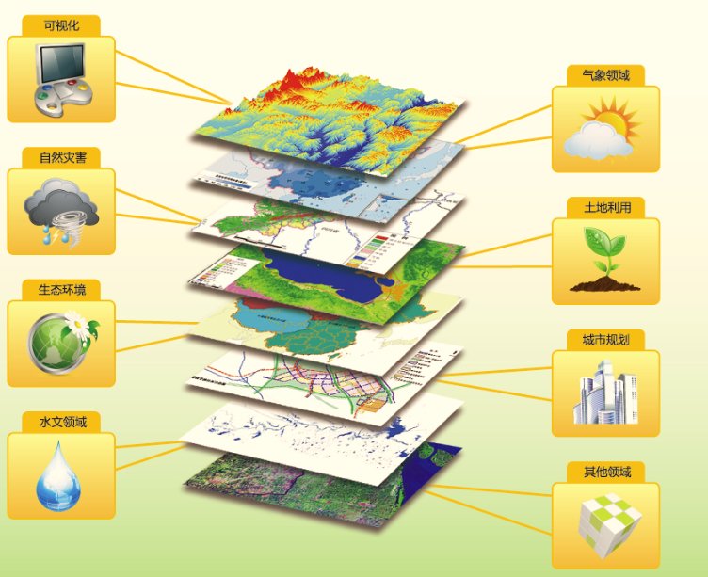
4. Sharing Archievements -- Field of Services
Natural disaster
City planning
Agriculture science
Forestry science
Grassland science
Other
Geoscience
Environmental science
Ecology
Meteorology
Hydrology
Marine Sciences
To October , 2011, the number of key reseach projects supported by International Scientific Data Service Platform reached 152. Among these projects, 84 projects come from CAS, 68 come from other institutes.
In the last few years, services of Platform has received great praise.
Notes:
services ['sə:visis] of our platform are very wide ranging. They include Geoscience,Environmental science,Ecology,Meteorology,Hydrology,City planning,Agriculture ,Forestry ,Grassland science, and also cover some other research field.
To October , 2011, the number of key reseach projects supported by the platform reached one hundred and fifty-two. Among these projects, 84 projects come from CAS.
Througth our Unremitting[,ʌnri'mitiŋ] efforts, In the last few years, services of Platform has received great praise.

Slide 22
CATALOG
1
Objectives
2
Data Resource
3
Multi-services
4
Sharing Archievements
5
Future Prospect
Notes:
Finally, come to the Future Prospect.

Slide 23
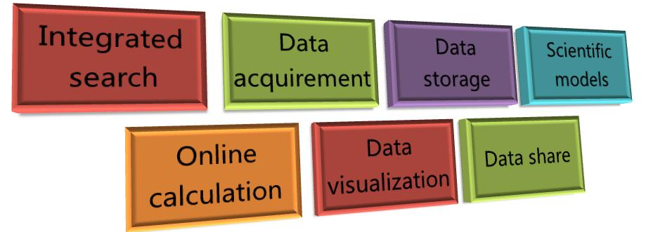
5. Future Prospect -- Geospatial Cloud Platform
Objective
  Building a Geospatial cloud platform
Notes:
Based on the previous work,building a Geospatial cloud platform is our target. it will fully upgrade the International Scientific Data Service Platform.

Slide 24
5. Future Prospect -- Geospatial cloud platform
Main characteristic:
  Mass data collection & service
    Dynamically dicover the science data which distributed in the global area and catch the metadata and data entity from Internet.
    Including public data, commercial data
  Private cloud storage for users
    Free, secured, permanent cloud storage for all users
    Using private data for the online calculation
    Permanent save model result in his own storage
  Integration of typical models and analytical tools
  Online data processing
Notes:
Geospatial cloud platform has 4 main characteristic:
The first is Mass Data Collection & service. In the future, the platform will can dynamically discover the science data which distributed in the global area and catch the metadata and data entity['enəti] from internet. the data resources will not only be public data, but as well including commercial[kə'mə:ʃəl] data.
Geospatial cloud platform also will supply Private['praivit] Cloud Storage for users.By the Private storage, users can save their data or result,and they also can realize online calculation.
on the other hand the Geospatial cloud platform will integrate['intiɡreit] more typical models and tools and Provide real-time processing and online calculation for spatial data.
I hope that through ours efforts,we can reach the goal as soon as possible.

Slide 25
Thank You!
http://datamirror.csdb.cn
Lin Qinghui
lqh@cnic.cn
86-10-58812538
Notes:
That’s all for my report, thank you!

