Slide 1
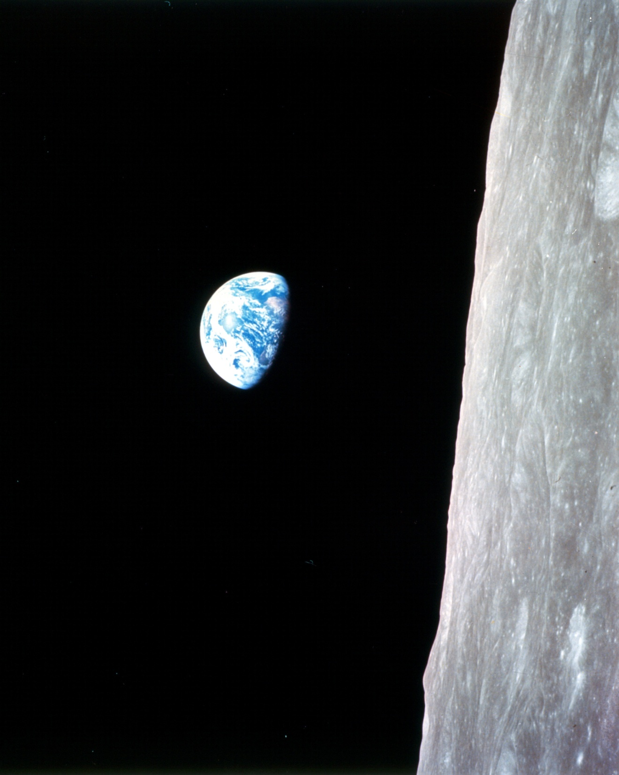

CODATA Update 2012
Robert S. Chen Secretary General February 2012

Slide 2
CODATA Mission Statement
The mission of CODATA is to strengthen international science for the benefit of society by promoting improved scientific and technical data management and use.
Adopted 25th CODATA General Assembly, Beijing, October 2006

Slide 3
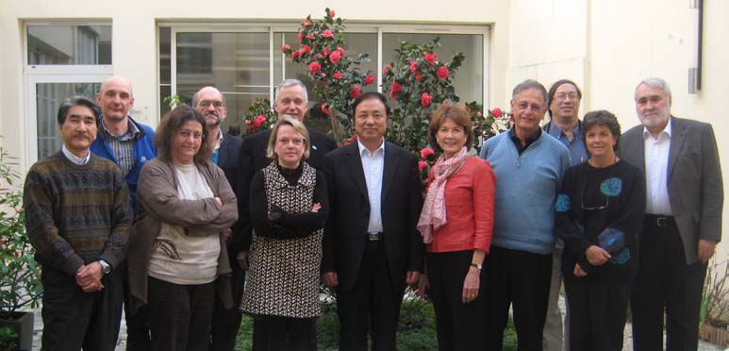

CODATA Leadership
Officers
Huadong GUO (China), President
Takashi GOJOBORI (Japan), Vice Pres.
Fedor KUZNETSOV (Russia), Vice Pres.
Krishan LAL (India), Past President
Robert CHEN (USA), Secretary-General *
TBD, Treasurer **
Executive Committee (2010-12)
Niv AHITUV (Israel)
John BROOME (Canada)
Dora Ann Lange CANHOS (Brazil)
Antony COOPER (South Africa)
Secretariat (Paris)
Kathleen Cass, Executive Director
CODATA Data Science Journal
Shuichi Iwata, Editor-in-Chief
Françoise GENOVA (France)
Sara GRAVES (USA)
Hiro-o HAMAGUCHI (Japan)
Mark THORLEY (UK)
* Reaching 10-year term limit
** M. Sabourin (Canada/IUPsyS) resigned this month for personal reasons

Slide 4
CODATA Membership
20 National Members
Potential for new members: Mongolia, Czech Republic, others
Unfortunately, Poland just gave notice of withdrawal
16 ICSU Scientific Unions
IAU, IGU, IUGG, IUGS…
3 Co-Opted Organizations
International Council of Scientific and Technical Information (ICSTI)
World Federation for Culture Collections (WFCC)
World Data System – Scientific Committee
20 Supporting Organizations
US National Archives and Records Administration and CAS Computer Network information Center just joined

Slide 5

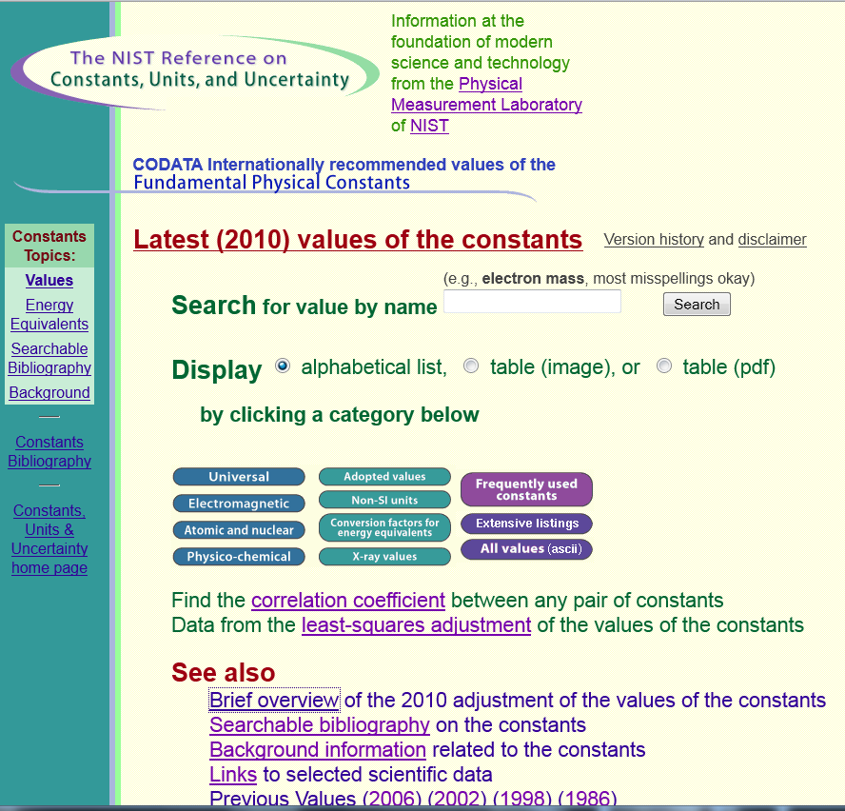

Renewed CODATA Task Groups, 2010-12
Anthropometric Data and Engineering *
Data Sources for Sustainable Development in SADC Countries
eGY Earth and Space Science Data Interoperability *
Exchangeable Materials Data Representation to Support Scientific Research and Education *
Fundamental Physical Constants *
Official member of the Consultative Committee on Units (CCU) of the International Conference on Weights and Measures (CIPM)
Global Information Commons for Science initiative - EU activities *
Polar Year Data Policy and Management
Preservation and Archiving of Scientific and Technical Data in Developing Countries *
* includes US chair, vice chair, or secretary

Slide 6
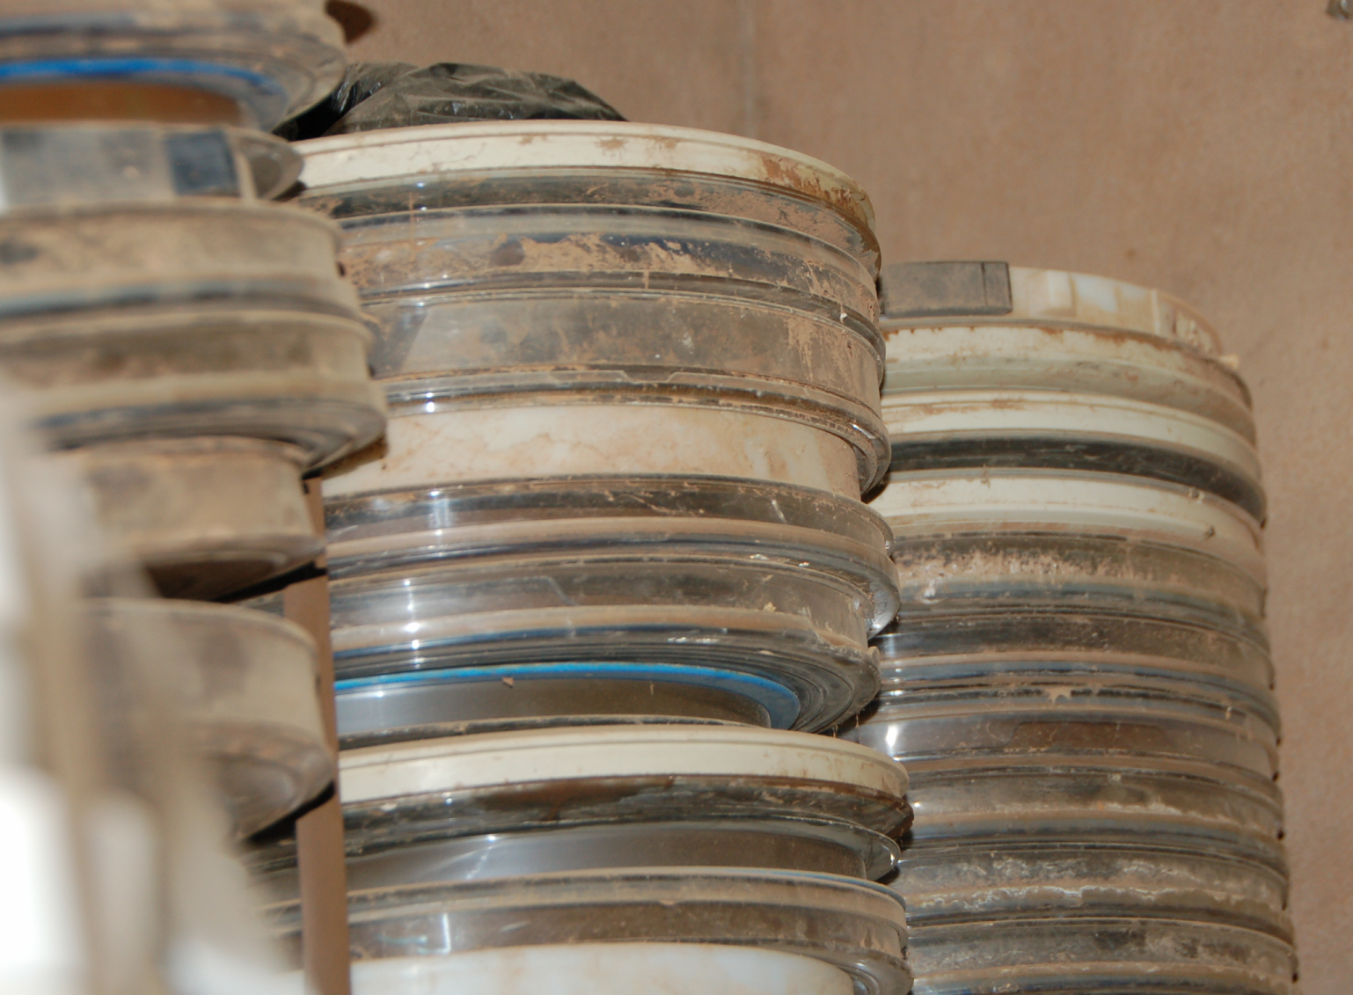
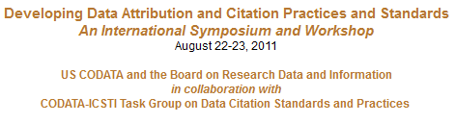
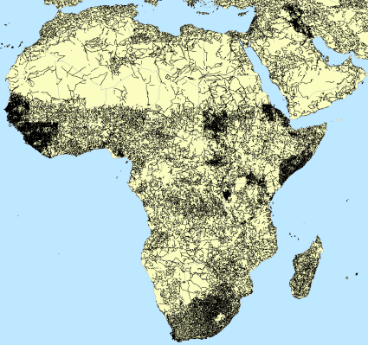

New CODATA Task Groups, 2010-12
Data at Risk *
Global Roads Data Development *
Data Citation Standards and Practices (with ICSTI) *
* includes US chair, vice chair, or secretary

Slide 7
CODATA Strategic Plans, 2006-12 and 2013-18
First plan established in 2005-06 in response to ICSU recommendation
Focused on digital divide and related data policy issues
Three major cross-cutting activities:
Global Information Commons for Science Initiative (GICSI)
Scientific Data across the Digital Divide Program (SD³)
Advanced Data Methods and Information technologies for Research and Education (ADMIRE)
Evaluation of past plan under way along with planning for the 2013-18 period
Survey sent to membership in late 2011
Coordination needed with ICSU Strategic Plan, 2012-17
New strategic plan to be considered at 2012 CODATA General Assembly in October 2012

Slide 8

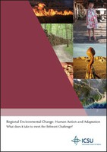

ICSU Strategic Plan II, 2012-17
ICSU Foresight Analysis, scenarios for the development of international science over the next 20 years
Earth System Science Initiative
Belmont Challenge on delivering knowledge to support human action and adaptation to regional environmental change
Strategic review on science education
Review of ICSU Regional Offices
New ICSU programs, e.g., hazards, urban health & wellbeing
Review of CODATA to be undertaken by ICSU

Slide 9
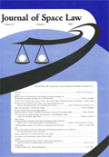

CODATA and GEO Data Sharing
CODATA involved in implementation of the Group on Earth Observations (GEO) Data Sharing Principles since 2008
Data Sharing Implementation White Paper published in 2009 by the Journal of Space Law and CODATA Data Science Journal
Helped draft data sharing guidelines and organize numerous side events at GEO and other events
CODATA represented ICSU as one of six co-chairs of the GEO Data Sharing Task Force, 2009-11 (P. Uhlir and R. Chen along with J. Gabrynowicz)
Data Sharing Action Plan accepted by GEO-VII Plenary in 2010; included establishment of the GEOSS DataCORE
P. Uhlir chaired Legal Interoperability subgroup
CODATA again representing ICSU as one of the co-chairs of new GEO Data Sharing Working Group (P. Uhlir and R. Chen)
Following up on data sharing implementation under GEO Task ID-01

Slide 10
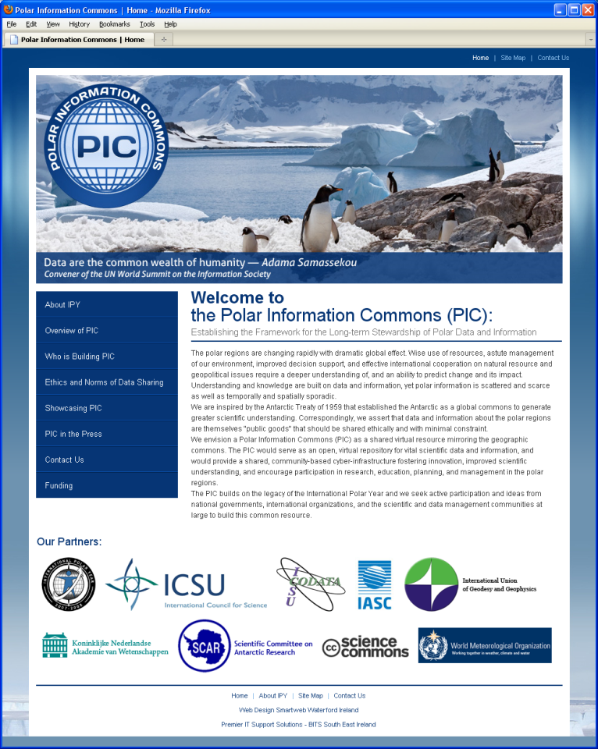

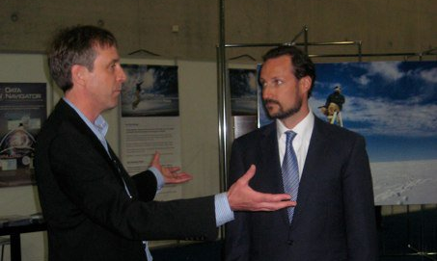
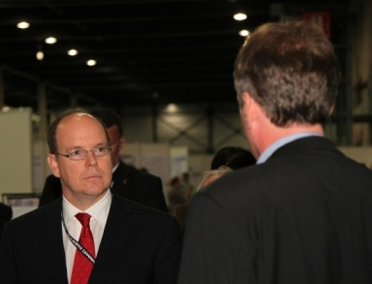
CODATA and the Polar Information Commons
Attempt to develop a long-term, community based structure for polar data sharing and stewardship after the end of the IPY
2008 ICSU Grant of 30,000 euros awarded in February 2009
Partners:
International Arctic Science Council (IASC), IPY IPO, IUGG, SCAR, WMO
World Data System Transition Team/Scientific Committee
Royal Netherlands Academy of Sciences
Science Commons
Established PIC Web Site and PIC Cloud
Defined structure for data sharing using CC licenses and public domain waiver
Prepared list of “norms” for data providers and users
Launch event at IPY Open Science Conference in Oslo in June 2010
http://www.polarcommons.org

Slide 11
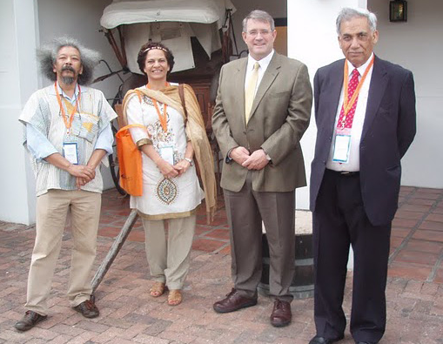

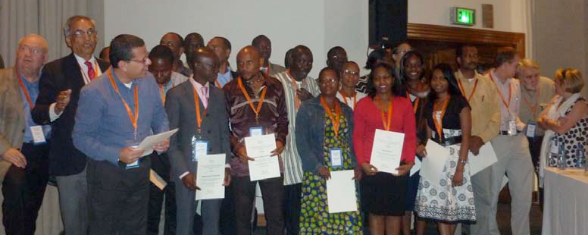
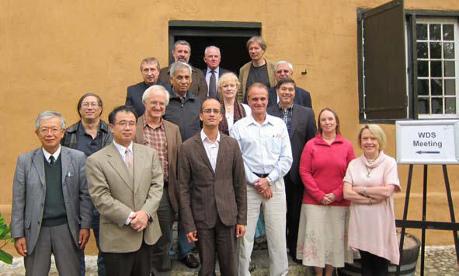
2010 CODATA Conference, Cape Town, South Africa
More than 250 participants (including staff and volunteers)
Around 80 scientists and students from Africa
Paul Laughton, co-chair Young Scientist WG
Strong keynotes, organized sessions
Significant support from South African NRF
Articles in SciDev.net, Nature
CODATA Prize award to Paul Uhlir
Two pre-meetings at the venue:
WDS Scientific Committee
Global Research Data Infrastructure 2020 initiative

Slide 12
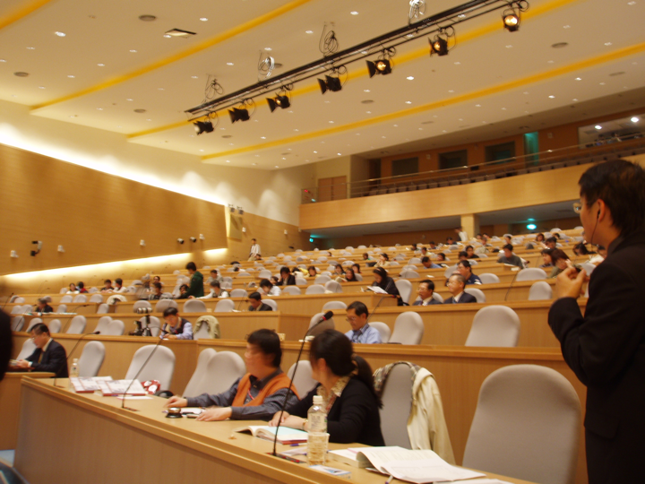
2012 CODATA Conference, Taipei
Conference, October 28-31; General Assembly, November 1-2
Conference theme
Open Data and Information for a Changing Planet
Scientific program committee
Chair: Prof. Ray Harris, University College London (retired)
Venue: Academica Sinica
Same venue as 2009 Symposium on Common Use Licensing of Publicly Funded Scientific Data and Publications
Modern campus, meeting rooms, Internet
Web site in development
Online submission, review (easychair.org)
Accommodations include rooms on campus, in nearby business hotel, and in Taipei City
Opportunities for pre-meetings and workshops

Slide 13

Other Recent & Ongoing Activities
Contributed to and endorsed Advisory Note on Data Sharing with Developing Countries issued by ICSU Committee on Freedom and Responsibility in the conduct of Science (CFRS) in 2011
http://www.icsu.org/publications/cfrs-statements/data-sharing/
MoU with the ICSU Integrated Research on Disaster Risk (IRDR) program
Organized data session at the first IRDR Conference in Beijing, 31 October-2 November 2011 (see background slide)
Coordination under way with IRDR Disaster Loss Data Working Group
Special issue of the CODATA Data Science Journal based on the First ICSU WDS Conference held in Kyoto in September 2011
Joint ICSU/CODATA workshop on common ontology and interoperable standards for nanotechnology, February 2012
Initiative on harmonization of data standards involving WDS and Unions
Data Session at Planet Under Pressure Conference, London, March 2012
Potential participation in Rio+20 in June (or related events)??
Young scientist activities

Slide 14


s
Session organized by ICSU, CODATA, WDS-SC: Data Challenges for Global Sustainability
Data intensive science and our changing planet (Guo)
Multidisciplinary, Integrated Data on Sustainability (Chen)
Long time series of data for sustainability (Minster)
Open science and open data: funders' role in ensuring open access to research data (Thorley)
Linking research data to articles: the role of publishers in supporting open and transparent research (Wilson)
The need of disaster loss data for global sustainability (Wirtz)

Slide 15




Recent CODATA Partnerships: “Hand in Hand”
World Data System
Integrated Research on Disaster Risk
International Society for Digital Earth
International Geographical Union and Geographical Society of China

Slide 16
Key Issues for BRDI
Inputs on CODATA Strategic Plan
Major topic of upcoming CODATA Executive Committee meeting in March (just before Planet Under Pressure)
Opportunities for linking with ICSU initiatives, e.g., Intergovernmental Platform on Biodiversity and Ecosystem Services (IPBES), Integrated Research on Disaster Risk (IRDR) program
Participation in CODATA Task Group activities
Late submission of new applications and renewals possible
Contributions to CODATA 2012 Conference
Possible joint activities, sessions, etc. (to be discussed later)
Inputs to GEO Data Sharing Working Group
CODATA – WDS Interactions
To be discussed tomorrow

Slide 17
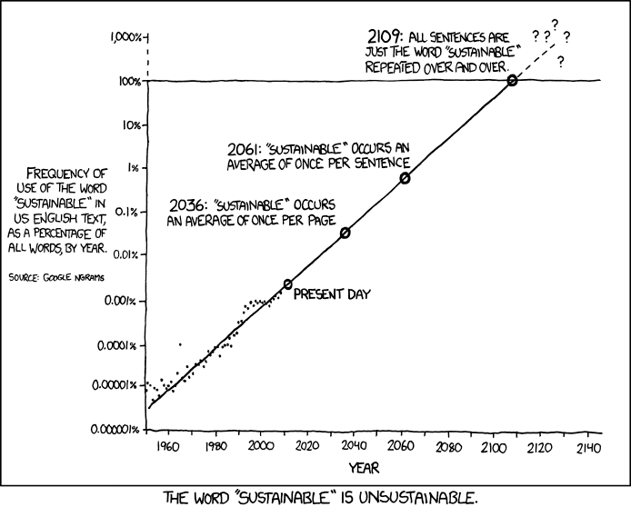
Background Slides
http://xkcd.com/1007/

Slide 18
Brief Timeline of CODATA’s Strategic Plan
2005-6 ICSU recommends development of Plan in its Priority Area Assessment on Data and Information and the ICSU Strategic Plan
2006 25th CODATA GA in Beijing reviews draft Plan and approves new mission statement and key initiatives and actions
2007 CODATA completes full version of plan and sends for review; ICSU GA in Maputo endorses Plan
2008 26th CODATA GA in Kiev endorses Plan
2006-10 Key initiatives are launched
2009 ICSU establishes Ad hoc Strategic Coordination Committee on Information and Data (SCCID) for 3 years
2010 27th CODATA GA in Cape Town calls for review of current Plan and development of new Plan for 2013 and beyond
2011 CODATA Executive Committee appoints Strategic Plan Committee; ICSU approves its Strategic Plan for 2012-17 including CODATA review; survey sent to CODATA members

Slide 19
CODATA and GEO Data Sharing
Group on Earth Observation (GEO) Task DA-06-01 led by CODATA, 2008-11
Data Sharing Implementation White Paper by Uhlir, Chen, Gabrynowicz and Janssen published in 2009 by the Journal of Space Law and the CODATA Data Science Journal
Data Sharing Guidelines accepted by GEO-VI Plenary in 2009
Organized side events at Ministerial Summits and Plenaries in 2007, 2008, 2009, and 2010; represented ICSU at 2011 plenary
One of six co-chairs of the GEO Data Sharing Task Force, 2009-11 (P. Uhlir and R. Chen along with J. Gabrynowicz)
P. Uhlir chaired Legal Interoperability subgroup addressing use of open access licensing approaches within GEO
Data Sharing Action Plan accepted by GEO-VII Plenary in 2010; included establishment of the GEOSS Data CORE
Co-chair of new GEO Data Sharing Working Group (P. Uhlir and R. Chen)
R. Chen serving as Task Coordinator for GEO Task ID-01
R. Chen also representing ISDE on working group
GEO Work Plan Symposium, Geneva, May 2012

Slide 20

Session organized by CODATA: Integrated Disaster Data in Support of Integrated Disaster Research
Importance of High Quality Data for Calibration and Verification of Hazard and Risk Models (Nadim)
OpenISDM: An Open Framework for Disaster Information Systems (Ho)
GEO Grid Disaster Response Task Force Activity for the 2011 Tohoku, Japan Earthquake (Iwao)
Progress and Challenges in Integrating Disaster Data and Information (Chen)

