Slide 1
ICSU World Data System
(update from 30th ICSU GA)
Jean Bernard Minster
Chair, WDS Scientific Committee
Presentation to BRDI, 02/01/2012

Slide 2
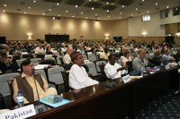
WDS creation
ICSU 29th General Assembly decision in Maputo (October 28, 2008):
to establish a new ICSU-World Data System as an Interdisciplinary Body to replace the WDC and FAGS.
Notes:
Following the recommendation from the Strategic Committee on Information and Data

Slide 3
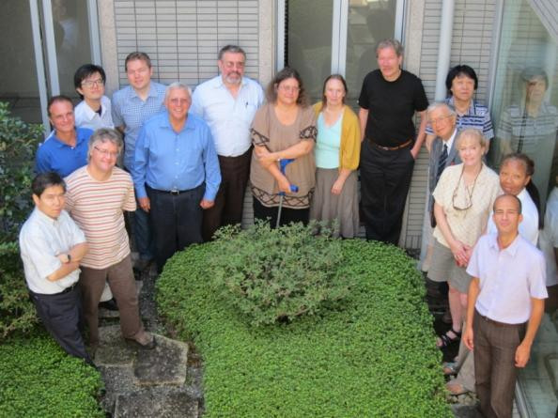
Scientific Committee
Jean- Bernard Minster (Chair), USA/France
Michael Diepenbroek, (Vice Chair) Germany
David Clark, USA
Francoise Genova, France
Luiz Horta, Brazil
Wim Hugo, South Africa
Ruth Neilan, USA
Lesley Rickards, UK
Takashi Watanabe, Japan
Baoping Yan, China
Michael Zgurovsky, Ukraine
Mustapha Mokrane, (ICSU ex officio)
Notes:
The WDS-SC met physically 5 times
Numerous teleconferences

Slide 4
WDS Scientific Committee ToR
To ensure ....long-term stewardship and provision of quality-assessed data and data services to the international science community and other stakeholders;
to develop ...an implementation plan for the creation of the World Data System;
to define agreed standards, establish ...procedures for the review and accreditation...
to monitor the geographic and disciplinary scope of the system
to consider resource issues and provide guidance on funding mechanisms for facilities within WDS when appropriate;
to develop close links and cooperation with CODATA.

Slide 5
WDS Objectives
Enable universal and equitable access to quality-assured scientific data, data services, products and information;
Ensure long term data stewardship;
Foster compliance to agreed-upon data standards and conventions;
Provide mechanisms to facilitate and improve access to data and data products.
Notes:
As defined in the constitution

Slide 6
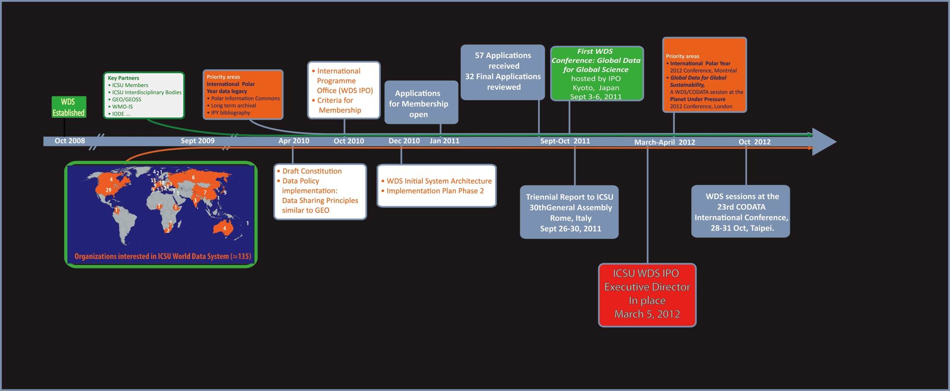
Where we are… and where we are going

Slide 7
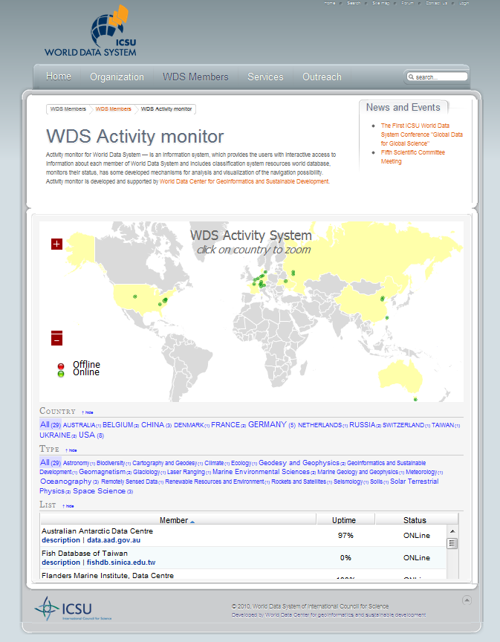
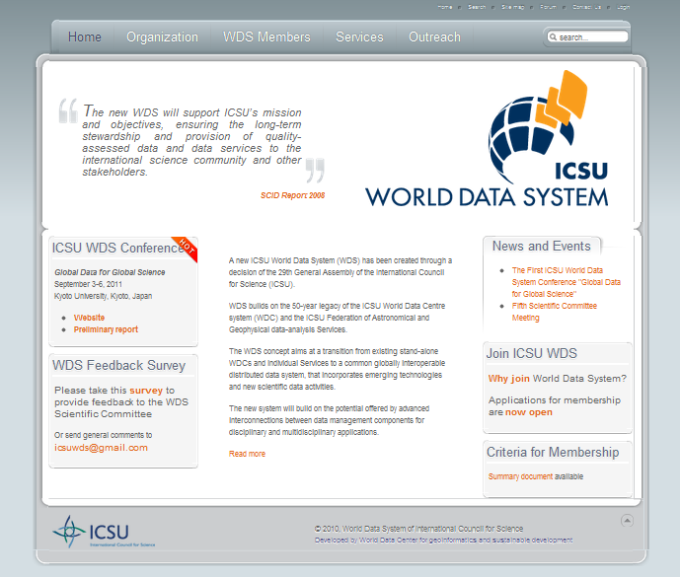
WDS Website
www.icsu-wds.org
Hosted in Kyiv, Ukraine

Slide 8
WDS Constitution
Constitution approved by ICSU EB in April 2010 with basic definitions of:
  WDS
  WDS-SC
  International Program Office (IPO)
Bylaws to be developed with input from Members:
  Details of operations of the IPO
  WDS membership

Slide 9
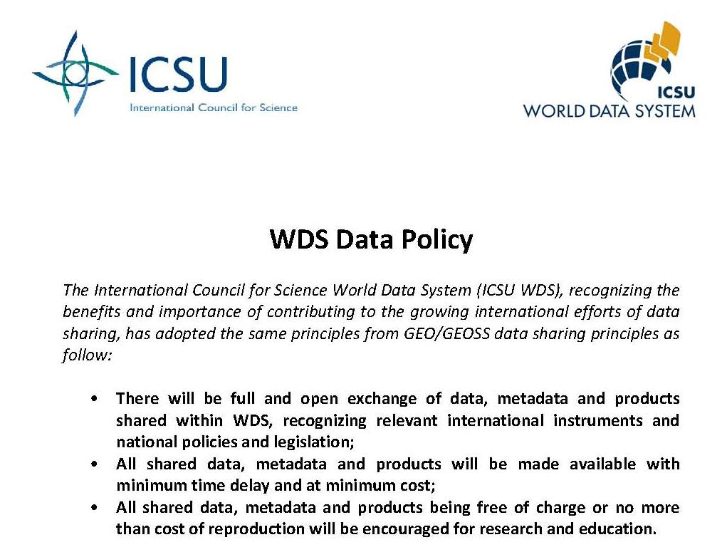
WDS Data Policy

Slide 10
Programme Office (IPO)
The International Programme Office (IPO) is responsible for implementing the decisions of the Scientific Committee and day to day tasks of coordinating the ICSU WDS activities.

Slide 11



Programme Office (IPO)
Approved by ICSU EB, April 2010
NICT proposal accepted, November 2010
Letter of agreement signed, July 2011
IPO hosted by NICT in Tokyo, Japan
IPO Executive Director, March 5 2012
Opening Ceremony, April 19, 2012
IPO staffing in place, 2012

Slide 12
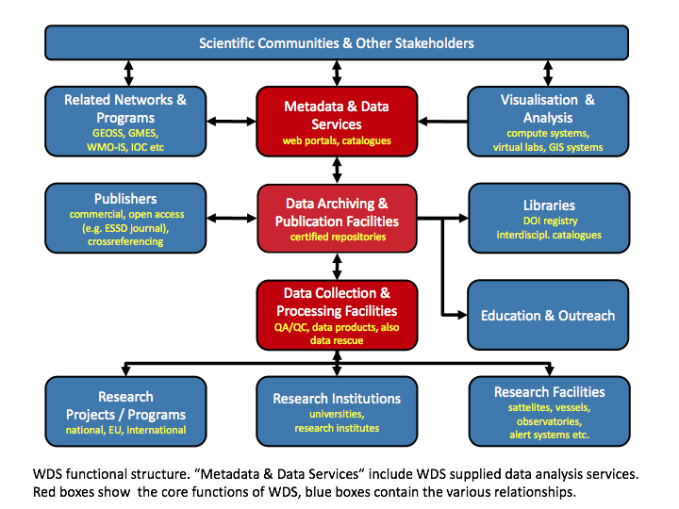
Structure & Architecture
Notes:
Highlight the main functions of WDS (red boxes)
The links to other orgnaizations (blue boxes)

Slide 13
WDS - a "system of data systems"
...of data archive centres, data analysis centres, data producers, data developers, data observing systems and networks, virtual observatories, etc., both regional (including national) and global
Membership criteria inclusive of this concept
Some may need to be more general than current ones
Tough concept to address until WDS is fully developed...

Slide 14
One node? … Or many?
IGS Associate Members
External Interfaces
Governing Board
Oversight
Committees of the GB
IAG/GGOS
IERS
BIPM
ICSU/WDS
UNOOSA/ICG
Executive Committee
Strategic Planning Committee
Elections Committee
Infrastructure Committee
Product Coordinators
Analysis Coordinator
Central Bureau
Executive Management
Network Coordination
Information Portal
Support Organizations
Reference Frame
Clock Products
IGS Institute
UNAVCO
Pilot Projects and Working Groups
Antenna WG
Bias & Calibration WG
Clock Product WG
Data Centers WG
GNSS WG
Ionosphere WG
LEO WG
Real-time WG
Reference Frame WG
Troposphere WG
Tide Gauge PP
Analysis Centers
Data Centers
IGS Tracking Stations
Global Network ACs
Global Network AACs
Regional Network AACs
Other AACs (Ionosphere, Real-time)
Global Data Centers
Regional Data Centers
Operational Data Centers
Project Data Centers
Reference Frame Stations
Multi GNSS Stations
Real-time Stations
Application Stations (e.g. Tide Gauge, Timing)
International Association for Geodesy/Global Geodetic Observing System (IAG/GGOS)
International Earth Rotation and Reference Frame Service (IERS)
Bureau International des Poids et Mesures (BIPM)
International Council for Science/Word Data Systems (ICSU/WDS)
United Nations Office for Outer Space Affairs/International Committee on GNSS (UNOOSA/ICG)
Analysis Center (AC)
Associate Analysis Center (AAC)

Slide 15

“System of data systems”
World Data System – A System of Data Systems
WDC = World Data Center*
WDS = World Data Service*
WDAS = World Data Analysis Service*
WDA = WDS Data Activity*
WNP = WDS Network Member
* Regular members of WDS
WDC
WDA
WDC
WDC
WDC
CD
WDC
WDA
WDA
WDC
WDC
WDC
WDA
WDA
WDS
WDC
WDC
WDA
WDAS
WDC
WDAS
= International
WDAS
= National
WDAS
WNP
WNP
= Regional
WDAS
WDA
WDC
WDA
= Disciplinary
WDA
WDA
WDA
WDA
WDAS
= Interdisciplinary
WDAS
WDA
WDA
Illustrative example of the interoperability between the components of a WDSSDS

Slide 16
WDS Membership types
Regular members: Data curation and data analysis services.
Network members: Groups of regular members, Umbrella organizations
Partner members: Do not deal directly with data collection, curation, and distribution
Associate members: Organizations interested in the WDS endeavor

Slide 17
WDS Membership criteria
Transparent and objective base for the
  Evaluation
  Accreditation
  Assessment
Trustworthiness in terms of
  Authenticity
  Integrity
  Confidentiality
  Availability
Notes:
These criteria will supply a transparent and objective base for the evaluation and accreditation of WDS candidates as well as for periodic assessment of the WDS facilities and the overall performance of the system. The certification procedures will ensure the trustworthiness of WDS facilities in terms of authenticity, integrity, confidentiality and availability of data and services.

Slide 18
WDS Membership criteria
Four categories of criteria for regular members:
General requirements and policies
Organizational framework
Management of data, products and services
Technical infrastructure
Notes:
These criteria will supply a transparent and objective base for the evaluation and accreditation of WDS candidates as well as for periodic assessment of the WDS facilities and the overall performance of the system. The certification procedures will ensure the trustworthiness of WDS facilities in terms of authenticity, integrity, confidentiality and availability of data and services.

Slide 19
WDS Membership status
37 accredited WDS Members
  Over 146 Expressions of Interest
  58 applications for membership
  33 regular members
  1 network member
  1 partner member
  2 associate members
  11 applications discouraged

Slide 20

IPY data legacy
Contribution to the CODATA Polar Information Commons (PIC) project
Bibliography effort to uncover IPY data from publications
Targeted invitations to 80 major IPY holders to join the ICSU WDS

Slide 21

IPY data legacy
IPY data holders already members of WDS :
Research Institute of Hydro-meteorological Information, Russia
Australian Antarctic Data Centre, Australia
Flanders Marine Institute, Belgium
PANGAEA - Earth & Environmental Science, Germany
World Glacier Monitoring Service, Switzerland
WDC for Geomagnetism, Denmark
WDC for Geophysics (NGDC/NOAA), USA
WDC for Meteorology (NCDC/NOAA), USA
WDC for Oceanography (NODC/NOAA), USA
Sources: WDS, IPYDIS, GCMD

Slide 22
First WDS Conference
1st ICSU World Data System Conference: Global Data for Global Science
3-6 September 2011,Kyoto, Japan
155 Participants from 22 countries
Representatives of data centres and data services, data scientists and engineers
Multidisciplinary: natural sciences, social sciences, information technologies

Slide 23
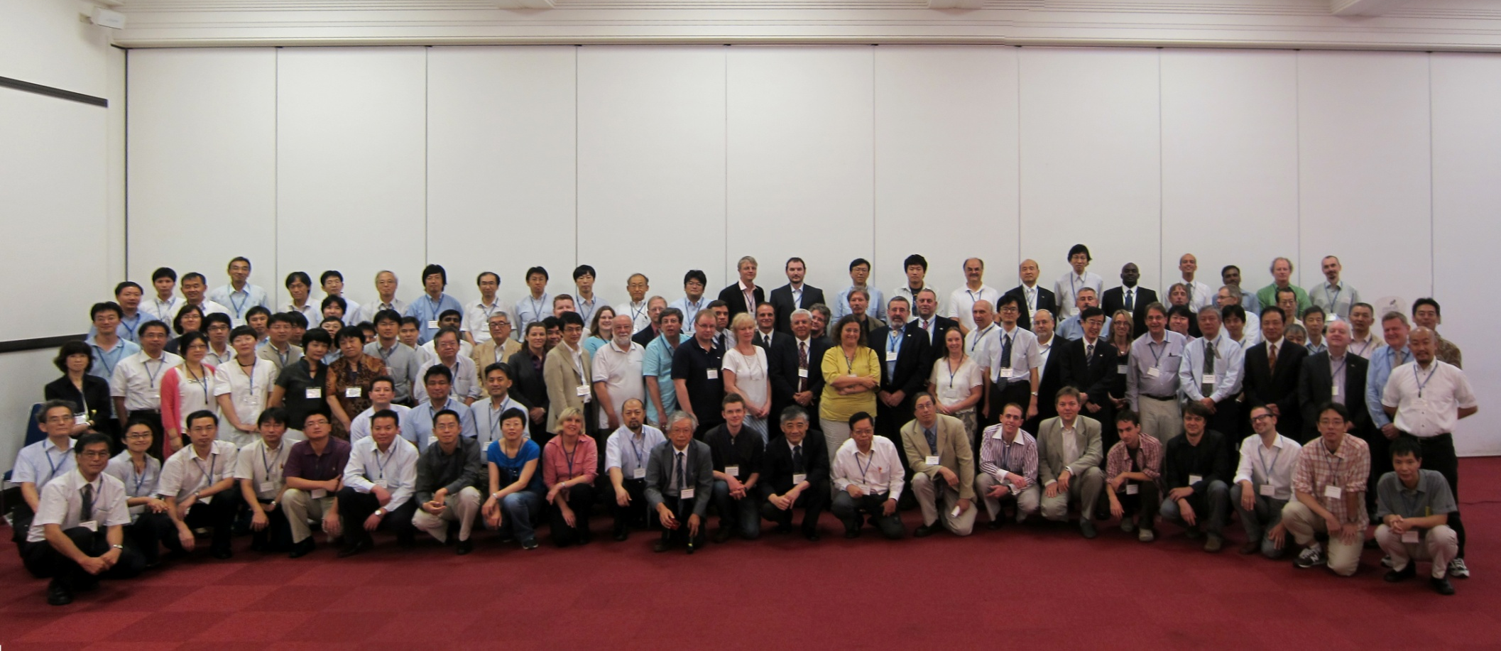
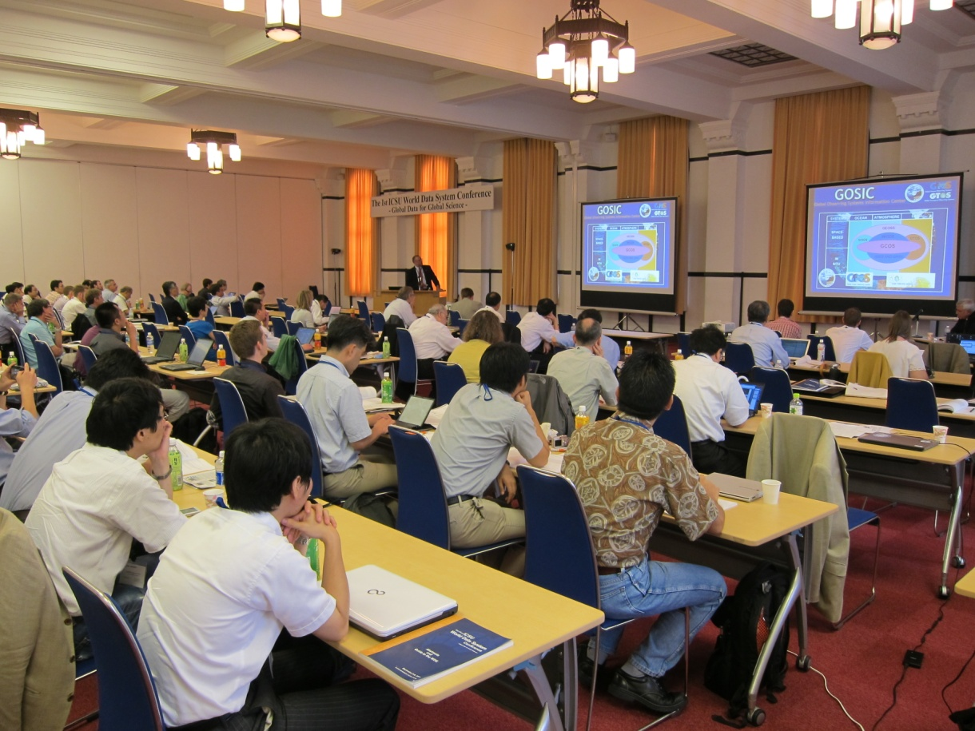
First WDS Conference

Slide 24
First WDS Conference
Session on Disasters Data in collaboration with IRDR
Session on Data Publication with participation of scientific publishers
Open Forum for input/recommendations
Conference proceedings in special issue of the CODATA Data Science Journal

Slide 25
Shared Understandings
....The WDS should aim at an integration of multidisciplinary scientific data and information to address the needs of ICSU programmes including the Earth System Sustainability Initiative...
... data publication and data citation should be adopted and promoted by the World Data System in order to facilitate the release of data, with proper recognition of providers...
...Ongoing collaboration between ICSU programmes—WDS, CODATA and IRDR—will be critical for building interoperable data systems that guarantee full and open access to data in support of better disaster prediction, understanding, and mitigation...

Slide 26
ICSU-WDS SC Goals (Draft)
Goal #1: Enable universal and equitable access to scientific data, data services, products and information
  Approach well-established communities of practice and disciplines, identify commonalities, and successful characteristics
  Protect existing communities whose practices serve their members well
  Approach emerging communities and disciplines, and help them identify their needs and organize their data activities
  Foster interoperable practices to approach universality
  Seek and promote innovations that lead to ever more affordable and reliable analysis services and sustainable data flow
Goal #2: Ensure long-term data stewardship;
  Spell out costs/benefits analysis of long-term data stewardship
  Promote international, national and disciplinary policies that lead to sustainable long-term stable funding
  Coordinate with data forums and technology forums to facilitate adaptation to new data models and curation paradigms
  Coordinate with technology forums to facilitate migration of long-term data holdings to new technologies
Goal #3: Foster compliance to agreed-upon data standards and conventions;
  Compile a catalog of well-accepted standards and conventions, adopted by communities of practice that include WDS members
  Document strategies employed by WDS members to promote or enforce adherence to standards and conventions
  Identify areas where weak standards or conventions constitute an impediment to achieving the goals of WDS
  Prepare nominal “template” standards and conventions based on successful examples, and incorporate these in “starter kits”
  Coordinate with international standards organizations such as ISO
Goal #4: Provide mechanisms to facilitate and improve access to data and data products
  Identify bottlenecks, or inadequate practices, that limit access to data and data products, and document the circumstances that lead to such shortcomings
  Actively promote policies of full and open access to data at national and international venues
  Identify mechanisms for data access, that are most affordable and most applicable to emerging economies

Slide 27
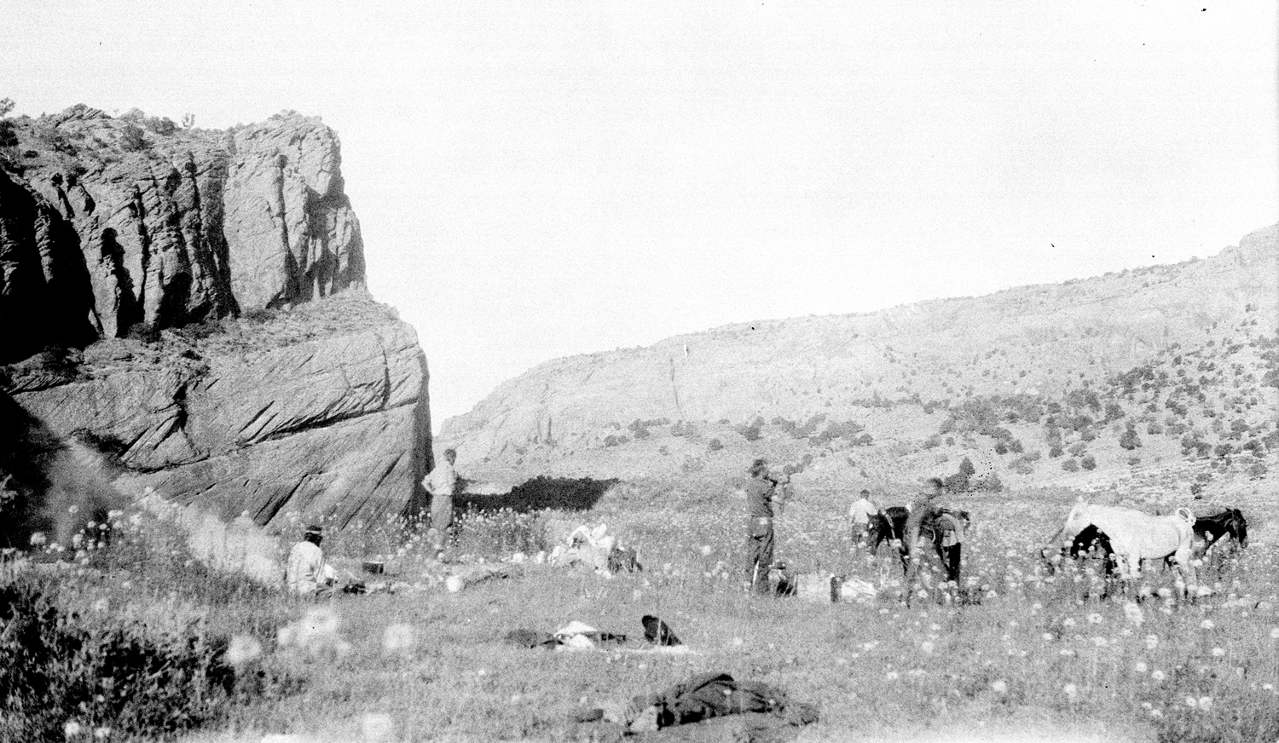
Tsegi Canyon, 1927
James J. Hanks Collection, Special Collections and Archives, Cline
Library, Northern Arizona University. NAU.PH.2005.3.1.2.3c. Metadata at http://archive.library.nau.edu/ item 45552

Slide 28
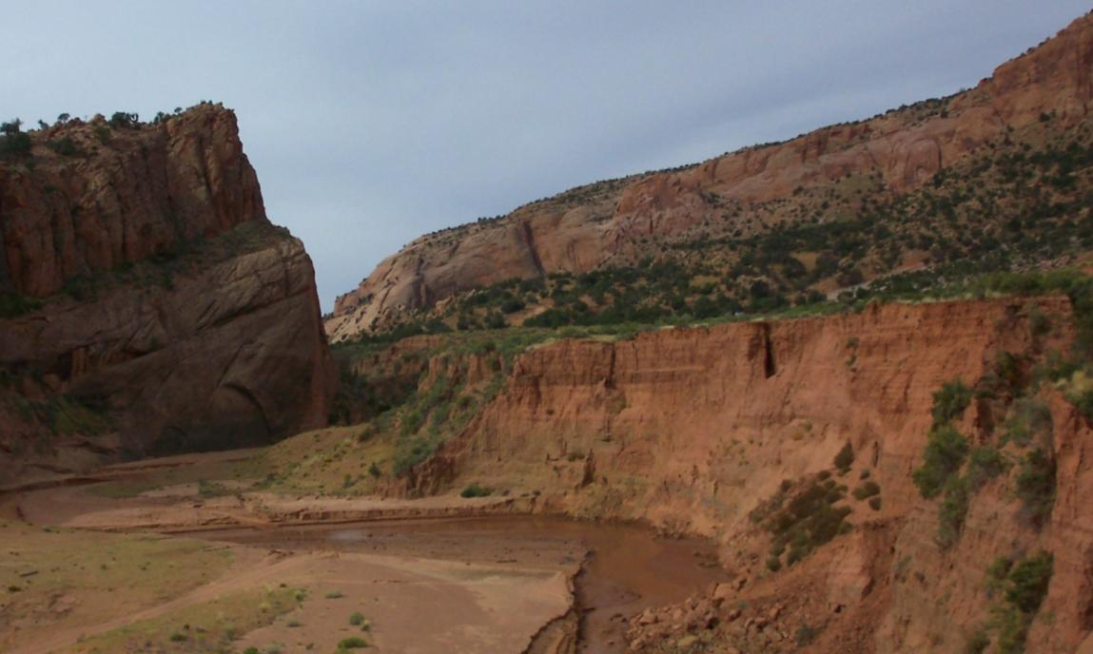
Tsegi Canyon, 2005 (Bob Webb)
Repeat geo-photography: A data publication, curation and analysis service for the geological community

Slide 29
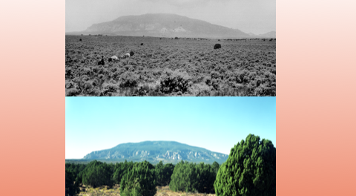
Thank you

Slide 30

Strengthening international
science for the benefit
of society

