Slide 1
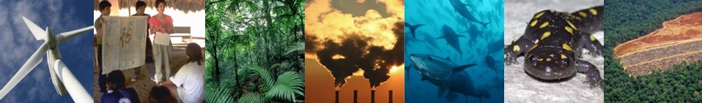
Scientific and Technical Advisory Panel Global Environment Facility (GEF)
Thomas E. Lovejoy
Chair, GEF-STAP
Biodiversity Chair
Heinz Center for Science, Economics, and the Environment

Slide 2
Outline of presentation
Overview of the Global Environment Facility
Role of the Science Panel within the GEF
Areas of possible collaboration
Notes:
Thank you for inviting us to spend a few minutes outlining the work of the Global Environment Facility and STAP
We would like to give you a quick overview of what the GEF is, what it does, and the role of the GEF’s Science Panel which I Chair
I’ll briefly touch on some of our recent work and advisory products (which we have brought a few examples of);
Along with a few upcoming STAP initiatives.
And conclude on our thoughts regarding possible areas of possible future collaboration
[NEXT SLIDE]

Slide 3
Snapshot of the GEF
Multi-lateral trust fund - established in 1991
Launched during the Rio Earth Summit, 1992
Designed to address challenges of the global commons:
Biodiversity
Climate Change
Ozone Depletion
International waters and the high seas
Now also includes:
Land degradation
Chemicals and POPs
Sustainable Forest Management
Climate Adaptation
Notes:
The GEF is not an organization, but rather a partnership of donor and recipient countries, along with 10 multi-lateral implementing agencies – such as The World Bank, UNDP, UNEP and others – supported by a Secretariat based in Washington and hosted by the World Bank
[NEXT SLIDE]

Slide 4



GEF Implementing Agencies
Specialized Technical Agencies
The original 3
Regional Development Banks
Notes:
The original 3 implementing agencies are UNDP, The World Bank, and UNEP
Increased technical needs and implementing capacity resulted in additional specialized agencies and regional development banks
UNEP is the only GEF implementing agency with the global environment as its core mandate
[NEXT SLIDE]

Slide 5
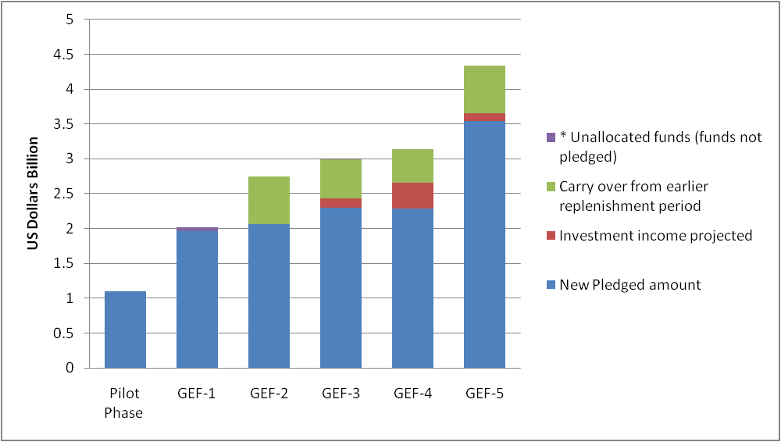
GEF funding allocation . . .
Beginning in 1990 – at 4 yr. intervals
Notes:
Each funding replenishment here covers a roughly 4 year period beginning in 1990.
GEF funding has grown substantially over the past two decades – the grant program is now roughly 1 billion a year
Funding approach is meant to compliment existing aid, lending, and development programs – implementing agencies, project partners, and recipient countries are required to bring co-financing
Overall funding – grants + co financing – is roughly 4.5 billion per year
For global environmental action – the GEF is by far the biggest game in town.
5

Slide 6
. . . and by focal area
Notes:
Biodiversity conservation and climate change mitigation efforts together represent almost two thirds of funding.
There have been notable success:
The GEF has been the primary driver behind a tripling of the world’s protected area estate over the past two decades.
GEF Energy efficiency and renewable energy initiatives have so far led to 6.2 billion tonnes of direct and indirect reductions in CO2 emissions – roughly equivalent to 1 year of emissions in the US
The GEF has been the primary funder of country action to implement the Montreal Protocol on Ozone Depleting Substances – the world’s most successful multilateral environmental agreement
[NEXT SLIDE]

Slide 7
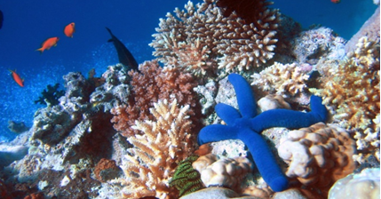
What is STAP?
The Scientific and Technical Advisory Panel (STAP) of the Global Environment Facility (GEF) provides independent scientific advice on:
GEF projects (roughly 100 per year)
Overarching themes or programs (e.g. payments for ecosystem services)
and GEF Policies (e.g. Targeted Research)
Notes:
STAP is a small group of international scientists with expertise in each of the thematic areas of the GEF.
STAP reports to the GEF Council – and assists Council in addressing the tackling the complex scientific challenges the GEF was created to address
The Panel is charged with ensuring that the GEF Council is plugged into the most authoritative and representative science – an important and gargantuan task.
[NEXT SLIDE]

Slide 8

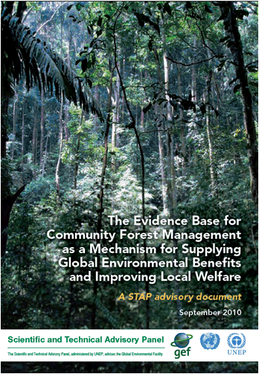

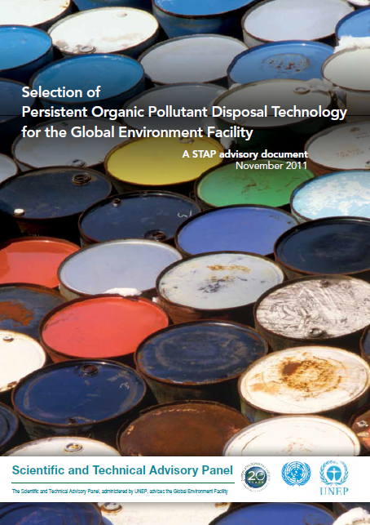
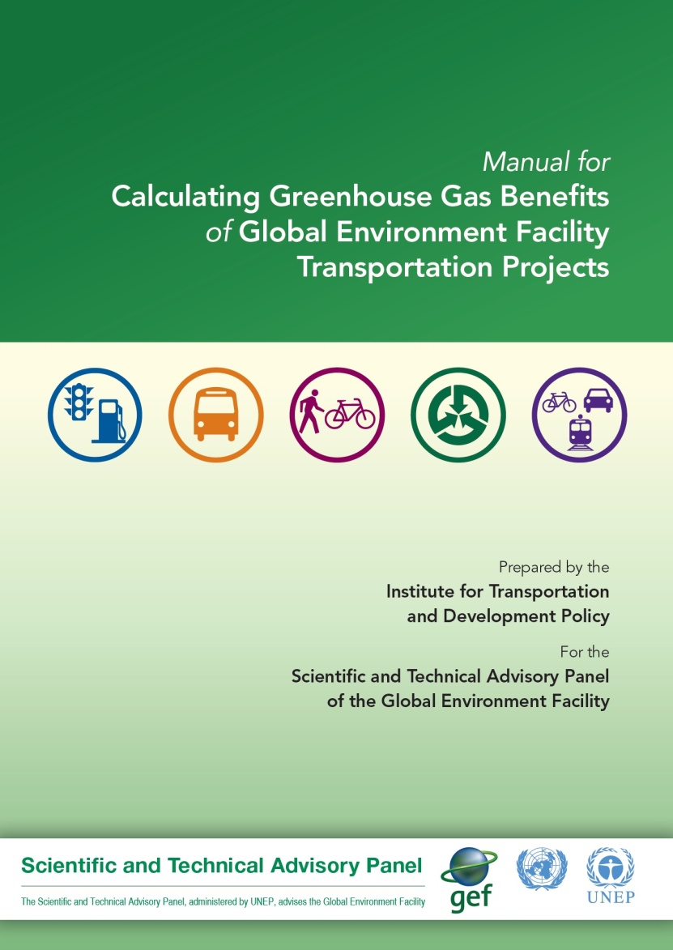
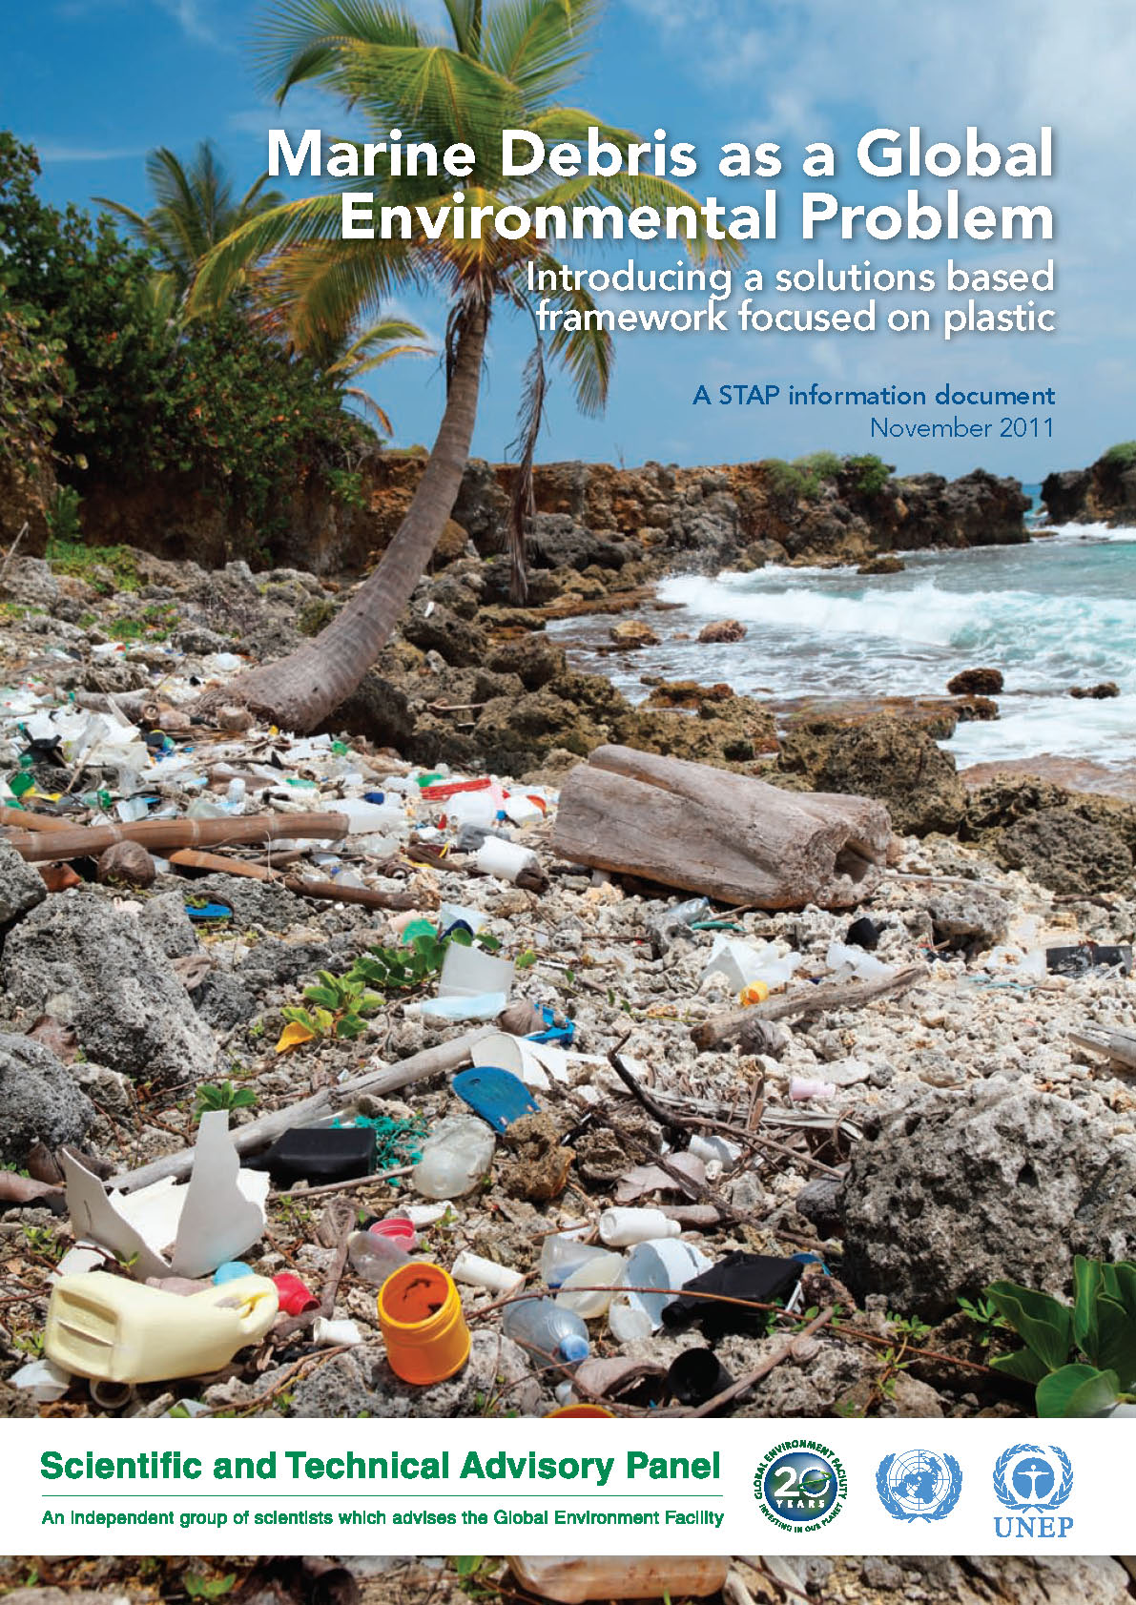
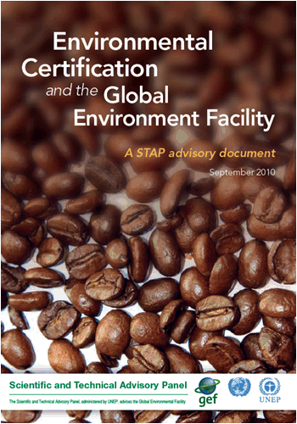
Recent STAP Advisory Products
Notes:
STAP’s Advisory Products and publication series continues to grow. Our most recent publications – [MOUSE CLICK ]“Hypoxia and Nutrient Reduction in the Coastal Zone” and [MOUSE CLICK]the “Selection of Persistent Organic Pollutant Disposal Technology for the GEF” – are now in circulation. All are available on our website, and as I mentioned we have brought a few copies with us. [NEXT SLIDE]

Slide 9
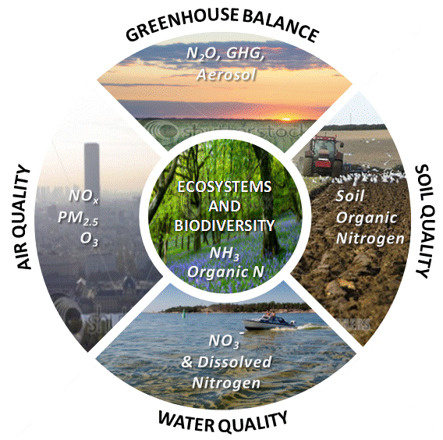
Global Threats of Excess Nitrogen
Source: European Nitrogen Assessment, 2011
Notes:
Upcoming initiatives include a systematic review of disruption of the global nitrogen cycle – based on the recently completed European nitrogen assessment – with a view to the GEF taking this on as a key program area

Slide 10
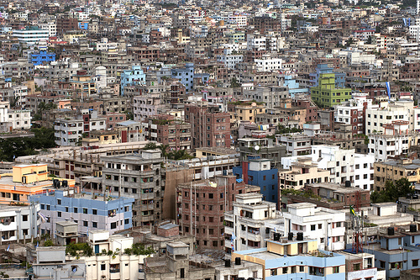
Urbanization
More than half of humanity now lives in cities… and 2 billion more will move to cities by 2030.
Over 90 % of urbanization is taking place in the developing world.
Scope of the study:
Effects on GEF Focal Areas
Emerging opportunities
Notes:
For the first 20 years, the GEF has had a distinctly rural focus.
With the world now at 7 billion – and with more than half of these people living in urban areas (which is rapidly increasing) – The GEF is now considering how a shift to a predominantly urban focus will re-shape the GEF program

Slide 11
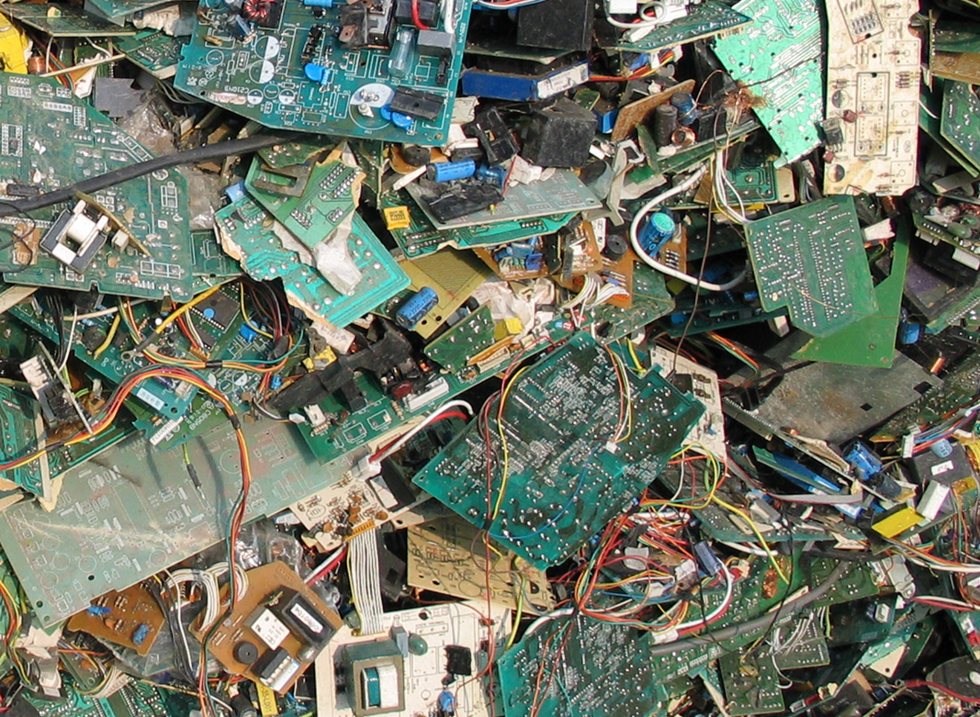
Emerging Chemical Mgt. Issues
Notes:
The GEF has been instrumental in significant reductions of persistent organic pollutants in many developing countries
But a host of new toxic chemical management challenges, such as e-waste and marine debris, have emerged since the GEF was created

Slide 12
Implications for the GEF (and STAP)
Protect past investments - and successes
Address planetary boundaries being crossed
Understanding, restoring, and maintaining Earth System thresholds
Notes:
The implications for the GEF will be familiar to you – as they are similar for the environmental science community more broadly
We need to protect what we have, and have accomplished
We need to focus greater attention on planetary boundaries – those we have crossed and those we will soon cross
and finally wherever possible restore and maintain earth systems
We also need to be cognizant of how these challenges will grow with a world of 9 billion people

Slide 13
Areas of collaboration
Assist STAP in connecting to emerging science & experts
STAP members use their professional networks, but we would like to make this systematic
Collaborate on GEF research efforts
Targeted research projects
Notes:
There may be more, but these are two areas of possible collaboration we would like to highlight:
- STAP is actively seeking to expand its networks in a systematic way, and we would welcome advice and collaboration from the NAS
The GEF, with STAP guidance, is also revising it’s research policy
This has been an underfunded and poorly used component of the GEF program
GEF Implementing Agency projects – and even targeted research projects - are typically not well grounded in science
We would welcome your advice in creating a fully transparent, science-based, and competitive research program within the GEF – which could perhaps leverage funding from existing research grant programs
[NEXT SLIDE]

Slide 14
Questions and comments welcomed
Thomas E. Lovejoy
Chair
GEF Scientific and Technical Advisory Panel
www.unep.org/stap
Notes:
I will leave it there – thank you for your time
We welcome any comments or questions you may have, and look forward to future collaboration

