Slide 1

Feedback from BRDI Sponsor Forum 11/11
January 29, 2012
Fran Berman

Slide 2












“What could BRDI take on that would help your agency and the community?”

Slide 3
The Government can’t / shouldn’t do it alone – partnership is critical
Partnership
What vehicles can be developed that create cross-sector partnerships to support data access, preservation, and stewardship?
How can agencies coordinate to strategically address the broad spectrum of needs for the research community?
What approaches would promote economies of scale, efficient use of resources, and data sharing and collaboration? What “carrots” and “sticks” are needed to make these approaches successful?
What additional vehicles should be developed to foster successful international partnerships to increase access to valued collections, foster the development of international data repositories, and accelerate the development of community standards and tools?
What approaches can be used to better coordinate regional, state, national and international efforts?

Slide 4
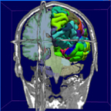

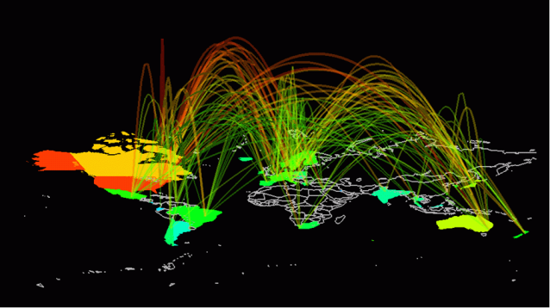
Stewardship and preservation of today’s data needed for future access and research impact
Preservation and Stewardship
What economically sustainable vehicles can be developed to support access and long-term preservation of valued research data?
What approaches are needed to ensure viable stewardship options for grantee data?
What should be provided to researchers and expected from researchers to support the access, stewardship, and/or preservation of valuable data?

Slide 5
Increasing data awareness and prioritization is fundamental to successful 21st century research practice and Innovation
Awareness and Prioritization
What approaches can be taken to promote data citations as a metric of academic success? How can we facilitate the linkage of publications and data sets?
How can we elevate data-oriented programs and infrastructure as a priority to decision-makers and stakeholders?
How can we coordinate communities of practice to accelerate data integration?
Education and training
What are good practices, standards, and resources with respect to data?
What can be done to educate grantees on good data management practice throughout the data life cycle?
What venues and curricula are critical to develop today’s and tomorrow’s data professionals and data-aware professionals?
How should agencies, universities, museums, libraries, repositories, data centers, and others be involved?

Slide 6
Clear criteria for success and ways of assessing status are needed to drive effective programs and efforts
Monitoring / Tracking / Assessment
What are effective vehicles for federal agency oversight of data?
How should data use and impact be monitored / assessed?
What approaches can we use to assess re-use of data beyond the original community?
Can we identify or develop tools that simplify / promote good data management ?
What additional tools and policies are needed to ensure data privacy and/or appropriate limited access?
Metrics of Success
(Community) How should we assess the potential impact of data?
How should the value of data to users and communities be measured?
How should the potential value of data for reuse or repurposing (and for how long) be measured?
(Infrastructure) How should successful stewardship be measured?
(Programs) How should the impact of data programs be measured?
How should the return on investment of data-oriented efforts be measured?
What is the “value proposition” for data-oriented efforts?

Slide 7
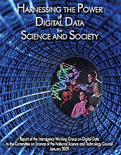
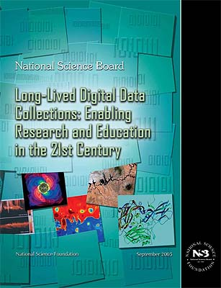
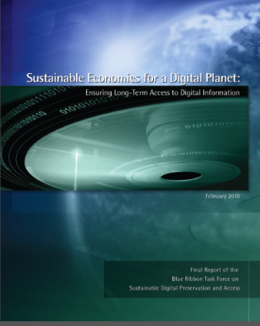
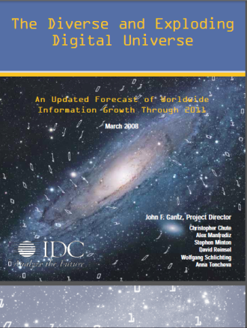
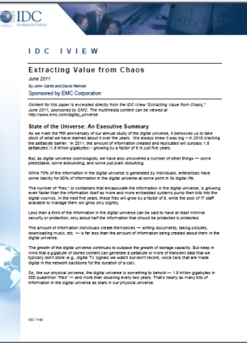
Cohesive approaches needed to project impact, use and opportunity for effective strategic planning
Strategic Planning
How can agencies project and address community and user data needs to inform the development of future programs, plans, and the allocation of resources?
What are the costs and downsides of inadequate data, programs, and infrastructure?
How can we identify valuable unique / irreplaceable data sets? What mechanisms are needed to collect key data and metadata of value for the community?

Slide 8
Thanks to our sponsors for an outstanding and timely discussion

Slide 9
Ideas / Issues from 1-30-12
How can we evolve institutional culture within universities to better support data-oriented infrastructure, curricula, research, publications, and culture? What are appropriate incentives / rewards / penalties?
What is the inter-relationship between data and the literature?
How do we strengthen data-oriented efforts within the tenure and reward proceses?
How do we elevate data citations within the proposal and academic process?
How can we maximize our digitization dollars? When should we digitize physical collections for efficient preservation purposes?
How can humans really deal with the data deluge? What cognitive, behavioral, environmental and other elements need to be developed / created / evolved?
How can we better integrate / interoperate data across boundaries? How do we frame the greater semantic and environmental context so that data can be used appropriately?
Administrative / commercial / research
Distinct disciplines, uses
Re-use of data involving humans
Regulatory data
How should we quantify the “bad news”? Cost of data loss, SW bugs, etc? What are the costs of bad infrastructure, no infrastructure, poor policies, etc.?

