Slide 1
NASA Funds and China:
Where Do We Draw the Line?
Presenter: Frank Barker, Export Control Officer
Johns Hopkins University
FDP Update
August 2012

Slide 2
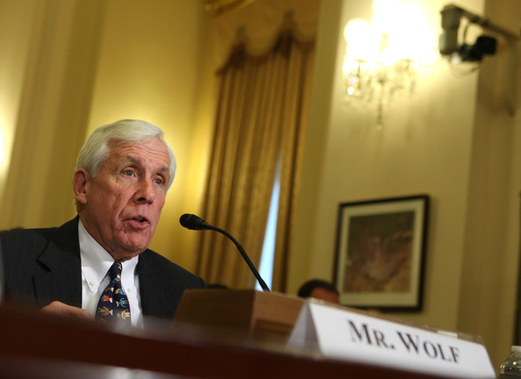
There once was a Wolf…
Frank Wolf (R-VA)
U.S. House of Representatives
FDP Update
August 2012

Slide 3

…who sought to protect his pack from The Dragon…
FDP Update
August 2012

Slide 4
In 2011, U.S. House of Representatives member Frank Wolf (R-VA), a long-time critic of the Chinese government who chairs a House spending committee that oversees several science agencies, inserted two sentences into spending bills that would forbid NASA and the White House Office of Science and Technology Policy (OSTP) to use federal funds “to develop, design, plan, promulgate, implement or execute a bilateral policy, program, order, or contract of any kind to participate, collaborate, or coordinate bilaterally in any way with China or any Chinese-owned company.”
FDP Update
August 2012

Slide 5
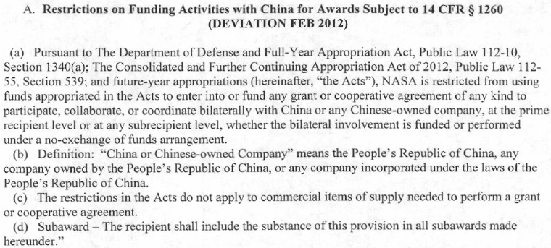
The bills passed and became law
FDP Update
August 2012

Slide 6
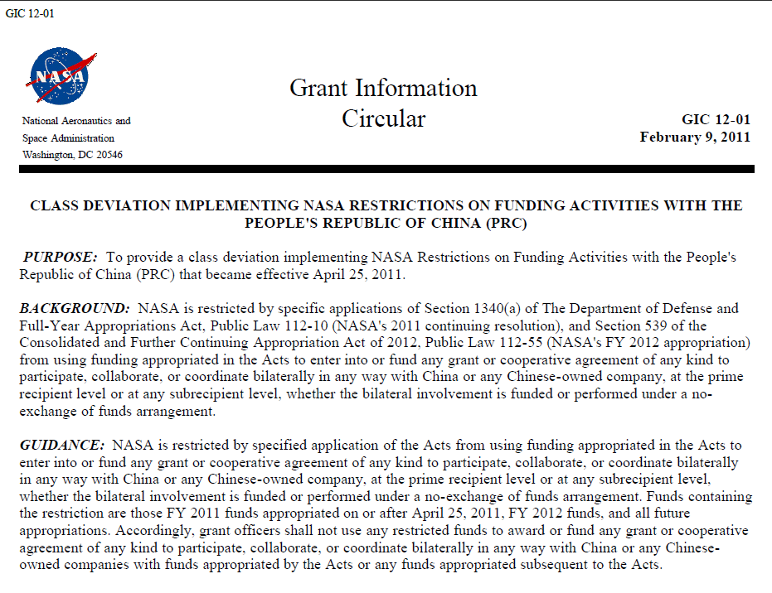
  NASA moved to comply with the new laws and issued instructions to its Grant and Contract Officers
Typo
NASA Grant Information Circular 12-01, February 9, 2012
FDP Update
August 2012

Slide 7
  NASA began to notify potential or actual grantees and contractors about the new laws and their duties under them
FDP Update
August 2012

Slide 8
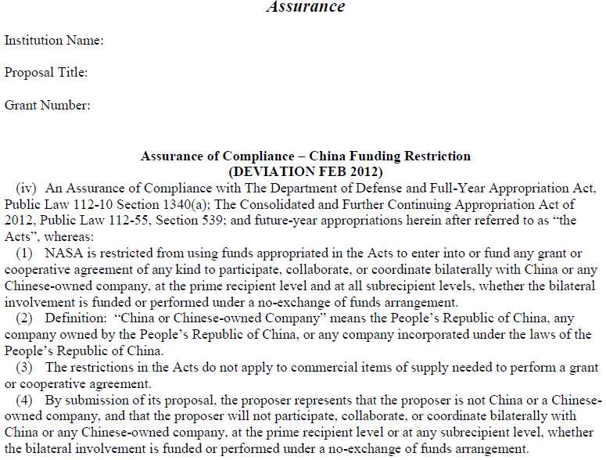
  NASA began asking grantees and contractors to certify that they would abide by the new laws
FDP Update
August 2012

Slide 9

  Many grantees and contractors have since requested interpretation and guidance from NASA on what they must do to be in compliance with the new laws.
Here is what we have learned from such requests…
FDP Update
August 2012

Slide 10
  NASA has had its own difficulties interpreting and complying with the new laws.
Feedback from NASA to the university community continues to be in flux
FDP Update
August 2012

Slide 11
  At present, the big-picture, take-home message is:
    Do not use funds from certain pots of NASA money to enter into bilateral research and/or other types of collaboration with the Chinese Government (including universities), Chinese companies, or those affiliated with them.
    These restrictions apply to our activities funded by NASA grants, cooperative agreements and contracts.
FDP Update
August 2012

Slide 12
  Why did you lump Chinese universities with the Chinese government?
Article 3 In developing socialist higher education, the State adheres to Marxism-Leninism, Mao Zedong Thought and Deng Xiaoping Theory as its guide and follows the basic principles laid down in the Constitution.
Article 4 Higher education shall be conducted in adherence to the educational principles of the State, in the service of the socialist modernization drive and in combination with productive labour, in order that the educatees shall become builders and successors for the socialist cause, who are
developed in an all-around way―morally, intellectually and physically.
  Excerpt from the Higher Education Law of the People's Republic of China
FDP Update
August 2012

Slide 13
  Are we talking about every active award instrument from NASA?
    Latest word from NASA: The restrictions only apply to activity under grants, cooperative agreements and contracts funded with FY11 (yes, it’s “retroactive”) and FY12 funds.
    Unsettled debate as to whether NASA has the authority to waive restrictions on projects comprised entirely of “fundamental research” or technology having no national security implications.
    NASA grant and contract officers have been instructed to notify us if the restrictions will apply to our work going forward (e.g., in proposal info, new award terms, and conditions on incremental funding).
      Don’t rely on direct notification
      Funds from restricted pots, added to old award, can mean required cutting off of historic collaborators from ongoing work.
FDP Update
August 2012

Slide 14
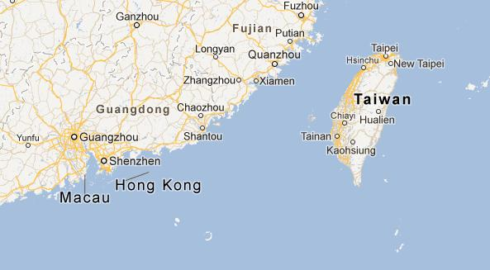
  What is a Macau?
    Under these new restrictions:
    Taiwan ≠ China
    Hong Kong = China
    Macau = China
FDP Update
August 2012

Slide 15
  What does it mean to be “affiliated” with the Chinese Government, universities, or companies?
    No exact definition as yet, but examples have been provided.
    Opinion: Appears to involve relationships with Chinese entities involving exchange of rights and duties, such as would be found in employment relationships, including serving as faculty for a Chinese institution of higher learning.
    NASA is not interested in past affiliations
FDP Update
August 2012

Slide 16
  “Affiliation” Breakdown 101
    Chinese citizenship alone is not considered an affiliation under these funding restrictions.
      E.g., an American citizen who works for a Chinese company (or who has a faculty position at a Chinese university) would have the kind of affiliation that would bar us from including him/her on a NASA-funded project.
    Chinese citizenship, however, might reasonably trigger investigation into possible, proscribed affiliations.
    Membership in Communist Party alone not considered affiliation.
FDP Update
August 2012

Slide 17
  “Affiliation” Breakdown 102
    A Chinese student or visiting scholar enrolled in a U.S. university on a J-1 visa would not have to be excluded from participation in a NASA-funded project unless he/she has a prohibited affiliation, such as:
      A contractual relationship with a Chinese institution of higher learning while in the U.S (includes enrollment).
    Similarly, Chinese students in U.S. on F-1 and H-1B visas could be included on NASA projects, if no affiliations.
    NOTE: NASA says that a scholarship from a Chinese entity alone is not treated as an affiliation.
FDP Update
August 2012

Slide 18
  “Affiliation” Breakdown 103
    A professor at a Chinese university, on sabbatical in U.S., would likely not be allowed on NASA project.
    A professor at a U.S. university, on sabbatical at a Chinese institution, would not be considered an affiliate, but NASA funding may not be used to pay for any salary, travel, or other activity associated with the sabbatical.
FDP Update
August 2012

Slide 19
  “Affiliation” Breakdown 104
    A faculty member whose only connection to a Chinese company, university, or other organization is the receipt of research funding will likely not be considered an affiliated, “tainted” individual, who must be denied participation in NASA-funded projects, so long as care is taken to prevent NASA-funded activity and results from benefitting Chinese entities.
      This scenario has enough of an obligatory relationship between researcher and China that you might want to run it by your contacts at NASA, in order to avoid any inadvertent, prohibited overlap between the work for the Chinese sponsor and work under NASA funding.
FDP Update
August 2012

Slide 20
  What does it mean to prohibit the programmatic involvement of Chinese entities and those affiliated with them?
    Projects funded with the NASA dollars that are impacted by the appropriations laws cannot include those affiliated with Chinese entities, even if they are volunteers.
    No affiliated person can be given access to data generated under NASA funds prior to that data being publicly disseminated.
    NOTE: Potential complexity involved in erecting firewalls around NASA-funded portions of work within project funded by multiple funding agencies.
FDP Update
August 2012

Slide 21
  Stuff that you can still do with entities and affiliates prohibited by the appropriations laws:
    Procure goods and services in support of NASA projects (commercial, off-the-shelf stuff only).
    Enter into general scientific discussions with affiliates (e.g., PRC researchers), as long as it is not in furtherance of some bilateral collaboration between NASA and Chinese entities.
    Include them on projects (or portions of projects) that are not funded by restricted NASA appropriations (e.g., NSF projects), so long as other regulations allow it (e.g., EAR and ITAR).**
FDP Update
August 2012

Slide 22
  What is a “bilateral collaboration”?
    No exact definition provided.
    Assume it is something like a formal, working arrangement between just NASA-funded U.S. parties and Chinese government or commercial entities (or those affiliated with them).
    Focus is on the entities involved, not the citizenship of individual persons.
    To escape prohibition of our participation, an undertaking would need to add at least a third entity from another country.
      Example: attendance at an international conference (even if it takes place at a Chinese University) or a multilateral project.
FDP Update
August 2012

Slide 23
  These Restrictions are Separate from Export Control Regulations
    Has not become part of ITAR or EAR.
    Restrictions are not based on citizenship, as on the CCL
    Would still have to screen a Chinese citizen for ITAR/EAR restrictions, even if allowed to work on project under these NASA appropriation restrictions.
    Denying access of an affiliated Chinese citizen on project would (probably) not eliminate the FRE, as provided for by the EAR.
      Participation would be forbidden, but not access via publication. Some debate on this.
FDP Update
August 2012

Slide 24

That’s all we know at this point. Until we know more…
FDP Update
August 2012

Slide 25
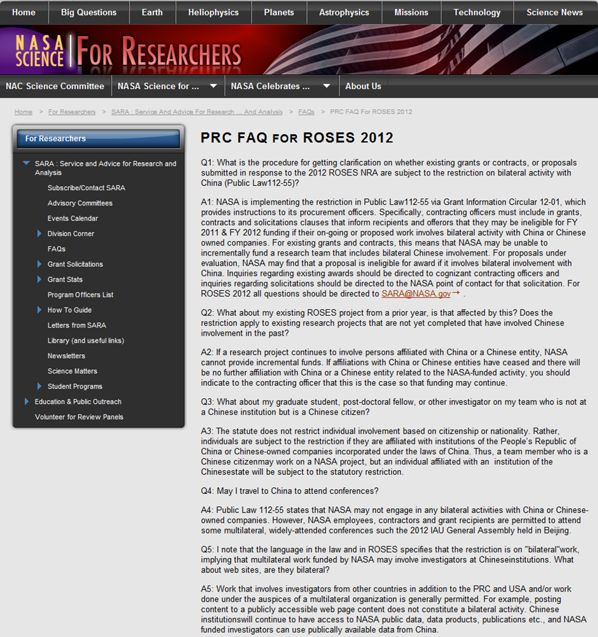
Read and request new FAQs from NASA
http://science.nasa.gov/researchers/sara/faqs/prc-faq-roses-2012/

Slide 26
Be on the lookout for proposed or active projects that are likely to be affected by these restrictions.
Same applies to emerging interpretations and enforcement of the restrictions.
FDP Update
August 2012

Slide 27
    Prepare research admin. and departmental personnel to address the new restrictions, as expressed in proposal, award and modification documentation (including required, signed assurances).
FDP Update
August 2012

Slide 28
  Suggested Preparations:
    Use internal databases (e.g., Coeus) to identify projects likely affected by restrictions.
    Create a notification/educational template to email to affected PIs and their projects.
    Provide a Web page as a resource for those affected
    Create an internal questionnaire/certification for those working on affected projects to ensure absence of prohibited affiliations and collaboration.
    Draft template letter to accompany assurance form, reinforcing JHU understanding of restrictions on Chinese students and employees.**
FDP Update
August 2012

Slide 29


With some persistence and attention to detail, you and your PIs should be able to scrub your institutions’ projects clean of unauthorized collaborations, so that the big, bad Wolf doesn’t come and get us.

Slide 30
Questions?

