Slide 1
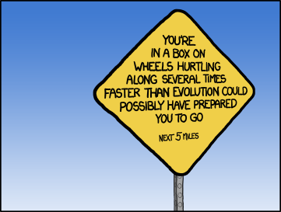

Good Afternoon…perhaps you feel today as I usually do:
http://www.xkcd.com/1075/

Slide 2

The data challenges are daunting, but “this is an exciting time”!!
http://www.xkcd.com/1071/

Slide 3
Big data brings great potential as well as potential danger
Author unknown
http://weknowmemes.com/2012/06/the-credible-hulk/

Slide 4
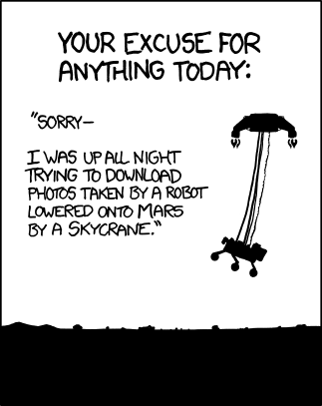
Technology both enables and frustrates
http://www.xkcd.com/1091/

Slide 5
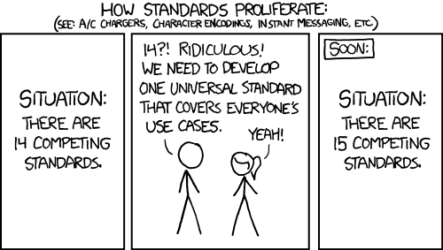
Still, there are no perfect solutions…
…but it is essential not to duplicate existing efforts!
http://xkcd.com/927/

Slide 6
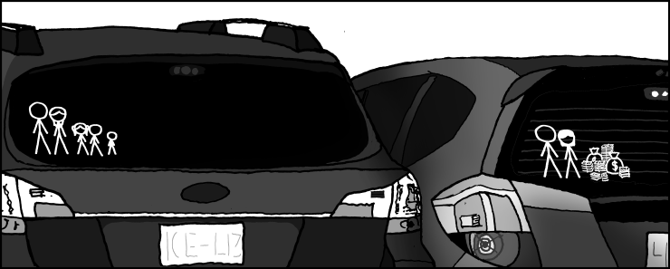
The Bottom Line:
Investing in the future costs $$$!
http://xkcd.com/946/

