Slide 1
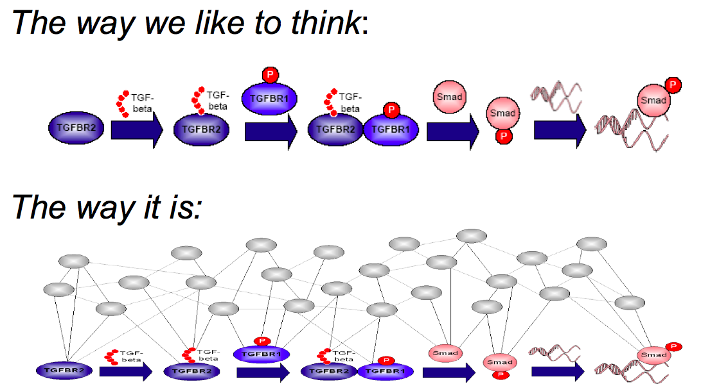
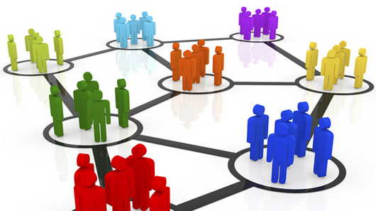
What is the problem?
Our current models of disease biology are primitive and limit doctor’s understanding and ability to treat patients
Current incentives reward those who
silo information and work in closed
systems

Slide 2
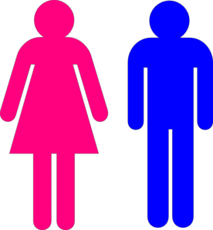




2
REWARDS
RECOGNITION
1
USABLE
DATA
Networked Approaches
BioMedical Information Commons
Patients/
Citizens
Data
Generators
CURATED
DATA
Data
Analysts
TOOLS/
METHODS
5
PRIVACY
BARRIERS
RAW
DATA
3
GOVERNANCE
ANALYZES/
MODELS
SYNAPSE
4
HOW TO
DISTRIBUTE
TASKS
Clinicians
Experimentalists

Slide 3
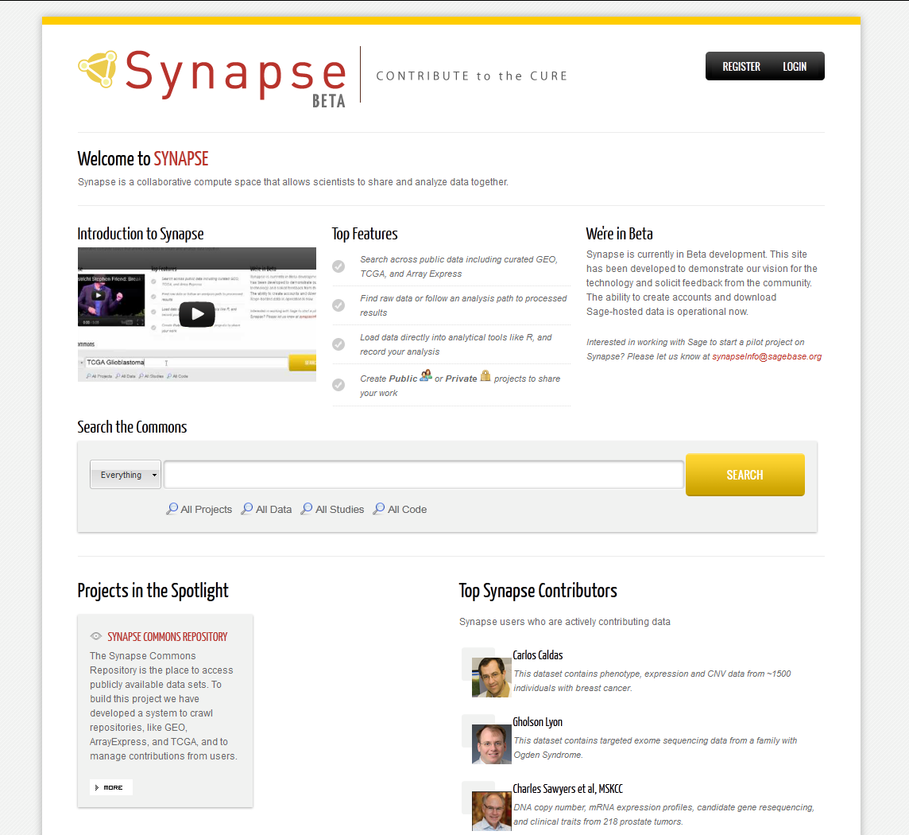
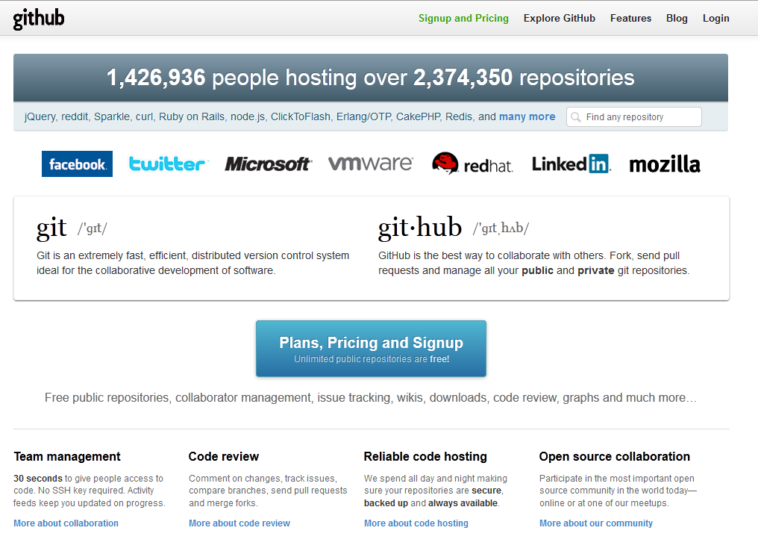
Synapse is GitHub for Biomedical Data
Every code change versioned
Every issue tracked
Every project the starting point for new work
All evolving and accessible in real time
Social Coding
Data and code versioned
Analysis history captured in real time
Work anywhere, and share the results with anyone
Social Science
Notes:
In Newton’s time scientists began leveraging the most advanced communication technology of the times which was the printing press. The circulation of the first scientific journals coincided with an explosion of scientific knowledge and advancements. Today we have a similar opportunity given new technologies like the internet and cloud computing. There is an opportunity to rethink how scientists interact with each other and work with human health data.
This has already happened in other domains for example software engineering. For example Git Hub gives software developers visibility into every code change, every bug or feature request, every build report associated with a project. These sorts of environments provide a collaborative workspace with tools that allow developers to work more effectively. Although GitHub is pretty strongly associated with the open source community, many big companies have adopted it for private commercial projects as well.

Slide 4
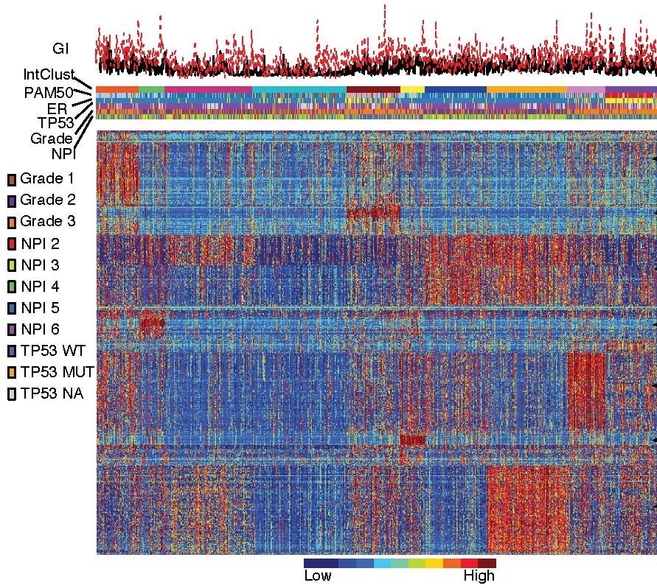


Breast Cancer Challenge Summary
Transparency,
reproducibility
Validation in novel
dataset
Publication in Science
Translational Medicine
Donation of Google-scale compute space.
For the goal of promoting democratization of medicine…
Registration starting NOW…
sign up at synapse.sagebase.org

Slide 5
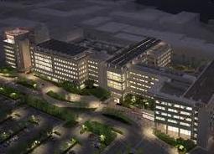
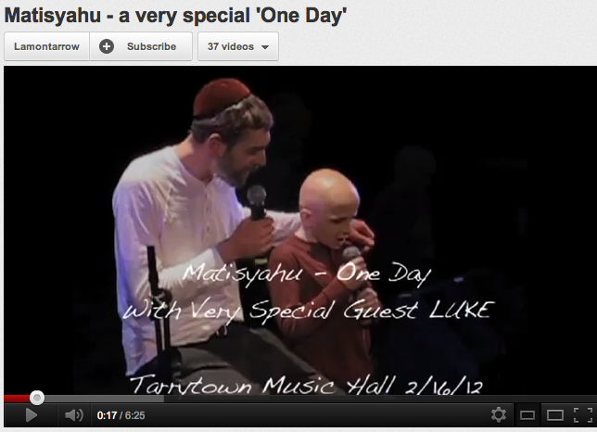
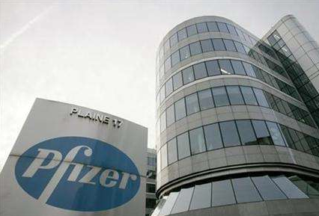
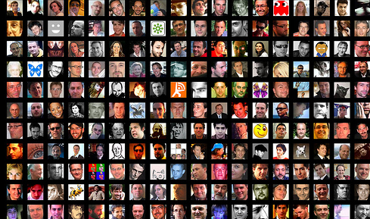

Slide 6
IT
Constituencies
Individual
Patients
Technology Platform
Biotech
Better Models of Disease: INFORMATION COMMONS
Governance
Patient Foundations
Impactful Models
Pharma
Challenges
Joint Patient/Scientist Communities
Academic Consortia

