Slide 1
Developments in Data Discovery at ICPSR
George Alter
Director, ICPSR
University of Michigan

Slide 2
About ICPSR
Established in 1962 to share the American National Election Studies
  Partnership of 21 universities
Today: More than 700 members
  ~400 U.S. institutions
  46 national memberships
8,000 data collections
Data available 24/7 for download and online analysis

Slide 3
What we do
Mission: ICPSR provides leadership and training in data access, curation, and methods of analysis for a diverse and expanding social science research community.
Acquire and archive social science data
Distribute data to researchers
Preserve data for future generations
Provide training in quantitative methods

Slide 4

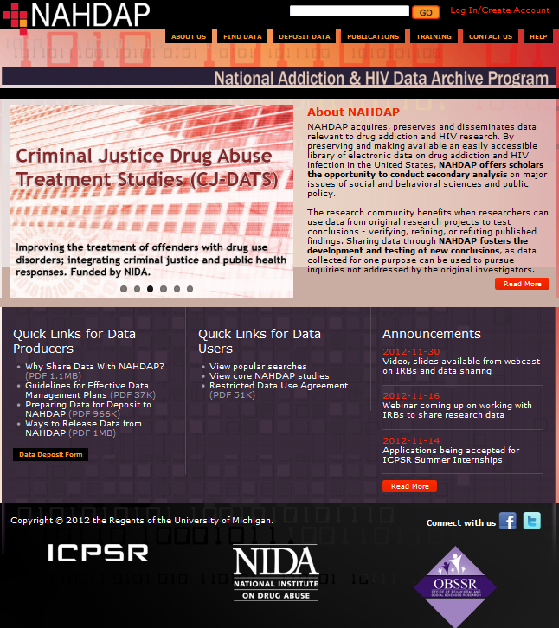
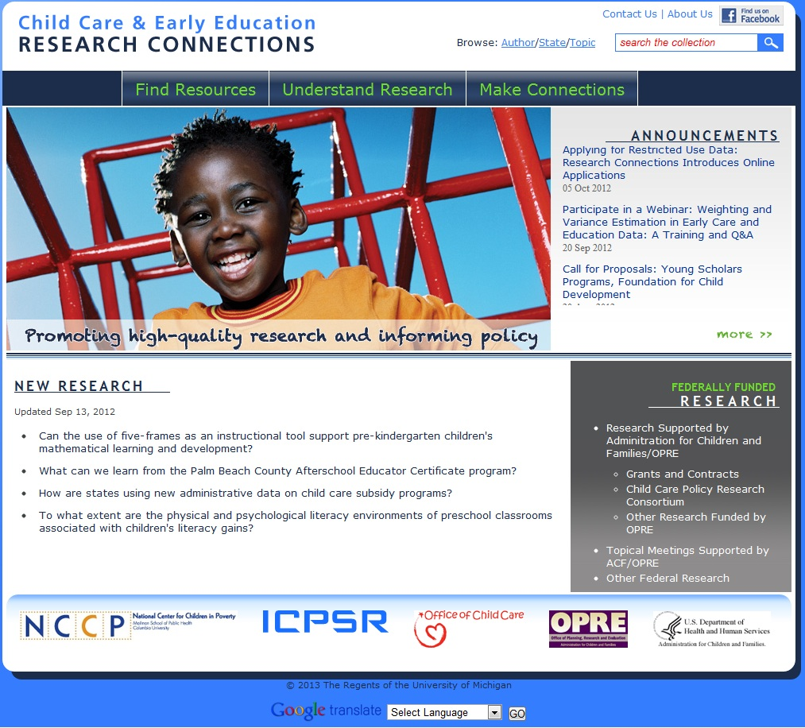
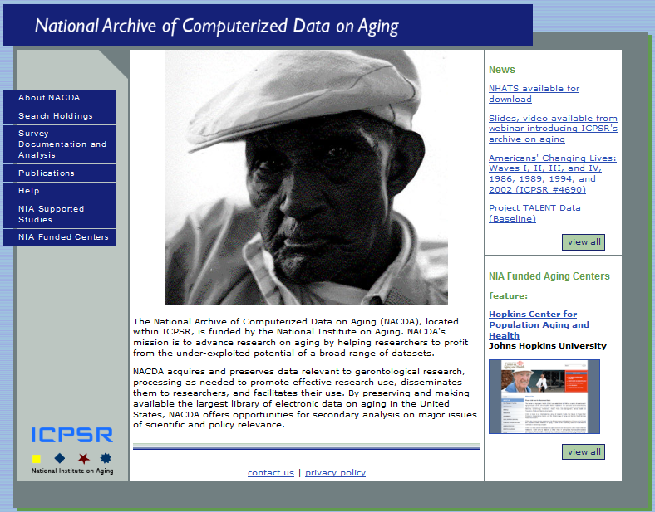
Sponsored Archives
Child Care and Early Education Research Connections
Data Sharing for Demographic Research
Health and Medical Care Archive
Measures of Effective Teaching Longitudinal Database
National Addiction & HIV Data Archive Program
National Archive of Computerized Data on Aging
National Archive of Criminal Justice Data
Resource Center for Minority Data
Substance Abuse & Mental Health Data Archive

Slide 5
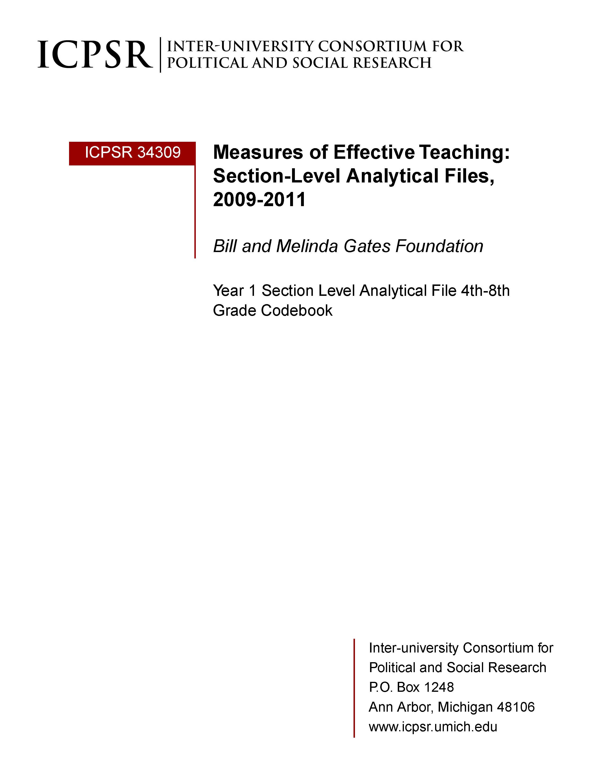
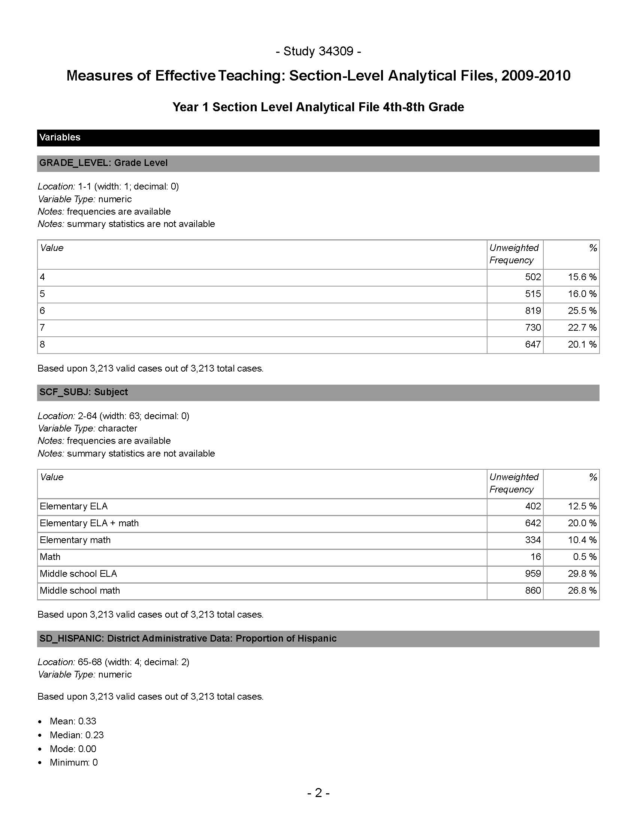
Data Discovery in the Social Sciences
Social science datasets tend to be wide (400+ variables) and shallow (<10K cases).
Sample Codebook
864 variables
423 pages
1 of 30+ data files in the MET LDB collection
ICPSR codebooks are generated from DDI.

Slide 6

DDI: Data Documentation Initiative
DDI is an international standard for describing data from the social, behavioral, and economic sciences.
  Founded in 1995
  DDI Version 1 released in 2000
Expressed in XML, DDI metadata is
  machine-actionable
  human readable

Slide 7
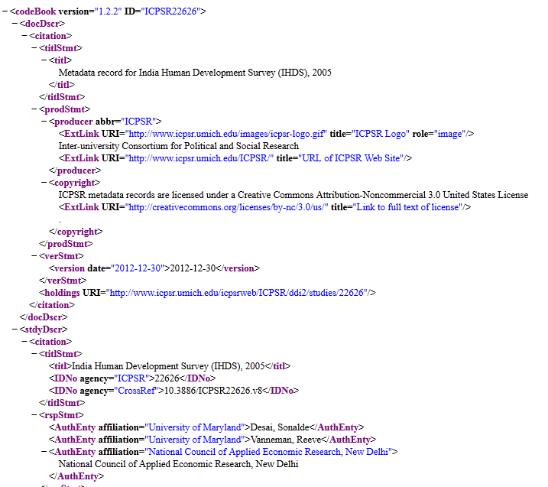
Data Documentation Initiative
ICPSR uses DDI for
Preservation
Codebook creation
Data discovery
4,000+ data collections have DDI at the variable level.

Slide 8
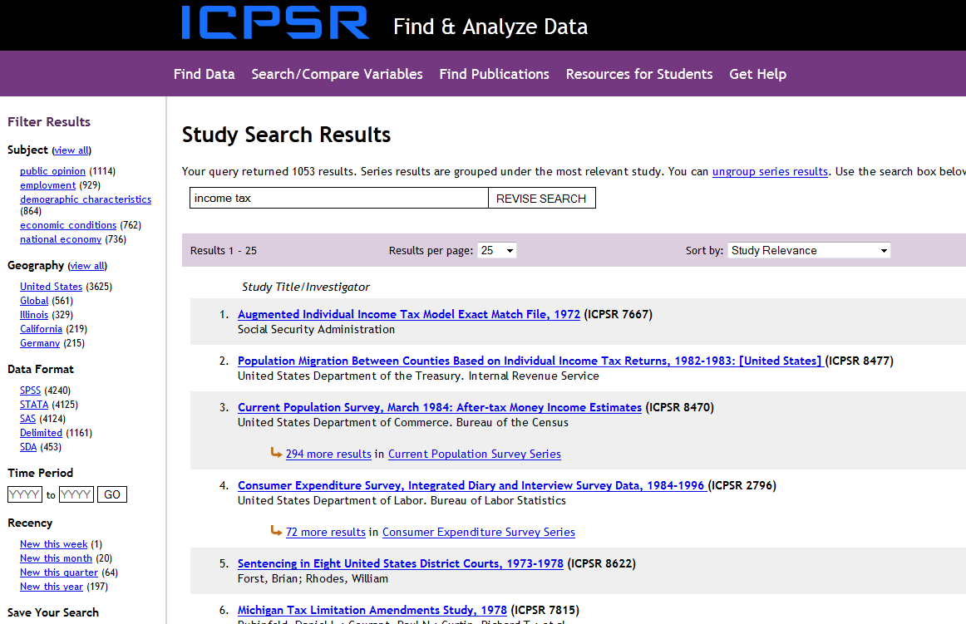

ICPSR study-level search
The problem with lots of metadata is that searches produce lots of results.
Single search box
Faceted filters

Slide 9
Testing the ICPSR search tool
Q: Do children of Asian immigrants speak English in the home more often than children of Latino immigrants?
A: Children of Immigrants Longitudinal Study (CILS), 1991-2006 (ICPSR 20520)
Portes, Alejandro; Rumbaut, Rubén G.

Slide 10
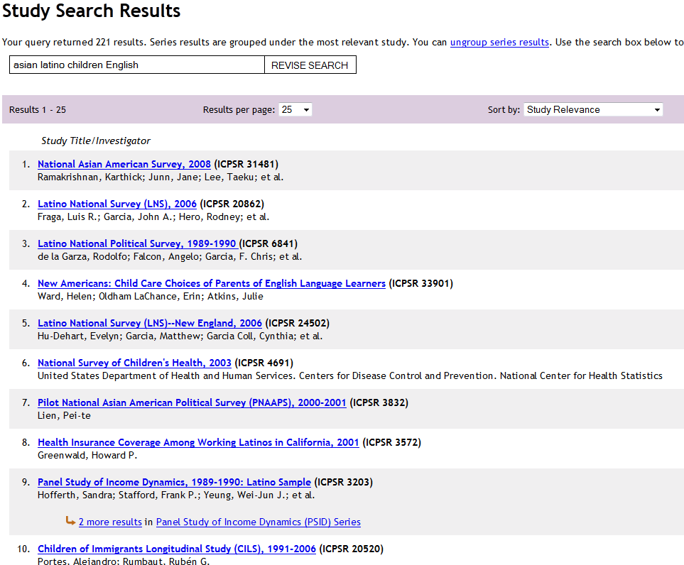
asian latino children English

Slide 11
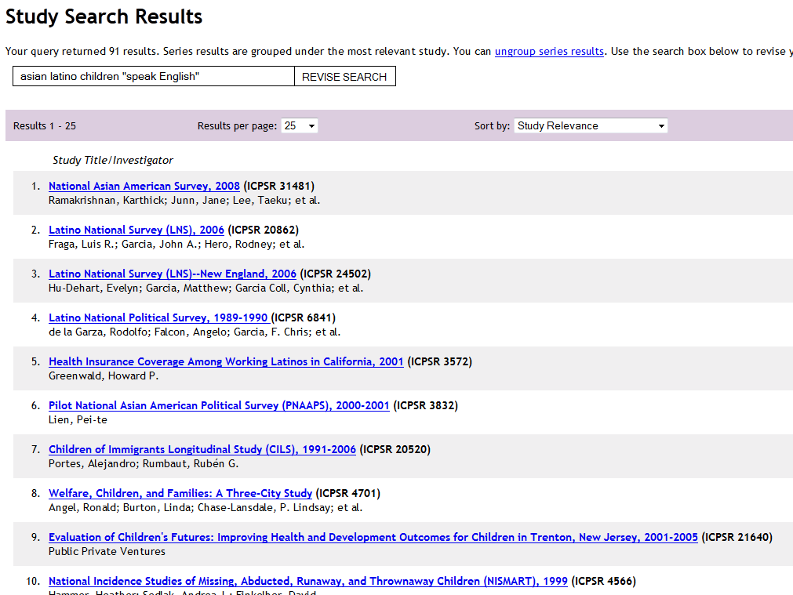
asian latino children “speak English”

Slide 12
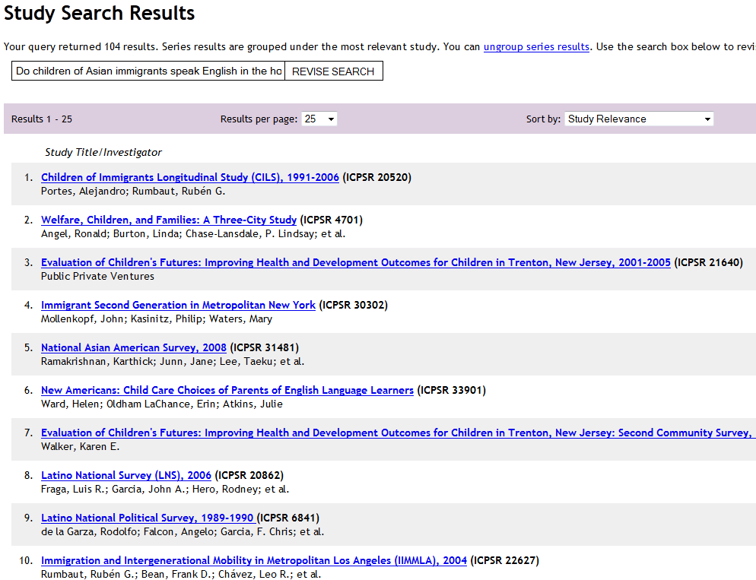
Do children of Asian immigrants speak English in the home more often than children of Latino immigrants?

Slide 13
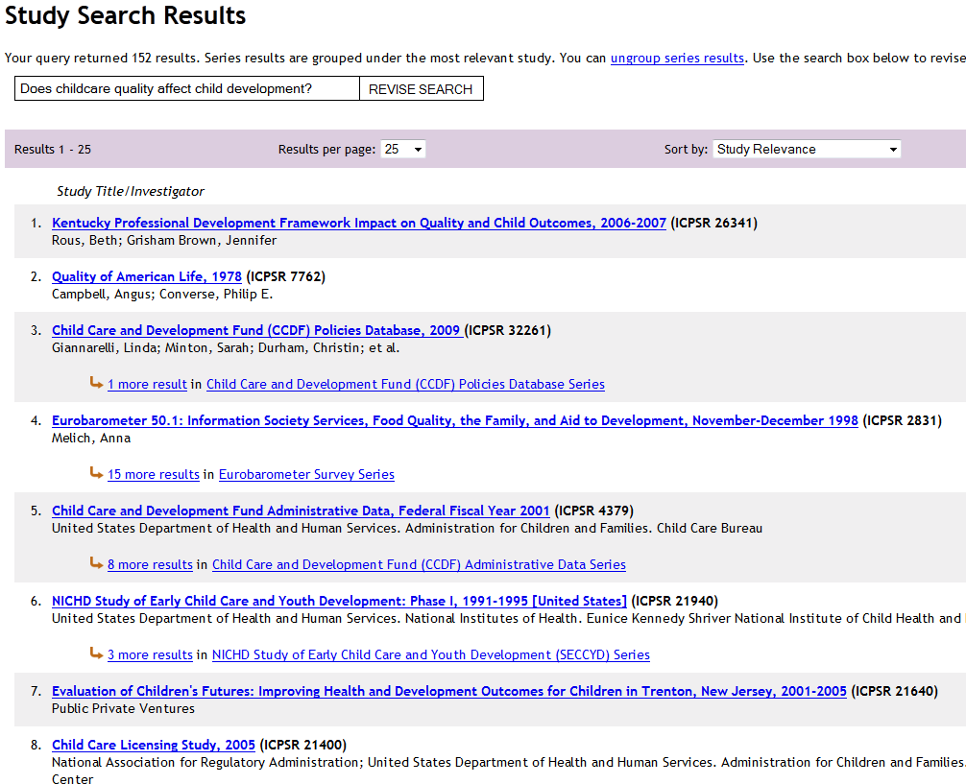
Does childcare quality affect child development?

Slide 14
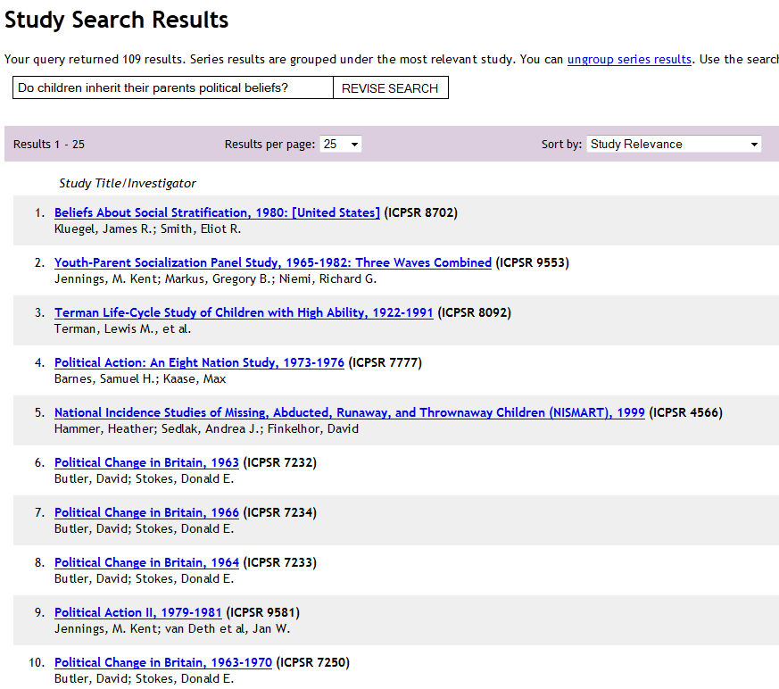
Do children inherit their parents political beliefs?

Slide 15
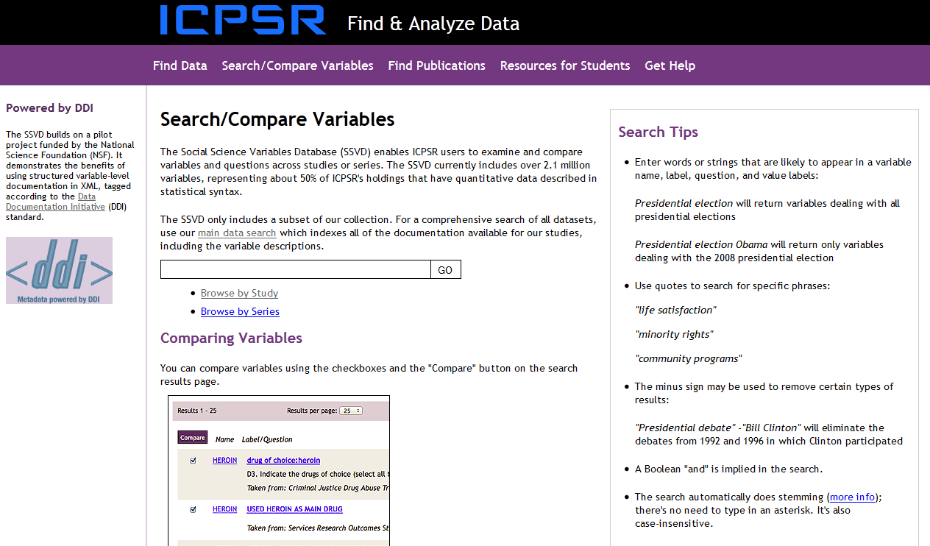
Search/Compare Variables
Social Science Variables Database with 2.1 million variables

Slide 16
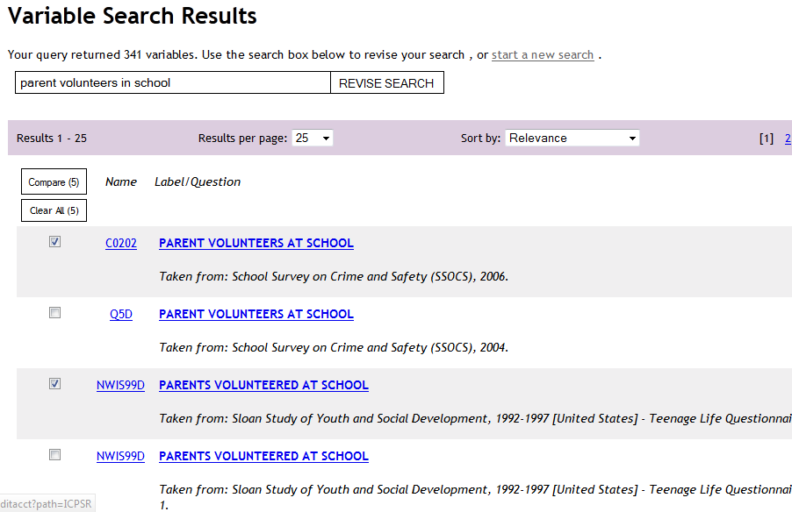
Finding variables across studies
parent volunteers in school

Slide 17
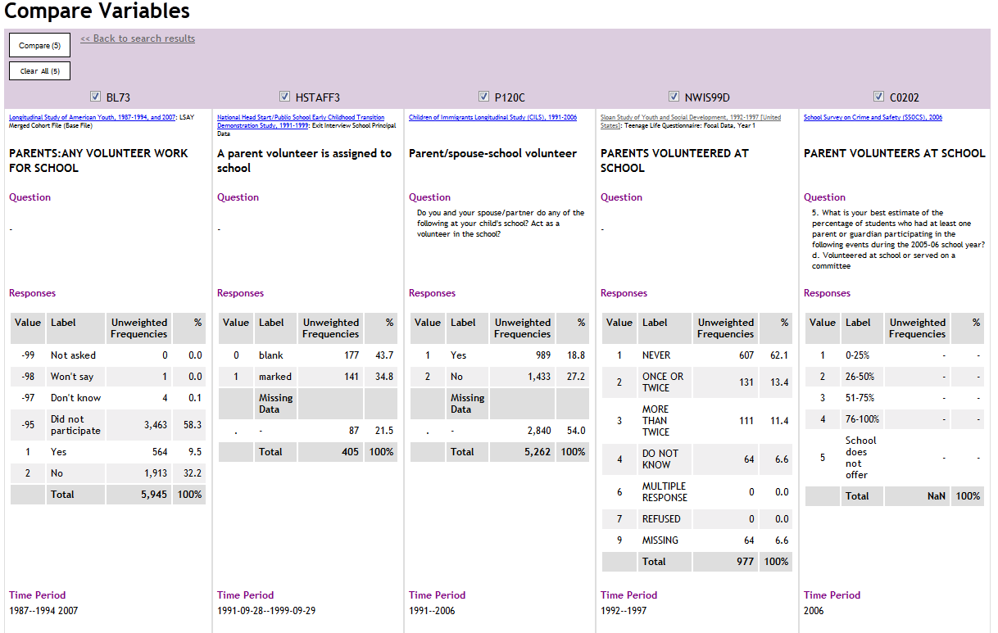
Comparing variables across studies

Slide 18
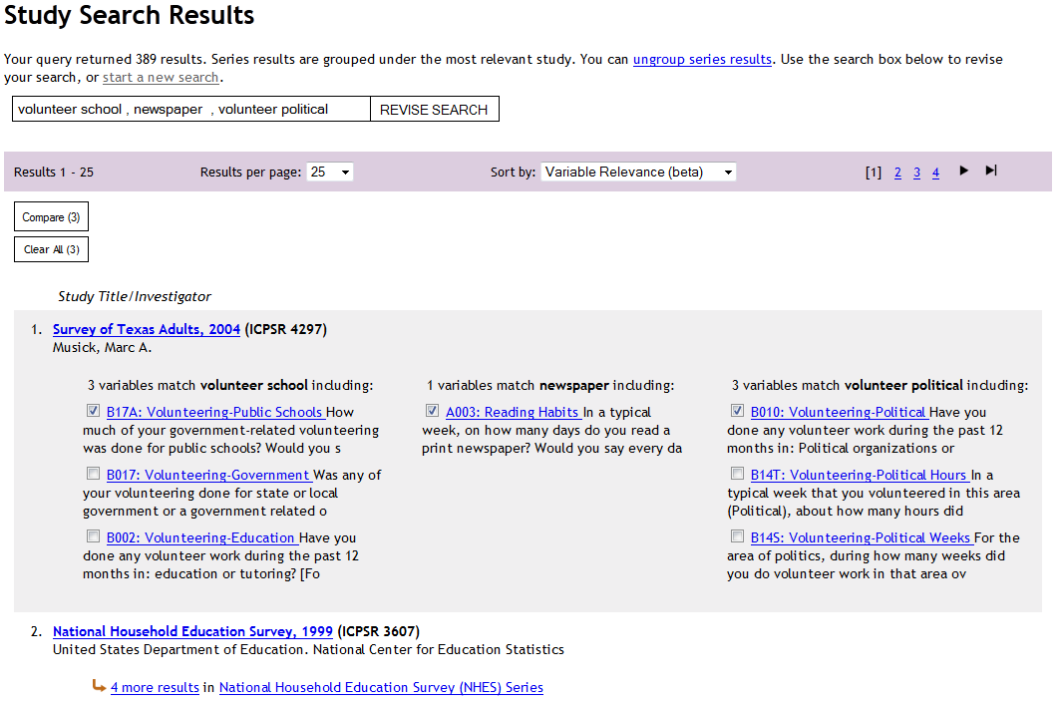
Searching for three variables at the same time
volunteer school, newspaper, volunteer political

Slide 19
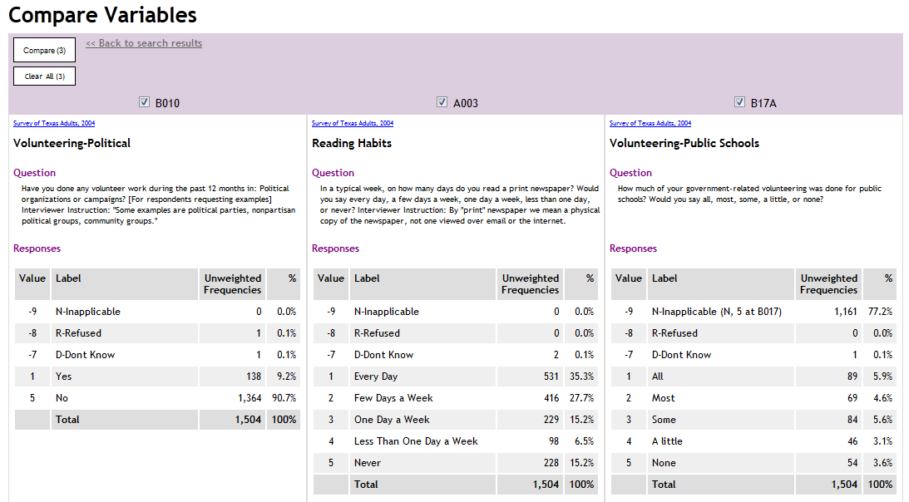
Examining three variables in the same study

Slide 20
NSF Project: Metadata Portal for the Social Sciences
Enhanced access to
  American National Election Studies [ANES]
  General Social Survey [GSS]
Aims
  Upgrade legacy metadata
  Federated search
  Dynamic codebooks
  Question bank
  Harmonization tools
  Improve survey workflows
Partners
  ICPSR
  NORC
  Metadata Technologies

Slide 21
Lessons
Rich metadata creates opportunities for powerful search tools
Advanced searches are more likely to produce too many results than too few
  Weighting of elements is critical
Users must be taught new ways to search
  Natural language searches are often better than keywords

Slide 22
Thank you
George Alter
altergc@umich.edu

