Slide 1
Finding Disease Data: The Autism Example
Finding the Needle in the Haystack
February 26, 2013
Greg Farber, Ph.D.
Director
Office of Technology Development and Coordination
National Institute of Mental Health
National Institutes of Health

Slide 2
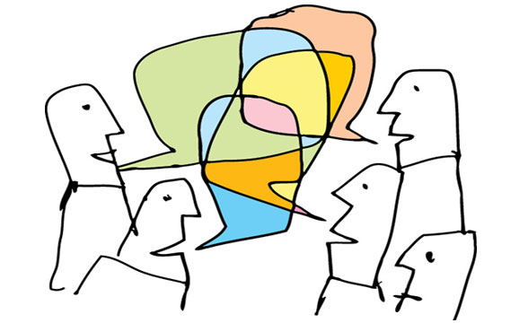
Following the Presentation by Mike Huerta, how are we making autism data A) Discoverable B) Useful to Others C) Citable D) Linked to the Literature
Talk Overview

Slide 3
NDAR Overview
Joint initiative supported by NIMH, NICHD, NINDS, and NIEHS
Federal data repository
Contains data from human subjects related to autism (and control subjects)
Data are available to the research community through a not too difficult application process
Summary data are available to everyone with a browser
Begun in late 2006, and first data was received in 2008
The data types include demographic data, clinical assessments, imaging data, and –omic data
Currently has data available from over 37,000 subjects
150TB of imaging and –omic data is stored in the cloud

Slide 4
Data Dictionary
The NDAR data dictionary is one of the key building blocks for this repository. It provides a flexible and extensible framework for data definition by the research community.
400+ instruments, freely available to anyone
35,000+ unique data elements and growing
A research community platform for defining the complex language characterizing autism research
Clinical
Genomics/Proteomics
Imaging Modalities
Accommodates any data type and data structure
Extended and enhanced by the ASD research community
Curated by NDAR
Allows investigators to quickly perform quality control tests of their data without submitting data anywhere.

Slide 5
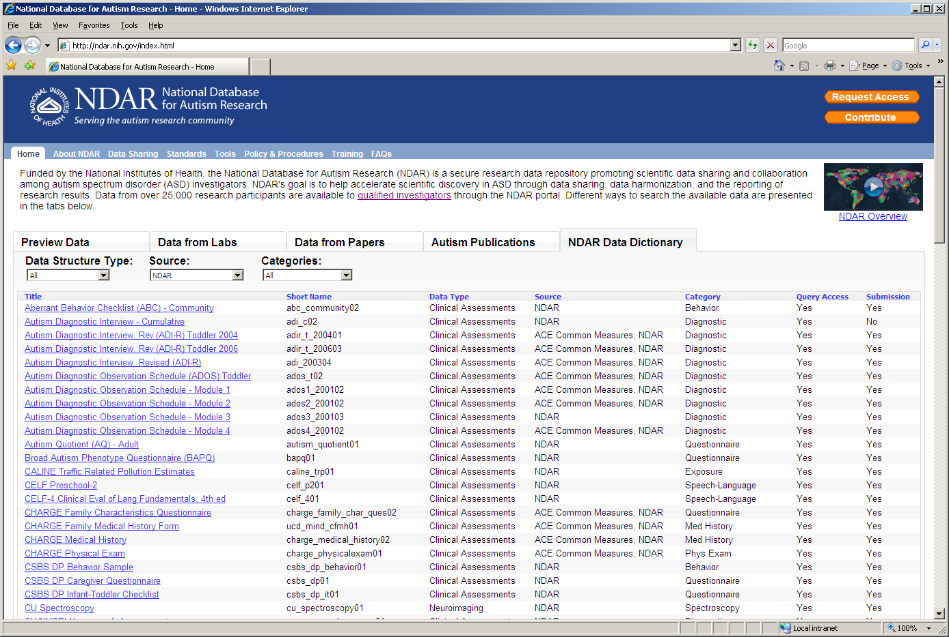
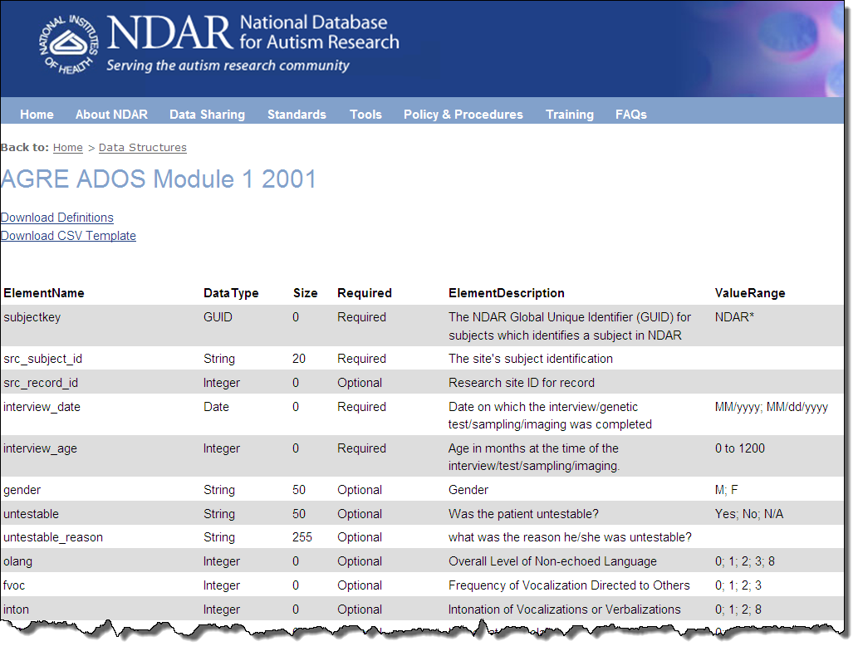
Data Dictionary
Data Definition (200+)

Slide 6
NIH Data Dictionary Efforts
Many ICs at NIH have initiated data dictionary/controlled vocabulary efforts, and a few are even mandating use of those data dictionaries for all awardees.
NINDS (CDEs for neuroscience clinical research and form builder)
PhenX (standards and measures related to complex diseases)
NIH Toolbox (an integrated set of tools for measuring cognitive, emotional, motor, and sensory function)
A summary of CDE efforts (both NIH and other) is available at (http://www.nlm.nih.gov/cde/).

Slide 7
Global Unique Identifier – the Other Building Block
The NDAR GUID software allows any researcher to generate a unique identifier using some information from a birth certificate.
If the same information is entered in different laboratories, the same GUID will be generated.
This strategy allows NDAR to aggregate data on the same subject collected in multiple laboratories without holding any of the personally identifiable information about that subject.
The GUID is now being used in other research communities and can be made available to you. We have created a video to help with informed consent issues. http://www.youtube.com/watch?v=Tb6euCVoous

Slide 8
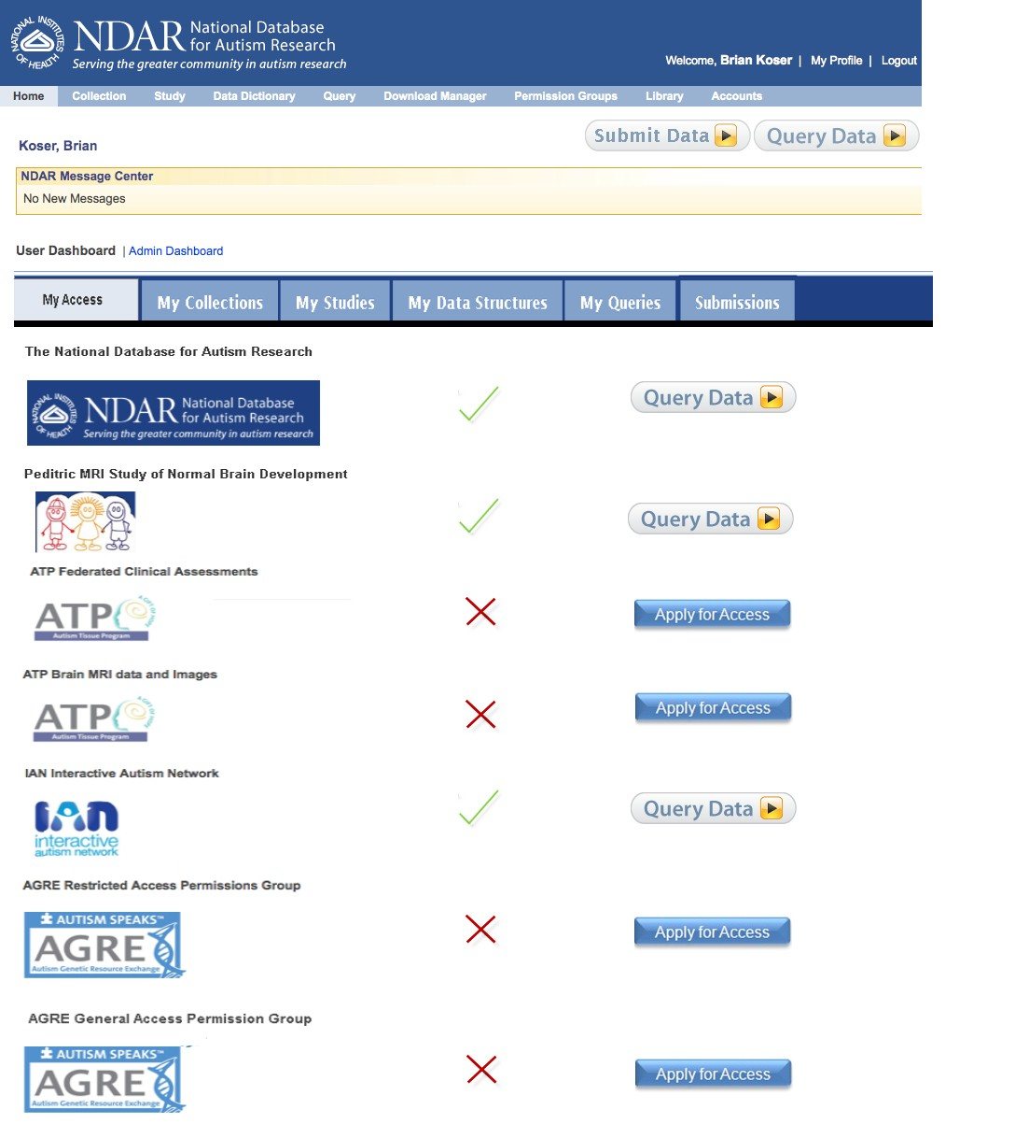
Data Federation
There are several other data repositories with data from human subjects related to autism.
NDAR has a deep federation with those repositories to allow queries and data downloads from multiple repositories simultaneously.

Slide 9
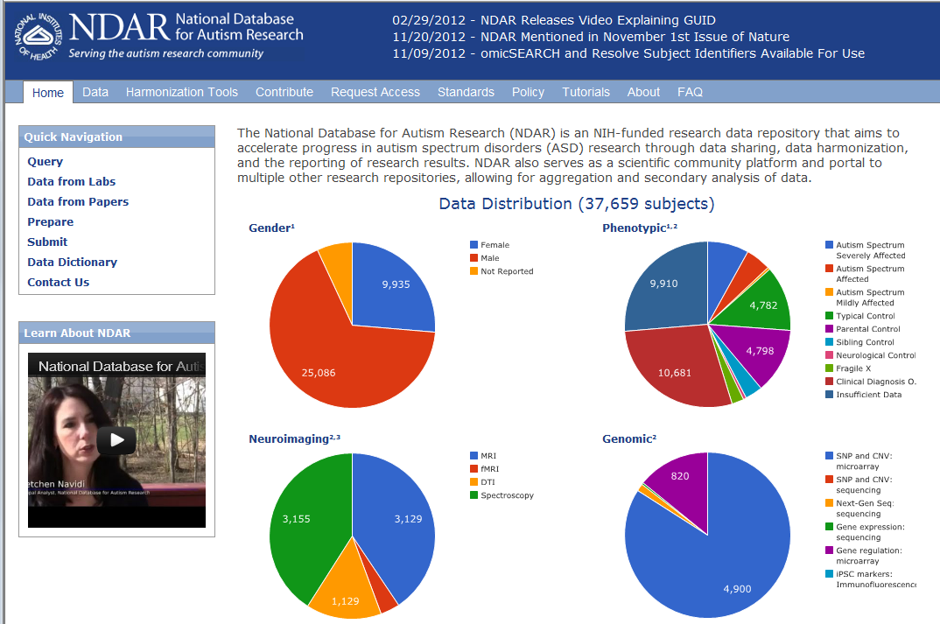

Slide 10
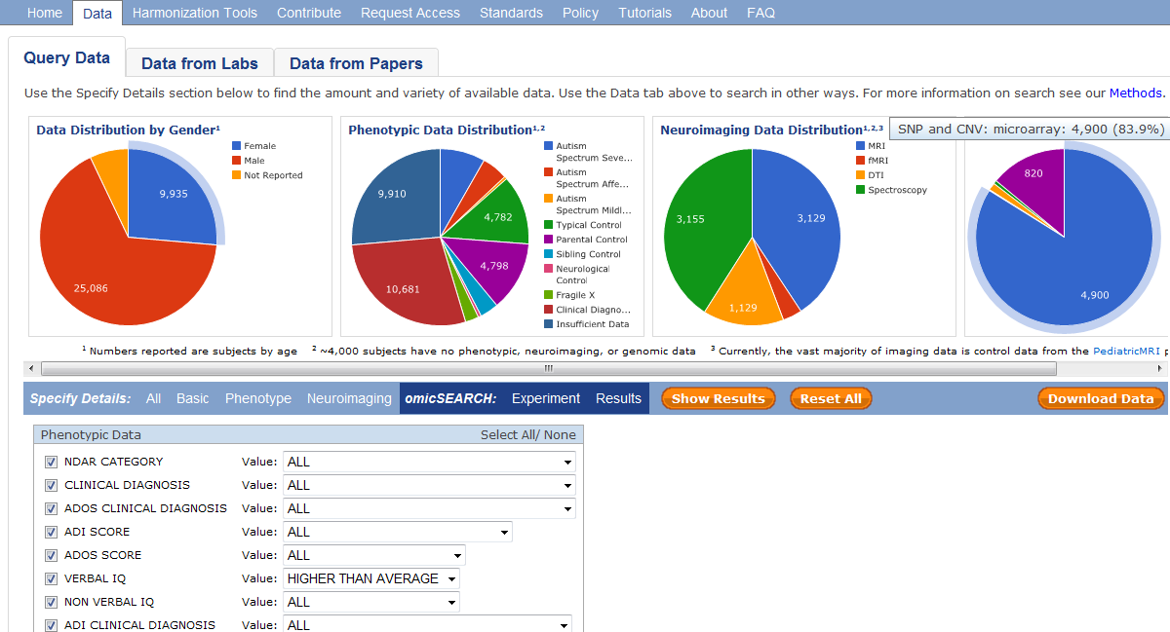

Slide 11
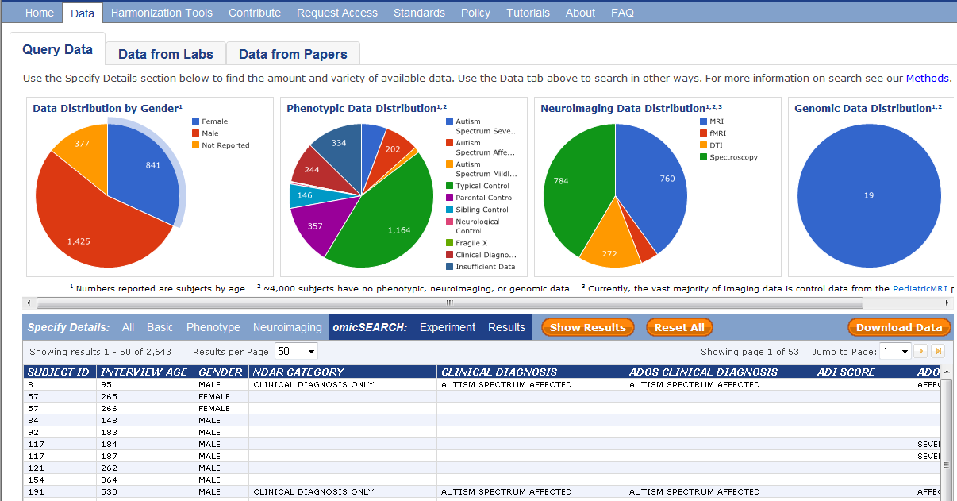

Slide 12
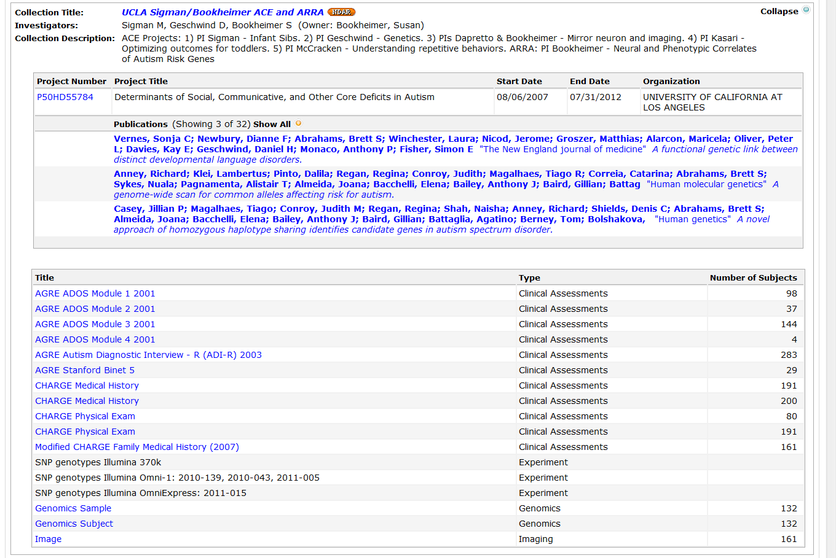
An Example of Data Associated with a Particular Laboratory

Slide 13
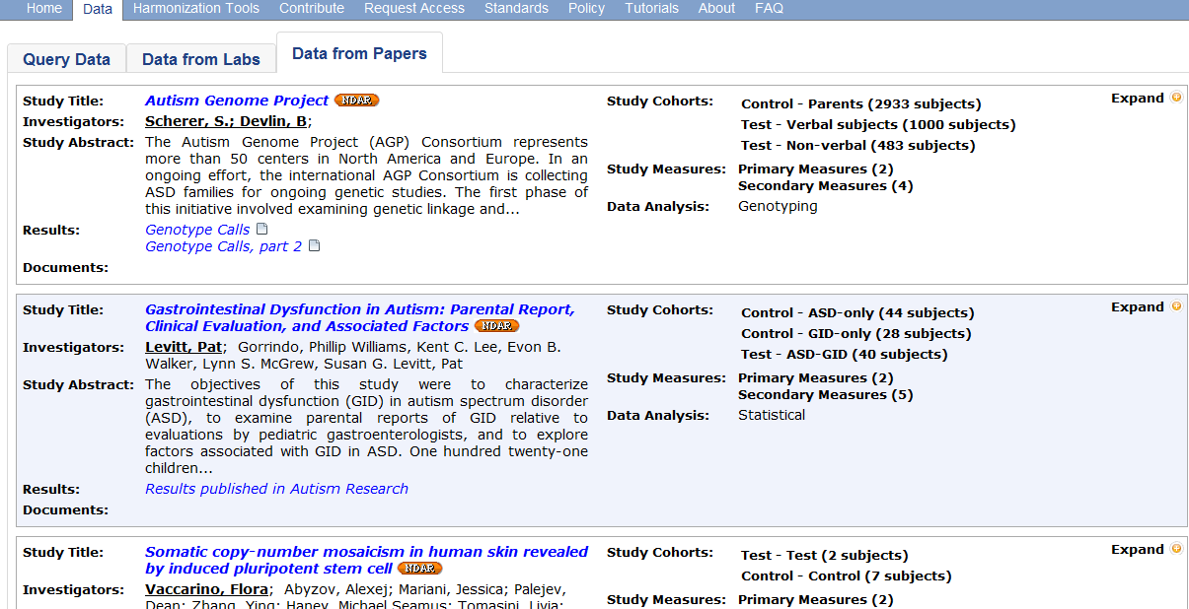
An Example of Data Associated with a Particular Paper

Slide 14
NDAR, making autism data: A) Discoverable – federation, useful queries, XML web services B) Useful to Others – data access, data QC, data analysis pipelines (soon), C) Citable – data from labs, data from papers D) Linked to the Literature – data link in PubMed
Summary

