Slide 1


DataCite and Science.gov
Finding the Needle in the Haystack
A Symposium of the Board on Research Data and Information on Strategies for Discovering Research Data Online
Lorrie Apple Johnson
Lead Librarian, Information Analysis & Services
Office of Scientific and Technical Information (OSTI)
National Academy of Sciences
Washington, DC
February 26, 2013

Slide 2
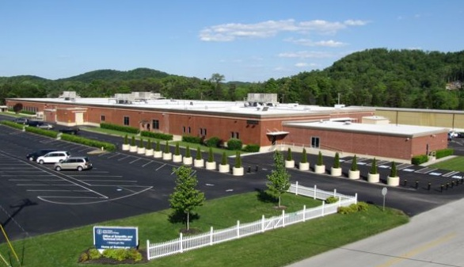
What Is OSTI?
OSTI is a program within the DOE Office of Science with the corporate responsibility for ensuring appropriate access to DOE R&D results.
Premise Science advances only if knowledge is shared
Corollary Accelerating the sharing of scientific knowledge accelerates the advancement of science
Energy Policy Act of 2005
“The Secretary, through the Office of Scientific and Technical Information, shall maintain within the Department publicly available collections of scientific and technical information resulting from research, development, demonstration, and commercial applications activities supported by the Department.”

Slide 3
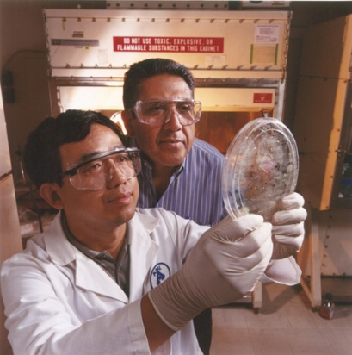
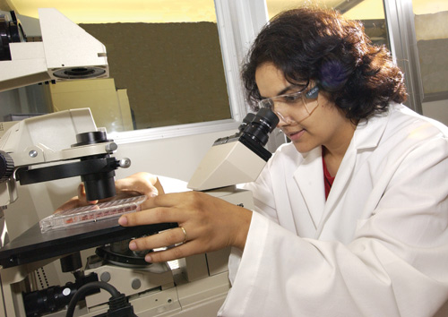

What Does OSTI Do?
DOE invests over $10 billion/year in basic sciences, clean energy technology, nuclear research.
The immediate output from this investment is information … knowledge… R&D results.
OSTI’s mission is to accelerate scientific progress by accelerating access to this information.

Slide 4
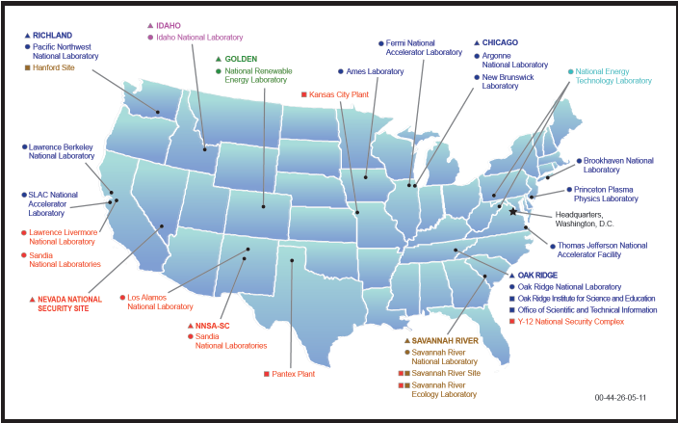
How Do We Do It?
DOE Scientific and Technical Information Program
OSTI coordinates with POCs across the DOE complex
DOE R&D results are:
Collected from DOE offices, labs, and facilities, as well as university grantees;
Preserved for re-use; and
Made accessible via multiple web outlets.
OSTI works to ensure that:
Research results from DOE programs are shared globally plus
DOE-supported researchers have access to scientific discoveries from around the world

Slide 5
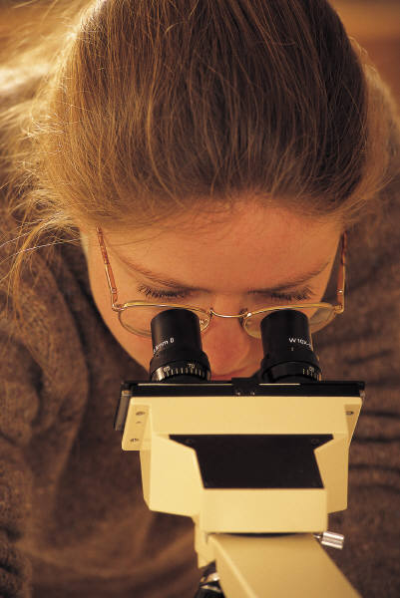



Scientific and Technical Information Challenges?
Scientific research is conducted at many agencies across the federal government.
Scientists and researchers produce a lot of information, in many different formats:
Textual – reports, journal articles, conference proceedings, patents
Multimedia– videos, images
Data

Slide 6

Our Solution:
Federated Searching
Since science is not bounded by agency, organization, or geography…
We integrate or aggregate multiple government R&D-related databases into single-search portals.
Innovative technology drills down to selected databases and websites in parallel, then presents ranked search results.

Slide 7
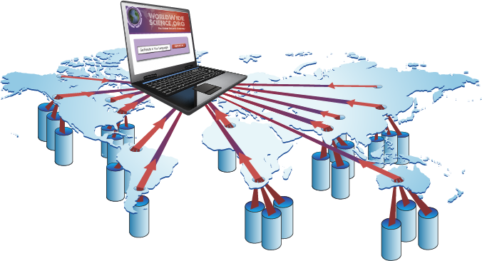
Advantages of Federated Search
Drills into the deep web, where scientific databases reside
Finds dynamically generated content living inside those databases; high-quality managed subject-specific content
Returns current, real-time results
Presents no burden for database owner
Allows for fielded searching
Plus
Inexpensive to implement
No need-to-know for user
No searching door-to-door
Automatic interoperability achieved

Slide 8
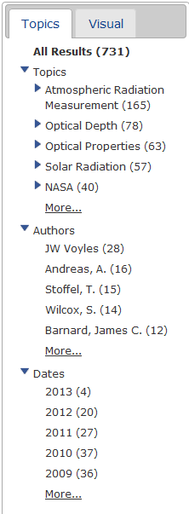
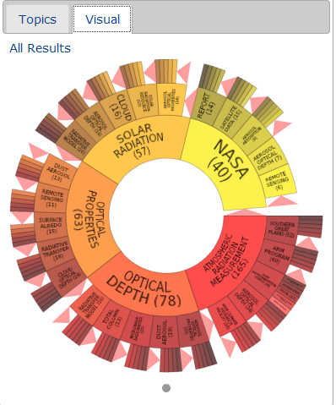
Federated Search Features
Parallel Searching
Visualization
Clustering
Relevancy Ranking

Slide 9



Federated Products
Covers a range of R&D results (reports, patents, citations, eprints, etc.) in databases provided by DOE
Databases and websites offer over 200 million pages of U.S. science information from 13 federal agencies
Provides over 400 million pages of science information from databases and portals worldwide, including access to scientific and numeric data sources

Slide 10

Science.gov Integrates Federal Agency R&D Results
OSTI developed and operates Science.gov…a single search box portal to STI from 13 federal science agencies.
Represents 97 % of the federal research and development budget.
200 million pages of science information
Over 55 databases
2,100 select websites
Expanding to formats beyond text to multimedia and data.

Slide 11
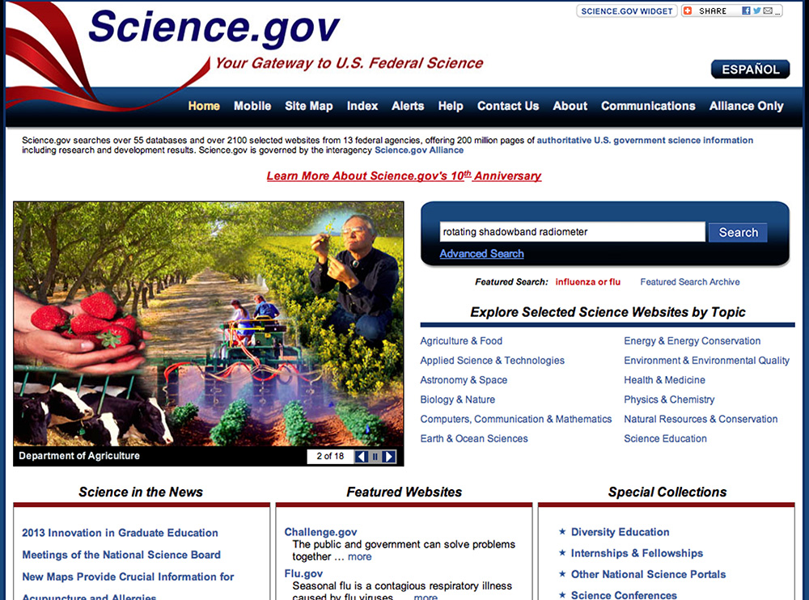

Slide 12
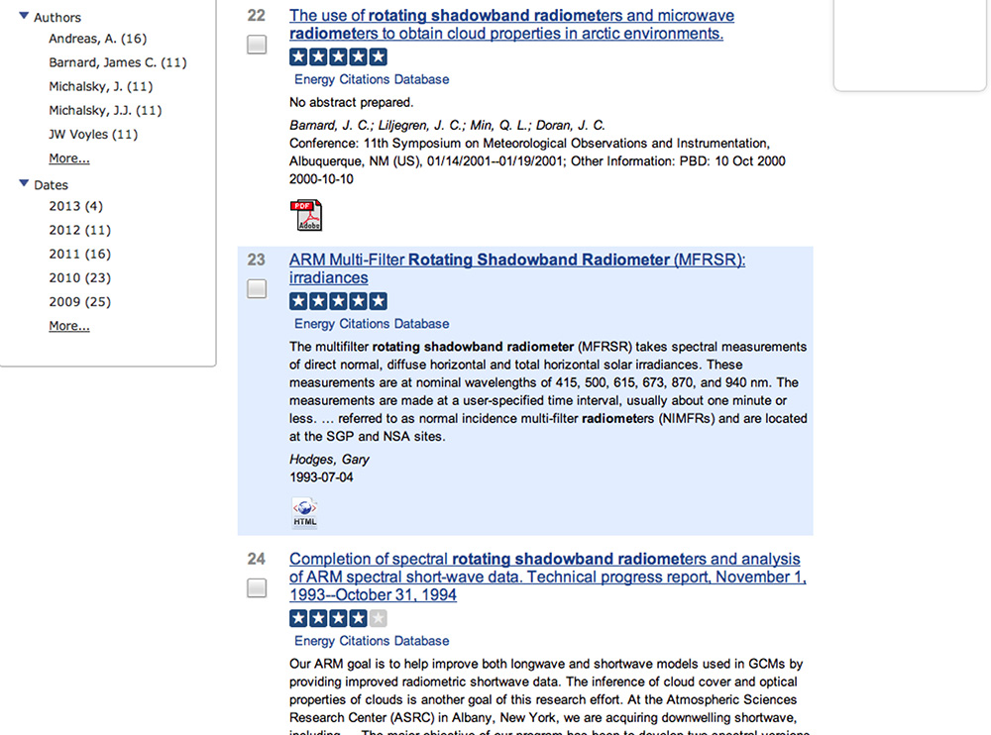

Slide 13
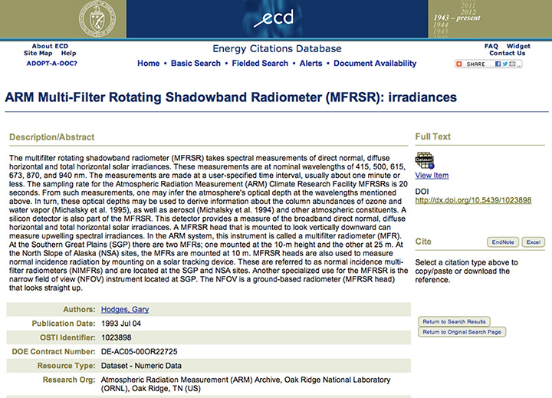

Slide 14
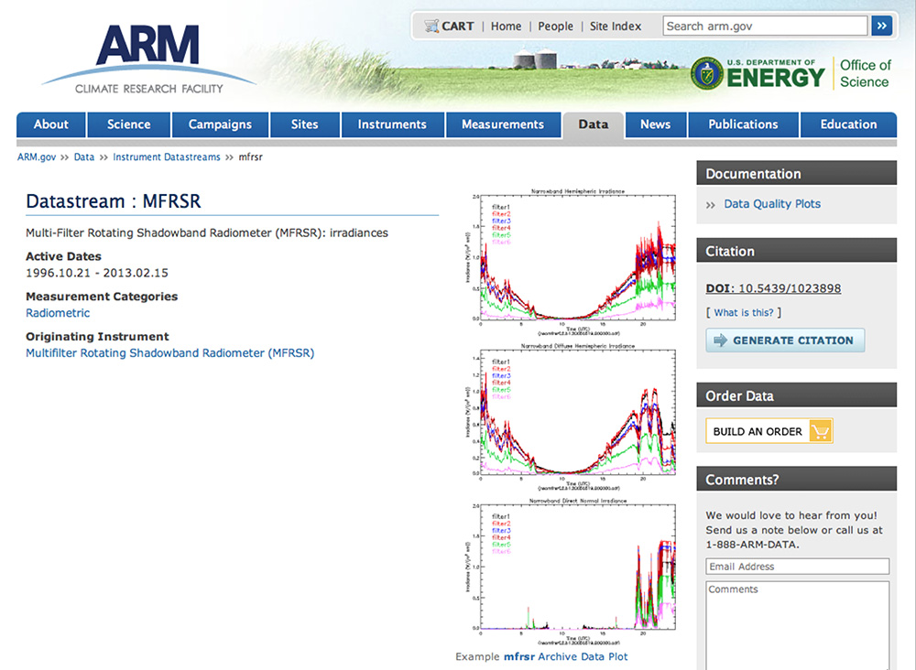

Slide 15

Why Cite Data?
Data should be cited in just the same way that other sources of information, such as articles and books, are cited.
Data citation can help by:
enabling easy reuse and verification of data
allowing the impact of data to be tracked
creating a scholarly structure that recognizes and rewards data producers

Slide 16
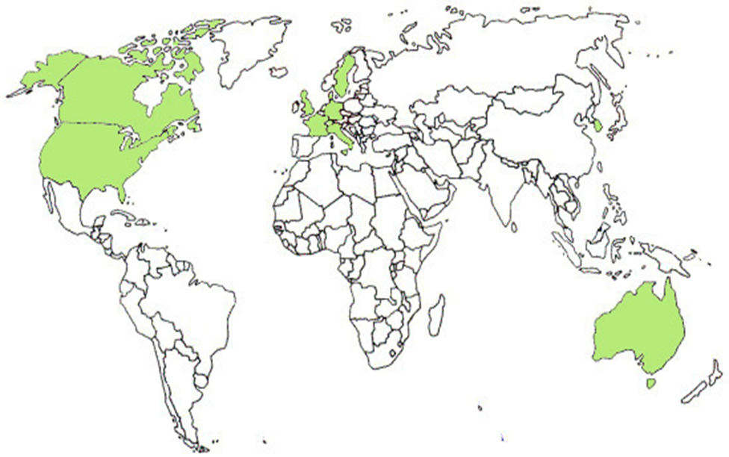
One Solution: DataCite
What is DataCite?
A global consortium composed of local institutions focused on improving the scholarly infrastructure around datasets and other non-textual information.
A service for assigning Digital Object Identification (DOIs) and metadata to datasets.
DataCite (www.datacite.org) helps researchers find, access and reuse data.

Slide 17


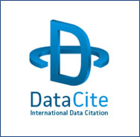
DOE Data ID Service
DOE/OSTI is the only U.S. federal member of DataCite.
Interagency agreement in place with NIH project, plus in discussions with seven other agencies representing 12 projects.
OSTI Partnered with Oak Ridge National Laboratory to pioneer procedure.
First DOI for a DOE dataset was minted and registered with DataCite on 8/10/2011.
DOE Atmospheric Radiation Measurement (ARM) has now registered over 400 datasets.

Slide 18
How Data Citation Works
Dataset Type
Dataset Title
Dataset Creator/Author or Principal Investigator
Dataset Product Number
DOE Contract/Award Number
Originating Research Organization
Publication/ Issue Date
Sponsoring Organization
URL where the Dataset is posted for access
Contact information
Data Citation metadata submitted to DOE-OSTI
=
Web Service API
241.6 AN
Creator/Author, Primary Investigator, or Submitter notified of Data Citation availability
Data Citation submitted to search engines for indexing
DOI Assigned By DOE-OSTI
DOE-OSTI submits nightly feed of new DOIs to DataCite
DOE-OSTI updates metadata record with DOI creating a full Data Citation
DataCite validates DOI registration with DOE-OSTI
DataCite Registers DOI

Slide 19

WorldWideScience.org Enabling Access to Global R&D Results
U.S. research results (Science.gov) plus research results from 70+ countries are searchable via single-query global science portal.
Multilingual translations capability for 10 languages.
More than 400 million pages of scientific and technical information, including:
Text
Multimedia
Data

Slide 20
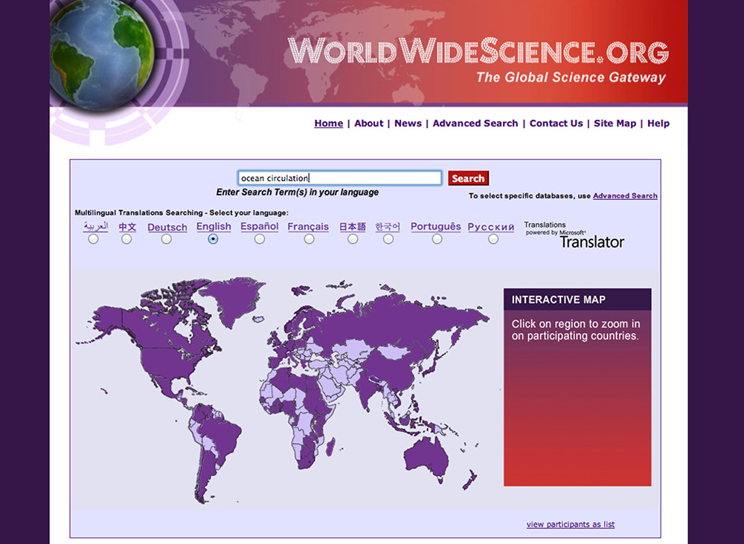

Slide 21
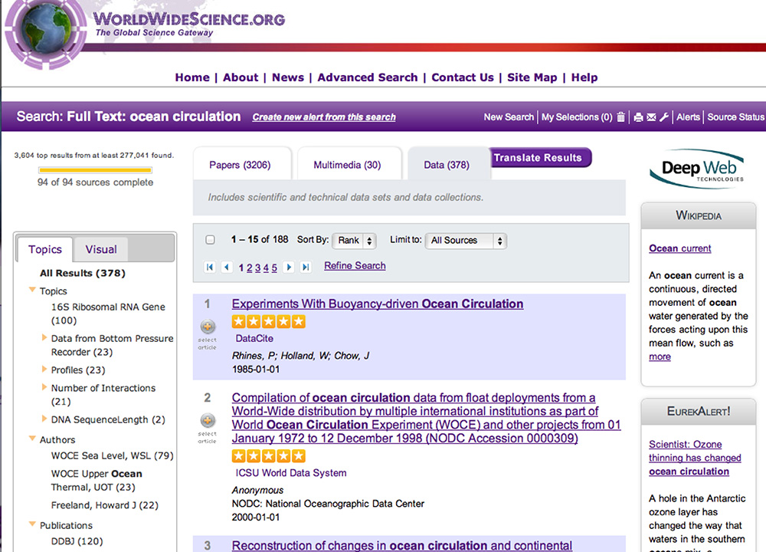

Slide 22
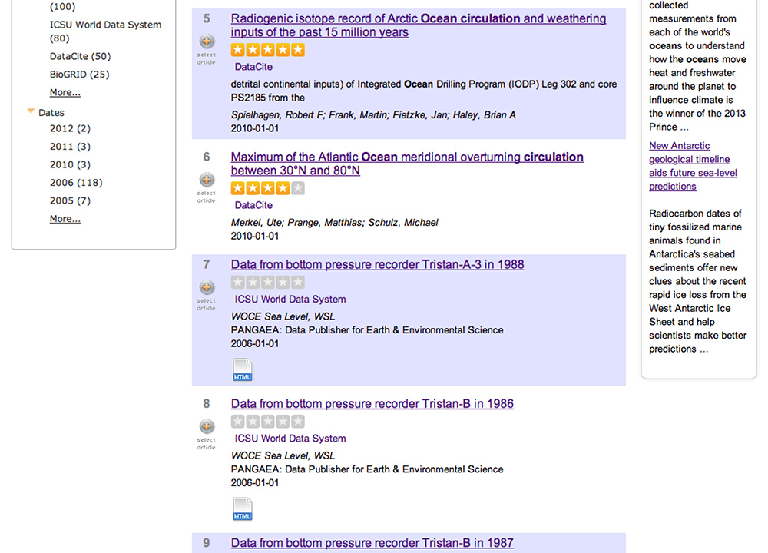

Slide 23
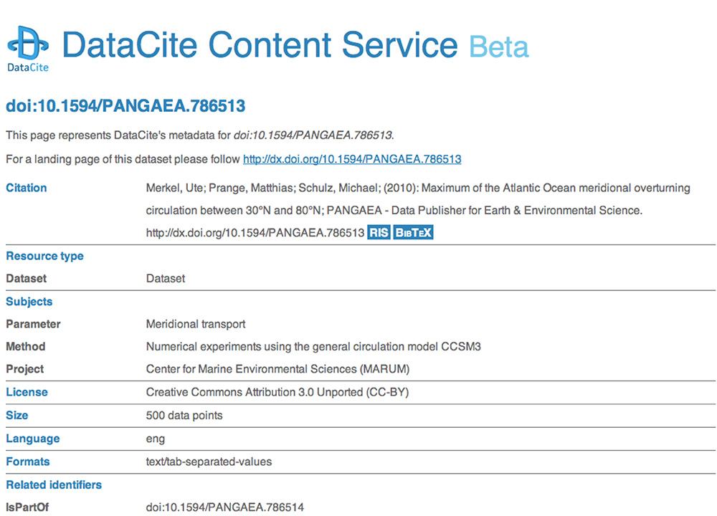

Slide 24
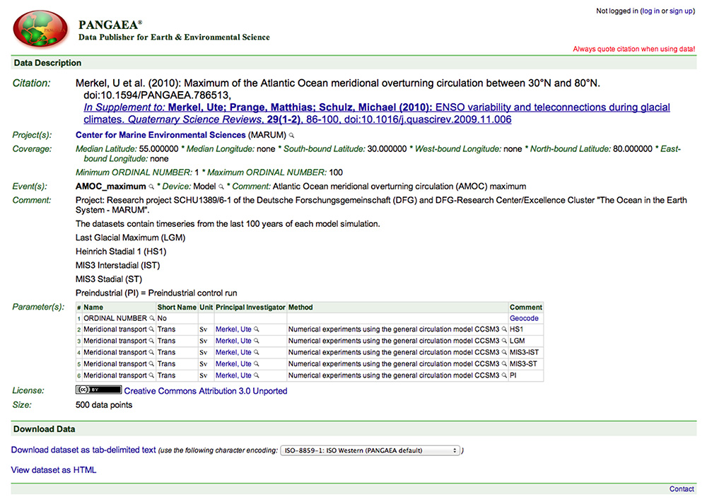

Slide 25
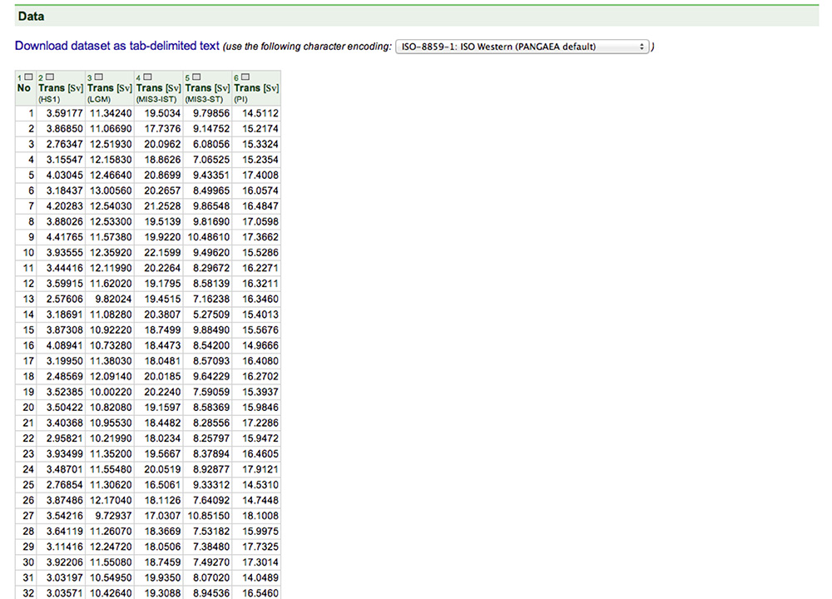

Slide 26
Conclusions
DataCite – data citation is increasingly important in scientific records.
Federated search is an interoperable solution that covers textual scientific information, as well as multimedia and data.
For more information:
Mark Martin
POC DataCite
martinm@osti.gov
Lorrie Johnson
POC WorldWideScience
johnsonl@osti.gov

