Slide 1
DATA CITATION INDEX:
UNLOCKING HIDDEN DATA
MIKE TAKATS
DIRECTOR PRODUCT STRATEGY
SCIENTIFIC & SCHOLARLY RESEARCH
FEBRUARY 2013

Slide 2
Agenda
  The Data Landscape
  Challenges with Research Data
  An A&I Solution (Data Citation Index)
  Questions & Answers

Slide 3
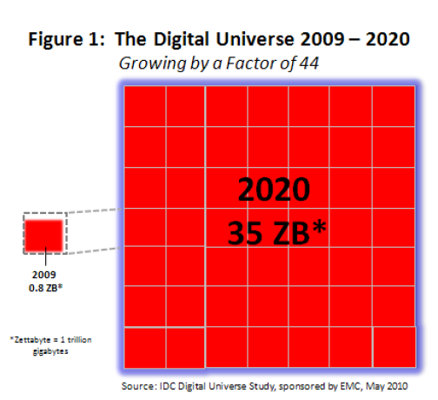
The Ubiquity of Research Data
Whenever and wherever there is research, there is research data
The digitization of data has created tremendous opportunities for research data of all varieties, creating a large and growing opportunity

Slide 4
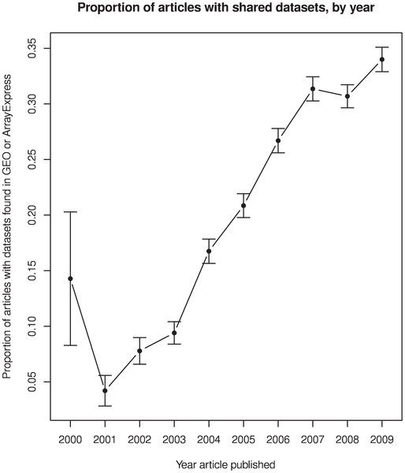

Data Sharing Rate is Increasing
PLOS ONE STUDY
Proportion of articles with shared data sets, by year published

Slide 5














The Increasing Visibility of Data
Data repositories &
registration agencies
Journal publishers
    Publisher websites
    Data journals

Slide 6

Why are Researchers Still Hiding Their Data?

Slide 7
Deposition of Data by Researchers
Source: Thomson Reuters Survey
7

Slide 8


The Emergence of Funding Mandates
  NIH (2003) Data Sharing Policy that all funding applications of $500,000 or more per year are expected to address data-sharing in their application.
  NSF (2011) All funding proposals submitted on or after January 18, 2011, must include a “Data Management Plan” describing how the proposal will conform to NSF policy on the dissemination and sharing of research results.

Slide 9


Data Management Requirements Extend Across the Globe
Aug 2011… “expectation that all our funded researchers should maximise access to their research data with as few restrictions as possible. …. submit a data management and sharing plan as part of the application process.”
2007… “Researchers are to retain research data and primary materials, manage storage of research data and primary materials, maintain confidentiality of research data and primary materials.”

Slide 10


Funding Mandates Becoming Stronger
  January 14, 2013… “failure to provide the requisite Data Management Plan will result in the application being rejected or terminated.”

Slide 11
Data Elevated to “Article Status”?
January 14, 2013.. Biographical Sketch(es), has been revised to rename the “Publications” section to “Products”…. This change makes clear that products may include, but are not limited to, publications, data sets, software, patents, and copyrights.
Biosketches now include “Products”, not “Publications”

Slide 12

Challenges with Research Data
Access & discovery
Citation standards
Lack of willingness to deposit and cite
Lack of recognition / credit

Slide 13
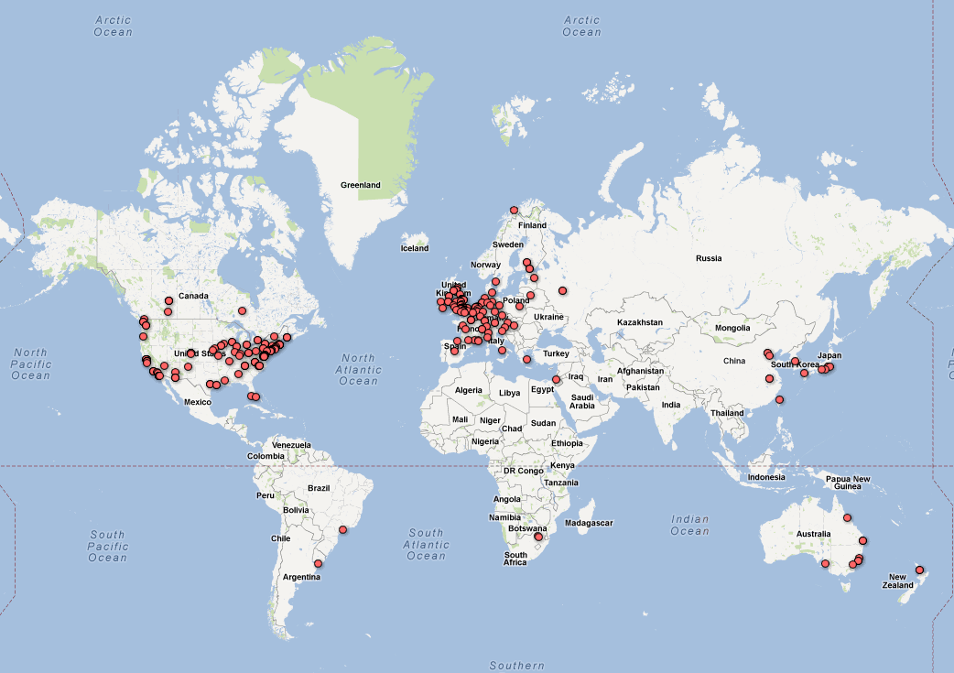
Over 500 Data Repositories Established

Slide 14





Research Data
Diverse and Disparate Sources
  There are many quality repositories maintained for the purpose of providing access to research data.
  Repositories are separately maintained, with varying schemes of organization and search capabilities.

Slide 15
Barriers to Researchers Citing Data
Researchers agree that data should be cited, but there are currently no universally accepted standards for citing data
“Lack of knowledge about standards for citation and of proper scholarly recognition and/or evaluation of such materials.”…
“…cumbersome citation formats including very long internet addresses.”
“Incomplete citation information available (dates and real author names as distinct from aliases)’”

Slide 16

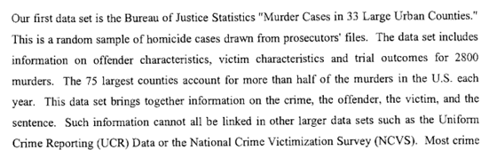
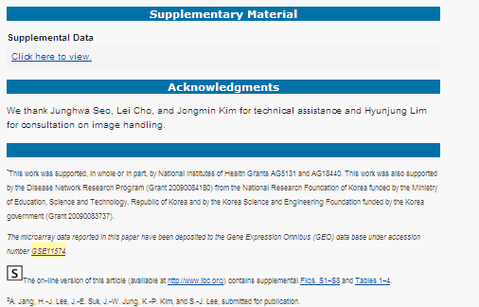
Data Citation Behaviour
Desired/future citation style
(as part of cited references)
Current citation style
(in full text of article)
U.S. Dept. of Justice, Bureau of Justice Statistics (1996): MURDER CASES IN 33 LARGE URBAN COUNTIES IN THE UNITED STATES, 1988. Version 1. Inter-university Consortium for Political and Social Research.
http://dx.doi.org/10.3886/ICPSR09907.v1
Lee, Seung-Jae; Lee, He-Jin; Cho, Ji-Hoon; Rho, Sangchul; Hwang, Daehee (2008): GSE11574: The responses of astrocytes stimulated by extracellular a-synuclein. Gene Expression Omnibus. http://www.ncbi.nlm.nih.gov/geo/query/acc.cgi?acc=GSE11574

Slide 17
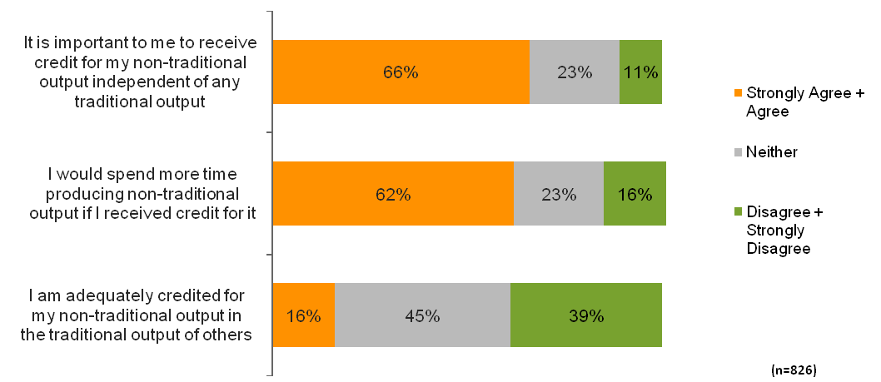
Researchers Are Not Receiving Appropriate Credit
Source: Thomson Reuters Survey
17

Slide 18
Where Do We Start?
Enable the discovery of data repositories, data in the context of traditional literature
Help researchers find data and track the full impact of their research output
Establish attribution standards and incentives to make data discoverable
Provide expanded measurement of research output and assessment

Slide 19
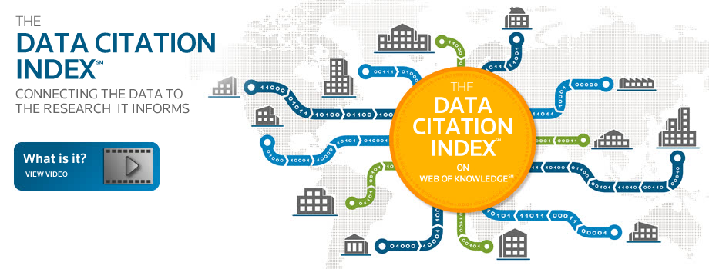
Thomson Reuters Solution

Slide 20

Repository Selection Considerations
  Relevant Content - ensuring that material is desirable to the research community.
  Persistence and stability of the repository, with a steady flow of new information.
  Thoroughness and detail of descriptive information.
  Links from data to research literature.
Notes:
Repository identification and selection are continuous and ongoing at Thomson Reuters, with repositories added as frequently as weekly. Moreover, existing coverage is constantly under review. Repositories now covered are monitored to ensure that they remain available and are maintaining high standards and a clear relevance to the Data Citation Index product. Research data considered for inclusion include data studies and data sets deposited in a recognized repository
Note: only repositories containing research data will be considered for inclusion. Traditional publications held in institutional or other repositories are not within scope of the Data Citation Index and will not be selected for inclusion.
Primary selection is at the level of the repository where evaluation includes:
Subject
Editorial content and repository attributes
Geographic origin and scope
Once a repository is accepted for inclusion, further evaluation determines the appropriate metadata elements which would allow for discovery and citation. Additionally, a number of factors are considered, but no one factor alone determines elibiblity.
Publishing standards - Persistence & Stability, Funding Statements, English Language metadata, Peer review (not rigid), Age of material, Links to research literature
Editorial content – three major subject areas (S&T, Social Sciences, Arts & Humanities), International diversity, data citation and standards.
Selection criteria and submission process on our publisher relations web site
These points are detailed in a selection essay which can be found on our web site.

Slide 21
Thomson Reuters Indexing of
Research Data Repositories
Web of Knowledge
Data Citation Index Record
TR takes descriptive metadata feed from repository
Repository raw metadata is analyzed by TR
TR adds metadata

Slide 22
Data Citation Record Model
Repository
Data Study
Data
Set
Repository: Comprised of data studies, data sets
Data Study: Descriptions of studies or experiments with associated data
Data Set: A single or coherent set of data or a data file provided by the repository
Notes:
22

Slide 23
Research Data Repository Coverage
Discipline Breakdown of Repositories

Slide 24
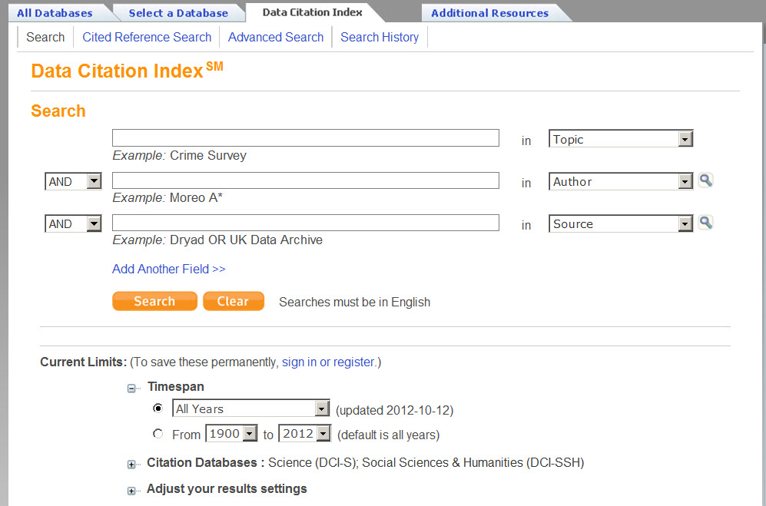
ischemic heart disease
The Data Citation Index is presented within the Web of Knowledge platform with the same look and feel as other resources, such as Web of Science.

Slide 25
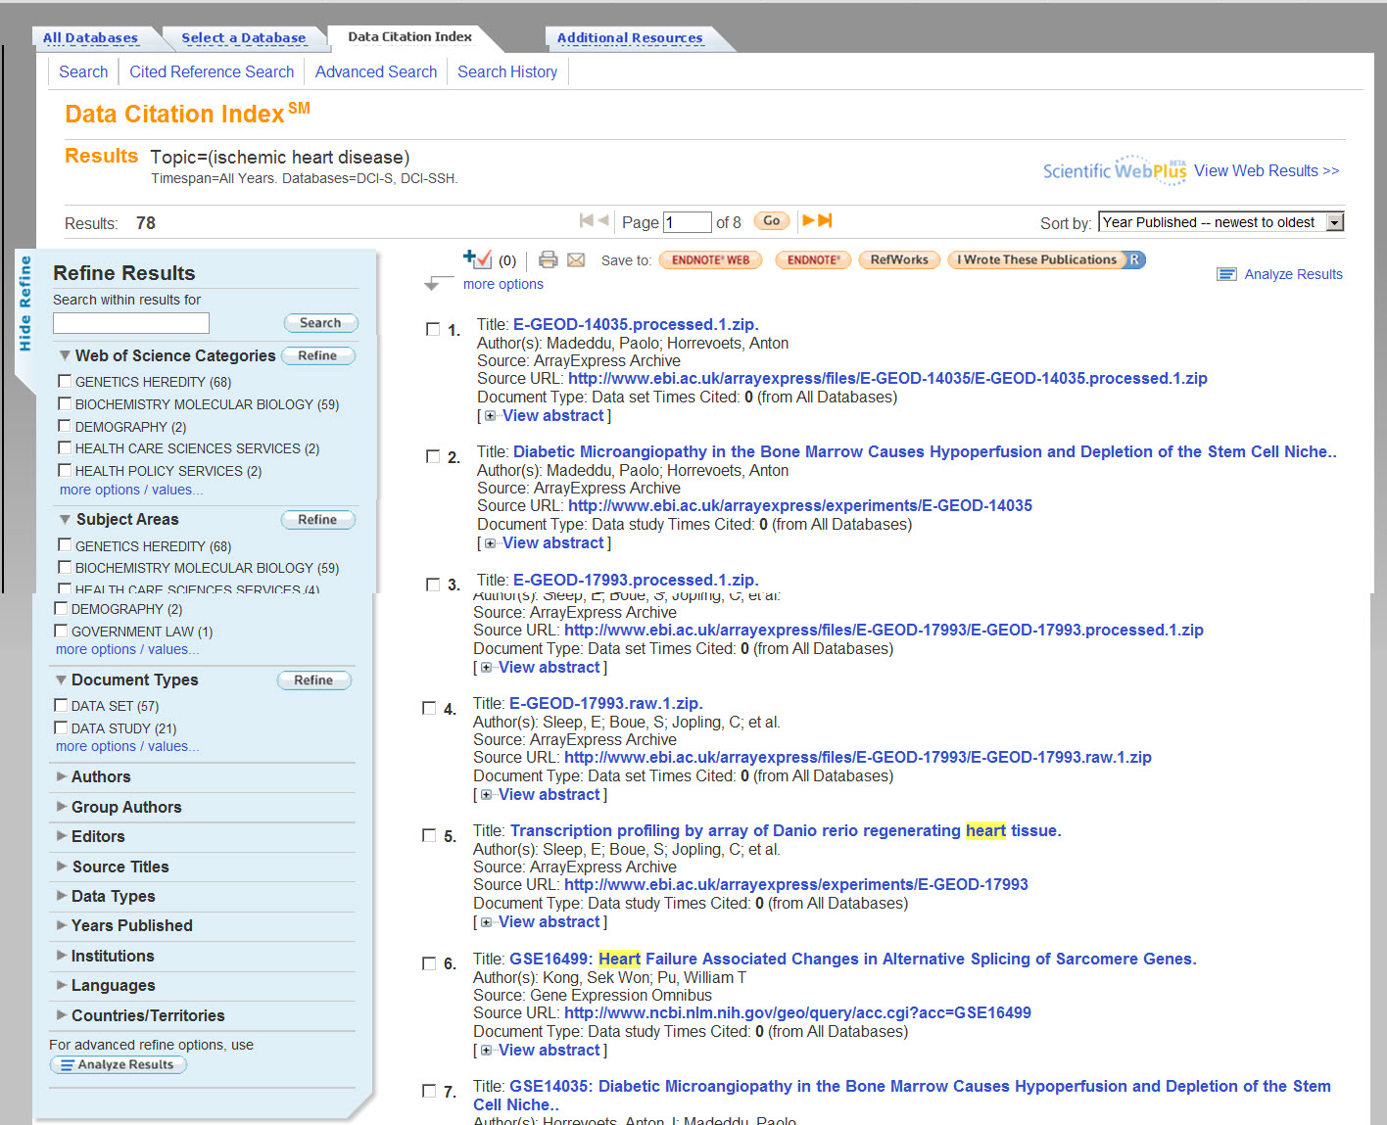
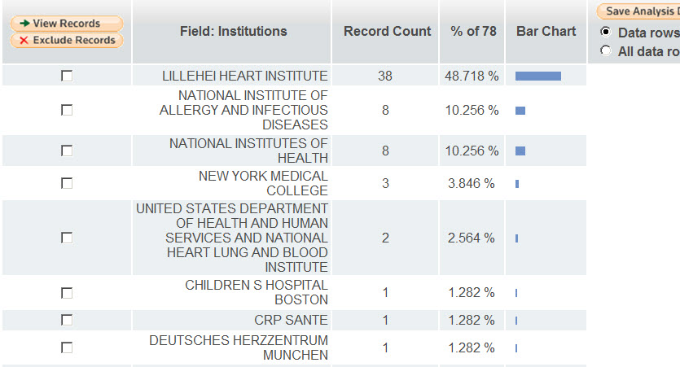
Data Citation Index presents all of the powerful Web of Knowledge options for exploring search results.
Utilize Analyze Results features as you would in any Web of Knowledge database – immediately gain insight into your a body of search results. Export analysis data!

Slide 26
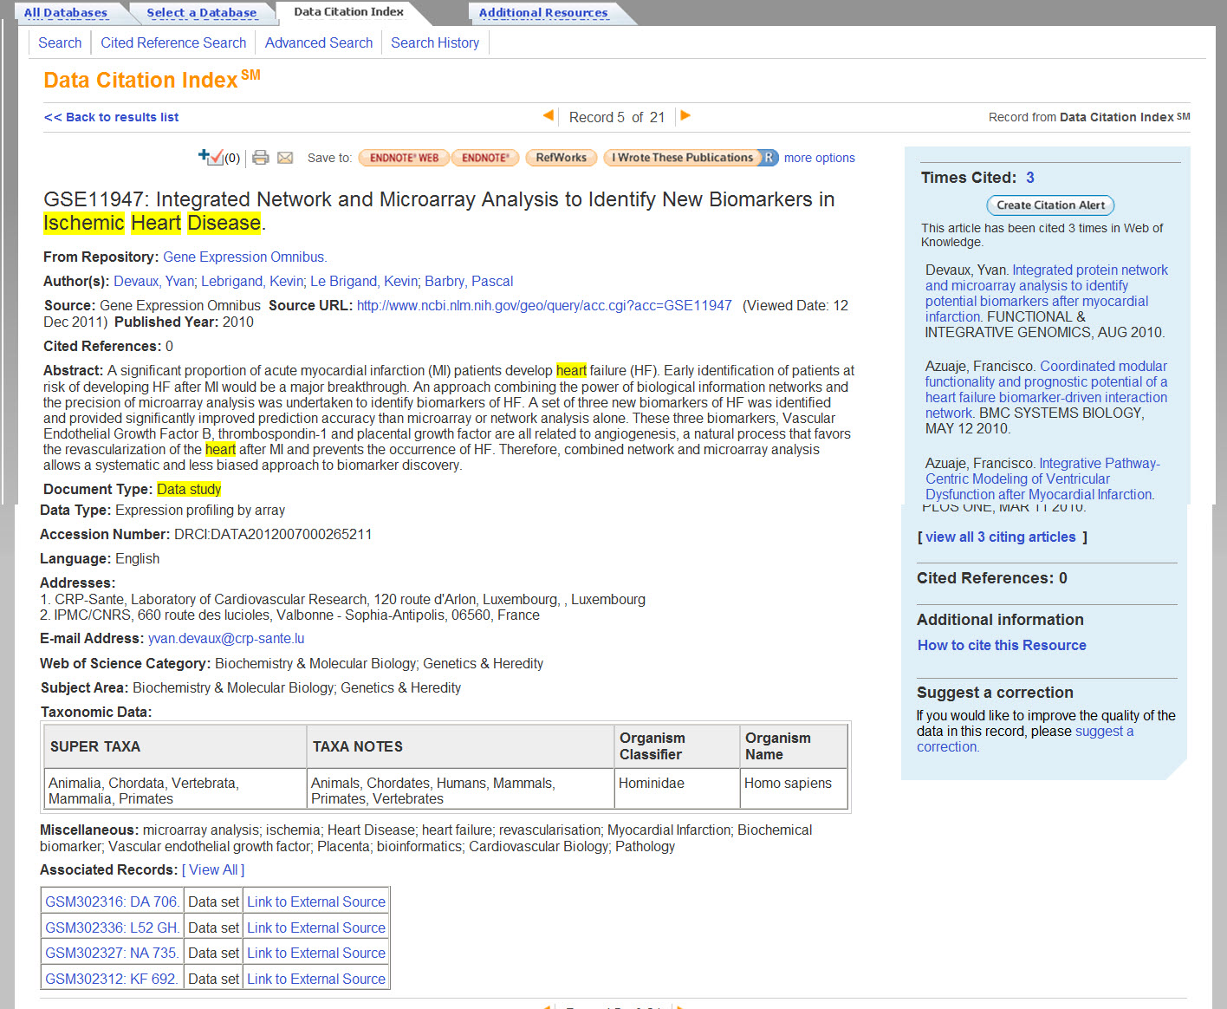

The full record presents fundamental information about this data study – an abstract, data type, miscellaneous descriptors, and basic taxonomic data.
Through recommendation of a standard format for citing research data we hope to impact the research community’s citing practices – facilitating capture and unification of cites to research data going forward.

Slide 27
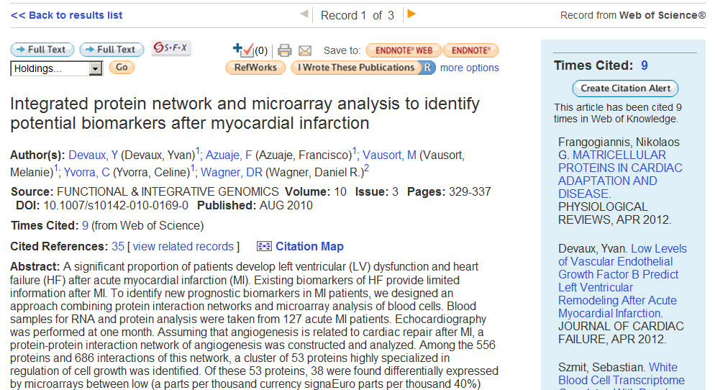
The full record serves as a central point from which to collect information around this data study, and link to related information – such as the articles that have referenced this Data Study.

Slide 28
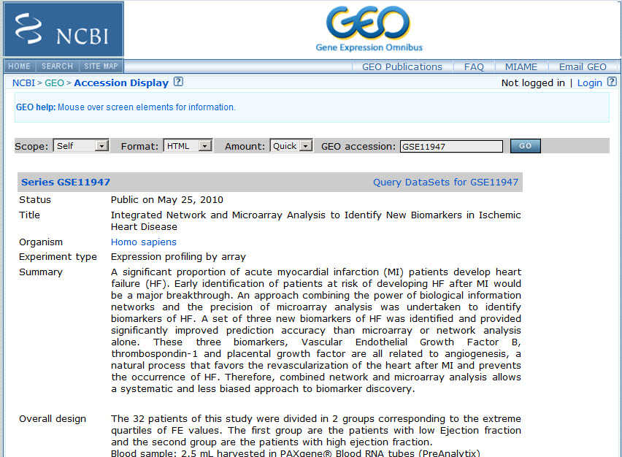
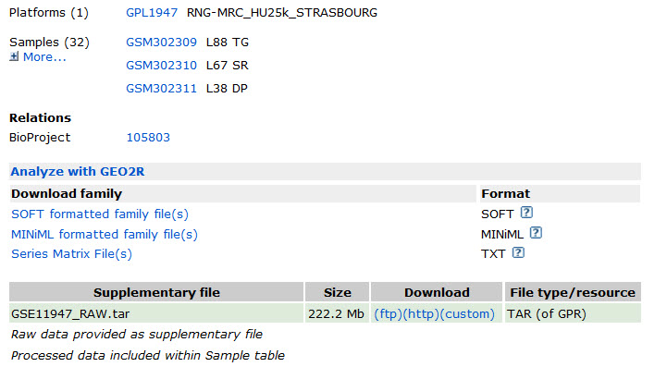
Above all though – the Data Citation Index is about getting users to research data itself.
Link to the Data Set information within the repository.
Notes:
And of course the ability to link out to the data study itself at the repository.
We think by raising visibility, accessibility, and “citeability” of data sets we can put

Slide 29
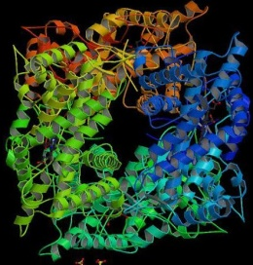
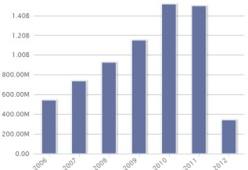
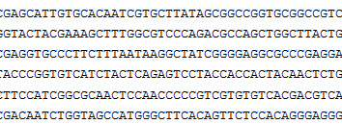
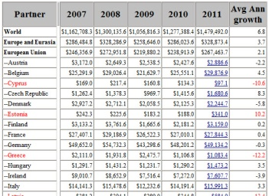

Challenges
Metadata availability
  Lack of resources
  Lack of expertise
Metadata quality
  Metadata inconsistencies
Data repositories are not static
Partnerships

Slide 30

Expected Outcomes: Data Citation Index
Discovery of data most important to scholarly research
Data linked to published research literature
Measures of data use and reuse
New metrics for digital scholarship

Slide 31
Thank you
Mike Takats
michael.takats@thomsonreuters.com

