Slide 1


Introduction to the Research Data Alliance
Dr. Francine Berman
Chair, RDA / US
Edward G. Hamilton Distinguished Professor in Computer Science
Rensselaer Polytechnic Institute

Slide 2
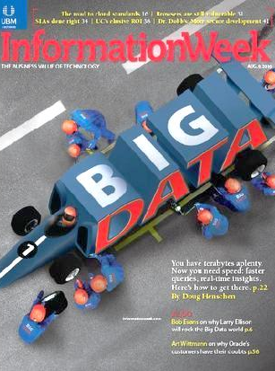
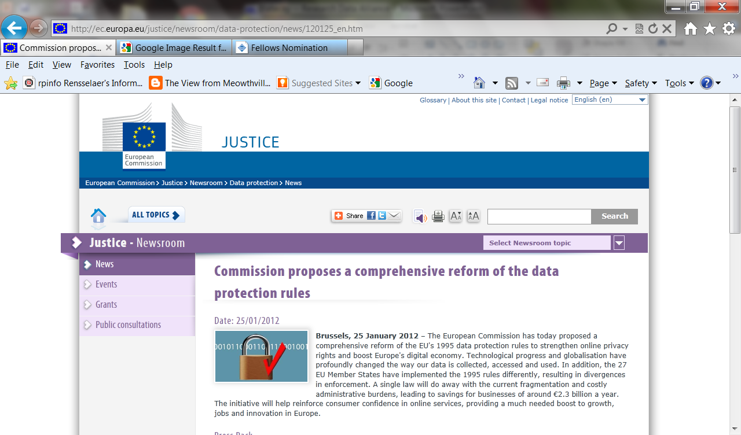
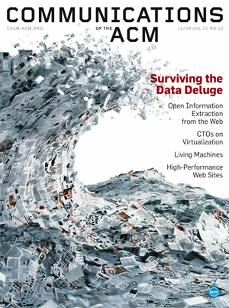
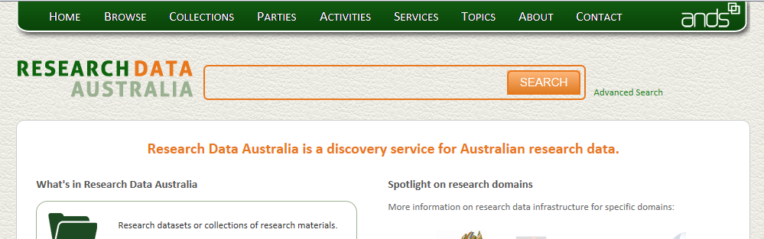
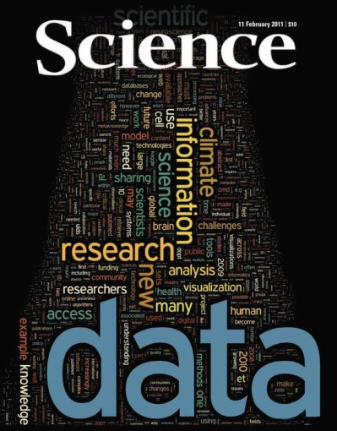

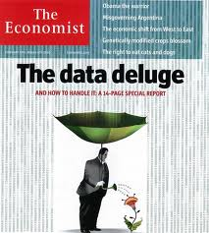
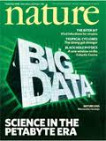
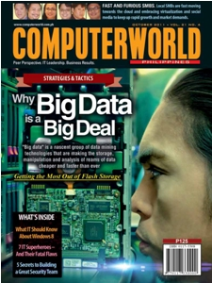
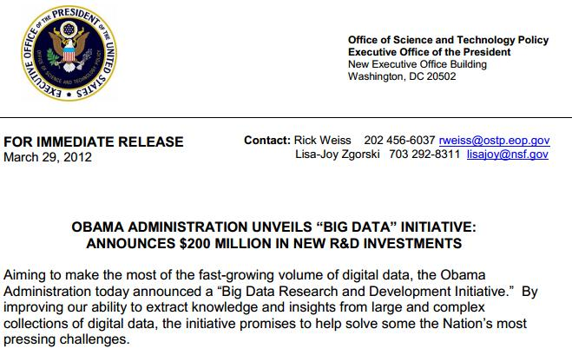
Digital Data has hit the “Tipping Point” as a National and Global Priority

Slide 3
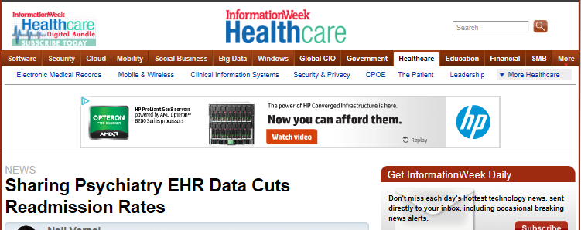
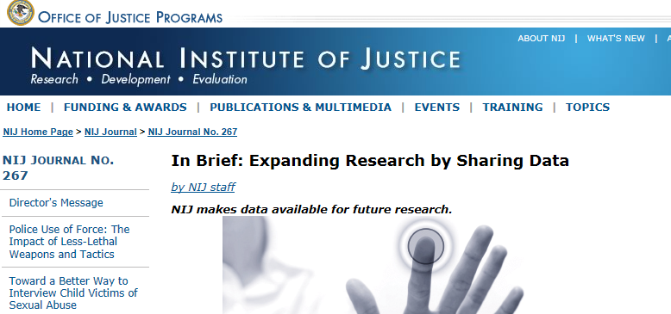
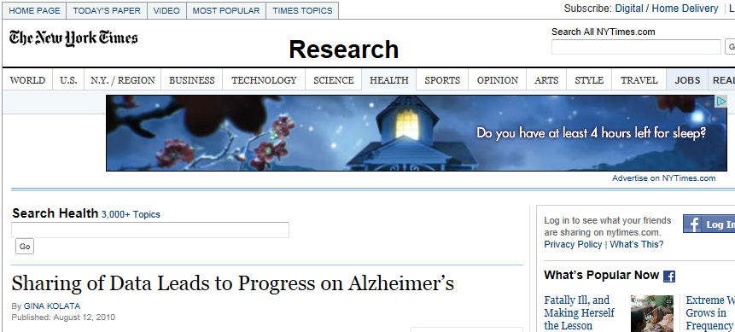
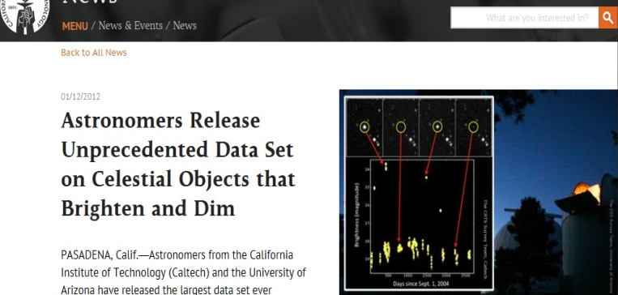
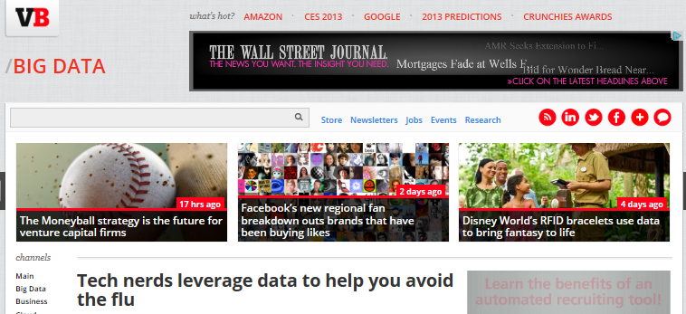
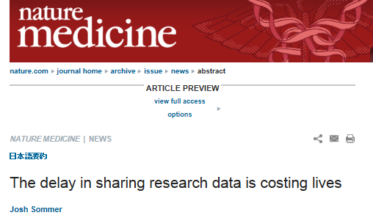
It’s Not Just Your Data, It’s Other People’s Data
Data Sharing Fundamental to Data-Driven Innovation

Slide 4
Common Infrastructure, Policy and Practice Drives Data Sharing and Exchange throughout the Data Life Cycle
Create
Edit
Use / Reuse
Preserve / Destroy
Publish
Common Interoperability Framework
Tools and Infrastructure that Promote Discoverability
Stewardship and Management Practice
Digital Object Identifiers
Sustainable economic model
Common Metadata standards
Preservation of Valued Collections
Framework for Comparative Analytics
Access and Distribution Policy
Policy for Sharing Data

Slide 5
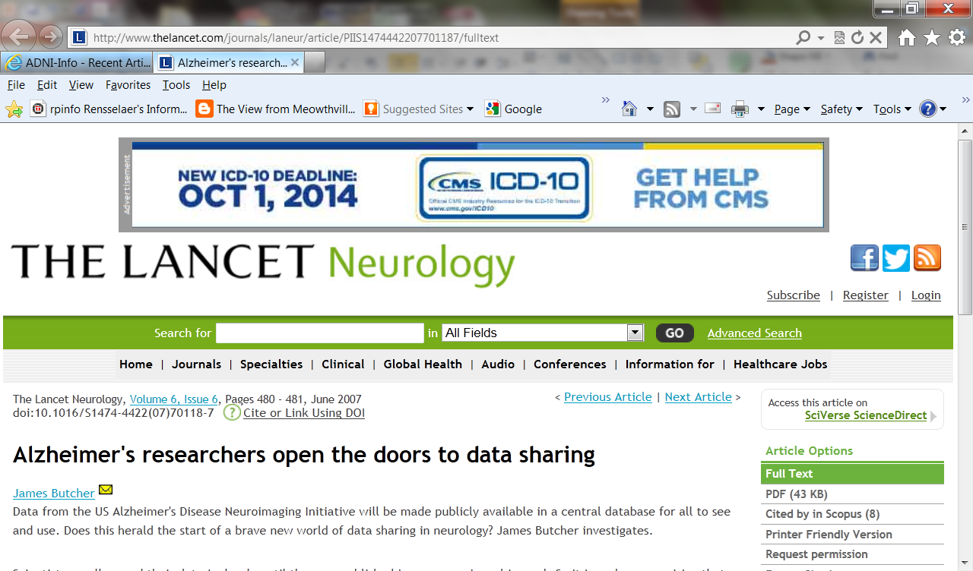
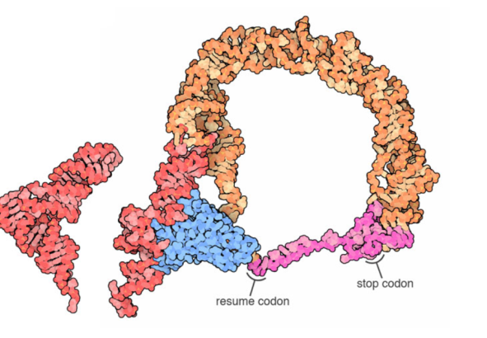


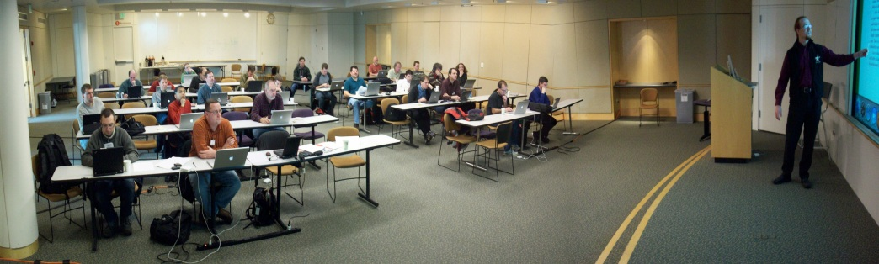
Community efforts accelerate data-driven discovery and innovation
“Just do it” -- Focused efforts help communities drive tangible progress
Creation / adoption of data sharing policies have accelerated research innovation
Development of a publicly available shared
data collection enabling new results for Alzheimer’s
Development and adoption of
parallel communication protocols through the
MPI Forum drove a generation of advances
Now 25 years old, the Internet Engineering Task Force’s mission “to make the Internet work better” has resulted in key specifications of Internet standards that support innovation
Transfer-Messenger RNA image (PDB Molecule of the Month for January 2013) courtesy of David Goodsell and the RCSB PDB
MPI Forum image from http://lists.mpi-forum.org/mpi-forum/2008/12/0198.php

Slide 6
Research Data Alliance: New Community Organization to Accelerate Global Data Sharing and Exchange
The Research Data Alliance (RDA) is a new organization forming to facilitate specific, short-term efforts that accelerate the sharing and exchange of research data
Working groups will serve as accelerants to data sharing practice and infrastructure. Work products / deliverables to include
  Adopted standards
  Deployed infrastructure
  Adopted policy
  Implemented best practice, etc.

Slide 7
Research Data Alliance Approach:
Focused efforts, tangible progress
Insufficient drivers for data sharing and exchange; preliminary research, discussion, reports
RDA DELIVERABLES: Needed policy, infrastructure, practice to drive new results
Improved data-driven research outcomes
RDA Working Group Deliverables are:
Focused pieces of adopted code, policy, infrastructure, standards, or best practices that enable data to be shared and exchanged
“Harvestable” efforts for which 12-18 months of work can eliminate a roadblock for a substantial community
Efforts that have substantive applicability to “chunks” of the data community, but may not apply to everyone
Efforts for which working scientists and researchers can start today while more long-term or far-reaching solutions are appropriately discussed in other venues

Slide 8
Initializing RDA: Organizational Framework
RDA Strategy and Leadership: Council
Responsible for overarching mission, vision, sustainability of RDA
Technical Leadership:
Technical Advisory Group (TAG)
Responsible for Technical Roadmap
Administrative Leadership:
Secretariat
Responsible for Administration and Operations
Organizational Partners: Organisational Advisory Group (OAG)
Responsible for Process and Strategy Reference Document
RDA Membership
Community Impact: Working Groups
Responsible for impactful, outcome-oriented efforts
Government Group
Appropriate International R&D Agency Support

Slide 9
Creating Working Group Efforts
Community discussion of issues and areas that facilitate data-driven research. Many groups forming at forum.rd-alliance.org.
Case Statement
Community feedback on Working Group ideas; assessment of technical, impact and alignment to RDA mission by TAB and Council
RDA WG Endorsement
RDA Working Group: 12-18 month outcome- oriented effort culminating in adoption and implementation of specific deliverables
Group Culmination
Post-completion broader community adoption of deliverables and amplification of impact

Slide 10
Making Data Work:
Assessing Case
Statement Impact
Implemented and adopted tools and infrastructure
Adopted Policy and Practice
Adopted harmonized standards
Key questions for Candidate
Working Groups:
What are the practical outcomes
of the work?
Who will benefit from the work
and what research issues will be facilitated?
How do the deliverables make it easier for researchers
to do their work? How do they change how research
will be undertaken?
Who will implement / adopt the deliverables?
Are adopters and beneficiaries included in the Working Group?
What is the schedule for implementation / adoption?
What are the advantages of this approach over existing approaches?

Slide 11
Building the RDA
  Growing the RDA Community
  Increase membership through the rd-alliance.org website and forums
  Create a pipeline of impact-oriented deliverables through the development and backing of RDA Working Groups
  Foster RDA Plenary events as a gathering place for the community
Growing the RDA Organization
  Develop a functional and effective organizational structure (v.1 by the Plenary)
  Reach out to founding Organizational Partners and Affiliates and create a win-win partnership model
Growing RDA Leadership
  Populate the initial Council, Technical Advisory Board, Organizational Advisory Board, Secretariat
  Work with active community members to take on leadership roles and responsibilities

Slide 12
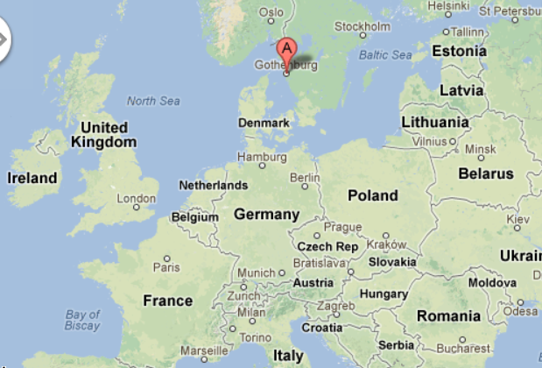
“T=0” in 2013: High-profile, high impact first RDA Plenary and Launch
March 18 -20, 2013
  Official launch event and first Plenary for RDA: Chalmers University, Gothenburg Sweden
Agenda includes
  Leading scientists and high-level international speakers
  Birds of a Feather Sessions for RDA Interest Groups
  All-hands sessions for technical, organizational issues, governance
  Data Organization and International Data Panels, etc.
RDA Plenary 2 being scheduled in the U.S. (Washington D.C. are) for Fall 2013.

Slide 13

Thank You
Information:
rd-alliance.org
Questions, comments: enquiries@rd-alliance.org
Forum:
forum.rd-alliance.org

