Slide 1
SCIENCE, RESEARCH DATA, AND PUBLISHING
Stewart Wills
Editorial Director, Web & New Media, Science
26 February 2013

Slide 2
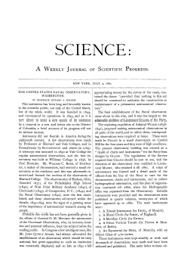
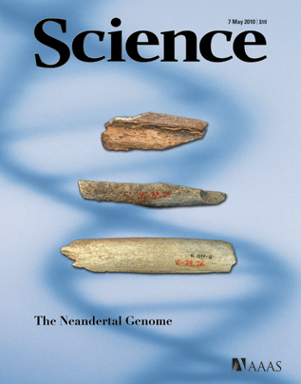
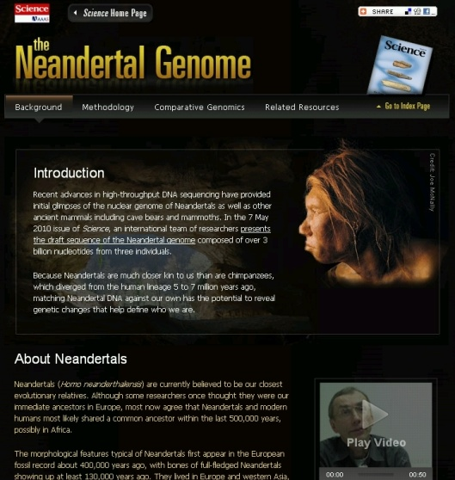
ABOUT SCIENCE
Founded in July 1880
Largest paid circulation of any peer-reviewed general science journal
Reaches an audience of millions through Web properties
  Early adopter of Web channel for content (second journal put online by HWP)
Science brand extended into several other journals and properties, all online-driven
  Science Signaling
  Science Translational Medicine
  Science Careers

Slide 3

ABOUT AAAS
Global organization, serving individual members and 262 affiliated societies
Mission: “Advance science, engineering, and innovation throughout the world for the benefit of all people”
  Science policy advocacy and information
  Education initiatives and public and press outreach
  Science workforce diversity and opportunity
  Advance international cooperation in science
  Publishing (including Science and affiliated products)

Slide 4
THE CHALLENGE OF NETWORKED INFORMATION
Publishers must still be (print) publishers – but also:
  Business model innovators
  Indexers and search-engine optimizers
  Content enhancers and managers
  Multimedia producers
  Data stores, data visualizers, data syndicators
  Social-media mavens
  Technology companies
  “Post-bibliometricians”

Slide 5
OPPORTUNITIES FOR PUBLISHERS
IN RESEARCH DATA
Content as data, data as content
Data services: New frontier of publishing/outreach value
Examples
  Data mining/APIs
  Capturing workflow and research-related objects
  Semantic enrichment of content
  Data visualization and actionability
  Syndication (and use) of linked open data
  Article-level metrics

Slide 6

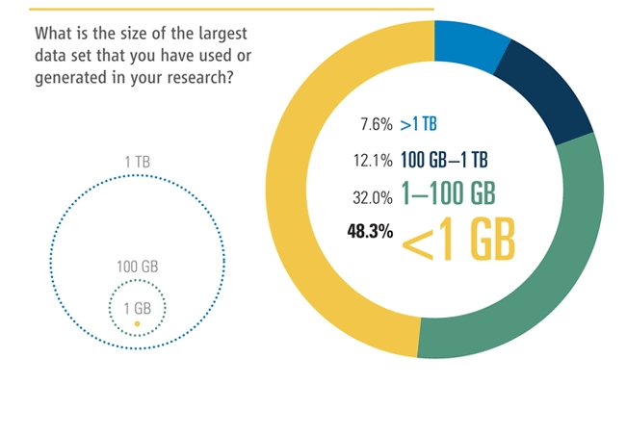
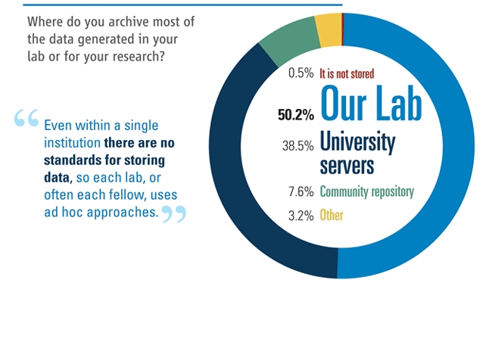
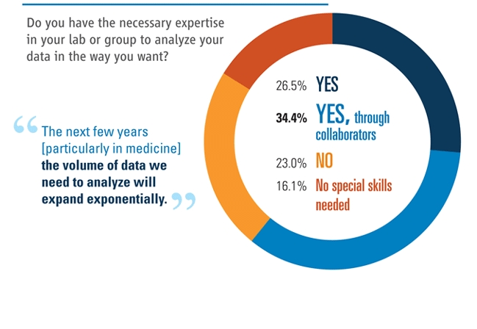
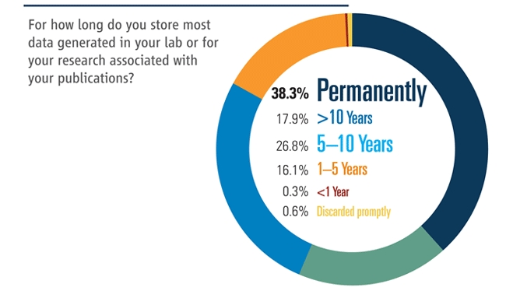
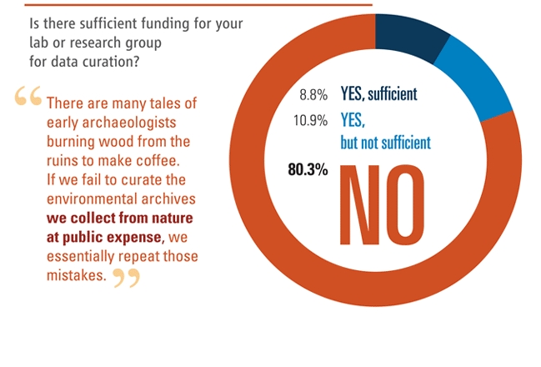
THE CHALLENGE OF DEALING WITH DATA
“. . . scientists are struggling with the huge amount, complexity, and variety of the data that are now being produced.” [Hanson et al., Science 331, 649 (2011).

Slide 7
CHALLENGES FOR PUBLISHERS
IN DEALING WITH DATA
Data size and volume
Diversity and difficulty of formats
Legacy data

Slide 8
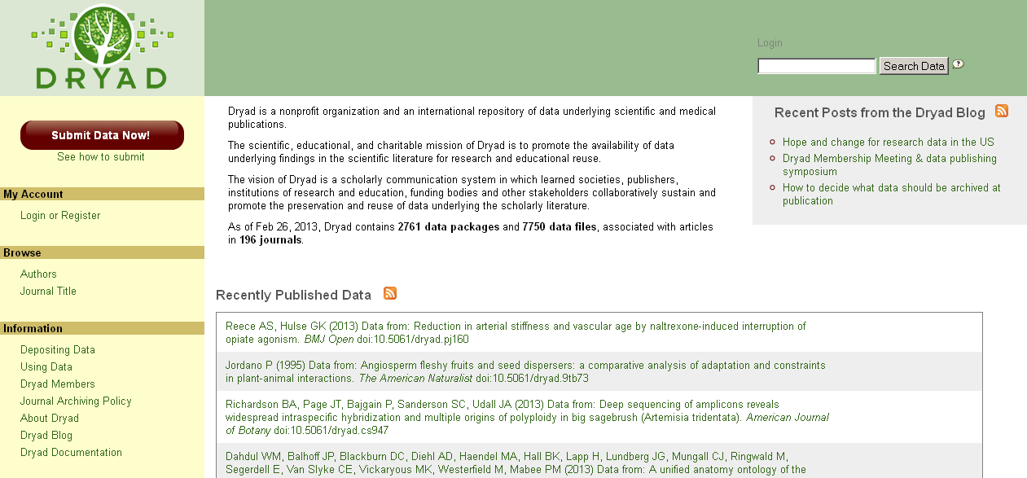
CHALLENGES FOR PUBLISHERS
IN DEALING WITH DATA
Persistence and discoverability
Uneven repository coverage

Slide 9
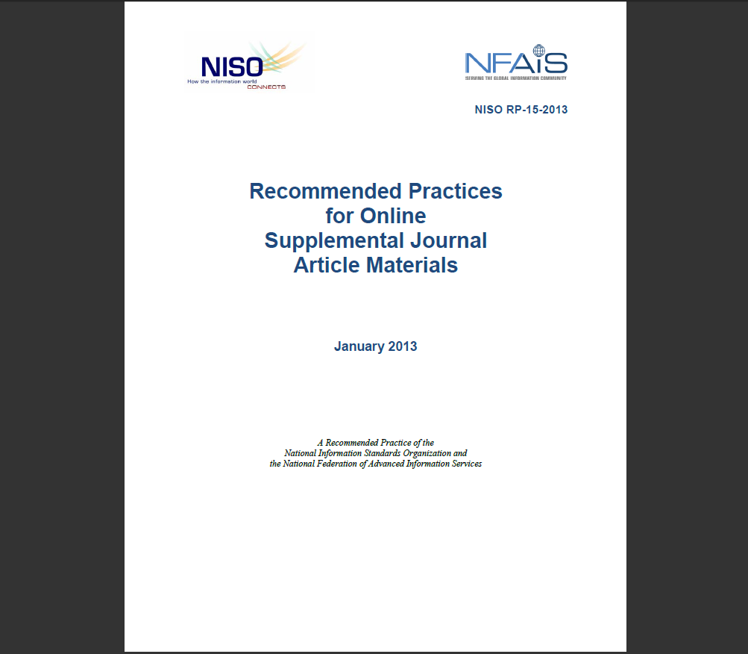
CHALLENGES FOR PUBLISHERS
IN DEALING WITH DATA
Lack of standards
  In markup, metadata, and format
  In what constitutes adequate supporting data
  What is “supplemental” versus “integral”
  Relevant level of peer review
  Data citation

Slide 10
CHALLENGES FOR PUBLISHERS
IN DEALING WITH DATA
Issues relating to authors
  Widely varying levels of sophistication
  Differing views on openness, ownership, rights
  Basic issues of funding and importance of curation function

Slide 11
BOTTOM LINE FOR SCIENCE/AAAS
Future publisher value to community in data services, data visualization, data connections, data enrichment
Grappling with many of same issues regarding management and standards as rest of community
Pleased to be part of discussion toward solutions
A good time for this owing to internal changes at Science

Slide 12
PAUL’S THREE QUESTIONS
“Areas in which we have common organizational objectives,
“What you think the Board should focus on in the near term, and
“Identification of any issues or activities in which you think we might usefully coordinate or collaborate”

Slide 13
SOME ALIGNMENTS OF INTERESTS
Mission to serve scientific communication
Addressing a broad swath of scientific enterprise
Integrity of the scientific record at core of mission
Clear interest in making data more findable and useful, to continue to drive best possible future research

Slide 14
NEAR-TERM FOCUS
Helping researchers figure out their own curation and archiving, and how to fund and manage it

Slide 15
POTENTIAL AREAS OF COLLABORATION
Participation in development and promotion of emerging standards
Outreach to community of authors, referees, and editors to understand problems and solutions

