Slide 1
Data and Information Opportunities
Board on Research Data and Information Sponsors Meeting
September 23rd, 2013
Laura Biven, PhD
Senior Science and Technology Advisor
Office of the Deputy Director for Science Programs
Laura.Biven@science.doe.gov

Slide 2
Priorities Challenges Opportunities
Data Management for primary research
Data Management for primary research
Data Management for reuse and repurposing
Data Management for reuse and repurposing
The World
The World on Big Data
Not only true for astronomy, high energy physics,… biology, climate, materials science,…

Slide 3
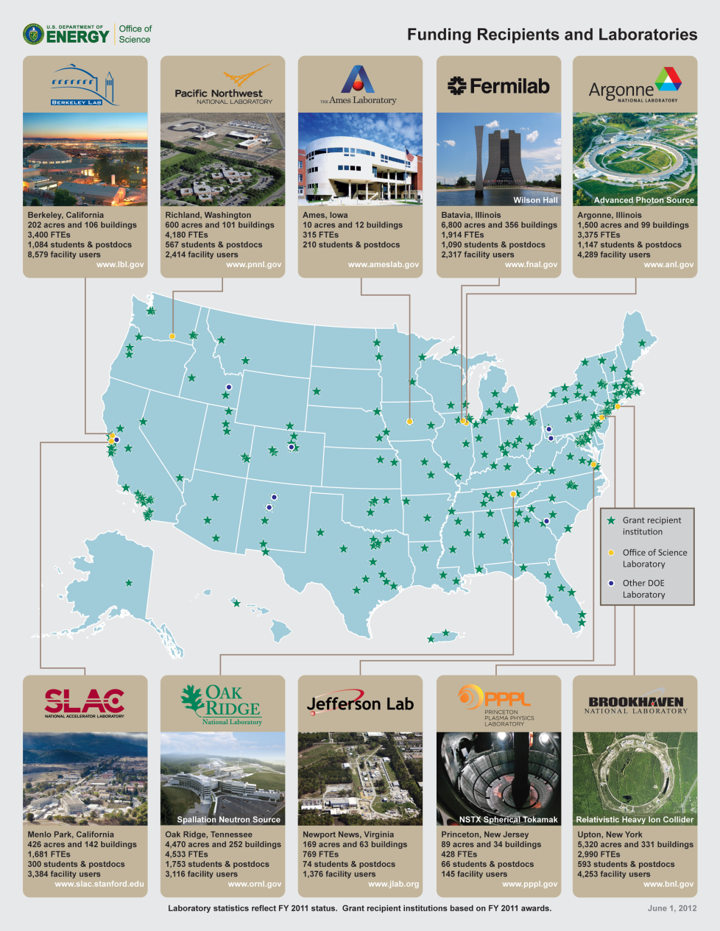
Quick-Facts about the DOE Office of Science
Advanced Scientific Computing Research
Basic Energy Sciences
Biological and Environmental Research
Fusion Energy Sciences
High Energy Physics
Nuclear Physics
Very diverse portfolio with truly big data

Slide 4

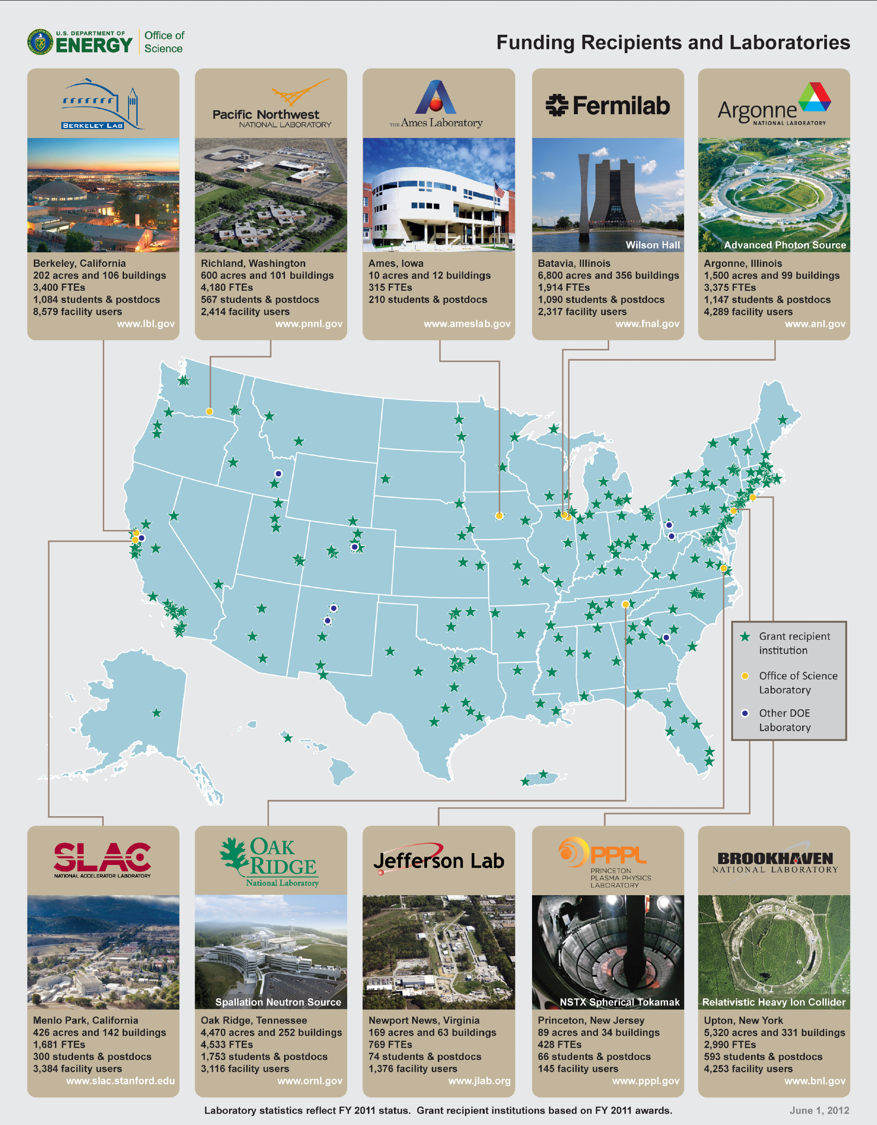
The DOE/SC Labs Today – User Facilities Us

Slide 5
Users Come from all 50 States and D.C.
Alcator
DIII-D
NSTX
SSRL
ARM
  26,000 users/year at 32 national scientific user facilities
JGI
EMSL
FES
ALS
ATLAS
Bio & Enviro
Facilities
HRIBF
TJNAF
Nuclear physics
facilities
APS
RHIC
Light Sources
B-Factory
High energy physics facilities
Tevatron
ALCF
Computing
Facilities
Neutron Sources
NSLS
OLCF
Nano
Centers
LCLS
HFIR
NERSC
Lujan
SNS
NSRCs

Slide 6
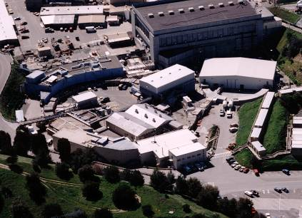
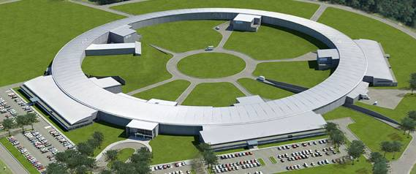
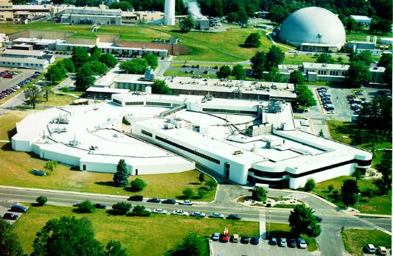
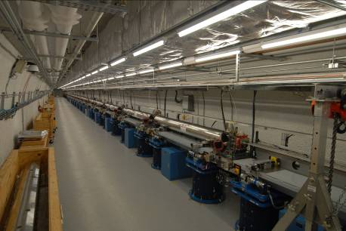
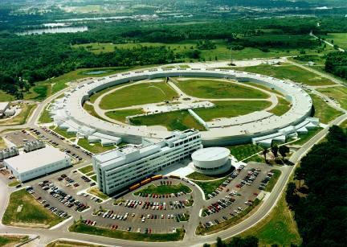
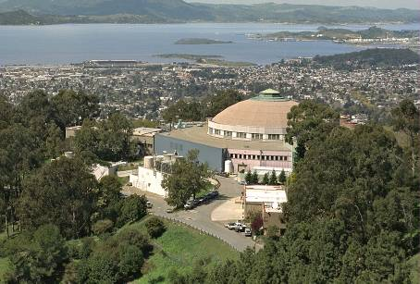
Synchrotron Light Sources
NSLS-II 2015
SSRL 1974 & 2004
NSLS 1982
APS 1996
ALS 1993
LCLS 2009
Researchers may use more than one facility

Slide 7
Users by Discipline at the Synchrotron Light Sources

Slide 8
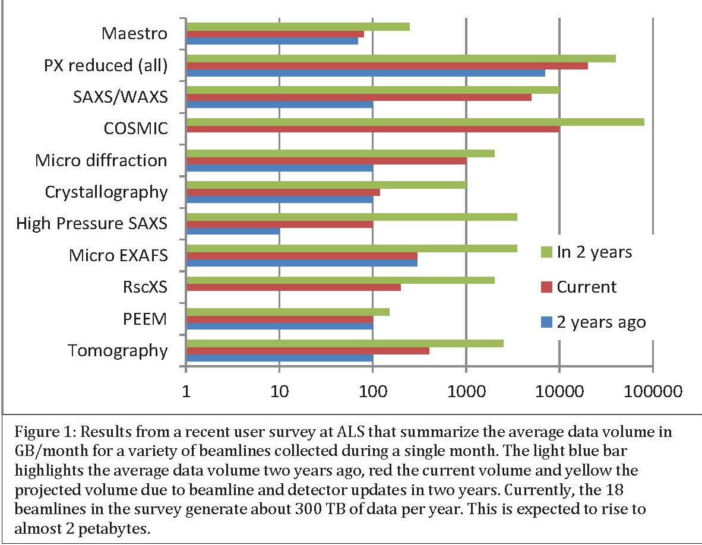
Advanced Light Source Data Rates
Data Strategy is very important to productivity and competitiveness
Data and Communication in Basic Energy Sciences:
Creating a Pathway for Scientific Discovery (2012)

Slide 9
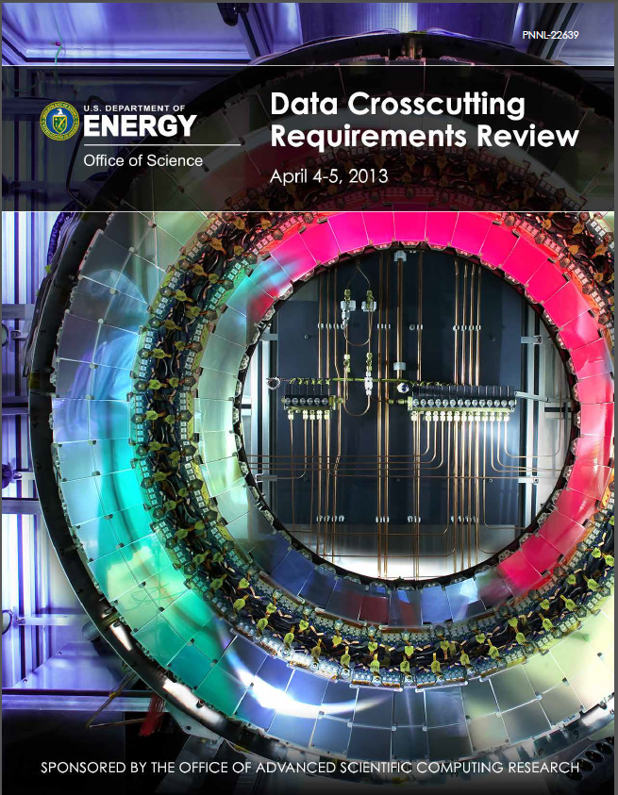
ASCR and BES, BER, HEP
Data Crosscutting Requirements Review
In April 2013, a diverse group of researchers from the U.S. Department of Energy (DOE) scientific community assembled in Germantown, Maryland to assess data requirements associated with DOE-sponsored scientific facilities and large-scale experiments.
http://science.energy.gov/~/media/ascr/pdf/program-documents/docs/ASCR_DataCrosscutting2_8_28_13.pdf

Slide 10
Crosscutting Requirements Report – Findings
Many Office of Science experimental facilities anticipate rapid growth in data volume, velocity, and complexity.
User Facilities need end-to-end systems that provide more automated workflows and capabilities to ingest, analyze, and manage much larger and more complex data sets generated at faster rates.
There is an urgent need for standards and community APIs for storing, annotating, and accessing scientific data.
The development of standards and protocols for distributed data and service interoperability is essential. Furthermore, API standards will enable collaborations and facilitate extensibility, whereby similar, customized services can be developed across science domains. Such standardization will facilitate data reuse and integration from multiple experiments. It also will be needed as part of any move to provide facility-wide data services.

Slide 11
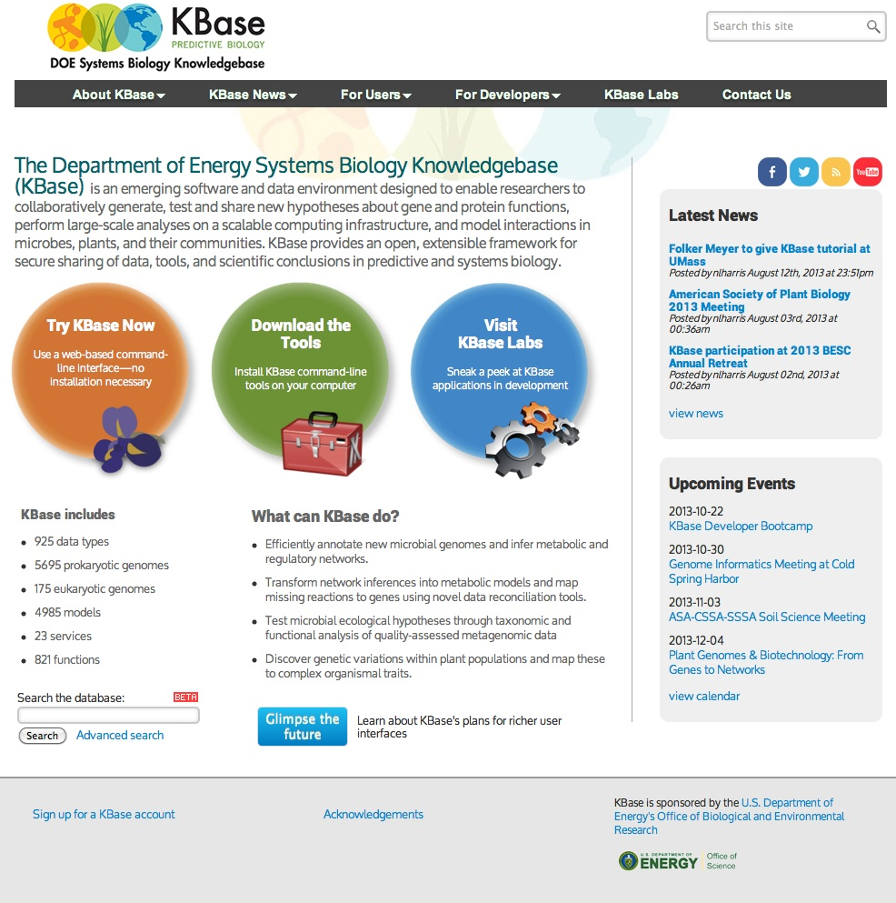
K-Base
http://kbase.us/

Slide 12
Administration Directives
Push for consideration of reuse and repurposing is very timely.
OSTP Memo: Increasing Access to the Results of Federally Funded Scientific Data
Open Data Policy – Managing Data as an Asset

Slide 13
DOE/SC Interests
Incentives for sharing: Data rights, licensing, citation, privacy, U.S. research competitiveness
Sustainability of data
Maintaining good communication with publishing communities
Maintaining good communication and coordination with international partners

Slide 14

ASCR and BES
The workshop was organized in the context of the impending data tsunami that will be produced by DOE’s BES facilities. Current facilities, like SLAC National Accelerator Laboratory’s Linac Coherent Light Source, can produce up to 18 terabytes (TB) per day, while upgraded detectors at Lawrence Berkeley National Laboratory’s Advanced Light Source will generate ~10TB per hour. The expectation is that these rates will increase by over an order of magnitude in the coming decade. The urgency to develop new strategies and methods in order to stay ahead of this deluge and extract the most science from these facilities was recognized by all.
http://science.energy.gov/~/media/ascr/pdf/research/scidac/ASCR_BES_Data_Report.pdf

Slide 15
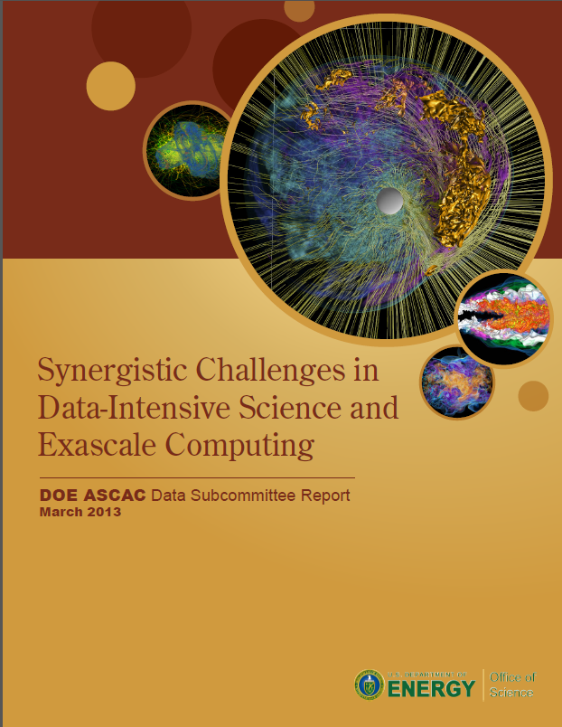
Reports
DOE ASCR Advisory Committee (ASCAC) Data Subcommittee Report
This new report discusses the natural synergies among the challenges facing data-intensive science and exascale computing, including the need for a new scientific workflow.
http://science.energy.gov/~/media/ascr/ascac/pdf/reports/2013/ASCAC_Data_Intensive_Computing_report_final.pdf

