Slide 1

NIST Data and Information Activities:
May 9th EO and the Common Access Platform
John Henry J. Scott
Physicist
Material Measurement Laboratory
National Institute of Standards and Technology
Gaithersburg, MD
Federal Government Sponsors Roundtable, BRDI, Sept 23, 2013

Slide 2
Scope of the Problem: Scientific Resources
Data
Software
Publications
Peer
Reviewed
Reference
Resource
Gray
Literature
Software
Research
???
White Papers, Talk Slides, …
NIST Pubic
Servers
Publications
Other
NIST
Storage
Community
Repositories
NIST Internal
Servers
Scientific & Professional Societies
Other Fed
Agency Repositories
Cloud
GPO
Private Sector

Slide 3
Scope of the Problem: Scientific Resources
Data
Ref
VETTING
INVESTMENT
ANNOTATION
CURATION
QUALITY
ACCESSIBILITY
PROVENANCE
FRESHNESS
Resource
Research

Slide 4
Internal Organizations
NIST Director
Scientific Data Committee
Chief of Staff
Data Access
WG
Data Mgt Plans
WG
Outreach
WG
Public Affairs
Management Resources
Laboratory
Programs
CIO
Library
Info
Tech
Lab
Engr
Lab
Physics
Lab
Materials
Lab
Other
Labs…
Office of Data and Informatics
Wo Chang
Chris Greer
John Henry
Scott

Slide 5
OMB M-13-13 Response
Pre-Decisional:
Not for Distribution
Task | Short-term owner
www.nist.gov/data page content | CIO, Public Affairs
data.json file content | Library
www.nist.gov/digitalstrategy Inventory schedule Plan for legacy data and new data Plan for expand, enrich, open | Chris Greer & Scientific Data Committee
Access Level Determination Process | TBD by Director’s Office
Customer Feedback | Public Affairs
Maintenance of Enterprise Data Inventory | CIO, Chris Greer & SDC

Slide 6
Notional “Common Access Platform”
Implement OSTP/OMB mandates
Build as little as possible
Capitalize on what already exists
Encourage standardization across agencies
Minimize stranded investments
Curation Metadata
Data Consumers
Portals / Federated Search / Discovery
Relationship Metadata
Domain Metadata
Services Layer
Metadata Registries/Catalogs
Extension Metadata
PID Resolvers
PID Type Servers
Req. if Applicable MD
PID-Type-Enabled Harvesters and Brokers
Agency
Repos
Federal
Repos
Publisher
Repos
Domain
Repos
Other
Repos
Core Metadata

Slide 7


Unique and Persistent Identifiers (PIDs)
Give every data object a unique identifier (including collection objects)
optionally
via PKI
At the core of proper
data management and access
hdl:10.12345/456
1 | PublicKey | 20520821aa9b07f46f7a70043ba2e497
2 | title | Atomic Spectral Database
3 | description | Database of line energies, transition probabilit…
4 | tags | spectrum; physics; standard reference data; …
5 | last update | 2013-09-23:15:35:33.0023
6 | publisher | NIST (006:55)
… | … | …
22 | accessURL | https://www.nist.gov/SRD/ASD.aspx
23 | ParentDataSet | 10.12345/886-a7-0f

Slide 8
Persistent Identifiers (PIDs)
10.12345/456
1 | PK | 20520821aa9b07
2 | IP | rights data
3 | Publisher | NIST
4 | GUID | a8-0c-22-7f-c1-00
5 | URL | http://pubmed.nih..
6 | HDL | 10.12345/9934
… | … | …
Rich PID types can persist relationships
PIDs can prove:
  Identity
  Integrity
  Authenticity
Not a solution for everything…
…but an important technology component in the architecture
How many PID types are needed ?
What fields are needed in each type ?
What process will be used to integrate new PID types as needed ?
10.12345/9934
1 | PK | publickey
2 | field1 | xxx
3 | field2 | yyy
… | … | …
PID Information Types Framework
Running code to manage types and PID type resolution services
NEED

Slide 9
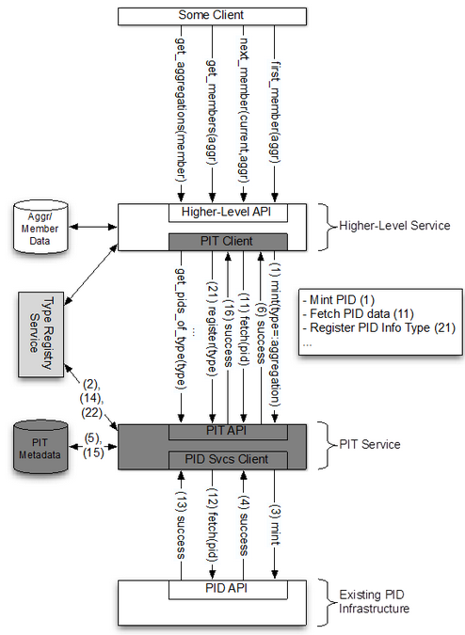

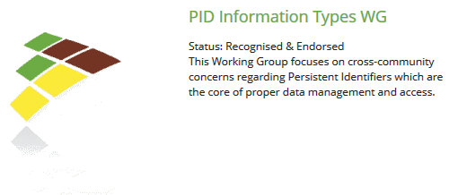


RDA: PID Information Types Working Group (PIT)
Tim DiLauro
JHU
Tobias Weigel
DKRZ†
†DKRZ = German Climate Computing Center

Slide 10



RDA: Data Type Registries Working Group (DTR)
Identify use cases for data type applications
Develop a management framework
Formulate a Data Model for types
Formulate an expressive framework
Design functional specifications for type registry services
Propose a federation strategy
Must articulate US Gov’t Needs
Requirements for
Common Access Platform
Reference Architecture
Federal Agency Use Cases
Larry Lannom
CNRI
Daan Broeder
MPI

Slide 11








Interagency Technical Advisory Group (iTAG)
$$$
$$$
iCORDI
RDA/US
$$$
PIT WG
DTR WG
$
advice
Articulate US Gov’t Needs
iTAG

Slide 12
Acknowledgments
NIST Scientific Data Committee
  esp. Chris Greer, Wo Chang
NIST Data Access Working Group
  Peter Linstrom, Sasha Kramida, Andrea Medina-Smith, Kellie Beall, Dan Samarov, Bill Turner, Kirk Dohne, Adam Morey, Carolyn Rowland, Jonathan Hardis, Susannah Schiller
NIST Office of Information Systems Management (CIO)
  esp. Pradip Pandya, Don Koss, Joe Kau, Dale Little, Jimmy Graham, Maxim Alexeev
CNRI
  Larry Lannom, Giridhar Manepalli
JHU
  Sayeed Choudhury, Tim DiLauro

Slide 14
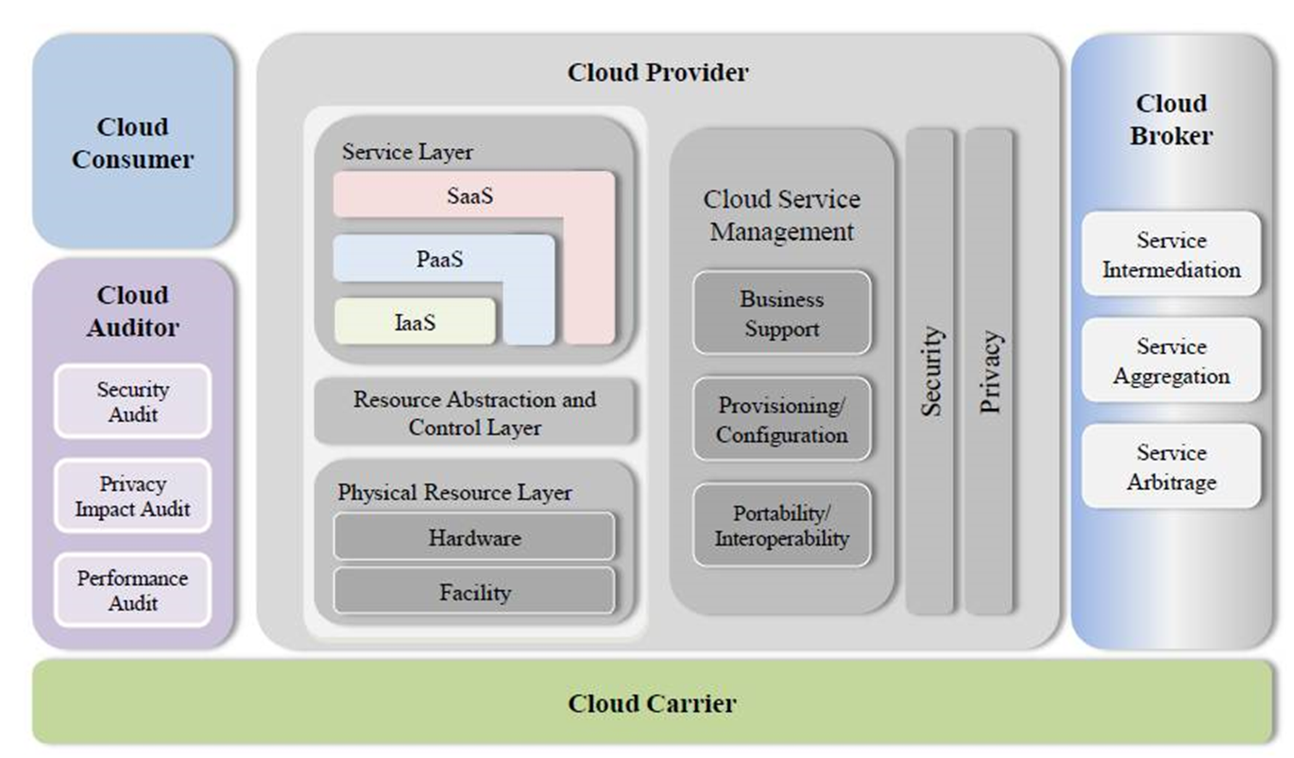
Why NIST ?

