Slide 1
Grand Challenges in Scholarly Communication:
Determining the Value, Assessment, and Reward Mechanisms
Prepared for
9th Meeting of the Board on Research Data and Information
September 2013
Dr. Micah Altman
<escience@mit.edu>
Director of Research, MIT Libraries
Notes:
This work. by Micah Altman (http://micahaltman.com) is licensed under the Creative Commons Attribution-Share Alike 3.0 United States License. To view a copy of this license, visit http://creativecommons.org/licenses/by-sa/3.0/us/ or send a letter to Creative Commons, 171 Second Street, Suite 300, San Francisco, California, 94105, USA.

Slide 2
DISCLAIMER
These opinions are my own, they are not the opinions of MIT, Brookings, any of the project funders, nor (with the exception of co-authored previously published work) my collaborators
Secondary disclaimer:
“It’s tough to make predictions, especially about the future!”
-- Attributed to Woody Allen, Yogi Berra, Niels Bohr, Vint Cerf, Winston Churchill, Confucius, Disreali [sic], Freeman Dyson, Cecil B. Demille, Albert Einstein, Enrico Fermi, Edgar R. Fiedler, Bob Fourer, Sam Goldwyn, Allan Lamport, Groucho Marx, Dan Quayle, George Bernard Shaw, Casey Stengel, Will Rogers, M. Taub, Mark Twain, Kerr L. White, etc.
Notes:
The structure and design of digital storage systems is a cornerstone of digital preservation. To better understand ongoing storage practices of organizations committed to digital preservation, the National Digital Stewardship Alliance conducted a survey of member organizations. This talk discusses findings from this survey, common gaps, and trends in this area.
(I also have a little fun highlighting the hidden assumptions underlying Amazon Glacier's reliability claims. For more on that see this earlier post: http://drmaltman.wordpress.com/2012/11/15/amazons-creeping-glacier-and-digital-preservation )

Slide 3
Collaborators & Co-Conspirators
BRDI Sponsor:
Ann Wolpert
Academic Collaborators:
Laura Bartolo, Clifford Duke
NAS Staff:
Subhash Kuvelker, Paul Uhlir

Slide 4
What is a “grand challenge”?
A fundamental research problem with broad applications and large impact, that is potentially solvable within 10-15 years.

Slide 5
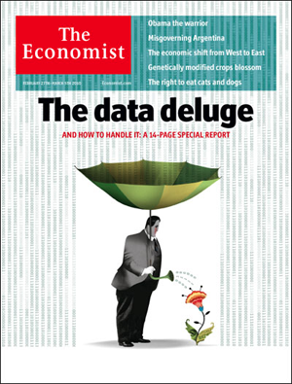

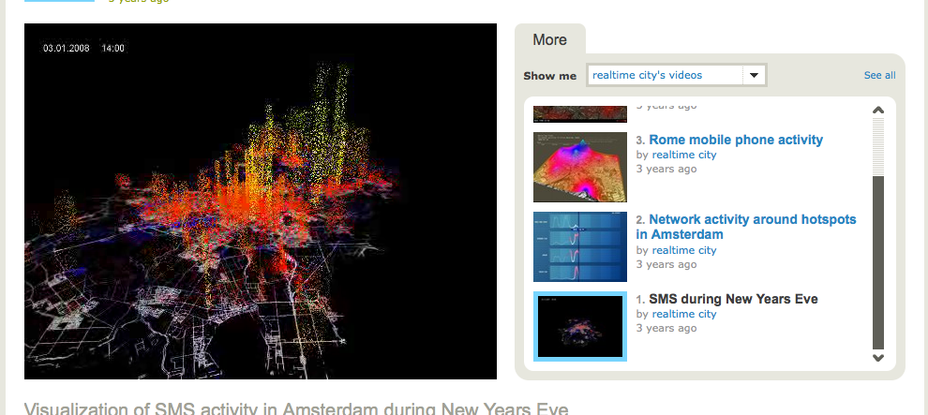





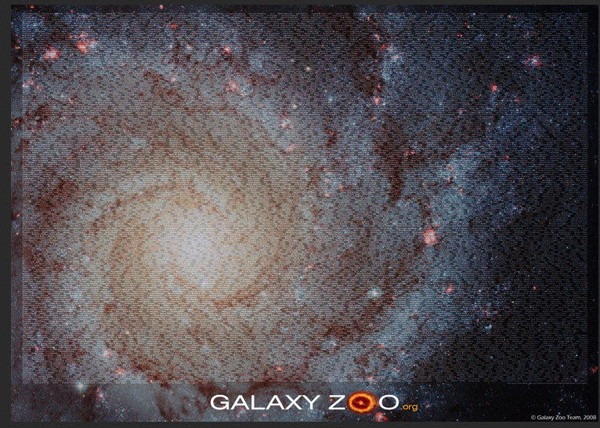




The New Challenge for Scholars– Dealing With More
More Data
More Open
Shifting Evidence Base
More
High Performance Collaboration
(here comes everybody…)
More Learners
Publish, then Filter
Notes:
LHC produces a PB every 2 weeks, Sloan Galaxy zoo has hundreds of thousands of “authors”, 50K people attend a class from the University of michigan, and to understand public opinion instead of surveying 100’s of people per month we can analyze 10ooo tweets per second.

Slide 6
Related National Research Council Reports
The Future of Scientific Knowledge Discovery in Open Networked Environments: Summary of a Workshop (2012).
The Case for International Sharing of Scientific Data: A Focus on Developing Countries (2012).
For Attribution – Developing Data Attribution and Citation Practices and Standards: Summary of an International Workshop (2012).
Designing the Microbial Research Commons: Proceedings of an International Workshop (2011).
Communicating Science and Engineering Data in the Information Age. (2011).
The Socioeconomic Effects of Public Sector Information on Digital Networks (2009).
Ensuring the Integrity, Availability, and Stewardship of Research Data in the Digital Age (COSEPUP, 2009).
Environmental Data Management at NOAA: Archiving, Stewardship, and Access (2007).
Putting people on the map: Protecting confidentiality with linked social­spatial data. (2007).
Engaging Privacy and Technology in a Digital Age. (2007)
Strategies for Preservation of and Open Access to Scientific Data in China (2006).
Expanding access to research data: Reconciling risks and opportunities. (2005)
The Role of Scientific and Technical Data and Information in the Public Domain (2003).
Sharing Publication-related Data and Materials: Responsibilities of Authorship in the Life Sciences (2003).
Access to Research Data in the 21st Century (2002)
Health Data in the Information Age: Use, Disclosure, and Privacy (2002).
Building a Workforce for the Information Economy (2001).
LC21: A Digital Strategy for the Library of Congress (2000).
Improving Access to and Confidentiality of Research Data (2000).
Bits of Power: Issues in Global Access to Scientific Data (1997).

Slide 7
Why Study Grand Challenges in Scholarly Communication?
Acceleration in growth of scholarly information – almost 3 articles published every minute
Huge degree of disruption and opportunity in this broad subject area
Increasing need for guidance by policymakers, funders, research organizations
Problems potentially span disciplines –
not systematically covered by research agendas within single disciplines
Most previous major studies focus primarily on data rather than on research information & communication more generally

Slide 8
Study Form
Consensus study to provide recommendations useful for guiding research & funding
Broad range of experts
18 month execution

Slide 9
Example Evaluation Challenges
Estimating the risks to and future value of the research information
(Library, information science & economics)
Evaluating the quality, verifiability and impact of research information
(Cross-cutting)
Adapting the university tenure, recognition and reward system
(Cross-cutting)

Slide 10
Some Other Grand Challenges in Scholarly Communication
(For Research Priorities in Data Management other BRDI studies, CSTB … ?)
Cost and reliability of scholarly information management processes, technologies, and institutions
(Library science, information science & management sciences)
Semantic representation, validation, and quality of research information
(Cross-cutting, information sciences, computer science)
Semantic representation, validation, and quality of research information
(Cross-cutting, information sciences, computer science)
Durability of research information, Scholarly Record
(Hardware engineering, Economics, Information Science)
Scalable discovery, integration and understanding of the scholarly record
(Computer science, information science)

Slide 11
Other Key References
2003. Atkins, Daniel. "Revolutionizing science and engineering through cyberinfrastructure: Report of the National Science Foundation blue-ribbon advisory panel on cyberinfrastructure.", National Science Dounation.
2005. Berman and H. Brady, Workshop on Cyberinfrastructure for the Social and Behavioral Sciences: Final Report, National Science Foundation.. .https://www.sdsc.edu/about/director/pubs/SBE/index
2006. Benkler, Yochai. The wealth of networks: How social production transforms markets and freedom. Yale University Press,
2007. Borgman, Christine L. Scholarship in the digital age. The MIT Press.
2007. Ostrom, Elinor, and Charlotte Hess. "Understanding knowledge as a commons: From theory to practice." Massachusetts Institute of Technology. Cambridge
2009. Welshons, Marlo. "Our Cultural Commonwealth: The report of the American Council of Learned Societies Commission on Cyberinfrastructure ror the Humanities and Social Sciences.”
2011. Education Advisory Board. "Redefining the academic library: Managing the migration to digital information services.”
2013. Altman, et al. National Digital Stewardship Agenda, National Digital Stewardship Alliance.
http://www.digitalpreservation.gov/ndsa/nationalagenda/index.html

Slide 12
Questions?
E-mail: escience@mit.edu
Web: micahaltman.com
Twitter: @drmaltman

