Slide 1
Research Data Alliance Plenary 2 Update
Dr. Francine Berman
Chair, RDA/US
Hamilton Distinguished Chair in Computer Science
Rensselaer Polytechnic Institute

Slide 2
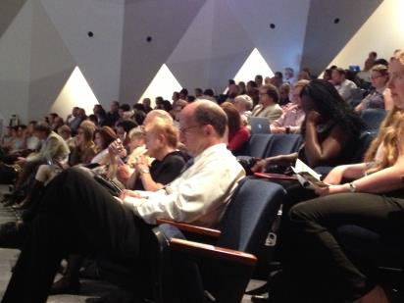
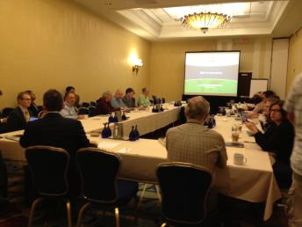
RDA Plenary 2 -- September 16-18, Washington D.C. -- 3 days of Peace, Love and Data
RDA Plenary 2
  368 participants from 22 countries and all sectors
  All-hands stakeholder talks and RDA working meeting
  Data Citation Summit convened by DataCite, FORCE11,CODATA/ICST, ESIP, DCC, etc. to create a common agenda
  ~5000 tweets over 3 days

Slide 3
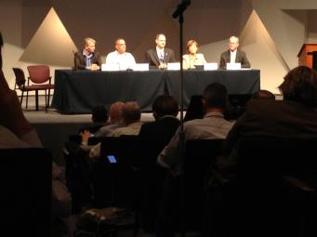
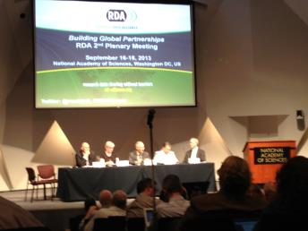
RDA Plenary 2 -- Stakeholders and Invited Speakers
Keynotes:
  Tom Kalil, OSTP (introduced by Farnam Jahanian, NSF)
  John Wilbanks, Chief Commons Officer, Sage Bionetworks
  Carole Palmer, Professor, UIUC School of Library and Information Science
Global Partnerships Panel:
  Chris Greer, NIST
  Mark Suskin, NSF CISE/ACI
  Kostas Glinos, European Commission
  Clare McLaughlin, Australian Embassy
  Mike Stebbins, OSTP
Affiliate Organization Panel:
  Sara Graves, CODATA
  Curt Tilmes, ESIP
  Phil Archer, W3C
  Jan Brase, DataCite
Sara!

Slide 4
RDA Community Current Status: ~1300 participants from 50+ countries
Albania
Australia
Austria
Bangladesh
Belgium
Bolivia
Botswana
Brazil
Bulgaria
Canada
China
Congo {Democratic Rep}
Costa Rica
Czech Republic
Denmark
Estonia
Finland
France
Germany
Greece
Iceland
India
Iran
Ireland
Ireland
{Rep}
Italy
Japan
Krygrystan
Kuwait
Mexico
Netherlands
New Zealand
Norway
Palestine
Poland
Portugal
Russian Federation
Rwanda
Serbia
Singapore
Slovenia
South Africa
South Korea
Spain
Sweden
Switzerland
Taiwan
Turkey
United Arab Emirates
United Kingdom
United States
Vatican City
Venezuela
Fran Berman

Slide 5
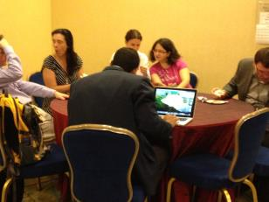
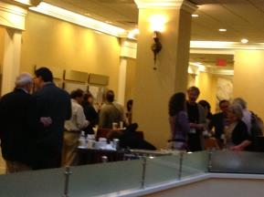
RDA Community Building Momentum
Growth in number and scope of Interest Groups and Working Groups
  New: BOFs for groups as precursor to Interest Groups
  Groups beginning to “self-monitor” to promote concrete deliverables to be used and adopted
  Increasing interest in more interaction and “connective tissue” between groups
Pressing To-Dos before Plenary 3:
  Develop an RDA policy for IP that comes up in Interest and Working Groups
  Determine the form of RDA deliverables and what’s needed in terms of an “RDA archive”

Slide 6
Groups that Met at the RDA Plenary
BOLD = new since last Plenary
Birds-of-a-Feather
  Linked Data
  Chemical Safety Data
  Education and Skills Development in Data Intensive Science
  Libraries and Research Data
  Cloud Computing and Data Analysis Training for the Developing World
Working Groups
  Data Type Registries
  Metadata Standards
  Practical Policy
  Persistent Identifier Types
  Data Foundations and Terminology
  Data Categories and Codes
Interest Groups
  Agricultural Data
  Big Data Analytics
  Data Brokering
  Certification of Trusted Repositories (joint with ICSU-WDS)
  Long tail of Research Data
  Marine Data Harmonization
  Community Capability Model
  Data Publishing (joint with WDS)
  Toxicogenomics Interoperability
  Research Data Provenance
  Data Citation
  Metadata
  Economic Models and Infrastructure for Federated Materials Data Management
  Engagement
  Preservation e-Infrastructure
  Legal Interoperability (joint with CODATA)
  Global Registry of Trusted Data Repositories and Services
  Digital Practices in History and Ethnography
Data Citation Harmonization Summit
  DataCite,FORCE11,
  CODATA/ICST,
  ESIP, DCC, etc.

Slide 7
RDA Organizational Partners
New RDA constituencies / stakeholders
Organizational Assembly = Organizational Members (subscription) + Organizational Affiliates (MOUs).
Organizational Advisory
Board will represent
Organizational Assembly.
Current Status:
  Organizational Membership under discussion with Microsoft, IBM, ANDS, Australian Antarctic Data Center, Intersect, Terrestrial Ecosystems Research Network, CSC – IT, Center for Science Ltd., Oracle, STFC, CNRI, STM, EUDAT, Barcelona Supercomputer Center, Columbia University Libraries / Information Services, and many more after the Plenary
  Organizational Affiliation under discussion with CODATA, WDS and others
Next 6 months (before Plenary 3)
  Firm up model for Affiliates (how many, how substantive should the interaction be?)
  Complete creation of legal entity to host subscriptions for Organizational Members
  Elect Organizational Advisory Board at Plenary 3

Slide 8
RDA Constituent Groups Coming Together
New Position: RDA recruiting for full-time Secretary- General
RDA Colloquium
(National Research Agencies and Funders)
RDA Membership
RDA Council
(overarching leadership)
Technical Advisory Board
(Technical oversight)
Secretary-General and Secretariat
(Administration and Operations)
Organizational Advisory Boards and Organizational Assembly
(Organizational partnerships and guidance)
Working Groups and Interest Groups
(impact - focused infrastructure)

Slide 9
New RDA Leadership since Plenary 1
Council:
  Patrick Cocquet (France)
  Doris Wedlich (Germany)
  Kaye Raseroka (Botswana)
  Tony Hey (US)
  Ross Wilkinson (AU)
  John Wood (UK), co-Chair
  Fran Berman (US), co-Chair
Organizational Assembly
  Juan Bicarregui, co-Chair
  Leif Laaksonen, co-Chair
Technical Advisory Board
  Peter Wittenburg
  Francoise Genova
  Andrew Treloar
  Bill Michenor
  Beth Plale, Chair
  6 new TAB members to be elected this month (14 candidates)
  12th TAB member to be appointed by Council (for balance)

Slide 10

Next Plenaries (2X a year)
Plenary 3 will be in Dublin March 26-28 in 2014, hosted by Australia and Ireland
Plenary 4 will be
in the Netherlands –
late September
in 2014
Plenary 5 or 6 likely
back in the U.S.
(west coast?)

Slide 11
Info: enquiries@rd-alliance.org
Fran Berman

