Slide 1
Project Payroll Certification
FDP Update
January 7, 2014
Julie Seppala, Executive Director,
Financial Services/Operations & Sponsored Programs
jhseppal@mtu.edu
Notes:
$45 M Sponsored Program Expenditures
$48 M in Sponsored Awards
Joined FDP in 2008
ONR Cognizant School
Pilot approval in October 2011
Pilot effective July 2011

Slide 2
Pilot Metrics
6100 less certifications annually
650 distributed in FY13
95% on time return rate
100% on time return rate in FY14
Notes:
1.

Slide 3
Observation
STATISTIC | EFFORT REPORTING | PROJECT PAYROLL CERTIFICATION
Certifications distributed per year | 6700 | 650
% NOT returned on time | 55% | 5%
# NOT returned on time per year | 3685 | 35
Average not returned on time per month | 307 | 3
Notes:
The difference between the amount of Effort Certifications and Project Payroll Certifications in which SPA, Departments and PIs had to spend time locating and attaining signed certifications is substantial. Tracking, phone calls, e-mails, etc..

Slide 4
OIG Review
Three Data requests submitted with the final submission in late September
System architecture/narratives, policies, procedures, audit reports, surveys, general ledger downloads, chart of accounts, recons of , crosswalks, query parameters, etc.
Audit date February - March 2014
Notes:
January 2013 – 1st Data Set Requested
So far the Office of Inspector General Audit Team has requested data items at two different times with short due dates. These items required data across several Michigan Tech departments. Sponsored Programs Office, Sponsored Programs Accounting, IT, HR and Payroll.
Michigan Tech was not accustomed to this type of audit; so it was a challenge for us at first. We used some LEAN tools such as kanban boards to meet the deadlines, which was a 3 to 4 week turn around time.

Slide 5
Outreach
On-line Audio/Power Point via the Learning Management/Canvas System
Audience – 92 PIs, 54 Co PIs, and 36 Department Staff
5 modules - 3 to 6 minutes each
Overview, how to read the PPCD document & new S&W report, PI/Dept/Central responsibilities
Notes:
The modules include
Payroll Certification Overview
Understanding the Payroll Certification Document
Understanding the S&W by Anniversary Year-supplemental report we distribute to the Pis
Responsibilities for the PI, Chair, Dept Admin, and Central Admin
Canvas is web based system that allowed us to track who we invited to take the course and who has completed the course
The modules are short videos

Slide 6
Outreach Stats
Completed Course- 33% of PIs, 39% of Co PIs, 64% of Depart Staff
Largest Department - $1.4M in S&W, 28 awards and 13 PIs
5 Departments over $1M in expenses, averaging 8 PIs
21 Departments - $10M in expenses, 15,000 transactions
Notes:
Follow ups
Enforcement- no new project set up

Slide 7
Internal Review
Report issued 10/21/13
Controls are adequate, annual certification completion and return rates have improved considerably.
Interviews confirmed that the pilot is less of an administrative burden and the turnaround time to complete the certifications has decreased.
Recommended to improve the grant close out process to reduce late close out PPCDs and to generate “No Payroll” PPCDs
Notes:
The payroll department is also conducting internal reviews in regards to the payroll processes in the academic departments. The review is to recommend changes to the process in the individual departments in regards to the time reporting method, approval of time reporting, etc.

Slide 8
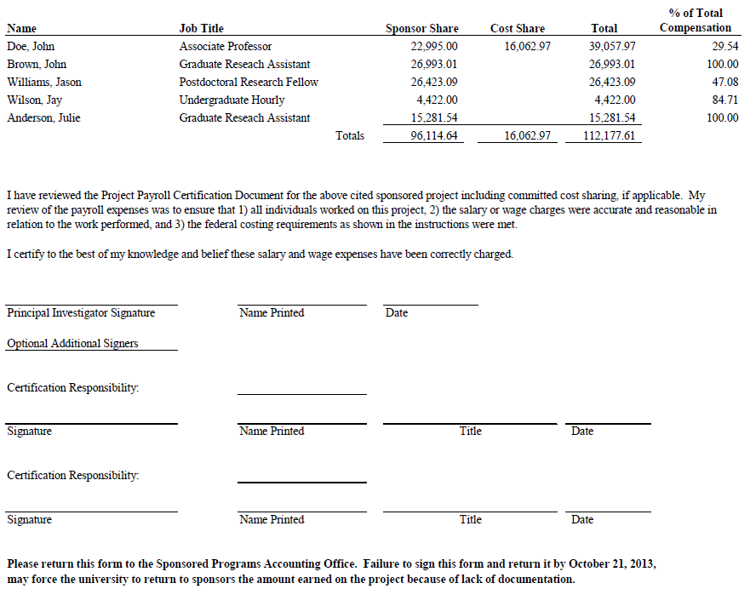
questions

