Slide 1
CODATA Report and CODATA and World Data System Conference SciDataCon 2014 November 2-5, 2014 New Delhi, India BRDI Meeting, March 11, 2014 Sara Graves, CODATA Secretary General

Slide 2
CODATA Executive Committee Meeting Israel Academy of Sciences and Humanities Jerusalem, Israel March 3-4, 2014 Bonnie Carroll, EC member from US Sara Graves, Secretary General Sara Graves, CODATA Secretary General

Slide 3
CODATA Executive Committee Meeting First EC meeting with Simon Hodson, Executive Director Met with Israel National CODATA Committee and the President of the Academy, Professor Ruth Arnon Big Data Workshop with China Academy of Science in Beijing on June 8-9, 2014 ICSU Future Earth and IRDR meetings also Preserving and Archiving S&T Data in Developing Countries Task Group Kenya Workshop Aug 6-8, 2014

Slide 4
SciDataCon 2014 CODATA and World Data System November 2-5, 2014 New Delhi, India http://www.scidatacon2014.org/ Sara Graves, CODATA Secretary General

Slide 5
SciDataCon2014, 2-5 Nov 2014
New Delhi, 2-5 November 2014, co-organised by CODATA and ICSU-WDS (World Data System).
Data Sharing and Integration for Global Sustainability
Considering data challenges for international science.
Data to underpin robust science to inform decision-making around sustainability.
Big Data and data integration.
Address challenges for Future Earth and other international science programmes.
CODATA Blog http://codata.org/blog
Website http://www.scidatacon2014.org/
Themes, invitation to contribute to discussion and call for papers shortly.
Suggestions for officer and executive committee nominations, keynote speakers, sessions, etc
Save the date and join the discussions! See you in New Delhi!
Proposals for hosting SciDataCon 2016 – 1. Letter of Intention and 2. Proposal to Host (guidelines in near future)

Slide 6
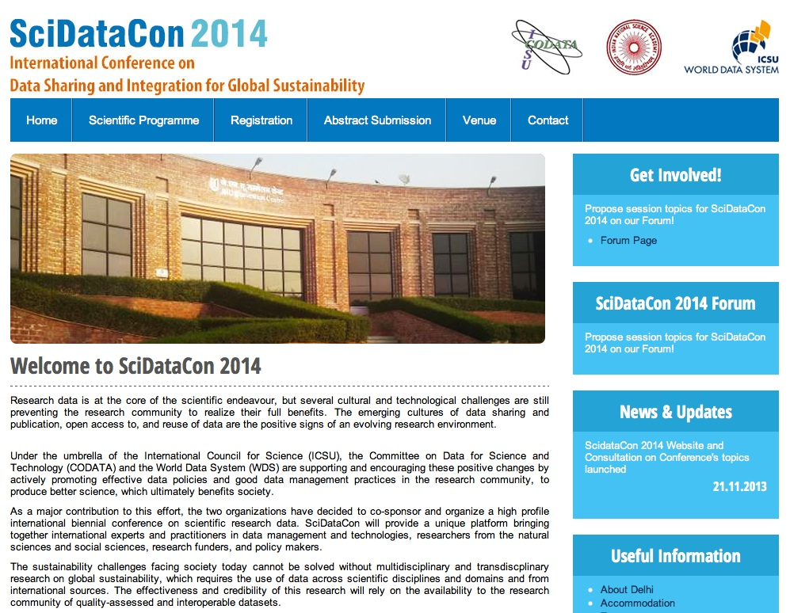
http://www.scidatacon2014.org

Slide 7
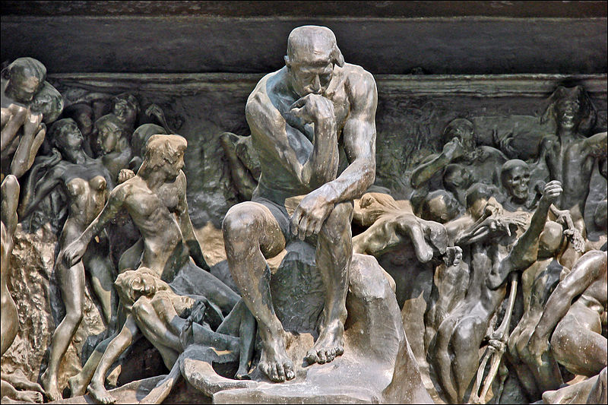
CODATA Task Groups
Be part of the community: proposals invited for CODATA Task Groups, deadline 30 April: http://codata.org/blog/2013/11/13/call-for-proposals-codata-task-groups/

Slide 8
Data Proposals for Future Earth
Future Earth: a ten-year overarching programme to coordinate research on global environmental change and sustainability.
Aims: ‘to provide the scientific evidence needed for a sustainable future.’
Research for evidence-based policy making.
Data issues will be very important: access to source data is what concerns the researchers; also need to think about availability of data outputs (verification, robust conclusions to underpin science and policy, reuse, legacy).
CODATA and ICSU-WDS working with the Future Earth team to raise the data agenda.
Proposed a set of high level principles and a policy requiring DMPs, use of accredited infrastructure and reporting/monitoring of implementation.

Slide 9
Thanks for your attention!
www.codata.org/blog
ED Email: execdir@codata.org
Twitter: @simonhodson99
Tel (Office): +33 1 45 25 04 96 | Tel (Cell): +33 6 86 30 42 59
CODATA (ICSU Committee on Data for Science and Technology), 5 rue Auguste Vacquerie, 75016 Paris, FRANCE

