Slide 1







Business Models and Economics of Sustainable Data Infrastructures
Patricia Cruse
University of California Curation Center
California Digital Library

Slide 2
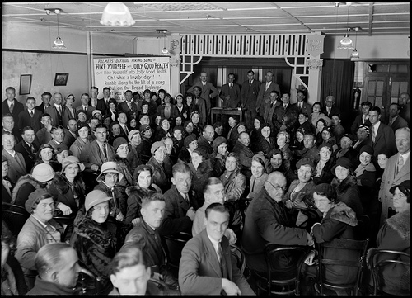
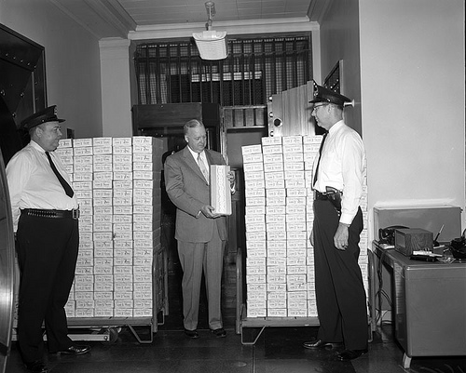
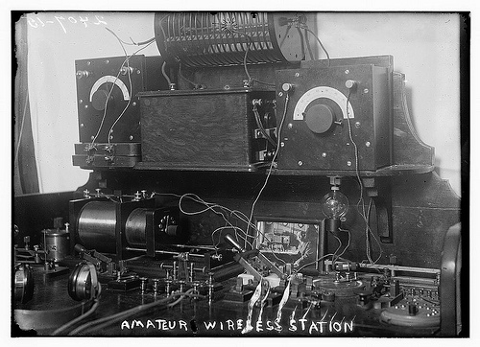
Sustaining the DataONE public repository
“capacity for the organization to evolve and persist as an agile, inclusive, responsive and transparent institution”
Sustainability
“financial capacity to preserve content and services and increase their value to the user community over time”
2009
2010
2011
2012
2013
2014
2015
2016
2017
2018
2019
“technical capacity for cyberinfrastructure to evolve gracefully over time and under changing conditions”

Slide 3


Costs and Revenue: One size does not all
UC3’s cost approach
Understand costs in order to plan for and implement sustainable preservation services
Two methods of cost recovery: paid-up or pay-as-you-go
Boom-or-bust budget cycles
Fixed-term, grant funded projects
^{Diversification}
Federal/international agencies
Additional grants and contracts
Private foundations
Membership fees
Pay-for-service
Corporations/business
Final report
Funding Portfolio

Slide 4
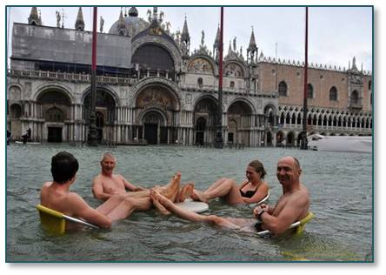

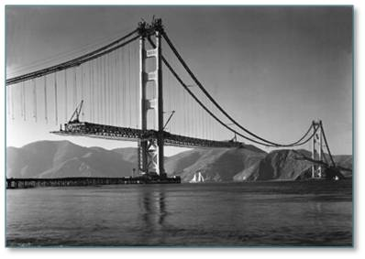
It is not so easy, but…
Climate change
Whose responsibility
Solve together

