Slide 1

Strategies for Economic Sustainability of Publicly Funded Data Repositories
Discussion Session Three—Current Policies for the Long-term Availability of Research Data
  Session Chair, Fran Berman, RPI
  Panelists:
    Michael Stebbins, OSTP
    Phil Bourne, NIH
    Prue Adler, ARL
    Myron Gutmann, ICPSR and U Colorado

Slide 2

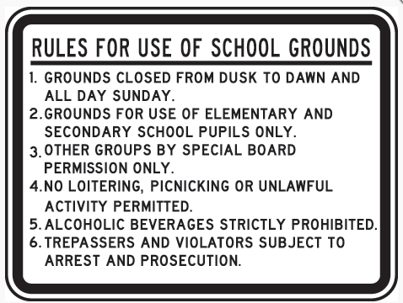

Policy can be an effective tool
to promote specific behavior / practice …
to focus efforts and resources…
to change community
culture …
School sign image: http://www.safetysign.com/categories/s84/school-safety-signs

Slide 3
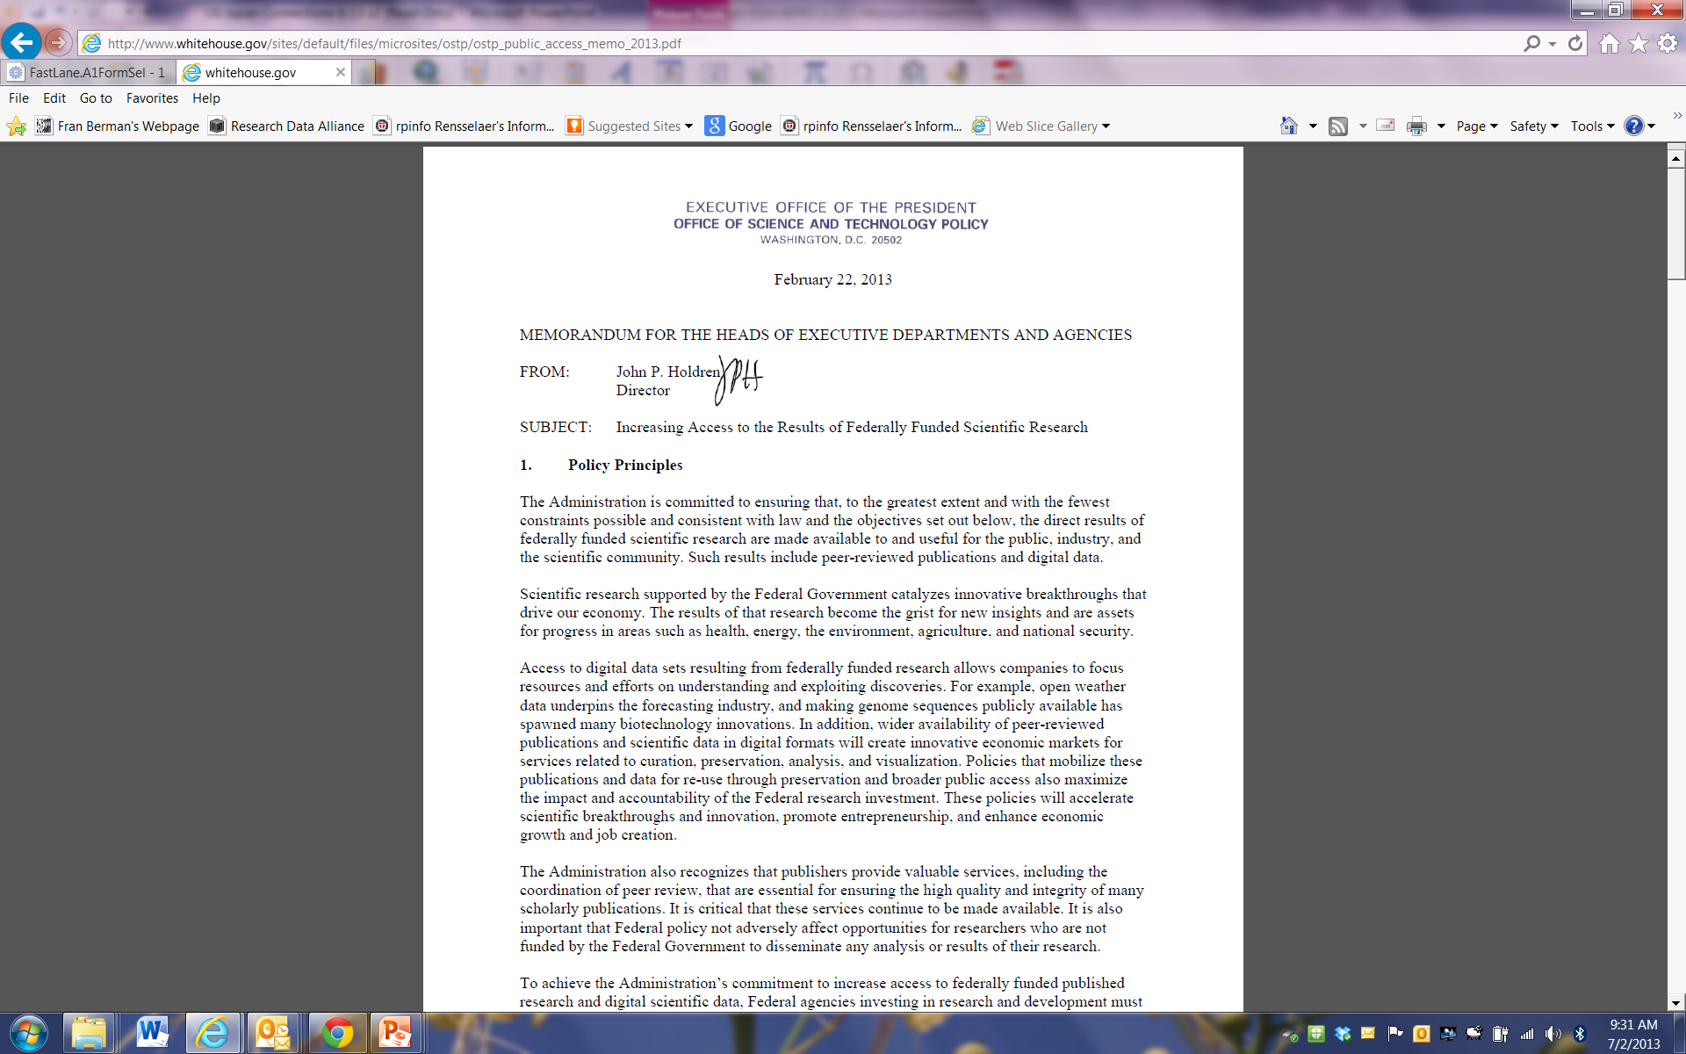
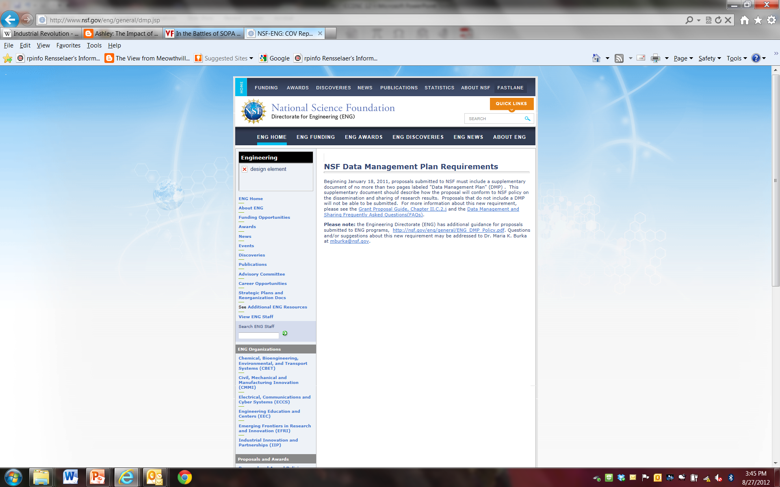

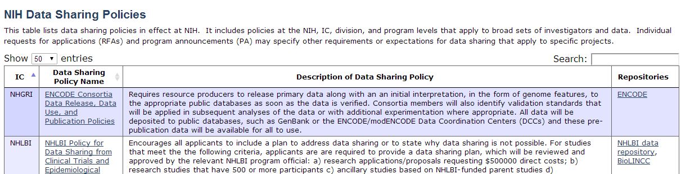
U.S. Research Data Policies Already Broadly Influencing U.S. Research Data Landscape and Potential for Data-Driven Innovation
Notes:
Halfway there. How can we go the distance?

Slide 4
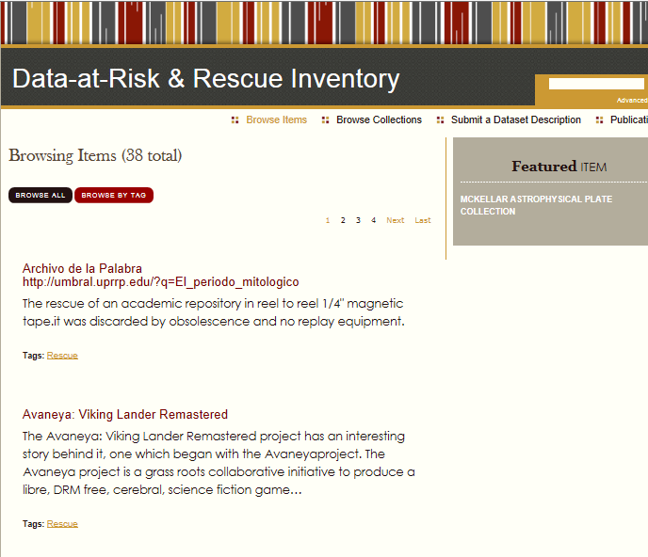
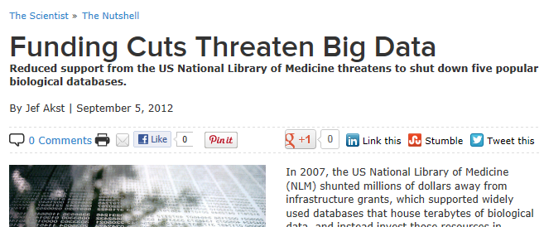
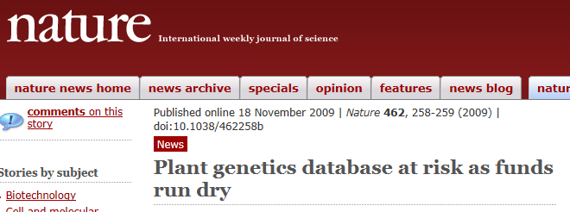
Government can’t support everything.
How can we use policy as a tool to promote economically sustainable data stewardship?

Slide 5
Discussion Session Three -- Current Policies for the Long-term Availability of Research Data
Michael Stebbins, Office of Science and Technology Policy
Phil Bourne, National Institutes of Health
Prue Adler, Association of Research Libraries
Myron Gutmann, Inter-University Consortium for Political and Social Research and University of Colorado

Slide 6
Prue Adler
Prue. Adler is the Associate Executive Director of the Association of Research Libraries. Prior to joining ARL in 1989, Ms. Adler was Assistant Project Director, Communications and Information Technologies Program, Congressional Office of Technology Assessment where she worked on studies relating to government information, networking and supercomputer issues, and information technologies and education.
Ms. Adler has an M.S. in Library Science and M.A. in American History from the Catholic University of America and a B.A. in History from George Washington University.
She has participated on multiple advisory councils including the Depository Library Council, the National Satellite Land Remote Sensing Data Archive Advisory Committee, the Board of Directors of the National Center for Geographic Information and Analysis, NRC’s Steering Committee on Geolibraries, the National Research Council Licensing Geographic Data and Services Committee, and NIH’s PubMed Central National Advisory Committee.

Slide 7
Myron Gutmann
Myron is Professor of History and Information and Research Professor in the Institute for Social Research at the University of Michigan.
From 2009 to 2013 he served as Assistant Director of the U.S. National Science Foundation, with responsibility for NSF’s Social, Behavioral, and Economic Sciences Directorate. Myron spearheaded NSF’s initiative to improve access to publications and data.
Prior to joining NSF, he was Director of the Inter-university Consortium for Political and Social Research (ICPSR) at the University of Michigan, the world’s largest repository of publicly available data in the social and behavioral sciences.
He has written or edited five books and more than eighty articles and chapters, is a Fellow of the AAAS, and has served on a numerous national and international advisory committees and editorial boards.

Slide 8
Michael Stebbins
Michael Stebbins serves as Assistant Director for Biotechnology in the Office of Science and Technology Policy and is the White House lead on open science. He was one of the first science advisers to the 2008 Obama for President campaign and served on the White House transition team after the 2008 election.
He is the former President of the S.E.A. Action Fund, and co-founder of Scientists and Engineers for America. He is the former Director of Biology Policy for the Federation of American Scientists (FAS) and ran their Biosecurity Project.
Stebbins is the author of the book Sex, Drugs and DNA: Science's Taboos Confronted. He previously worked as a legislative fellow for U.S. Senator Harry Reid and as a policy fellow for the National Human Genome Research Institute. He has also worked as a senior editor for the journal Nature Genetics.
He received his B.S. in biology from the State University of New York at Stony Brook and a Ph.D. in genetics while working at Cold Spring Harbor Laboratory.

Slide 9
Phil Bourne
Philip E. Bourne PhD is the Associate Director for Data Science at the NIH. Formerly he was UCSD Associate Vice Chancellor for Innovation and Industry Alliances, a Professor in the Department of Pharmacology at the UC San Diego., Associate Director of the RCSB Protein Data Bank and an Adjunct Professor at the Sanford Burnham Institute.
.Bourne is a Past President of the International Society for Computational Biology, an elected fellow of the AAAS, the International Society for Computational Biology (ISCB), and the American Medical Informatics Association (AMIA).
Recognitions include: the Jim Gray eScience Award (2010), the Benjamin Franklin Award (2009), the Flinders University Convocation Medal for Outstanding Achievement (2004), the Sun Microsystems Convergence Award (2002), and the CONNECT Award for new inventions (1996 & 97).
Phil has co-founded 4 companies and published over 300 papers and 5 books. He is the co-founder and founding Editor-in-Chief of the open access journal PLOS Computational Biology

Slide 10
BRDI Planning Workshop
Economic Sustainability of Data Repositories
Session 3
Myron Gutmann

Slide 11
Policy Today
Generally supports replication and reuse of scientific data
Government-owned data are well supported
PI Data policies are mixed – NIH and NSF have proactive policies that encourage sharing, not necessarily preservation
Holdren memo (2013) encourages preservation
Large data collections better supported than small

Slide 12
Why Good Policy is Difficult
Many different interests: researchers, (research) institutions, repositories, sponsoring agencies & foundations, policy makers & policy thinkers
Inadequate consensus about the value of preserving data (unlike publications)
Limited resources and tension between data preservation and support of new research

Slide 13
What the Panel Should Think About
What has made the library model successful for publications, and how would it extend to data?
How do we create a peer-review system for data preservation?
How do we make the cost of data curation and preservation sustainable?
How do research sponsors find the happy point between supporting data preservation and new research?

