Slide 1
Business Models and Economics of Sustainable Data Infrastructures
Robert J. Hanisch
Space Telescope Science Institute
Virtual Astronomical Observatory

Slide 2
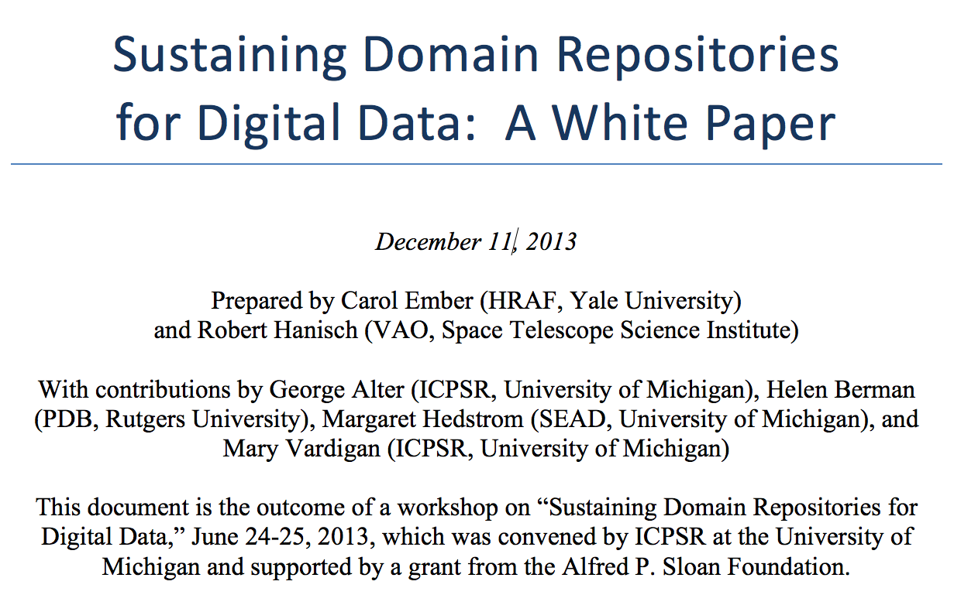
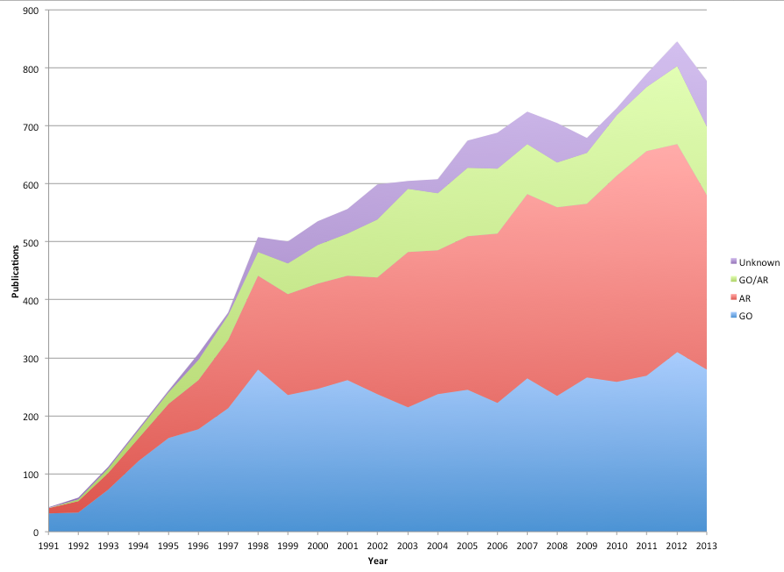
Over the past 10 years, an average
of ~60% of HST publications
have been based on
archival data
Integrated cost of HST
archive development
and operations < 1% of
integrated HST mission
cost
418
280

Slide 3
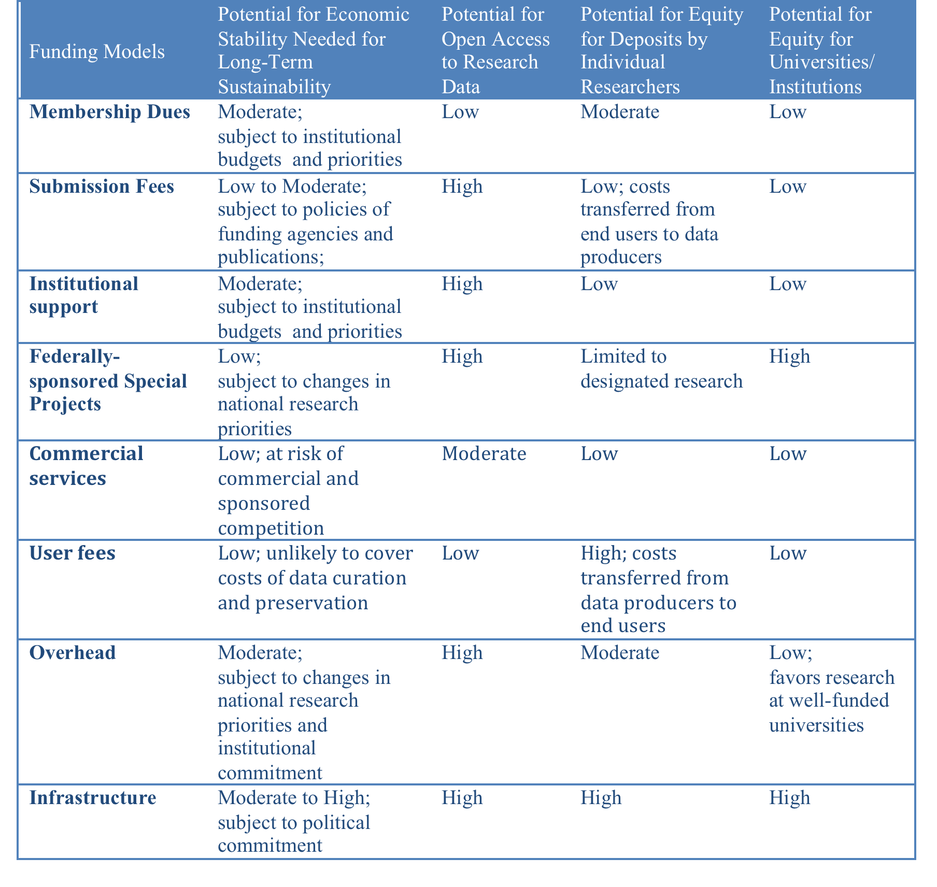

Slide 4
Increasing Interest/Concern
Research Data Alliance interest group (George Alter, Peter Doorn)
ICSU World Data System
CODATA
Article prepared for the Chronicle of Higher Education
ANDS newsletter
Physics Today editorial, M. Mountain
NRC report Proposed Revisions to the Common Rule for the Protection of Human Subjects in the Behavioral and Social Scienceshttp://www.nap.edu/catalog.php?record_id=18614.

