Slide 1
Scientific Data as Research Infrastructure
A data infrastructure is a digital infrastructure
promoting data sharing and consumption.
Physical infrastructures present a challenging model! WOW!
Bonnie C. Carroll
Founder & CEO, Information International Associates, Inc.
Strategies for Economic Sustainability of Publicly Funded Data Repositories
Board on Research Data and Information, March 12, 2014

Slide 2
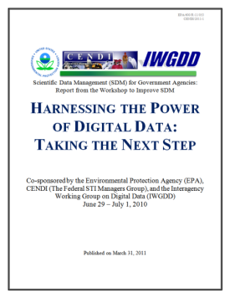
The Federal STI Context for Repositories
Open Access Issues in Building Infrastructure -- Publically funded data repositories
Dedicated repositories
Multiple agency funded research
Control and compliance
Deposit
Preservations and archiving
Access and cross repository research and interoperability
“Trusted” Repositories
Drivers Push/Pull
Changing patterns of scientific communication
Data Management Plans
Open Access Directives
Open Government and Open Data as a Framework
Scientific Developments
Data Intensive Science

Slide 3
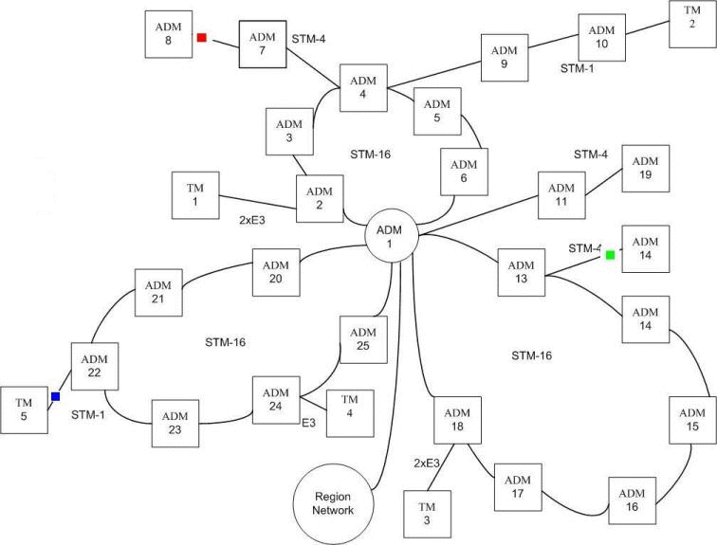
Definitions of Data, Types of Repositories, and Change
Repositories
Data
Metadata
Documentation
(the “Mother” of
repositories)
Numeric
Other Media
Video
Images
Audio
Social Media
Institutional
Disciplinary
Media
Mission
Government
Academic
Commercial
Change Elements
Data Citation
Data Publishing
Data Linking
Reward Structures
Many Players: RDA, CODATA/BRDI, WDS, Force 11, etc

Slide 4
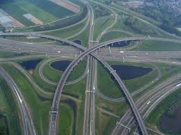
From Repositories to Infrastructure Sustainability
Lessons Learned:
One size never fits all, BUT
There are basic core elements
Interoperability is critical
Sciences increasingly include social science & business data for problem solving
Chief Data Officer vs CIO
Laying the Groundwork for Strategies for Sustainability
User requirements and use cases – and they differ by discipline, mission, age
As does our physical infrastructures -- like our road systems
Navigation is critical

