Slide 1
Open Government
David Curren – NIH
Susan Ross – Columbia University
January 28, 2013

Slide 2
Recap from Last Meeting
DATA Act – thought it would pass, ultimately didn’t
GRIP Pre-Pilot – suggest expanding membership of similar initiatives to include administrators, faculty (if progress reports included), and agency reps
Desire for resource of high-level agency staff responsible for transparency

Slide 3
Today’s Goals
Recap from last meeting
OMB GRIP Pre-Pilot
Agency contacts and tools
Open Government beyond the Data Act

Slide 4
OMB GRIP Pre-Pilot
Pilot program with 9 institutions representing the universe of Federal grantees
Goal of reducing transparency burden by pulling data from existing reporting portals
Successfully completed in Nov 2012

Slide 5
GRIP Pre-Pilot
Detailed evaluations submitted by participants
Session is Tuesday at 9 am

Slide 6
GRIP Pre-Pilot
Feedback:
Data collection method and documentation were much better than other similar reporting initiatives – allowed reporting by data stream or web forms (actually a choice!) with validation feedback available immediately after submission.

Slide 7
GRIP Pre-Pilot
Feedback:
Information provided crossed normal areas of responsibility for the university (both financial and grant administration) that might be problematic if those areas have different reporting lines at the university.

Slide 8
GRIP Pre-Pilot
Feedback:
Lesson learned from burden perspective – [University] would support only if this replaced other reporting requirements for multiple agencies rather than just adding another one.

Slide 9
GRIP Pre-Pilot
Evaluation comment:
“…The GRIP pre-pilot data requirements highlighted problems regarding the quality and utility of the data being requested.”
“…There is no one source that provides all of the GRIP reporting requirements.”

Slide 10
GRIP Pre-Pilot
Accuracy – Manual retrieval and entry of some data elements increases potential for inaccuracy and makes effort burdensome
Utility – Need to balance level of accuracy and amount of effort required to retrieve and report with usefulness of data element

Slide 11
Agency Contacts and Tools
FDP Open Gov website being updated
Adding Information from Federal Agencies:
Open Government web sites
Transparency and Reporting web sites
Agency Points of Contact
A few agencies have responded…waiting for information from others
Send information to CurrenD@mail.nih.gov or SusanRoss@Columbia.edu

Slide 12
Open Government beyond the DATA Act
Possible resurgence of DATA Act – Data Transparency Coalition and other advocates
Open Government movement
Recommended reading
“Open Government: Collaboration, Transparency, and Participation in Practice”
Edited by Daniel Lathrop & Laurel Ruma

Slide 13
Open Government beyond the DATA Act
“Open Government: Collaboration, Transparency, and Participation in Practice”
Chapters include:
Government as a Platform
Open Government and Open Society
My Data Can’t Tell You That
When is Transparency Useful
Invite select authors to future meeting?

Slide 14
Open Government Beyond the DATA Act
Increase Transparency through better tools, not just more data
Don’t provide more data, make it more understandable and searchable
Improve utility of transparency tools for public
Connect existing data sets
Better explain what the data actually says, and what it doesn’t say.

Slide 15
Open Government beyond the DATA Act
Spaghetti chart still exists
Chance to transition from reactive to proactive
What data elements already exist?
How would we design/conduct transparency reporting?
FDP Open Gov pilot?
Agencies
Recipients
Both?

Slide 16
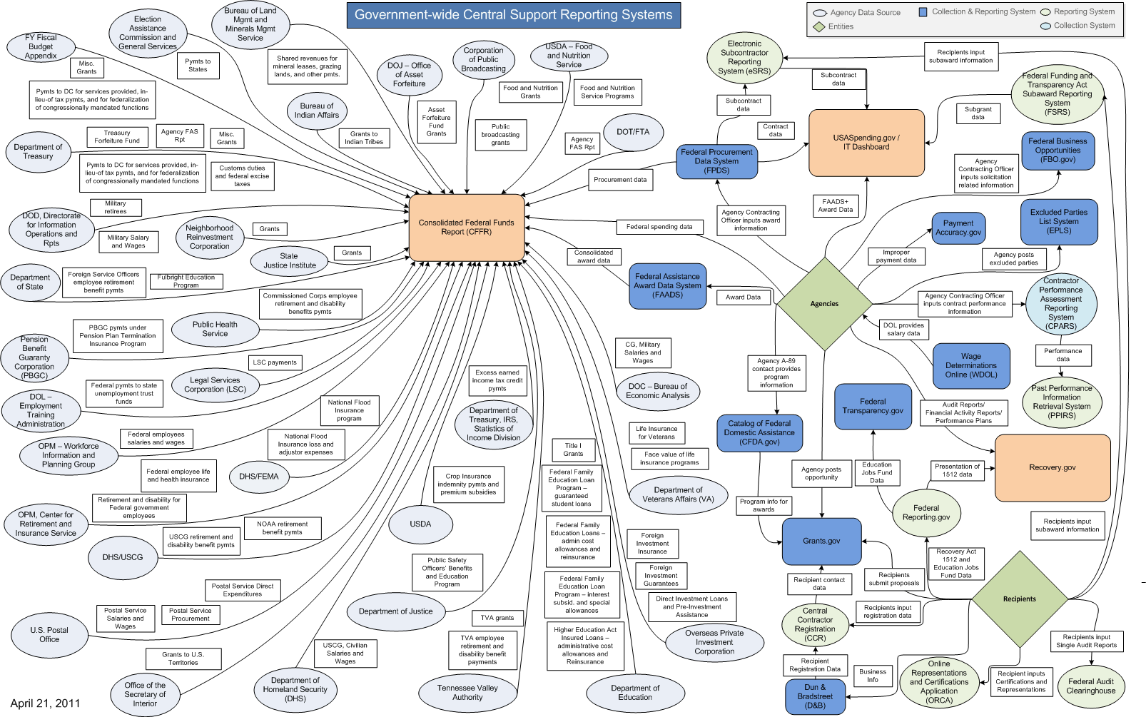
Spaghetti Chart
Source: Nancy DiPaolo, Recovery Accountability & Transparency Board

Slide 17
Final Discussion Issues
Public reporting of expenditure data
FederalTransparency.gov
Ways to better inform public of research activities without new reporting
What needs are not being addressed?

Slide 18
Thank You!

