Slide 1
Notes:
ABOUT THE CONFERENCE
Systems analysis is one of the few research tools that has both the breadth and depth to identify smart pathways through the complex nexus of increasing globalization, shifts of economic and political power, taxing environmental challenges, and unpredictable social conflicts to reach a world that accommodates the needs and aspirations of different groups and respects the limits imposed by the planet itself. The conference Systems Analysis 2015 will highlight recent advances, current gaps, and untapped disciplinary potentials in the field of systems analysis.
ABOUT HOWARD RAIFFA
The Systems Analysis 2015 conference is dedicated to Howard Raiffa for his huge contribution to systems analysis. As an influential Bayesian decision theorist, Raiffa is a pioneer in the field of decision analysis, with works in statistical decision theory, game theory, behavioral decision theory, risk analysis, and negotiation analysis. He helped found and was the first director of the International Institute for Applied Systems Analysis. He is currently the Frank P. Ramsey Professor (Emeritus) of Managerial Economics, a joint chair held by the Business School and the Kennedy School of Government at Harvard University, USA.

Slide 2

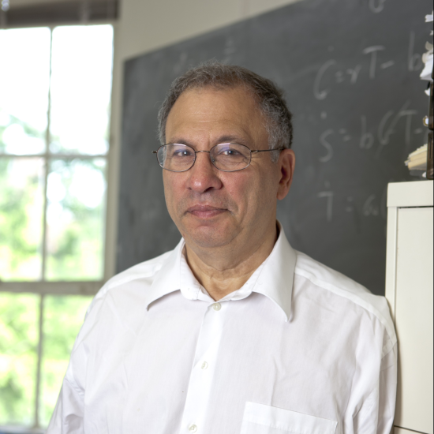
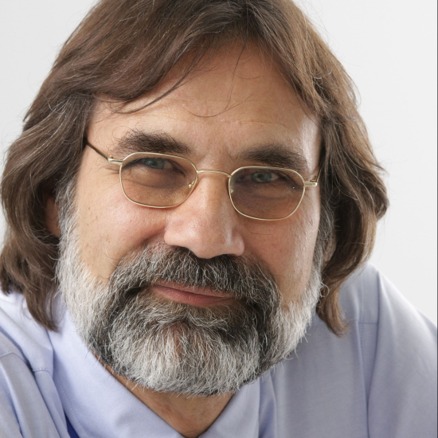
SPEAKERS
Over 30 experts in diverse areas of systems analysis including:
Robbert Dijkgraaf
Mathematical physicist
Director & Leon Levy Professor, Institute for Advanced Study, USA
Simon A Levin
Ecologist
George M. Moffett Professor of Biology, Princeton University
Nebojsa Nakicenovic
Energy economist
Deputy Director General, IIASA

Slide 3
PROGRAM
Requirements for Methodological Advances in Systems Analysis
Trans-disciplinary Inspiration in Systems Thinking
Poster Session
The Art and Craft of Systems Analysis
New Methods for Understanding Complex Systems
Addressing Stakeholder Diversity
Devising Integrated Solutions
A New Generation of Systems Analysis
Notes:
1. Requirements for Methodological Advances in Systems Analysis
This session focuses on the methodological advances required for the successful future development of systems analysis as an approach to address the 21st century’s major transformations. These advances need to expand the prowess of systems analysis in addressing challenging features of complex adaptive systems, such as nonlinearities and path dependence, surprises and tipping points, process uncertainty and model uncertainty, macroscopic patterns emerging from microscopic processes, massive availability of highly multivariate yet often unstructured and imprecise data, bounded rationality driving exchanges among social and economic actors, and impacts cascading across extended and interconnected networks.
2. Trans-disciplinary Inspiration in Systems Thinking
This session showcases the diversity of conceptual approaches that different fields of natural and social science have developed for defining and analyzing systems. Elucidating alternative systems perspectives across research areas as disparate as neuroscience, quantum theory, engineering sciences, ecology, economics, psychology, sociology, and computer science, key ideas concerning system elements, system interconnectedness, system boundaries, and system dynamics will be introduced and compared, with the goal of promoting trans-disciplinary inspiration in systems thinking.
3. Poster Session
The dedicated poster session will enable conference participants to scope and share a diversity of perspectives on innovative methodologies, applications, and future challenges of systems analysis.
4. The Art and Craft of Systems Analysis
Both art and craft are involved in all major steps of systems analysis – from posing a specific research question, to specifying the assumptions underlying a model, to transforming those assumptions into mathematical or computational form, and to representing and communicating the results. These features are making systems analysis an exciting and creative process.
This session considers the creative tensions inherent in this process by touching on the following questions:
What modern approaches can be recommended for model selection, calibration, and validation?
How are systems boundaries best to be defined, emergent phenomena tackled, robustness checks designed, and validity limits delineated?
How can multiple models be compared, interfaced, and integrated?
How can a proliferation of false positives be avoided as the pool of data that can be correlated explodes?
How can big data be used while skirting a temptation to construct big models in which a plethora of nonlinear interactions defies understanding and associated uncertainties cannot be assessed?
In any of these regards, are best-practice recommendations becoming available that help delineate a safe operating space for systems analysis?
5. New Methods for Understanding Complex Systems
As the challenges of systems analysis develop, so must its methods. The system analyst’s tool chest can be expanded in three ways:
by taking advantage of as yet untapped advances in mathematics and computer science,
by the gradual honing of tools applied and developed in a disciplinary context, and
by trans-disciplinary innovation and cross-fertilization.
This session will provide an extensive horizon scan of new methods and approaches that have potential for strengthening systems analysis in the 21st century.
6. Addressing Stakeholder Diversity
Scientific insights into global transformations invariably require accounting for a plurality of stakeholder groups and interests. Contemporary applications of systems analysis are breaking new ground by explicitly accounting for such diversity, as well as for the associated complexity of human behavior. Participatory processes engaging stakeholders and policy makers in the whole cycle of designing and implementing research have proven invaluable for promoting a wider acceptance of scientific analyses. The interfacing of science with art is also increasingly recognized as a powerful conduit for reaching broader audiences.
This session focuses on methodological approaches that facilitate stakeholder involvement and promote accounting for stakeholder diversity.
7. Devising Integrated Solutions
Systems analysis strives to capture crucial connections within a domain. When impacts cascade through systems, policy interventions affect multiple sectors, and stakeholder utilities are intertwined, capturing such connections becomes crucial. Integrated assessments are devised to meet these challenges. On the one hand they reveal synergies and co-benefits, leading to particularly cost-effective solutions, while on the other hand they can highlight conflicts among stakeholders or mutual exclusions among policy options. By accounting for interconnections, integrated assessments can also promote the robustness of solutions and enable predictions over longer time horizons.
This session features methodological approaches underlying cutting-edge nexus studies and highlights methodological challenges that need to be overcome for devising future integrated assessments of increasing scope and reliability.
8. A New Generation of Systems Analysis
In the closing session, conference participants share their vision on the future of systems analysis, offering personal views on the most promising directions and on methodological advances needed to pursue these directions. The session opens with four researchers who have not yet spoken sharing their reflections on the conference proceedings in the form of 10-minute statements, followed by a closing panel with conference speakers opening up to questions that can be submitted by all conference participants to the session moderator.

Slide 4
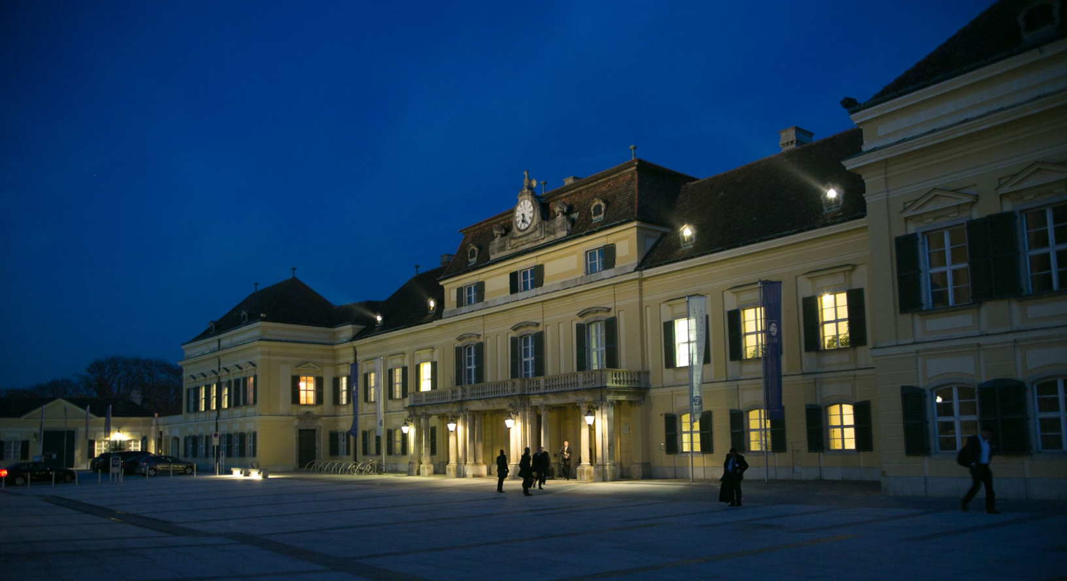
VENUE
At the International Institute for Applied Systems Analysis (IIASA), just south of Vienna, Austria

Slide 5
TAKE PART
REGISTER
learn about the state-of-the-art methods in systems analysis
participate in a platform for transdisciplinary inspiration and the transfer of methodological knowledge among different applications of systems analysis
CALL FOR POSTERS
present your innovative methodology in or application of systems analysis via a poster
sa2015.iiasa.ac.at
Notes:
For more information, to register and to apply to present a poster, visit the conference website at sa2015.iiasa.ac.at

