Slide 1
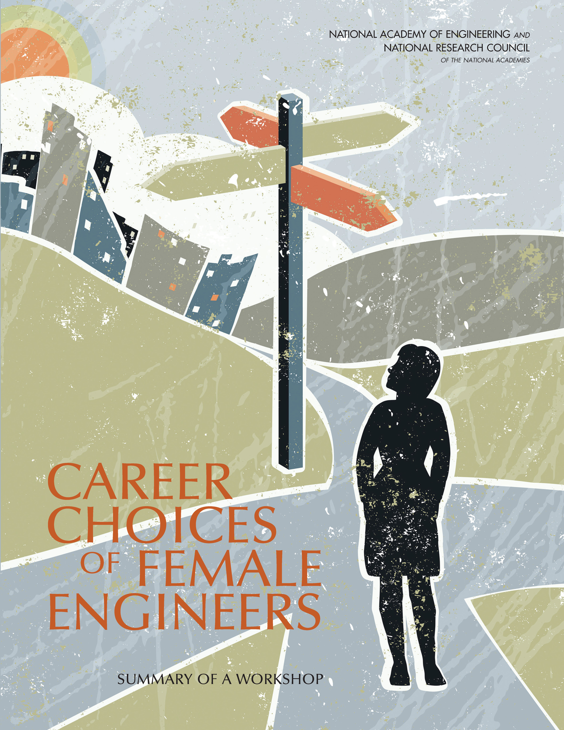

Slide 2

Background
As part of a project to examine the career outcomes of female recipients of bachelor’s degree in engineering, the National Research Council Committee on Women in Science, Engineering, and Medicine (CWSEM) held a workshop on April 24, 2013, titled “Career Outcomes of Female Engineering Bachelor's Degree Recipients”. The project was supported by the National Science Foundation (Grant No. 1137641).
The workshop was designed to increase (1) understanding of gender differences in the recruitment, retention, and advancement of women at critical transition points and (2) investigate and share the best practices to facilitate career transitions and advancements for all.
A summary of the workshop was published in 2014. This overview highlights some presentations and data from the workshop summary.
The views expressed are those of individual conference participants and do not necessarily represent the views of all conference participants, the planning committee, the National Research Council, or the National Science Foundation.
Notes:
The ad hoc committee for this project scheduled the workshop to coincide with the 2013 NAE Engineering Convocation, which drew many leaders of engineering societies and associations. This was an opportunity to engage leaders of engineering societies and association in the workshop.
Participants included academic researchers and representatives from the US Department of Labor, National Science Foundation, Census Bureau, and several engineering professional societies.
The topic of the importance of educating and training a technical workforce has received significant public interest lately, but there has been much less on the subject of retaining scientific and technical workers in the workforce.
Some other questions that the committee tried to address at the workshop included: Are women less likely to stay in engineering because of work and family issues? Do women have better success than men in moving from technical to managerial work in engineering?

Slide 3
Introduction
Despite decades of government, university, and employer efforts to close the gender gap in engineering, women make up only 11 percent of practicing engineers in the United States.
Efforts at this workshop to examine women’s career paths and obstacles can point the way to ensuring that our world has a system in which women and minority groups can fully participate.
The loss of women engineers from technical workplaces has implications for women themselves, the organizations they leave, and society as a whole.
It is critical to US technological competitiveness and national security to understand factors that will help engineering organizations retain their highly trained workforce and avoid preventable turnover.
Notes:
Engineering remains one of the most sex-segregated occupations in the US.
Engineering has the highest turnover rate among skilled professions such as accounting, law, medicine, and higher education.
The workshop sought to answer the following questions:
What are the career outcomes of women who receive bachelor’s degrees in engineering?
How do these outcomes compare to men?
Are women less likely to stay in engineering because of work and family issues
The workshop consisted of three main panelists: 1)Gail Greenfield from Mercer LLC, who examined women’s workforce participation; 2)Fouad and Singh, who tackled the question of why women were leaving the engineering/technical workplace?; 3)Carnegie Melon graduate students, who examined issues of recruiting and retaining of the female workforce within small and medium business.

Slide 4
Career Outcomes of Women Engineering Bachelor’s Degree Recipients
Gail Greenfield
Greenfield examined two key career outcomes: (1) the percentage of graduates in the labor force (“labor force participation”) and (2) the percentage of employed graduates working in the field of their major (“retention”)
Overall, Greenfield found:
“participation in the labor force is not a concern: women are participating in the labor force at high rates. It is retention in engineering that appears to be a challenge for both men and women: ten years after graduation.”
Notes:
Gail Greenfield, principal at Mercer LLC, attempted to address these questions by analyzing data from the Department of
Education’s Baccalaureate and Beyond (B&B) Longitudinal Study, which gathers information on the postgraduation
experiences—education, employment, and family experiences—of people who have graduated with a bachelor’s degree. The B&B study also collects information on degree recipients’ undergraduate experiences (e.g., major field of study, how they paid for college) and demographic information such as gender, ethnicity, and age.
Greenfield used two methods of analysis for the B&B data—1. Descriptive Comparison, 2. Multiple Regression
Her research questions:
What are the career outcomes of women who receive bachelor’s degrees in engineering?
How do these outcomes compare to men who receive bachelor’s degrees in engineering and to women who receive bachelor’s degrees in other “career oriented” majors (e.g., business and management, education, and nursing)?
What factors help explain these observed career outcomes?

Slide 5
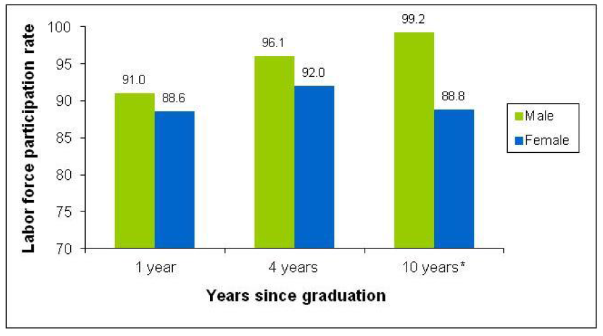
Labor force participation rate by gender for engineering bachelor’s degree recipients in the 1992-1993 academic year
Key findings
Male participation increases with time, female participation does not.
While female participation 10 years after graduation remains high, it is still 10% lower than males.
*Difference between men’s and women’s rates is statistically significant at the 5 percent level.
Source: National Center for Education Statistics.
Greenfield, G. (2014). The Career Outcomes of Female Engineering Bachelor's Degree Recipients: a study using the Baccalaureate & Beyond (B&B) Longitudinal Study. Taken from Career Choices of Female Engineers: A Summary of a Workshop. The National Academies Press, 2014.
Notes:
Cohort 1 (the above): about 11,000 students who graduated with a bachelor’s degree during the 1992-1993 academic year. These students were surveyed in their last year of college and then one year, four years, and ten years after graduation (in 1994, 1997, and 2003, respectively).
Gail Greenfield studied 3 Cohorts in total.
Figure: Labor force participation rate by gender for engineering bachelor’s degree recipients, Cohort 1 of the National Center for Education Statistics Baccalaureate and Beyond Longitudinal Study. *
Key findings from the descriptive comparison analysis (figure above) for participation in male and female engineers also suggest:
For the same cohort, the rates of participation for female engineers are similar to female graduates in other career oriented fields. In other words, female engineering graduates are just as likely as their counterparts in other disciplines to participate in the workforce.
Key Findings from the participation model using multiple regression analysis:
Women engineering graduates are generally no more less likely to be participating in the labor force than graduates in other career-oriented majors.
Women graduates in engineering and other career-orientated major:
Are less likely to be in the labor force if they have children
Are less likely to be in the labor force four years and ten years after graduation if their spouses income is relatively high
Are more likely to be in the labor force one year and four years after graduation if they incurred debt in college
Are less likely to be in the labor force one year and four years after graduation if they are enrolled in school, but are more likely ten years after graduation
Are more likely to be in the labor force ten years after graduation if they have a graduate degree

Slide 6
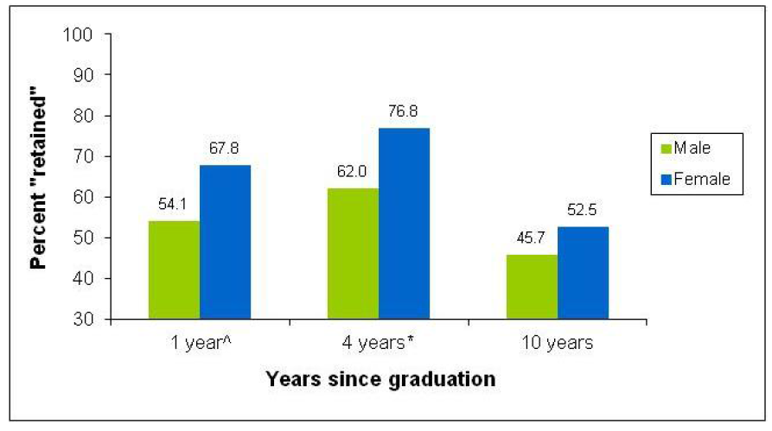
Employed engineering bachelor’s degree recipients from the 1992-1993 academic year in an engineering/architecture occupation
Key findings
The retention rate for both men and women drops ten years after graduation.
The retention rate at each year for engineering bachelor’s degree recipients is higher for females than male.
^Difference between numbers for women and men is statistically significant at the 10 percent level. *Difference between numbers for women and men is statistically significant at the 5 percent level. The decline in the percent retained from four to ten years after graduation is statistically significant at the 5 percent level for both men and women.
Source: National Center for Education Statistics.
Greenfield, G. (2014). The Career Outcomes of Female Engineering Bachelor's Degree Recipients: a study using the Baccalaureate & Beyond (B&B) Longitudinal Study. Taken from Career Choices of Female Engineers: A Summary of a Workshop. The National Academies Press, 2014.
Notes:
Cohort 1(the above): about 11,000 students who graduated with a bachelor’s degree during the 1992-1993 academic year. These students were surveyed in their last year of college and then one year, four years, and ten years after graduation (in 1994, 1997, and 2003, respectively).
Gail Greenfield studied 3 Cohorts in total.
Other key results from the descriptive comparison analysis (above figure):
By ten years after graduation the retention rate for female engineering bachelors degree recipients is significantly lower than the rates for education and health-related major; but comparable to that for management/business majors
Across cohorts, the percent of female engineering bachelor’s degree recipients “retained” has fallen significantly from one cohort to the next.
Key findings from the multiple regression analysis on the retention model:
Employed female engineering graduates are not retained in the field of engineering at lower rates than male engineering graduates.
In fact, female engineering graduates are more likely than male graduates to be working in the field of engineering four years after graduation.
Employed male and female engineering graduates:
Are more likely to be working in their field of engineering one year and ten years after graduation if their undergraduate GPA was 3.5+
Are less likely to be working in the field of engineering ten years after graduation if they have a graduate degree in a non-engineering field

Slide 7
Stemming the Tide: Why Women Engineers Stay in, or Leave, the Engineering Profession
Nadya Fouad and Romila Singh, University of Wisconsin
Comparison of the women who leave with those who stay in engineering revealed four trends:
No difference in self-confidence in performing tasks, navigating work politics, or managing non-work roles
No difference in terms of interests
Differences in experiences with supportive workplace environment
Differences in level of commitment and satisfaction with the engineering profession. Women who are still in engineering report higher level of satisfaction.
Notes:
Main Finding:
Women are leaving engineering careers because of a lack of advancement opportunities and because the climate does not support work-life balance.
Interests: According to prominent vocational psychologists, individuals seek out jobs, careers, and work environments that match or fit their dominant interests, which in turn enables them to fully flourish in those chosen fields or areas.
Fouad and Singh’s analysis revealed no significant differences in types of interest between women working in engineering and those that left.
Other findings:
Fouad and Singh also found that racial/ethnic minority women were more likely to report a greater incidence of supervisory undermining than Caucasian women.
According to the study, women in engineering considered leaving their profession much more than in any other field.
Fouad and Singh also make various recommendations for policy makers and corporate leadership (see page 34 of conference workshop).

Slide 8
Stemming the Tide: Why Women Engineers Stay in, or Leave, the Engineering Profession
Nadya Fouad and Romila Singh, University of Wisconsin
Workplace climate is the biggest differentiator that sets apart women who are currently working in engineering from those who left the technical field.
Women currently working in the engineering field:
  Experienced a supportive workplace
    Supportive workplace: family friendly work culture characterized by recognition of the importance of work-life balance and availability of work-life benefits
  Worked with empathic and understanding supervisors and coworkers
  Experienced fewer barriers at work in the form of incivility and undermining behaviors compared to women who left the technical field

Slide 9
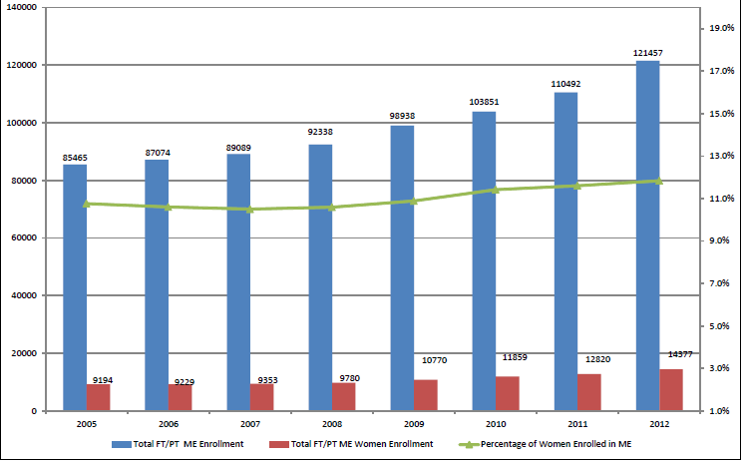
Retaining Technical Talent: a discussion on data needs, critical transitions, and career pathways
Total full-time/part-time enrollment in US undergraduate mechanical engineering programs, 2005-2012
The figure shows that despite seven years of continual enrollment growth in mechanical engineering, the enrollment of women remained stuck at 11-12 percent.
Can we dig deeper into the data?
Source: ASEE Data Mining Site, www.asee.org
Notes:
The figure above shows demonstrate the need to delve further into the data. While women enrollment in engineering seem to be stagnant at 11 to 12 percent, a closer look at the data, reveals that since 2005 the number of undergraduate women studying mechanical engineering has risen more than 10%, faster than the increase for men.
Is more data needed to further understand why women enter, stay, or leave the engineering field? If so, what kind of data should we mine?

Slide 10
Retaining Technical Talent: a discussion on data needs, critical transitions, and career pathways
 |  | 2005 | 2012 | Change in number | Percent increase
 | Female ME undergraduate education | 9,194 | 14,377 | 5,183 | 56.40%
 | Male ME undergraduate education | 76,271 | 107,080 | 30,809 | 40.40%
Upon closer examination, the data from the previous figure reveals that since 2005 the number of undergraduate women studying mechanical engineering has risen more than 10 percent faster than the number of men—an increase in women of over 55 percent, compared to a 40 percent increase in men.
 |  | 2007 | 2012 | Change in number | Percent increase
 | Female ME undergraduate education | 9,353 | 14,377 | 5,183 | 53.70%
 | Male ME undergraduate education | 79,736 | 107,080 | 27,344 | 34.30%
Source: ASEE Data Mining Site, www.asee.org

Slide 11
Retaining Technical Talent: a discussion on data needs, critical transitions, and career pathways
How to leverage the right resources to get the data we need
Promote collaboration among engineering societies
Make data publicly accessible while protecting confidentiality
Engaging a diverse range of societies to ensure the inclusion of populations that aren’t well represented in national datasets
Benchmark datasets and conduct comparisons with other cultures , disciplines, and professions
Encourage researchers to take a broader, interdisciplinary perspective in conducting their research
Notes:
The above points are the key takeaways from the discussion on data needs.

Slide 12
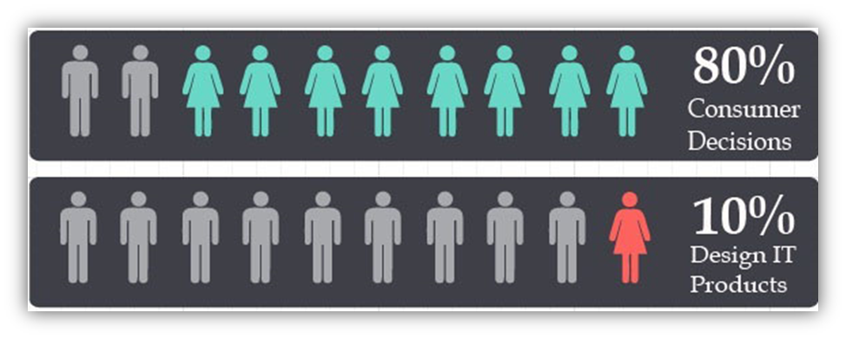
Technical Women in Small and Medium Businesses
Emily Blakemore, Angie Im, Channing Martin, Albery Melo, Sara Raju, and Liz Schuelke. The H. John Heinz III College, Carnegie Mellon University
Women control 80 percent of consumer decisions but design only 10 percent of IT products and services.
Source: Harris, K., and M. Raskino. 2007. Women and Men in IT: Breaking Sexual Stereotypes. Stamford, CT: Gartner.
Notes:
Graduate students of the Carnegie Mellon University Heinz Graduate Systems Projects presented their research on women in information technology in small and medium-sized businesses.
While over 90 percent of men reported feeling at least somewhat comfortable (with physical space), only 63 percent of women
did.
~ Carnegie Mellon study group
Findings:
job postings for IT jobs can be problematic in that they tend to favor syntax
that describes typically male traits, and therefore males tend
to gravitate to those jobs.
Employers claim to value “organizational fit” during the hiring process. In other words, someone who could fit into their office “culture”
work life balance programs and mentorship were important but underutilized.
Recommendations:
Reduce job posting bias
Integrating physical space
Providing support system for women

Slide 13
Technical Women in Small and Medium Businesses
Emily Blakemore, Angie Im, Channing Martin, Albery Melo, Sara Raju, and Liz Schuelke. The H. John Heinz III College, Carnegie Mellon University
Barriers to recruitment of women in IT:
Subtle job posting bias deter women from seeking technical positions.
Stereotypical environments (e.g. Star Trek posters, video games, etc.) marginally reduce women’s identification with the computer science field.
Barriers to retention of women in IT:
The IT field lacks a culture of collaboration and hands-on learning, causing women to feel isolated in their working environments.
The stereotypical perception of women as less technologically capable than men perpetuates the underrepresentation of women in the IT field.
Small businesses have more flexibility to propose and implement interventions rapidly. Opportunities for small businesses:
Adapt organizational environment to accommodate diverse populations, including women
Encourage recruitment and implement mentoring programs for women in IT
Provide access to professional technical societies that can be alternatives to internal mentoring program

Slide 14
Closing Discussion
What is needed to create environments where all people feel comfortable, rather than just one group?
An understanding that diversity brings value to every field
A change in paradigm, from gender neutrality, which often means the environment favors men, to a paradigm of inclusion
Action taken by management to define success by taking gender into consideration

