Slide 1

USG agencies in development partnerships with USAID
National Science Foundation
Jessica Robin, PhD
Office of International Science & Engineering
May 20, 2016
Notes:
Numbers have been updated with BFA figures 1/13/15
NSF is the primary funder of basic research across all disciplines of science and engineering (25% of all basic research conducted at universities is funded by NSF).
But for comparison, NIH budget is ~$30.4B for 2015
~45% of support for basic research in the physical sciences is funded by NSF
~65% of support for basic research in biology (that is not health related) is funded by NSF

Slide 2
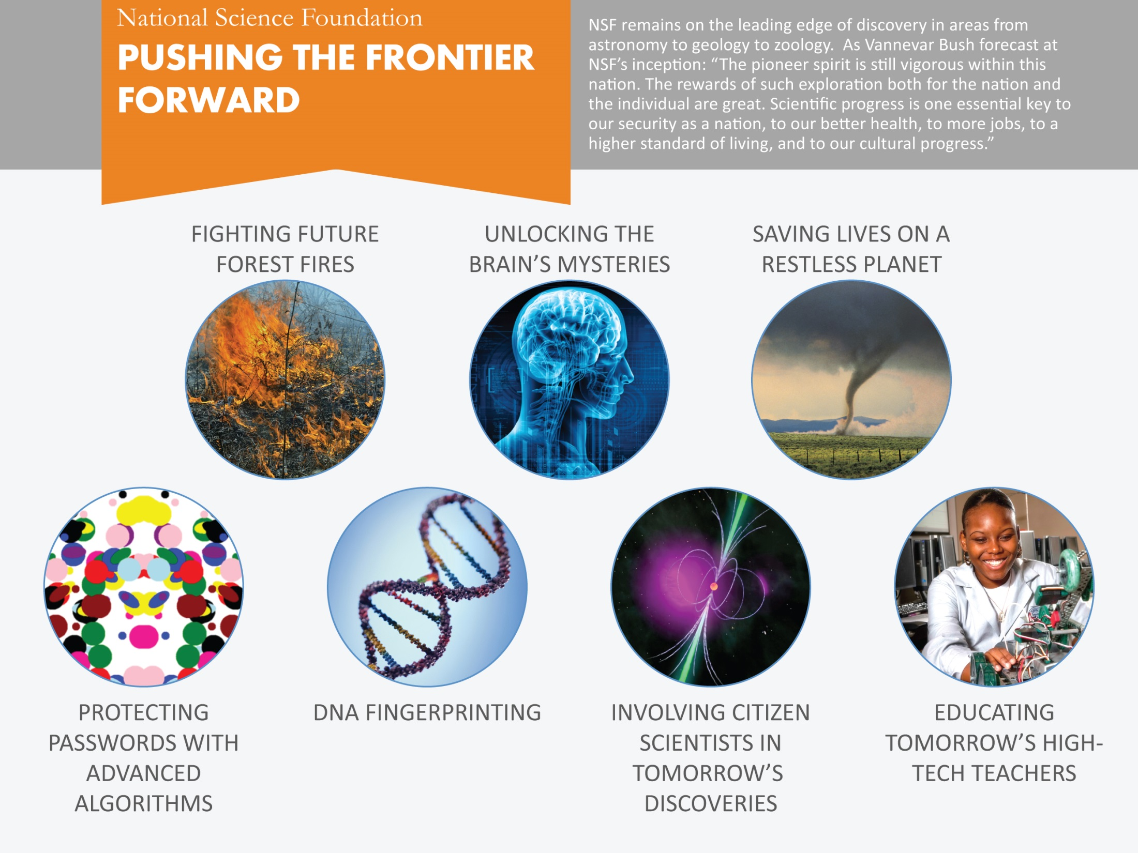

Data Current as of 2014

Slide 3
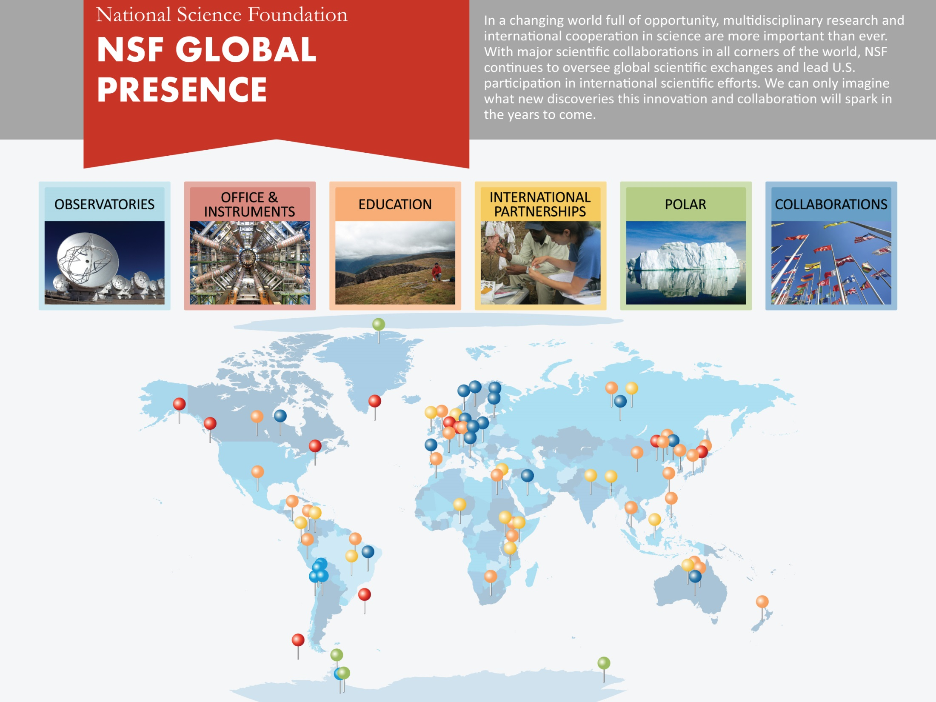
Data Current as of 2014

Slide 4
NSF and USAID: Different Mandates But Mutual Areas of Interest
NSF
USAID
Congressional mandate is scientific research
Primary client is the US science community
Funding is allocated to US institutions
Merit review for research proposals is fundamental
Congressional mandate is foreign assistance
Primary clients are developing countries
Funding flows to implementing partner, often a US institution
Highly decentralized - strategy and funding decisions are made in the USAID Missions
MOU

Slide 5
USAID-NSF MOU (2008)
Office of International Science & Engineering
Higher Education for Development
Consultative Group on International Agricultural Research
NSF
USAID
Notes:
Numbers have been updated with BFA figures 1/13/15
NSF is the primary funder of basic research across all disciplines of science and engineering (25% of all basic research conducted at universities is funded by NSF).
But for comparison, NIH budget is ~$30.4B for 2015
~45% of support for basic research in the physical sciences is funded by NSF
~65% of support for basic research in biology (that is not health related) is funded by NSF

Slide 6
Initial focal points
Water
Information Technology
Food Security
Hazards Awareness, Prevention, Mitigation
Supply Chains
Construction Research
Notes:
Numbers have been updated with BFA figures 1/13/15
NSF is the primary funder of basic research across all disciplines of science and engineering (25% of all basic research conducted at universities is funded by NSF).
But for comparison, NIH budget is ~$30.4B for 2015
~45% of support for basic research in the physical sciences is funded by NSF
~65% of support for basic research in biology (that is not health related) is funded by NSF

Slide 7
Activities under initial MOU
Workshops
EAGERs
RAPIDs
USAID Climate Change Office (Peru & Nepal)
USAID Climate Change Office & NASA Marshall (Panama)
USAID, USGS, DOS (Malawi)
USAID Office of U.S. Foreign Assistance (Costa Rica)
USAID, NASA, DOS (Kenya)
USAID, CDC (Haiti)

Slide 8
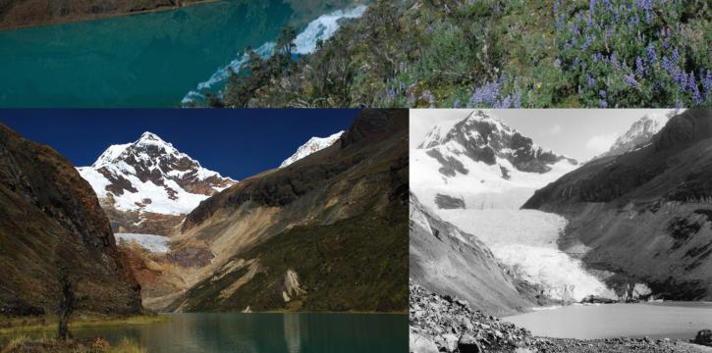
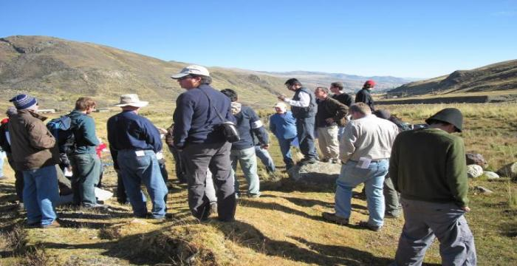
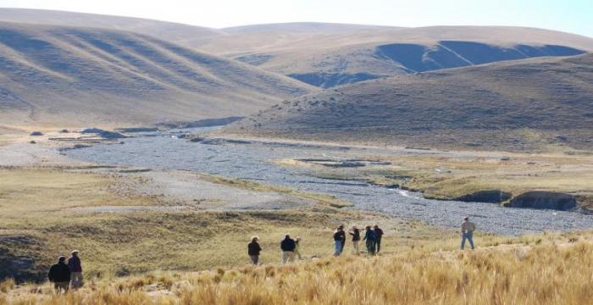
NSF & USAID PERU & NEPAL WORKSHOPS (2009 & 2010)
Adapting to a World without Glaciers
Photo Credit: High Mountain Adaptation Partnership

Slide 9

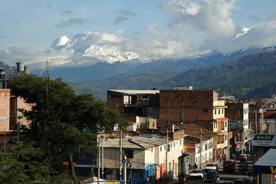
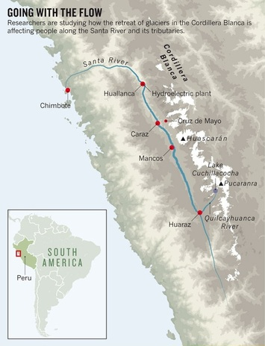
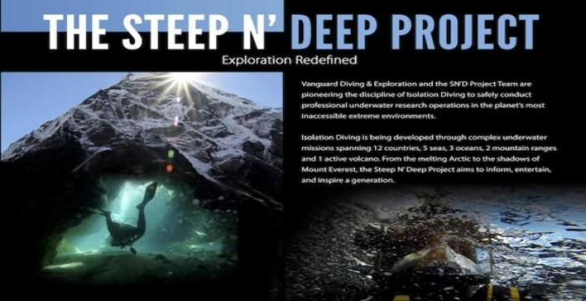
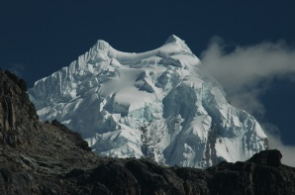
NSF: Hydrologic Transformation and Human Resilience to Climate Change in the Peruvian Andes
USAID
Photo Credit: Bryan Mark

Slide 10
NSF-USAID PARTNERSHIPS
PIRE
GROW
PEER
Partnerships for International Research and Education
Graduate Research Opportunities Worldwide
Partnerships for Enhanced Engagement in Research

Slide 11
Partnerships for Enhanced Engagement in Research (PEER)
USAID-funded competitive grants program to support research & capacity building for developing country scientists
Researchers must have USG-funded collaborator
Program began in 2011 as USAID-NSF partnership and has expanded to include NIH, NASA, USGS, USDA, NOAA, Smithsonian
Proposals reviewed by panel of science experts with development experience
USAID contributes 6 to 7 million annually to this program
National Academies of Science administers PEER
There are ~ 150 PEER awards that involve NSF-funded researchers

Slide 12
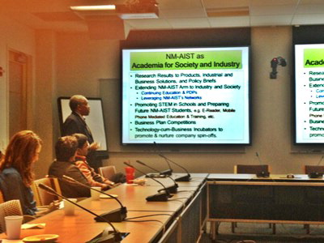
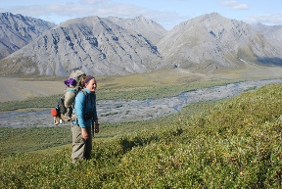
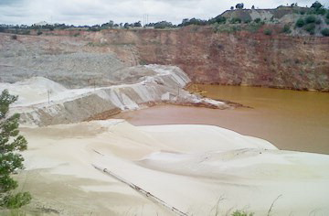
HOW PEER BENEFITS U.S. SCIENCE
Unique access to facilities and sites
Strengthens collaborations between U.S. and international researchers
Workforce development
Photo courtesy Dr. Najib
Abandoned South African Gold Mine
(Photo courtesy of Dr. Tutu)
U.S. Graduate Student Meghan Miller in Kenya
Notes:
Pictures (L):
(Left) – PEER Cycle 2: Development of advanced composite materials and geopolymers for the removal of uranium and toxic elements from gold mine-polluted water
PI: Hlanganani Tutu (University of the Witwatersrand)
U.S. Partner: Edward Rosenberg (University of Montana)
(Middle) – Peer Cycle 2: Computational Mathematics, Modeling and Analysis of Biological, Bio-inspired and Engineering Systems
PIs: Madundo Mtambo and Burton Mwamila (Nelson Mandela African Institute of Science and Technology);
U.S. Partner: Padmanabhan Seshaiyer (George Mason University)
(Right) -- PEER Cycle 1: Natural pest and weed suppression functions by birds as incentives to conserve a globally threatened bird species and enhance livelihoods in an agricultural landscape
PI: Peter Njoroge (National Museums of Kenya)
U.S. Partner: Matthew Johnson (Humboldt State University)

Slide 13
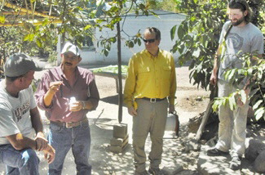
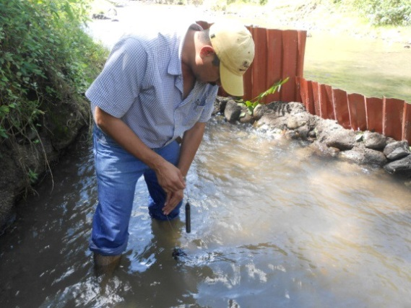
PEER & PIRE
PEER: Demonstrating the integration of ground-based monitoring and satellite remote sensing for forecasting landslides and flooding hazards in volcanic terrains
PEER PI: Dr. José Fredy Cruz, University of El Salvador
NSF Partner: Dr. John Gierke, Michigan Tech University
PIRE: Remote Sensing for Hazard Mitigation and Resource Protection in Pacific Latin America

