Slide 1
The role of agricultural science and technology in international development today
Willem Janssen
Lead Agricultural Economist

Slide 2
Content
The importance and the state of science and technology in agriculture
The World Bank and agricultural science and technology
New issues
Redesigning technology generation, progress and challenges
USAID, the WB and the CGIAR
USAID and agricultural science and technology

Slide 3
The importance of science and technology in agriculture - 1
Productivity growth is the key to agricultural development, and is often driven by science and innovation
Science not only helps to grow more but also better, more nutritious food;
The efficiency of food systems warrants attention: waste, obesity, pollution, water use
The returns to agricultural research in developing countries have consistently proven to be high, even in recalibrated estimations (14%)
New issues are coming on the agenda, and science will be key again

Slide 4
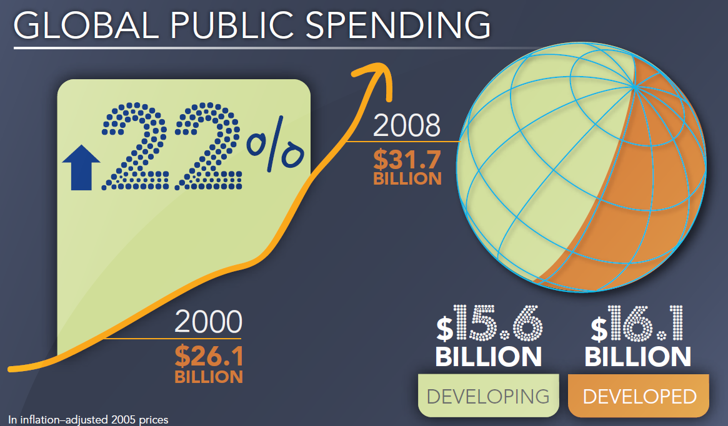
Spending on public agricultural research increasing; developing countries catching up
China, India, and Brazil accounted for half of combined spending in developing countries.
Source: ASTI

Slide 5
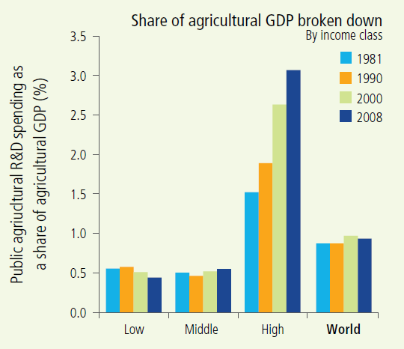
Agricultural science remains a tool of the wealthy
Source: ASTI

Slide 6
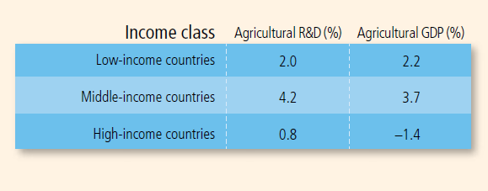
Annual growth rates 2000-2008, low-income countries stay behind
Source: ASTI

Slide 7
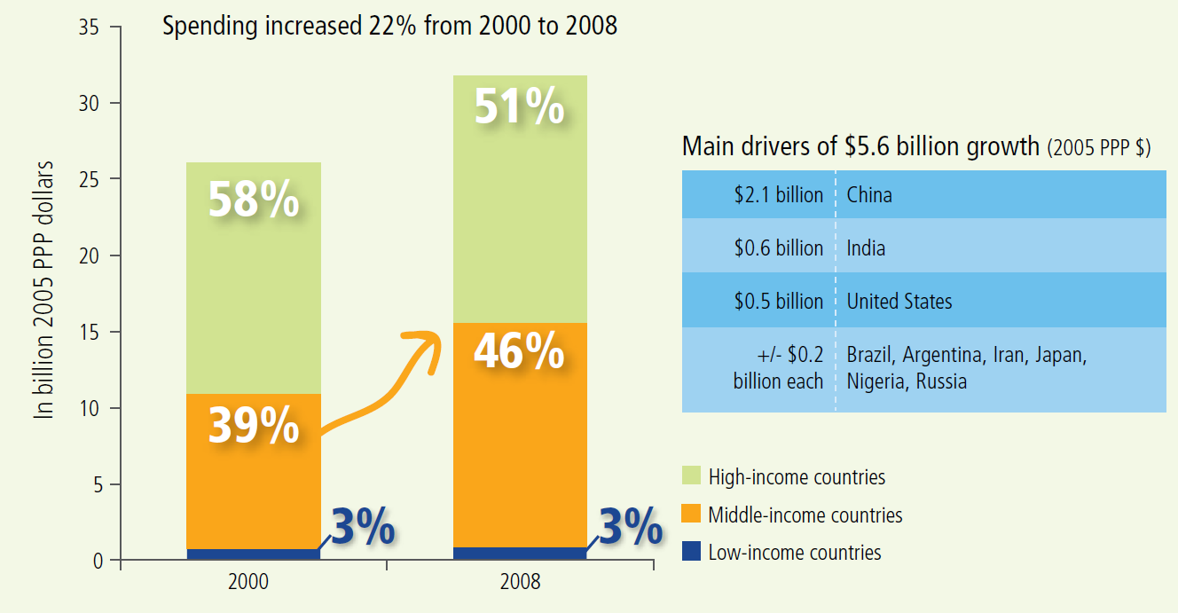
The big countries increase public spending!
Source: ASTI

Slide 8
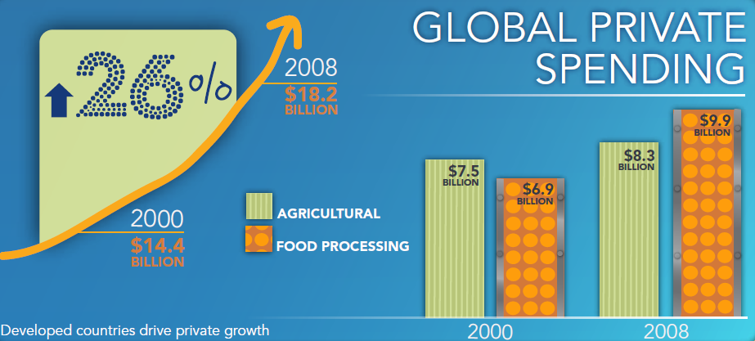
Private spending grows more quickly, especially in food processing
Private spending concentrated in developed countries, and growing in Brazil, India, China
Source: ASTI

Slide 9
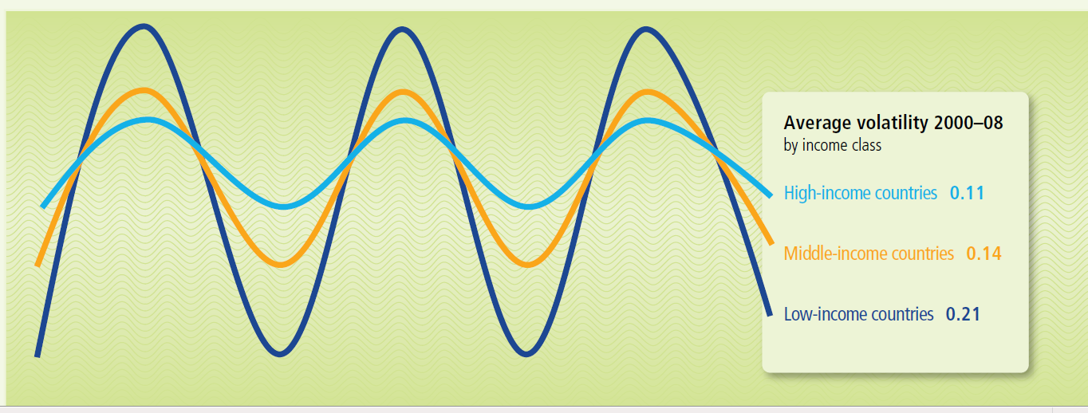
Volatility of research expenditures, by country category
Source: ASTI

Slide 10
Conclusions on (public) science and technology in agriculture
Public science plays a big role in agriculture! 79% of total global spending is public
In developing countries science may be even harder to appropriate…..
Public-sector capacity to carry out cutting-edge science and innovation remains weak in many developing countries. Scientists are aging
Private sector R&D strongly benefits from an enabling environment with access to public research organizations and researchers
Policy makers in many developing countries do not appreciate the returns to investment in science and innovation, resulting in under investment and volatility
The traditional concept of a National Agricultural Research System is under pressure. It works better in larger than in smaller countries

Slide 11
The World Bank and agricultural science and technology
World Bank supported public investments ($millions)
 | Under implementation | In preparation
Agriculture | 20,625 | 7,563
Agricultural R&D | 2,018 | 494
More than 30% of projects support R&D
Less than 10% of projects focus on Ag R&D
Source: WBG, portfolio indicators

Slide 12
The World Bank’s commitment to agricultural science and technology
Source: A.Pape-Christiansen, Portfolio Review 2016, GFADR

Slide 13
The World Bank’s approach: science as a tool
“ A renewed urgency, and international and national commitment, is needed to sustain climate-smart agricultural research to deliver needed science based solutions”. (Shaping a Climate-Smart Global Food System, WBG 2015)
Incorporate technical assistance in productive alliance and other market based approaches (Linking farmers to markets through Productive Alliances: an assessment of the World Bank experience in Latin America)
“Increase research and development of more nutrient-rich crops” (Shaping the Global Food system to Deliver Improved Nutrition and Health, WBG 2016)
Strengthen partnerships with the CGIAR and other knowledge providers (Shaping a Climate-Smart Global Food System, WBG 2015)

Slide 14
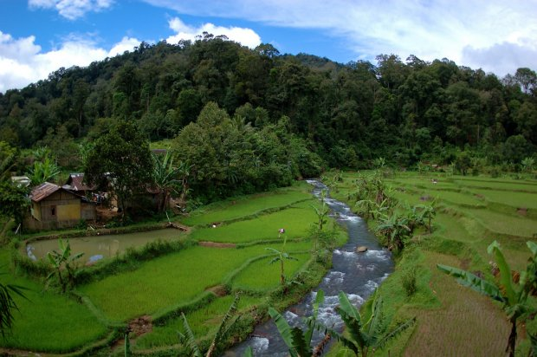
New issues: Climate smart agriculture
The triple win!
Systems oriented research (socio-economic and biophysical)
Natural resource management
Landscape approaches
Data management and ICT

Slide 15
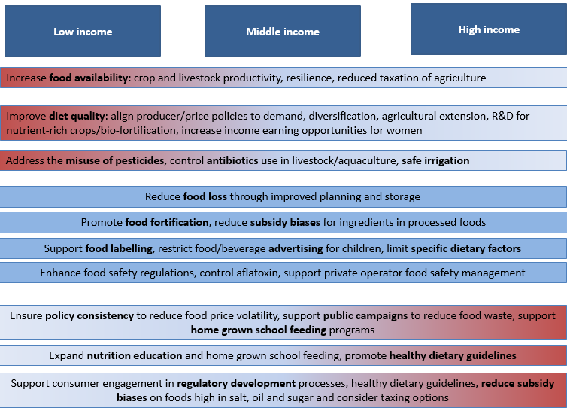
New issues: the sustainable global food system
Soil depletion and pollution
Scarcity and waste
Stunting and obesity
Food safety
Regulatory research
Nudging approaches and consumer science
From more to better

Slide 16
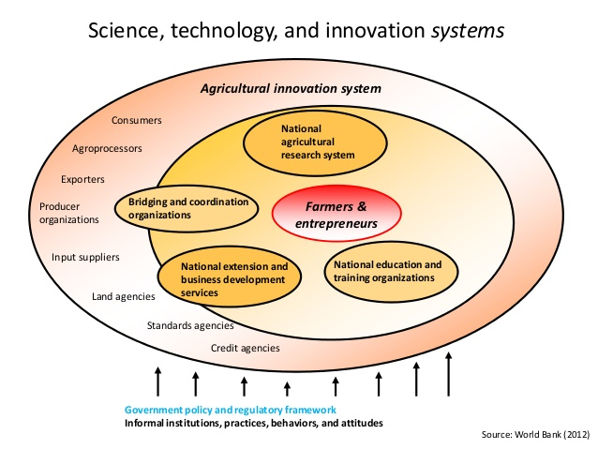
Redesigning technology generation: innovation systems and innovation platforms
More market driven
Larger role for the private sector
Greater adaptive capacity (good for small countries)
More attention to the last mile
Need for local capacity
How to attribute impact
Scaling up

Slide 17



USAID, WB and the Consultative Group on International Agricultural Research
A core building block of scientific progress in developing country agriculture
USAID and WB are both staunch supporters!
Focusing on long-term research continuity and scientific breakthroughs
Translating research into development impact, requiring “downstream partnerships”
Often aligned around CGIAR’s comparative advantage in the science of genes (varietal improvement)
Transforming smallholder systems through sustainable intensification;
Leveraging the expertise of U.S. universities and scientists into the CGIAR system
Encouraging, facilitating and benefiting from CGIAR partnerships

Slide 18


and agricultural science and technology
Some suggestions:
Science and low income countries: develop incentive systems to encourage spending on public science; strengthen extension systems and innovation platforms; support the enabling environment for private sector engagement; regional collaboration
Volatility in country systems and in the CGIAR: consider stabilization funds, avoid funding swings, pursue domestic co-financing
Renewing capacities: support training in country and in region, strengthen (lean) institutions; enhance twinning approaches
Strengthen engagement with systems approaches and social sciences
Invest in the science of delivery: comprehensive risk assessments, comimpact analysis, pilot projects, research alliances
A highly appreciated partner
For the long run
Keep up or increase support!

