Slide 1
FDP Expanded Clearinghouse
Lynette Arias, University of Washington
Pamela Webb, University of Minnesota
NCURA Annual Meeting – August 2016

Slide 2
Agenda
FDP Overview
Pilot Background and Overview
Phase 1 – Excel Repository
Phase 2 – Web based system development
Opportunities for involvement
FDP Expanded Clearinghouse Web Site:
http://sites.nationalacademies.org/PGA/fdp/PGA_055835

Slide 3
Federal Demonstration Partnership (FDP) Website: thefdp.org
154 academic research institutions and 10 federal agencies working together to streamline the administration of federally sponsored research
Agency: Grant Administrators + Program Officials
Institutions: Grant Administrators + Faculty + Technical Professionals
Face-to-Face
(3 x a year)
“Demonstrate” Better Ways of Doing Business
Initiatives All the Time!
Notes:
NSF, NIH, ONR, USDA, AFOSR, ARO, AMRMC, NASA, EPA and DHS

Slide 4
Past and Current FDP Initiatives
Expanded Authorities
FDP Subaward Agreement
Research Terms and Conditions
Faculty Workload Survey (2)
Emerging Research Institutions GUIRR Partnership Workshop
Serve as key sounding board for Research Business Models Subcommittee of the Committee on Science, grants.gov, research.gov, etc.
ARRA Cost of Compliance Report
FDP Clearinghouse related to FCOI
Congressional Testimony on Administrative Burdens
And now …
FDP Expanded Clearinghouse!

Slide 5
Problem Requiring a Solution
Subrecipient Monitoring Programs include forms, forms and more forms:
Entity based info to perform risk assessment
Project based information to perform non fiscal/audit compliance and risk assessment reviews per project
Annual audit updates
Conflict of interest forms
Collected at various times, sometimes multiple times
Entity Information typically not maintained centrally
Some have gone electronic, but only allow one person to complete form

Slide 6

Expanded Clearinghouse Pilot Background
~2004 – A133 Database
2012 FCOI Clearinghouse
(currently 1028 Institutions)
2013 Expanded Clearinghouse Original Working Group
Uniform Guidance
Temporary hiatus as we figure out how subrecipient monitoring will change under the UG
2015 Expanded Clearinghouse Reignites
Institution Profile
F&A Rate
Audit/Financial Questionnaire
Risk Assessment

Slide 7

The Beauty of the Clearinghouse Concept
Online resource to house entity based information
Entity based forms would no longer be needed
Institutions enter their information once, and update annually or as needed
Entity information available at all times / real time
Does not hold up proposal, subaward or invoicing
Allows for entity risk assessment for new & annual
Streamline entity review and assessment process
Reduce resource needs at institutions

Slide 8
FDP Pilot Purpose & Overview
Reduce administrative burden associated with verifying standard information required for subaward issuance and subrecipient entity monitoring
Eliminate exchange of subrecipient commitment forms on a transaction-by-transaction basis in favor of accessing an on-line, up-to-date standardized, streamlined subrecipient data repository (an “entity profile”)
Determine whether such an on-line repository:
reduces the data collection and review burden for both pass-through entities and subrecipients
increases efficiency and effectiveness (timeliness of data acquisition, speed of review, data consistency)

Slide 9


Origin of Entity Profile Template
133 FDP Institution Subrecipient
Commitment Forms
Entity Profile
(Excel)

Slide 10





Expanded Clearinghouse – Phase I (40 institutions)
REPOSITORY
ON
FDP
WEB SITE
Johns Hopkins
Minnesota
Institute for
Systems Bio
Washington
SIMPLE EXAMPLE:
4 Standard Entity Profiles OR
13 Variant Sub Commitment Forms
Notes:
154 Total FDP Institutions
128 Research Institutions – 100% subject to Single Audit
26 Emerging Research Institutions – 65% (at least) subject to Single Audit (still collecting info)
Of total – at least 94% subject to Single Audit
Since we are all subawarding to each other – the Pilot will cover a large # of entities and actions
Results similar if you extrapolate out to FDP Institutions and their sub entities
That’s a whole lot of admin burden reduction!!!

Slide 11

Participant Responsibilities
Participate as both a subrecipient and as a pass-through entity
Agree to Terms of the Pilot
Create profiles & have approved by Authorized Official
Send profile to Working Group Co-Chair for review
Agree that profile, F&A rate and Audit info can be posted publically
Agree to update profile timely and at least annually
Forego use of other entity form or request for entity info
Track number of subawards issued using this mechanism
Suggest improvements & evaluate at least twice
Optional –
Help test the use of a standard Letter of Intent & Financial Questionnaire
Post link to profile on webpage for use by other FDP institutions and non-FDP institutions
Can terminate participation at any time

Slide 12
Pilot Impact on Subaward Lifecycle
Proposal
Subrecipient uses Pilot’s optional Letter of Intent (LOI) to provide pass-through entity (PTE) the info they need
JIT
Use Entity Profile for any entity related information
Award
Core Specifics: LOI + Subrecipient’s Proposal + Award Information
Subaward
Use Entity Profile for any entity related information
Then they won’t need to send you their form to complete!
LOI includes basic project info
Entity Profile available for any entity information needed
Core Template: FDP Subaward Template (soon to include compliance information like human subjects approval info)

Slide 13
Pilot Supporting Documents
NOT required as part of the Pilot
But helps support the goals of the pilot
SAMPLE Letter of Intent (LOI)
SAMPLE DRAFT Financial Questionnaire
for non Single Audit Entities
Transaction/Project Specific Form/Data Set
Need determined during forms analysis and via Pilot survey
Shifting to potentially be a component of the FDP Subaward Agreement Template

Slide 14
Letter of Intent
Subgroup suggested data set/template
To be used when necessary at proposal stage between pilot institutions
Information included is minimal in order to reduce administrative burden
Much discussion in subgroup about what really is needed at time of proposal
Much information is currently collected, but not used
Compliance certs handled in subaward agreement – not needed at proposal stage
Goal - provide PTEs the info they need and encourage them not to send forms at proposal time!

Slide 15
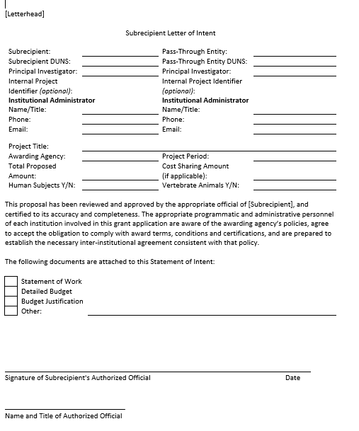

Slide 16
Financial Questionnaire
Available for Entities NOT subject to Single Audit
Series of questions to help assess Entity overall
Matches very closely with NSF Financial Management Systems Questionnaire:
General Information
Fiscal Responsibility and Internal Controls
Accounting System
Facilities & Administrative Costs
Cost Sharing
Funds Management
Personnel
Procurement
Property Management
Cost Transfers
Program Income
Smart Form Under Construction!

Slide 17

Cohort 1 Go-live Steps
DATE | ACTION
1/10/2016 | Proposal approved by Executive Committee!!
1/22/2016 | Entities Authorized Official approvals obtained
January 2016 | Instructions developed
2/10/2016 | Welcome Packets distributed
2/17 & 24 | Welcome Calls
3/1/2016 | Deadline for submission of Entity Profiles
Feb & March | Piloteers ready their institutions for Pilot Go-Live
3/28/2016 | Go-live for Pilot use of Entity Profiles
4/29/2016 | Gathered preliminary tracking info from Working Group members
6/30/2016 | End date of first official period for Pilot Tracking Forms

Slide 18

Cohort 1 Pilot Entities – “Piloteers”
40 FDP Member Institutions
Large Public & Private
Institutions of all sizes!
Emerging Research Institutions (ERI)
Wide range of total funding per Institution
53 Entity Profiles
Multiple campuses
Sub entities
Multiple DUNS #s

Slide 19
Cohort 1 Pilot Entities
Red = Beta Tester
Augusta University Research Institute
Brandeis University
Brown University
California Institute of Technology
Cedars-Sinai Health Systems
Dana-Farber Cancer Institute
Duke University
Florida State University
Georgia Institute of Technology
Harvard Medical School
Harvard T.H. Chan School of Public Health
Harvard University
Johns Hopkins University
Icahn School of Medicine at Mount Sinai
Institute for Systems Biology
Michigan Technological University
New York University, Washington Square Campus
Northern Illinois University
Northwestern University, Evanston Campus
Oregon Health & Science University
Partners HealthCare
Brigham and Women’s Hospital
Massachusetts General Hospital
McLean Hospital
Purdue University
Syracuse University
Tufts University
University of Alabama
University of Alabama, Huntsville
University of Arkansas for Medical Sciences
University of Cincinnati
University of Florida
University of Kansas
University of Miami
University of Minnesota
University of South Alabama
University of Tennessee, Knoxville
University of Tennessee Health Sciences Center
University of Texas Medical Branch at Galveston
University of Texas at Austin
University of Washington
University of Wisconsin
Vanderbilt University
Washington University
Wayne State University

Slide 20
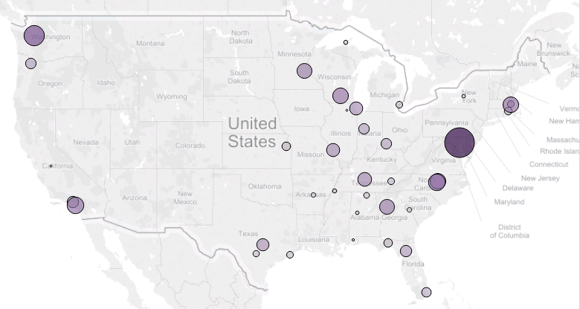
Cohort 1 Pilot Entity - Distribution

Slide 21
Cohort 1 – Survey & Tracking
Assess Roll-Out – very high satisfaction rating!
Utilized feedback for Cohort 2 rollout
Baseline for Potential Time Saved
Hours to gather data & complete Entity Profile – 67% <2 hrs
Average estimated hours as a PTE to disseminate & review subrecipient commitment forms – 80% < 2hrs
Average estimated hours as a subrecipient to complete subrecipient commitment forms – 87% < 2hrs
Quarter 1: 3/28/16 – 6/30/16. Deadline 7/15/16
Compilation and analysis in process currently
Results planned to be shared at Sept FDP Meeting, and on Pilot webpage

Slide 22
Cohort 2 Go-live Steps
DATE | ACTION
5/3/2016 | Call for volunteers for Cohort 2 sent to FDP main email list
Week of 5/16 | Call to Entities recommended by Working Group for Cohort 2
6/3/2016 | Email sent to Cohort 2 volunteers re: obtaining Authorized Approval
6/17/2016 | Entities Authorized Official approvals due
7/6/2016 | Welcome Packets distributed via email
7/14 & 7/22 | Welcome Calls
7/29/2016 | Deadline for submission of Entity Profiles
July / Aug | Piloteers ready their institutions for Pilot Go-Live
8/15/2016 | TENTATIVE Go-live for Pilot use of Entity Profiles
9/30/2016 | Tentative End date of first official period for Pilot Tracking Forms

Slide 23
Cohort 2 Pilot Entities
Arizona State University
Case Western Reserve University
Clemson University
Colorado State University
Cornell University
Emory University
Florida A&M University (ERI)
Florida International University
Indiana University-Bloomington
Indiana University-Purdue University, Indianapolis
Iowa State University
Massachusetts Institute of Technology
Medical University of South Carolina
Nevada System of Higher Education
University of Nevada, Las Vegas
University of Nevada, Reno
New York University School of Medicine
North Carolina State University
Northeastern University
Pennsylvania State University
The Pennsylvania State University, College of Medicine
Research Foundation for the State University of New York
Alfred State College
Binghamton University
Buffalo State College
College at Old Westbury
College of Optometry
Empire State College
Purchase College
SUNY Brockport
SUNY College of Environmental Science and Forestry (ESF)
SUNY Cortland
SUNY Delhi
SUNY Downstate Medical Center
SUNY Geneseo
SUNY New Paltz
SUNY Oneonta
SUNY Oswego
SUNY Plattsburgh
SUNY Polytechnic Institute
SUNY Potsdam
State University Ag/Tech/Cobleskill
State University College at Fredonia
State University Maritime College
Stony Brook University
University at Albany
University at Buffalo
Upstate Medical Center

Slide 24
Cohort 2 Pilot Entities
Rockefeller University
Stanford University
Texas Tech University
University of Alabama, Birmingham
University of California
University of California, Berkeley
University of California, Davis
University of California, Irvine
University of California, Los Angeles
University of California, Riverside
University of California, San Francisco
University of Central Florida
University of Colorado, Boulder
University of Hawaii
University of Idaho
University of Illinois, Chicago
University of Kentucky
University of Maryland, Baltimore
University of Maryland, College Park
University of Massachusetts, Medical School
University of Michigan
University of Missouri
University of Nebraska-Lincoln
University of North Carolina, Chapel Hill
University of Notre Dame
University of Rochester
University of Texas Health Science Center at San Antonio
University of Texas at Dallas (ERI)
Yale University

Slide 25
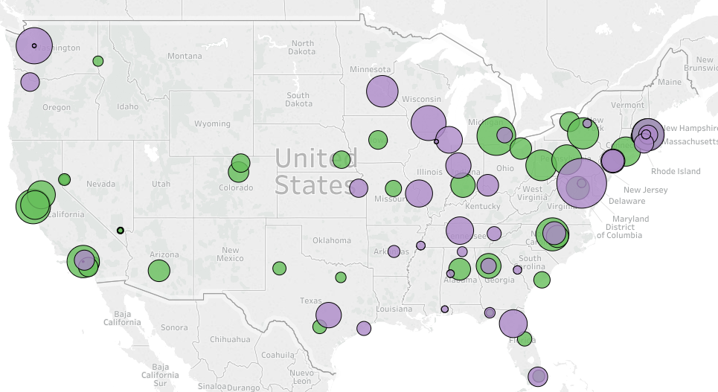

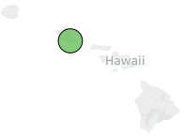
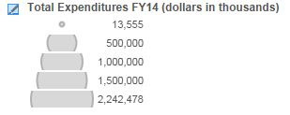
Pilot Entity – Cohort 1 & 2 Coverage

Slide 26
Phase 2 – Web Based System
Vanderbilt volunteered to build!
4/18/2016 – Exploratory Meeting
6/9/2016 – submission of Proposal
6/16/2016 – FDP Executive Committee approved
Development is currently active!!!!
Demo of initial development – 9/22 FDP Meeting
FDP Clearinghouse domain name/ Hosted cloud based dev
System Dev Working Group
Vanderbilt developers – Chris Renner and Bryce Embry
Lead of FDP eRA committee – Mark Sweet
FDP Executive Director – David Wright
Content Dev/Review Subgroup – Robert Prentiss, Courtney Swaney, Jennifer Rodis, Lulu Sun, Lynette Arias

Slide 27
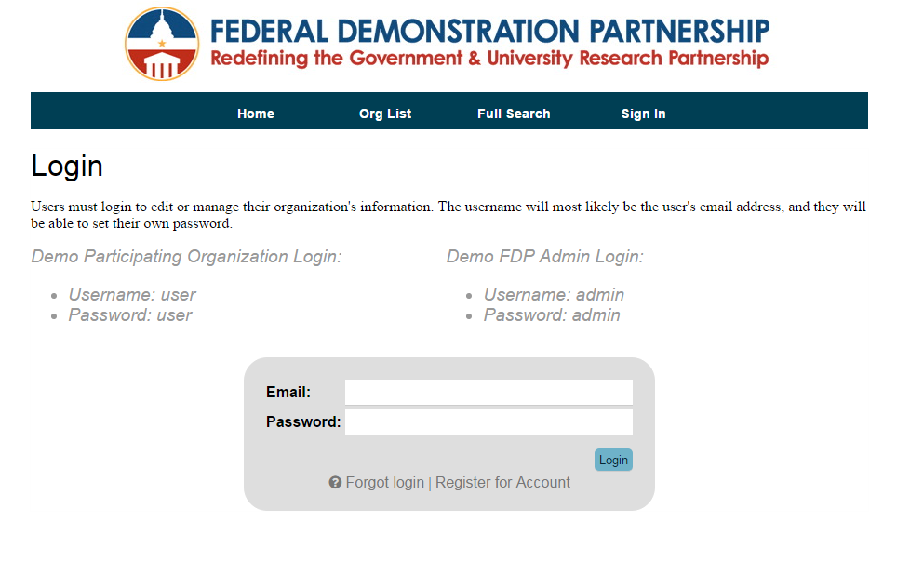
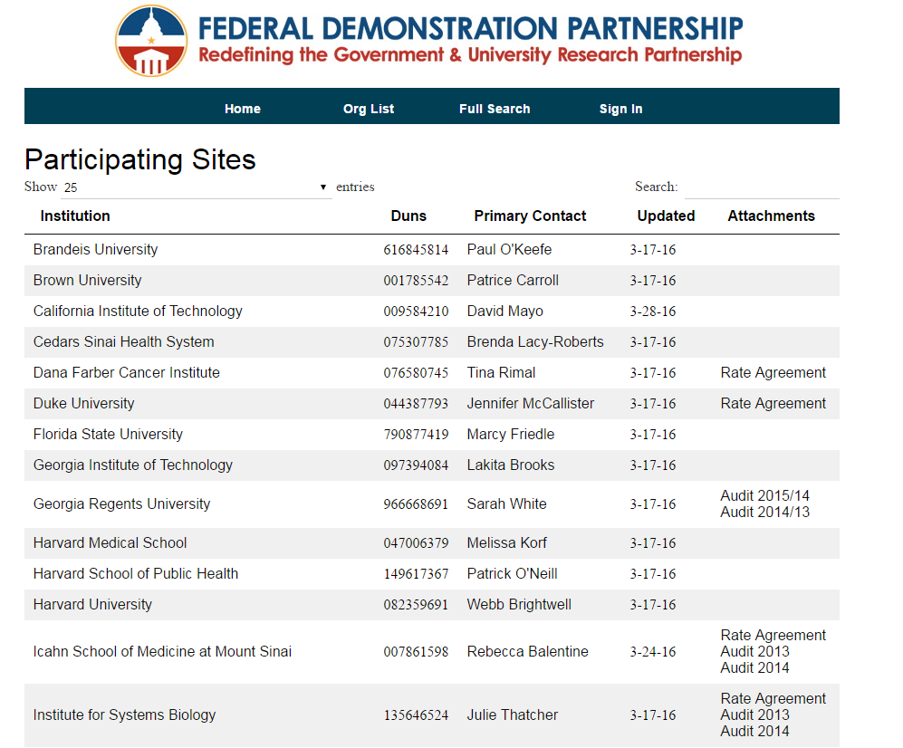

Slide 28
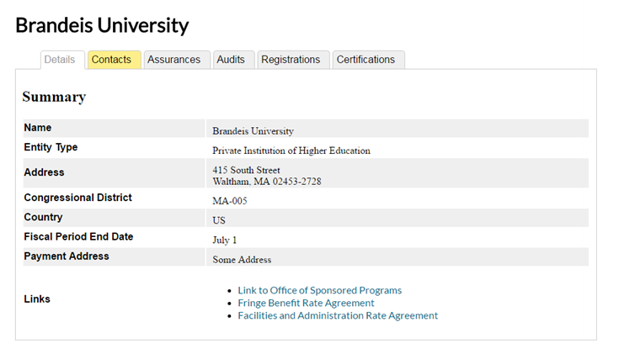
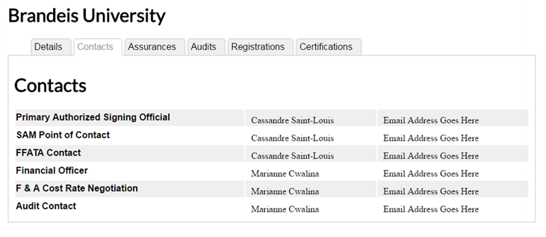

Slide 29
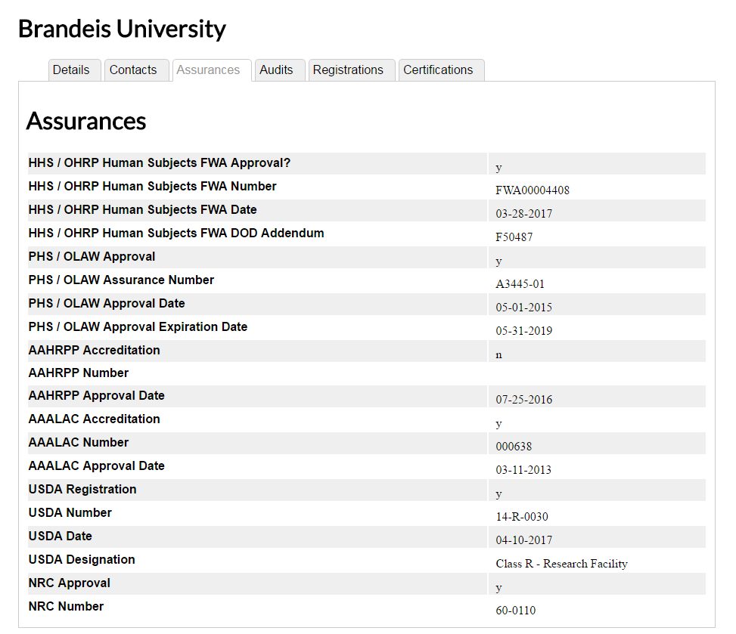
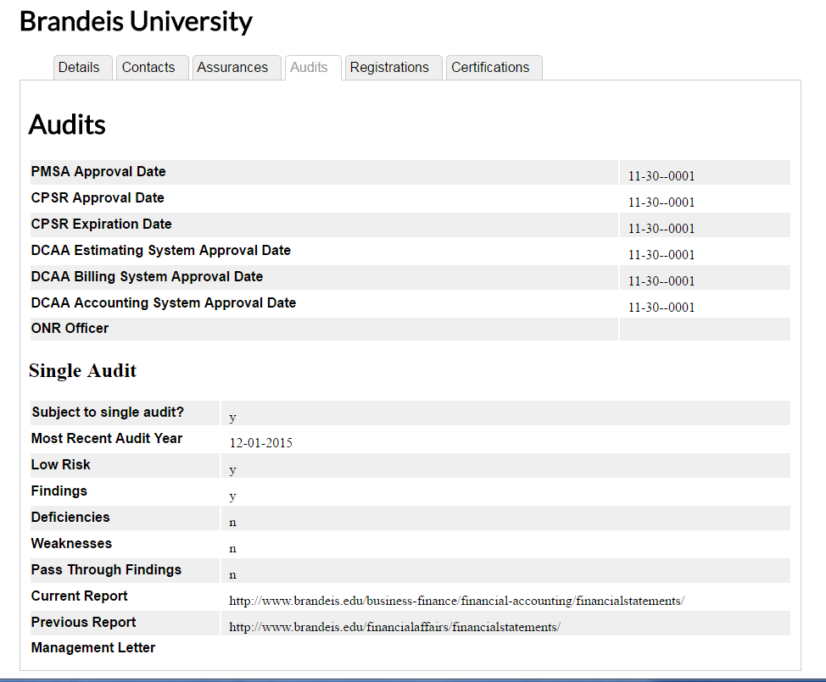

Slide 30
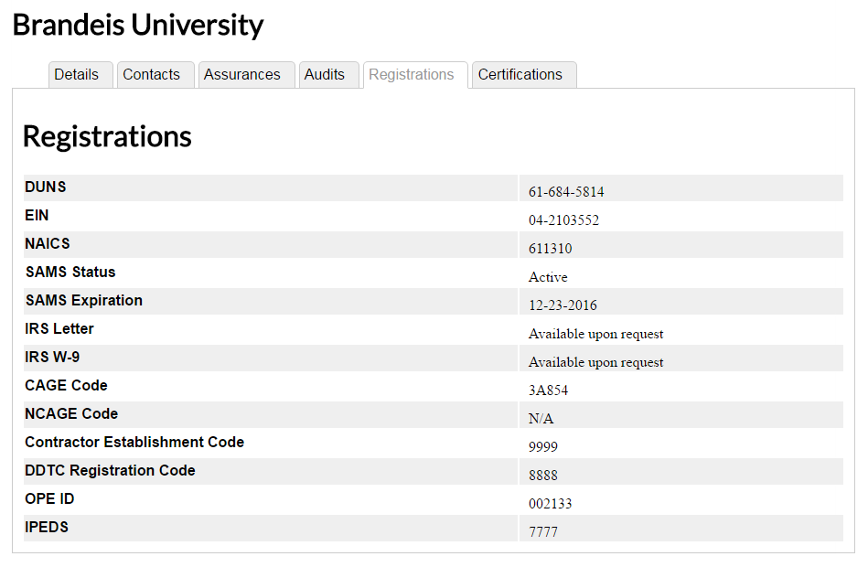
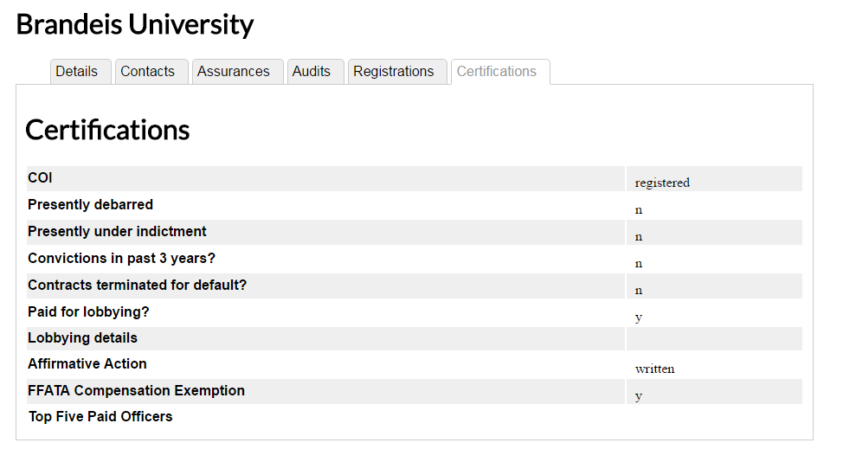

Slide 31
Additional information
These are all the “output” pages
Also data entry forms, with validation and dropdown lists for standard consistent options
Will pull data from other systems, as feasible (SAM)
Will notify POC of expired information
Users will sign business use agreement
User access management structure
Output / data / reports
Cohort 1 & 2 data will be converted into new system

Slide 32
Pilot Estimated Timeline
Phase 1 Proposal approved by FDP Executive Committee
1/10/2016
Official State Date of Pilot
2/1/2016
Estimated End Date of Pilot
Phase 2 - Web Based System Proposal approved by FDP Executive Committee
6/16/2016
6/30/2017
2015
Jan
Apr
Jul
Oct
2016
Apr
Jul
Oct
2017
Apr
2017
1/8/2015
9/1/2015
Today
8/15/2016
1/16/2017
Expanded Clearinghouse Working Group gathers again
Forms Data Collection/Analysis completed
Cohort 2 Go-Live
Cohort 3 Go-Live (???)
3/28/2016
12/2/2016
Cohort 1 Go-Live
System user acceptance testing
9/22/2016
Web based system initial dev demo at Sept FDP Meeting
12/18/2015
Entity Profile developed & Beta tested

Slide 33
How can you all be involved?
Anyone can currently access and use the Entity Profiles!!
81 FDP Members will be involved – 128 individual Entity Profiles – after Cohort 2 Go-live, est 8/15/16
We encourage you to do so and add to your processes for entity review / risk assessment
Questions/feedback – be sure to let us know!
We learn new things every day ☺
http://sites.nationalacademies.org/PGA/fdp/PGA_171219

Slide 34
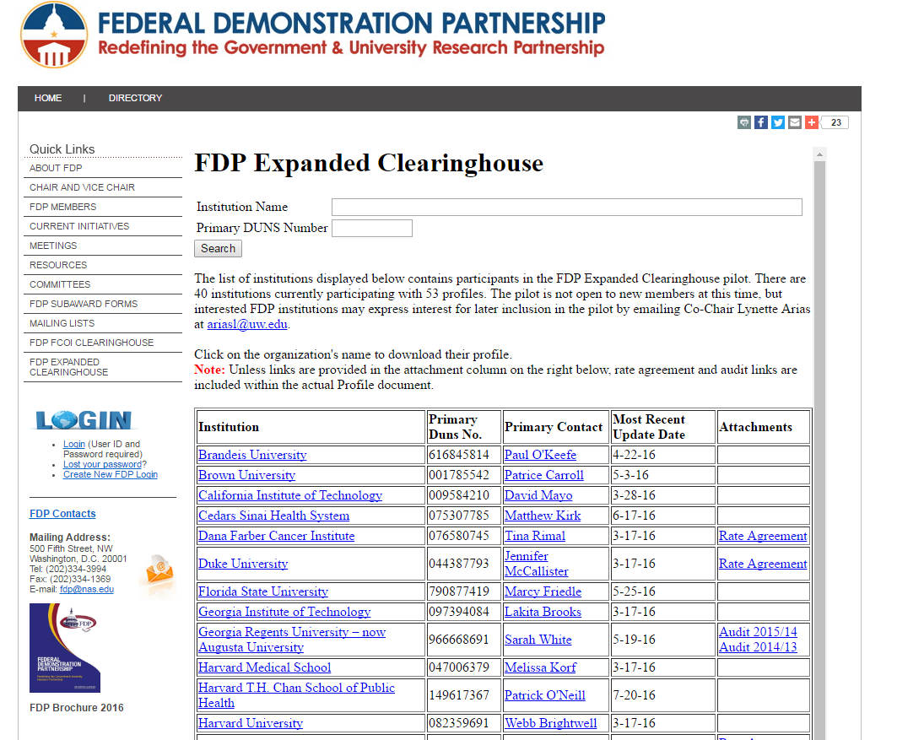

Slide 35
How can you all be involved?
Opportunities to join in the future?
If you are with FDP member institution – but not part of Cohort 1 or 2 – gather support at your institution!
For possible Cohort 3 addition in 2017
If institution not interested in joining – why not? Let us know so we can help make changes, if feasible, that would help!
If all goes well with Pilot and web based system could be recommended for non FDP institutions
Keep an eye on what we are up to! ☺
FDP Expanded Clearinghouse Webpage
http://sites.nationalacademies.org/PGA/fdp/PGA_055835
Everything we are working on is kept here! We are fully transparent!

Slide 36


Great Team!
WORKGROUP MEMBERS
Lynette Arias (Co-Chair) | University of Washington
Jennifer Barron (Co-Chair) | Johns Hopkins University
Pamela Webb (Co-Chair) | University of Minnesota
Patrice Carroll | Brown University
Marcy Friedle | Florida State University
Rebecca Balentine | Icahn School of Medicine at Mount Sinai
Julie Thatcher | Institute for Systems Biology (ERI)
Amanda Hamaker | Purdue University
Gloria Greene/ Steve Parker | University of Alabama
Jennifer Rodis | University of Wisconsin-Madison
Sara Clough | UT Austin
Courtney Swaney | UT Austin
Robert Prentiss | UT Austin
Tyra Patrice Darville-Layne | Northwestern University
Christopher Renner | Vanderbilt University
Lulu Sun
UW Work study student

Slide 37

Questions & Discussion

Slide 38



Contact Info
Lynette Arias
University of Washington
ariasl@uw.edu
Pamela Webb
University of Minnesota
pwebb@umn.edu
Jennifer Barron
Johns Hopkins University
jlb@jhu.edu

