Slide 1
Managing and Sharing your PEER Data and Publications
Meeting and exceeding USAID's Public Access Plan
Notes:
Hello! In this presentation we are going to provide guidance on managing and sharing your PEER data and publications. It also an opportunity for you to provide us input and ask questions.
Before we start, be aware that the slides will be posted afterwards, along with the webinar recording.
Additionally, if you have questions, please click the chat box arrow to maximize the window and type questions in the chat box. We will answer questions at the end. These questions will be initially visible only to panelists.
==
Image from https://datascience.nih.gov/sites/default/files/data-for-good2.jpg

Slide 2
Public Access to Research
USAID research programs strive to:
Support best practices for managing publications and scientific research data
Increase public access to results of scientific research
Facilitate the use of research
Why? To enhance scientific discovery and improve development outcomes
Notes:
USAID research programs, like PEER, are committed to increasing access to scientific research so that we can solve development challenges, and solve them better, faster, and with less resources. As part of this goal, PEER
Support best practices for managing publications and scientific research data
Increase public access to results of scientific research
Facilitate the use of research
USAID has a public access plan that lays this out. The Public Access Plan is a guide for managing research outputs that applies to all USAID-supported projects.

Slide 3
Pathway for Data and Publications
Research data
Metadata
Research publications
Data
Metadata
Metadata
Structured data
Unstructured data
Sector-specific repository
USAID’s Development Data Library (DDL)
USAID’s Development Experience Clearinghouse (DEC)
Notes:
This diagram shows the path for your PEER data and publications. On the left you’ll see the data pathway, and on the right the publication pathway.
PEER projects produce many types of data, in structured and unstructured formats. Structured data can be presented in a spreadsheet with rows and columns. Unstructured data includes everything else, for example images or recordings of bird calls. All of these data need to be properly stored and shared, along with metadata that identifies what information is stored, why, and how.
PEER data that is structured should be put in a repository. A repository is a data library. You can put your data on a sector specific repository or you can store your data in USAID’s Development Data Library, called the DDL. If you put it on a sector specific repository you will need to link it to the DDL at the end of your project.
Your peer-reviewed publications, plus unstructured data, should be uploaded to USAID’s publication library called the DEC. We expect PEER projects to put at least one publication here.
We will have a seperate webinar that provides guidelines for managing your PEER publications when your research projects are closer to completion.

Slide 4
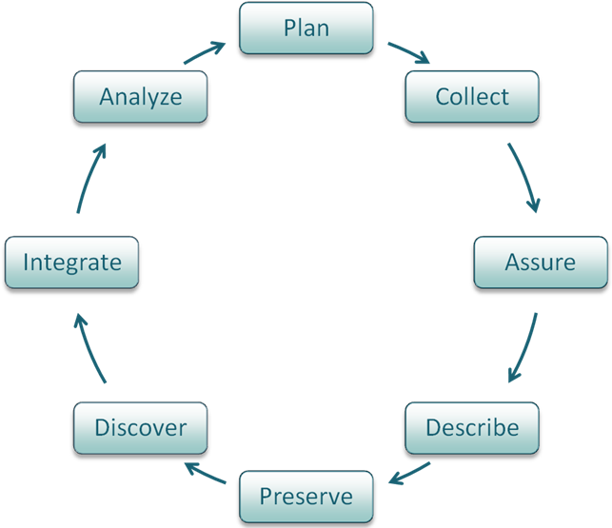
Data Management
Manage data responsibly throughout lifecycle
Produce high-quality, usable data
Include necessary information for reuse
Protect data and make sure you get credit
Notes:
We want PEER scientists to be awesome research data managers and take great care of the data that they produce under USAID awards. The end result of taking great care of that data is sharing the data, and getting credit for all this great work.
When we talk about data management, we are really talking about managing data responsibly throughout its lifecycle – from collection, to analysis, to curation in a repository. We do this to ensure that the project is collecting high-quality, understandable data that include all the necessary information to re-use. This can’t just happen at the end of a project, because you might not have been saving information as you go if you weren’t thinking about data management.
An example of poor data management happened to me in graduate school, where I was supposed to validate computer simulation results from someone who had graduated a few years before. All of their data was saved on about 200 DVDs. They were labeled with short descriptions and dates but had no clear order and no document with more details, where the base code was, or how to read the data on the discs. I had to manually put each one in a computer to see if they had what I needed and it wasted a lot of time.
If they had saved that data with an explanation of how the data was produced, including the code used for each run and how the data output was structured, it would have been much more valuable to me and other researchers working in that field. These are things that you will think about when you create a data management plan for your PEER project, which we will talk about later in this presentation.
==
Image from http://training.dasish.eu/export/sites/dasish/training/1/img/fig1-1.PNG

Slide 5
Sharing Research Data
Goal
Open Data is the idea that data should be freely available for everyone to use whenever possible
Makes science more efficient and more adaptive - faster learning from project results across wider audiences
Preserve access to your data with a persistent identifier
Research context
Public Access mandates mean that research funded by the US government should be accessible
The data is the research product, not the journal article
Many repositories exist for housing data in perpetuity
Notes:
You might have heard about open data. Open data is the idea that data should be freely available for everyone to view and to use. For scientists like us, this means freely sharing the data that we have collected during our research. Sharing our data makes science cheaper and more efficient. This is because if other researchers use the data that I have collected, they don’t have to spend their time and money to do work that I have already done. Instead, they can simply give me credit for collecting the data and use it to make new scientific advances.
Many funding agencies and publishers are now requiring data sharing in some way. Within USAID, the Public Access Plan covers data produced by research. In science, we often think that the final product of our research is the journal article that we produce. However, scientists are beginning to see the data as the research product, and the journal article is just one of many possible analyses of the data. This new recognition of the importance of data motivates us to share our raw data. Many repositories exist that can house data in perpetuity, and should have a persistent ID that doesn’t change, so people can easily find your data even after a website change for example.
We understand there are privacy concerns that need to be considered, however, which is why it says “whenever possible”. There are options for taking out information that identifies people and sensitive biodiversity or artifact locations. There are also options for embargoing your data for a period of time to protect that intellectual work. USAID is committed to helping you share your data in a way that is ethical.

Slide 6
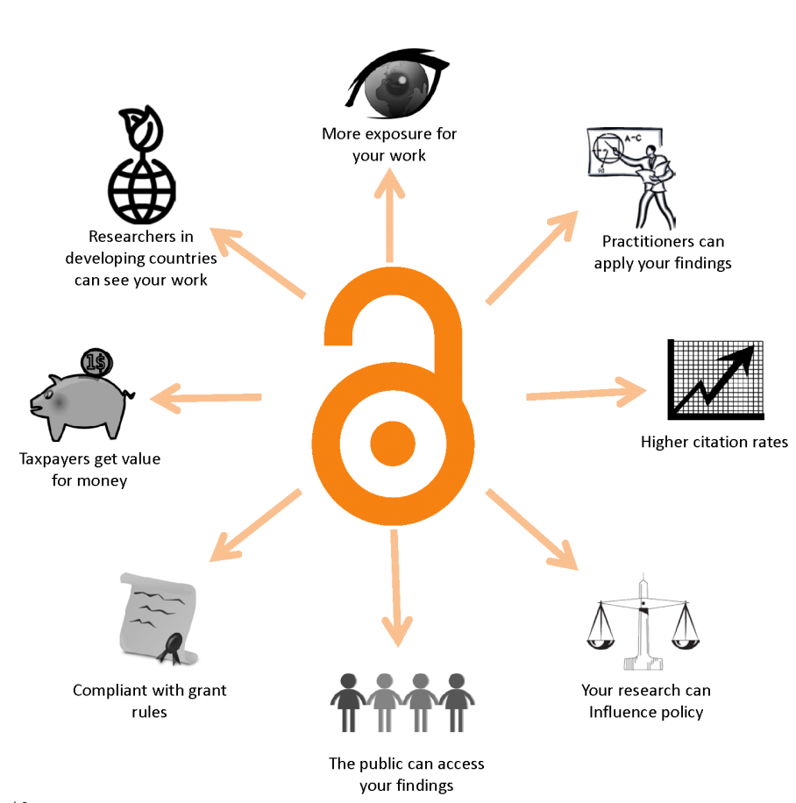
Sharing Research Data
How to share:
Release with journal article
Peer-reviewed data paper
Citizen science
Why share?
Notes:
There are many ways to share your data. Most scientists will upload their data once they have written a journal article. It is becoming a best practice to upload your data during the journal submission process and to share the data with the peer-review panel. Because you have nothing to hide and want to share, this makes your research look very strong to the peer reviewers.
It’s hard to know who else may want your data. There was a project recently that used samples taken from sooty feathers of old preserved birds in museum storage to see how air quality had changed over time. This helped build a historical record of atmospheric soot that they hadn’t had before, and will help improve historical models. (https://www.motherjones.com/environment/2017/10/scientists-are-using-135-years-worth-of-dead-birds-to-study-pollution/)
You can also share your data before writing the journal article by writing a “data paper” instead. A data paper does not analyse or interpret the data that you are sharing. It simply provides in-depth documentation on the data set itself and answers questions like: what data is in the data set? how was it collected? What steps did you take to make sure the data is high quality and accurate? What are the limitations of the data? And so on. This may be a dataset that will not get published for whatever reason, but may still have utility to other people.
Citizen science means there was some public participation in scientific research, and we’ll describe an example in a moment.
Unexpected research crossovers, more exposure, higher citation rates, and more value for these research dollars spent are all reasons you may want to share your research data.
==
Image from http://scilog.fwf.ac.at/content/uploads/2015/09/CC-BY-Danny-Kingsely-Sarah-Brown-e1442828235907.png

Slide 7
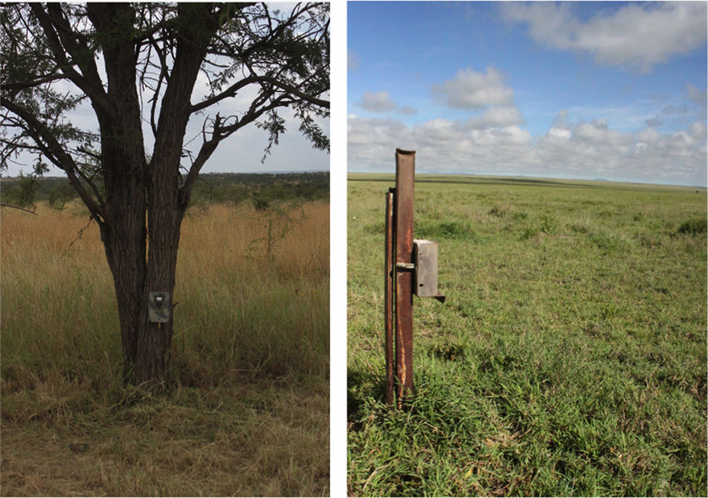
Example: Snapshot Serengeti
Motion activated cameras
Source: dx.doi.org/10.1038/sdata.2015.26
Notes:
Snapshot Serengeti is an example of Open Science data in action. Two early-career researchers deployed 225 motion-activated cameras across 1000 square kilometers in the Serengeti to study how animal species were changing over time. From 2010-2013, the cameras collected millions of images.

Slide 8
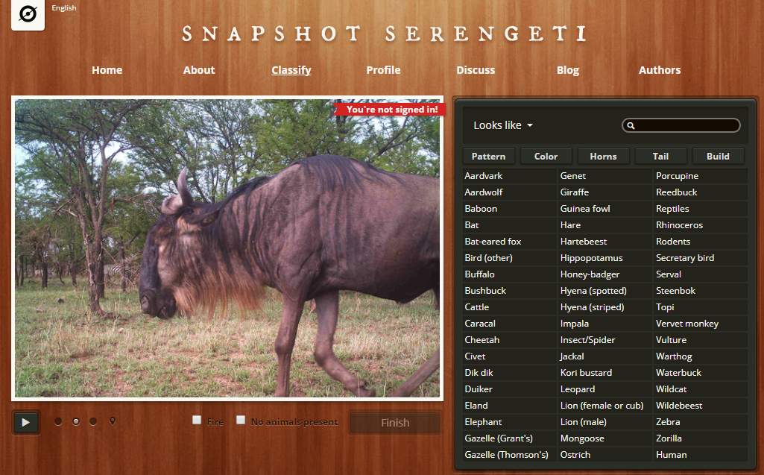
Example: Snapshot Serengeti
Source: www.snapshotserengeti.org
Notes:
It would be impossible for the researchers to look through every image to identify the number and species of animals present in the images. So they opened their data to the public through a citizen science website and let non-scientists classify the contents of the images. The non-scientists correctly identified the animal species in the images 96.6% of the time -- pretty good!
http://ecologybits.com/index.php/2016/06/15/open-data-authorship-and-the-early-career-scientist/
https://www.nature.com/articles/sdata201526
http://datadryad.org/resource/doi:10.5061/dryad.5pt92

Slide 9
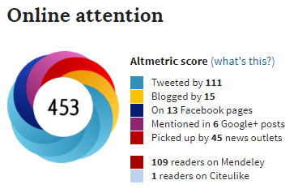
Example: Snapshot Serengeti
One of the most popular articles from 2015 on Altmetric
Notes:
The classified images were then published openly along with a data paper in the journal Nature. Through the citizen science website and releasing their research data, their work has been highly visible. Not only are other ecologists using their data, but so are scientists in computer science and education. In only two years, their data set has already been downloaded hundreds of times, and the paper has been cited in the literature 17 times. Here we show their Altmetric score, which measures engagement outside of the scientific literature, and their paper was one of the most popular scientific articles of 2015 - and it is simply documentation of a data set that they are freely sharing! You can contribute to the conversation around your paper too by including the full publication URL in your tweets and blog posts.

Slide 10
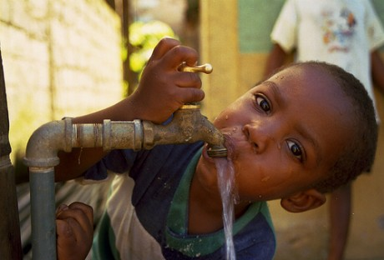
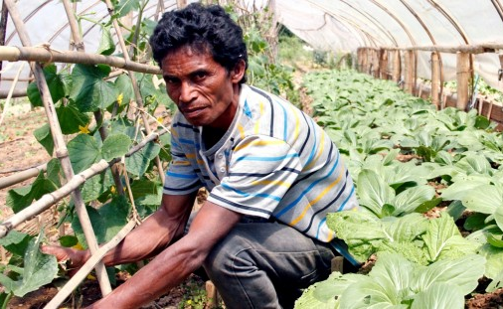
Importance for PEER
Prepare PEER awardees for latest academic research trends
Increase the visibility of research of PEER Principal Investigators
Expand networks and enable new opportunities for funding
Notes:
We want to help PEER principal investigators be leading 21st century researchers.
Expertly managing and sharing data enables new analysis and scientific discoveries. It will also increase your profile and visibility as a scientist. This helps in getting new funding to continue your research.
The data you gather and the results you generate have the potential to do amazing things. Your work can help save endangered species, deliver clean water, improve farming practices, make your country more resilient to natural disasters, or make any number of other important contributions. You can help your community by making your data easily available, promoting your work, and helping other researchers and government officials understand what you’ve done. This will increase the chance that your work will be used to solve the development challenges that we are all so passionate about.
==
Images:
By International Rhino Foundation - Ratu and Andatu Day 4Uploaded by FunkMonk, CC BY 2.0, https://commons.wikimedia.org/w/index.php?curid=26777793
https://blog.usaid.gov/wp-content/uploads/2013/05/water-460x312.jpg
https://www.usaid.gov/sites/default/files/styles/banner_738x311/public/Timor%20Leste_2013-07-26-Alberto-Martins%20E_0.jpg?itok=zJ0Qkv7r
https://www.usaid.gov/sites/default/files/styles/home_carousel/public/carousel/usaid-volcano.jpg?itok=vG4tlLyi

Slide 11
PEER Award Agreement
Article VIII - Data Rights and Publications
(a) All data, written materials, photographs, drawings, or other information created or generated under this Subaward (the "Subject Data"), and the copyrights therein in all media and languages throughout the world will be irrevocably assigned to and owned by Subawardee. NAS and the U.S. Government shall have an irrevocable, transferable, royalty-free, non-exclusive worldwide license in all media and languages now or hereafter known to reproduce, disseminate, publish, prepare derivative works in, or otherwise utilize all Subject Data, including without limitation, the right to authorize others to use and disseminate such Subject Data.
(b) Attribution: Subawardee shall cite in any published article that such article is derived from the Subject Data funded in whole or part by NAS and USAID under the USAID Prime Award Number AID-OAA-A-11-00012, and that any opinions, findings, conclusions, or recommendations expressed in such article are those of the authors alone, and do not necessarily reflect the views of USAID or NAS.
(c) Electronic Program Deliverables: Subawardee shall provide the Senior Program Officer with an electronic copy of all deliverables and any publications produced with project funds.
(d) Submission of Datasets to the Development Data Library: Subawardee shall submit data under this Subaward to the Development Data Library in accordance to Section M23 of the Standard Provisions for Non-U.S. Nongovernmental Organizations, Attachment C.
Notes:
So what does this mean for you as a PEER scientist? Excellent data management and open data are important aspects of the PEER program and are part of your PEER agreements.Here is what is in the agreement your institutions have signed. It’s long, but we'll help walk you through:
Essentially, you retain the rights to all your data and information, but USAID and NAS have the ability to use this information. This is in paragraph a.
Paragraph b is about how to acknowledge PEER in published articles. Please use the attribution phrase here in the acknowledgement sections of any publication you write that were funded by this grant. With proper acknowledgement of PEER, USAID can identify your publication more quickly as well as promote you and your work whenever it is cited or mentioned by others.
Paragraph C says that sharing electronic copies of publications and other research products are part of your PEER program deliverables. Completing annual reports are also part of your electronic program deliverables.
Finally, paragraph d talks about the submission of your datasets to a repository and USAID’s Development Data Library. This is one of the primary end results of your PEER project. If needed, you will be allowed to post your data privately, called an embargo, for up to one year after your award ends.

Slide 12
Data Management
for the PEER Program
Choose a repository for your data
Create a short data management plan
1st year
of your PEER project
Notes:
So what exactly does all of this mean for your PEER project? Let’s go through the process....
For the PEER program, there are 4 main elements of data management that we require. Following these steps will help you be good data managers and should enable you to share your data. It also ensures you comply with data and public access requirements in your terms of award.
Choose a place to put your data-- data repository
Create a basic data management plan-- there are resources later in this presentation to guide you through this.
We suggest you work with your US partner to select a data repository and create this data management plan. These are both things you should do in the first year of your PEER award. But you will keep updating the data management plan as the project progresses.

Slide 13
Data and Publication Sharing
for the PEER Program
Submit data to a repository and link to USAID’s Development Data Library (DDL)
Submit any publication author’s manuscripts to USAID’s document platform - the Development Experience Clearinghouse (DEC)
Year 2-3
of your PEER project
Notes:
As you analyze data and work on publications, you should be preparing your data to share. Each year you should also revisit your data management plan to make sure it is up to date. Sharing your research is the focus of step 3 and 4.
Step 3. When you publish, you should at the same time submit your data to a repository and USAID’s Data Library, called the DDL. The data can be embargoed, meaning stored privately, so that it does not become public before your paper is published.
Step 4. Then you should upload the publication to USAID’s document platform-- the Development Experience Clearinghouse (DEC). If you publish, which we assume each of you will do, at least one publication should be put on the USAID platform.
These two steps should be done before your project ends.
We will not talk in detail about steps 3 and 4 in this presentation. We will have a separate presentation on these two steps.
We will look in more detail at steps 1 and 2 now.

Slide 14
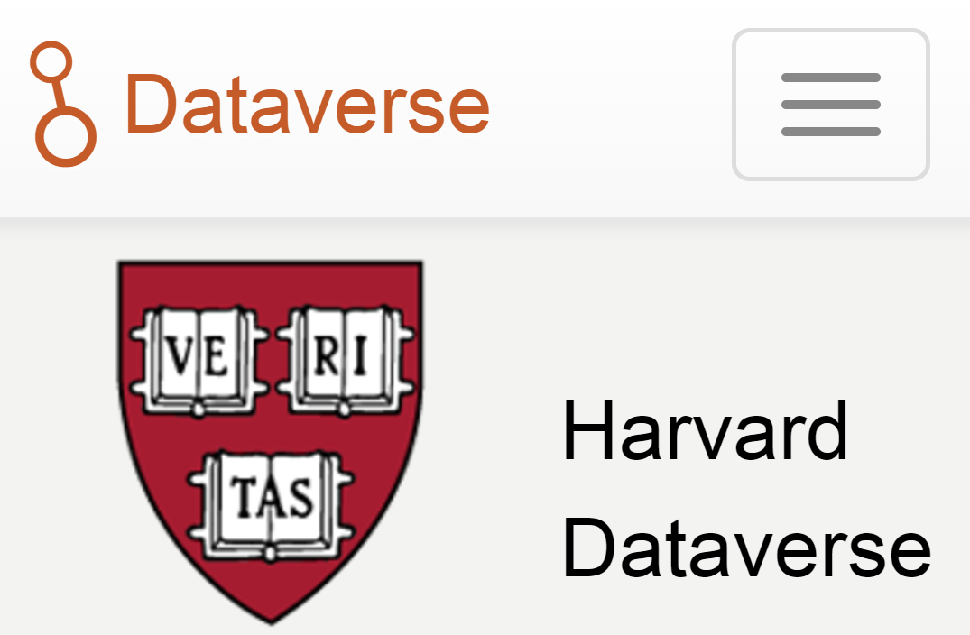
Step 1: Choose a Repository
Choose a data repository where your data will be seen
General Data:
dataverse.harvard.edu
General Data:
datadryad.org
Earth Science:
www.pangaea.de
Notes:
Let’s look in detail at Step 1: choosing a data repository.
A data repository is a professionally managed online resource where data sets are kept for long-term storage and sharing. They will have a website that a researcher can use to upload or download data. I encourage you to find a few data repositories that are relevant to your work--visit data repositories and search for data that is similar to your own. Here are 4 repositories that might be good places to start.
The USAID DDL is a good option for social science data, public health research, agricultural data.
Three other large and well-respected repositories include: Dryad, Pangaea, and the Harvard Dataverse. Dryad and the Harvard Dataverse accept almost all types of data. Pangaea is a well known repository for environmental and earth science.

Slide 15
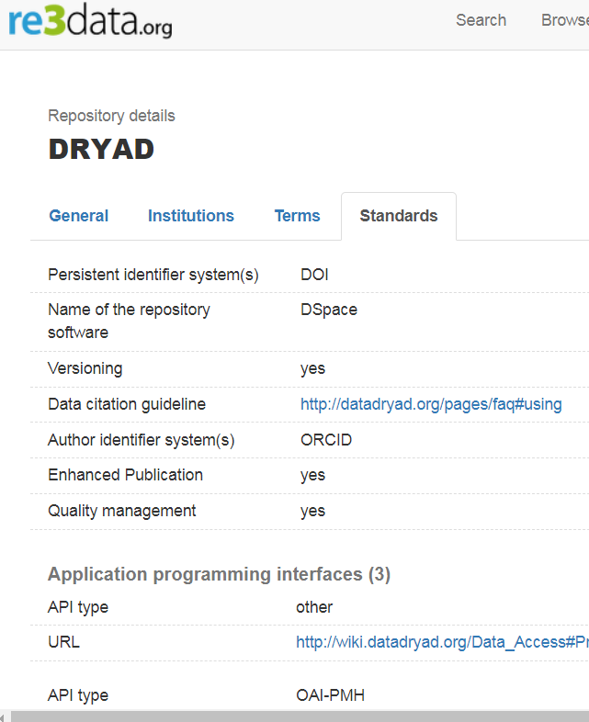
Step 1: Choose a Repository
How do I know if a repository is good?
Has a long term data management plan
Has a commitment to preserving your data or preservation plan (in mission statement or terms of service)
Provides a persistent identifier (ideally DOI) and a URL to the data
Has data citation guidelines to ensure you get credit for your work.
Makes data widely available and free for public use with clear licensing and use terms, CC-0 or CC-BY licenses recommended
Allows wide sharing of metadata
For further guidance, see the Development Data Overview
Notes:
I just shared 4 repositories, but there are thousands, and even within a specific discipline there can be hundreds. So you might ask, how do I know if a repository is trustworthy?
Right now USAID does not have official guidance on repositories, but we can recommend what you should look for to make sure your data is safe and that you meet USAID and PEER data sharing requirements:
Check details about a repository, such as terms of service, citation guidelines, and persistent identifier system, you can go to a site like the Registry of Research Data Repositories (https://www.re3data.org/) to do this.
You can also browse recommended repositories provided by journals-- PLOs One, Nature, and Science all have lists. There are also repository certifications that you can look for. We’ll provide links to these at the end of the slideshow.
Okay let’s talk about exactly what you should look for. Here we have an example of the profile page for the repository Dryad in the re3 registry of research data repositories.
You can look at the terms of service and other info about the repository-- the repository should be able to demonstrate it’s sustainable, has a long term data management plan-- that the repository is not going to disappear tomorrow.
Then ask, does it provide me a persistent identifier (ideally DOI) and a persistent URL to the record? (And preferably a persistent URL to the data itself). This is essential for access to the data and essential for linking data to the DDL, a PEER requirement.
Check that it gives you an option for a data citation, we want you to get credit for your work.
You can see Dryad has both of these: a persistent identifier system and citation guidelines.
A few other things to look for:
Does the repository make data widely available and free? Does it have clear licensing and use terms? Those that encourage CC-0 or CC-BY are best -- CC- BY license lets others distribute, change, and build upon your work, even commercially, as long as they credit you for the original creation. CC-0 has no restrictions on use.
Here is a link to the PEER Development Data Overview that provides additional guidance on these topics.
Additional tips:
The repository must allow USAID to hold our own metadata record (allow wide-sharing of metadata) and (meta)data are registered or indexed in a searchable resource.
Ways to verify repository is good:
Check certified repositories, like coretrust seal- this is a newer certification so not everything will be here, but good place to start
Is it on PLOs one list, or meet those criteria?
Check Fairsharing.org

Slide 16
Step 1: Choose a Repository
A good opportunity to work with your US partner colleagues
Notes:
Remember that you can ask your US partner for help. They might already be doing Open Data and have advice that is specific to your academic field. Also ask colleagues at your university or research organization.
If your US partner or other colleagues in your field are not familiar with a particular repository, chances are it is not the best place for your data-- you want a repository known in your field so your data will be seen and you’ll get credit for your research.

Slide 17
Step 2: Data Management Plan
Draft a data management plan
1 or 2 page document:
how you will handle your data as it is collected
how you handle data after research project ends
Submitted with PEER year 1 annual report
Data management plan instructions
Notes:
A data management plan is a one or two page document that describes how you will handle your data as it is being collected and also after the research project ends.
This helps you to prepare for uploading your data. We encourage you to do this in partnership with your US partner if possible. Even if your US partner is not familiar with all these data management and open data concepts it can be a good opportunity for learning for everyone.
You will submit this with your PEER year 1 annual report. We will send you a data management plan template to fill out. We have created a step by step guide for completing this template-- your data management plan-- to help you. You will create this year one and update as your project progresses. Don’t worry if you are not sure of everything at this time, you can update the plan.

Slide 18
Step 2: Data Management Plan
The DMP in Foundant covers:
Types of data produced
Metadata
Data storage and preservation
Policies for access and sharing
It is a living document that you can update over life of project!
Notes:
The data management plan is a form you fill out in Foundant, similar to an annual report form.
You will answer data management questions in 4 different sections.
Types of Data Produced: What data will you generate through your research, and how will you safely handle it (particularly if there is human subject data). How will you ensure the data is high quality?
Metadata: This is about how your data will be documented and what file formats you will use. Metadata provides descriptive information (content, context, quality, structure, and accessibility) about a data product and enables others to search for and use the data product.
Data storage and preservation: This is where you select a repository and provide information about when you will start uploading data to the repository
Policies for access and sharing: Here you will answer questions about who is responsible for managing your data. You will note here if there are any ethical or privacy issues with sharing your data. You can also request an embargo to keep your data private for a certain amount of time. You will need to justify why this is important
Do not worry about understanding each of these topics fully now. There are instructions for completing each section, each question right in the Data Management Plan form in Foundant.

Slide 19
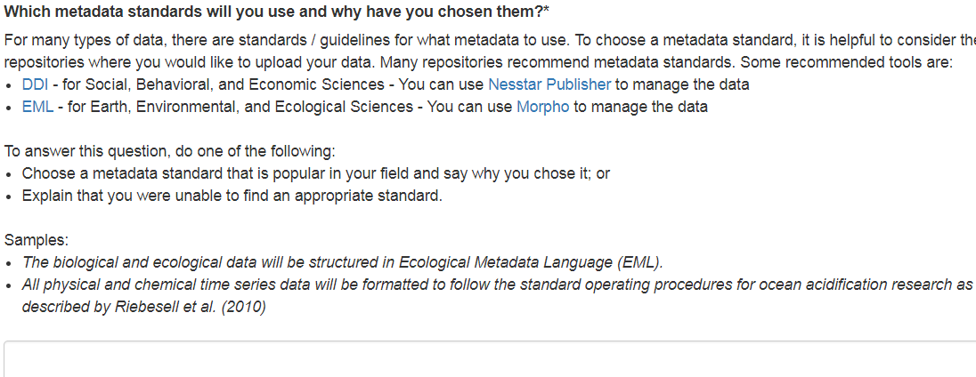
Step 2: Data Management Plan
Example Question: Metadata Standard
Notes:
As we noted, there are instructions for each question. For example, one question will ask you about metadata standards.
Below the question there are resources and links to help you learn more about metadata and guide you in choosing a metadata standard if you do not already have one selected.
Extra tips:
Use of an existing metadata standard is highly recommended. Recommended metadata standards include: Data Documentation Initiative (DDI) standard for Social, Behavioral, and Economic Sciences: http://www.ddialliance.org/ and Ecological Metadata Language (EML) for Earth, Environmental, and Ecological Sciences. https://knb.ecoinformatics.org/#external//emlparser/docs/index.html

Slide 20
Step 2: Data Management Plan
Ideally all data can be shared immediately, but this may not be possible in all cases
You will be asked to identify privacy concerns
May need to remove personally identifiable information (e.g. human subjects)
May need permission to share certain country data (e.g. water quality or river flow)
Data can be private for up to 12 months under embargo if data is sensitive or there are publishing concerns
Notes:
In order to share your data, you need to make sure that you have permission to do so. You may not be able to share all your data. If you are working with human subjects where privacy is a concern, then you will need to get permission. Data that includes names, addresses, birthdates, or house GPS coordinates may also qualify as sensitive, personally identifiable information.
In your country, other types of data might also need permission. For instance, water quality, river flow data, or agricultural data require permission in some countries. Precisely identifying the location of an endangered species may be risky as well. You can ask your relevant Ministry or Science Advisory Board if you need help.
You are an expert and probably already know the legal issues around your data, but it is best to be safe. The key is to think through these risks at the beginning of your project. As you create your data management plan is a good time to plan for this.
In other cases, you may have permission but not want to share your data right away. For example, you may want to wait until a paper is published. In these cases you can request an embargo, or a specified period of time during which your data will not be publicly available. For PEER projects, this can be up to 12 months after publication.
Other tips:
The best and easiest time to get permission is in the very beginning of the project. If you are told that sharing your data is not allowed, you still have time for conversations with the Ministry to hopefully reach a compromise. If you can develop a data sharing procedure with your Ministry, that will make it possible for other researchers in your field to share their data as well. You will be an open data pioneer!
===
Image: http://billystrean.com/wp-content/uploads/2012/01/permission.jpg

Slide 21
General Resources
PEER Data Management Webpage
Development Data Overview
E.g.: Metadata Standards, Persistent Identifiers, Data Anonymization, etc.
USAID’s Development Data Library (DDL)
USAID’s publication library, the Development Experience Clearinghouse (DEC)
Notes:
So that’s it for our introduction on managing and sharing PEER data. If you would like a bit more information, we have prepared several training documents. All of these can be found on the PEER data management webpage, the first link here.
The Development Data Overview document is a general training that will teach you some of the most important concepts for discussing your data. You will learn ideas such as metadata, metadata standards, persistent identifiers, and data anonymization.
You may want to start familiarizing yourself with USAID’s Development Data Library (the DDL) and the Development Experience Clearinghouse (DEC). The DDL is where you will register your data, and share the link to the repository it is housed on. The DEC is where you will upload publications. These are steps 3 and 4 of PEER data management and sharing and will be covered in depth in a webinar in year 2 and 3 of your project.

Slide 22
Repository Resources
Social science and public health research
USAID Development Data Library (DDL): https://www.usaid.gov/data
Inter-university Consortium for Political and Social Research (ICPSR) https://www.icpsr.umich.edu/icpsrweb/deposit/index.jsp
Natural Sciences:
http://www.sciencemag.org/authors/science-editorial-policies#data-deposition
https://www.nature.com/sdata/policies/repositories
Repository registries:
https://www.coretrustseal.org/why-certification/certified-repositories/
Registry of research data repositories https://www.re3data.org/
Fairsharing.org
Tips for selecting a data repository from PLOS ONE
Notes:
We have also put together some recommended repositories and resources:
For social science and public health research, we suggest using the USAID Development Data Library (DDL): https://www.usaid.gov/data or the Inter-university Consortium for Political and Social Research (ICPSR) (https://www.icpsr.umich.edu/icpsrweb/deposit/index.jsp) at the University of Michigan.
For other types of research, you can start looking at the lists of repositories that the journals Science and Nature have put together: http://www.sciencemag.org/authors/science-editorial-policies#data-deposition, and https://www.nature.com/sdata/policies/repositories. The data repositories are organized by scientific field, so it should be easy to find the ones that are of interest to you. Everyone should also look at the list of “generalist repositories”, because they might contain useful data as well.
For more information on repositories, including quality checks such as certification, terms of service, and persistent identifiers, check the last group of links.

Slide 23
Conclusion
In the 1st year of your PEER project, you will need to:
Choose a repository for your data
Create a short data management plan
Questions?
Notes:
So in conclusion you have two data tasks for year 1 of your PEER project: choosing a data repository and crating a short data management plan.
Now we will take questions. You can type your questions in the chat box and we will read them and discuss.
If you have any further questions about data, feel free to contact your Program Officer and they can direct you to a helpful resource. Thank you for your attention and have a great day!
(Again, the NAS data sharing website is at http://sites.nationalacademies.org/pga/peer/pga_185467)

Slide 24
Extra Slides

Slide 25
Example: Quakemap Nepal
Notes:
Let’s talk about the value of a set of open street maps of Nepal.
This is an example of data collected for one purpose, but other researchers were able to use it for something else, because of good data management.
in 2015, USAID partnered with Kathmandu Living Labs (KLL), a local NGO formed by university students in Nepal, to map the infrastructure of their city. This was before tragic earthquakes struck Nepal. The data was stored in a form that could easily be reused.
When the 7.8 and 7.3 magnitude quakes hit, USAID was able to upload timely and current mapping data onto GPS units of Disaster Assistance Response teams for search and rescue efforts throughout the damaged areas.
https://www.ushahidi.com/case-studies/quakemap

Slide 26
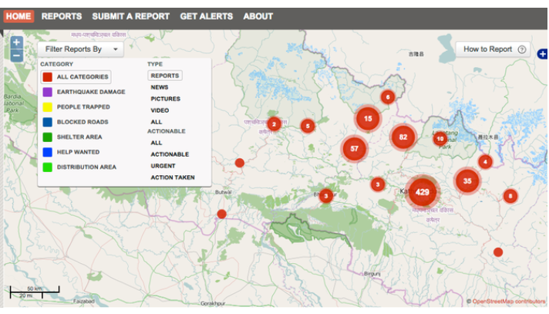
Example: Quakemap Nepal
Trustworthy, usable data unlocked rapid response to earthquake
Notes:
These maps showed where and what supplies or help were needed.
https://www.ushahidi.com/case-studies/quakemap

Slide 27
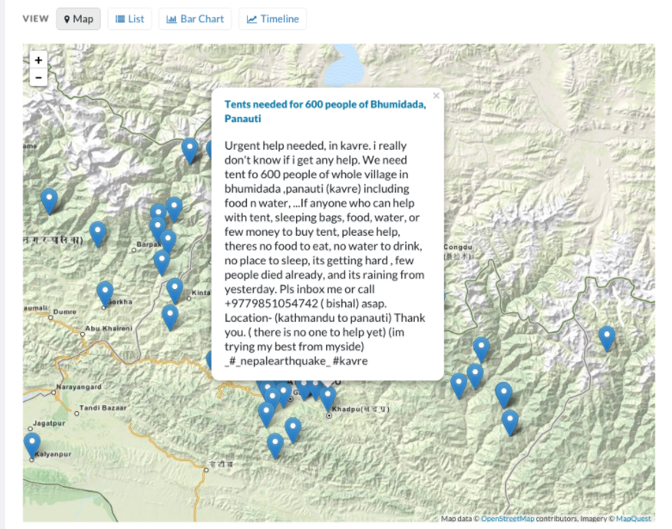
Example: Quakemap Nepal
Notes:
Users could also include requests for assistance. Organizations could then follow up to see that aid was actually delivered. In one case, 18 trekkers from a relief center were stranded between dangerous landslides in Dobhan. They were evacuated within 48 hours of receiving the report, and food supplies were distributed to more than 60 others living in the area.
For data to have this kind of positive impact, it must be trustworthy and usable. Programs and projects that plan for data management, and use data management best practices, have the capacity to efficiently and effectively curate, publish, and share their data and results. They are able to disseminate well-documented results and ensure that others can verify and re-use their work. They also can contribute directly to learning initiatives.
https://www.ushahidi.com/case-studies/quakemap

