Slide 1

SPACE STUDIES BOARD
Thomas H. Zurbuchen, Ph.D.
Associate Administrator
Science Mission Directorate
@Dr_ThomasZ
March 26, 2019

Slide 2
NASA Science Overview
SMD FY20 Budget Strategy & Highlights
Diversity and Inclusion Activities
Commercial Partnership Strategy

Slide 3
NASA Science Overview
SMD FY20 Budget Strategy & Highlights
Diversity and Inclusion Activities
Commercial Partnership Strategy

Slide 4
FY20 Budget Strategy
Advance National Science and Exploration Goals
Maintain a Balanced and Integrated Science Program
Execute Innovative Partnerships
Inspire Future Leaders

Slide 5

Advance National Science and Exploration Goals
FY20 Budget Highlights
Execute Lunar Discovery and Exploration Program to leverage commercial partnerships and innovative approaches to achieve human and science exploration goals
Enable Mars Sample Return mission, a Decadal Survey priority, leveraging international and commercial partnerships
Prepare for launch of James Webb Space Telescope, world’s premier space telescope

Slide 6

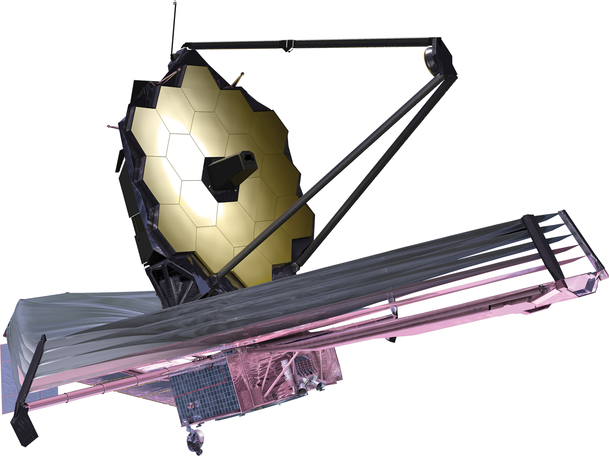
Maintain a Balanced and Integrated Science Program
FY20 Budget Highlights
Execute program informed by Decadal Surveys
Continue leveraging innovation and commercial partnerships, including SmallSats/CubeSats, rideshares and hosted payloads; invest in innovative early-stage research and technology to promote economic growth
Protect Astrophysics portfolio by prioritizing funding for competed astrophysics missions and research; fully fund Webb for launch in 2021; no funding for WFIRST
Support for Europa Clipper mission; no funding for Europa Lander
Execute a robust and innovative Earth Science portfolio; no funding for PACE or CLARREO-PF

Slide 7
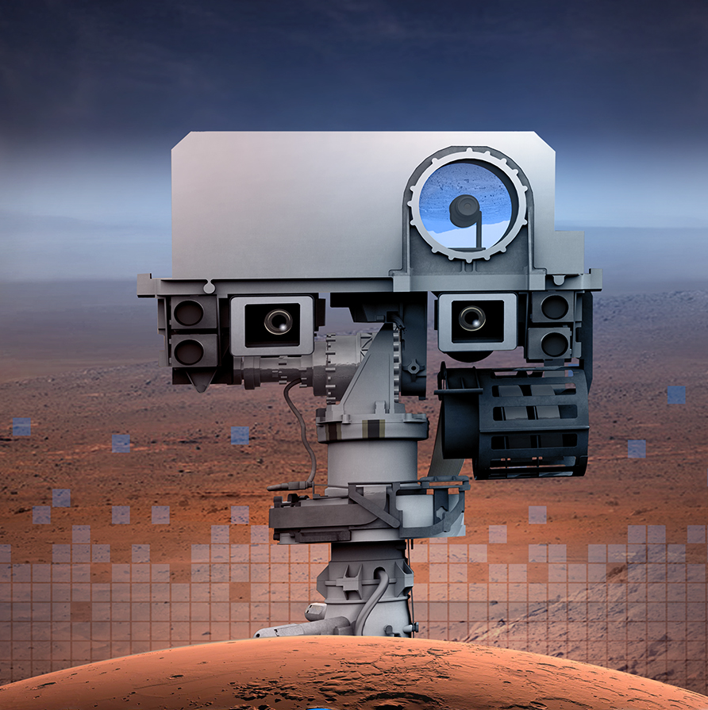
Execute Innovative Partnerships
FY20 Budget Highlights
Pursue science on potential future commercial lunar and Mars missions
Finalize multiple pilot contracts to purchase Earth observation products from existing private sector SmallSat constellations; for evaluation by NASA researchers
Leverage data and expertise through interagency partnerships to achieve missions; provide data and products to support operational agencies
Remain the preferred partner across the globe in all levels of experience, ~400 agreements, comprising nearly 60% of NASA international agreements
Enable science learners across the U.S. through over 200 community-based organizations

Slide 8

Inspiring Future Leaders
FY20 Budget Highlights
Achieve excellence by relying on diverse teams, both within and external to NASA, to most effectively perform SMD’s work
Attract and retain talent by promoting a culture that actively encourages diversity and inclusion and removes barriers to participation
Encourage development of future leaders, including the next generation of mission principal investigators, through targeted outreach and hands-on opportunities
Support early-career scientists to build careers working with NASA
Engage the general public in NASA Science, including opportunities for citizen scientists

Slide 9
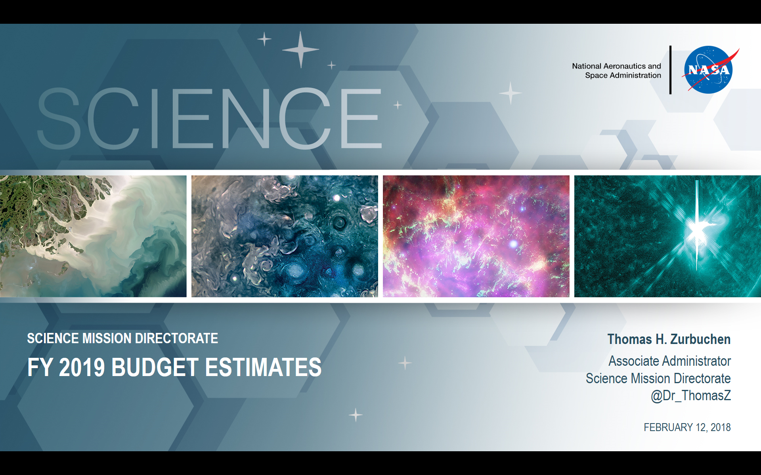
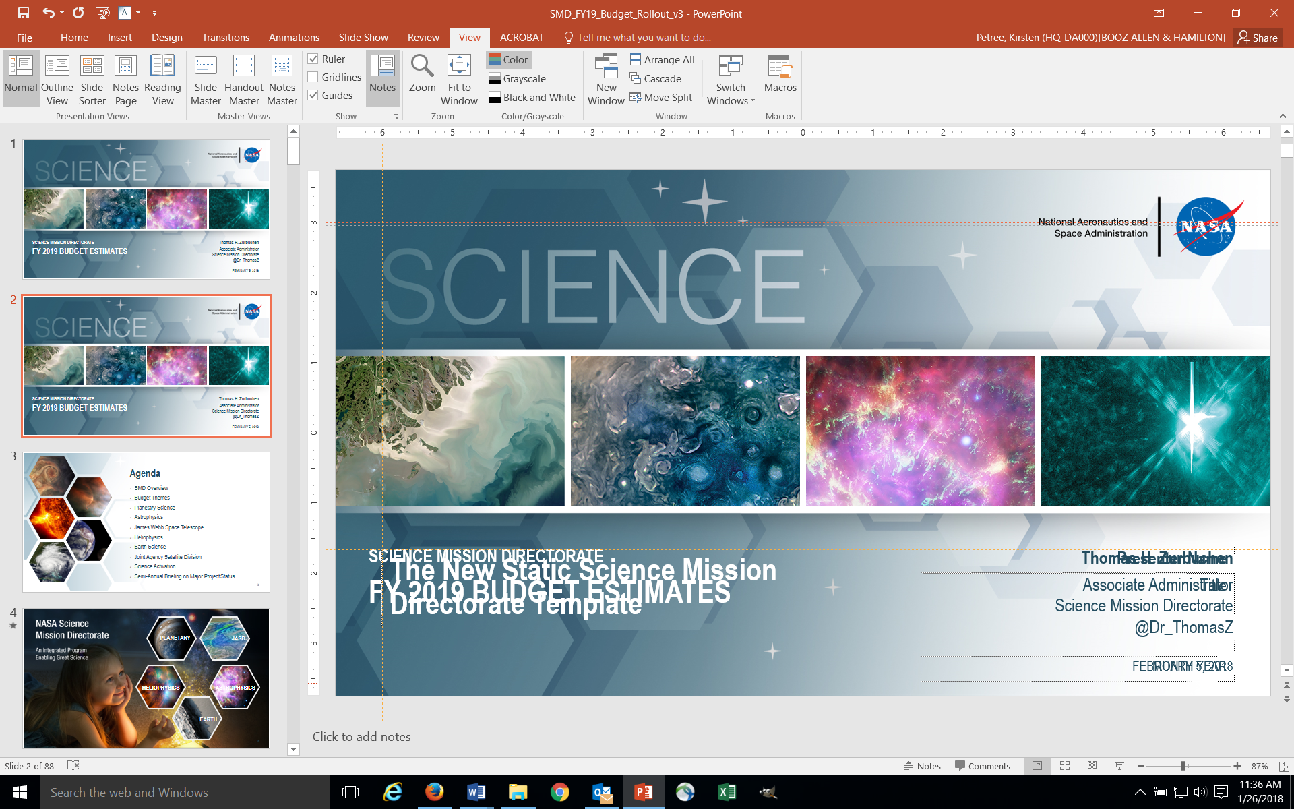
FY20 Budget
Program Highlights
Planetary Science
Astrophysics
Heliophysics
Earth Science
Lunar Discovery and Exploration program continues to grow commercial partnerships and innovative approaches to achieving science, technology demonstration and human exploration objectives
Enables Mars Sample Return launch as early as 2026
Accelerates launch readiness date for Europa Clipper to 2023
Accommodates Webb re-plan for 2021 launch
Maintains regular cadence of Astrophysics Explorers and Missions of Opportunity
Given its significant cost and competing priorities within NASA, provides no funding for WFIRST
Space Weather increase strengthens cross-agency collaboration on Research-to-Operations/Operations-to-Research
Provides for a balanced Heliophysics portfolio, including enhanced emphasis on small missions, technology development and expanded opportunities for R&A
Continues focused, balanced Earth science portfolio
Maintains regular cadence of Venture Class missions and instruments solicitations
Enables healthy research and applied science programs, and SmallSat/CubeSat investments

Slide 10
Science Budget Request Summary ($M)

Slide 11


Slide 12
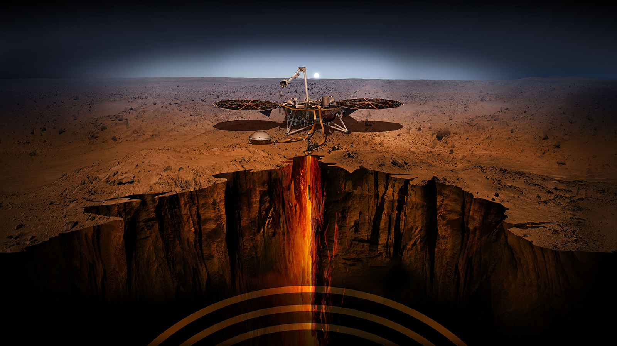

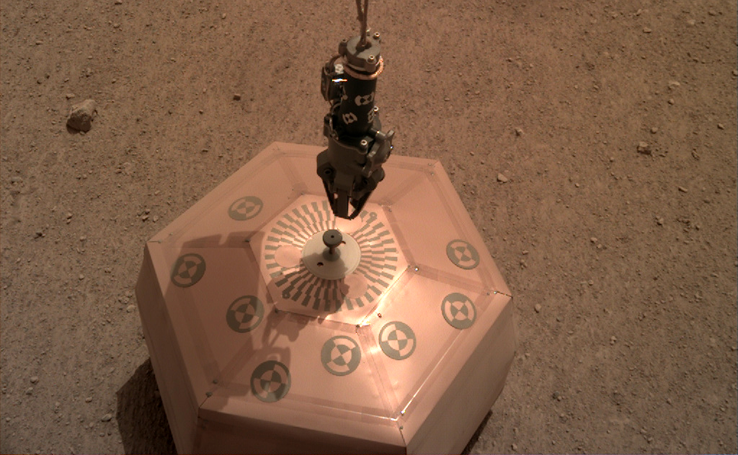
SCIENCE
HIGHLIGHT
Dec. 19, 2018 – InSight seismometer on Martian surface – first time a spacecraft robotically placed a seismometer onto surface of another planet
InSight
Taking the ‘Vital Signs’ of Mars

Slide 13
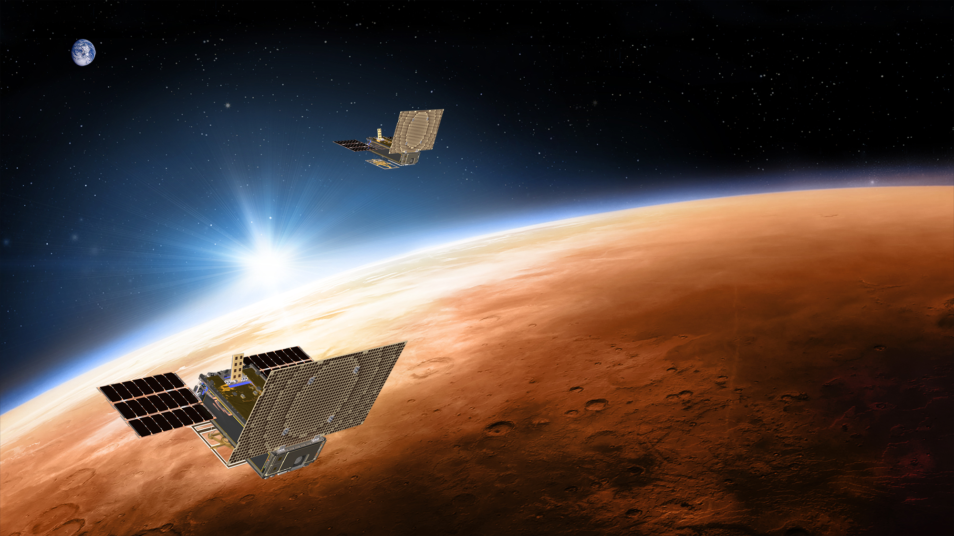
SCIENCE
HIGHLIGHT
MarCO
Mars Cube One
Nov. 26, 2018 - MarCO image of Mars from about 4,700 miles away during its flyby
13
13

Slide 14

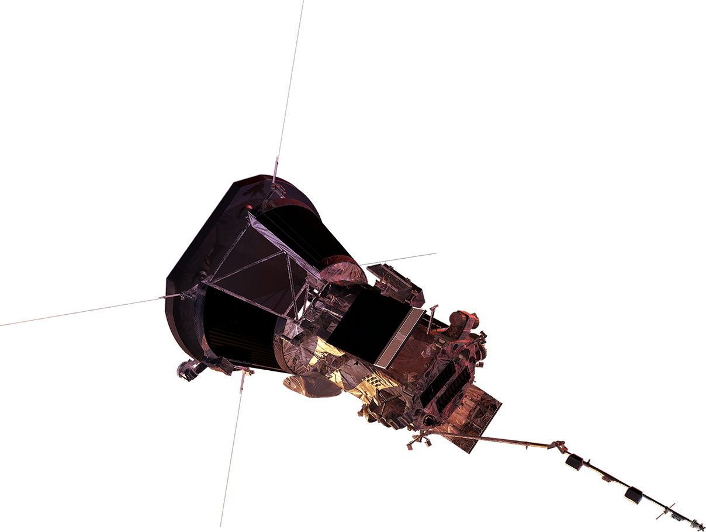
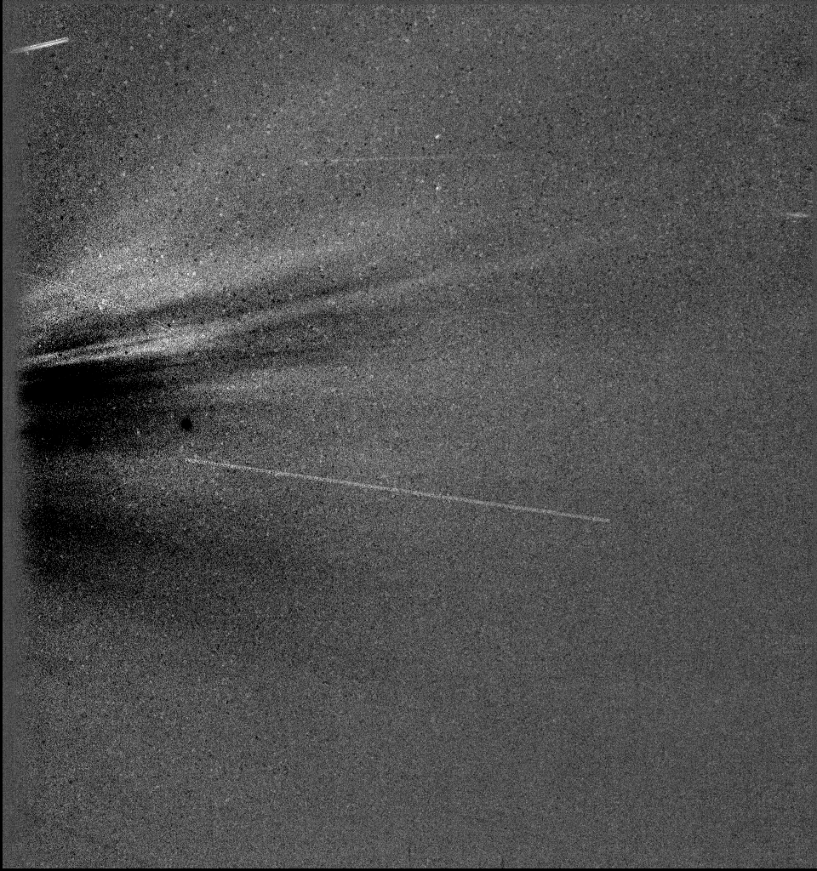
SCIENCE
HIGHLIGHT
Magnetic Flux Rope
Streamers
Cosmic Ray
(Energetic Particle)
Parker Solar Probe
A Mission to Touch the Sun
Nov. 6, 2018, 18:16 UT – Data from WISPR instrument on Parker Solar Probe during
first perihelion
14

Slide 15
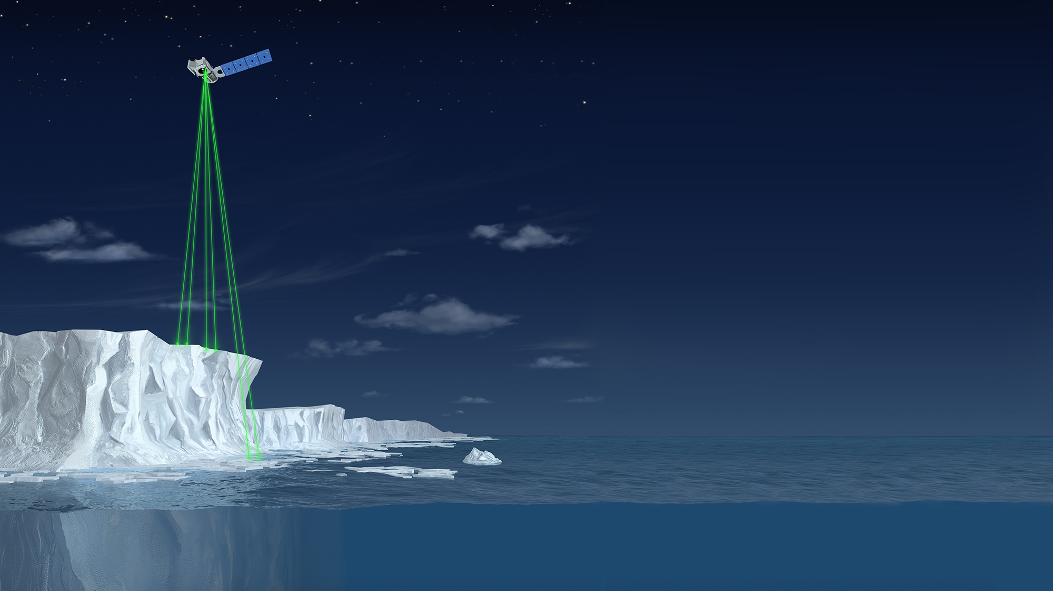
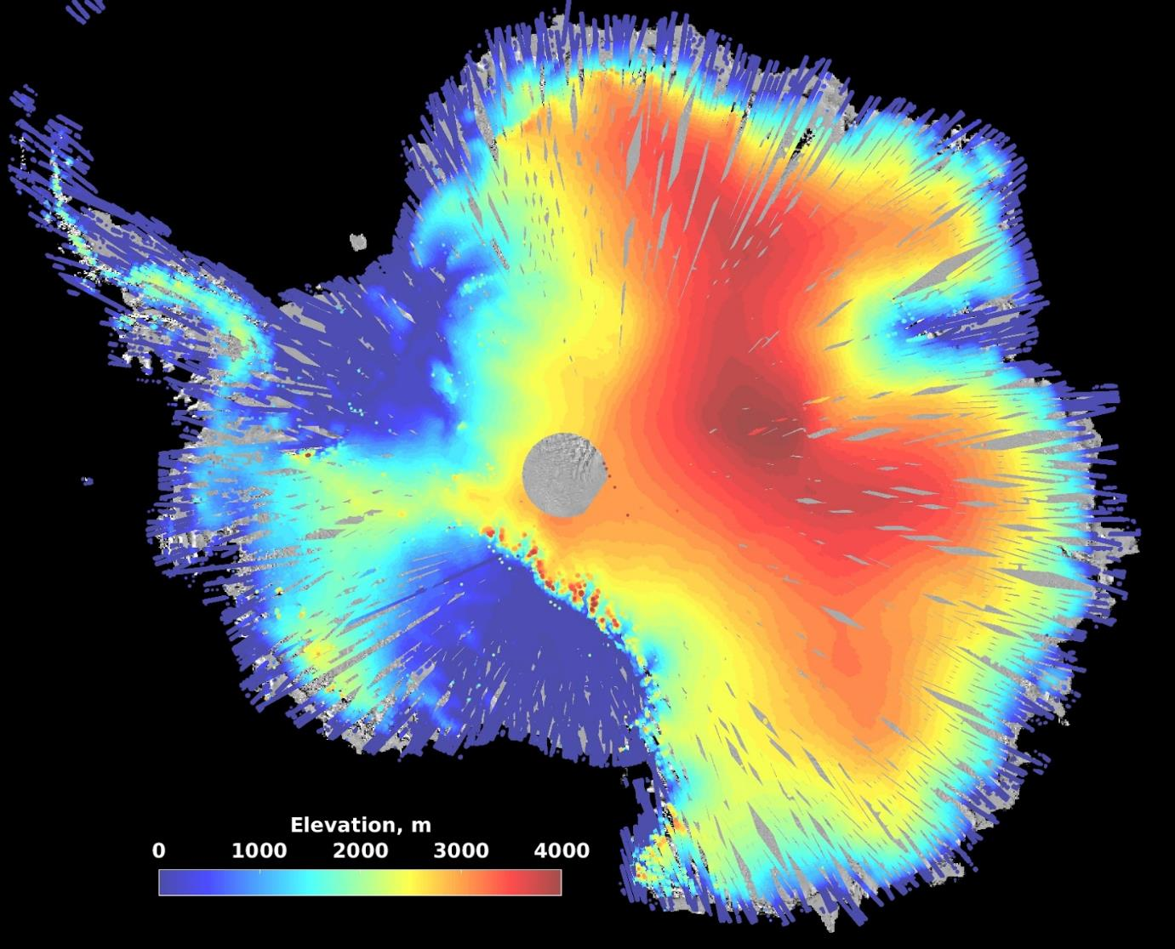
SCIENCE
HIGHLIGHT
ICESat-2
Ice, Cloud, and land
Elevation Satellite-2
Dec. 2018 - First three weeks of observations over Antarctica
15
15

Slide 16
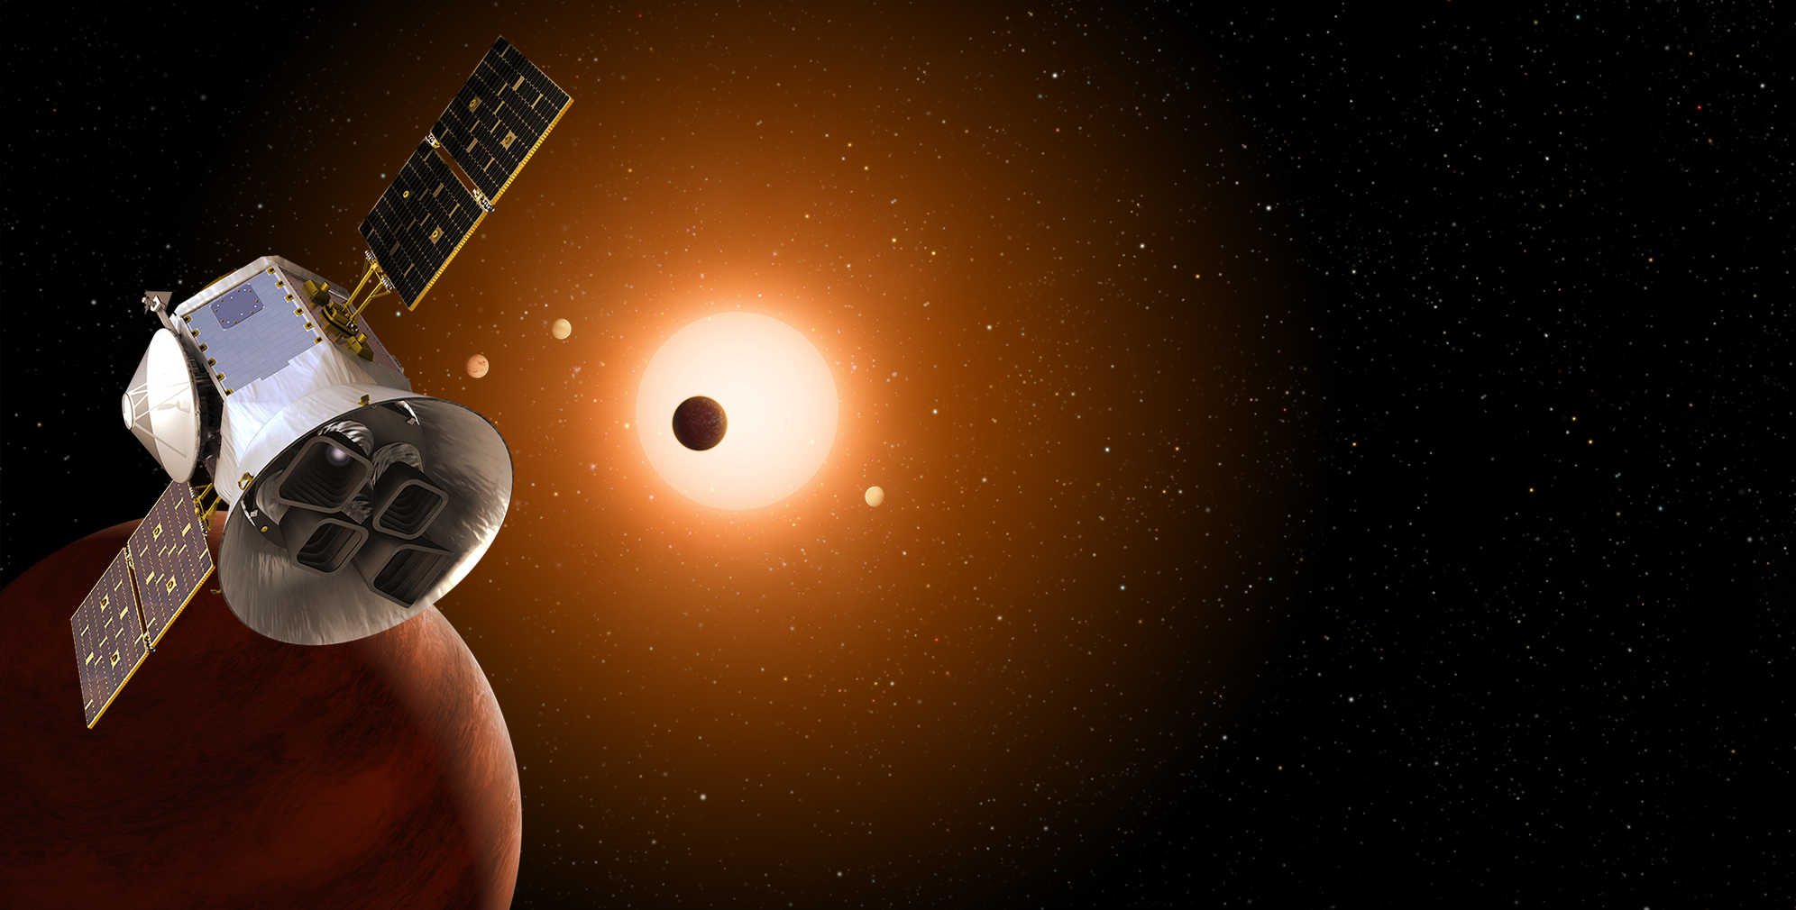
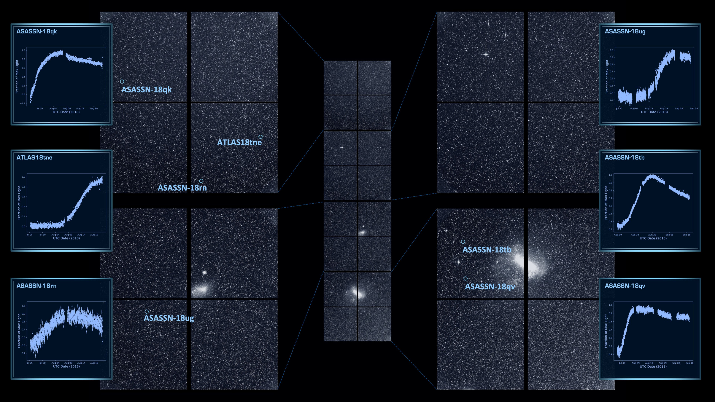
TESS
Transitioning Exoplanet
Survey Satellite
Early analysis of TESS data from Sectors 1-7 has yielded at least a dozen new confirmed exoplanets, including 4 multi-planetary systems, and over 400 exoplanet candidates
16
16

Slide 17
Mars 2020 on Track for 2020 Launch
RIMFAX, MOXIE, MEDA delivered to ATLO
SHERLOC concluded risk review
  Flight unit to be delivered end of June
  Flight laser power supply replaces engineering model by end of 2019
All other systems and instruments to be delivered over next several months
Notes:
4
SCS is the Corer/turret and Adaptive Caching Assembly

Slide 18
Europa Clipper Update
As a result of continued, significant cost growth and remaining high cost risk, the ICEMAG investigation on the Europa Clipper mission is terminated
Headroom to Cost Trigger
ICEMAG
NASA will pursue a flux-gate only magnetometer provided by UCLA. We will appoint a science team leader, and integrated product manager, and retain all ICEMAG Co-Investigators.

Slide 19
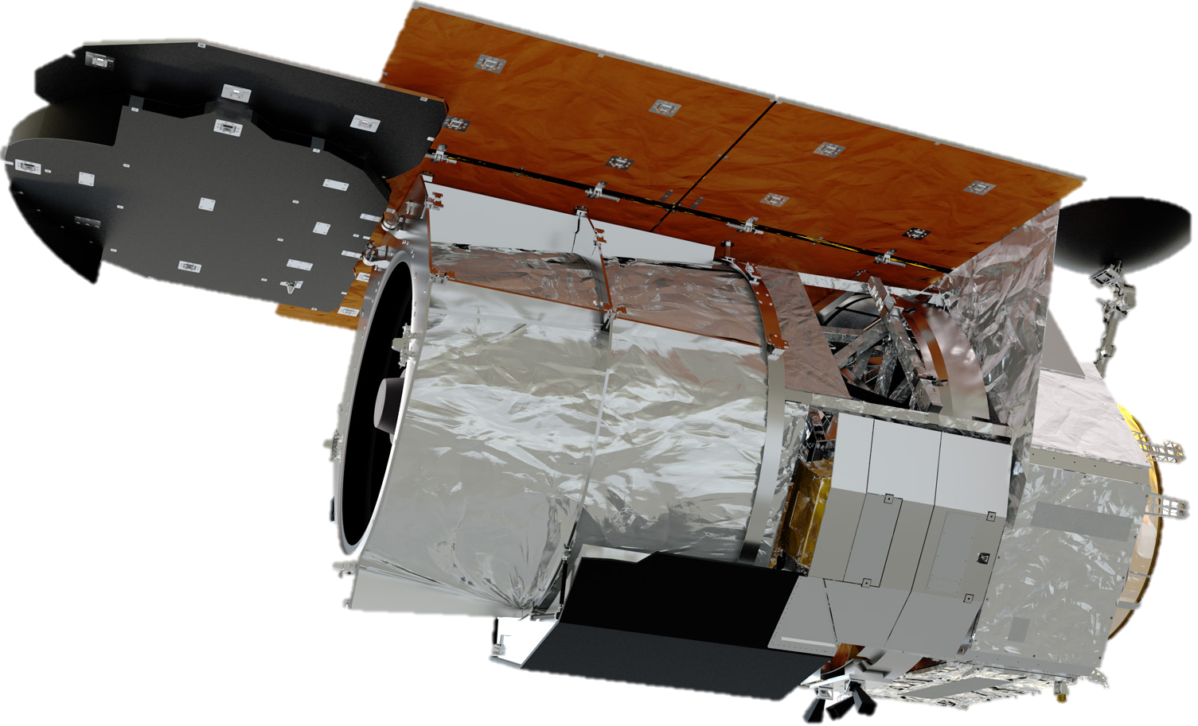
Wide-Field Infrared
Survey Telescope
Work continues under new Project Manager and Deputy Project Manager and enacted FY19 appropriation which includes $312M for WFIRST.
WFIRST is at $3.2 B without agency reserves, per Academy and Congressional guidance.
Key Progress/Milestones
  Primary mirror polishing continues; shows slightly better than expected figure for this stage
  Four element Preliminary Design Reviews by September, leading to combined Spacecraft and Mission PDR planned in October 2019
FY20 budget request provides no funding for WFIRST; instead, focuses on completing Webb

Slide 20
Planetary Science Budget Features
What’s Changed
Enables a Mars Sample Return launch as early as 2026
Accelerates launch readiness date for Europa Clipper to 2023; proposes Clipper launch on a commercial vehicle, which saves over $700 million
  No funding included for Europa Lander beyond FY19
Restructures Technology Program to align investments with flight programs
Establishes 5-year cadence for New Frontiers while maintaining 2-to-3-year cadence for Discovery – with first New Frontiers mission selection since 2011
Provides for SmallSat future opportunities within the Discovery Program
What’s the Same
Supports development of Mars 2020, DART, Psyche and Lucy as well as instruments on ExoMars 2020, JUICE and MMX
Funds all prime operating and extended missions through FY20, with Senior Review
in 2019
Maintains Nation’s radioisotope power system capability and stable planetary R&A program

Slide 21
Astrophysics Budget Features
What’s Changed
Webb budget increased consistent with 2018 re-plan, Webb proceeding toward launch in March 2021
Probe program deferred to fund Webb replan
SPHEREx begun within Explorers program as next Astrophysics MIDEX
SOFIA mission extended beyond 5-year prime mission, extended mission starts in FY20 with details pending 2019 independent reviews
Provides no funding for WFIRST space telescope; instead, focuses on completing Webb
What’s the Same
Spitzer ends operations January 2020 per 2016 Senior Review
Phase A studies of Small Explorers (SMEX) and Missions of Opportunity from 2019 AO
IXPE, GUSTO, XRISM, and Euclid development remains on track and within budget
Hubble, Chandra, and six smaller operating missions continue pending 2019 Senior Review
CubeSat initiative and four balloon campaigns within healthy research program

Slide 22
Heliophysics Budget Features
What’s Changed
Space Weather increase will strengthen interagency collaboration on Research-to-Operations/Operations-to-Research, a priority of National Space Weather Strategy and Action Plan
Increased investments in CubeSats and technology development
Solar Orbiter launch now scheduled for February 2020
ICON delayed from October 2018 to 2019 to address launch vehicle issue
Imminent release of MIDEX announcement
What’s the Same
GOLD launched as planned in January 2018
Parker Solar Probe launched as planned August 2018
Solicited science and technology demonstration missions of opportunity for rideshare with IMAP and other missions of opportunity
Accommodation of NOAA SWFO mission launching with IMAP
Operating missions funded consistent with Senior Review recommendations
IMAP selected as planned next Solar Terrestrial Probes mission (LRD October 2024)
AWE selected as planned to fly on ISS as next SMEX Mission of Opportunity (LRD February 2022)

Slide 23
Earth Science Budget Features
What’s Changed
New Decadal Incubation project within ESTO
Initiated Earth Venture Continuity strand within Venture Class
Four new DO studies within Decadal Survey
DSCOVR (operations) and OCO-3 (for FY19 launch) funded through budget window
TROPICS instrument confirmed as build-to-storage
Selection of EMIT and PREFIRE instruments within Venture Class
What’s the Same
Supports recently launched missions GRACE-FO, ICESat-2, GEDI; ESD now operating 20 on-orbit missions
SWOT, NISAR, Sentinel-6, Landsat 9, TEMPO, GeoCarb, and MAIA remain on schedule for launch in budget window
Maintains regular cadence of Venture Class missions and instruments solicitations
Healthy research and applied science programs, SmallSat/CubeSat investments, and commercial data buy activities
Like FY19 Presidential Budget Request, provides no funding for PACE and CLARREO-PF

Slide 24
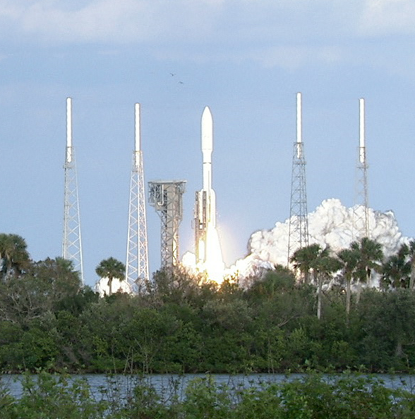
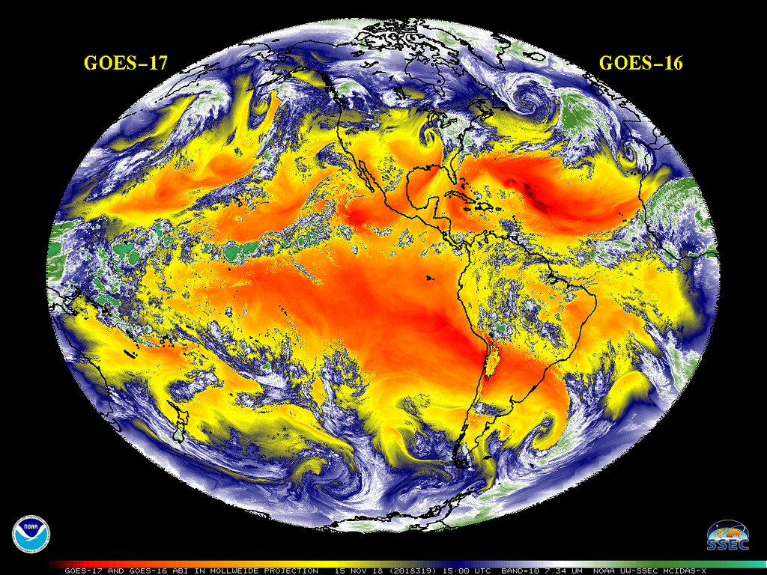
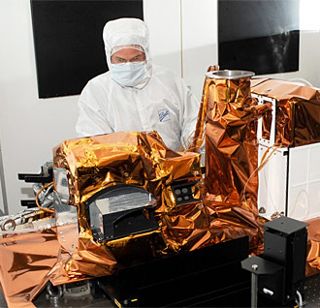
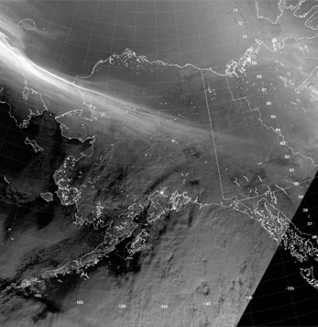
Joint Agency Satellite Division Overview
Strategic Objective
Ensure excellence in the Nation’s operational weather satellites
by applying NASA’s expertise in systems engineering and program and project management to satellite and ground system development
Major Activities
Advance collaboration opportunities with NOAA and partner organizations
  Strategic planning
  Performing studies
  Formulating and Implementing missions
  Developing technologies
  Identifying ride shares and hosting opportunities
Continuing projects: GOES-T, GOES-U, GOES-R Ground System, JPSS-2, JPSS-3, JPSS-4, JPSS Ground System, Space Weather Follow On
Note: Budget information and justification provided in NOAA budget documentation

Slide 25
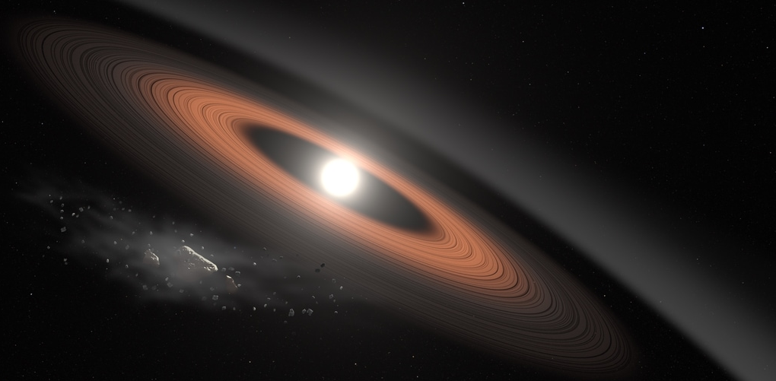

Citizen Science Initiative
New Citizen Science Initiative ($1M / year starting FY20) will award agreements to develop and share best practices within SMD and beyond
Supports already existing programs in all divisions through cross-divisional training, templates and continuous improvement processes
Initiative ensures open source platforms, common protocols, transparency of data and reporting, and strong linkages are made to NASA science
Leverage successes, including projects that have published results by citizens: Stardust, Backyard Worlds/Planet 9 and ArcticSigns
Approach consistent with 2017 American Innovation and Competitiveness Act, and adds the rigor of professional science

Slide 26
NASA Science Overview
SMD FY20 Budget Strategy & Highlights
Diversity and Inclusion Activities
Commercial Partnership Strategy

Slide 27


Program Investigator Workshop
Held November 27-28, 2018 in Washington, DC
Nearly 100 participants from NASA, academia, research organizations, and industry in attendance
Workshop designed to explore various aspects of mission PI role and barriers

Slide 28
Key Takeaways
Great interest in being part of mission team, but ways to do so not always well understood
NASA needs to create better transparency of requirements and expectations of PI vs. mission leadership team
NASA should create opportunities for new and emerging leaders to be part of mission teams and must incentivize this diversification
NASA can help foster new partnerships between “gateway institutions” and smaller institutions
To be successful, science community needs to move away from a “who you know” culture and create a climate free from harassment

Slide 29
Post-Workshop Activities
Completed Actions:
Conduct pre-reviews of review panels to ensure diversity and reduce conflicts of interest
Add PI resources webpage to science.nasa.gov
Add conference code of conduct requirement to ROSES 2019
Restart proposal writing workshops at major science conferences
Actions In Work:
Include career development positions (i.e. deputies) and associated evaluation criteria as part of future AOs
Update NASA grant terms and conditions to require notification when grantees are under academic suspension
Require anti-harassment and bystander training for mission teams
Develop “PI 101” training for prospective PIs
Future Work:
Assess communications channels by which prospective PIs learn about opportunities
Assess interest in holding proposal writing workshops at affinity group conferences
Evaluate potential partnerships between “gateway institutions” and smaller institutions
Develop a PI Incubator Program

Slide 30
NASA Science Overview
SMD FY20 Budget Strategy & Highlights
Diversity and Inclusion Activities
Commercial Partnership Strategy

Slide 31
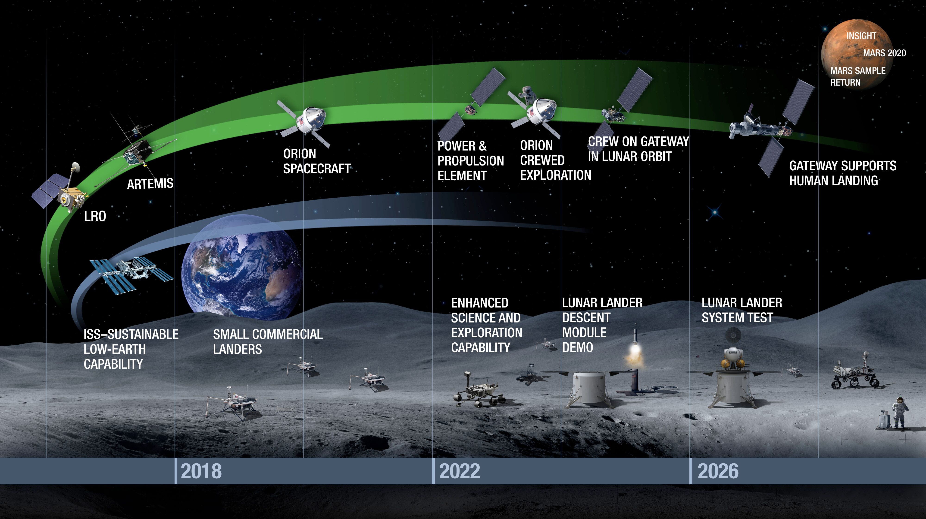
Lunar Exploration Campaign

Slide 32
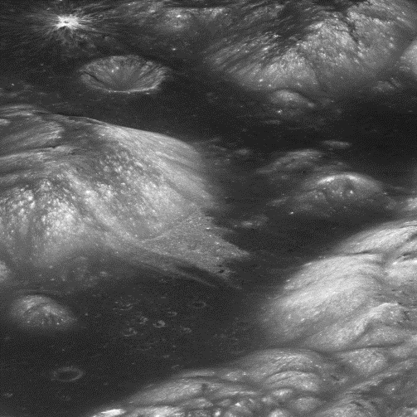
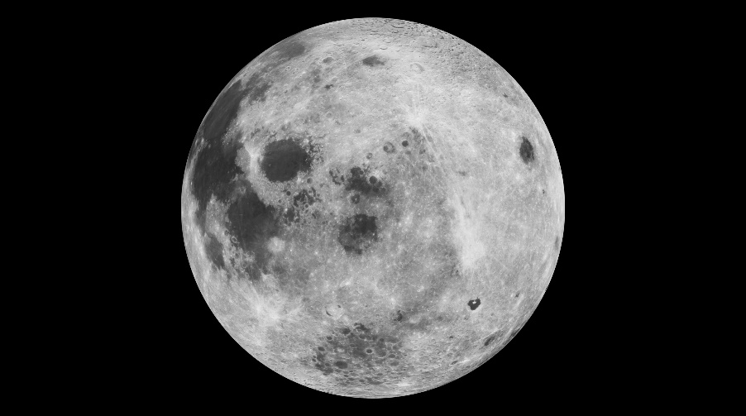
Lunar Academies Reports
Received two reports from Committee on Astrobiology and Planetary Science
  Review of the Planetary Science Aspects of NASA SMD’s Lunar Science and Exploration Initiative
  Review of the Commercial Aspects of NASA SMD’s Lunar Science and Exploration Initiative
Working to develop a strategy for path forward in response to recommendations

Slide 33
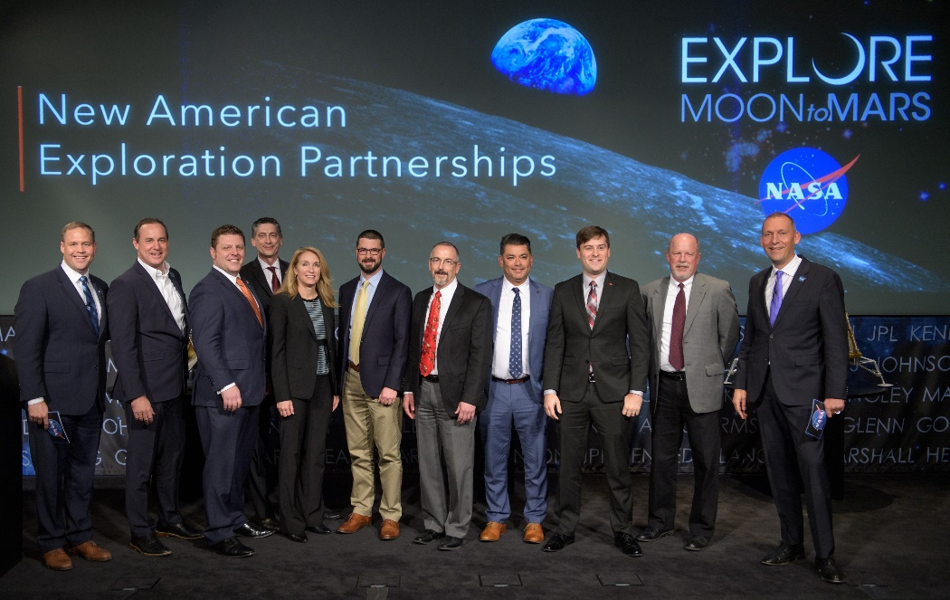
Commercial Lunar Payload Services
Nine U.S. companies selected through CLPS Nov. 2018, developing landers to deliver NASA payloads to Moon surface; pre-authorized to compete on individual delivery orders
Competition open to U.S. commercial providers of space transportation services, consistent with National Space Transportation Policy and Commercial Space Act
Multi-vendor catalog, 10-year IDIQ contract, managed through task order competition for specific payload deliveries
On ramps to the CLPS contracts will be used to provide additional capabilities as made available
Structured for NASA as one of many customers of commercial service
Building on NASA’s model in low-Earth orbit, expands partnerships with industry and other nations to explore Moon and advance missions to farther destinations such as Mars, with America leading the way
Winning CLPS companies:
  Astrobotic
  Deep Space Systems
  Draper
  Firefly Aerospace
  Intuitive Machines
  Lockheed Martin Space
  Masten Space Systems
  Moon Express
  Orbit Beyond

Slide 34
Lunar Payload Selections
Thirteen science and technology demonstration payloads selected to fly to the Moon as early as end of 2019, depending on the availability of commercial landers
Selected payloads, along with Lunar Surface Instrument and Technology Payloads, will begin to build pipeline of scientific investigations and technology development payloads using U.S. commercial landing delivery services
Instruments include:
  Linear Energy Transfer Spectrometer
  Near-Infrared Volatile Spectrometer System
  Advanced Neutron Measurements at the Lunar Surface
  Ion-Trap Mass Spectrometer for Lunar Surface Volatiles
  Quadrupole Mass Spectrometer
  Low-frequency Radio Observations from the Near Side Lunar Surface
  Stereo Cameras for Lunar Plume-Surface Studies
  Surface and Exosphere Alterations by Landers
  Navigation Doppler Lidar for Precise Velocity and Range Sensing
Two technology demonstrations selected to fly:
  Solar Cell Demonstration Platform for Enabling Long-Term Lunar Surface Power
  Lunar Node 1 Navigation Demonstrator
Future calls for payloads planned to be released each year for additional opportunities

Slide 35
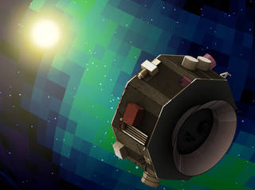
SmallSat Opportunities
  Three InVEST-17 Awards Announced July 20, 2018
  First Major Investment in
  Astro SmallSat Missions
  Investing up to $65M for ESPA-class Payloads
  Investing up to $55M in Deep Space SmallSat Missions
Earth Venture Missions (EVM/EVI) and In-Space Validation of Earth Science Technologies (InVEST)
Astrophysics Small Explorer (SMEX) and Astrophysics Science SmallSat Studies
Heliophysics Technology Demonstration Mission of Opportunity
Small Innovative Missions for Planetary Exploration (SIMPLEx)
SmallSat/CubeSat commercial engagement opportunities are essential to
NASA Science’s balanced portfolio, achieving distinct science objectives

Slide 36
ROSES Solicitations
Many ROSES solicitations are specifically and exclusively for SmallSats (see table below), with other ROSES program elements (Heliophysics Technology and Instrument Development for Science) that allow CubeSats and SmallSats
In total, 30 solicitations fully funded, with 20 from outside vendors, between 2015 and 2018
Selections for the SIMPLEx SALMON-3 AO are expected next month
Title | Due date | Selections
Small Innovative Missions for Planetary Exploration (SALMON-3 AO) | 7/24/2018 | Spring 2019
Astrophysics Science SmallSat Studies (ROSES-18) | 7/13/2018 | 08/29/2018
Planetary Science Deep Space SmallSat Studies (ROSES-16) | 11/18/2016 | 3/27/2017
Small, Innovative Missions for Planetary Exploration (ROSES-14) | 04/10/2015 | 08/08/2015
Notes:
Recent past selections / Upcoming selections
Astrophysics SmallSat Studies
Appendix D12 on Nspires – Astrophysics Science SmallSats Studies (new opportunity coming up)
B9 – Heliophysics Flight Opportunities for Research and Technology (looking for things that can fly on smallsat and rideshares)
Double check with Max Bernstein to see if he knows of anything else

Slide 37
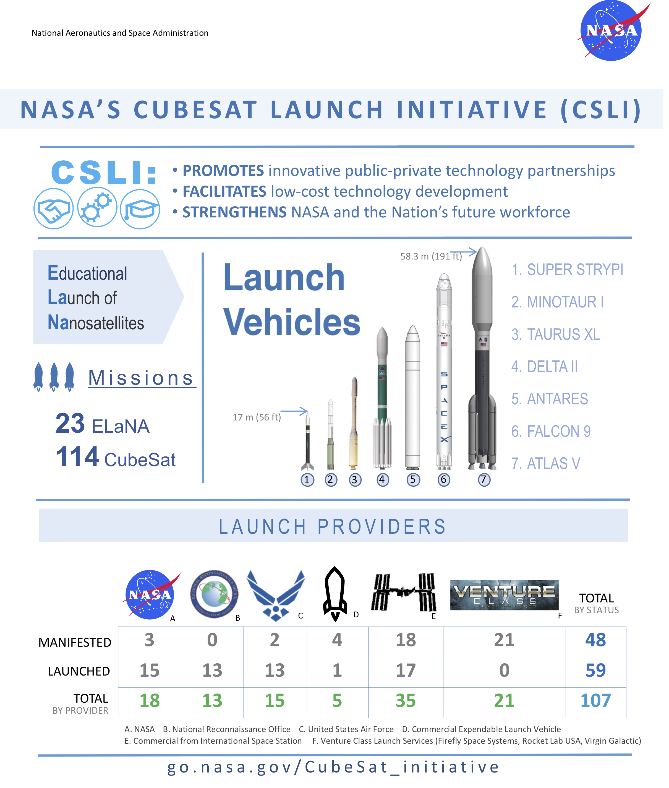




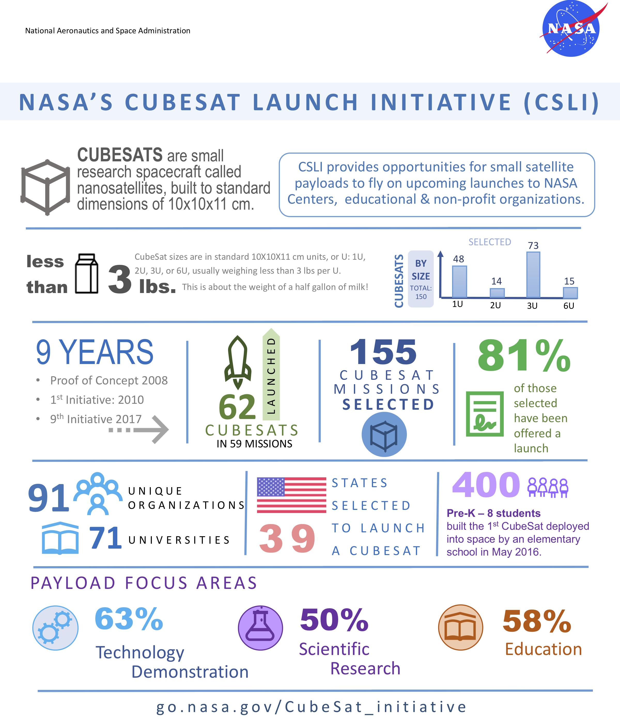

CubeSat Launch Initiative Broadens Access to Space
Launch
Providers
Launch
Vehicles
4 | 0 | 2 | 2 | 9 | 21 | 38
15 | 13 | 13 | 1 | 24 | 0 | 66
19 | 13 | 15 | 3 | 33 | 21 | 104
93
176
74
March 2019

Slide 38
Rideshare Enables Small Mission Science
Enables diverse constellation system science and access to beyond LEO science, possibly through direct-inject approaches
Provides means to define and answer new science questions via sustained continuity measurements with spacecraft refreshed and improved, on a regular basis, with new technology
Significant international growth and activity is underway

Slide 39
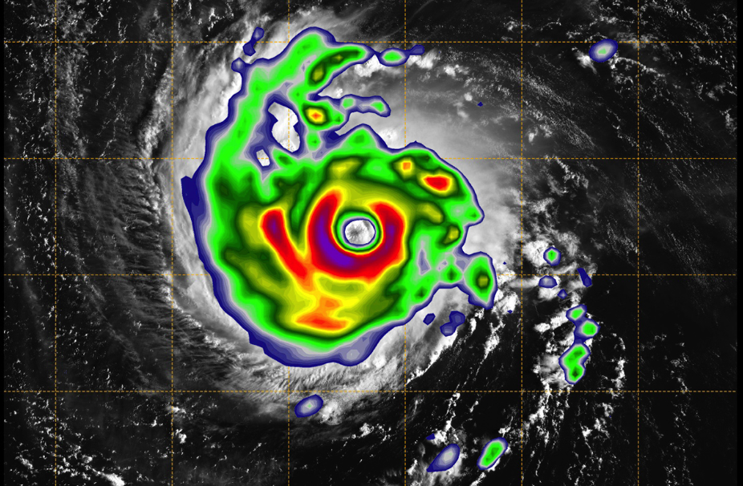
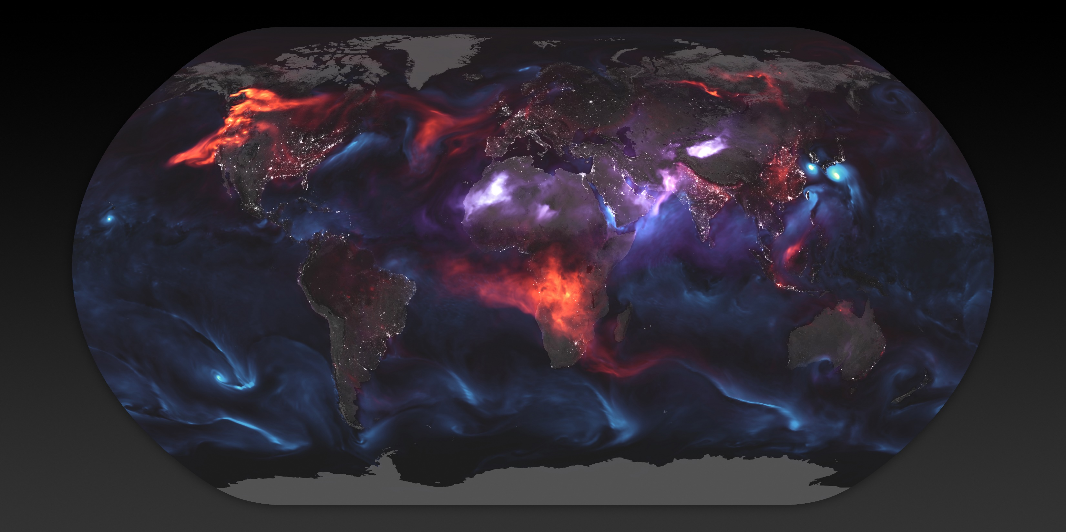
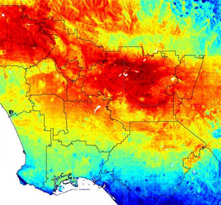
Commercial Opportunities in Low Earth Orbit
Enabling New Science
Providing platform for Technology Demonstration
Providing Satellite Broadband and for communication services
Remote Sensing
Providing Military Intelligence
Providing transportation to LEO
Notes:
Find a big problem
Have a unique advantage in solving it
Provide a roadmap towards profitability
Companies increasing investing in LEO to provide commercial services such as
Satellite Navigation
Satellite TV
Remote sensing
Communication
Broadband internet
Technology development
Space tourism
Space manufacturing

Slide 40




NASA Awards Venture Class Launch Services Contracts
Three companies selected to provide new commercial launch capabilities for SmallSats/CubeSats
    Firefly Space Systems Inc.
    Rocket Lab USA Inc.
    Virgin Galactic LLC
Increases frequency NASA can utilize SmallSats/CubeSats for scientific research
Opens doors for commercial launch services dedicated to transporting smaller payloads
5.5 million
6.9 million
4.7 million

Slide 41
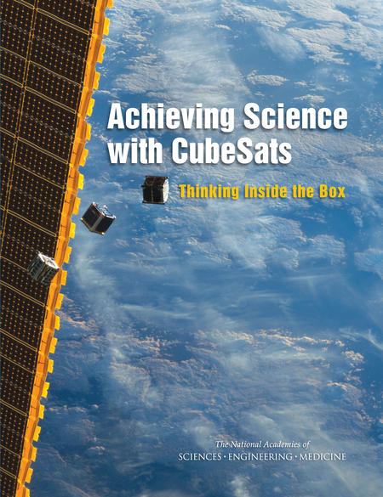
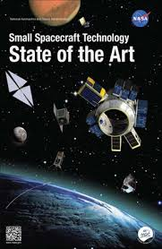
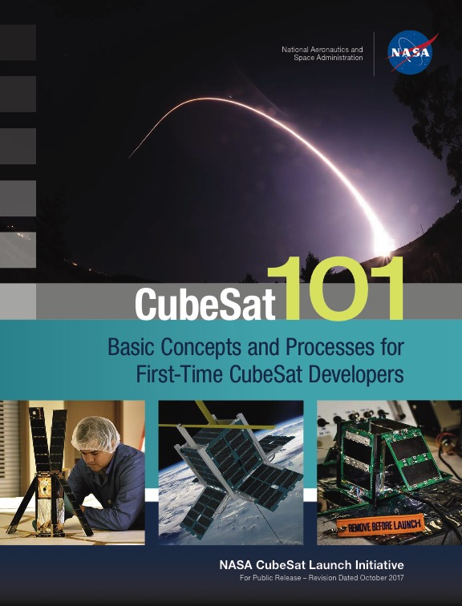
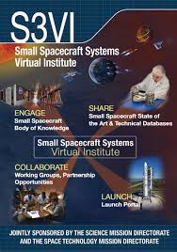
Engaging the Community for Mission Success
Small Spacecraft Coordination Group to advise on agency strategy & policy
Engaging commercial NewSpace industry to partner on science and technology
Utilize Small Spacecraft Systems Virtual Institute (S3VI) to support community
https://www.nasa.gov/smallsat-institute

Slide 42


with us

